Slide 1
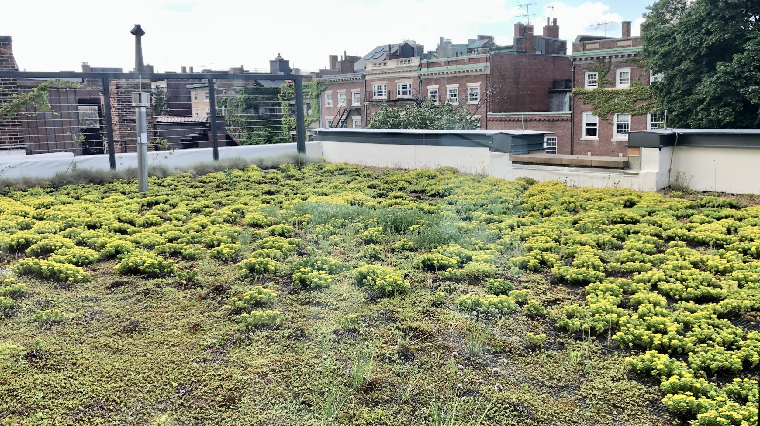
All Faculty Meeting
Spring 2021
Arts & Sciences Writing Program
January 29
Notes:
AGENDA
Spring 21 announcements: 3:30
admin, directors, OH, coordinators>Michele.
% teaching stats from Alyssa
FAR: Christina
Submit/Deadline
Observations coming
Mentoring : Clare Fitzgerald (or later?
Teaching Writing: 3:45-50
5 min visit/Teaching Writing activity
LfA coaches?
Other resource slides again? necessary?
Looking Ahead 4:00 or so
Director search
CGS Exchange
WR 153
DEI in the WP: 4:10 or 15
Jarvi/tech
DEI committee update (faculty seminar slide here, then Swati will lead into the Dean)
Guest: Dean Vincent Stephens
Wrap up 4:40
Writing Center, Faculty Hour

Slide 2
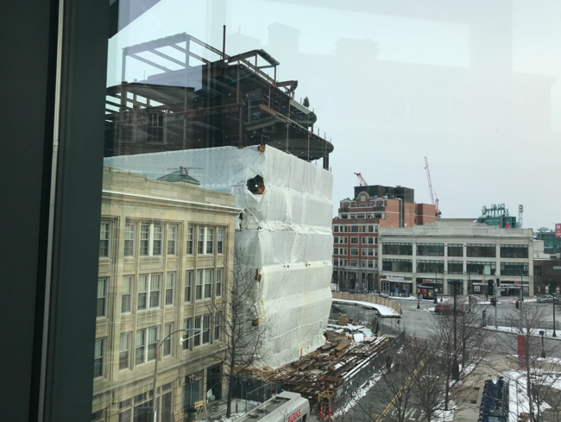

Slide 3
Administrative Staff
Academic Administrator: Alyssa Hall akhall@bu.edu
Program Administrator: Dan Ivey divey@bu.edu
Senior Staff Assistant: Adam Znideric adznid@bu.edu

Slide 4
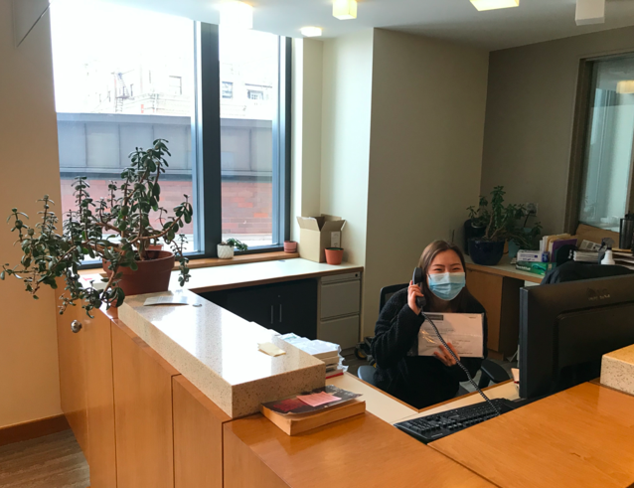

Slide 5
Directors
Acting Associate Director for ESL Christina Michaud cmichaud@bu.edu
Associate Director: Sarah Madsen Hardy smhardy@bu.edu
Associate Director for WID: David Shawn dshawn@bu.edu
Director: Chris Walsh cwalsh@bu.edu

Slide 6
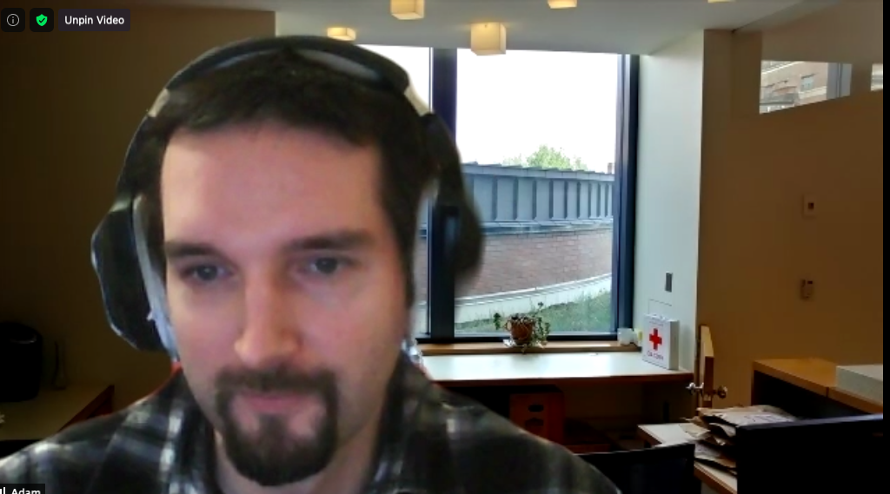
Wpadmin Office Hours
https://bostonu.zoom.us/my/adznid
Mondays and Thursday 11 a.m.- noon
Adam will open this room on Mondays and Thursdays for an hour, and at least one director will also be available as well as Alyssa and Dan. Please stop by with any WP questions or suggestions you might have!

Slide 7
Coordinators
Writing Center Coordinator: Heather Barrett heathbar@bu.edu
Coordinator of ESL: Malavika Shetty mlshetty@bu.edu
Curriculum Coordinators:
Kevin Barents kbarents@bu.edu
Michele Martinez mcmartin@bu.edu
We are happy to announce that Jessica Bozek will begin a two-year term as curriculum coordinator next year.
We are happy to announce that Jessica Bozek will begin a two-year term as curriculum coordinator next year.

Slide 8
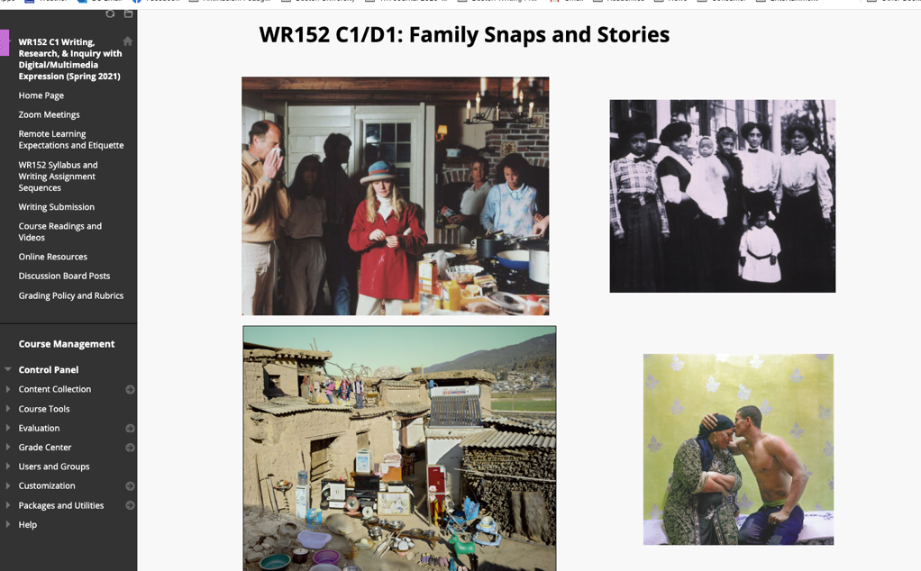
Michele Martinez
Show students around your Blackboard site several times in the first few weeks

Slide 9
Imagine a Writing Consultant Helping Your Student Understand Your Assignment Sheets
Clear Learning Goals
Concise Scaffolding Language
Illustrative Examples

Slide 10
Take Care of Yourself
Students relish being as generous to you as you are to them.
Remember that the syllabus is flexible.
If you’re exhausted, try to slow things down. Simplify where possible.

Slide 11
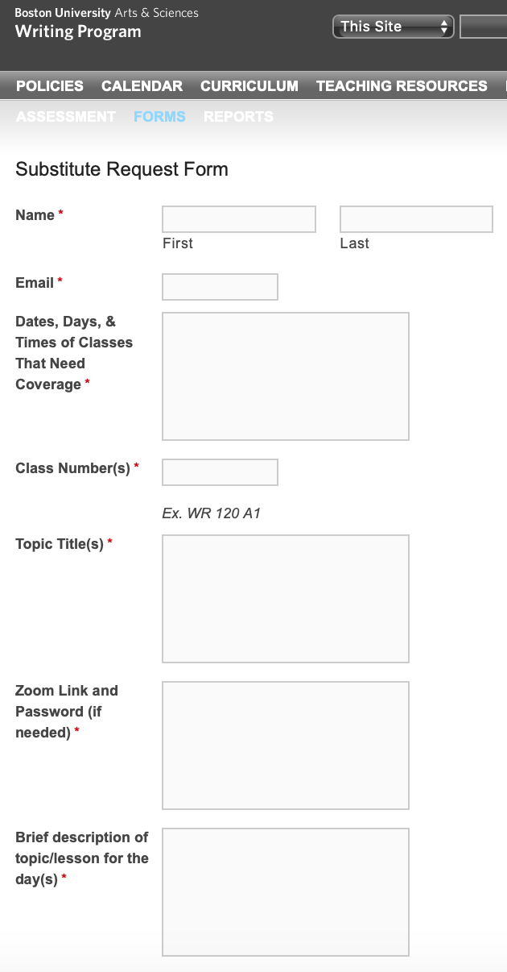
Sub Alliance
Request a Substitute form is now available on the WPnet
Questions? Contact Lesley Yoder (layoder@bu.edu)
Notes:
Lesley

Slide 12
Call for DME Exercises
Multimodal Analysis/Genres (e.g., how to analyze/interpret still images, graphic narrative, moving pictures, podcasts, etc.)
Information Literacy on Multimodal Sources (e.g., reliable videos, podcasts, blogs, and other sources)
Universal Design (e.g., webpage design, video/audio projects, etc.)
If you have exercises/handouts related to these subjects, please email: mcmartin@bu.edu

Slide 13
Spring 2021 CAS WR Sections
In-person 1/week: 59 sections
Fully remote: 124 sections
Total sections: 183

Slide 14

YOUR LFA FACULTY COACHES
•STEPHEN HODIN SHODIN@BU.EDU
DROP-IN OFFICE HOURS M 2-4:00
LINK: HTTPS://BOSTONU.ZOOM.US/J/3426243517
•JAMES PASTO JPASTO@BU.EDU
DROP-IN OFFICE HOURS TU 11-12:00
LINK: HTTPS://BOSTONU.ZOOM.US/J/9459197305
•ROBIN STEVENS RJS01@BU.EDU
DROP-IN OFFICE HOURS: TH 10-11:00 LINK: HTTPS://BOSTONU.ZOOM.US/J/99861028567?PWD=S0P2SGFOSVUVBKWXLY91V0U4DKLKZZ09

Slide 15
FAR/MyCV (1 of 3)
Faculty Advisory Group: faculty across the university giving input to IT, Faculty Actions, and software developer on our experiences with the site
Some improvements/changes to FAR process since last year:
2020-specific addition: a field to explain the effect of the pandemic on your professional life
More automatic FAR process: FAR now imports (almost) everything, so there is no need to select items manually.
*Caveat 1: All professional activities should either have end dates (if, say, the committee no longer exists, go back and put in an ending date, “May 2018” or whatever, for it) OR be truly ongoing events. Anything without a specified end date will show up on your FAR...
FULL-TIME LECTURERS ONLY

Slide 16
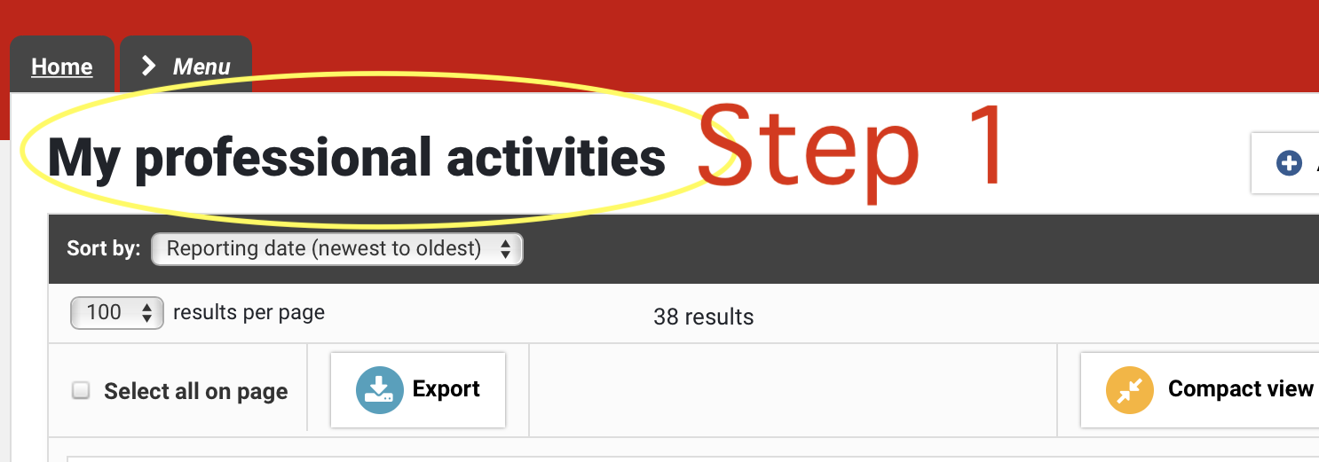
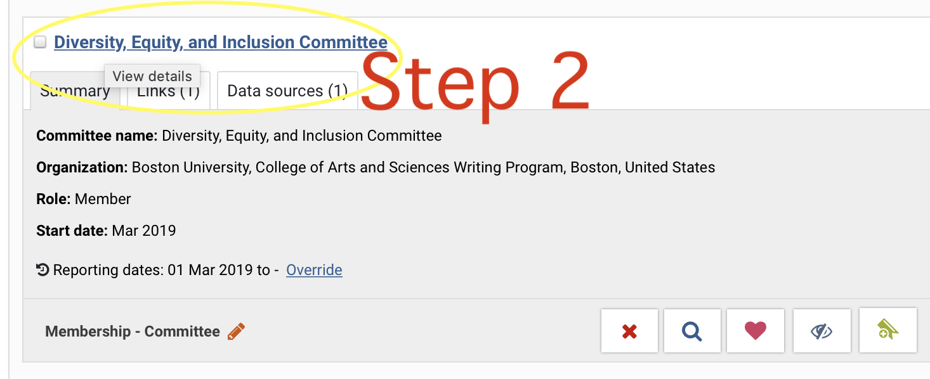
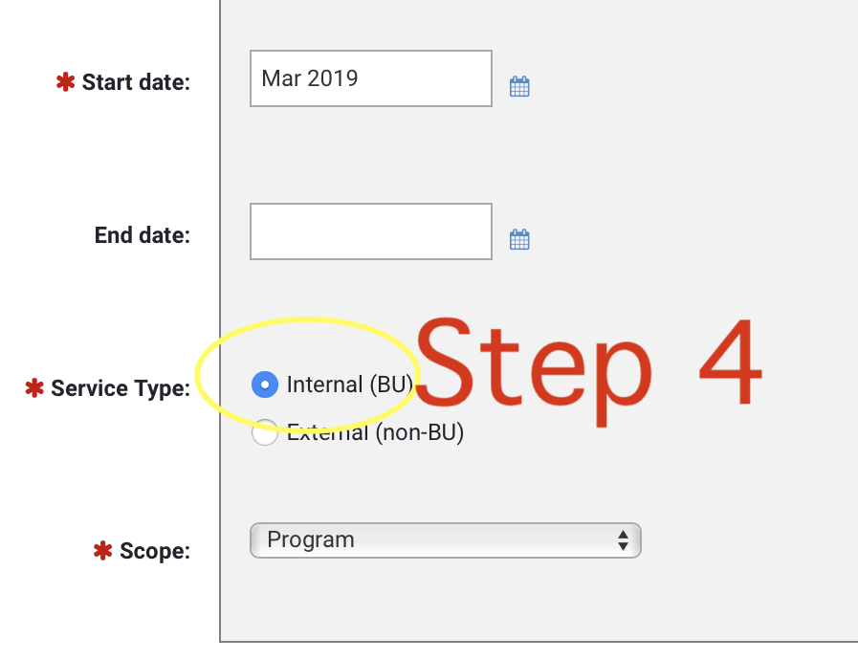
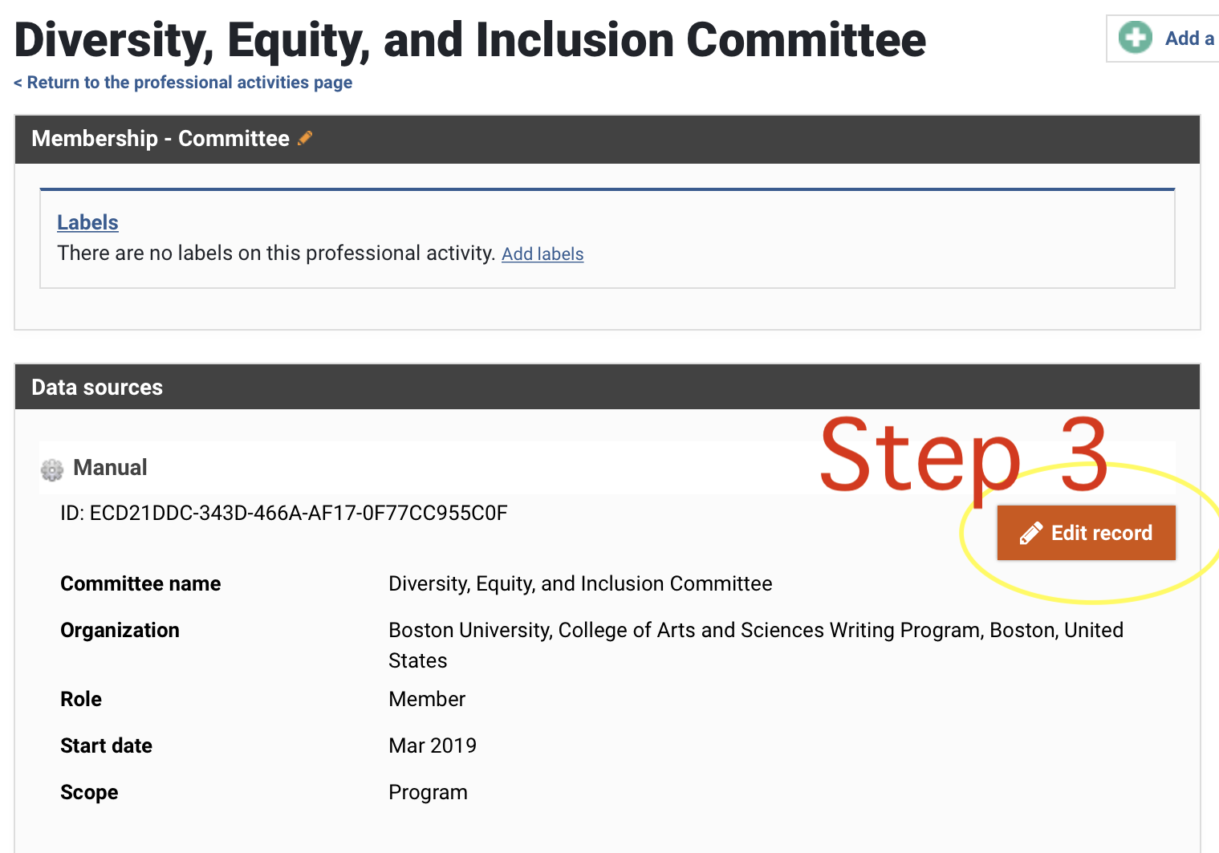
FAR/MyCV (2 of 3)
*Caveat 2: ...EXCEPT that past professional activity entries, even if they have no specified end date, will NOT show up on the FAR if they have not been coded as internal or external service (new fields).
So, be sure to check your FAR as a .pdf before marking it as done.
FULL-TIME LECTURERS ONLY

Slide 17
FAR/MyCV (3 of 3)
Some clarifications:
Official word: No one cares about the address fields. Just “CAS Writing Program,” etc., is fine.
Try to get in the habit of including ending dates for committees, etc.: they help with the automatic import to the FAR.
For WP purposes, the FAR affects FWRP/Time-Intensity Points; don’t enter citizenship things, like “wrote four letters of recommendation” or “attended CTL talk/workshop.” [See Jan. 2020 FIC notes covering this process, but be aware that some of the steps in this document have changed due to the 2021 changes to the FAR.]
FULL-TIME LECTURERS ONLY

Slide 18
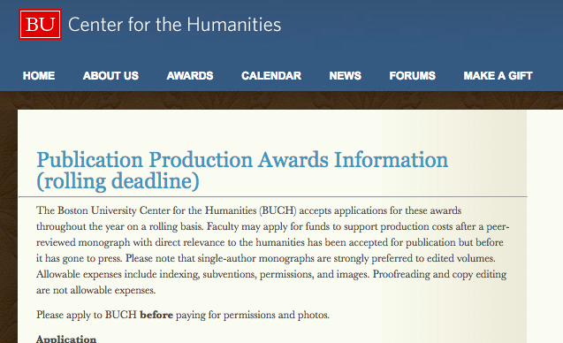
Funding Sources

Slide 19
Funding Sources
Part Time Lecturer Professional Development Funds
What can you apply for: “to support attendance at an academic conference or other relevant professional development related to teaching at Boston University”
•Virtual conferences; local conferences or meetings; training and enrichment courses related to pedagogy or field of teaching
Information: https://www.bu.edu/ctl/teaching-resources/part-time-faculty-professional-development-fund/
Process:
•Read guidelines
•Check with CTL if you are not sure if your project/expenses meet the criteria (dfbreen@bu.edu)
•Complete paperwork and submit to Director, WP for signature
•Submit to CTL for approval
•If approved, submit receipts to WP for reimbursement (Dan Ivey) within 30 days of your conference/course etc.
Amount:
•No specified ceiling, but unlikely to receive more than $1500; one allocation per year

Slide 20
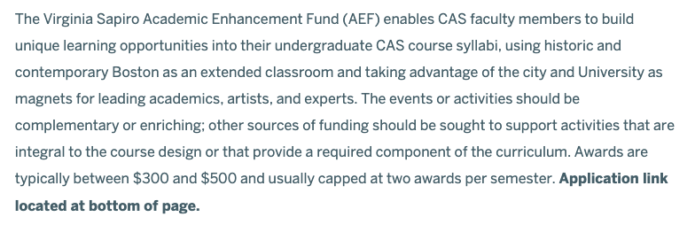
Funding Sources
https://www.bu.edu/cas/faculty-staff/instructors-guide/academic-enhancement-fund/
Course Enhancements

Slide 21
SUBMIT!
Office hours/directory form:
https://www.bu.edu/wpnet/forms/directory-form/
Spring 2021 syllabi:
https://www.bu.edu/wpnet/forms/syllabus-submission-form2/

Slide 22
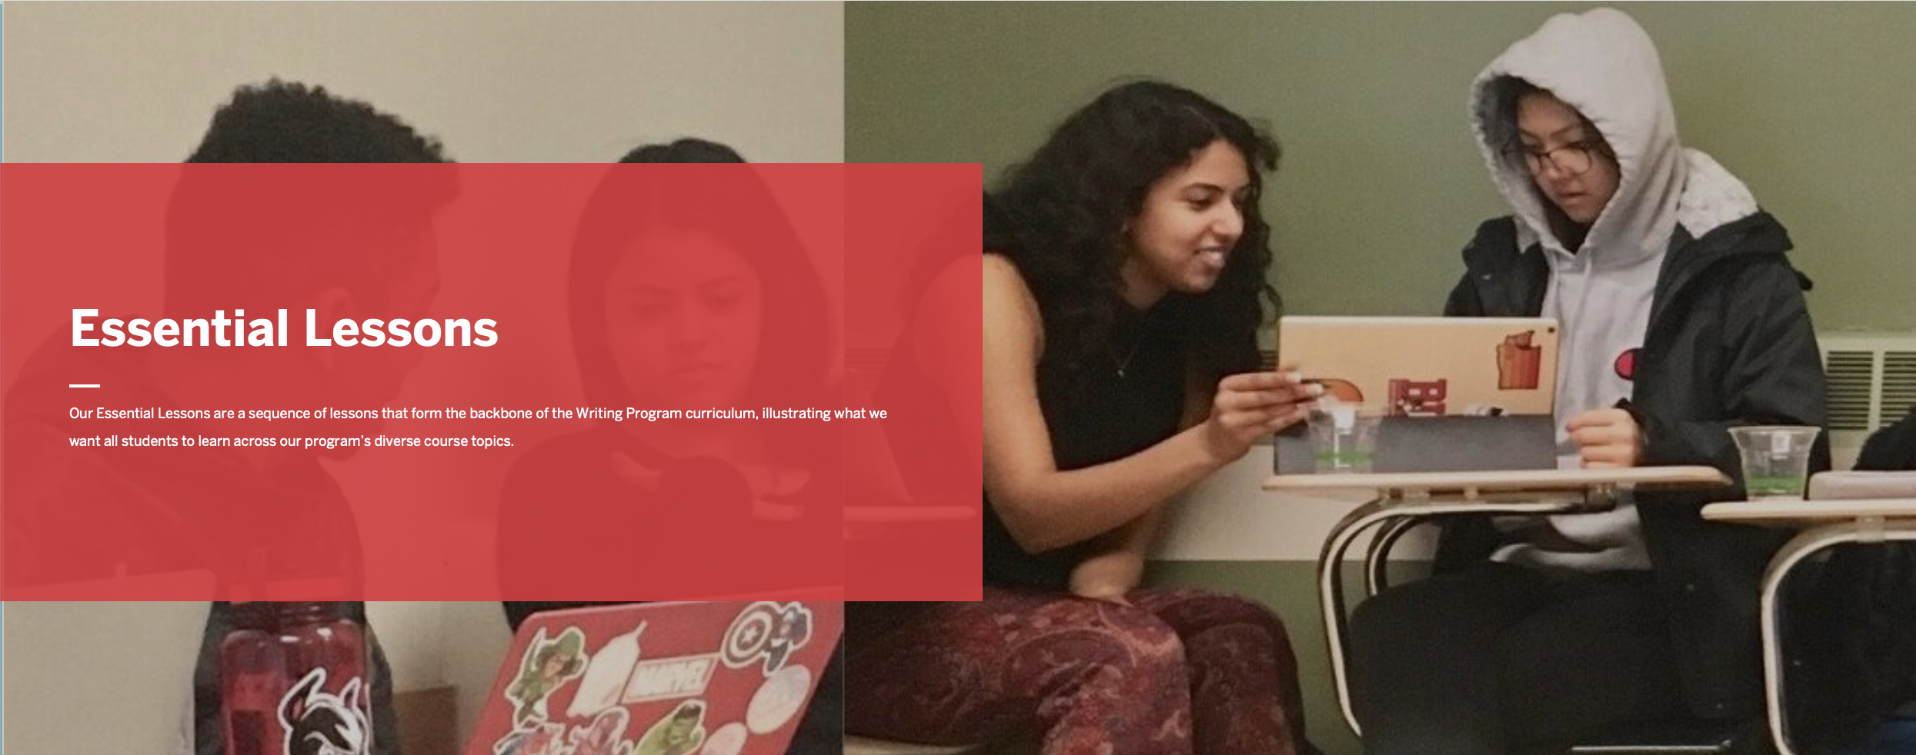
Teaching Writing Site
Essential Lessons, Sample Activities, Remote Teaching Guides, Flipped Learning Modules (and more)
https://forms.gle/tytcKnyTNWmKu1ju7
Notes:
Hope to start this by 3:45 Activity is 15 minutes
Paste link in chat: https://forms.gle/tytcKnyTNWmKu1ju7

Slide 23
Looking ahead

Slide 24
Philanthropy and the Writing Program
The Writing Program received a gift of $75,000 from Jennifer Templeton Simpson, CAS 2000, to support writing in the disciplines.
The gift will support
discipline-specific writing tutoring in academic units in CAS
faculty workshops on writing pedagogy in the disciplines
new initiative for Writing Program faculty to work in consultation with CAS academic units to shape curricular writing goals/plans within departments
More Information about the gift & these projects will be forthcoming
Notes:
DAVId

Slide 25
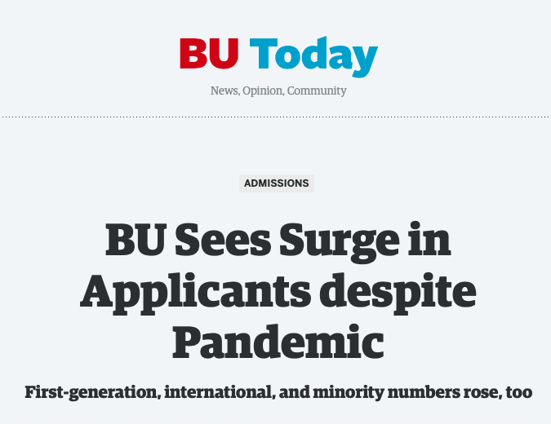
Fall 21 Course for PTL
1. Seniority
2. Flexibility of level and time
3. Teaching record
4. Diversification of instructors
Initial course assignments for F21 coming soon!
We anticipate adding sections
Appointment letters by May 1 or so

Slide 26

Back in person*
Notes:
SARAH

Slide 27
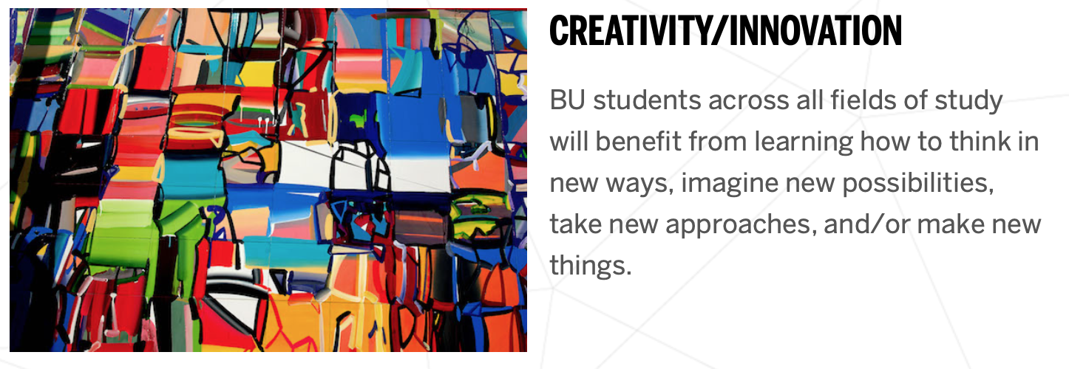
WR153:WRITING, RESEARCH & INQUIRY WITH CREATIVITY AND INNOVATION
Coming Soon! Spring 2022
Anna Panszczyk Jessica Bozek
Theodora Goss Brandy Barents

Slide 28


WR 150 RETIRING
IN DECEMBER 2021!
May 2021
WR153 Information Sessions
Fall 2021
WR153 Creativity and Innovation Seminars
Spring 2022
    Maybe you’d like to teach WR153

Slide 29
Other news...
CGS Exchange
Observations
Director searches
FTL searches next AY likely

Slide 30

Notes:
Hope to be able to introduce Clare at 4:15

Slide 31
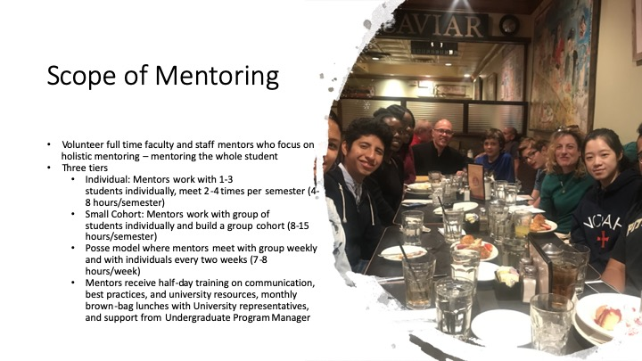

Slide 32
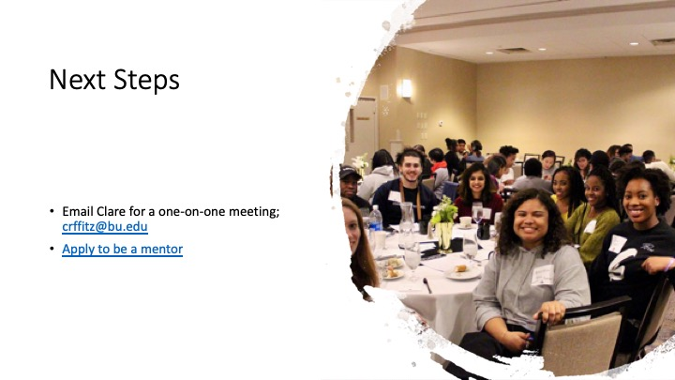

Slide 33
DEI in the WP
Notes:
CHRIS

Slide 34
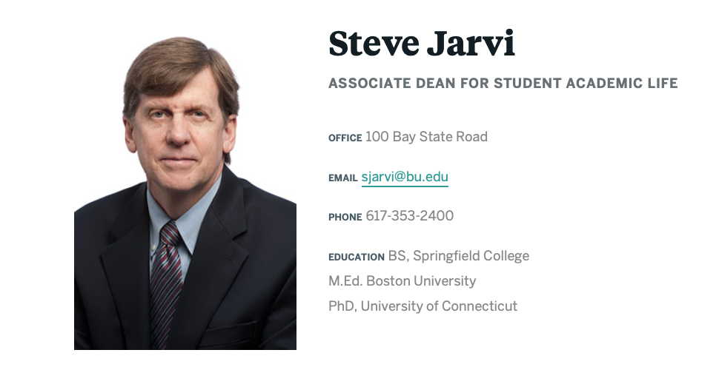
Support for student access to tech
sjarvi@bu.edu

Slide 35
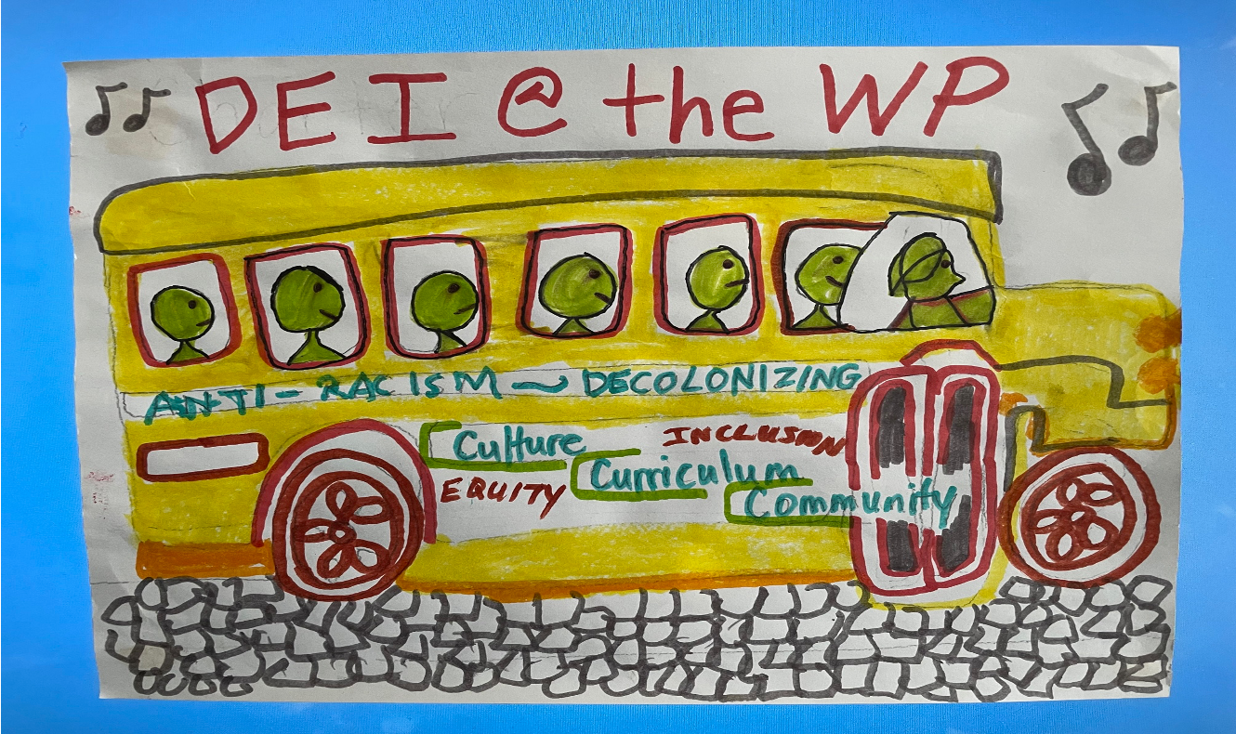
We’ve Chartered the Bus! 2021 Playlist

Slide 36


Faculty Seminar
Grading Equitably:
Rethinking Grading, from Contract Grading to Ungrading, Specs Grading, and More
?
facilitated by Marie McDonough and Christina Michaud
Fridays 2:30-3:30 p.m., February 12, February 19, February 26, and March 5

Slide 37
BU-Wide DEI Support / CAS DEI Action Team
•Pandemic Ethos of Faculty and Staff Community Networks BU D & I
•CAS DEI Action Team: Phase One into Phase Two
•Warm welcome to Associate Dean Vincent Stephens!

Slide 38
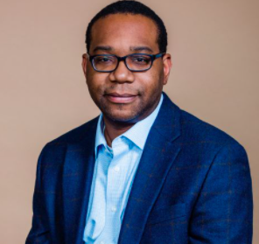
Vincent Stephens
Welcome to BU
ASSOCIATE DEAN FOR DIVERSITY AND INCLUSION
Notes:
Aiming for 4:30

Slide 39
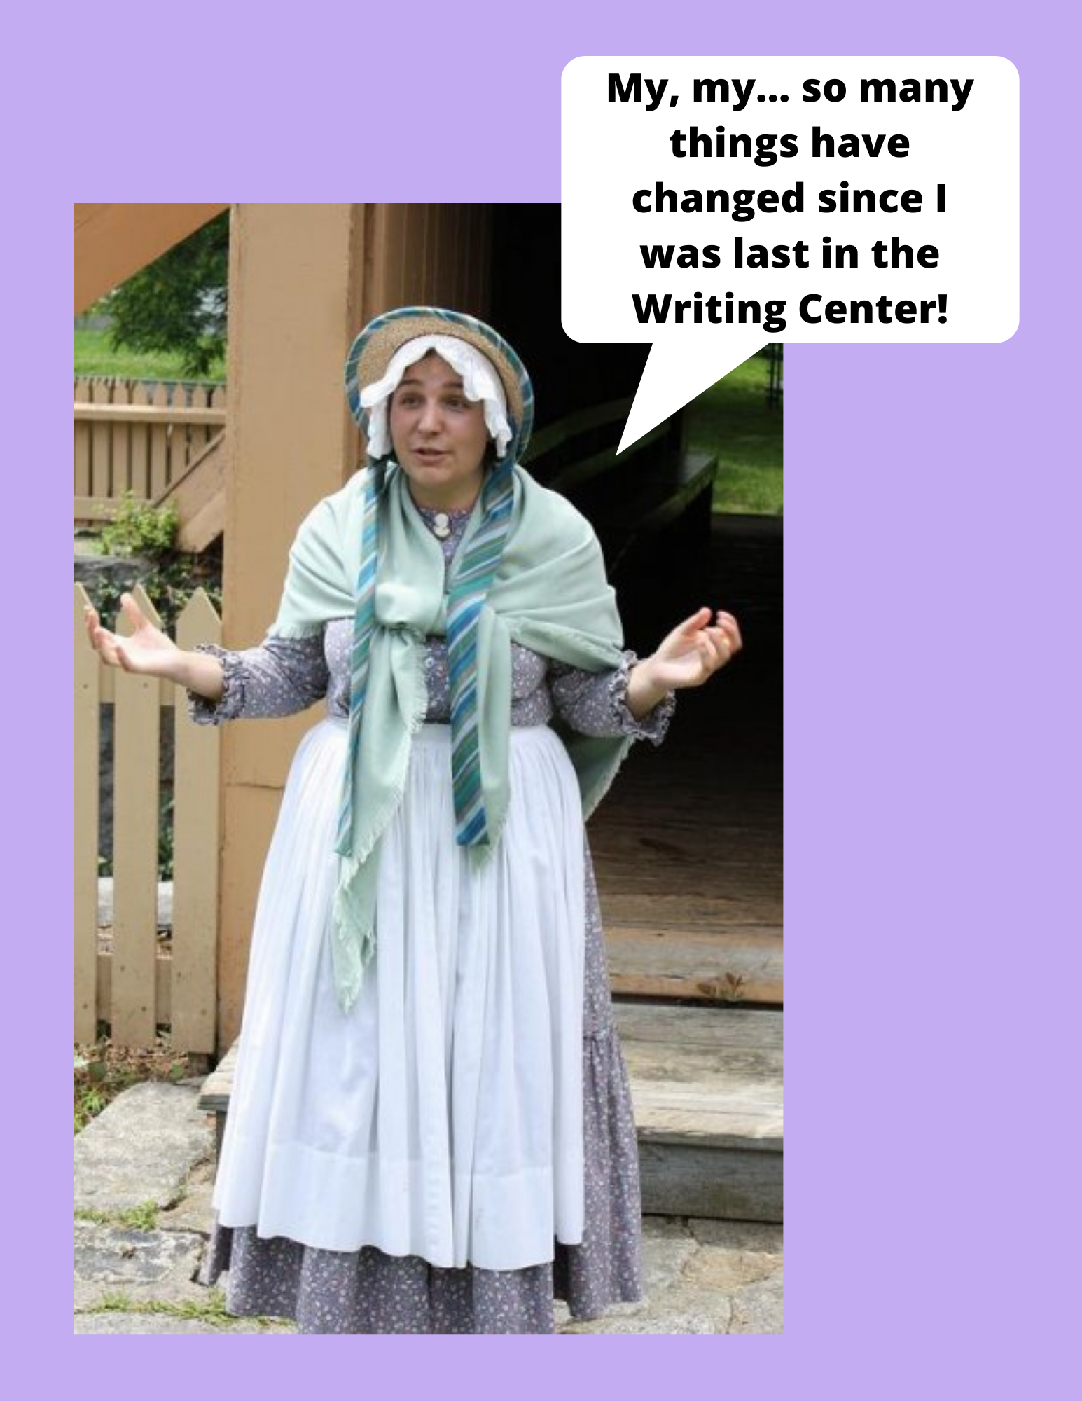
CAS Writing Center
Spring 2021 Operations
Heather Barrett
Writing Center Coordinator heathbar@bu.edu

Slide 40
CAS Writing Center Spring 2021
Students can visit for assistance with ANY WR assignment
Synchronous & asynchronous appointments available
Virtual class visits: Complete Google form to arrange them
Intensive tutoring: Referrals accepted on rolling basis
We will soon be hiring for 2021-2022!
  Please encourage BIPOC students & first-generation college students to apply!
Check us out on Instagram & Facebook: @bucaswriting
Questions? Email Heather Barrett: heathbar@bu.edu

Slide 41
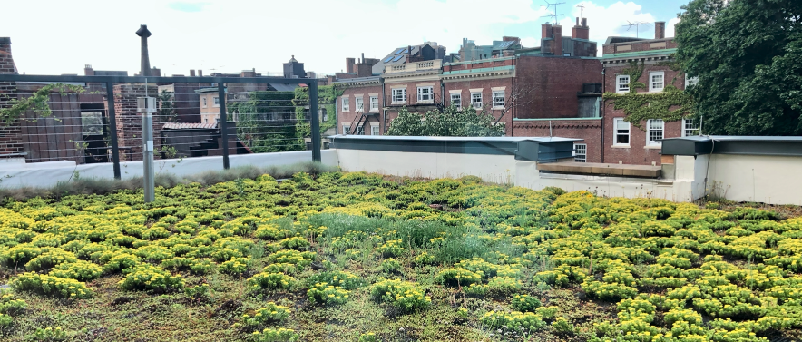
You are cordially invited to the
Writing Program
Faculty & Staff
Hour
Friday, February 12, 3:30-4:30
& other Fridays TBA
Hosted by Kim Shuckra

