Slide 1
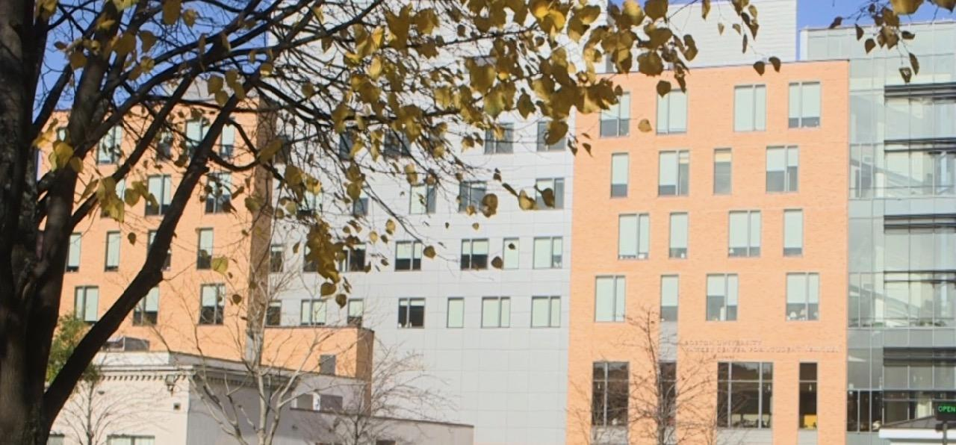
All Faculty Meeting
Fall 2020
Arts & Sciences Writing Program
September 11
Notes:
Welcome & introductions
Service and committee updates
Resource reminders
Good new/ Congratulations

Slide 2
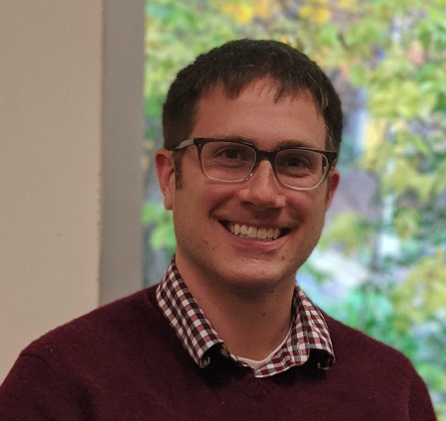
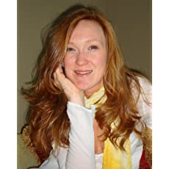
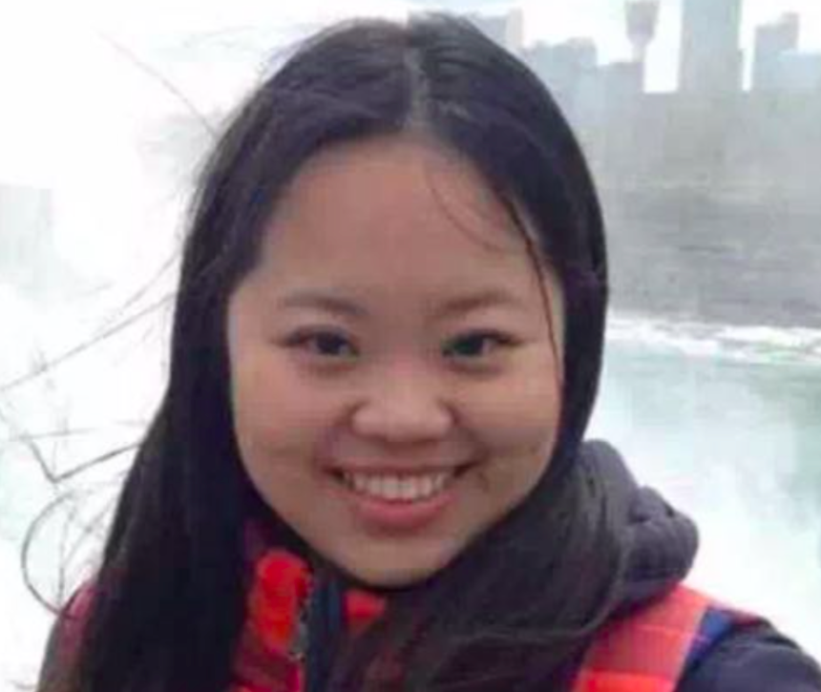
Welcome New Faculty
Jake Burg
Jamie Cox Robertson
Yelin Zhao

Slide 3
Congratulations to Our Newly Promoted Faculty
Diane Allenberg, Senior Lecturer
Gavin Benke, Senior Lecturer
Sarah Hanselman, Master Lecturer
Jessica Kent, Senior Lecturer
Marie McDonough, Senior Lecturer
Pary Fassihi, Senior Lecturer

Slide 4
Administrative Staff
Academic Administrator: Alyssa Hall akhall@bu.edu
Program Administrator: Dan Ivey divey@bu.edu
Senior Staff Assistant: Adam Znideric adznid@bu.edu

Slide 5
Directors
Director of ESL: Maria Zlateva mariazl@bu.edu
Director: Chris Walsh cwalsh@bu.edu
Associate Director: Sarah Madsen Hardy smhardy@bu.edu
Associate Director for WID: David Shawn dshawn@bu.edu

Slide 6
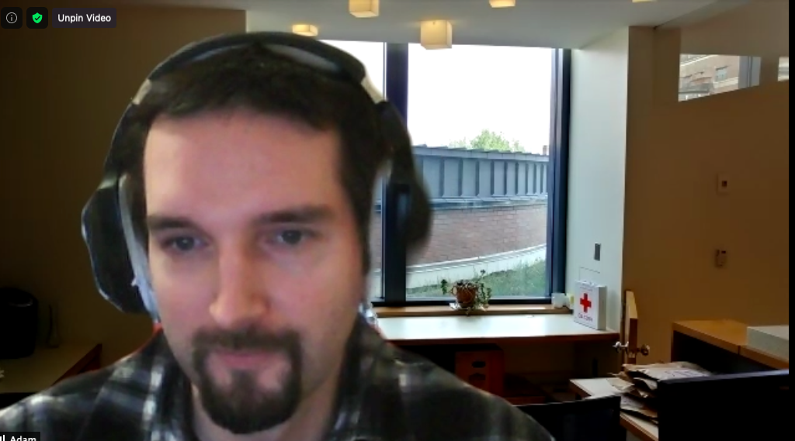
Wpadmin Office Hours
https://bostonu.zoom.us/my/adznid
Monday - Friday 11 a.m.- noon
Adam will open this room every day for an hour, and at least one director will also be available as well as Alyssa and Dan. Please stop by with any WP questions you might have!

Slide 7
Coordinators
Writing Center Coordinator: Heather Barrett heathbar@bu.edu
Coordinator of ESL: Malavika Shetty mlshetty@bu.edu
Curriculum Coordinators: Kevin Barents kbarents@bu.edu and Michele Martinez mcmartin@bu.edu

Slide 8
5-Minute Visit
In your group…
(re)introduce yourself
relive your favorite summer memory (real or imagined)
or: recommend something you read/watched/listened to for pleasure this past summer

Slide 9
Service & Committee Updates

Slide 10
Faculty Workload and Rewards Project Update
Jessica Bozek & Sean Desilets for the FIC

Slide 11
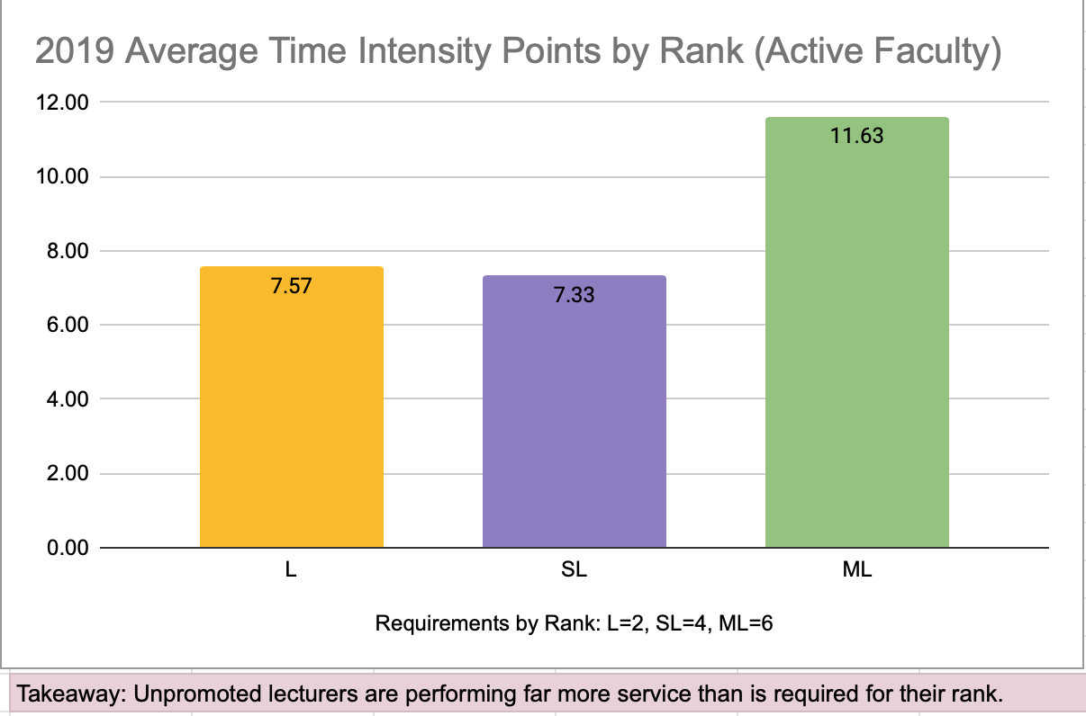

Slide 12
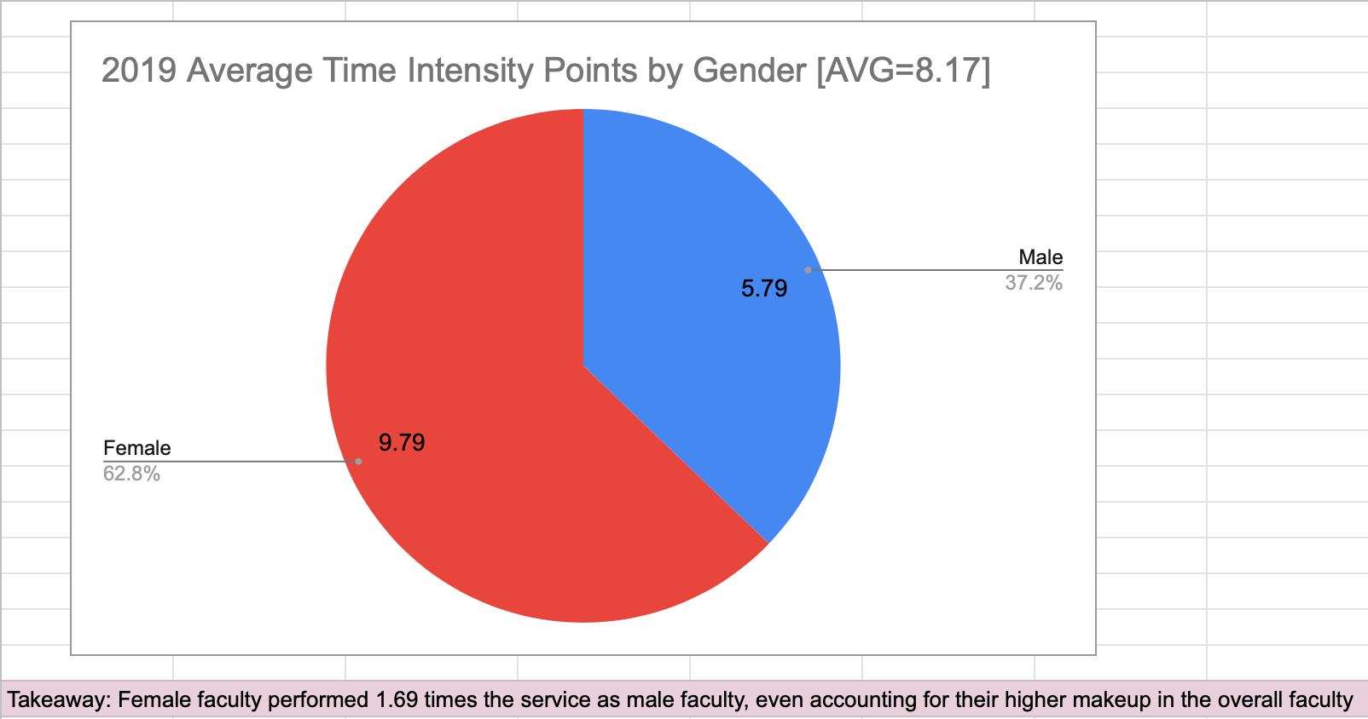

Slide 13
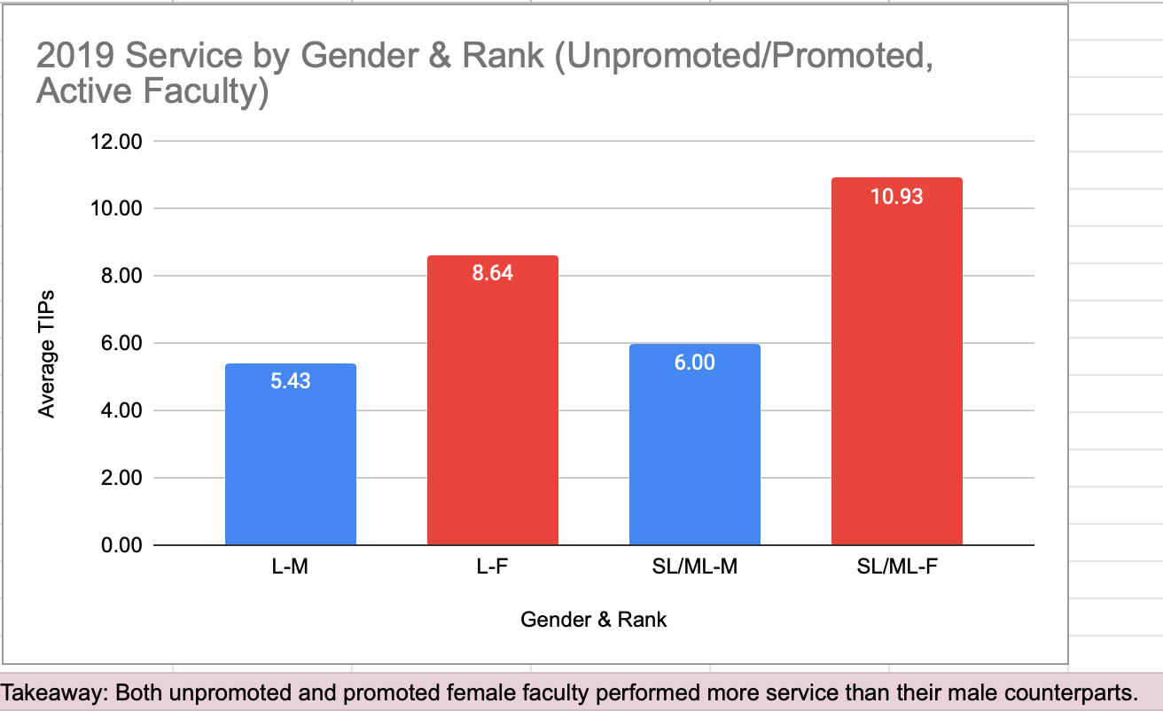

Slide 14
Reduced Service Expectations
AY 20-21
PT Lecturer/GWF
No expectation of service; contributions are welcome
FT Lecturer
Service on one opt-in WP committee or equivalent of the lecturer’s choice
Senior Lecturer
Service on one opt-in or assigned WP committee
Master Lecturer
Service on assigned WP committee in addition to any opt-in

Slide 15
Contingency Planning Team
Rebecca Kinraide, chair
Heather Barrett
Michael Degener
Sean Desilets
Pary Fassihi
Maria Gapotchenko
Dora Goss
Aleks Kasztalska
Michele Martinez
Marie McDonough
Sam Myers
Malavika Shetty
George Vahamikos
Maria Zlateva
Thank you!

Slide 16
Writing Program Committees
AY 20-21
DEI Committee
WR 153 Committee
Faculty Issues Committee
Performance Review Committee
GWF Selection Committee
Sub Alliance
Plus the CPT, the Collaborative Mentoring Initiative, and many other opt-in service opportunities
On hold
Faculty Mentors (now CMI)
WR Journal
Curriculum Committee
Alumni Essay Awards
MLK Essay Award
Writing Center Advisory Board
No searches planned for this year
Faculty seminars
Notes:
Updated 2021 SMH

Slide 17
SUBMIT!
Office hours/directory form:
https://www.bu.edu/wpnet/forms/directory-form/
Fall 20 syllabi:
https://www.bu.edu/wpnet/forms/syllabus-submission-form/

Slide 18
WP’s DEI Committee 2020-2021
We are dedicated to political and pedagogical actions, including promoting antiracist practices in the classroom, prioritizing the hiring and retention of faculty of color, and supporting students of color across Boston University.
The summer of 2020 marked an inflection point in the public’s response to police violence and systemic racism. Our actions this summer, and this past week during #scholarstrike, will continue to inform the critical work we are doing together as a committee and across the Writing Program.
Notes:
Swati

Slide 19
DEI Committee to DEI Community @ the WP
Listening to our students and each other
Learning about anti-racism together
Piloting ideas in our classrooms, in partners, and sharing
Humanizing a pandemic and supporting each other

Slide 20
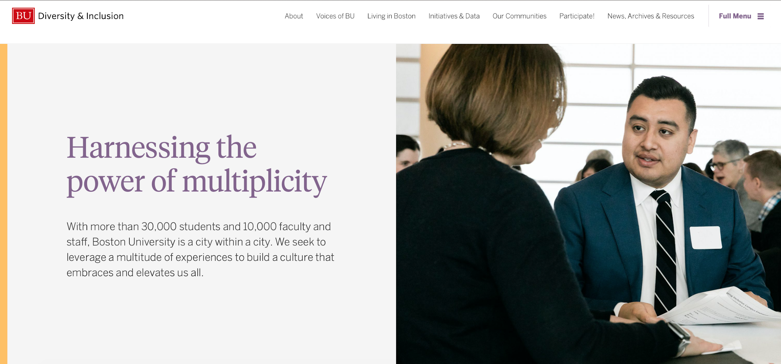
Office of Diversity and Inclusion @ BU
Faculty and Staff Community Networks
Information on how to sign up for newsletter
Repository of Day of Action lectures
Guides for navigating Boston life for students, staff, faculty
And more!
https://www.bu.edu/diversity/

Slide 21
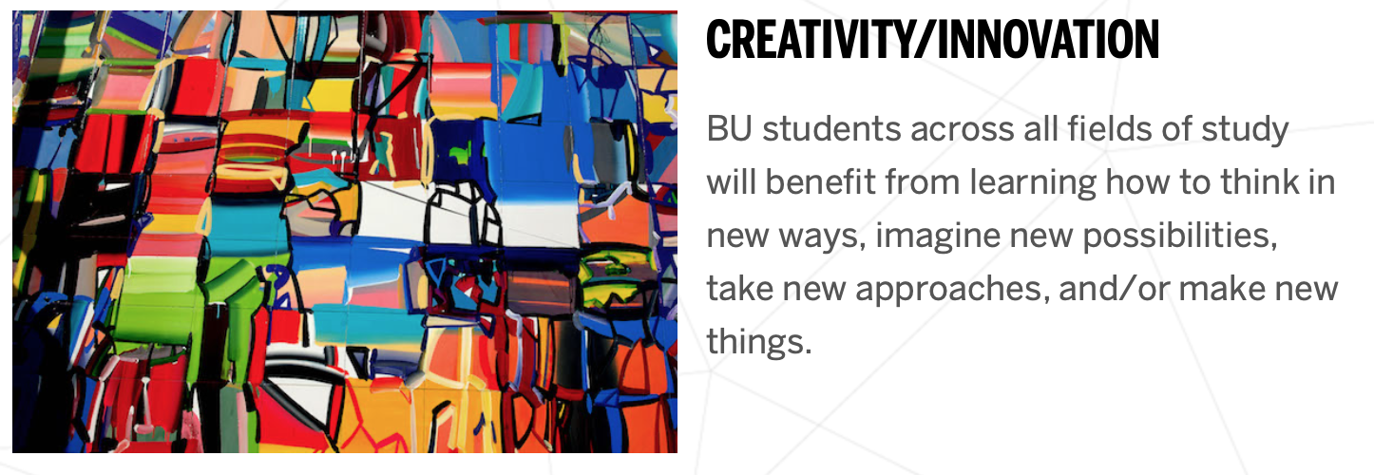
WR 153 Committee
A new Writing, Research & Inquiry course with a Hub unit for Creativity and Innovation
Brandy Barents Dora Goss
Jessica Bozek Anna Panszczyk

Slide 22
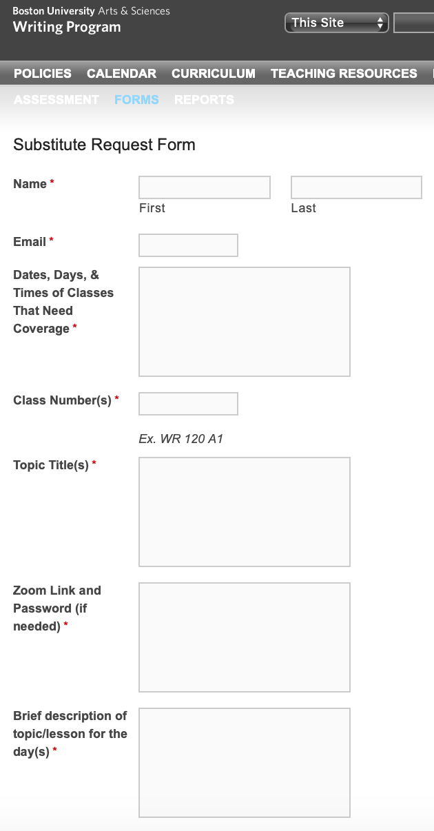
Sub Alliance
Request a Substitute form is now available on the WPnet
Questions? Contact Lesley Yoder (layoder@bu.edu)
Notes:
Lesley

Slide 23
Things to come
Beginning-of-year meetings
Teaching observations
Promotion process

Slide 24

Humanities Task Force
A questionnaire from the CAS Humanities Taskforce
will soon reach your inbox.

Slide 25
5-Minute Visit
In your group…
talk about whatever you’d like

Slide 26
Resource Reminders

Slide 27
WR Portfolio Project
Aleksandra Kasztalska, Chris McVey, Stephen Hodin

Slide 28
The WR Portfolio Project is an initiative to simplify, expand, and standardize writing portfolios for WR classes. Supported by an Assessment Mini-Grant, the project seeks:
To facilitate metacognitive student portfolios that better reflect the BU Hub and recently redeveloped WR curriculum, including and especially multimodal projects;
To offer a “ready-to-go” portfolio assignment for graduate students and instructors who might be unfamiliar with portfolios in first-year-composition (FYC) curriculum, and to make it easier for all instructors to integrate portfolios in their WR courses;
To provide instructors with a clear rubric and criteria for assessment of student metacognitive writing as documented in portfolios;
To build the groundwork for a better, more standardized dataset that the Writing Program can utilize during its biennial quantitative assessment;
To design a portfolio template that has the potential for students to create a single, unified WR portfolio across their WR coursework.

Slide 29


We have developed a number of portfolio resources for WR112, WR120, and WR15X, including:
assignment sheets,
Word and Digication templates
grading rubrics, and
instructor guides.

Slide 30
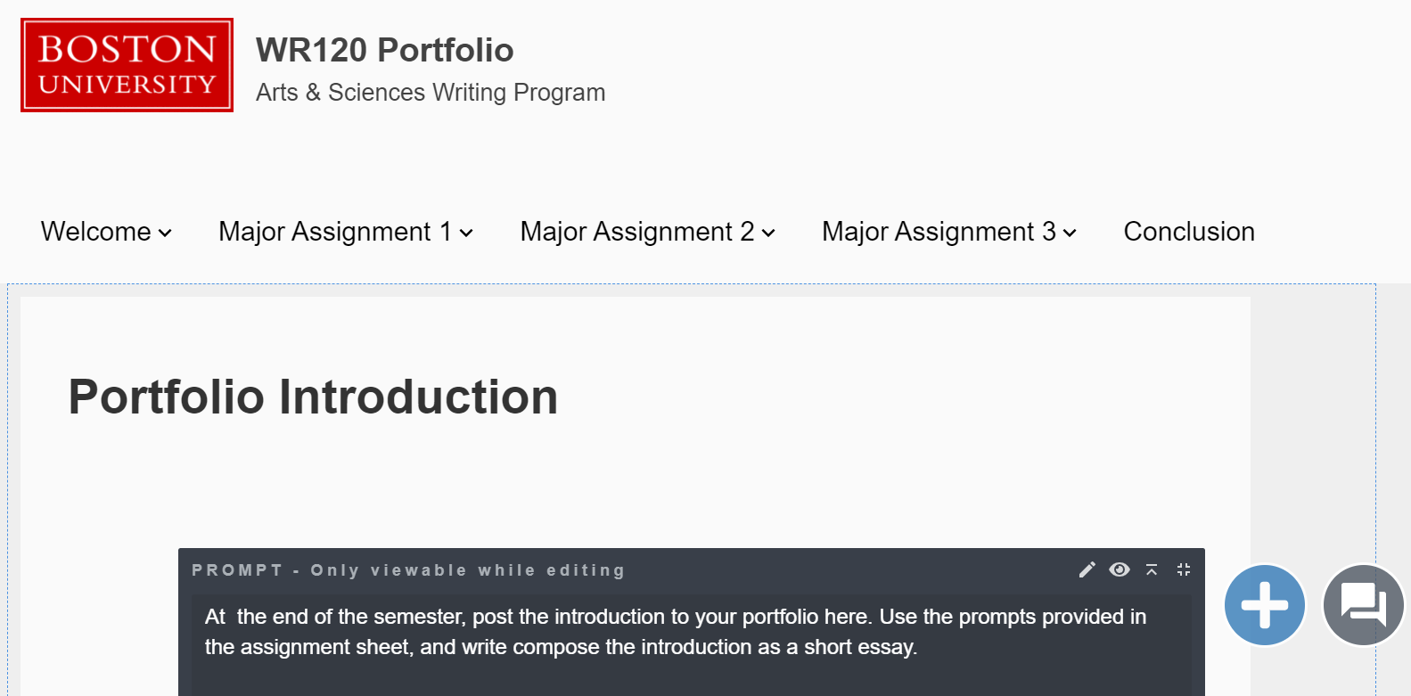

Slide 31
These resources can be adapted and edited as you see fit!
We will further refine these resources at the end of the semester after testing them in our own classes and, hopefully, piloting them with some of you this fall.

Slide 32
You can access all the resources at:
https://drive.google.com/drive/folders/1OdM22gw9Zt_vQJq7DL3_ddAChjWznYPz?usp=sharing
You can access the Digication templates at:
https://bu.digication.com/wr-portfolio-project-wr120-template
https://bu.digication.com/wr-portfolio-project-wr15x-template

Slide 33
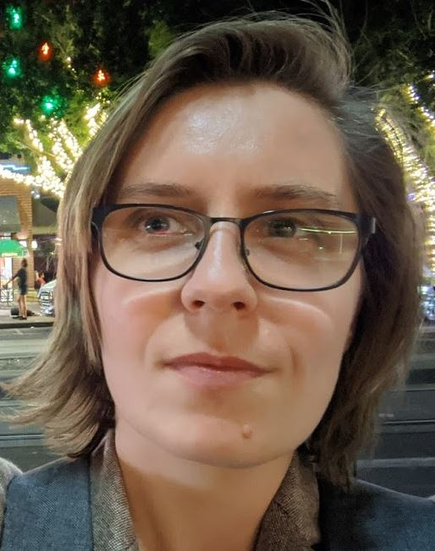
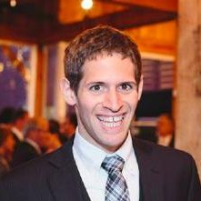
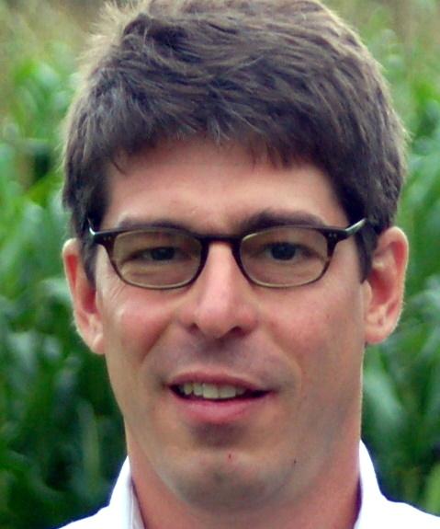
Questions? Comments? Contact us!
Aleks Kasztalska
alekasz@bu.edu
Chris McVey
cmcvey@bu.edu
Stephen Hodin
shodin@bu.edu

Slide 34
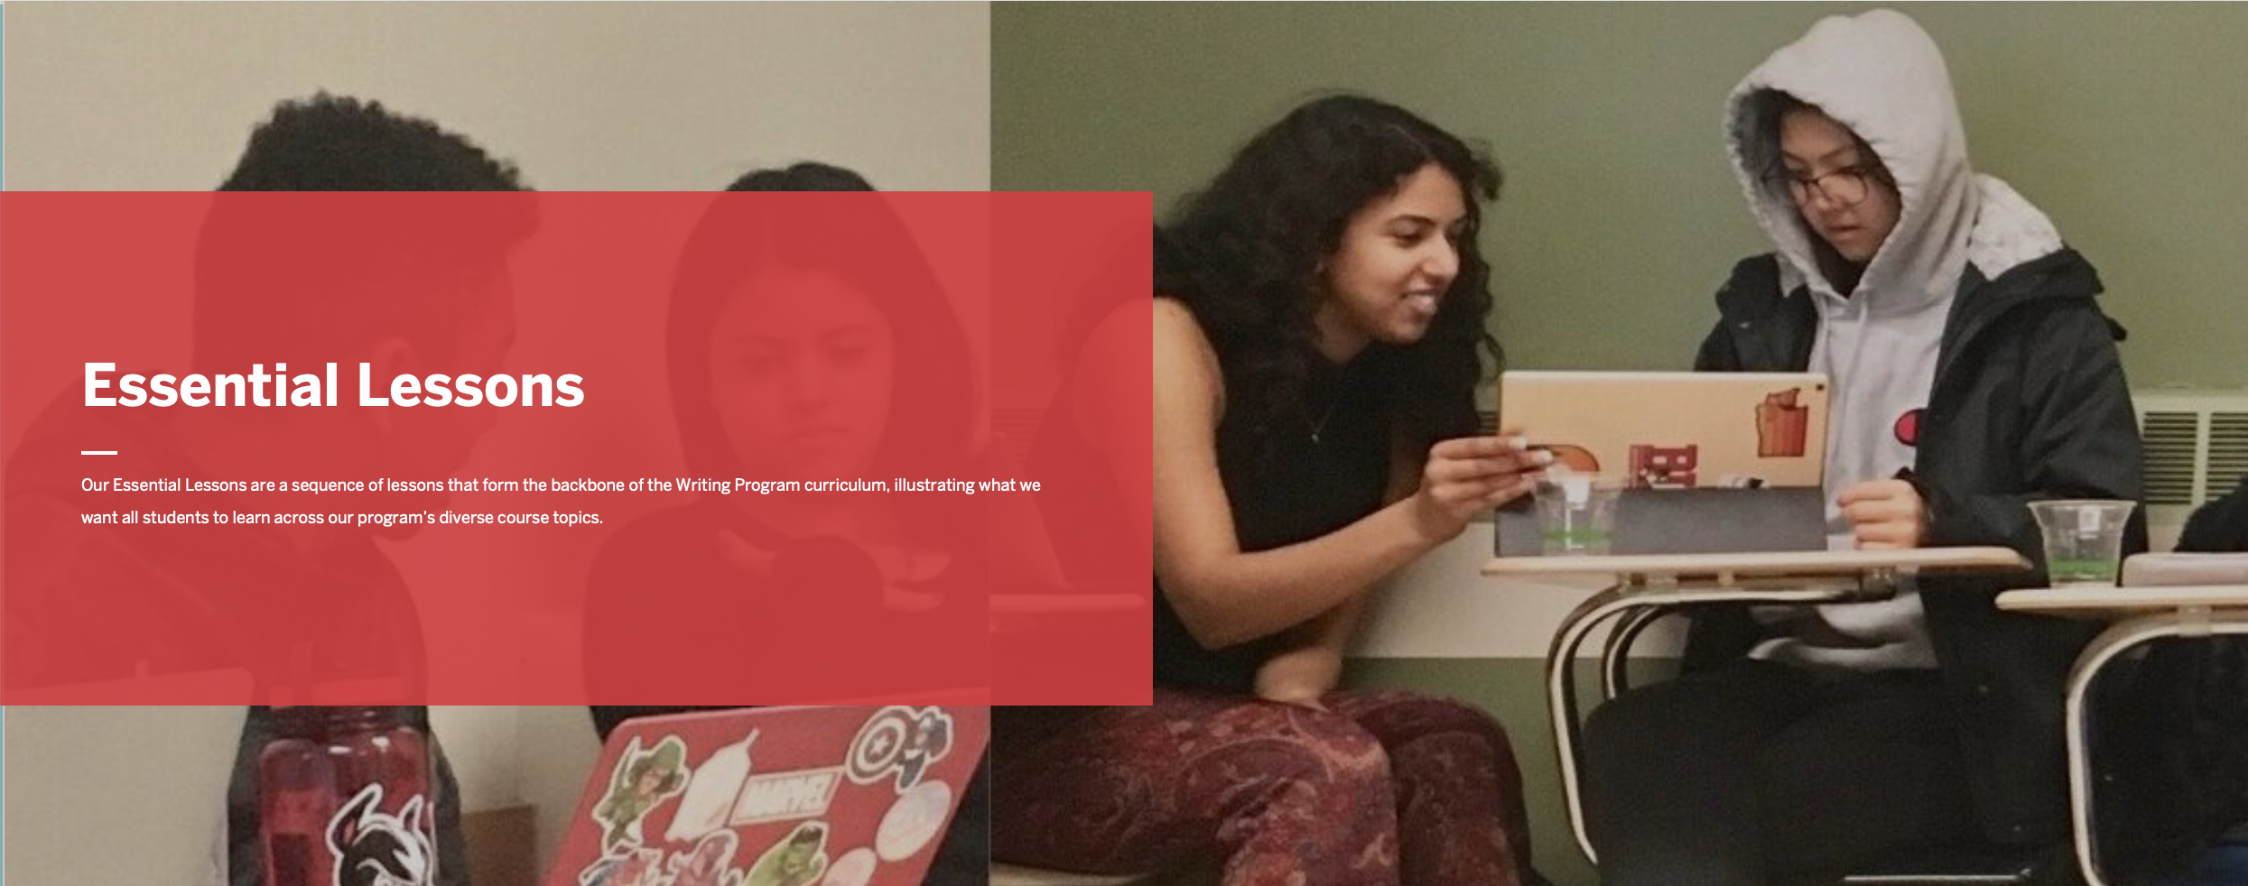
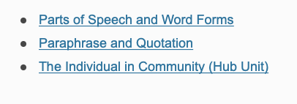
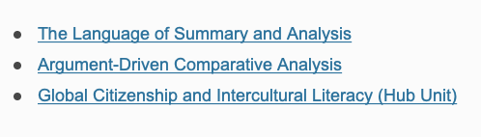
Teaching of Writing Site
Essential Lessons
WR 111
WR 112

Slide 35
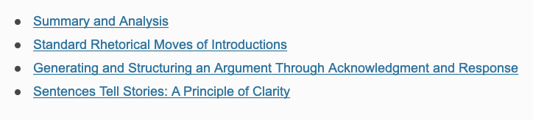
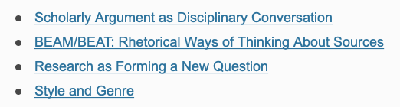
Teaching of Writing Site
Essential Lessons
WR 120
WR 15X

Slide 36
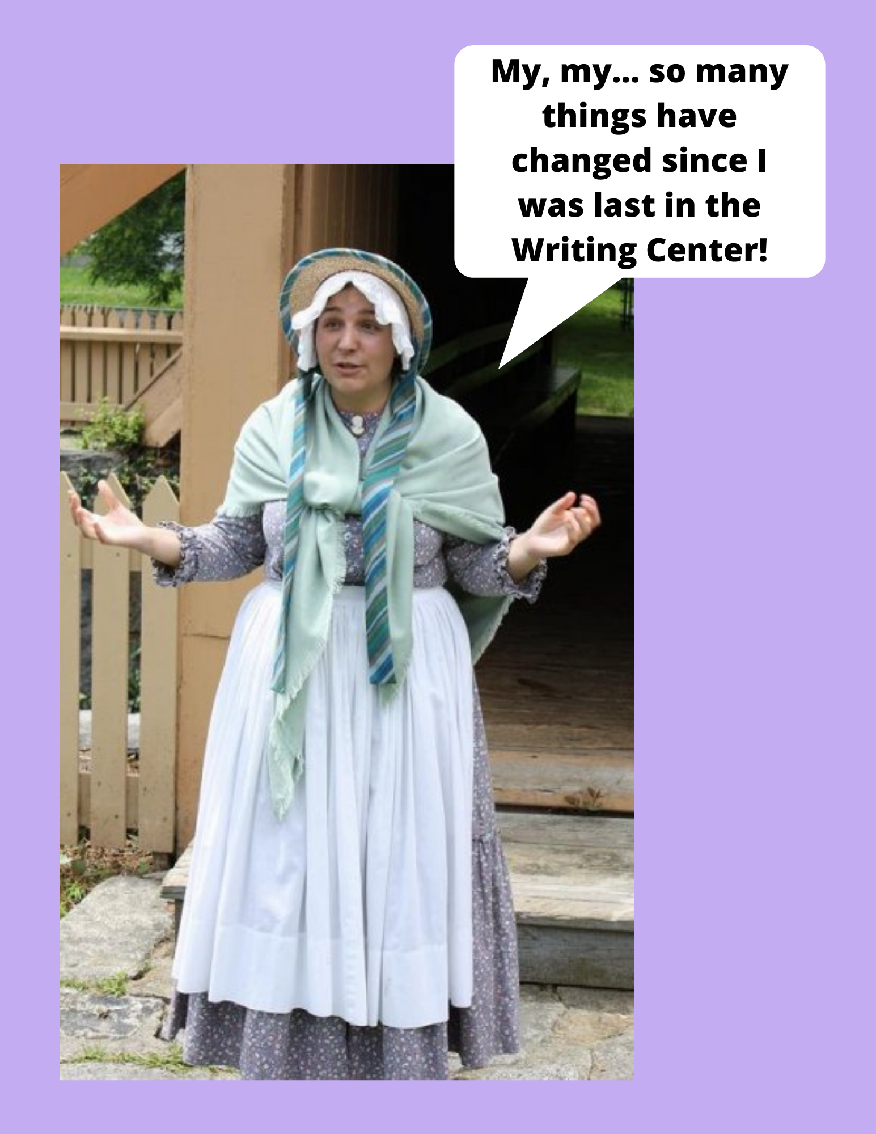
CAS Writing Center
Fall 2020 Operations
Heather Barrett
Writing Center Coordinator heathbar@bu.edu

Slide 37
Students can visit for assistance with ANY WR assignment
Synchronous appointments
  Video chat live with a consultant
Asynchronous appointments
  Upload drafts in advance & get written feedback from a consultant in response to specific questions
Virtual class visits
  Complete Google form to arrange them
Intensive tutoring
  Referrals accepted on rolling basis until early October
Check us out on Instagram & Facebook: @bucaswriting
http://www.bu.edu/writingprogram/the-writing-center/

Slide 38
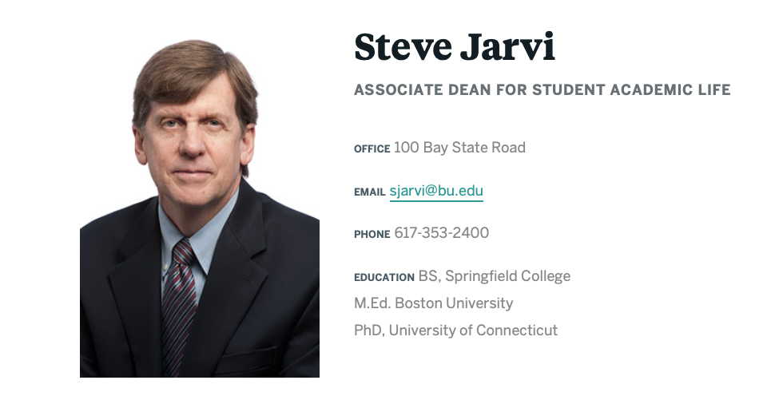
Support for student access to tech
sjarvi@bu.edu

Slide 39
PPE + Tech
Masks (in the copy room)
Headsets (in the copy room)
Bluetooth Headsets (IT Help Center lobby in west campus at 179 Amory St. )
CO2 monitor (details to come)

Slide 40
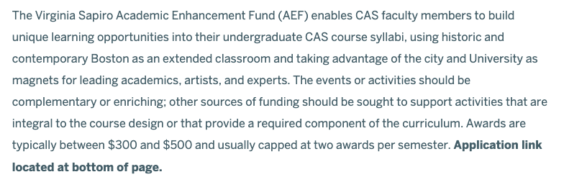
Funding Sources
https://www.bu.edu/cas/faculty-staff/instructors-guide/academic-enhancement-fund/
Course Enhancements

Slide 41
Funding Sources
Part Time Lecturer Professional Development Funds
What can you apply for: “to support attendance at an academic conference or other relevant professional development related to teaching at Boston University”
•Virtual conferences; local conferences or meetings; training and enrichment courses related to pedagogy or field of teaching
Information: https://www.bu.edu/ctl/teaching-resources/part-time-faculty-professional-development-fund/
Process:
•Read guidelines
•Check with CTL if you are not sure if your project/expenses meet the criteria (dfbreen@bu.edu)
•Complete paperwork and submit to Director, WP for signature
•Submit to CTL for approval
•If approved, submit receipts to WP for reimbursement (Dan Ivey) within 30 days of your conference/course etc.
Amount:
•No specified ceiling, but unlikely to receive more than $1500; one allocation per year

Slide 42
Funding Sources
Salaried Lecturer Professional Development Funds
What can you apply for: “for professional development funding for opportunities or resources related to teaching at Boston University”
•Virtual conferences; local conferences or meetings; training and enrichment courses related to pedagogy or field of teaching; resources (including tech hardware or software; books)
Information: https://www.bu.edu/ctl/programs/grants/salaried-lecturer-professional-development-fund/
Process:
•Read guidelines
•Check with CTL if you are not sure if your project/expenses meet the criteria (dfbreen@bu.edu)
•Complete paperwork and submit to Director, WP for signature
•Submit to CTL for approval
•If approved, submit receipts to WP for reimbursement (Dan Ivey) within 30 days of your conference/course etc.
Amount:
•$1000, plus additional amount of up to $650 (Senior/Master Lecturers) or $500 (Lecturers); may apply more than once if funds are available

Slide 43
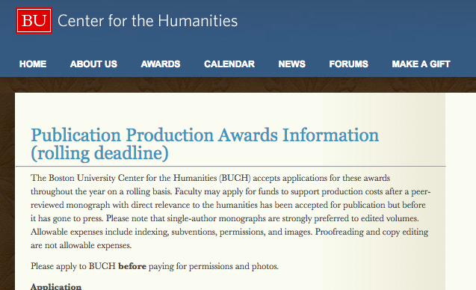
Funding Sources

Slide 44
Resource Fatigue?
No need to remember it all on a Friday afternoon. These slides and other Fall 2020-specific information will be available on the WPnet’s Covid FAQ page
http://www.bu.edu/wpnet/fall-2020-covid-faqs/

Slide 45



Faculty Publications
Congratulations

Slide 46
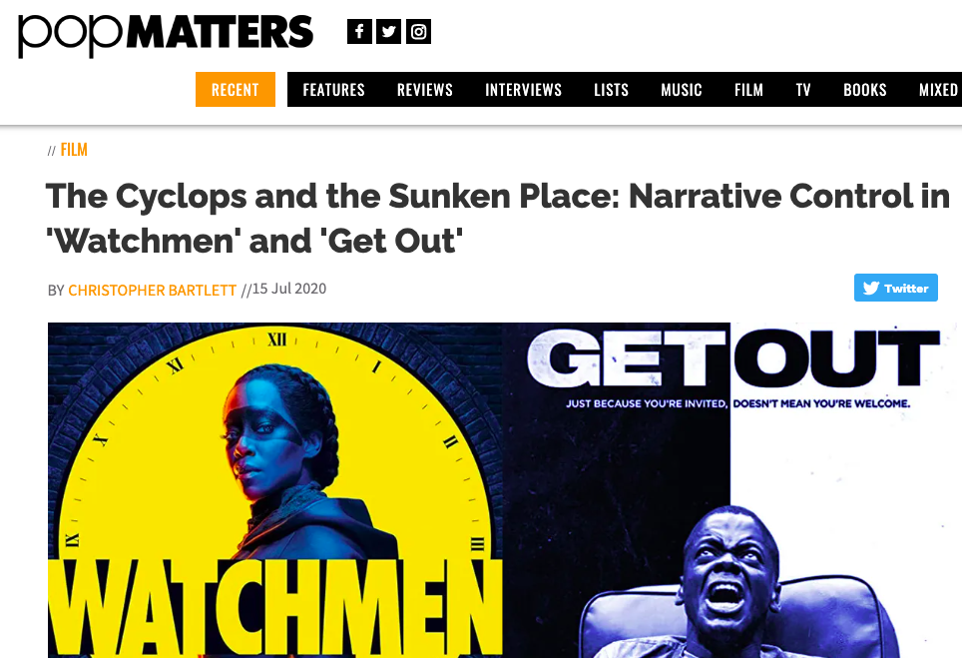

Slide 47
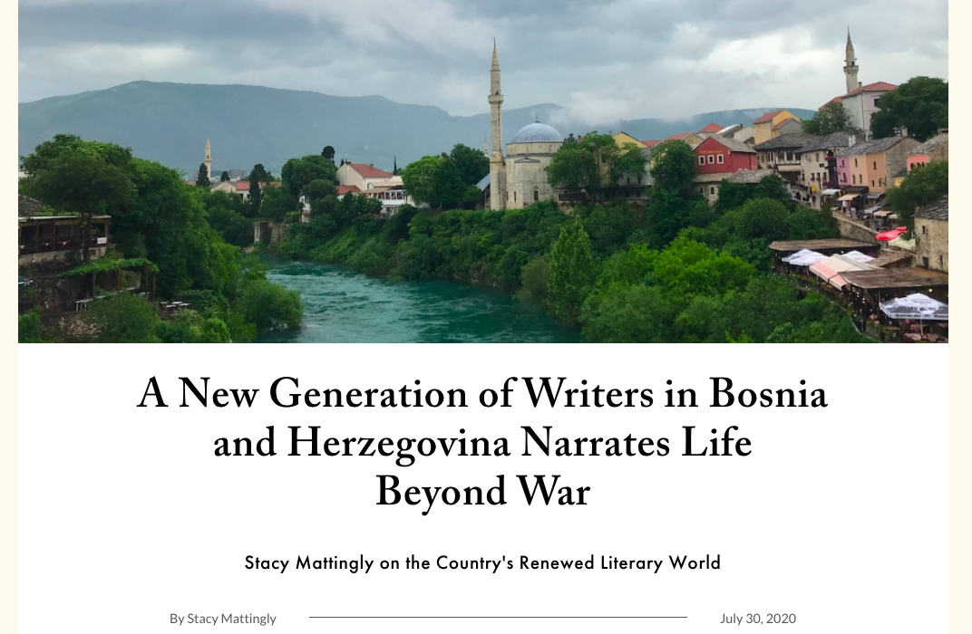

Slide 48
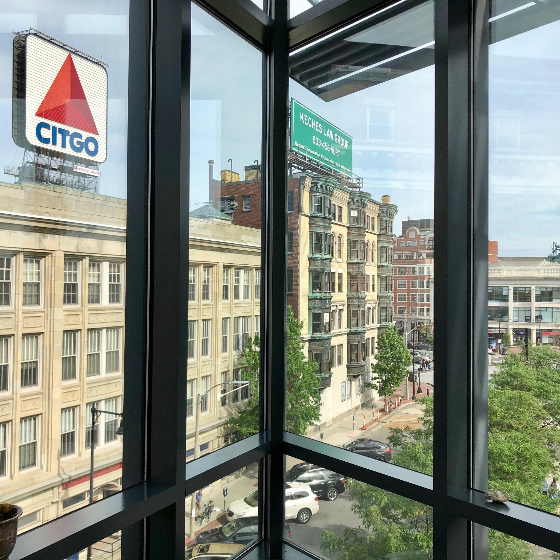
You are cordially invited to the
Writing Program
Faculty & Staff
Hour
Friday September 25, 3:30
and other dates TBA
Hosted by Kim Shuckra

Slide 49
QUESTIONS / COMMENTS
THANK YOU

