Slide 1
All Faculty Meeting
Fall 2019
Arts & Sciences Writing Program
September 13

Slide 2
Welcome New Faculty
Anne Blaschke
Lucas Fain
Beth Fincke
Robert Kilpatrick
Michael McCluskey
Swati Mehta
Peter Ruggiero
Michelle Smith

Slide 3
Congratulations to these Newly Promoted Faculty
Ingrid Anderson, Senior Lecturer
Jura Avizienis, Senior Lecturer
Maria Gapotchenko, Master Lecturer
Chris McVey, Senior Lecturer
Samantha Myers, Master Lecturer
Holly Schaaf, Senior Lecturer

Slide 4
Writing Program Committees
Standard Search
ESL Search
ESL Director Search
Curriculum Committee
Faculty Issues Committee
Performance Evaluation
GWF Selection
Diversity and Inclusion Committee
CMI/Faculty Mentor
WR Journal
Alumni Essay Awards
MLK Essay Award
Writing Center Advisory Board

Slide 5
Some random deadlines
Oct 25 FT Lecturer reappointments (for those with a 12/15 notification date) due in FA
Dec 2 PD LOA requests due in FA
March 8 PT Lecturer reappointments due in FA
March 22 FT Lecturer reappointments (for those with a 6/1 notification date) due in FA

Slide 6
Faculty due to be observed
Allenberg, Diane
Anderson, Ingrid
Barrett, Heather
Beauvais, Carroll
Blaschke, Anne
Fain, Lucas
Fincke, Mary (Beth)
Gapotchenko, Maria
Giraldi, William
Goss, Theodora
Gruenglas, Jeffrey
Gutierrez, Jeffrey
Hashem, Noor
Hodin, Stephen
Kasztalska, Aleksandra
Kilpatrick, Robert
Kinraide, Rebecca
Martinez, Michelle
McDonough, Marie
McVey, Christopher
Michaud, Christina
Milanese, Marisa
Myers, Samantha
Penn, Darren
Rani, Swati
Ruggiero, Peter
Shawn, David
Shetty, Malavika
Smith, Michelle
Tandon, Jason

Slide 7
Faculty Workload and Rewards Project Update
Moving from Data to Action
Seth Blumenthal
Jessica Bozek
Sarah Madsen Hardy
Christina Michaud
Tom Underwood
Chris Walsh

Slide 8
Agenda
Present 2018 demographics & service (as reported in FARs)
Standardize FAR reporting (FIC task)
  Differentiate Service from Citizenship & Professional Development
Record and acknowledge citizenship
Pilot service expectations
Clarify expectations and roles for WP committees, pilot committee assignments
Standardize Beginning of Year (BoY) Meetings

Slide 9
Writing Program Faculty
Who we are, by rank and gender

Slide 10
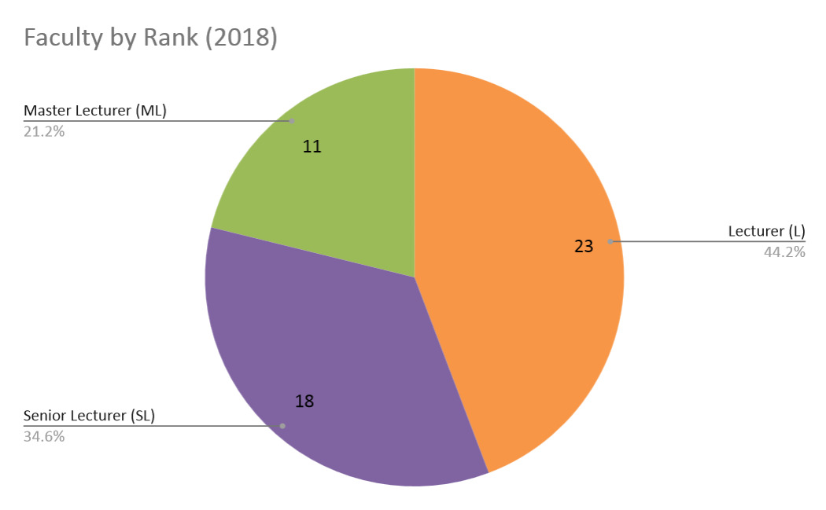
Notes:
This slide shows how successful at promotion our department is. Compare with next slide, 2017 rank: Our total number of ML changed from 3 to 11.

Slide 11
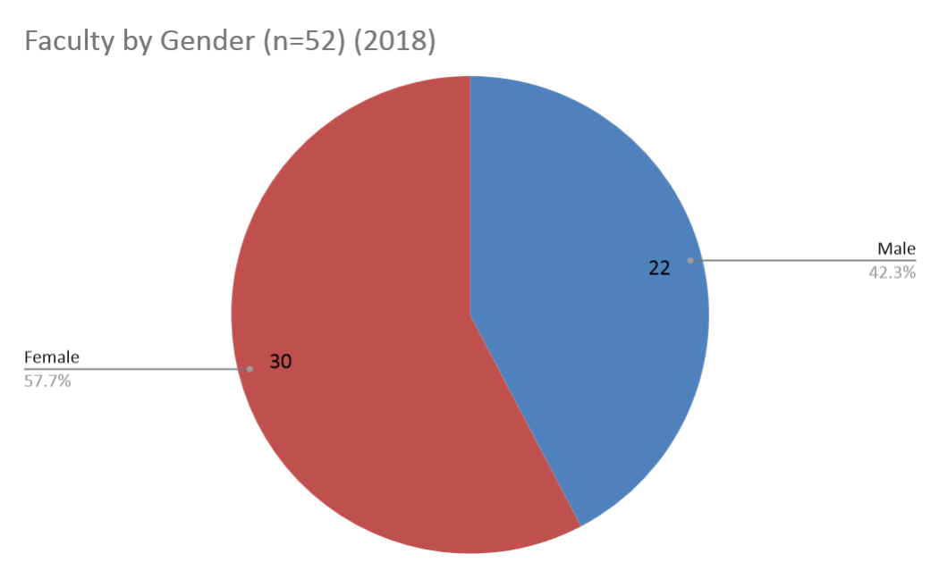
*1 of 30 female faculty members (SL) was on leave in 2018

Slide 12
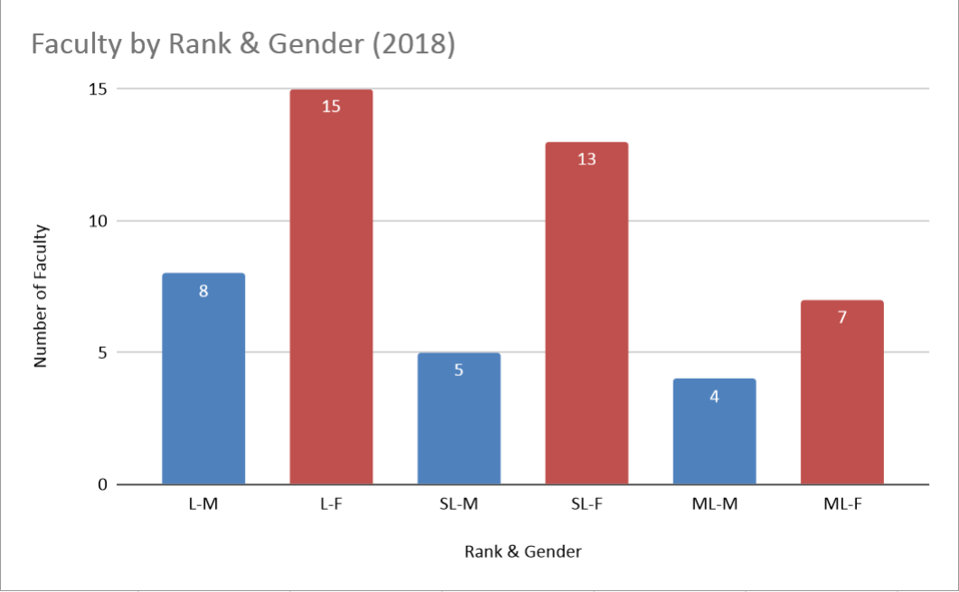
Notes:
Because the # of ML-M is less than 5, we weren’t able to break ML data down by gender, so our reports aren’t as specific as we’d like.

Slide 13
Service
A look at the data reported on our 2018 FARs

Slide 14
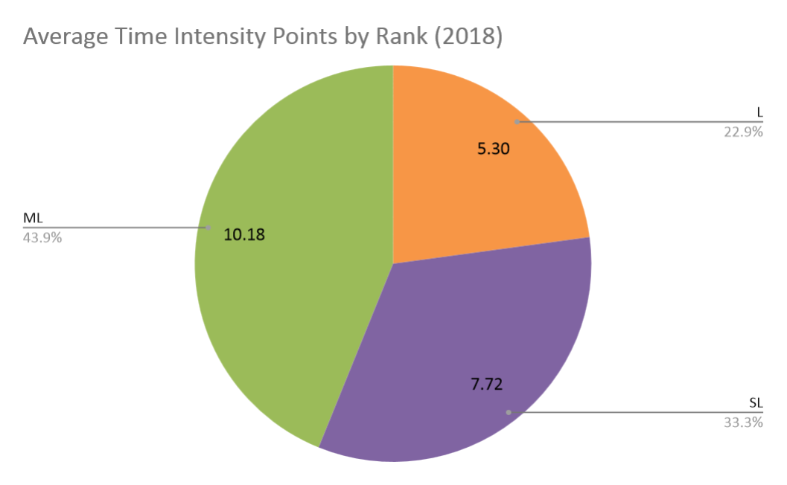
Notes:
This trend looks good—the service expectations increase with rank, and reflects the changes we’re piloting this year (Service Expectations, which we’ll discuss shortly).

Slide 15
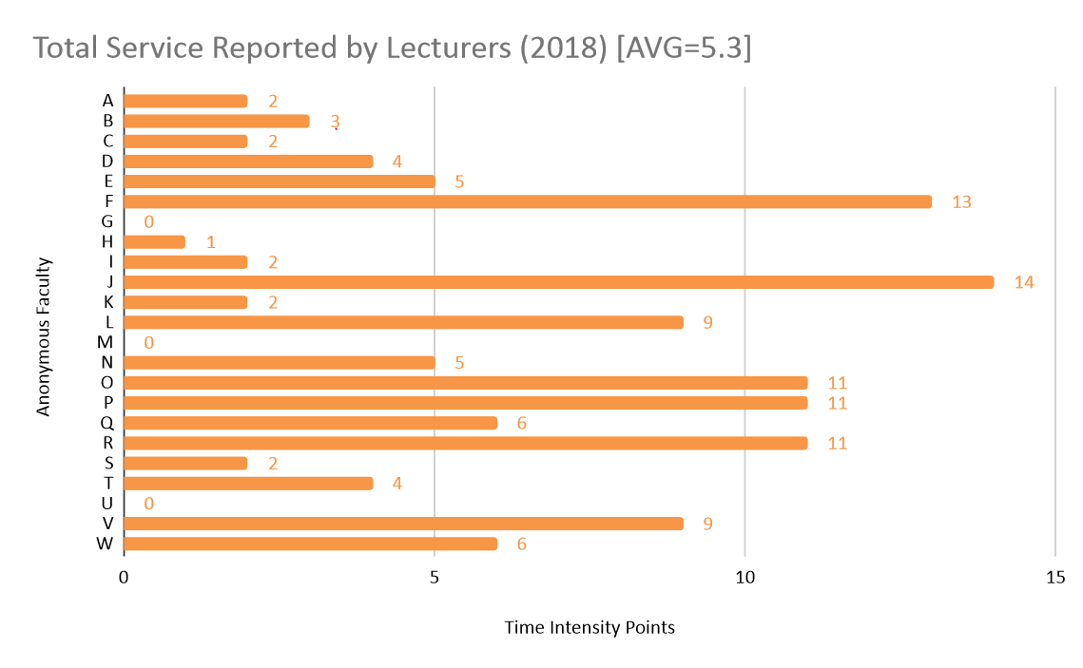
Notes:
Only 7 of 20 Lecturers were above the average, but this isn’t necessarily a problem, since the minimum number of TIPs we’ll be proposing for Lecturers this year is 2. In this case all but 4 people would have fulfilled expectations. In general, we do a lot! These numbers are anonymous here, but will appear on the form your have to fill out for your Beginning of Year meeting with a director. Chris will speak more about this later…

Slide 16
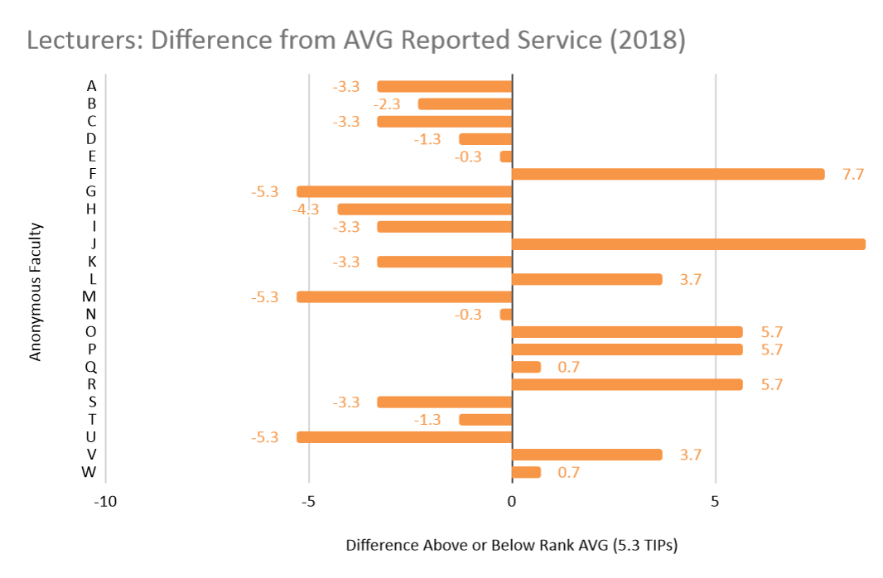
Notes:
Another view: how far from the average each Lecturer was. 9 of 20 Lecturers performed more service than the average.

Slide 17
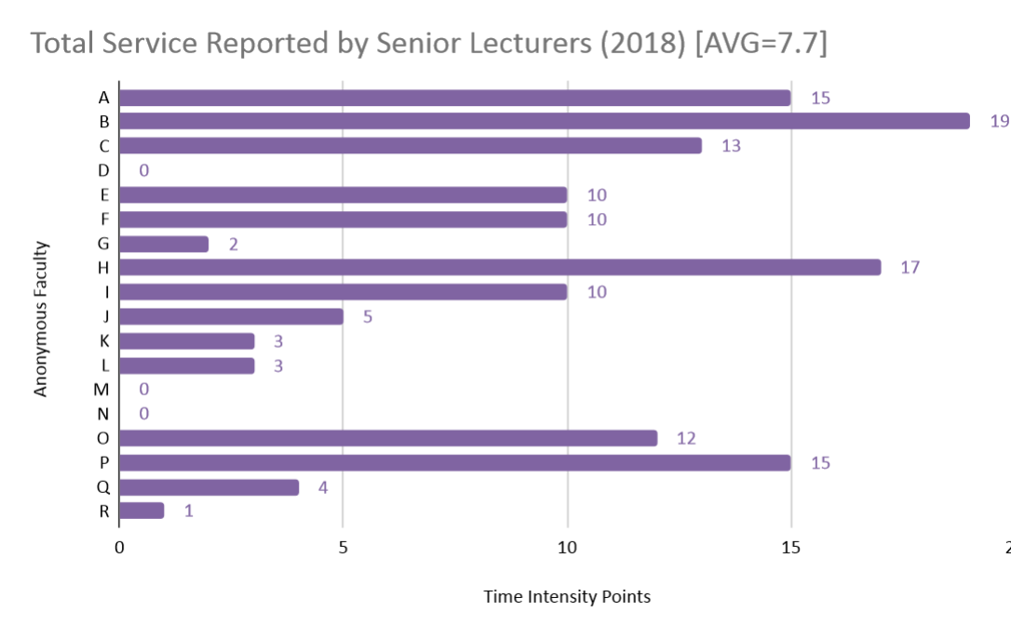
Notes:
9 of 21 Senior Lecturers were above the average. Moving forward, the minimum number of TIPs we’re proposing for SLs is 4. In this case all but 8 people would have fulfilled expectations. Lecturers (as a group) would have done better if we using 2018 data to assess 2019 service.

Slide 18
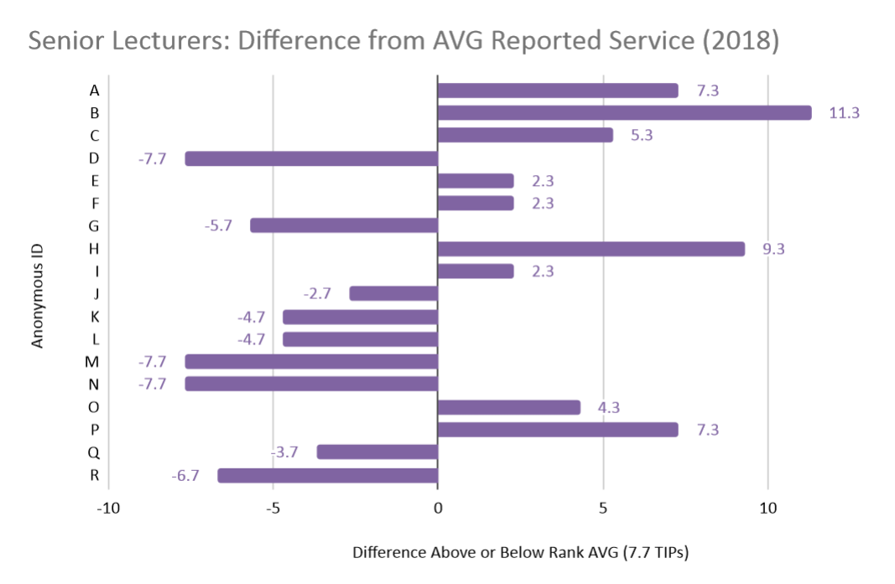
Notes:
9 of 21 SLs performed more service than the average.

Slide 19
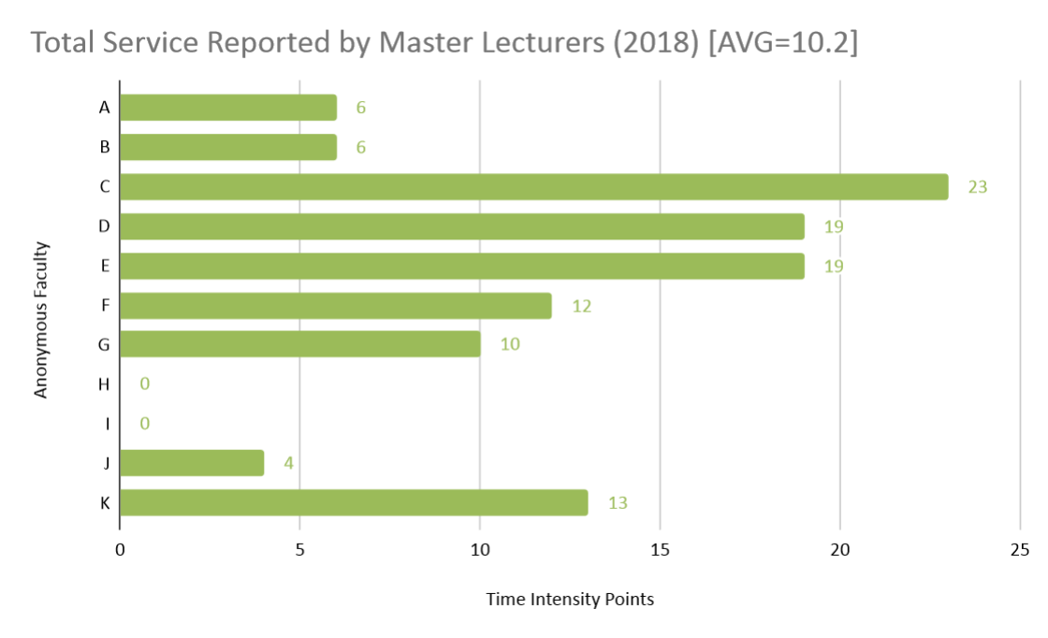
Notes:
5 of 11 Senior Lecturers were above the average. Moving forward, the minimum number of TIPs we’re proposing for MLs is 6. In this case all but 4 people would have fulfilled expectations, but that’s statistically significant—36% of MLs will need to do more.

Slide 20
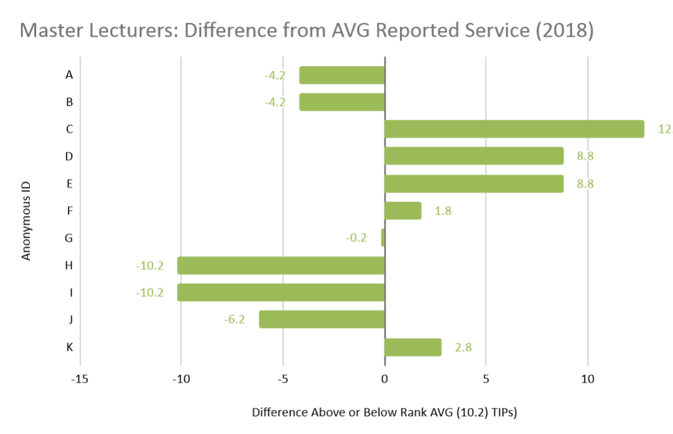
Notes:
5 of 11 MLs performed more service than the average.

Slide 21
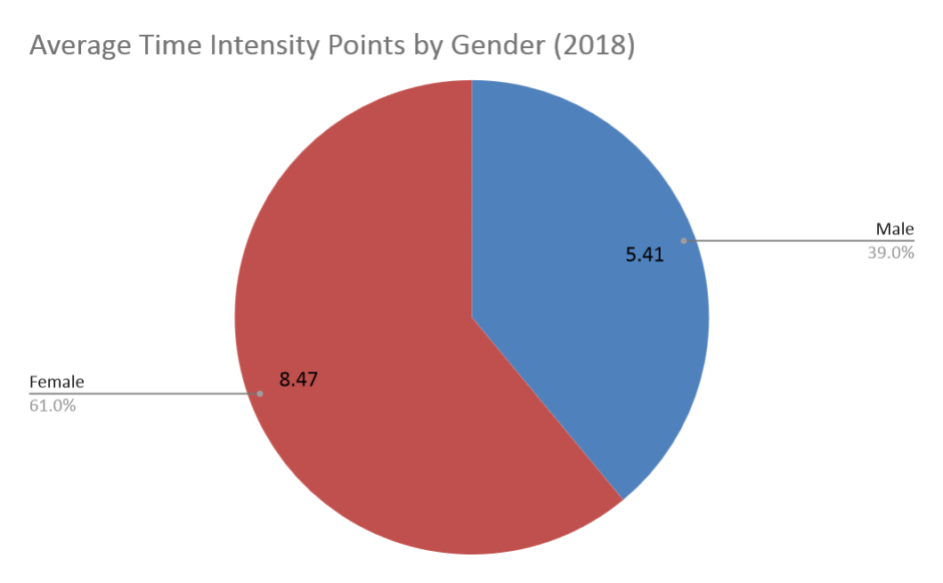
Notes:
While our data looks good for rank, we still see a slight equity issue when we look at gender. Across all ranks, women faculty are doing 1.5x more service than men. But when we look at faculty by rank, the picture shifts…

Slide 22
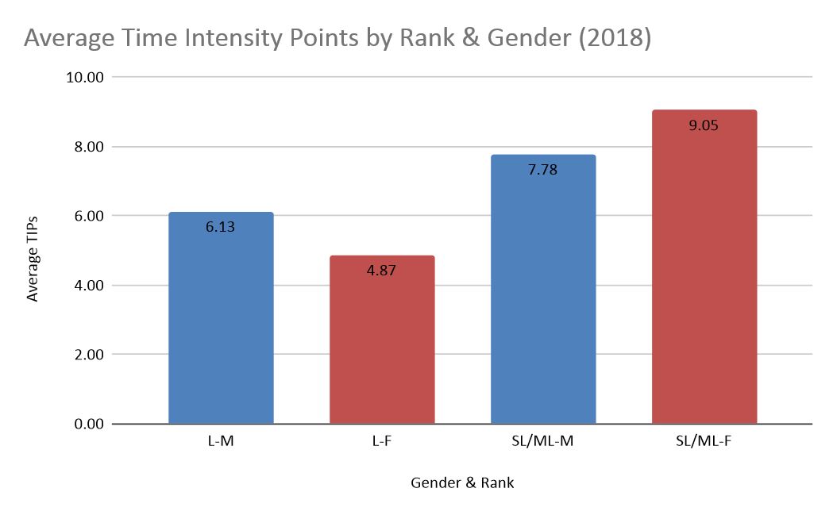
Notes:
Among unpromoted faculty, L-Ms do 1.26x more service than L-Fs. But among promoted faculty, female SL & ML do more service (1.16x) than male SL & ML. These numbers are weighted (take into account number of faculty). Promoted men have stepped up their service since 2017, when the disparity was Female S/ML = 10.21, Male S/ML = 2.5. Looking ahead, just meeting the new minimum service requirements would even things out more.

Slide 23
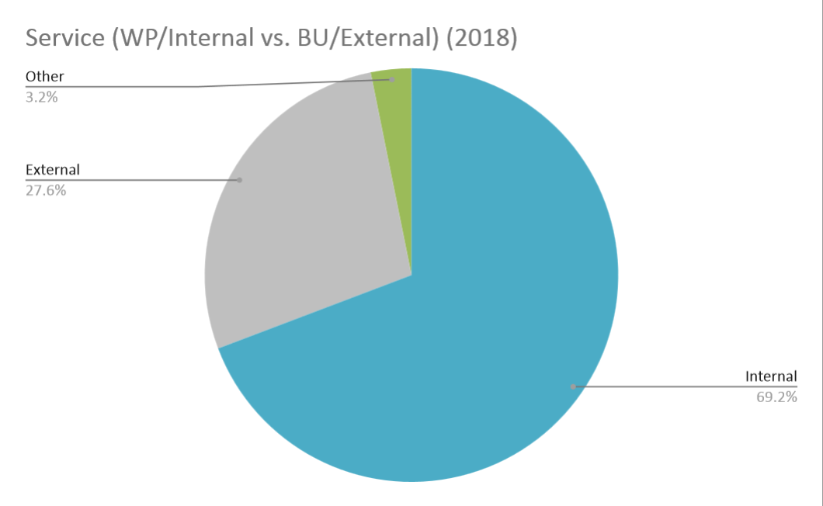
Notes:
[DO WE NEED THIS SLIDE?] We didn’t get very far with our analysis of how service broke down as internal or external, but we figured it was worth noting. We’d like to keep talking about what kind of ratio makes sense, especially for promoted lecturers.

Slide 24
FAR Reporting
Standardize FAR reporting (FIC task)
  Differentiate Service from Citizenship & Professional Development
Record and acknowledge citizenship (survey)
  How to record citizenship without cluttering FAR?

Slide 25
Piloting New Policies (Chris)
Service Expectations
Committee Assignments
Beginning of Year Meetings

Slide 26
Service Expectations
Rank/Expectation | Lecturer Service on one opt-in committee or equivalent of the lecturer’s choice with a substantive product or impact that contributes to the Writing Program) (2 time-intensity points) Note: Full-time lecturers in their first year teaching in the WP or on non-continuing contracts are exempt from this expectation. | Senior Lecturer Service on one assigned WP committee and one other substantive opt-in service contribution or equivalent with a product or impact that contributes to the Writing Program or Boston University (4 time-intensity points) | Master Lecturer Service on one assigned WP committee and two other substantive opt-in service contributions or equivalent, at least one of which should contribute to the Writing Program internally) (6 time-intensity points)

Slide 27
Committees (AY 19/20)
Standard Search
ESL Search
ESL Director Search
Curriculum Committee
Faculty Issues Committee
Performance Evaluation Committee
GWF Search
CMI
Faculty Mentor
WR Journal
Alumni Essay Award Committee
MLK Essay Award Committee
Diversity and Inclusion Committee
Promotion Committee and Mentoring

Slide 28
Goals for AY19/20
Pilot service expectations
Clarify expectations and roles for WP committees, pilot committee assignments
Standardize Beginning of Year (BoY) Meetings
Standardize FAR reporting (FIC task)
  Differentiate Service from Citizenship & Professional Development
Record and acknowledge citizenship

Slide 29
Administrative Staff
Academic Administrator: Alyssa Hall
akhall@bu.edu
Department Administrator: Dan Ivey
divey@bu.edu
Senior Assistant: Adam Znideric
adznid@bu.edu

Slide 30
Coordinators
Writing Center Coordinator
Heather Barrett heathbar@bu.edu
Coordinator of ESL
Sarah Hanselman hanselms@bu.edu
Curriculum Coordinators
Jessica Kent jessicak@bu.edu
Michele Martinez mcmartin@bu.edu
Digital/Multimedia Media Coordinator
Jason Prentice prentice@bu.edu

Slide 31
Directors
Director: Chris Walsh cwalsh@bu.edu
Director of ESL: Maria Zlateva mariazl@bu.edu
Acting Associate Director: Tom Underwood
rhetoric@bu.edu
Associate Director for WID: David Shawn dshawn@bu.edu

Slide 32
SUBMIT!
Office hours / Directory form:
https://www.bu.edu/wpnet/forms/directory-form/
Fall 19 syllabi:
https://www.bu.edu/wpnet/forms/syllabus-submission-form/

Slide 33
Welcome New Faculty
Anne Blaschke
Lucas Fain
Beth Fincke
Robert Kilpatrick
Michael McCluskey
Swati Mehta
Peter Ruggiero
Michelle Smith

Slide 34
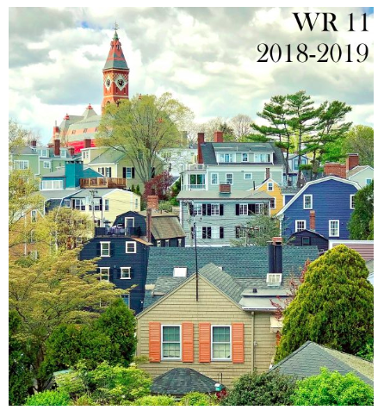

Slide 35
Teaching of Writing Site
Essential Lessons Overview
111: Summary and analysis
1. Topic: Parts of speech and word forms
2. Topic: Paraphrase/Quotation
3. Topic: Individual in Community
112: Bringing texts into conversation
1. Topic: Language of the task of summary and analysis
2. Topic: Argument-driven comparative analysis
3. Topic: Global Citizenship and Intercultural Literacy

Slide 36
Teaching of Writing Site
Essential Lessons Overview
120: Argument as conversation
1. Topic: Summary and analysis
2. Topic: Standard intro/problem statement
3. Topic: Generating and structuring an argument through acknowledgement and response
4. Topic: Sentences tell stories: Principles of clarity
150/1/2: Researched argument
1. Topic: Scholarly argument as disciplinary conversation
2. Topic: Rhetorical ways of thinking about sources
3. Topic: Research as forming a new question
4. Topic: Style vis a vis genre

Slide 37
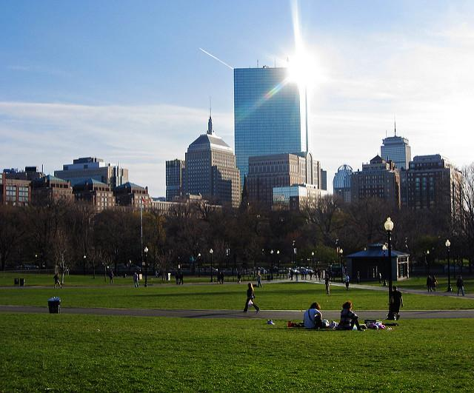
Writing in the Field Lecture
Joe Bizup
Thursday, October 24 exact time TBA

Slide 38
Faculty Seminar
Portfolios in First-Year Writing: Theory and Practice
Stephen Hodin and Chris McVey, Facilitators
Mon. 10/7 Portfolios – Theory and Pedagogy
Tues. 10/15 (Mon schedule) Portfolio Assessment
Mon. 10/21 Digital and Multimedia Portfolios
Mon. 10/28: Portfolios in the Writing Program
Meeting time: 3:30-5:00pm, WR conference room
Email cmcvey@bu.edu for more information

Slide 39
Faculty Seminar: Topics in Digital/Multimedia Expression
Facilitator: Jason Prentice prentice@bu.edu
Meeting times: Exact details TBA (4 meetings, on Tuesdays or Thursdays in October-November, 2-3:30 p.m.)
Session Topics:
Visual Texts and Photography
Geographical and Concept Mapping
Copyright and Fair Use
Going Forward: DME and the WP Curriculum

Slide 40
3 Casual Collaborations
1) The Class Visit: One teacher visits another teacher's class to give a lecture on a topic or skill; perform or share a work of art or scholarship; co-teach with the regular teacher; or…..
2) The Combined Class: Two sections join together, perhaps to have students work in pairs or groups with students from another class; or share expertise with a partner or group from the other class; or have students give presentations on topics of mutual interest; or….
3) The Outside Event: Students and teachers from two or more sections meet outside of class for an event, which could be: a reading, lecture, or other occasion organized by the teacher(s); a play, film, reading, exhibit, or other cultural experience; a field trip to a museum, historical property, neighborhood, or other place relevant to course topics.; or…..

Slide 41
5 Formal Collaborations
If you're interested in a more long-term and robust collaboration, try one of these:
Mediated Integration: Pairs an ESL section with a non-ESL section to help acclimatize international students. If interested, contact Kim Shuckra (kmsbarth@bu.edu)
Now! Courses: Engage students with the city, particularly arts events in Boston. Individual instructors often work together in course clusters focused on specific genres, including Theater, Jazz, and Poetry) If interested, contact Holly Schaaf (hschaaf@bu.edu) or Allison Blyler (ablyler@bu.edu)
Creative Composition: Includes creative assignments and activities. Instructors sometimes collaborate on events and assignments. If interested, contact Carrie Bennett (carrie19@bu.edu) or Jessica Bozek (jbozek@bu.edu)
Collaborative Mentoring: Pairs GWFs and full- or part-time lecturers to share information on teaching. If interested, contact Anna Panszczyk (annapan@bu.edu) or Seth Blumenthal (sblument@bu.edu)
Interdisciplinary Courses: Pairs teachers from different departments. Interdisciplinary Course Development grants are available: see details at www.bu.edu/ctl/teaching-resources/icdgrants/

Slide 42
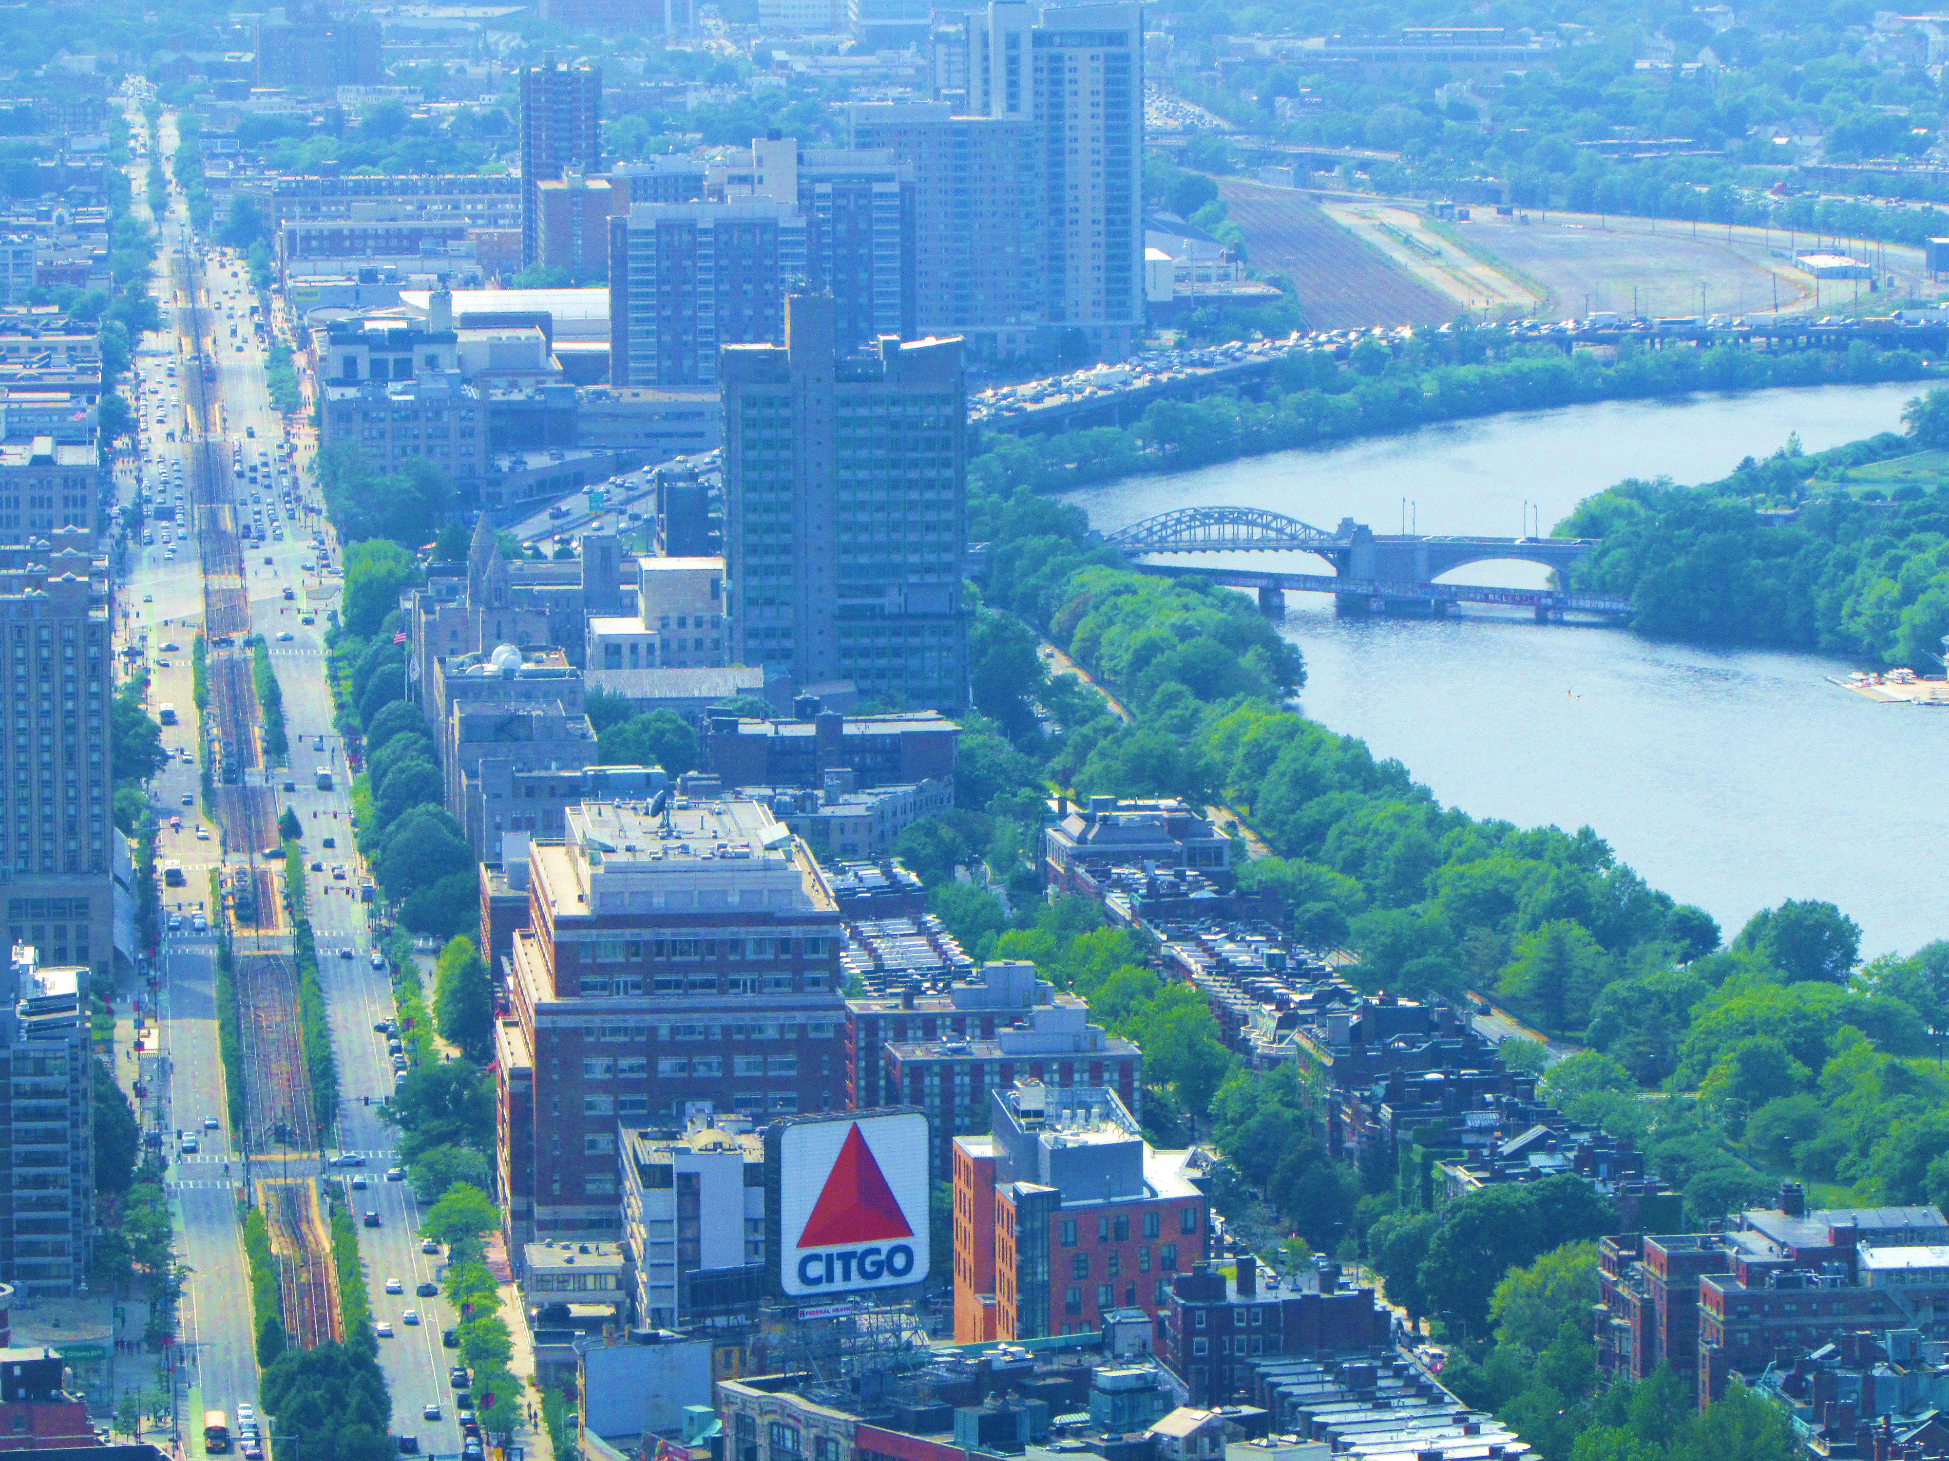
Boston Now

Slide 43
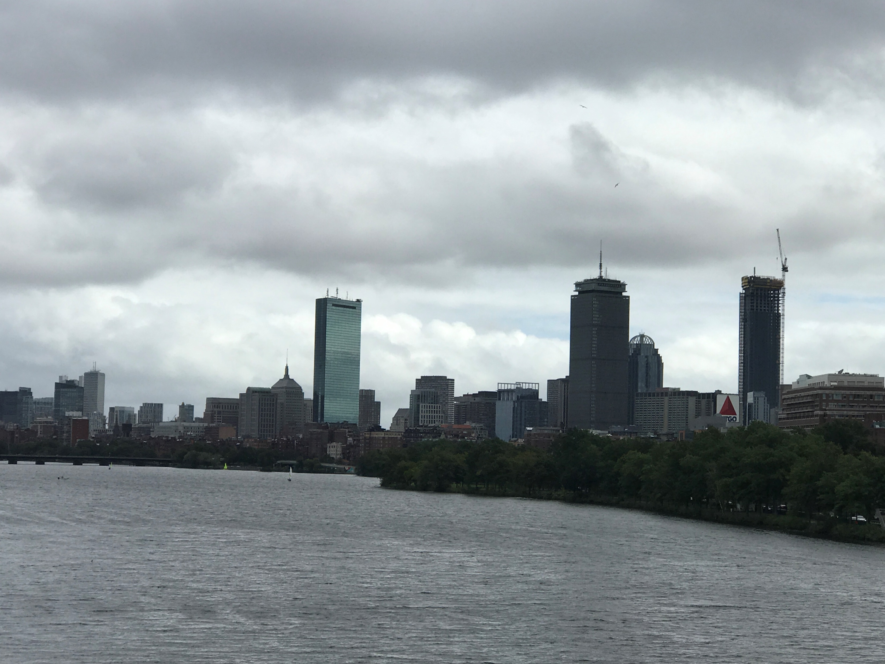
What’s happening Now
Building the Future of Now
Mapping Now through Mediakron!
Meeting: 9/23, 3:30-4:30, Conference Room

Slide 44
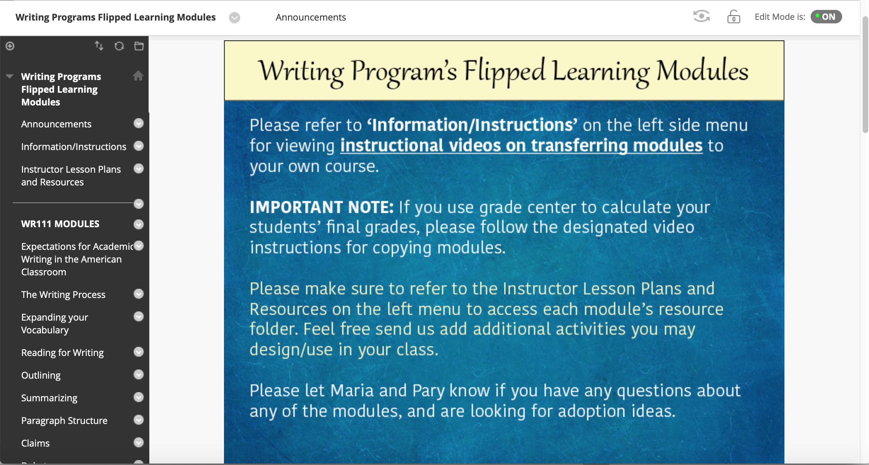
Flipped Learning Modules
31 Modules on BB
Created by 20 faculty members!
An additional 2 FLMs coming within the next month!

Slide 45
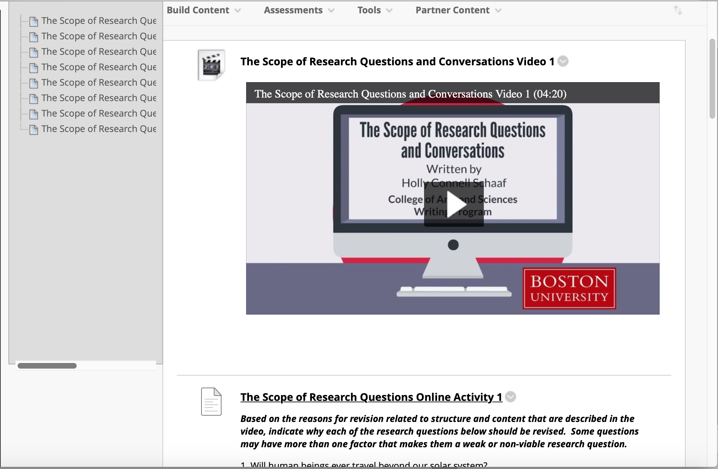

Slide 46
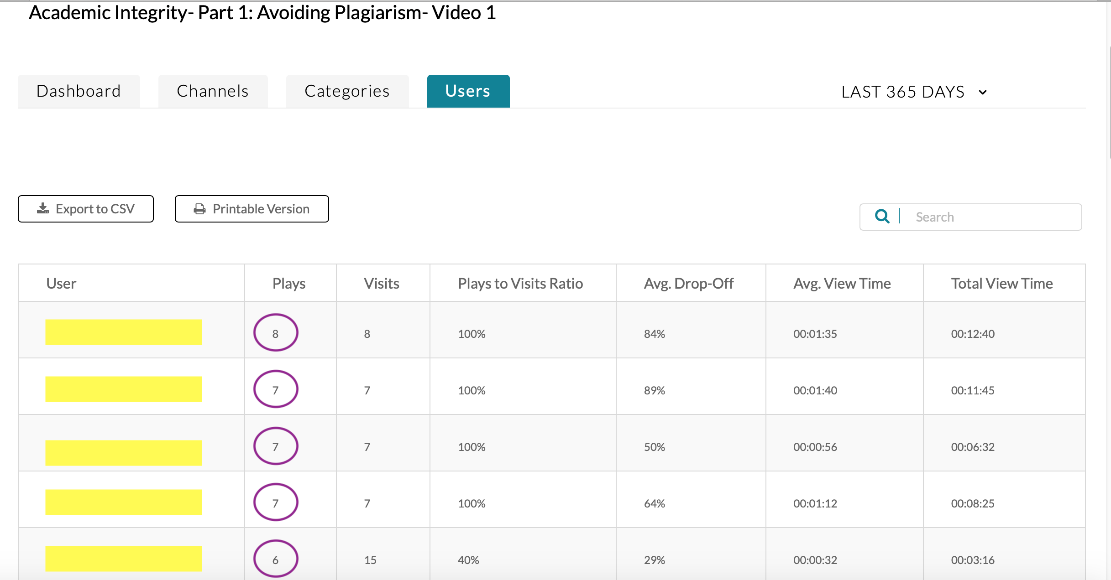

Slide 47
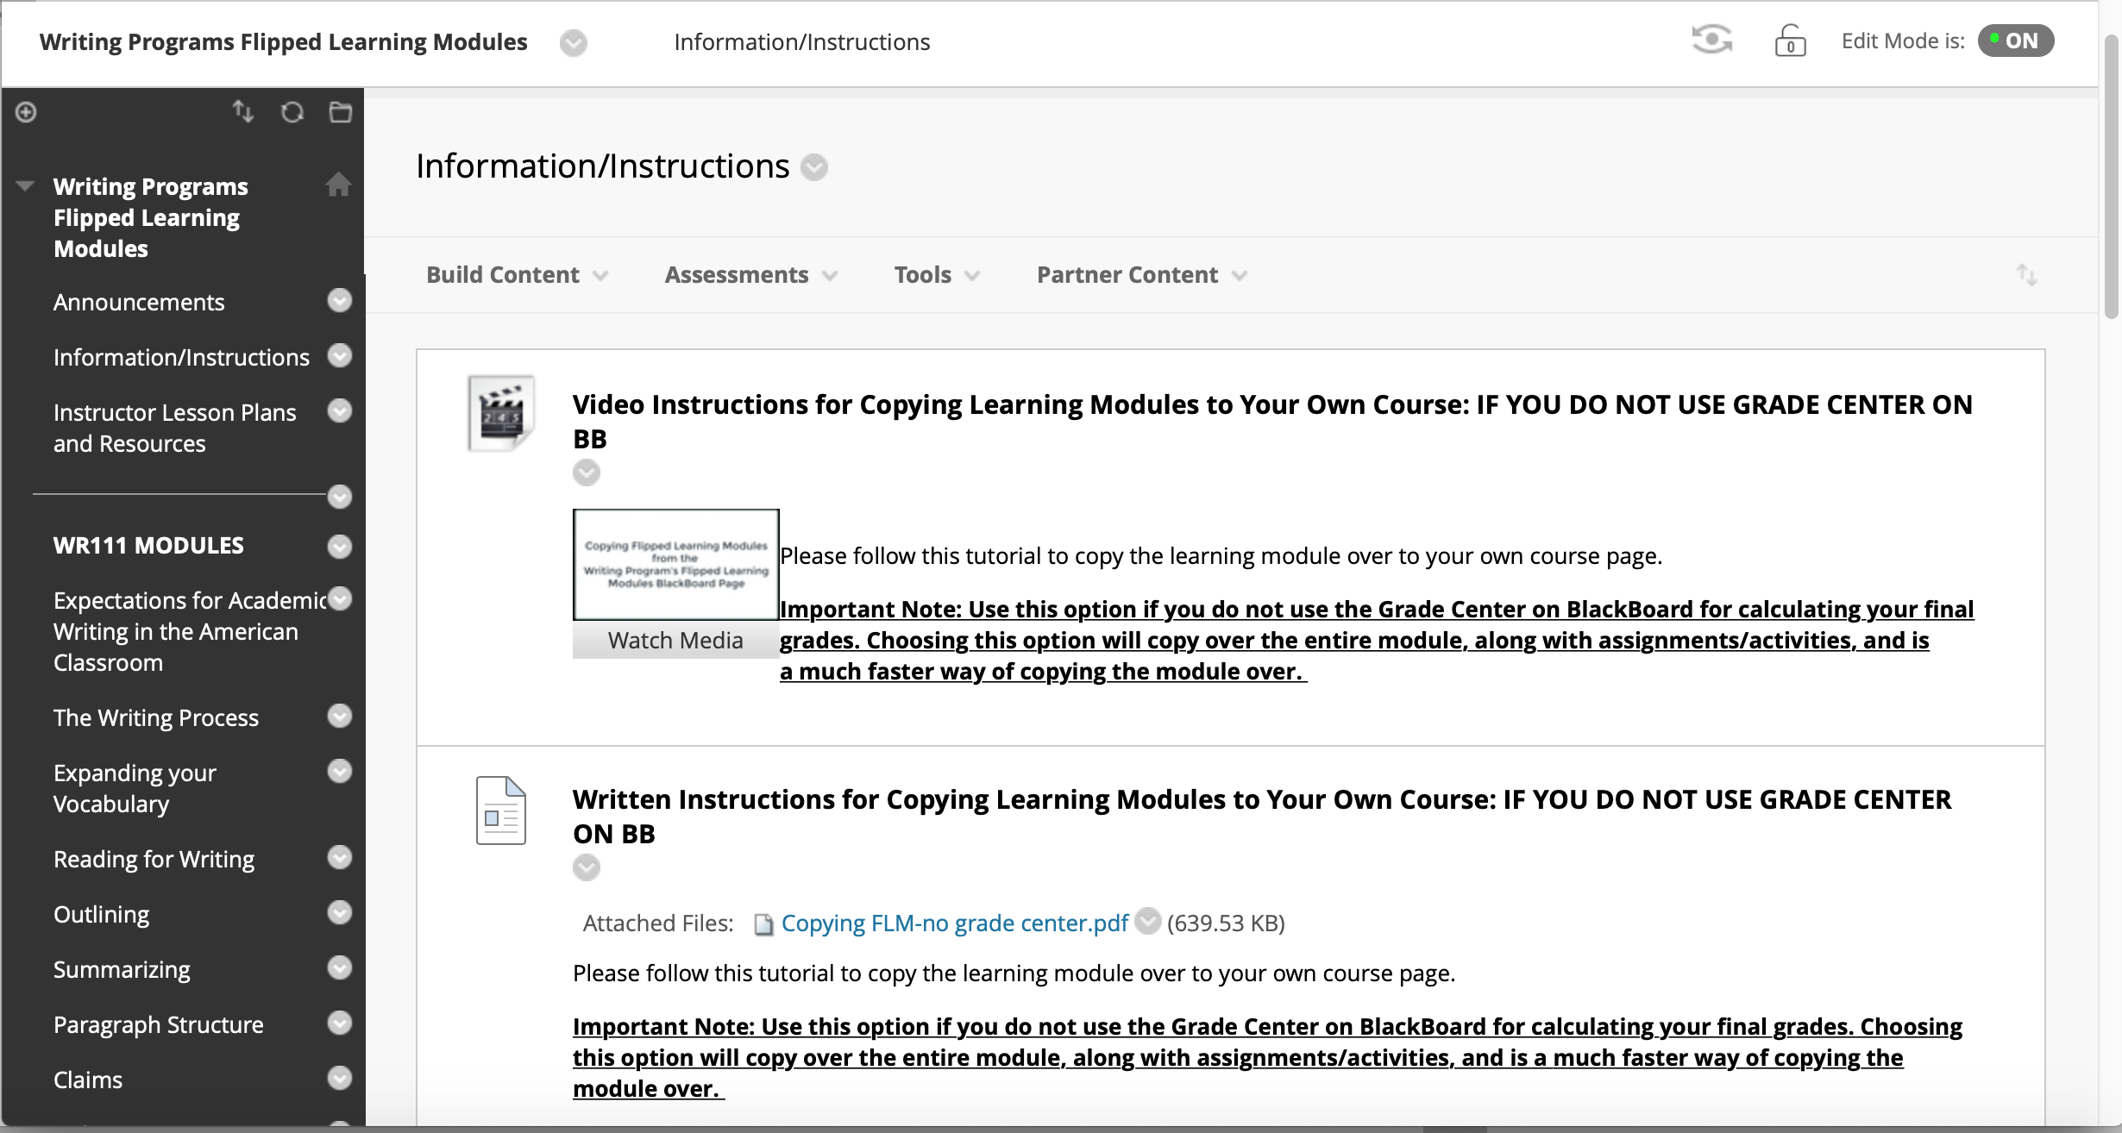

Slide 48
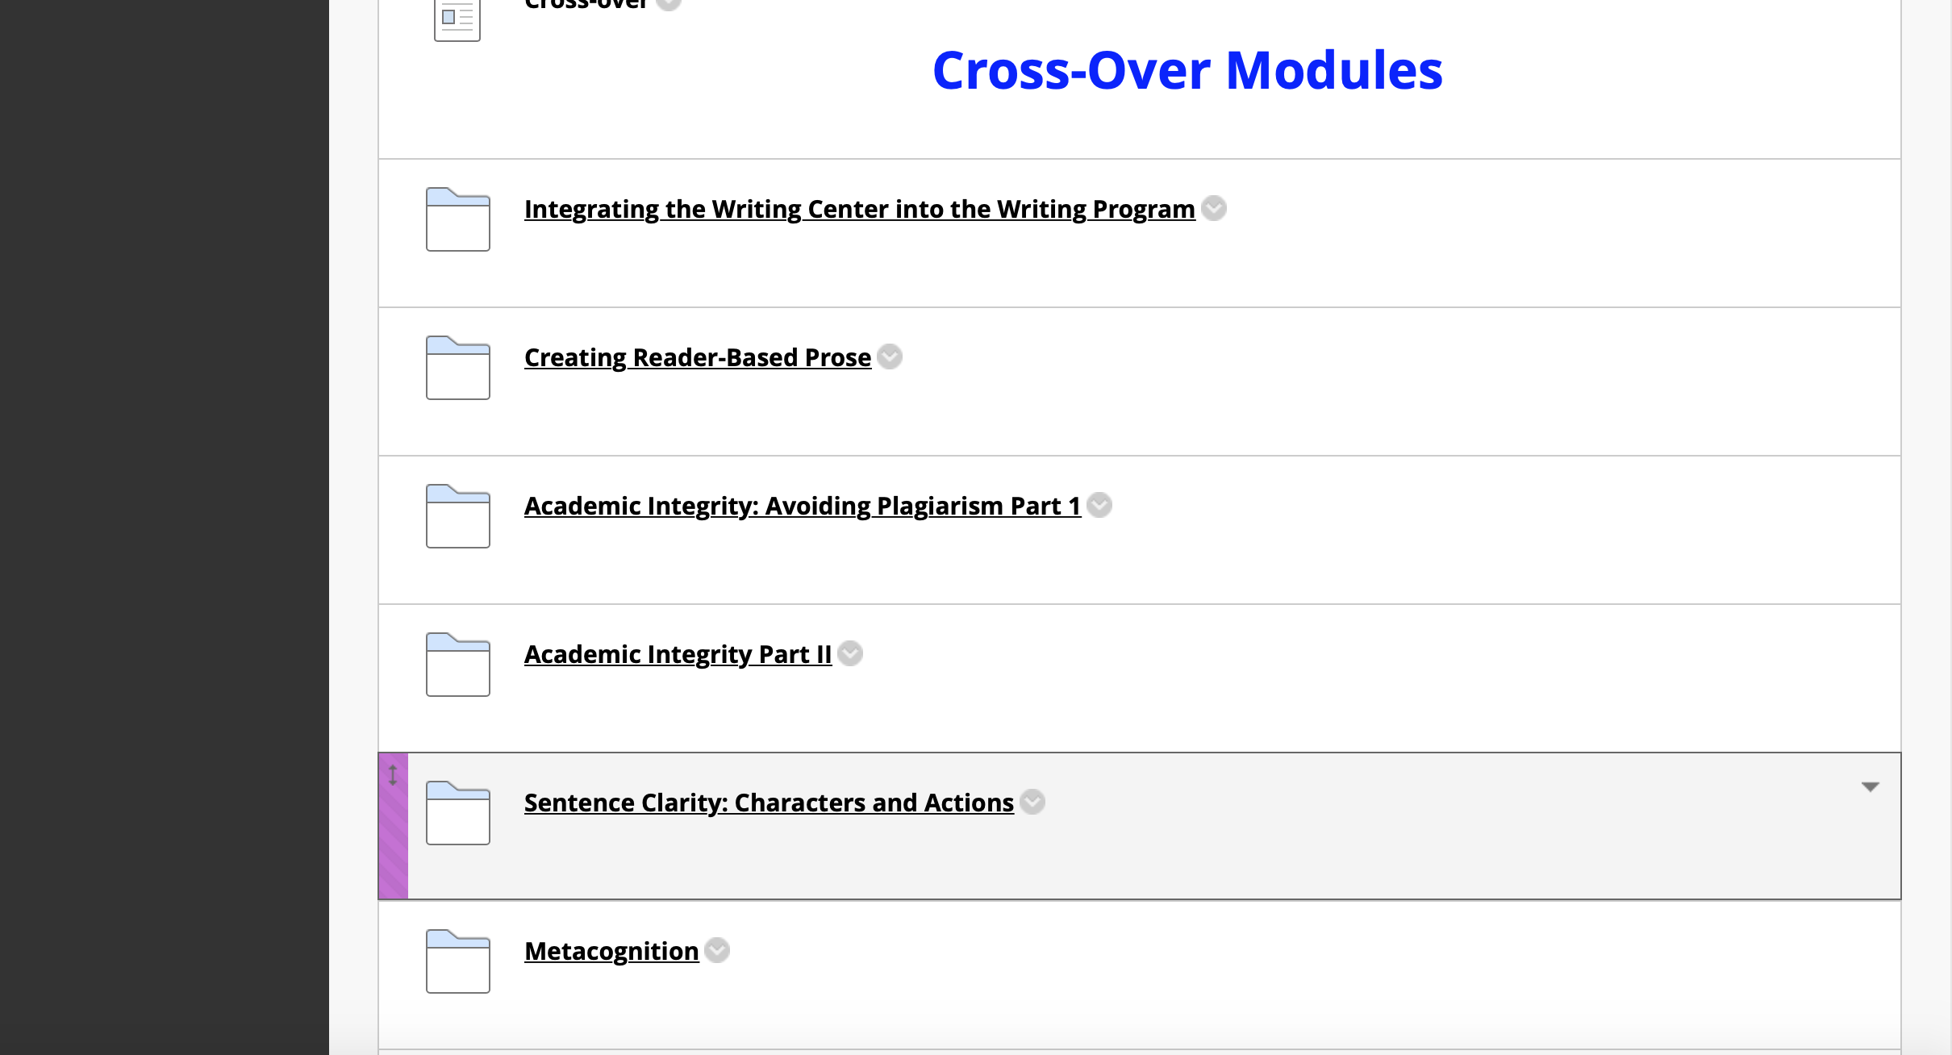

Slide 49
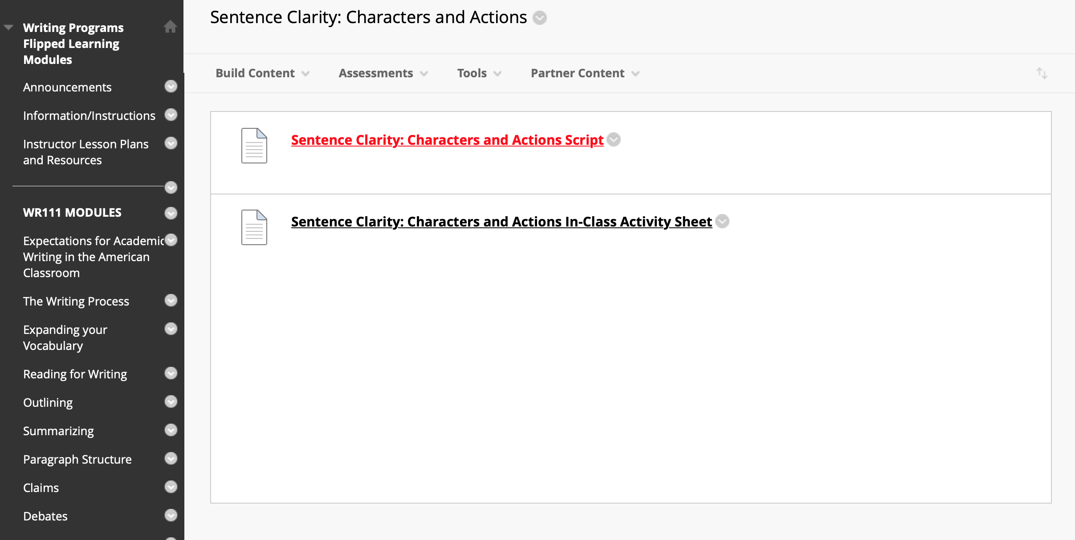

Slide 50
Reminders
Copying over the modules to your own course
Editing the modules
Getting tech and implementation support
Upcoming implementation sessions:
*Tuesday, September 17th: 11:30am-12:30pm (WP conference room)
*Wednesday, October 2nd: 4-5pm
We are always available to help and looking for collaborators!
mariazl@bu.edu and pfassihi@bu.edu

Slide 51
CAS Writing Center
All WR students can visit us!
We have an introductory video & a flipped module with more information about our work
Intensive tutoring will begin soon
We’ve formed an advisory group
We’re going to be on social media (#yay)
Questions welcome anytime!
Email Heather Barrett at heathbar@bu.edu

Slide 52
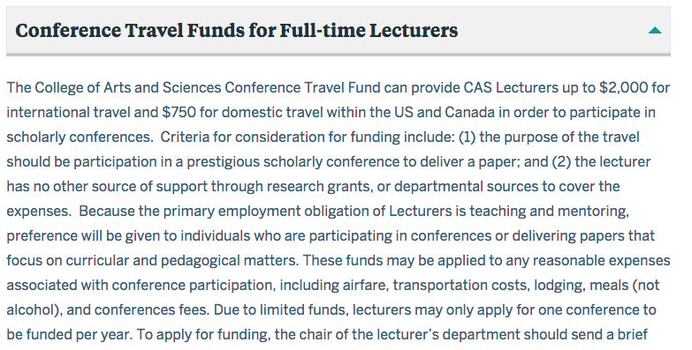

Slide 53
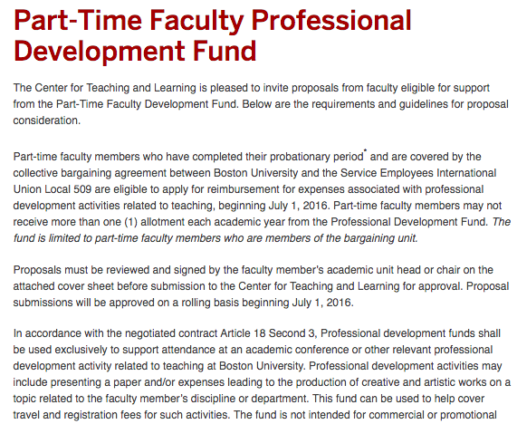

Slide 54
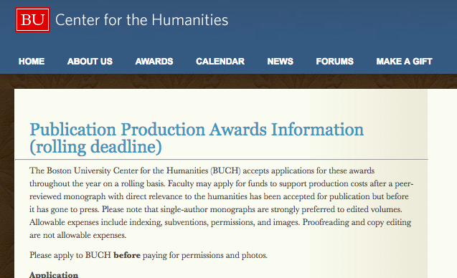

Slide 55
RECEPTION AT THE
WRITING CENTER
Now!

