Slide 1
All-Faculty Meeting
Fall 2018
Arts & Sciences Writing Program
September 7

Slide 2
Directors
Director: Chris Walsh cwalsh@bu.edu
Director of ESL: Maria Zlateva mariazl@bu.edu
Associate Director: Sarah Madsen Hardy
smh@bu.edu
Associate Director for WID: David Shawn dshawn@bu.edu

Slide 3
Administrative Staff
Academic Administrator: Alyssa Hall
akhall@bu.edu
Department Administrator: Dan Ivey
divey@bu.edu
Senior Assistant: Adam Znideric
adznid@bu.edu

Slide 4
Coordinators
Writing Center Coordinator
Heather Barrett heathbar@bu.edu
Coordinator of ESL
Sarah Hanselman hanselms@bu.edu
Curriculum Coordinators
Sam Myers samm@bu.edu
Jessica Kent jessicak@bu.edu

Slide 5
Committee Chairs
Curriculum Committee Co-Chairs:
Dora Goss tgoss@bu.edu
And __________
Faculty Issues Committee Co-Chairs:
Christina Michaud michaud@bu.edu
And___________

Slide 6
Special thanks to
Marisa Milanese
Tom Oller
Anna Panszczyk
Kim Shuckra
Lesley Yoder

Slide 7
Welcome New Faculty!
Julie Baer
Carroll Beauvais
Noor Hashem
Aleksandra Kasztalska
Michele Martinez
Darren Penn
Kristine Perlmutter
Brian Walsh
Max White
Notes:
Michele Martinez? Brian Walsh?

Slide 8
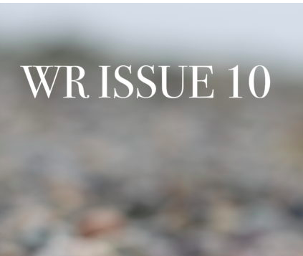

Slide 9
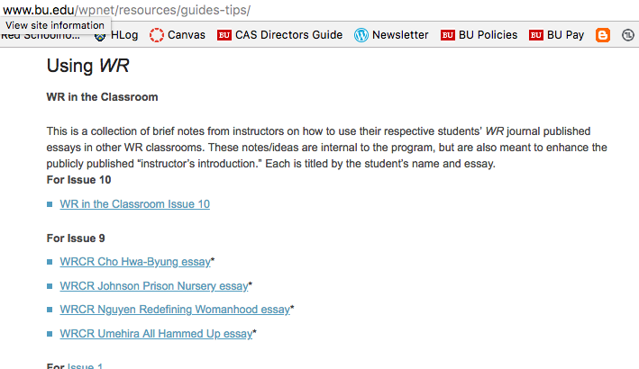

Slide 10
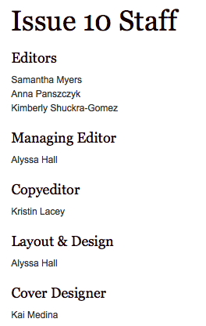
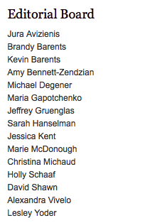

Slide 11
Writing Center Open for Business!
Writing Center consultants will be available to meet with WR students beginning on Monday, September 10.
Consultants will soon be available to visit your class to give brief presentations about the Writing Center.
Contact Heather Barrett, Writing Center Coordinator @ heathbar@bu.edu

Slide 12
Reminders
Office Hours and Syllabi due today!
http://www.bu.edu/wpnet/forms/directory-form/
http://www.bu.edu/wpnet/forms/syllabus-submission-form/
Observations and B-o-Y meetings
”Merit Review” next week
GWF Collaborative Mentoring Initiative

Slide 13
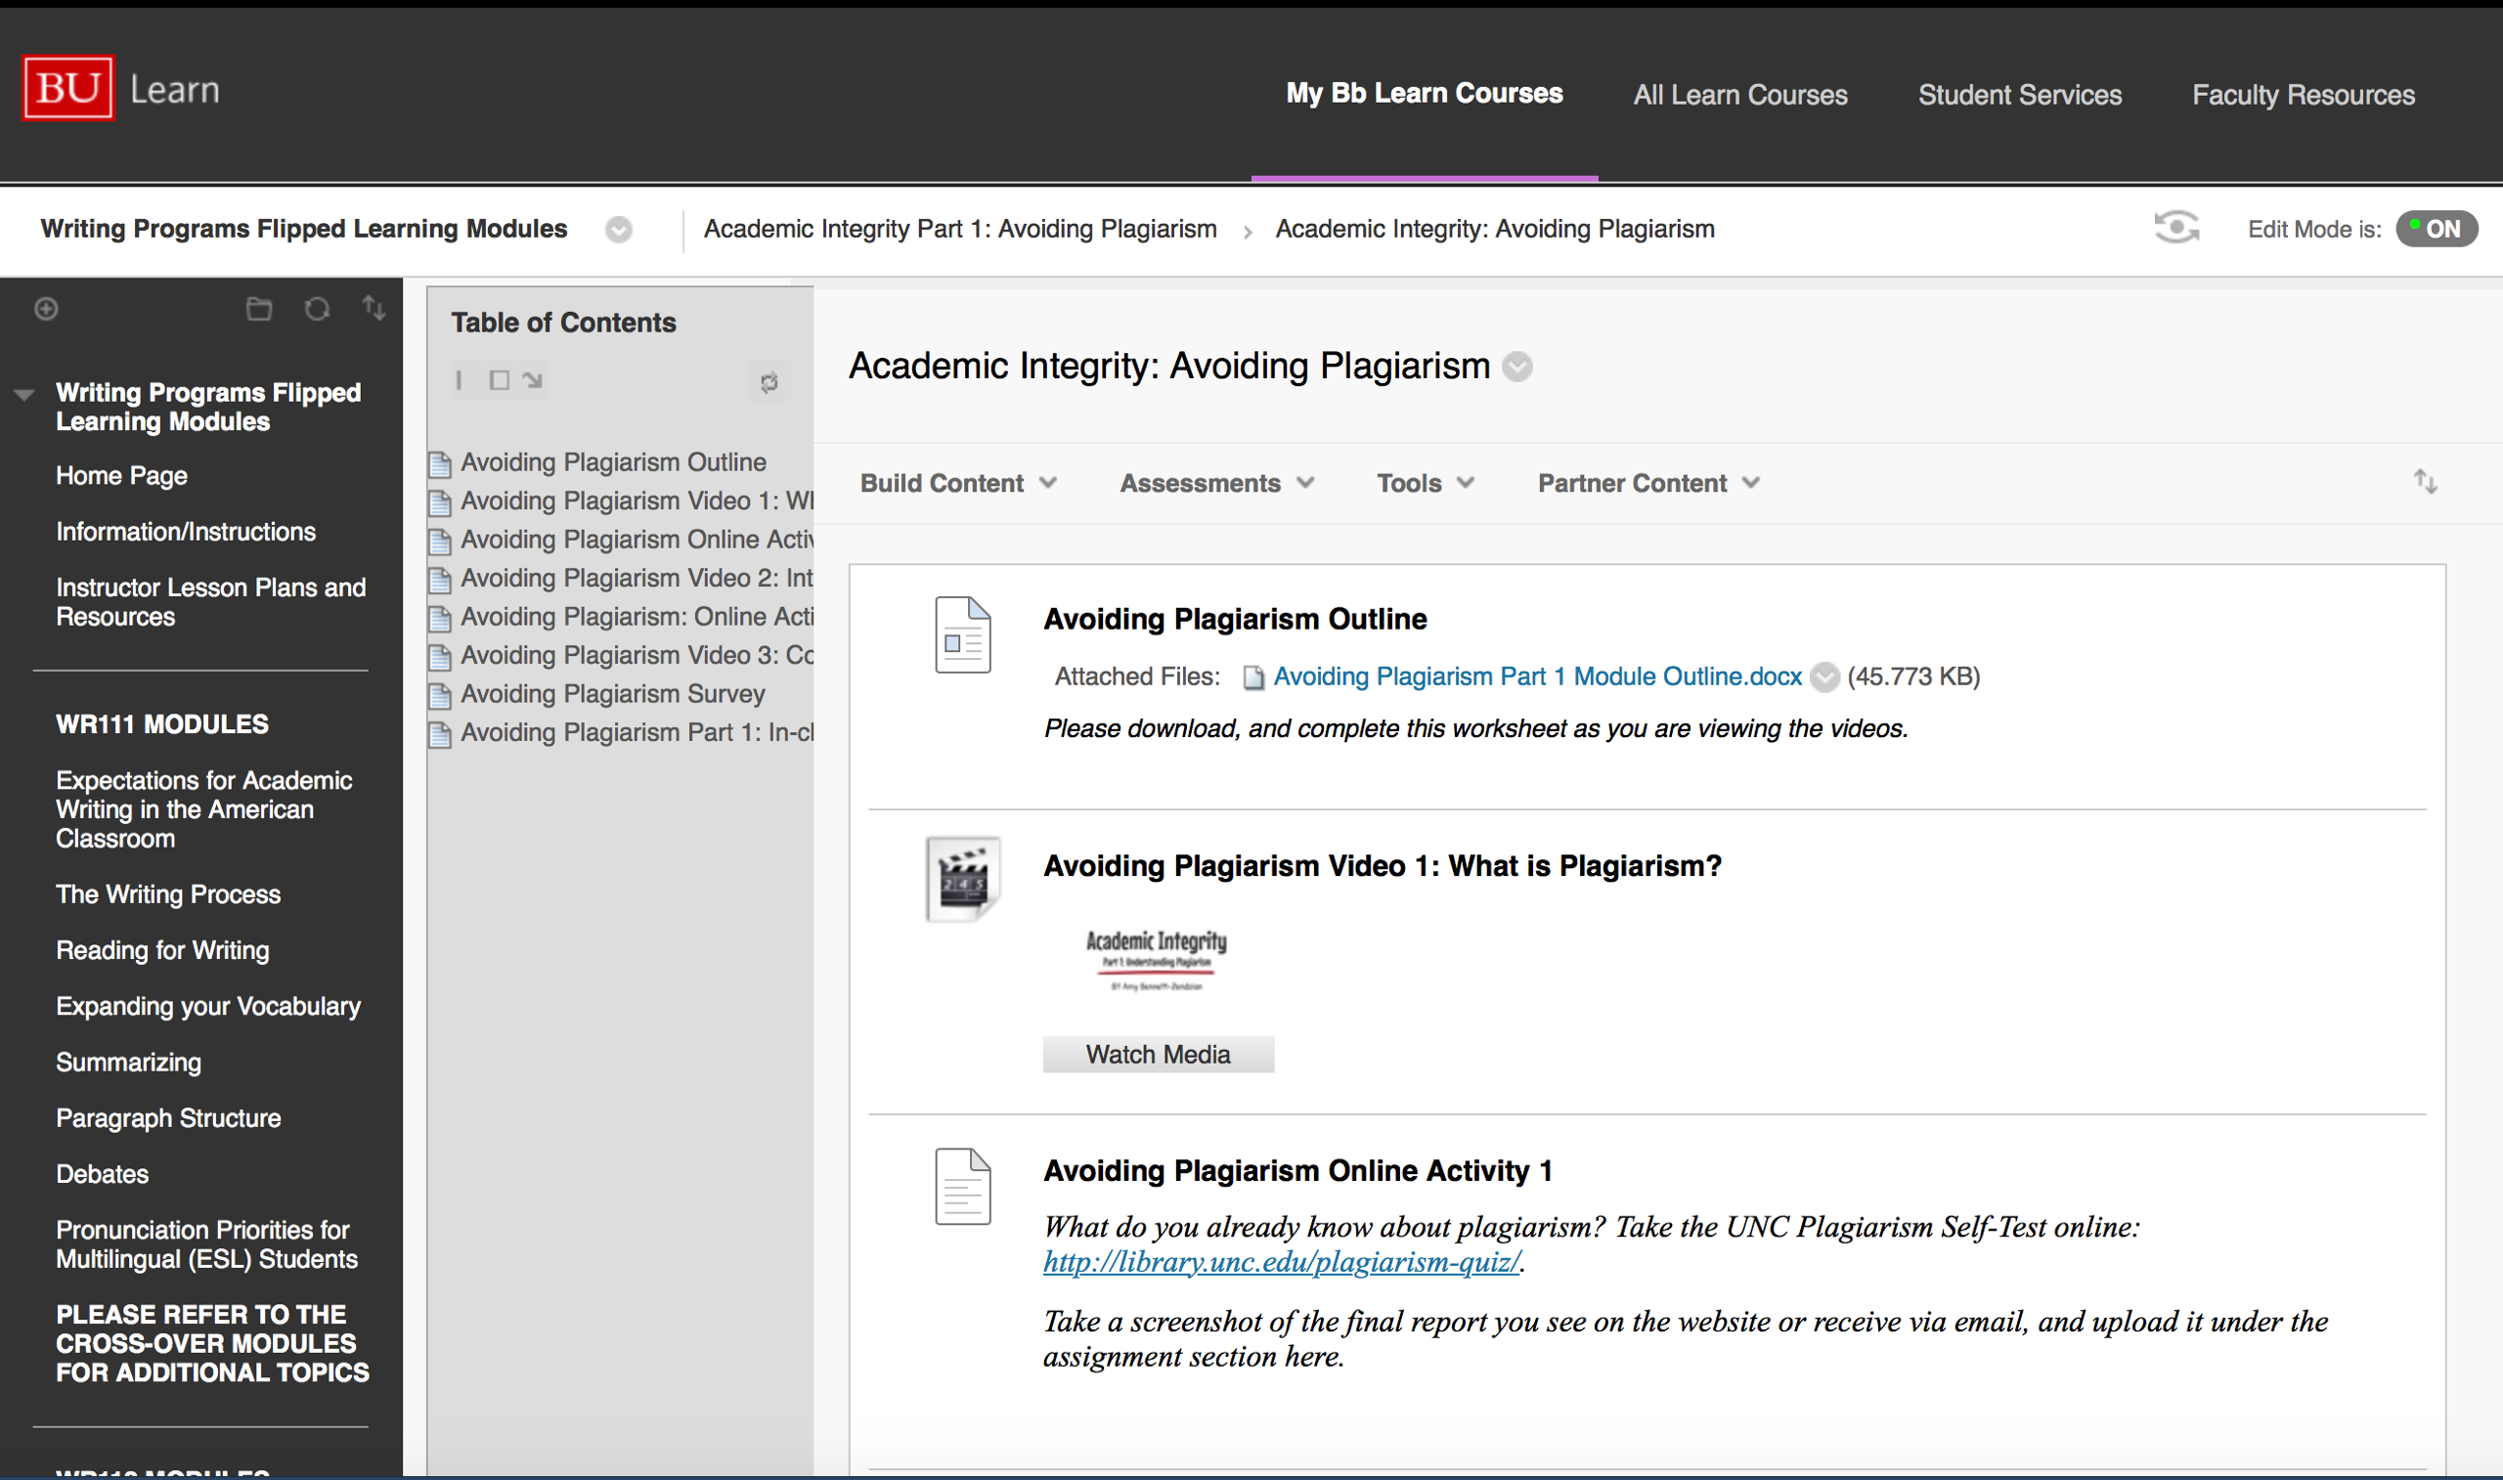

Slide 14
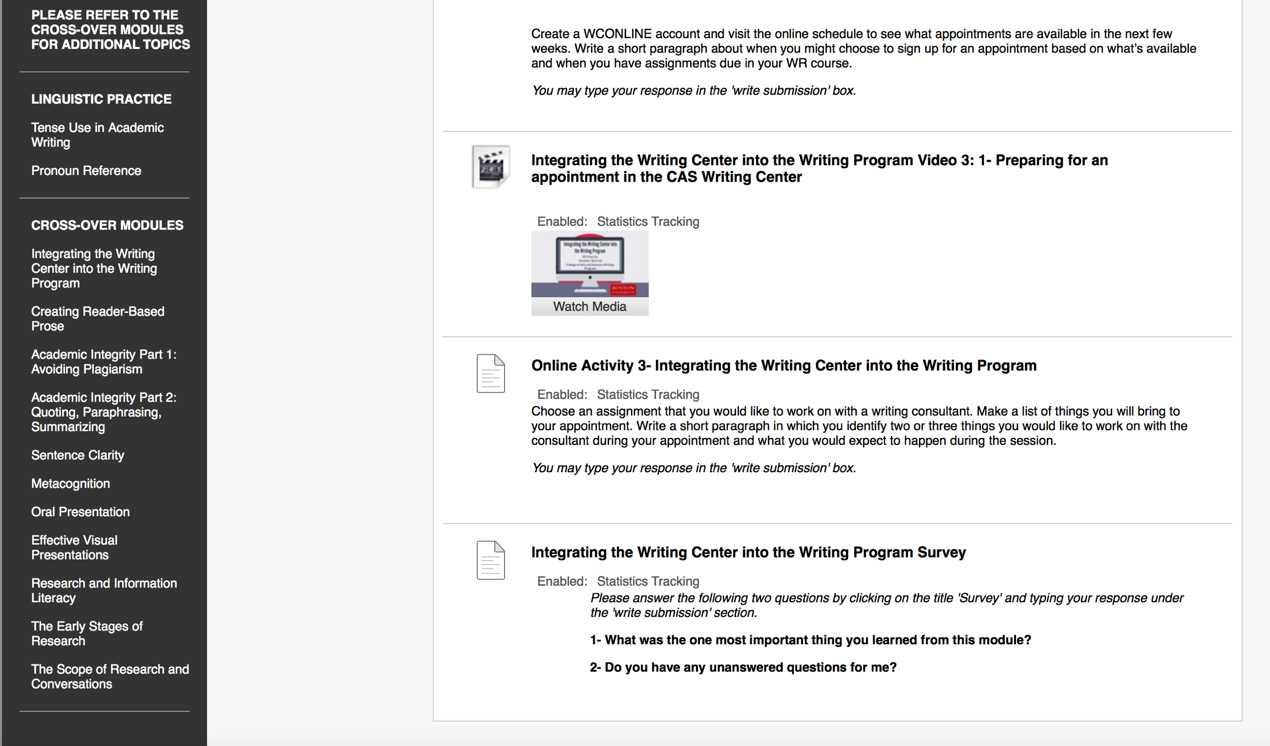

Slide 15


Slide 16


Slide 17
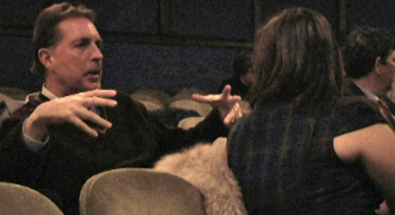
Tony Wallace: a Celebration
Thursday, September 20, 5 pm in the Writing Center
Contact Bill Marx (wmarx@bu.edu)
or Holly Schaaf (hcschaaf@bu.edu)

Slide 18
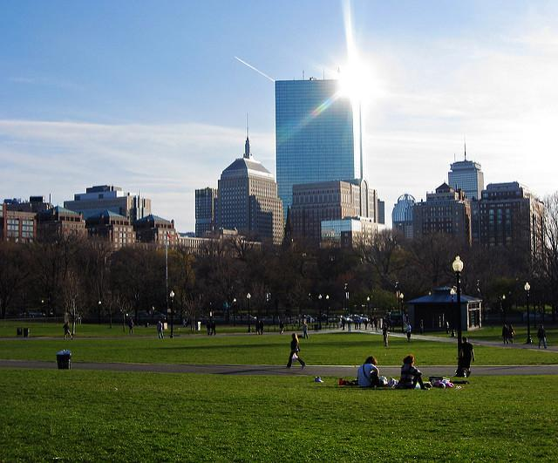
Writing in the Field with Gavin Benke
October 25
WID AND TWID
with David Shawn

Slide 19


Slide 20
Faculty Seminar
Creativity and Collaboration Carrie Bennett and Jessica Bozek
This faculty seminar will be devoted to the practice of creativity and collaboration in the first-year writing classroom. Using scholarly and non-scholarly texts to create a framework, we will explore the traditions and intersections between creative and critical writing. How can creative approaches broaden students’ understanding of critical texts? What is lost and gained when we re-envision learning as a group endeavor? In what ways do creativity and collaboration increase student agency, engagement, and sense of community in the college classroom?
There will be three 2-hour sessions. Participants need to attend all three to earn Faculty Seminar credit.
November 1: Creativity
November 8: Collaboration
November 15: Practical Applications & Assessment

Slide 21
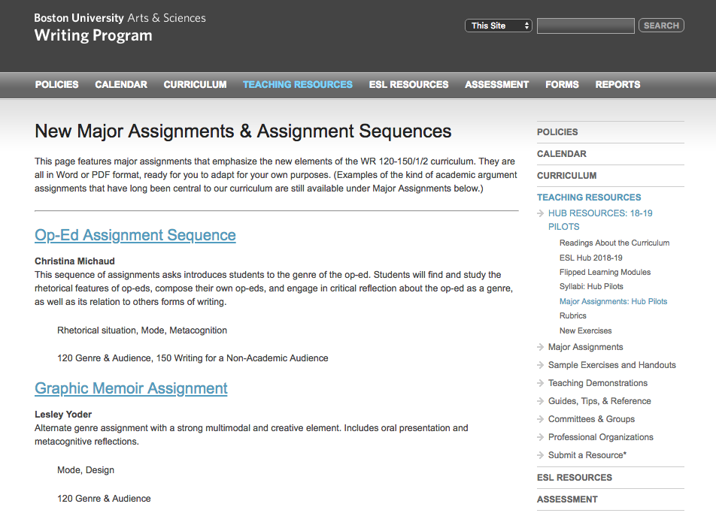
Wpnet resources

Slide 22
Curriculum Committee
Co-chairs 2018-19: Dora Goss and ______
Topics to discuss this semester include:
Assessing Hub 1.0—the end of innovation
Revisions of Teacher’s Guide to curriculum
anything you, our faculty, bring to the table.

Slide 23
Faculty Issues Committee
Co-chairs 2018-19: Christina Michaud and ______
Topics to discuss this semester include:
developing some “internal process” for the new Professional Development Leaves of Absence
developing additional criteria for program evaluation of teacher performance (now a subject of discussion between the full-time faculty union and BU’s Office of Labor Relations)
Having better parties
anything you, our faculty, bring to the table.

Slide 24
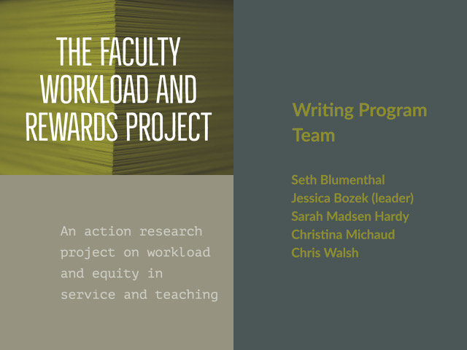

Slide 25
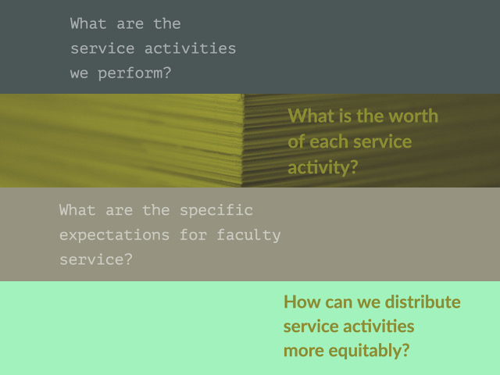

Slide 26
BU’s strategic plan
The Hub
WP 3.0
“Racial, ethnic, and cultural diversity is imperative for excellence in a 21st-century educational institution.”
“General education for an interconnected world”
“Skills and habits of mind essential to your academic success and to your future personal, professional, and civic life”
Notes:
CW Our faculty has never had a focused conversation about diversity though many of us address it in our classes and do it well—but 2018. BU is trying and is already succeeding in recruiting a more diverse student body. Chance to add even more rigor. We are trying to teach all students to write excellently: changes to syllabus. Universal design idea.

Slide 27
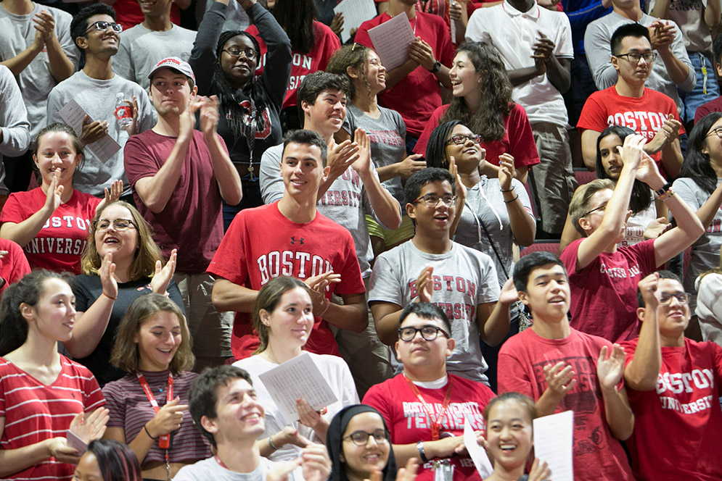
Who we are teaching
Photo credit: BU Today, 9/4/2018
Notes:
SMH About 18 students from the class of 2022. Looks about right. What do we know about them?

Slide 28
About 1 in 4 are international students
Notes:
SMH

Slide 29
About 1 in 6 are under-represented minorities
(combined: African American, Latino/a, Native American, Hawaiian/Pacific Islanders)
Notes:
SMH

Slide 30
About 1 in 5 are Asian American
Notes:
SMH

Slide 31
About 1 in 3 are white
Notes:
SMH

Slide 32
About 1 in 6 are first-generation college students
Notes:
SMH

Slide 33
About 1 in 6 are Pell Grant recipients
(from families earning under $30K)
Notes:
SMH

Slide 34
About 1 in 10 will request accommodation for a disability
Notes:
SMH

Slide 35
Uncounted but out there: LGBTQ students
Notes:
SMH Some differences visible, some likely be invisible. Some students will disclose, some won’t. Some groups have more barriers to learning and success at BU than others: that’s just a fact

Slide 36

What BU students say
  Faculty are important to the positive experience of students in the classroom.
  Some faculty have a limited understanding of race and diversity which is apparent in their teaching.
  Students need more faculty support as they deal with difficult situations in the classroom.
  Students see a need for greater racial and ethnic diversity in the curriculum.
      ⎼Final Report of the Task Force on Faculty Diversity and Inclusion, 2016
Notes:
SMH: For me, meeting with a group of students to learn about their impressions of diversity and inclusion last year at part of a CAS committee was eye opening. We are all committed teachers, and we all know about the barriers some groups of students face. But we may know less about other groups. Plug “what I wish I knew my professors knew”

Slide 37
“How do you address diversity
and inclusion in your teaching?”?
Notes:
SMH: This question has been asked of all job candidate for the past two years as part of BU’s larger DEI efforts. But it is question for all of us.
You are good teachers, so you do do this, but maybe you haven’t reflected on this.We also all brign different things> still learn new thigns
“When compared to its national-level peer group, BU ranked 14 out of 17 in percentage of black faculty in 2015, the last year for which those numbers are available.” (August 18 Bostonia article)
“Creating a more diverse and inclusive environment has to be the work of the whole, and in particular, the work of people who haven’t historically understood the work to be ‘theirs,’. . . .
Some of the most effective advocates for diversity and inclusivity, for justice, are not people of color.” Crystal Williams, associate provost for diversity and inclusion

Slide 38
How has your experience working with students with different identities and backgrounds informed your teaching practices?
Notes:
SMH: Today we’re going to do this tiny thing and in January we will do more. 3 to write and 7 to talk minute small group (3 or 4) discussion

Slide 39
Describe one thing you could do to make your class more inclusive this semester.
Notes:
JO: Present the handout and explain, then 7 minutes in same small groups

Slide 40
Resources
@BU
Your own WP colleagues who have expertise in these areas
“Blind Spots,” a talk by Raul Fernandez of SED (available online here)
“Advising in a Pluralistic Society” 5th Annual Advising Symposium Keynote by Geoffrey Cohen (available online here)
Wheelock Ed School’s Equity Diversity and Inclusion Community Meetings (to get on the mailing list write Laura Jimenez @ jiminez1@bu.edu)
The Office of Disability Services
Jean Otsuki at CTL (jotsuki@bu.edu)
Elsewhere
What I Wish My Professor Knew, Stanford FLIP
“Ask Me: What LGBTQ Students Want Their Professors to Know” Chronicle Sept. 3 2015
Reducing Stereotype Threat
Tulane’s Accessible Syllabus site
Harper and Davis, “Eight Actions to Reduce Racism in College Classrooms” Academe Nov-Dec 2016
Increasing Inclusivity in the Classroom, Vanderbilt Center for Teaching
Creating Inclusive Classrooms, U Michigan CRLT
“Teach With a Heterogenous Audience in Mind,” Carnegie Mellon Teaching Excellence & Innovation Center
Notes:
JO

Slide 41
BU Resources for you
Faculty & Staff Assistance Office: http://www.bu.edu/fsao/
Chaplains Office: http://www.bu.edu/chapel/about/staff/chaplains/
Office of the Ombuds:
https://www.bu.edu/ombuds/

Slide 42


Slide 43


Slide 44


Slide 45


Slide 46


Slide 47


Slide 48


Slide 49


Slide 50
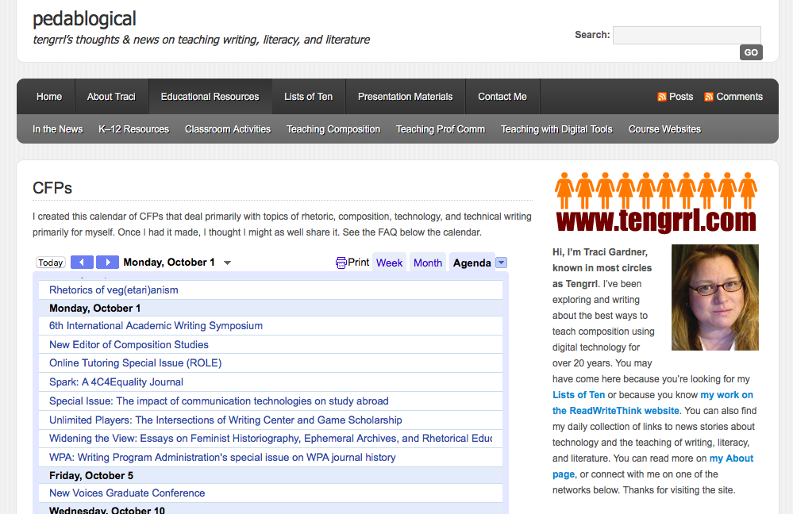
Opportunities in Writing Studies

Slide 51
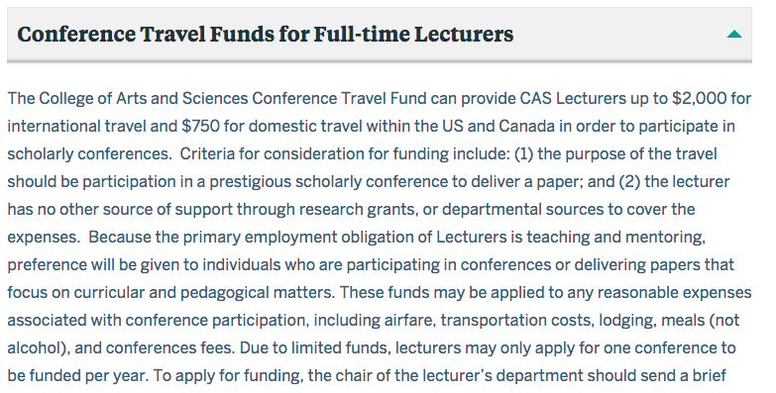
Professional Development Support

Slide 52
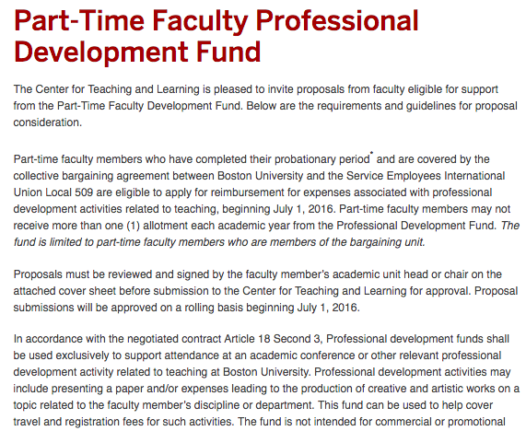

Slide 53
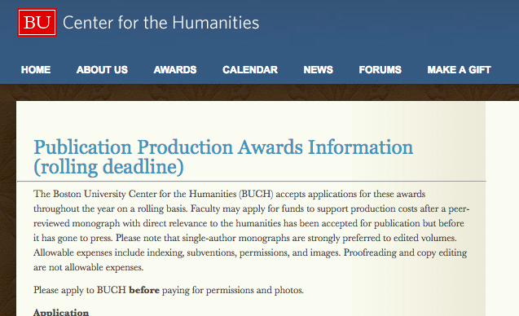

Slide 54
RECEPTION AT THE
WRITING CENTER
Now!

