Slide 1
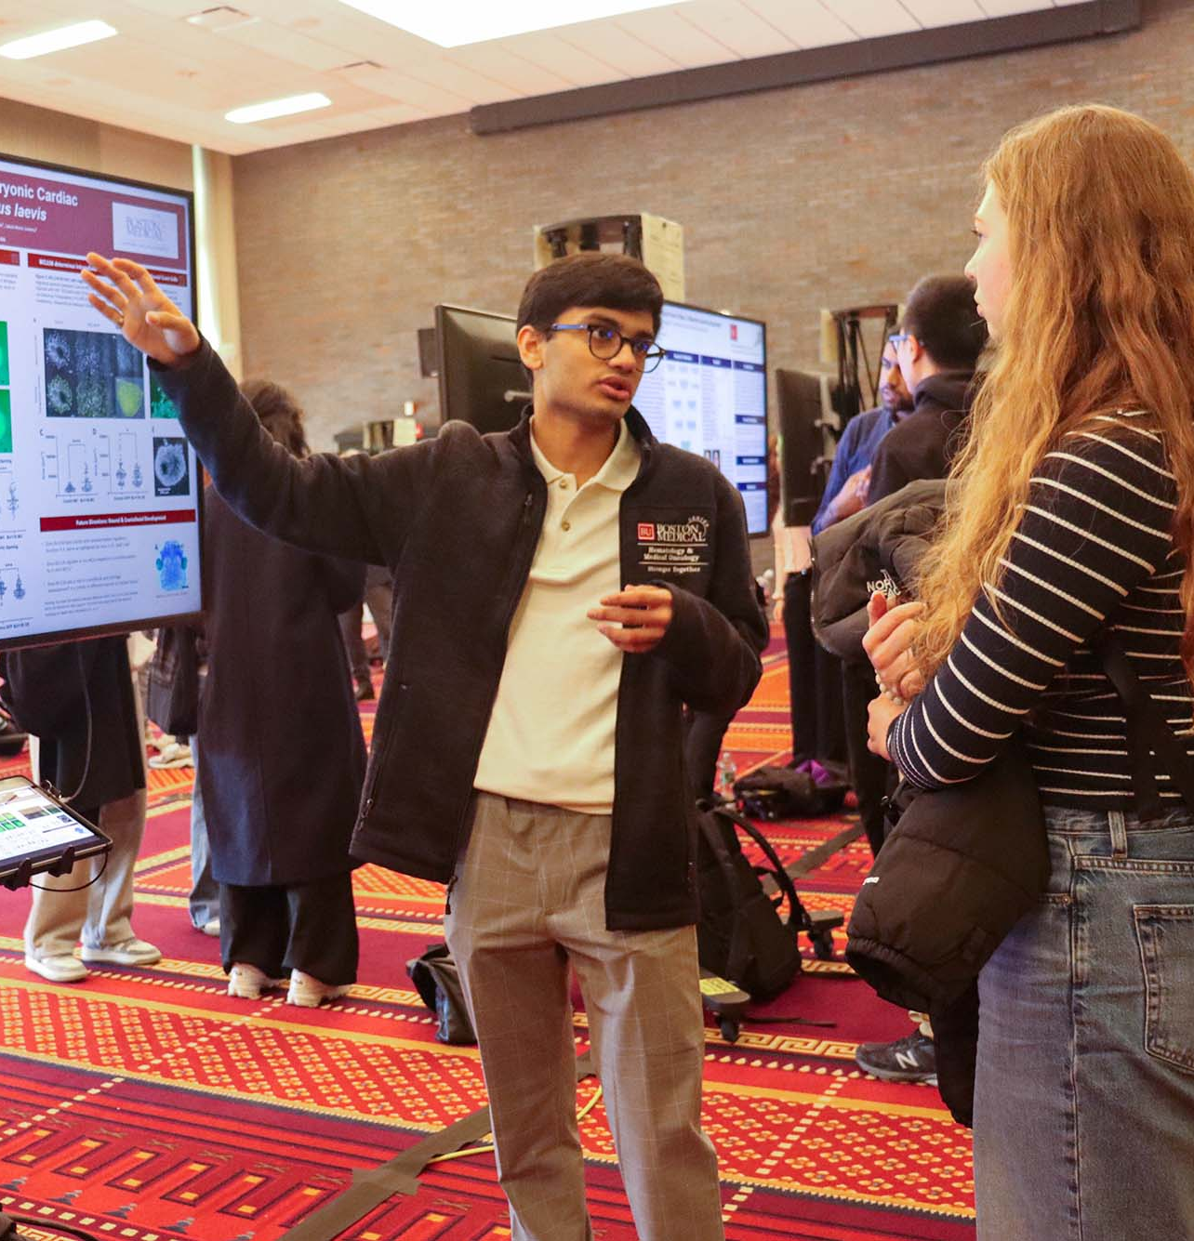


Abstract Writing and the UROP Symposium
July 2026

Slide 2


29th Annual UROP Symposium
Friday, October 16, 2026
GSU Metcalf Ballroom
Poster Presentations: 10am-2pm
250 poster presentations and ~1000 attendees
1
Write your abstract.
2
Prepare your poster.
3
Present your poster at the Symposium!

Slide 3
Preparing your abstract
A short description of what you did and learned.
Keep to the requested format (for UROP, <250 words, ~½ page).
Should be informative and interesting.
Write for a broad audience: explain key concepts briefly and spell out abbreviations on first use.
Don’t assume reader knows why your work is important.
Don’t get caught up in numerical data - include only numbers that are most important.

Slide 4
Structuring your abstract
1. Introduction
2. Body
1 sentence placing the study in context
1-2 sentences explicitly stating what the study investigated and why it was special
1-3 sentences summing up the approach, or the most important methods used to investigate the problem
3. Results and Discussion
4. Conclusion
1-3 sentences that summarize the MAJOR results and potential future applications
1 sentence that summarizes why your results are significant and future directions

Slide 5
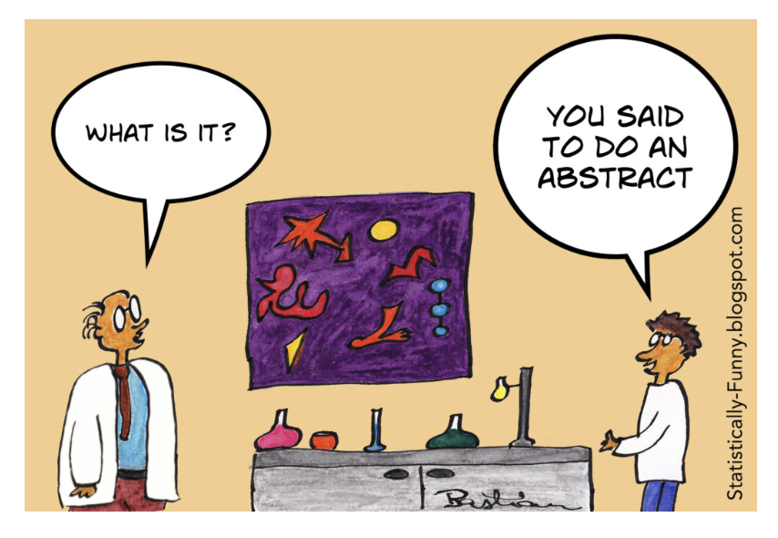
Avoid these in your abstract
Too many references to the literature.
References to figures or images.
Overuse of abbreviations or acronyms.
Repetition.
Unhelpful or vague sentences.
Not following abstract guidelines (font, length, title, authors).

Slide 6
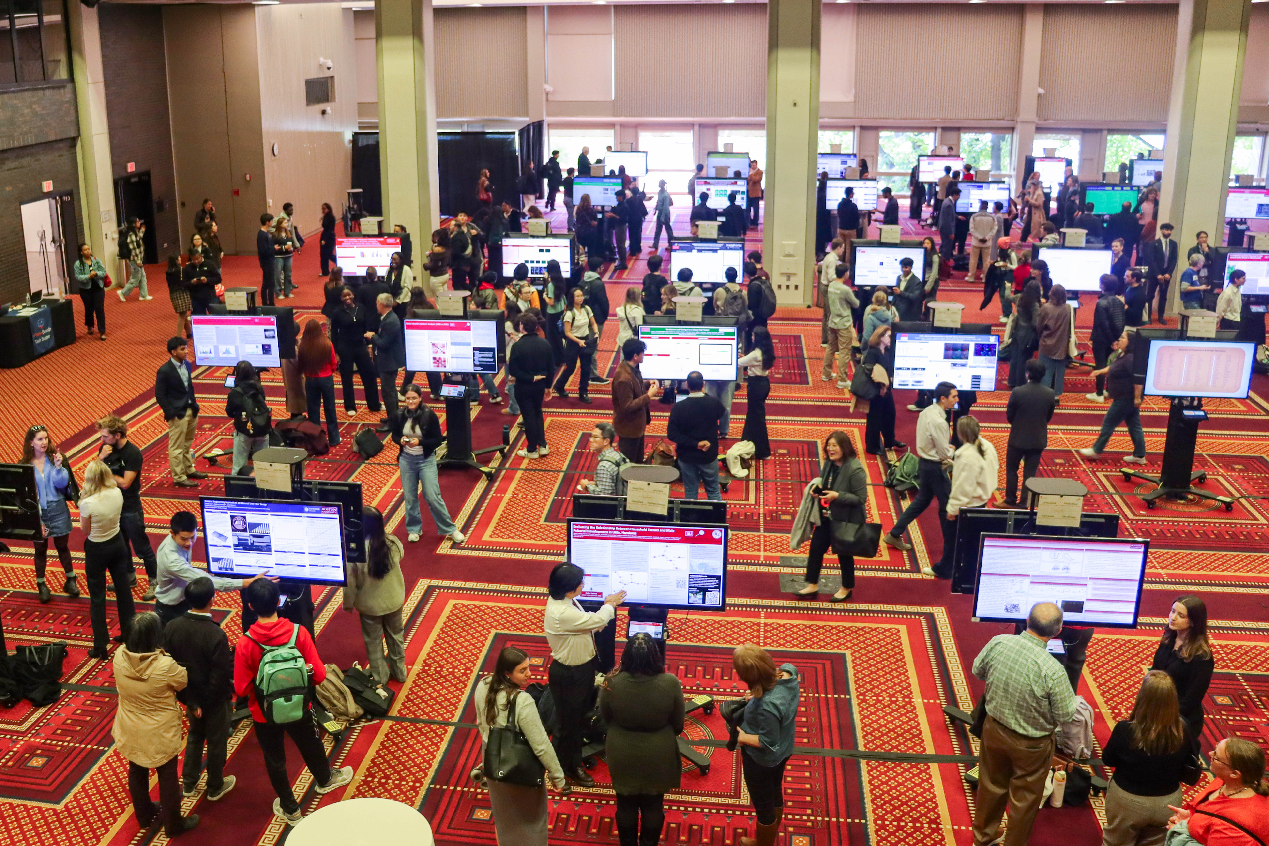
Abstract FAQs
Q: Can I update my abstract after August 21?
A: Maybe. We compile the abstracts into the abstract booklet, so we need them ready promptly. Typically, updates are not available after Sept. 1.
Q: I don’t have a lot of results, what should I include in my abstract?
A: Focus on the overall goals of your study and future directions.
Q: Can I put my abstract on my poster?
A: Yes, and many people do! Make sure the font size is just right.

Slide 7
Abstract submissions
Due Friday, August 21 by midnight through online abstract submission form.
Mentor approval form is required.
Hosted on Open BU in the UROP abstract booklet.

Slide 8
UROP Symposium at a glance
What to Know Now
Coming Soon
Select your top 3 presentation times when you submit your abstract.
There are four, 45-min poster presentations.
All posters are digital.
If you’re studying abroad, let us know in your abstract submission form. You’ll submit an abstract but not a poster.
Poster templates will be sent via email in August.
E-Poster boards will host a virtual event with tips on submitting and creating posters.
UROP will host a more detailed Symposium preparation event in September or early October with poster tips.

Slide 9
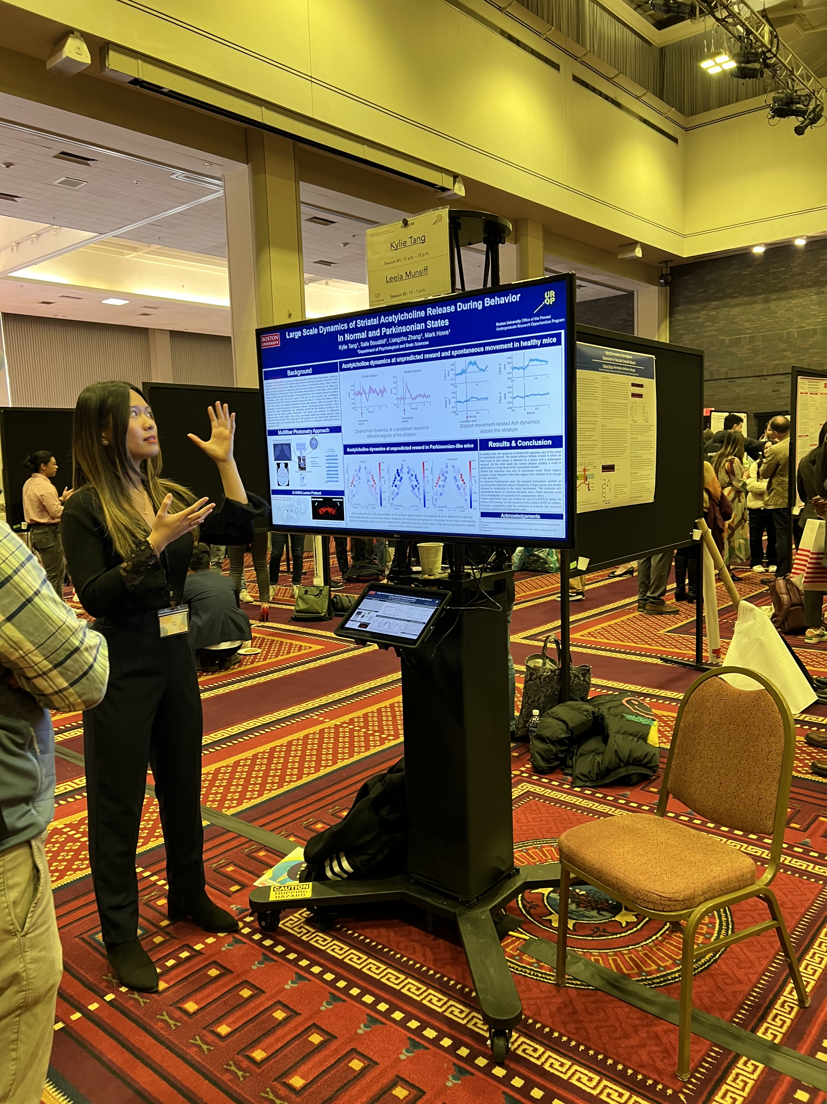
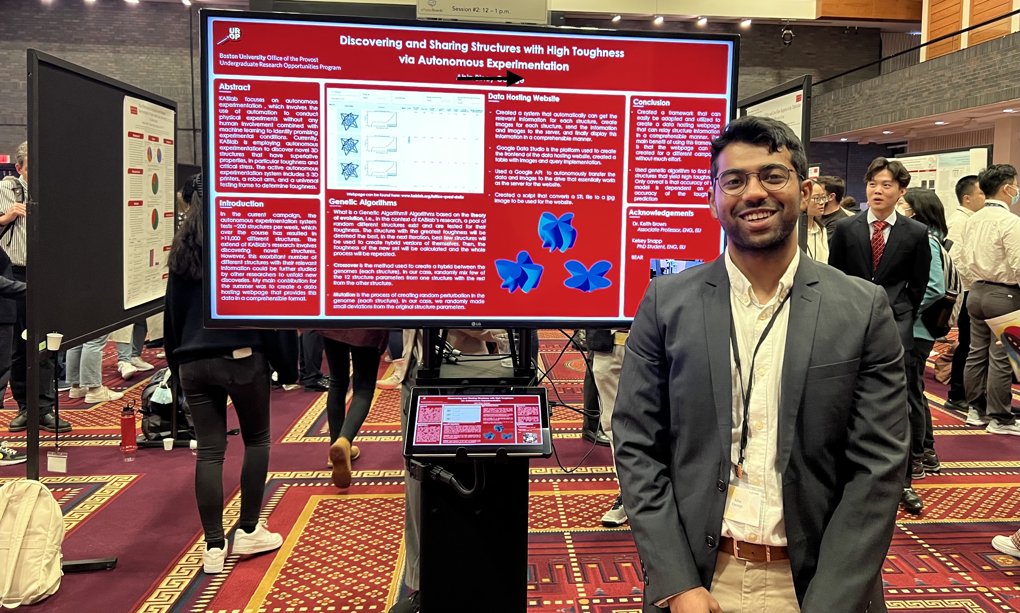
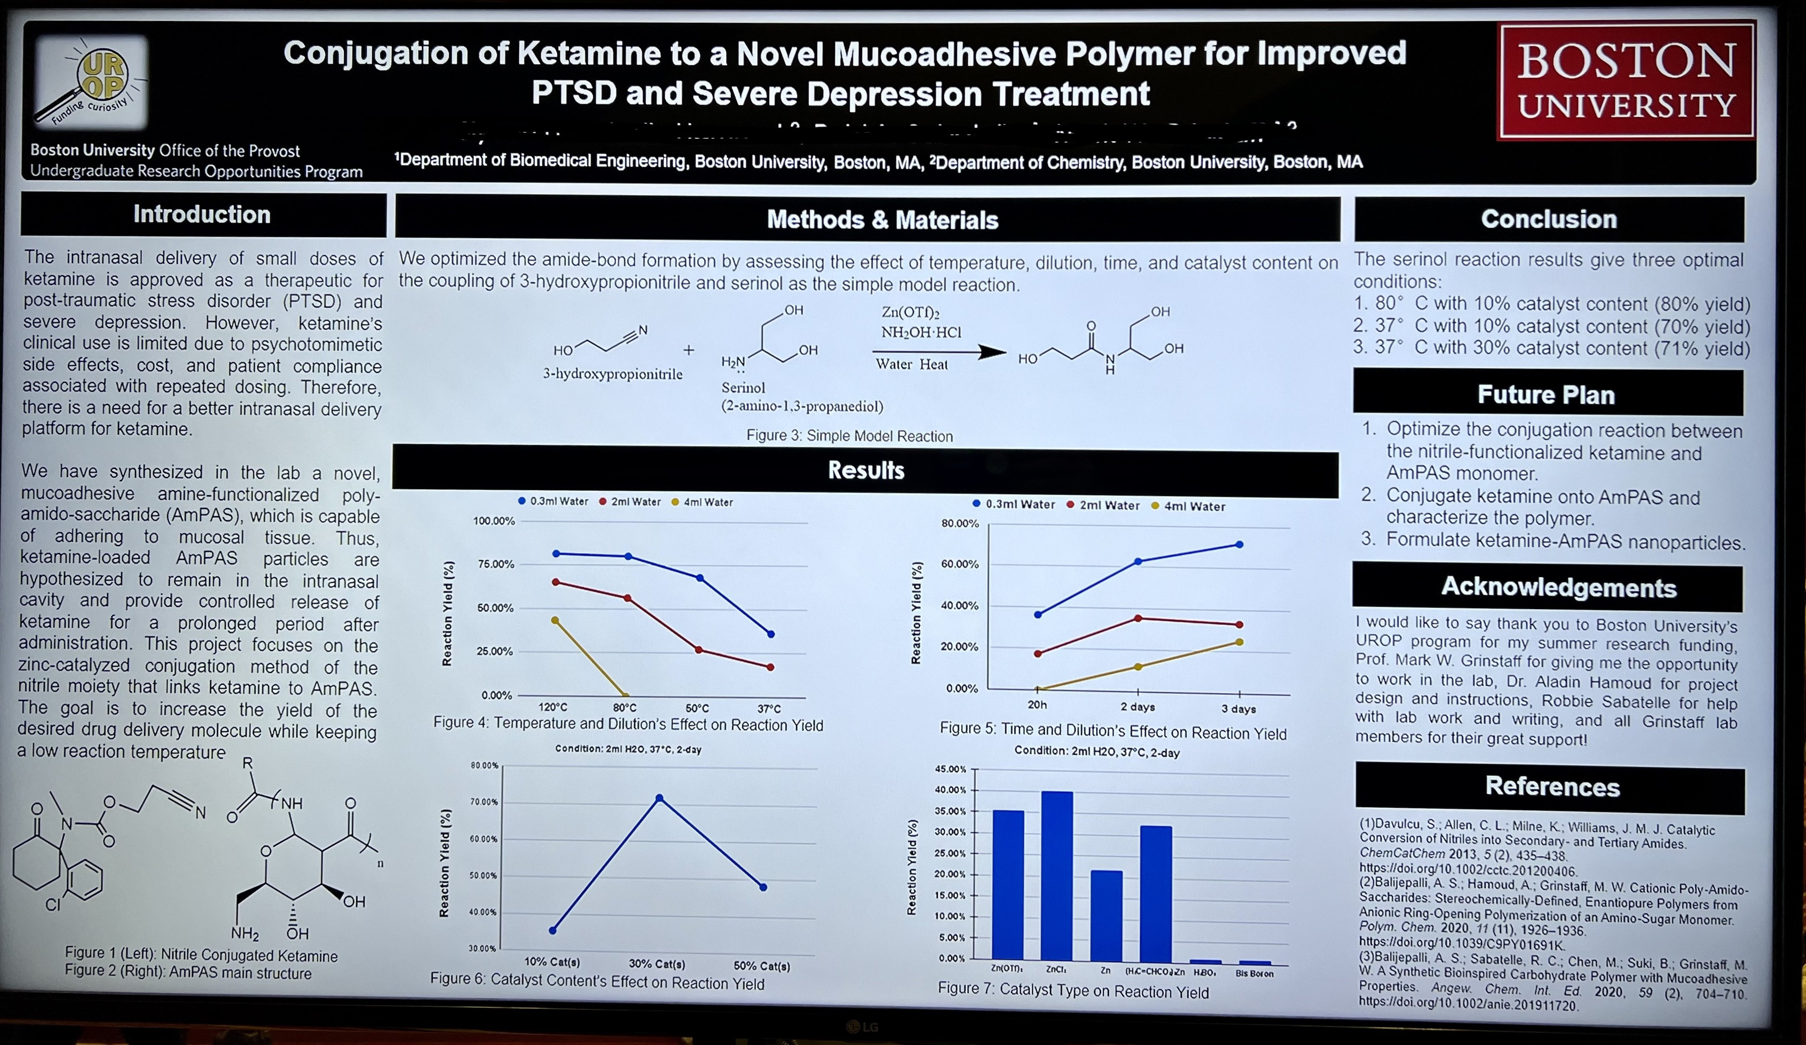
Digital posters

Slide 10
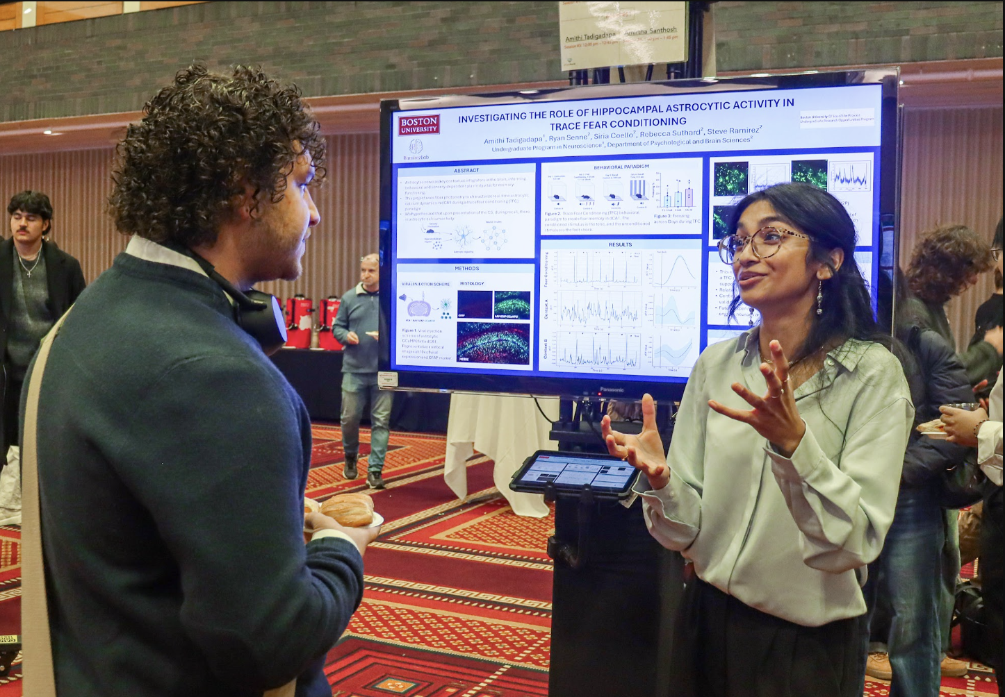
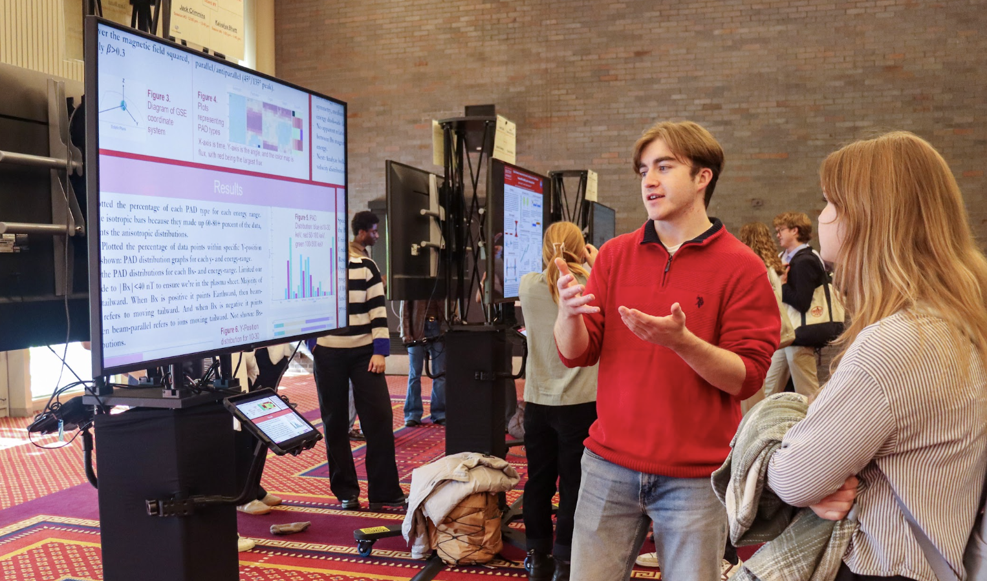
Symposium help
Symposium logistics and 2025 abstract booklet.
Abstract writing tips and examples.
Poster preparation tips.
Abstract tips for non-STEM research.

Slide 11
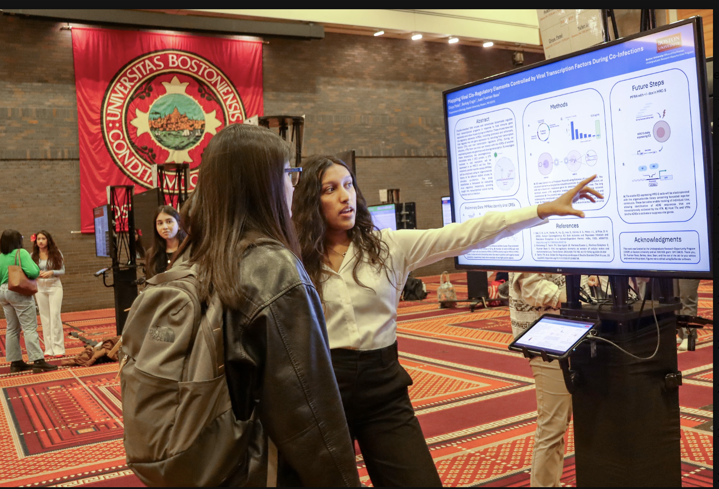

Connect with us:
Bu.edu/urop
@bu_studentsuccess
urop@bu.edu

