Slide 1
UROP Symposium Prep
Abstracts, Posters, and Presentations
August 2, 2023

Slide 2

26th Annual UROP Symposium
Friday, October 20, 2023
GSU Metcalf Ballroom
Poster Presentations: 11am-Noon and Noon- 1pm
200+ poster presentations and ~1000 attendees
Write your abstract > prepare your poster > present your poster at the Symposium!

Slide 3
Abstracts
Due Friday August 18 by midnight through online abstract submission form
Mentor approval form is required
Hosted on Open BU in the UROP abstract booklet

Slide 4
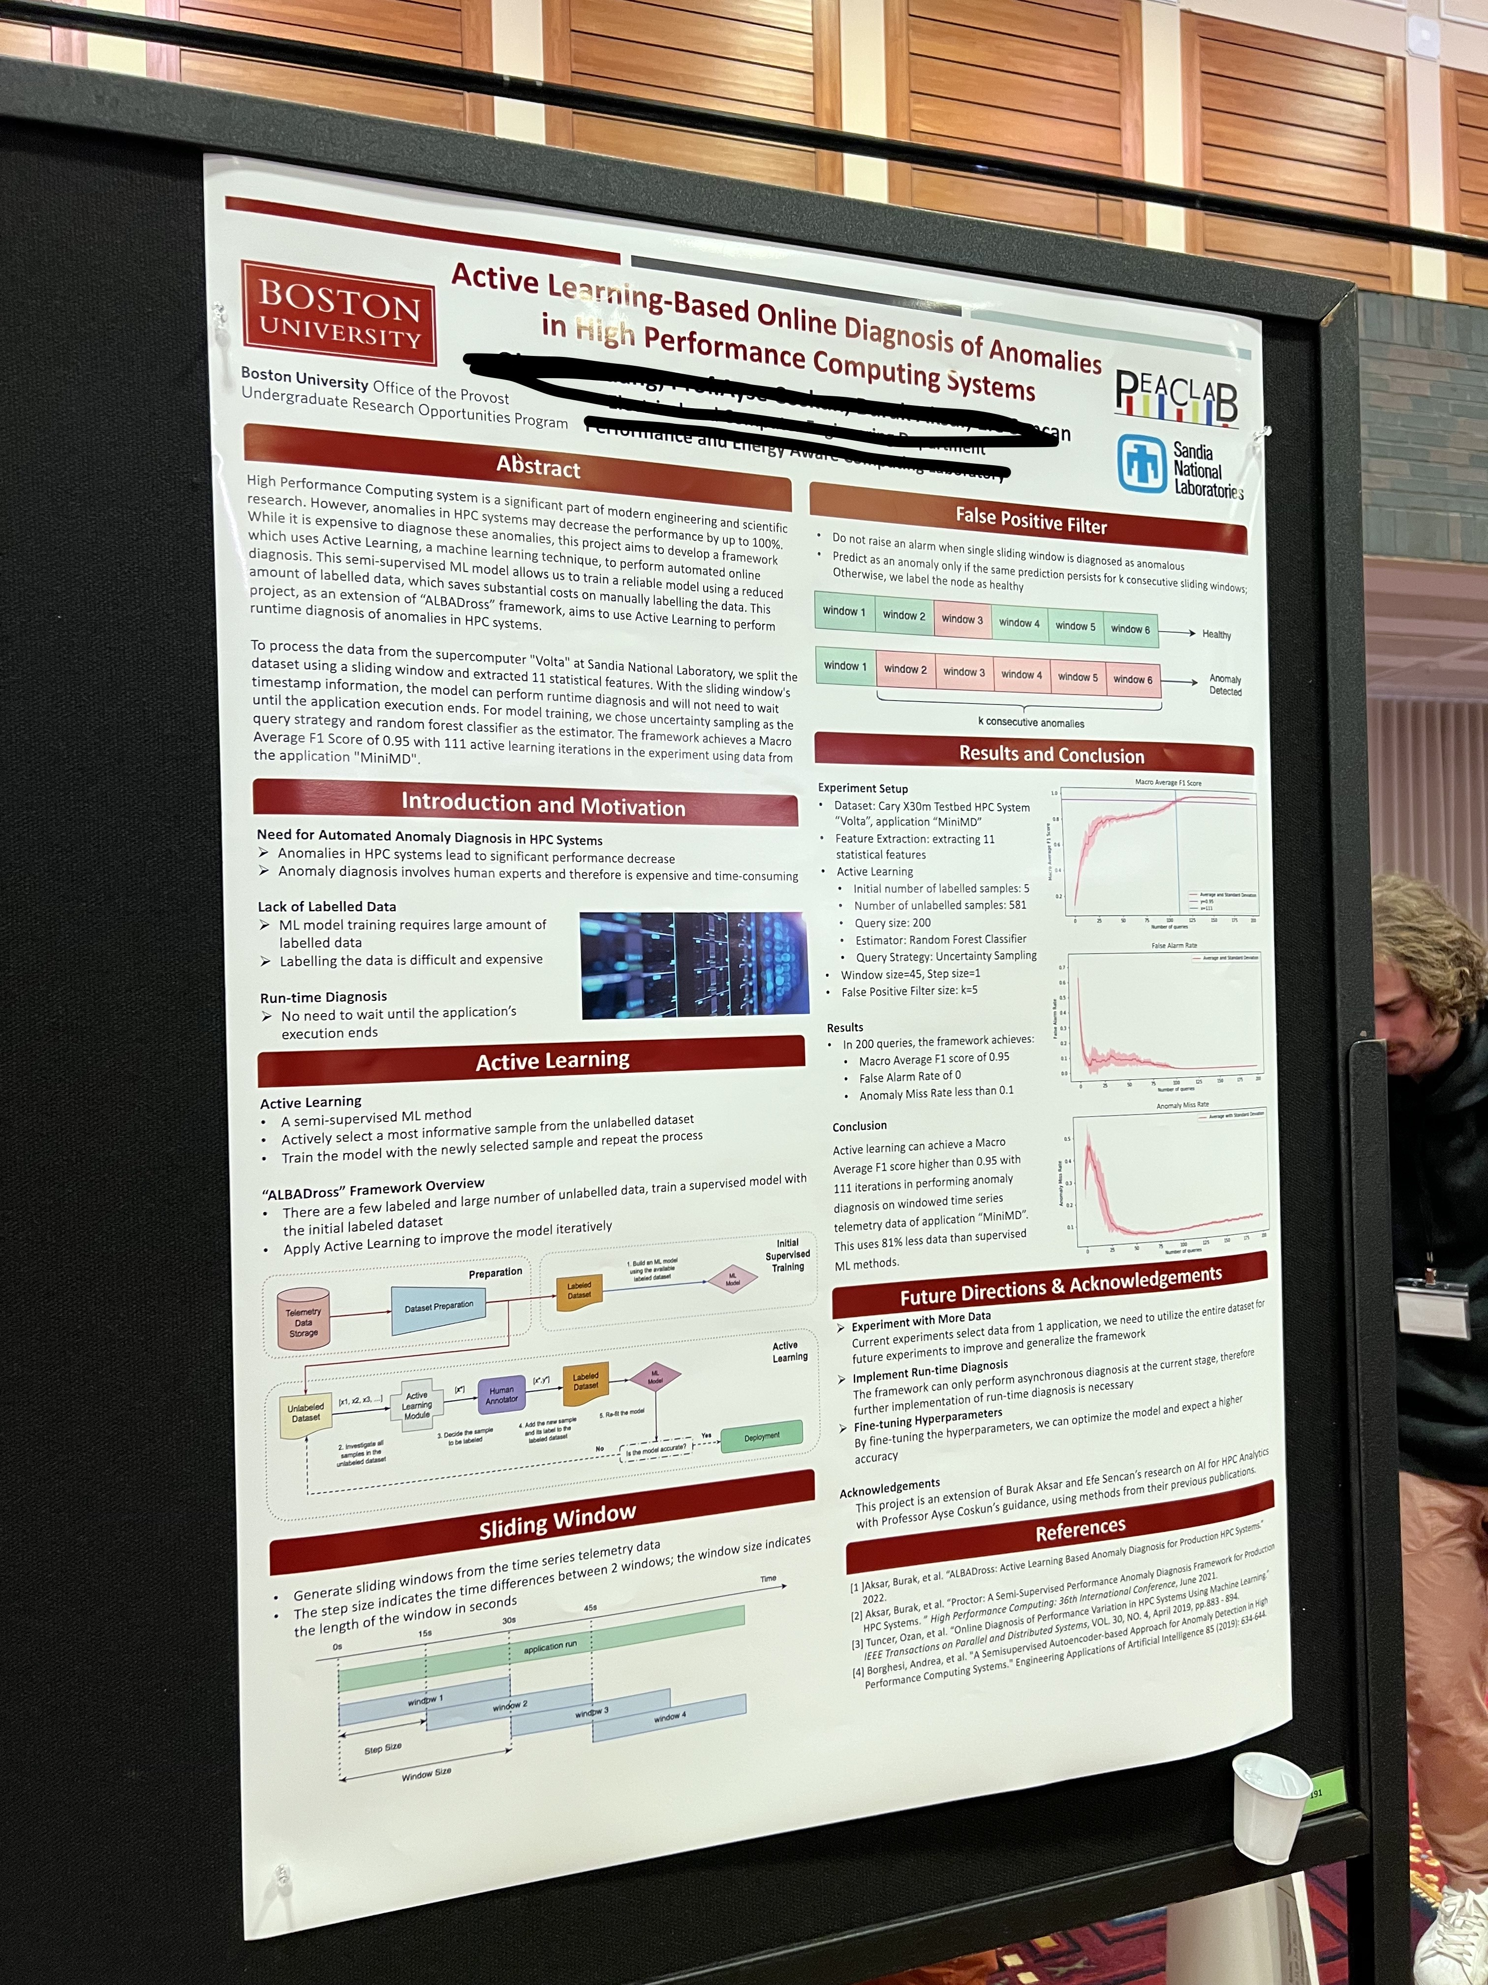
Preparing your abstract
A short description of what you did and learned
Should be informative and interesting
Keep to the requested format (for UROP, <250 words, ~½ page)
Write for a broad audience: explain key concepts briefly and spell out abbreviations on first use
Don’t assume reader knows why your work is important
Don’t get caught up in numerical data - include only numbers that are most important
Abstract examples are on the UROP website and in past Symposium booklets on Open BU

Slide 5
How to structure your abstract
Introduction
1 sentence placing the study in context
1-2 sentences explicitly stating what the study investigated and why it was special
Body
1-3 sentences summing up the approach, or the most important methods used to investigate the problem
Results and Discussion
1-3 sentences that summarize the MAJOR results and potential future applications
Summary
1 sentence that summarizes why your results are significant and future directions
Notes:
Think about it as a very brief version of your UROP application, but with results

Slide 6
Things to avoid in your abstract
Too many references to the literature
References to figures or images
Overuse of abbreviations or acronyms
Repetition
Unhelpful or vague sentences
Not following abstract guidelines (font, length, title, authors)

Slide 7
Abstract FAQs
Q: Can I update my abstract after August 18?
A: Maybe. We compile the abstracts into the abstract booklet, so we need them ready promptly. Typically, updates are not available after Sept. 1.
Q: I don’t have a lot of results, what should I include in my abstract?
A: Focus on the overall goals of your study and future directions.
Q: Can I put my abstract on my poster?
A: Yes, and many people do! Make sure the font size is just right.

Slide 8
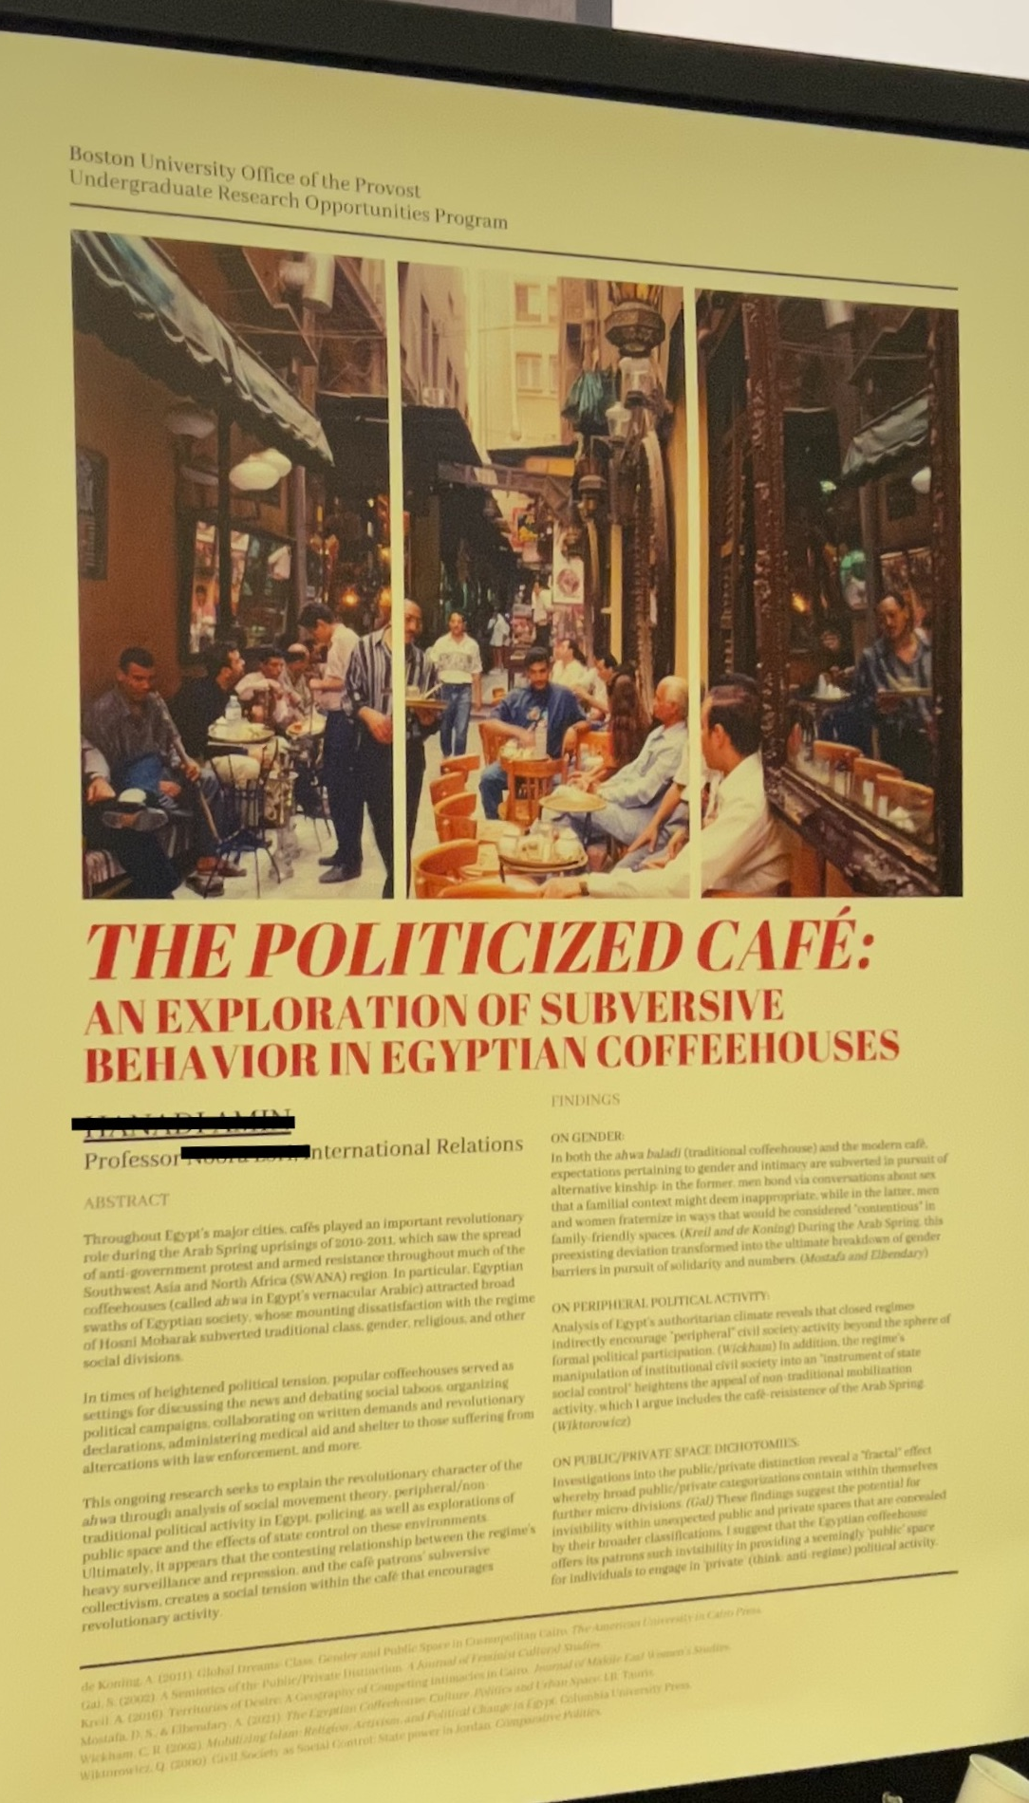
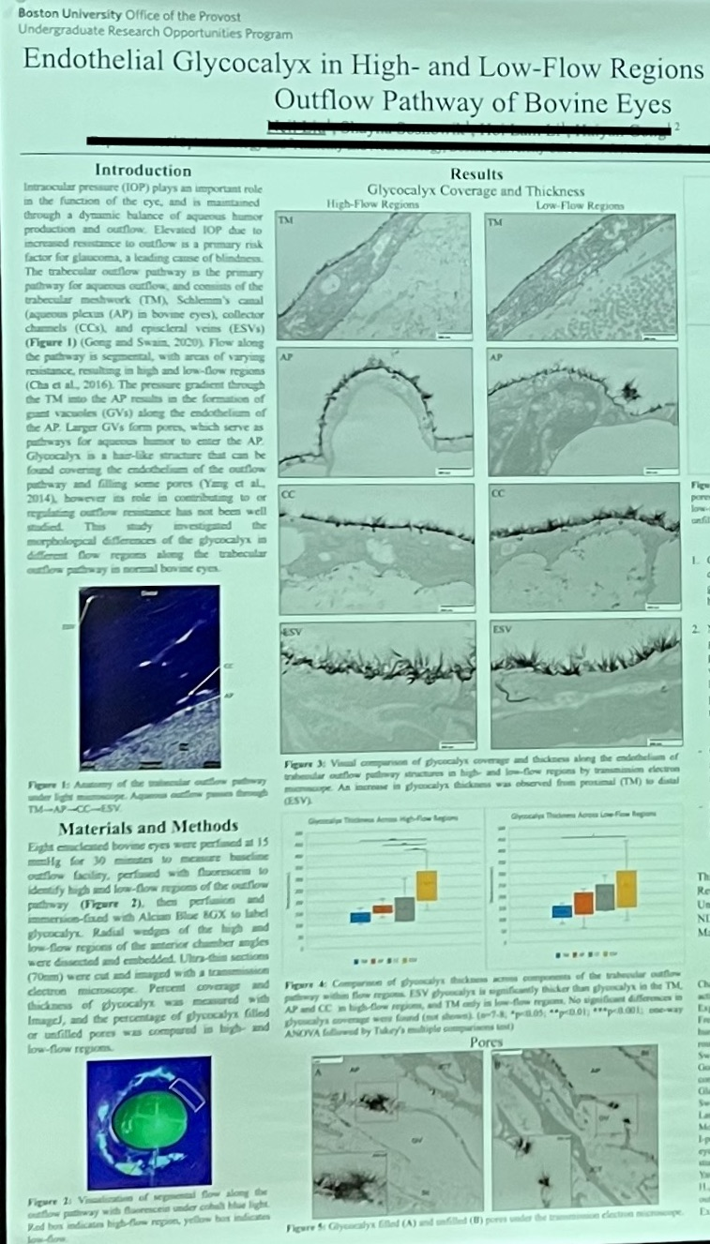
Preparing your poster

Slide 9
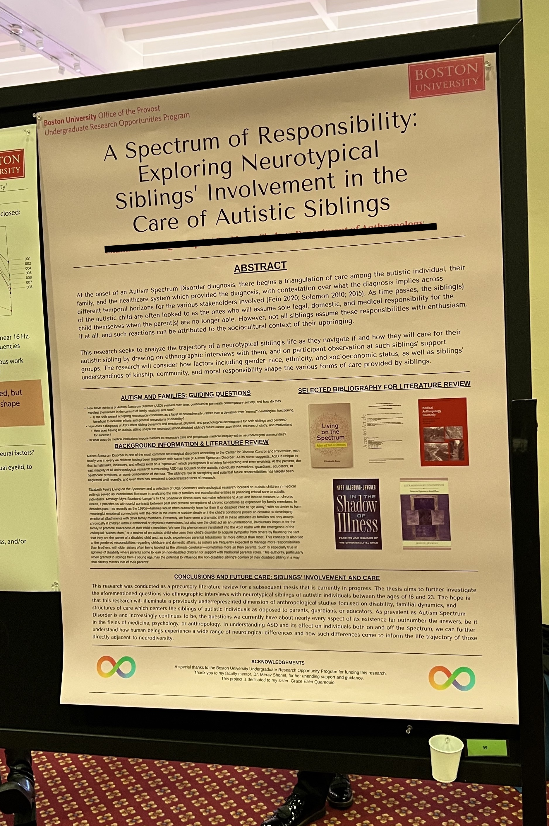
Potential poster elements
Title
Your name, your mentor’s name (and department), and any other authors
Abstract
Your research methods and goals
Results and conclusions
Graphs, figures, and images
Future directions for the research
A (short) bibliography or list of references
Acknowledgments (citing any help you received or sources of funding)
  Be sure to acknowledge UROP special awards
Notes:
Humanities posters

Slide 10
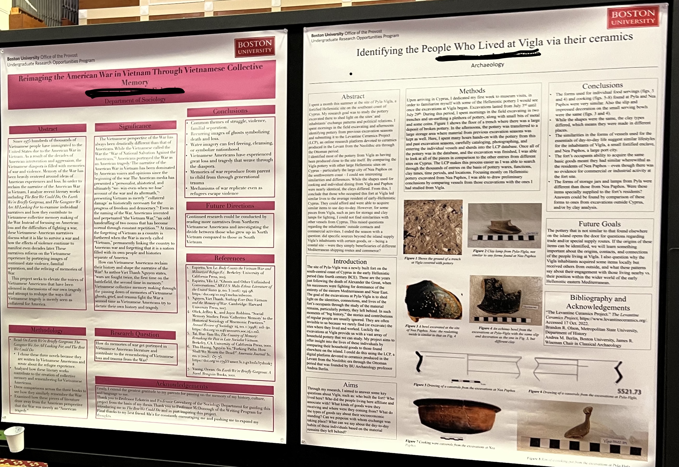
Poster tips
Font types and sizes should be consistent and easy to read
Colors should be consistent
Content should be easy to see from up to 4 feet away
Explain any graphs, figures, or images on your poster
  Add titles like Table 1, Figure 1, for easy reference
Think about presenting your findings/data in an interesting medium (graph, image, etc.) rather than text
Posters should not be too wordy
Simple posters are often the best posters

Slide 11
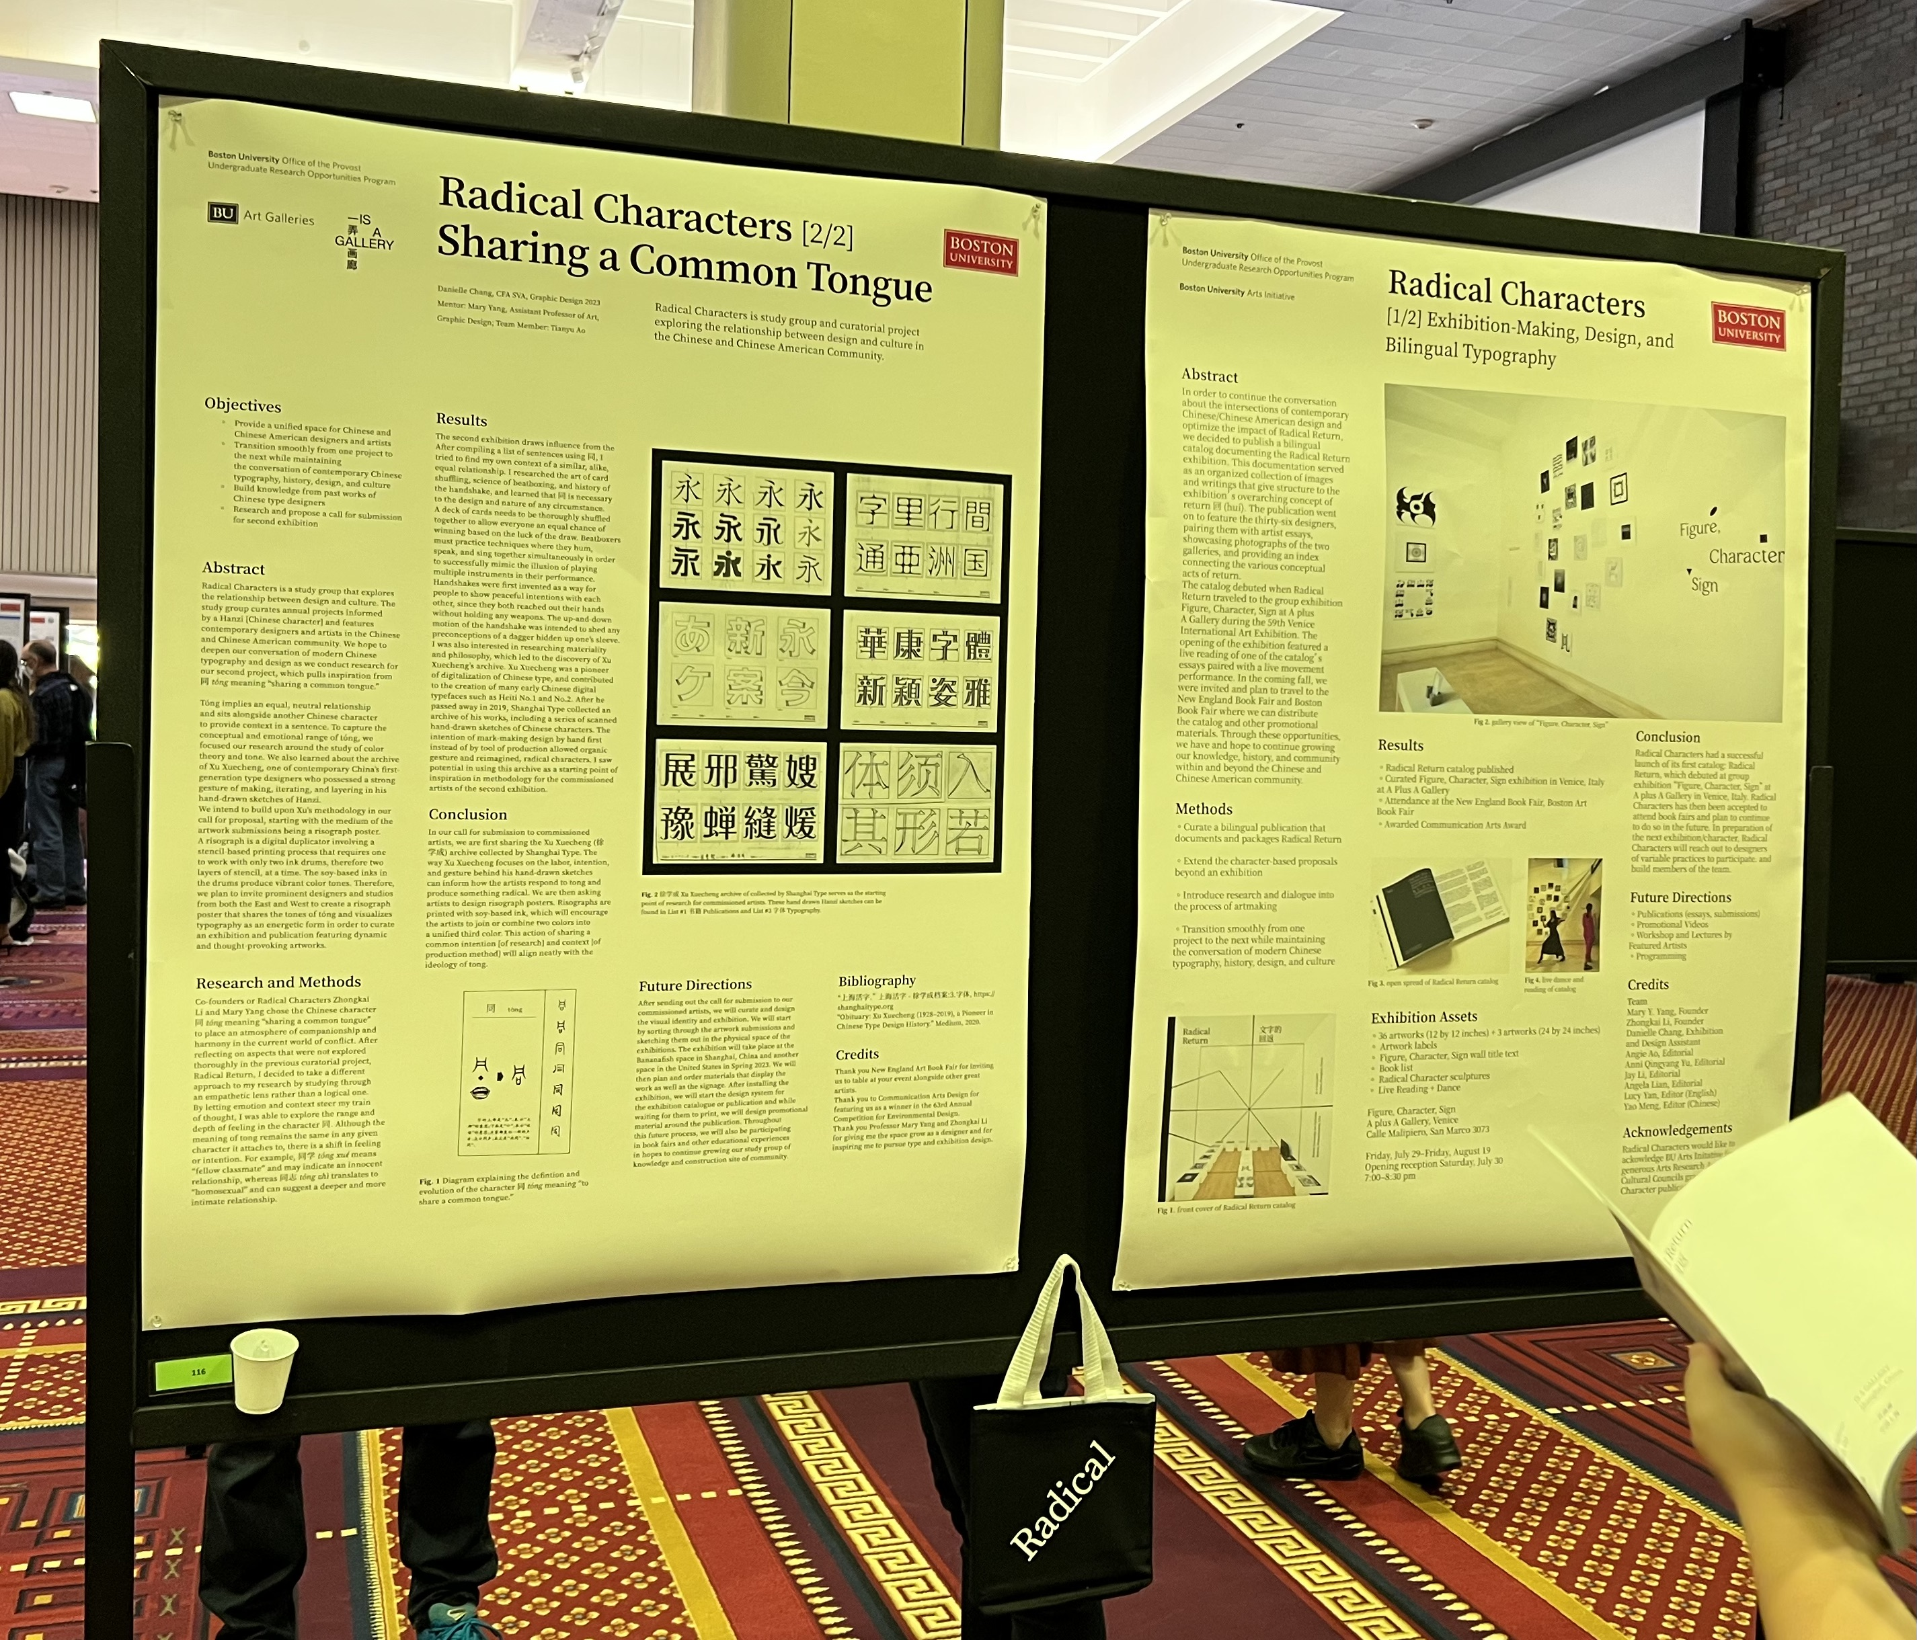
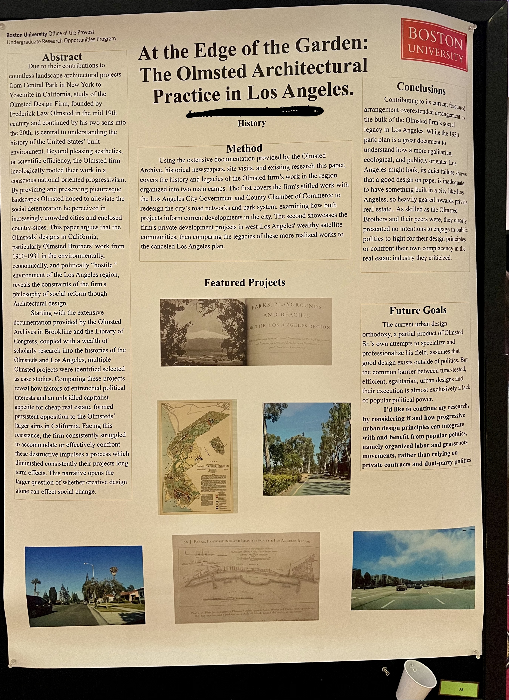
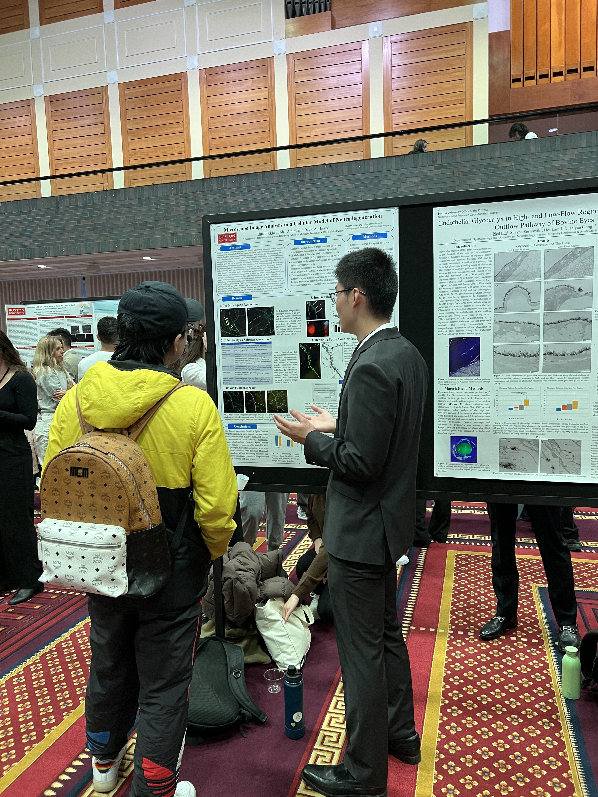
Printed posters

Slide 12
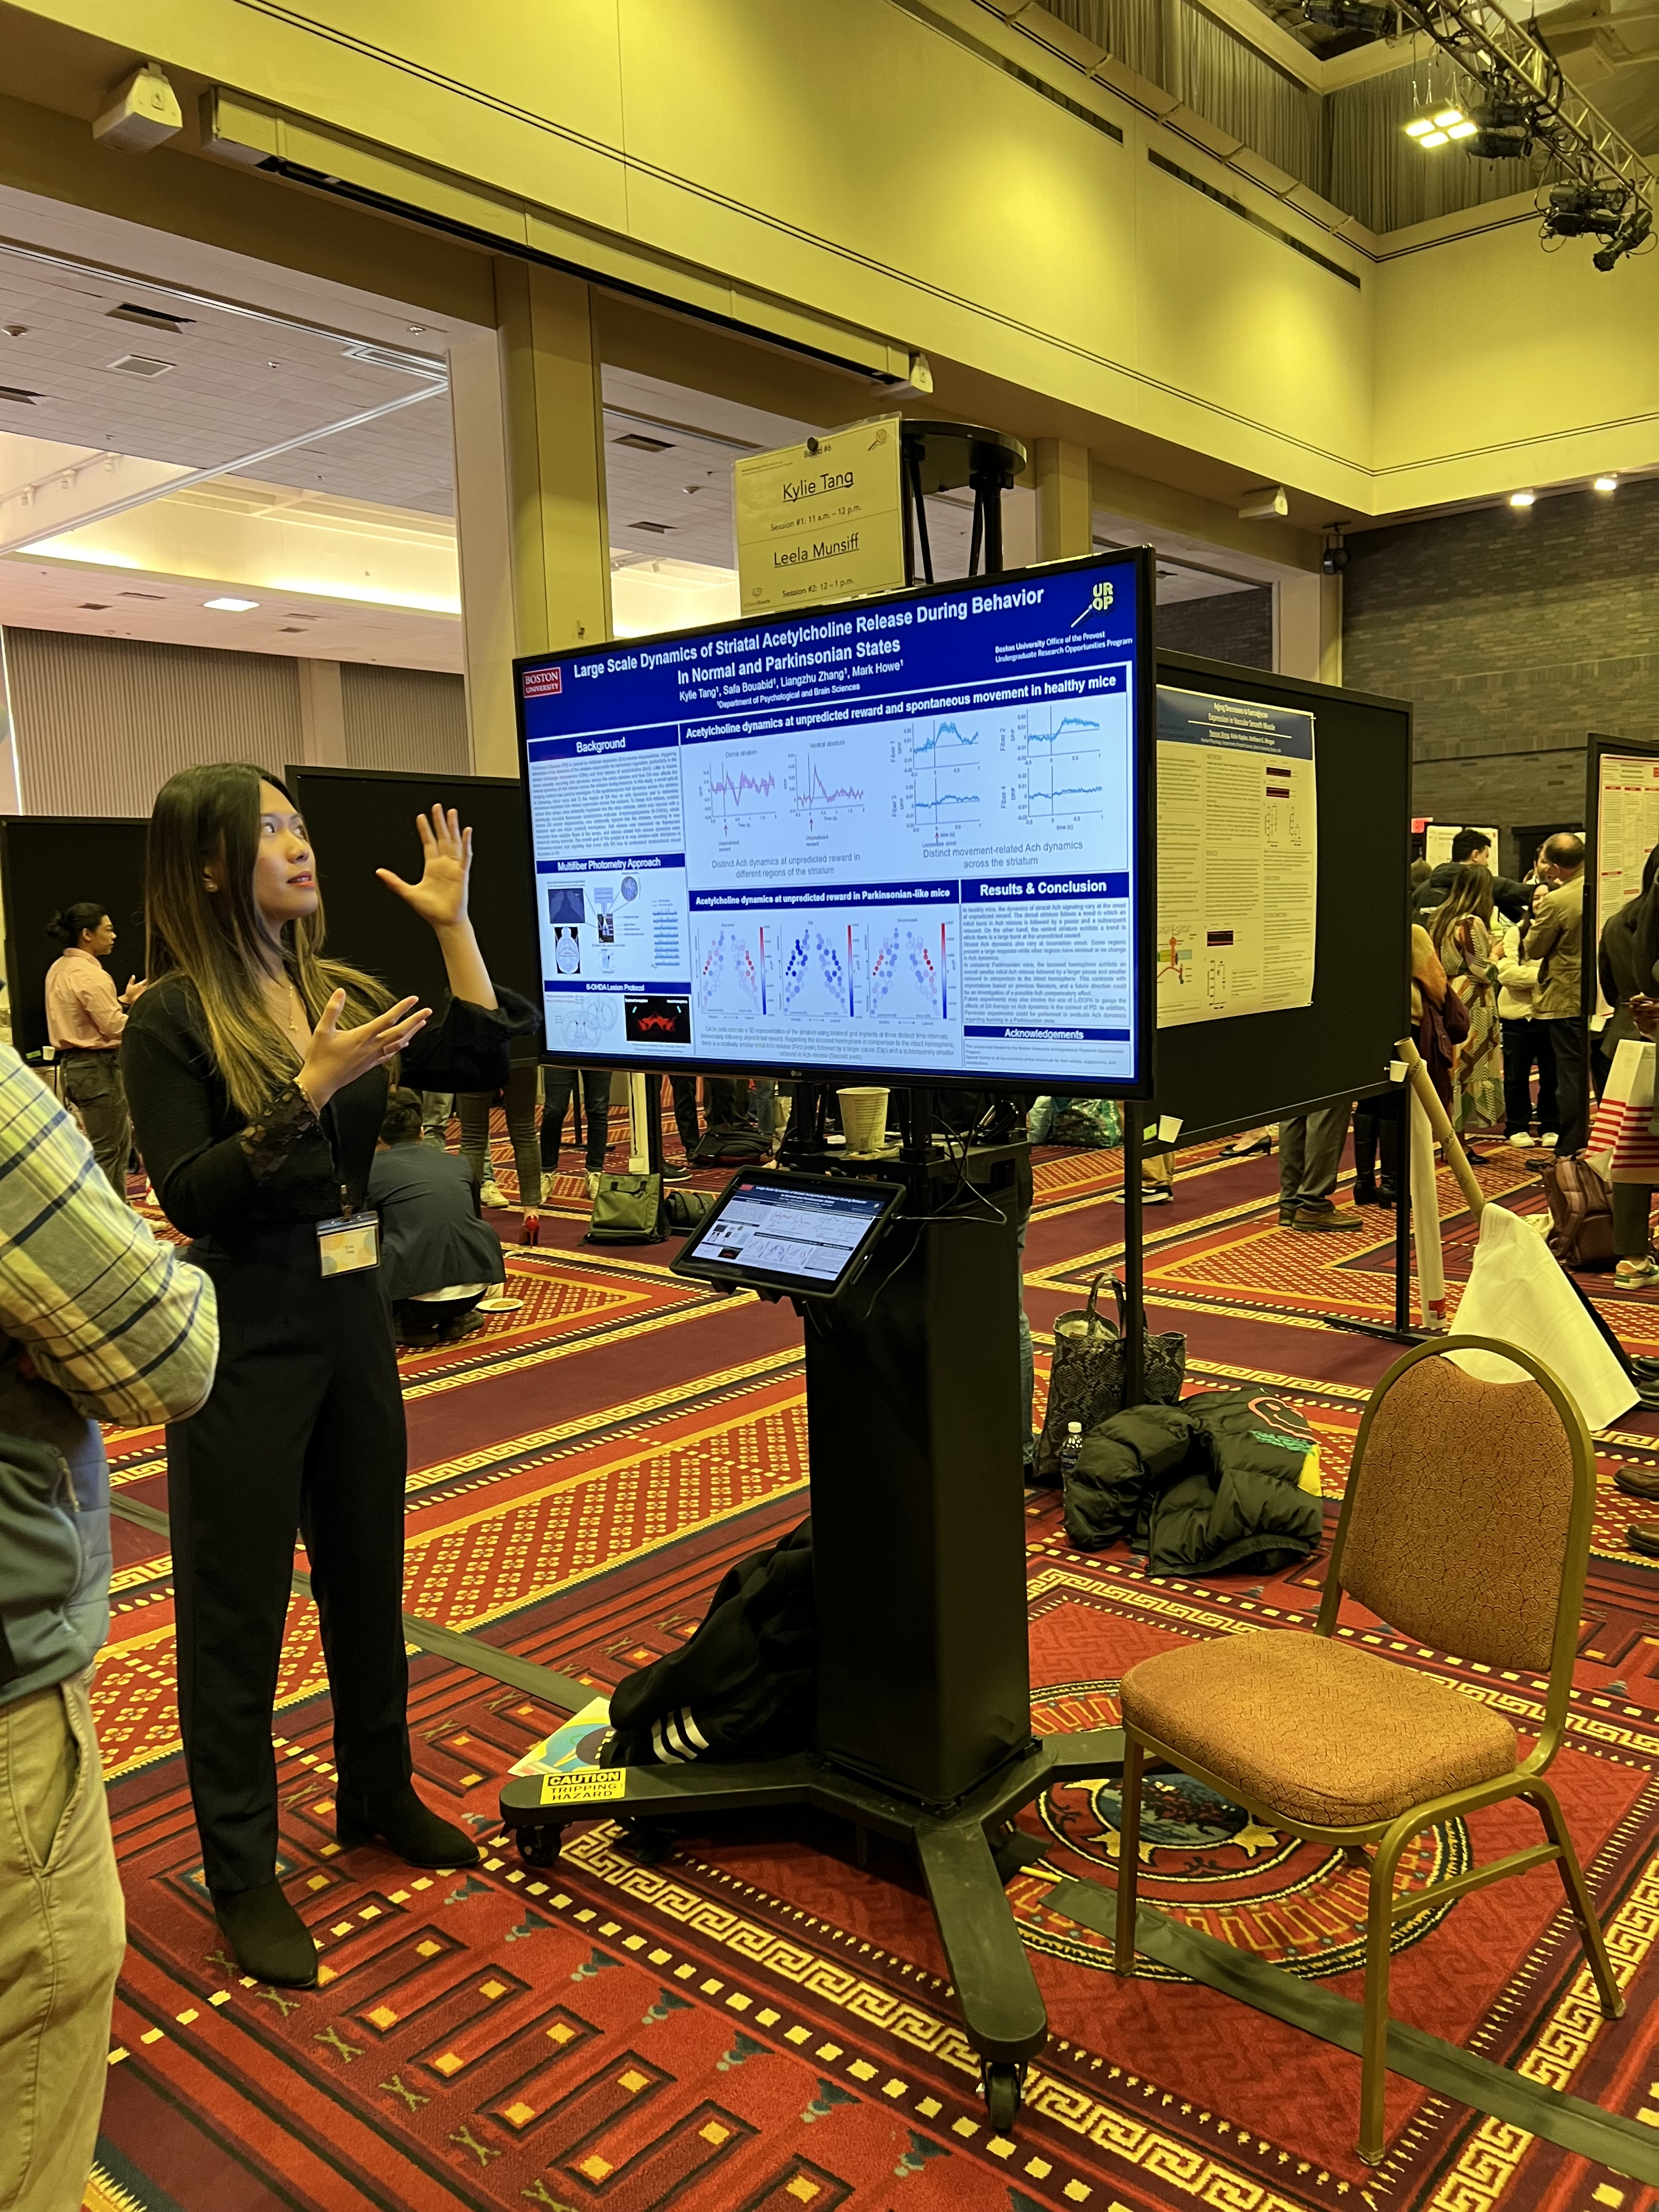
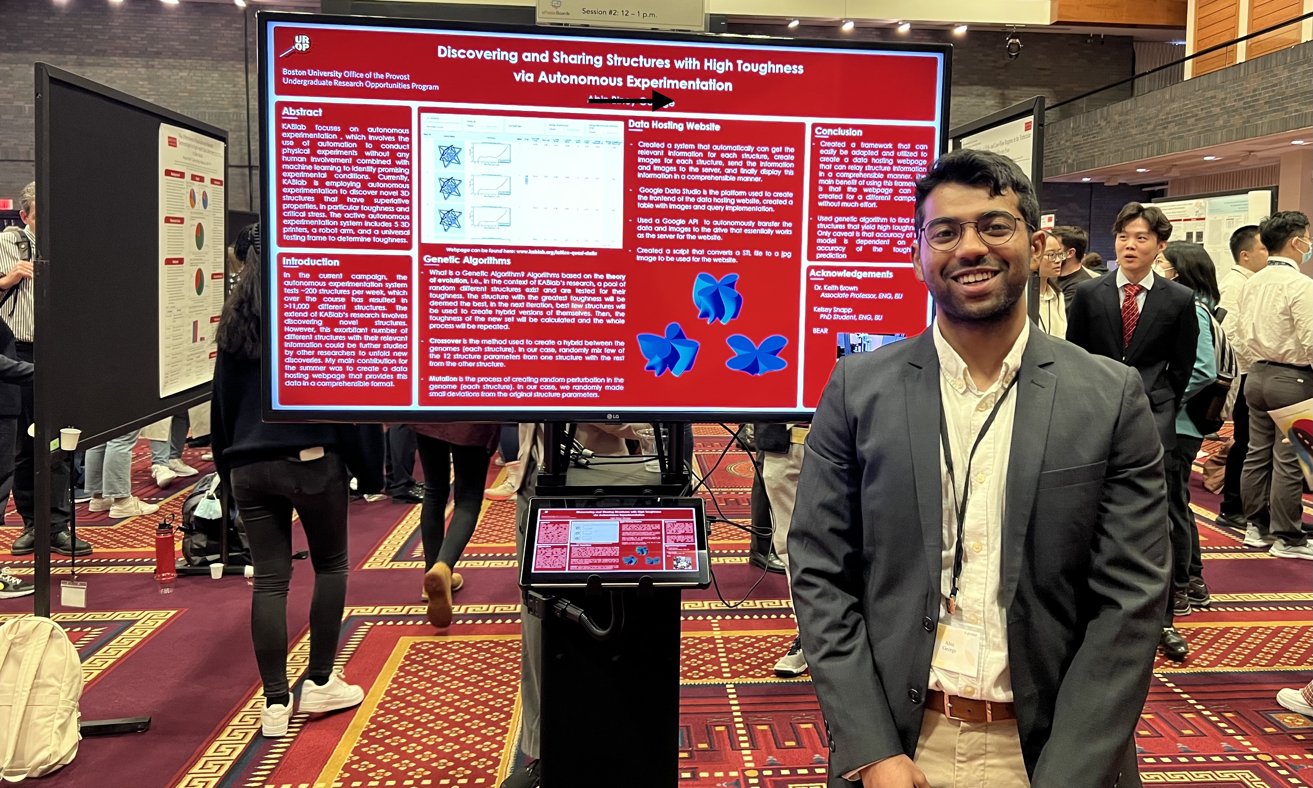
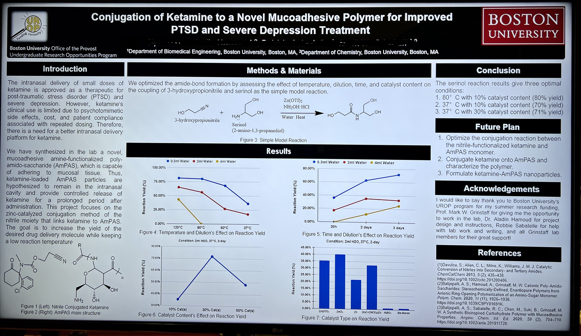
E-posters – Volunteers needed!
Notes:
38 e-posters, 19 during each session. If you have images, movies, data, sound that can best be presented via an electronic poster, please consider volunteering to present. We will send you templates from the eposter board company to help you. You can let us know if you are interested in the abstract submission form.

Slide 13
Common poster mistakes
Notes:
All caps, too many colors, small text, hard to read, no images/graphs/data

Slide 14
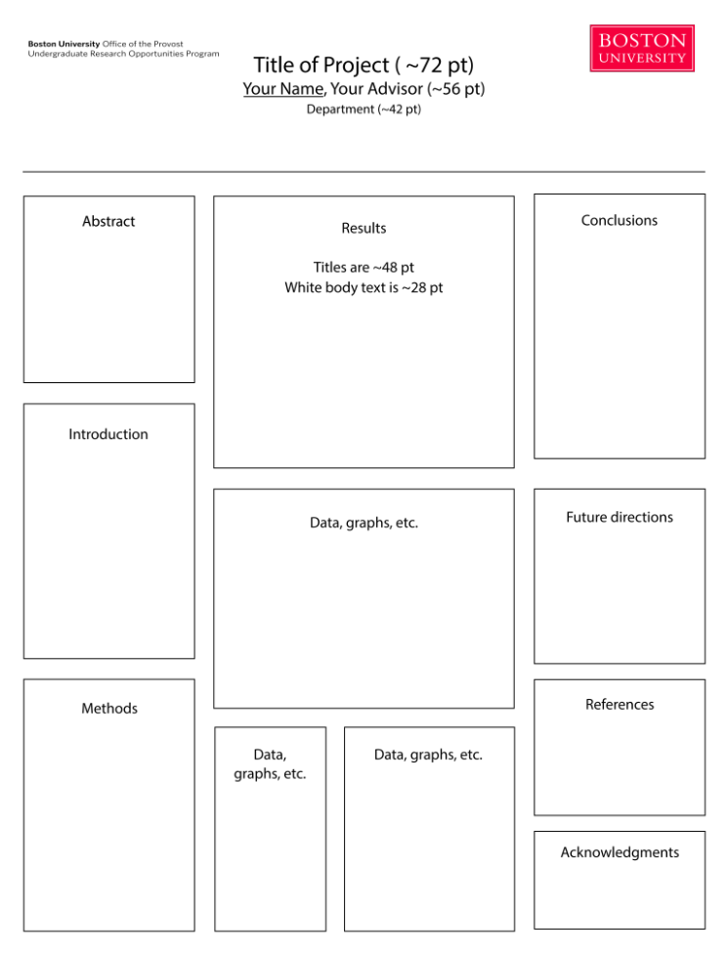
UROP poster specifications
Your poster must be within 42″h × 32″w
Include the UROP logo and the BU block logo on your poster as shown here.
  Logos can be found on the UROP website
Physical poster boards are double sided and hold 4 posters
You will be sharing a poster board with one other presenter

Slide 15
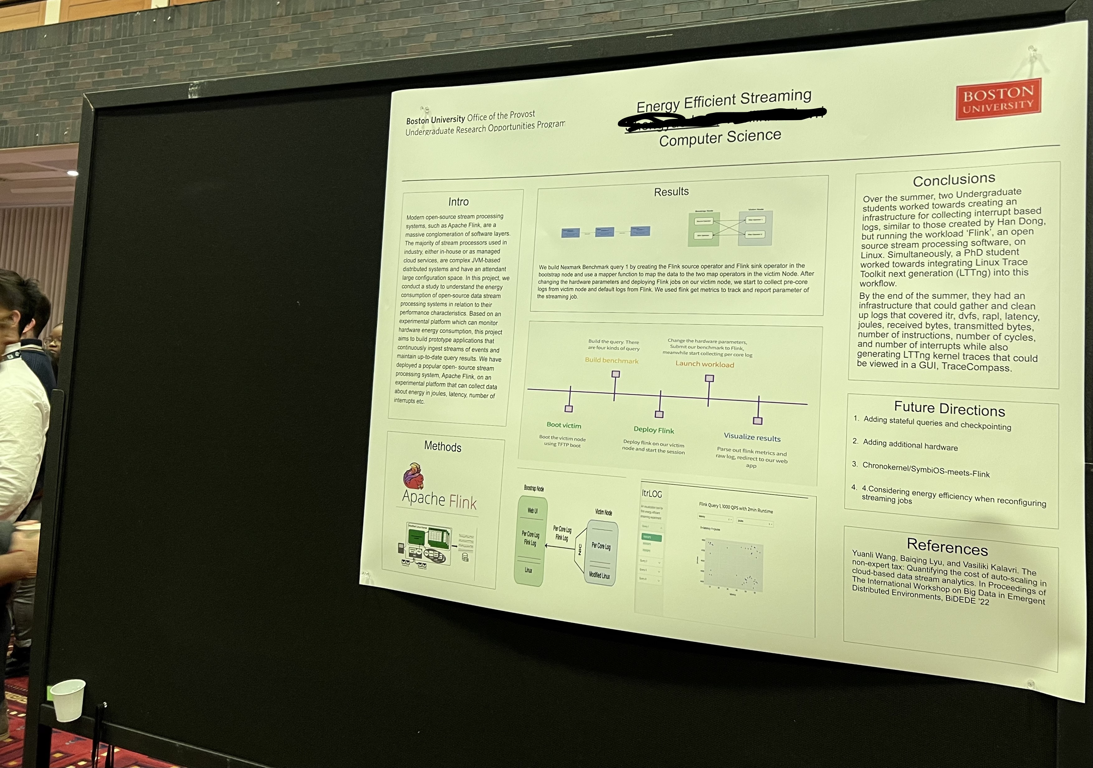
Stick to the poster sizing specifications!

Slide 16
Poster Printing
UROP will pay for printing at BU Fed Ex. Details sent by email in early Sept.
Ask your mentor how to print your poster. Some departments have poster printing capabilities.
Biology majors and students working with Bio faculty will have their posters printed by the Bio Department.
Allow about a week for printing.

Slide 17
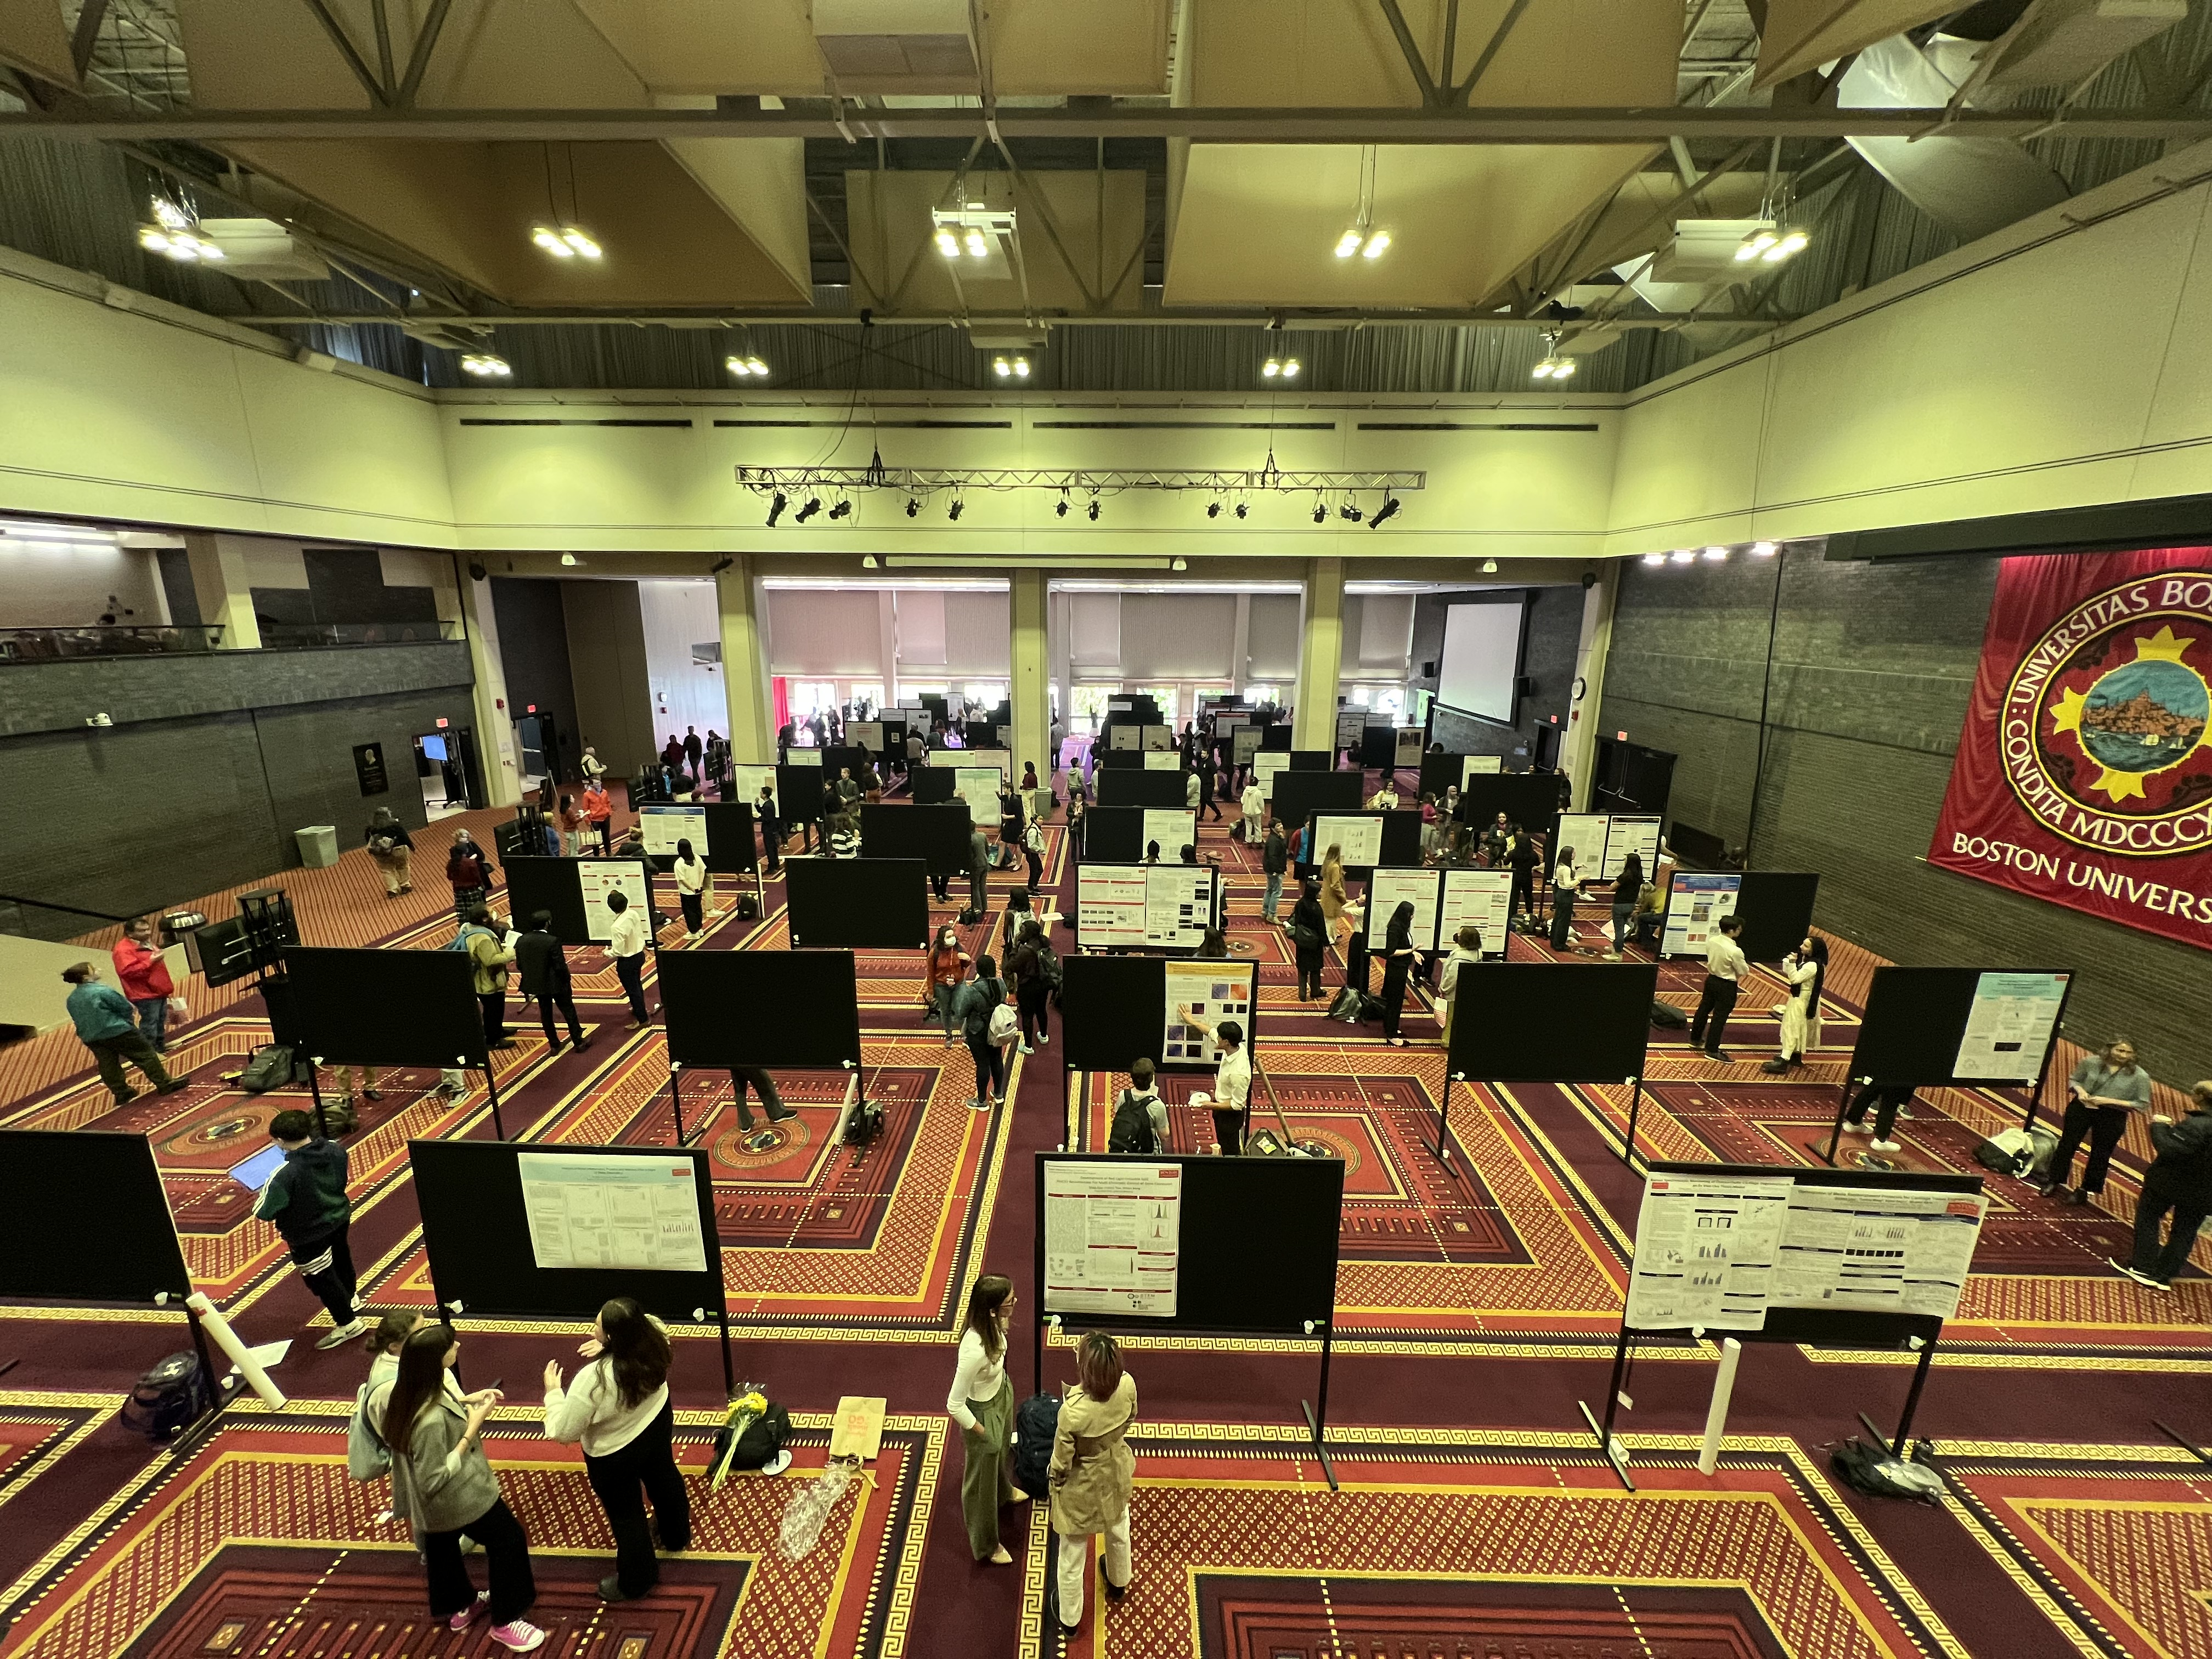
Poster Presentations

Slide 18
Symposium: What you should know
Who is the audience?
  Undergraduates, graduate students, faculty, staff, families, friends
Prepare a general 3 minute talk that you have mostly memorized.
  Note cards are ok!
Be prepared to tailor your presentation to the level of knowledge of your audience.
Invite attendees to learn more about your research or ask nearby presenters about their research
Relax and have fun!

Slide 19
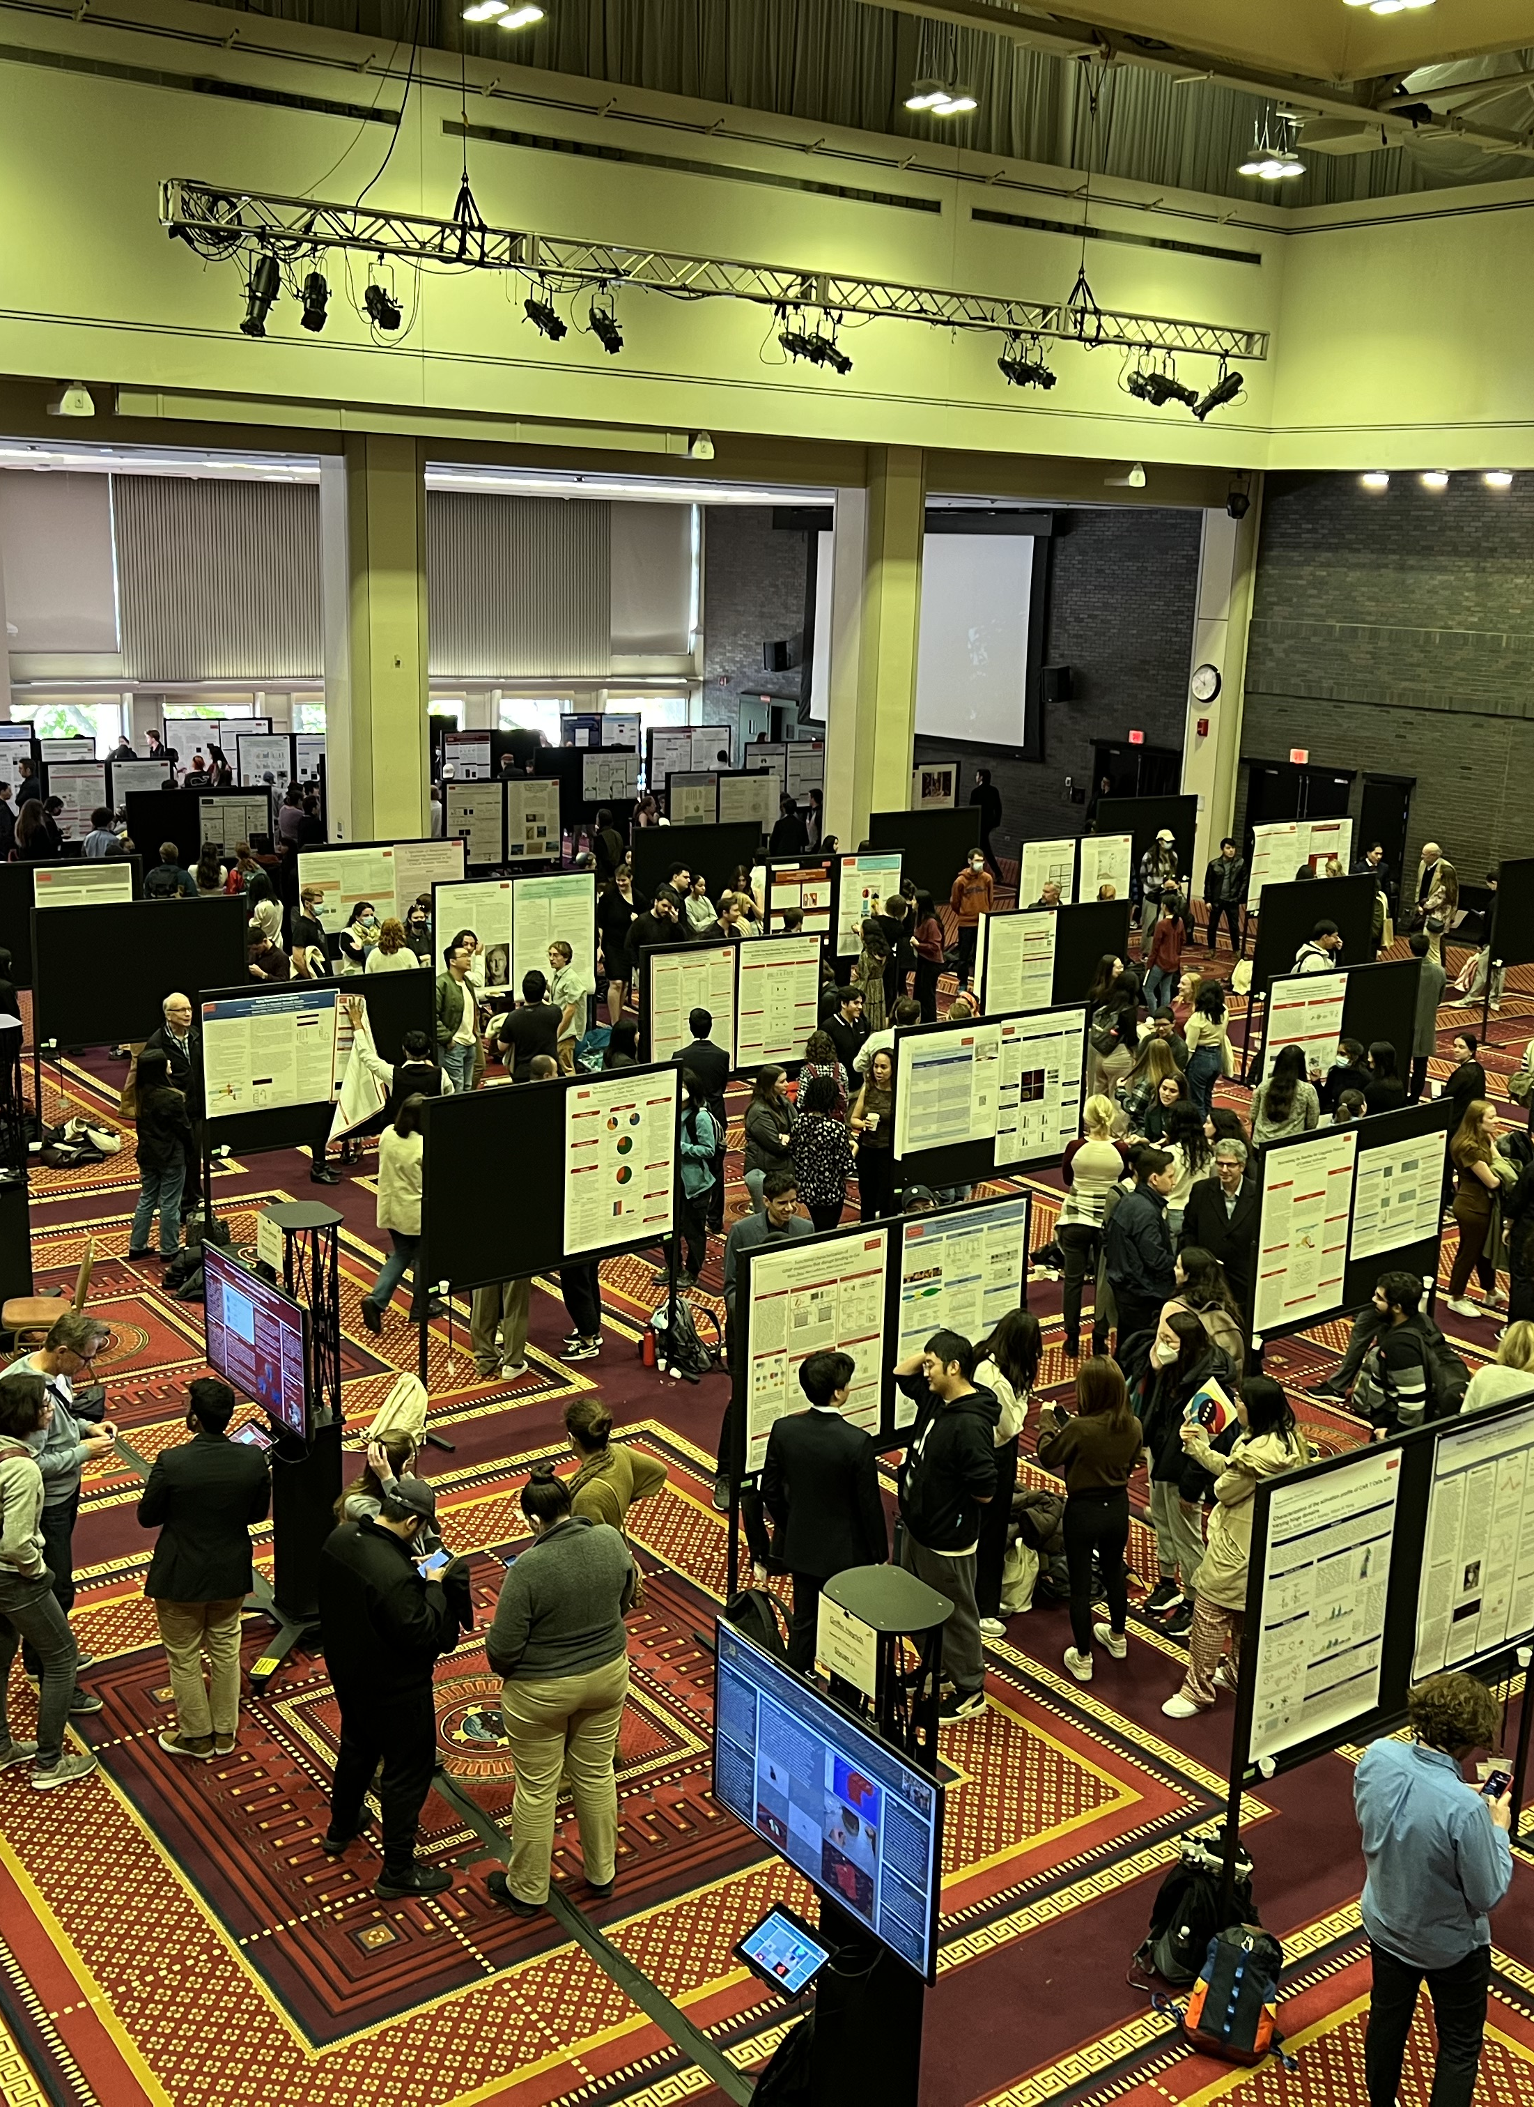
Day of Symposium logistics
Poster set-up
  Arrive as early as 10am to display your poster
  Or set up your poster 5-10 minutes before you are scheduled to present
You will be assigned a poster number
  Find poster location on map - tacks and nametag will be at your poster
Take down your poster when finished presenting, but no later than 1:00pm

Slide 20
Symposium FAQ
Q: When is my poster “due”?
A: Bring your poster the day of the Symposium. E-posters are due ~1 week before the Symposium.
Q: What if I am studying abroad in the fall?
A: Submit your abstract. You are excused from presenting.
Q: Can I present my poster with someone else from my lab or research group?
A: Likely, yes. Email us to confirm.
Q: What if I have class during my assigned presentation time?
A: Presentations times are 11-12 or 12-1pm. If you can only make it during one of those times, email us to let us know.
Q: What should I wear?
A: Business casual.

