Slide 1

Outsmarting Our Future Selves
Boston College Information Technology Services and the Journey to an Enterprise Password Manager
A generally vendor neutral presentation by Tiffany Bradford (tiffany.bradford@bc.edu)

Slide 2


Familiarity is Comfortable
July 2015 (Publix)
August 2015 (Stop & Shop)

Slide 3

We may be too comfortable with how we manage all our passwords.
Email
Social media
Banking
Gaming
E-commerce
Network Access
Applications
Phones
Computers
Servers
Websites

Slide 4
Hidden Needs for Password Management Amongst Staff
“We use SSO for everything internal! Why would we need a password manager?”
Seems reasonable, but what about:
Vendor site credentials
API credentials
SSH keys
P-cards
Database info
Router info
Local server credential management

Slide 5
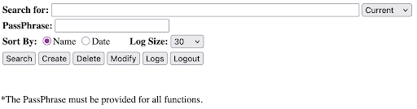
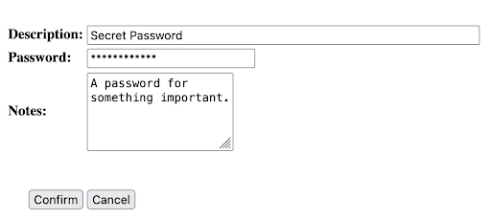
History of ITS Password Management at BC
2010’s
Rebus*, a homegrown application, comes online; ITS recommends specific password managers for personal and individual use but does not provide specific support or training.
2023
It was time for a change as the risk of doing nothing became too high. Security began a project to procure a password manager for ITS.
Notes:
I’ve also heard it was made in 1930.

Slide 6
Why invest into enterprise licensing?
Group management
Oversight on shared passwords
Events reporting
Official business partnership
24/7 Support
Customer Service
Customer Success Representative
Guarding against orphaned passwords

Slide 7
2024: PoC and Deciding on the Vendor

Slide 8
What we asked about when evaluating an enterprise password manager:
Individual vs team access to passwords
SSO and MFA compatibility
Provisioning and deprovisioning functionality
Existence of events API
Billing structure (site license or bulk discount)
Experience in higher ed
Granularity in shared vault security settings

Slide 9
Extra perks we were made aware of:
Custom/ editable templates
High availability of the product
Thorough documentation and support
Community resources
Vouchers for personal use of the product separate from a person’s business account
*YMMV as vendors regularly develop their software

Slide 10
January 2025: Kickoff Meeting with 1Password
Me, “How long will it take to get this off the ground?”
1Password, “You could do it in one month in all reality.”
Me, (giggles) “Let’s give it six. This is a Higher Ed project.”

Slide 11
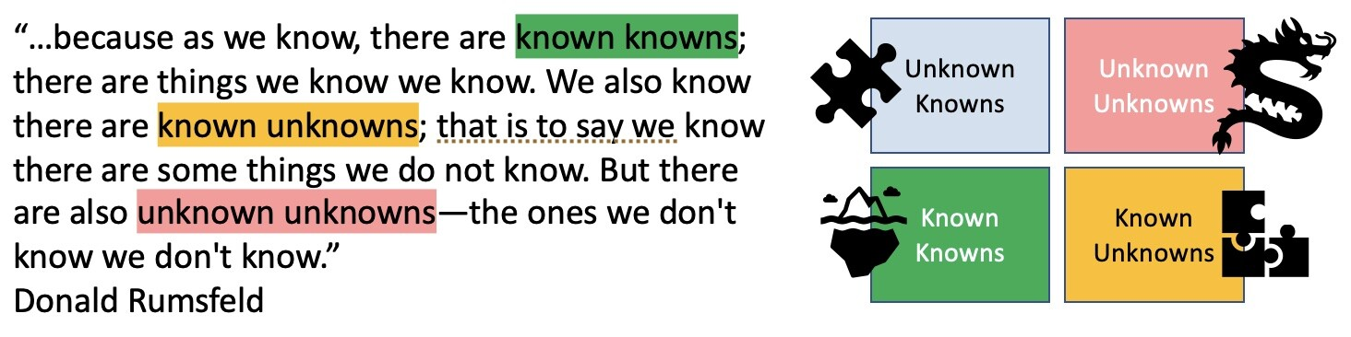
Rumsfeld Ignorance Matrix
Notes:
https://www.linkedin.com/pulse/rumsfeld-matrix-theory-application-michael-o-donnell/

Slide 12
Who supports various aspects of the product?
Ticketing
Deployment
Software Updates
Training
Troubleshooting
Creating and managing vaults
Creating and managing integrations
Notes:
We have a separate IAM team and separate Systems team at BC from Security.

Slide 13
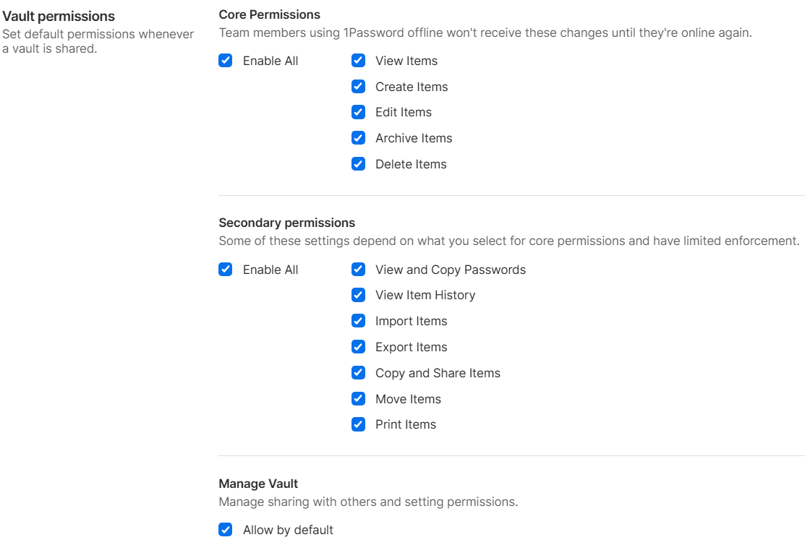
Managerial Decisions
Account password length
Default vault settings
Sharing permissions
Shared password link expiration timeline
Creation and management of vaults
SSO (DR and takeover issues)
Provisioning and deprovisioning accounts

Slide 14
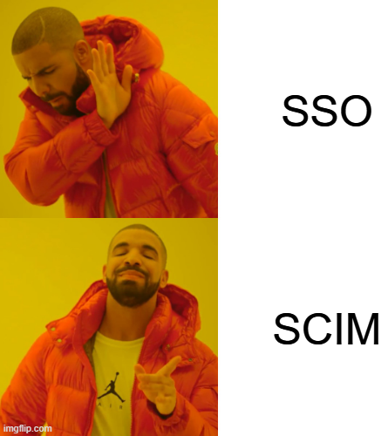
Have you heard of SCIM?
System for Cross-domain Identity Management (SCIM) specification is designed to make managing user identities in cloud-based applications and services easier. https://scim.cloud/
Integral for provisioning and deprovisioning
Can still be used in the future if we switch to SSO for logins
Guardrails
Vault creation and management
Controlling access
Transparency for managers

Slide 15
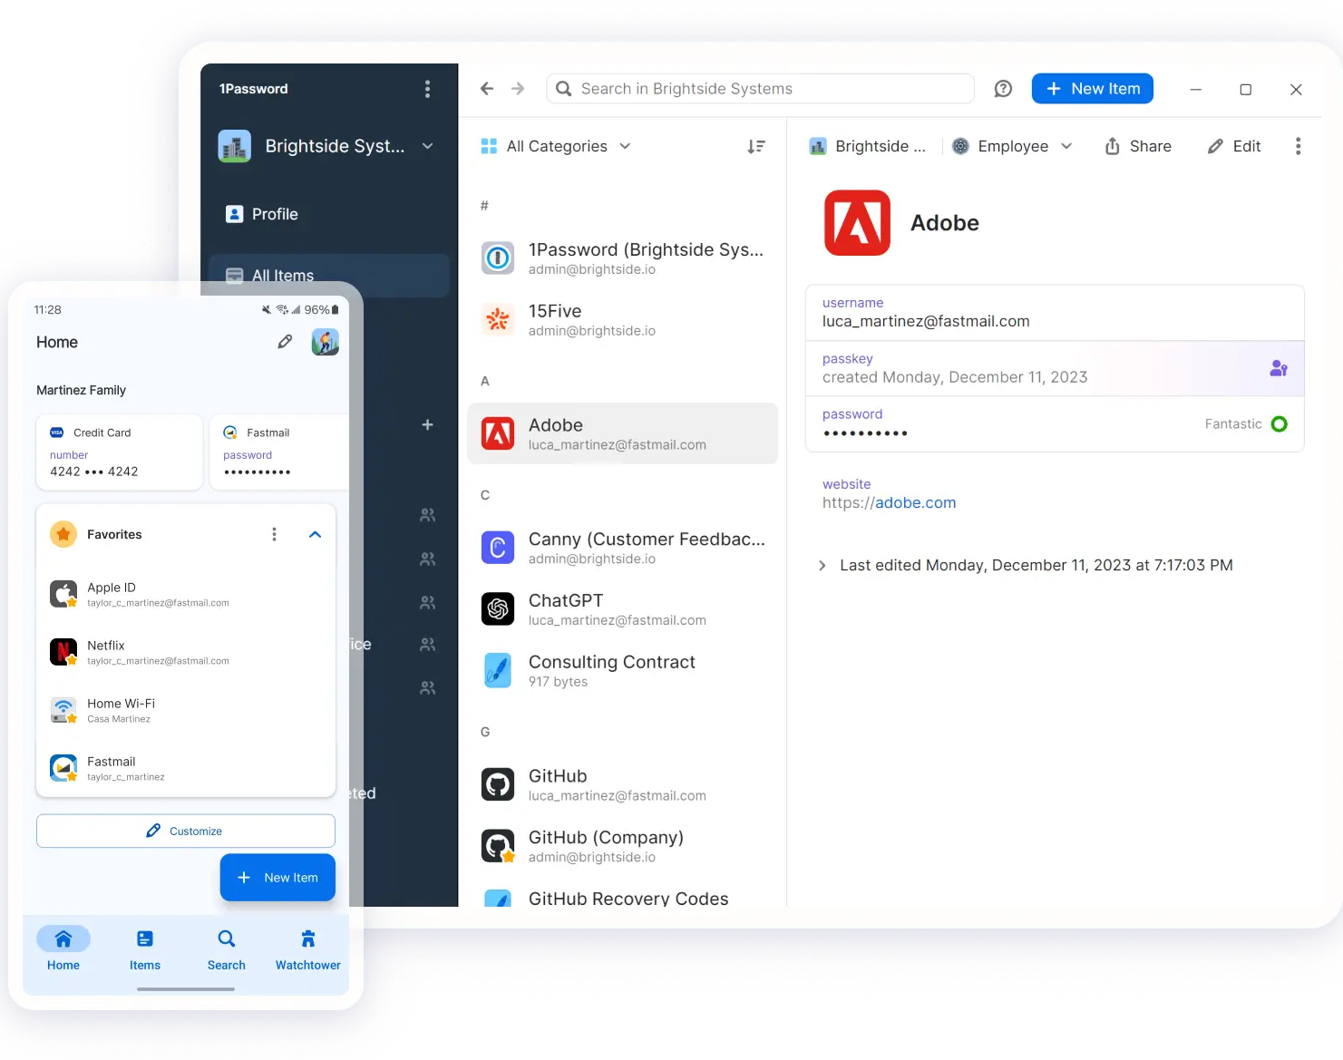
Understanding and Communicating Different Levels of Functionality
Browser extension
Command Line Interface
Connect Server
Desktop client
Phone application

Slide 16

Marketing Blitz
All ITS
Director Level
Department Specific

Slide 17
Things that you didn’t expect to have to tell people… (but you aren’t surprised at the same time if you’ve been in IT for more than a week)
Make your account password completely unique from your SSO password
Your account password must be completely unique (yes, this is different from the first bullet point)
Yes, the enterprise password manager we procured is more secure than the unencrypted csv file on your desktop

Slide 18
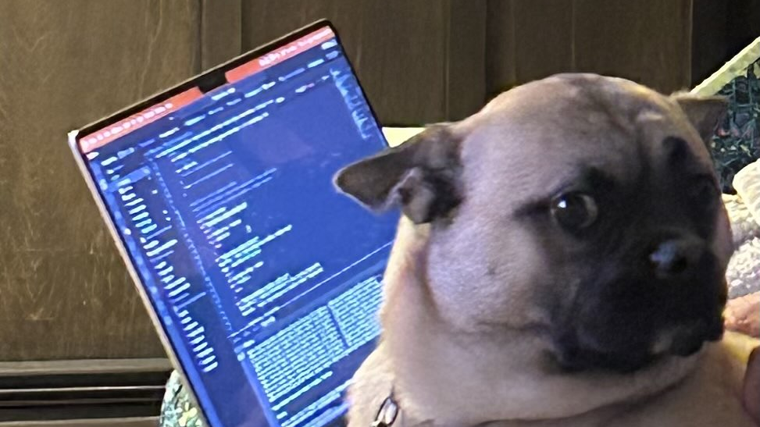
June 2025
Go live.

Slide 19
Findings Post Go-Live
Nothing blew up!
Rebus users are excited and interested in integrations
Usage metrics are highly contextual so don’t immediately panic if something seems off

Slide 20
What we learned from this project:
What about passwordless? Ahem, not right now (Known Known)
Higher ed customers may be more difficult to help for the vendor because of unique, individualized infrastructure and political needs (Known Unknown)
Our up-to-date org charts were invaluable (Unknown Known)
We learned a lot the hard way (Unknown Unknowns)
Technical minutia
Integrations required a lot of managerial input
Terminology confusion (groups and vaults)
No tool is applicable for every project even if it is available (SSO)

Slide 21
What’s next?
Special training for administrative staff
Rollout for Libraries department system admins
Finishing up with Rebus usage and officially retiring it
Making it more comfortable to use 1Password than other, less secure methods of password management

