Slide 1
Privileged Access Management (PAM): moving from Project to Program

Slide 2

Privileged Access Management
(PAM)

Slide 3
PAM Program Team
Core Team:
  Robert Piscitello (TTS Project Services Manager)
  Jeff Stich (OIS)
  Ned Harvey (ESCP)
  Ian Altgilbers (IAM)
  Petar Ivanov (IAM)
  Andrew Levine (IAM)
  Jon Rice (IAM)
Sponsors:
  Lorna Koppel (Dir. OIS)
  Karen Gratiano (Dir. ITEE)
  Marvin Nachatelo (Assoc. Dir. ESCP)
Participation by other groups
  Client Support Services
  End Point
Activities
  Working sessions
  Regular check-ins with sponsors
  Meetings with Vendors
  Participation in events
  Operational work
  Outreach
Notes:
Ongoing Working sessions
Expansion of service
Troubleshooting

Slide 4

What is Privileged Access Management (PAM)
Our Approach to PAM
Technologies powering our PAM Strategy
  Cisco Duo
  CyberArk Privileged Cloud
  CyberArk Secure Cloud (fka Conjur Cloud)
  Microsoft PIM
Notes:
Started as a CyberArk implementation project and expanded to a broader scope including additional technologies.
DUO – fits in to Security-First Access Management
PIM -

Slide 5
What is PAM?
Definition*:
  PAM is a cybersecurity practice that focuses on securing and managing access to critical systems that require elevated permissions.
Notes:
Synthesized
Distilled
A concise definition

Slide 6
Terms / Concepts
Privileged Accounts | Accounts with elevated permissions, such as administrator accounts. Removing privileges from “daily drive” accounts is a fundamental concept.
Least Privilege | The principle of granting users only the necessary permissions to perform their job functions, minimizing the potential for misuse.
Standing Privilege | Persistent (always-on) privileged access rights. Achieving a Zero Standing Privilege posture is desirable.
Secure Standing Privilege | Using alternative credentials and managed password rotation. This has been effectively deployed with CyberArk Privileged Cloud.
Just-in-Time Access | Allowing users to request access to privileged accounts only when they need them, for a limited duration, and then revoking access after the task is complete. A great example of this is our implementation of MS PIM.
Notes:
Higher-ed: balancing open-ness with security. Teaching, learning, research and innovation balanced with security.
Challenges of getting folks on board with separation of daily drive accounts from privileged accounts.
Over-provisioning of services – over-provisioning of access.
Most-privileged vs least privileged.
People is the biggest hurdle: Product, Process, People.

Slide 7
Information Security Programs and Identity Security
How does PAM fit into the overarching enterprise cybersecurity programs?
Enterprise Information Security Program Management
Identity Access Management
Privileged Access Management
Threat Detection and Response
Vulnerability Management
Endpoint
Security
DLP /
Data Privacy
Network
Security
Governance, Risk and Compliance
Application Security
Business Continuity / Disaster Recovery
From the CyberArk Blueprint Toolkit
Notes:
From CyberArk Blueprint Toolkit
Where does PAM fit into the broader cybersecurity landscape
Since IAM owns the authentication stack, it is a good.
Close partnership with OIS for anchoring our approach. Our security posture.

Slide 8
Risk and level of controls
High-Risk Access
Sensitive Access
Level of Controls
Standard Access
Level of Risk
From the CyberArk Blueprint Toolkit

Slide 9
Effort vs Risk
Low
Medium Priority
High Priority
Level of Effort
Low Priority
Medium Priority
High
Level of Risk
From the CyberArk Blueprint Toolkit

Slide 10

Cisco Duo
Provides flexibility supporting privileged account access. Examples:
Duo Admin login – verified push ONLY
Risk-based authentication (RBA) provides adaptive multi-factor authentication
  IP changes / Wi-Fi fingerprint changes
FUTURE:
  Move to FIDO for highly privileged accounts.
  Duo Desktop
  Duo Passport
  Passwordless authentication
  Cisco Identity Intelligence
Notes:
Foundational for our PAM program

Slide 11
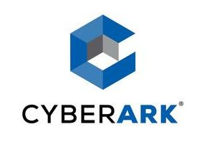
CyberArk Privileged Cloud
Cloud safes / AD group configuration and automation
Confluence documentation
Active Directory
  Domain Administrators, Server Administrators
    Review
    Assess
    Clean up
    Move to CyberArk – dedicated accounts, password rotated
HTML Gateway
  Game changer: frictionless access to Windows servers.
Notes:
Talk about the domain admins Server Admins much the same
– reviewed, trimmed down, created dedicated accounts, password rotated.
Confluence content – Rob
HTML GW: Provides a method connect to servers (on/off VPN) through a secured connection in Privileged Cloud through our Privileged Session Management servers. These provide auditing and recording of activity. Credentials are not exposed to the end user. We can virtualize applications as well – think ADUC.

Slide 12
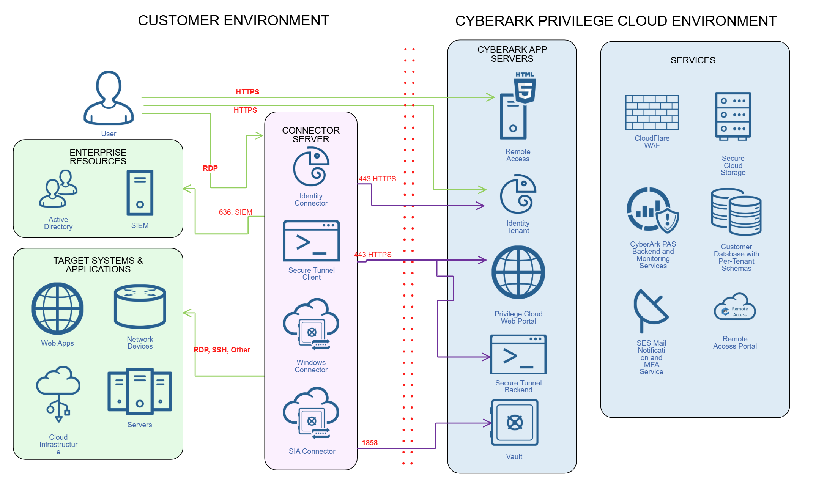
CyberArk Privileged Cloud Overview
Notes:
Deployment challenges

Slide 13
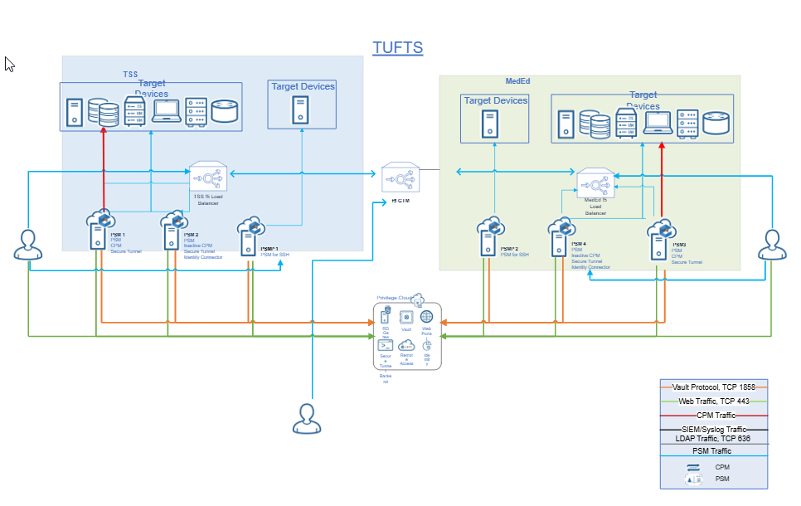
CyberArk at Tufts

Slide 14
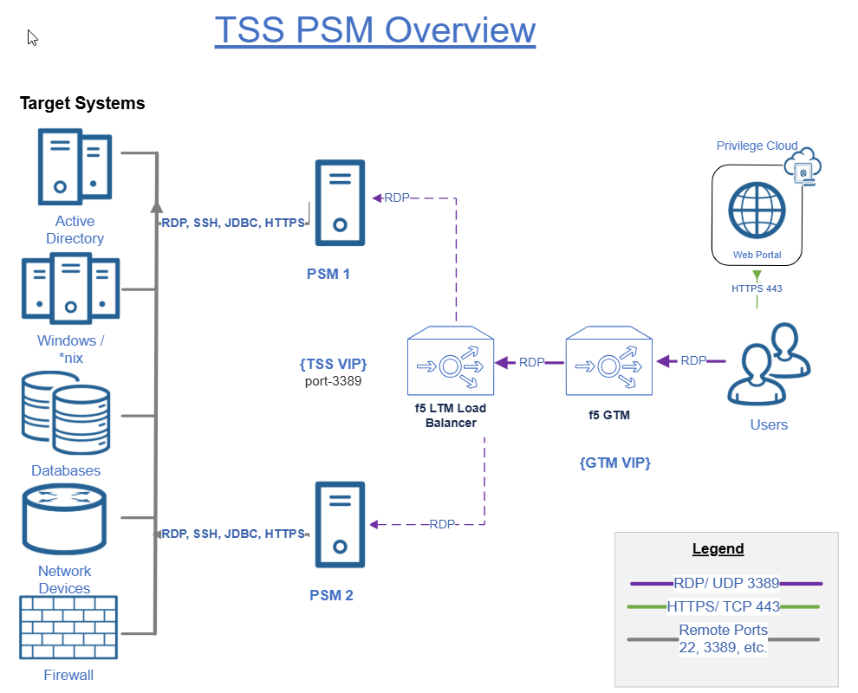
CyberArk Tufts PSM configuration
Privileged Session Manager (PSM)

Slide 15
Conjur Fundamentals
Variables – usernames/passwords/hostnames – the data you are trying to load
Workloads – the service principal to which access is granted
Authentication
API key
Platform Auth (AWS-IAM, Azure, GCP, k8s, etc.)
Notes:
Yaml deployment not intuitive.
Challenges with deploying secrets in a repeatable way (warts and all).
Makes is hard to get from project to program.
Does not solve the secret zero problem (no secret sauce)

Slide 16
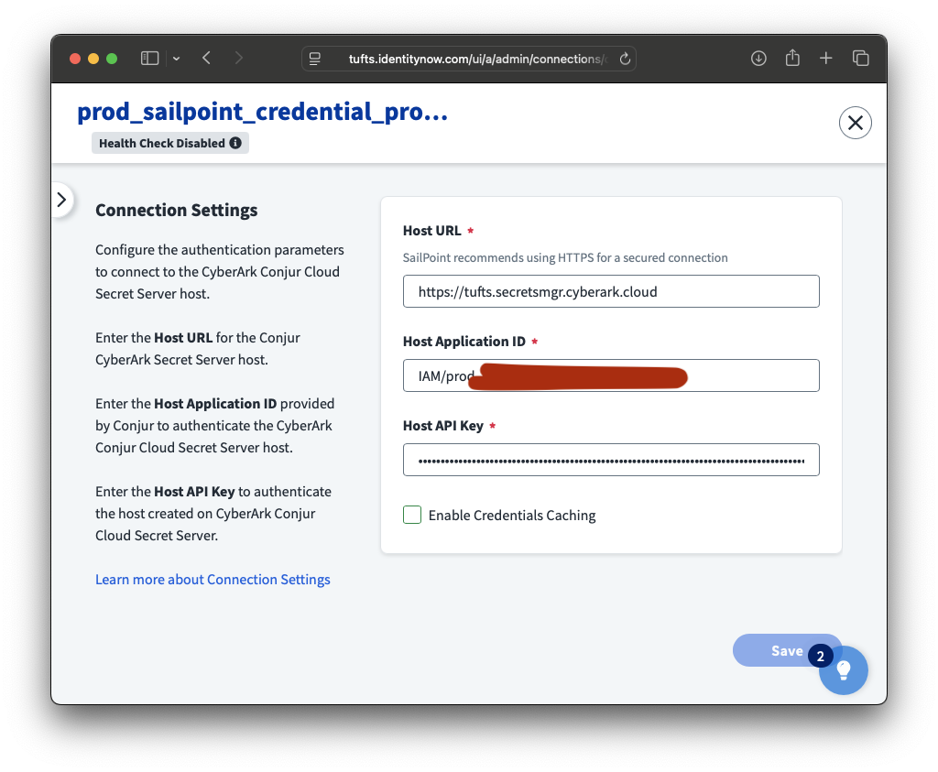
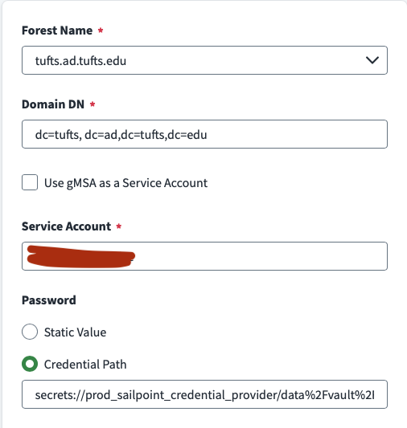
Retrieving Secrets
There are SDKs/Libraries for retrieving secrets with
Python
Java
Ruby
.NET
Go
Also be on the lookout for secret providers in SaaS solutions.

Slide 17

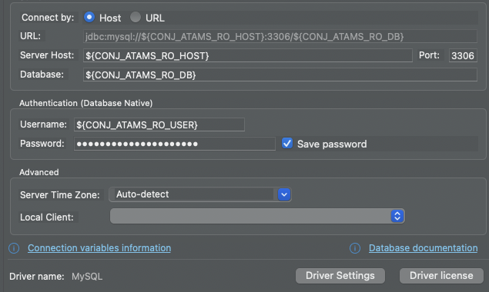
Conjur: Interesting Use Cases
DBeaver lets you reference ENV variables in your config. If you launch DBeaver with Summon, you can feed in Conjur-backed credentials.
This could open the door for rotating DB credentials more frequently than we currently do.

Slide 18
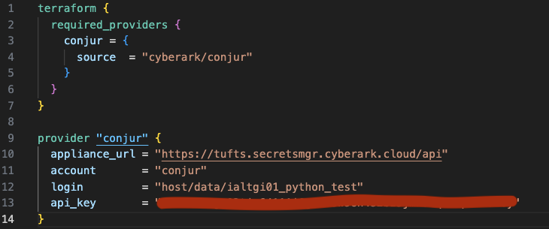
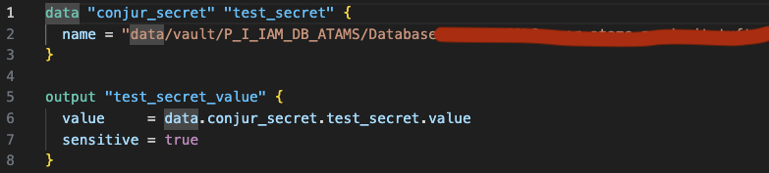

Conjur: Interesting Use Cases
Two options here:
Use Summon to call terraform, and use variables prepended with TF_VAR
Use Conjur Provider for a deeper integration
Be aware that secrets are still stored in your state files, but this helps to get them out of your manifests.

Slide 19
Microsoft PIM
PRIMARY GOALS
Securing the cloud: Our most extensively used cloud platform
Another technology powering our PAM program.
Privileged Identity Management (PIM) is a service in Microsoft Entra ID that enables management, control, and monitoring of access to resources in Microsoft Entra ID, Azure, and other Microsoft Online Services such as Microsoft 365 and Microsoft Intune
  https://learn.microsoft.com/en-us/entra/id-governance/privileged-identity-management/pim-configure
Secure highly privileged accounts
Remove standing elevated access
Easy adoption
Notes:
PIM lowers the attack surfaces and removes standing privileges.

Slide 20
How do we get there?
IMPROVE SECURITY
* “Cloud-only” accounts for highly privileged roles.
AUDIT
* Periodic review of permissions based on monitoring data.
LIMIT ACCESS
* Permissions applied to groups, not user accounts.
* Keep it simple
* Don’t interrupt operations
*Meaningful changes
ADOPTION
​* Microsoft MFA required for all roles.
* Management of group ownership/membership.
* Elevated roles are applied via checkout.
* Appropriate privileges are made available based on role.
* Reduce privileges on service accounts, service principals.

Slide 21
Wins
GLOBAL ADMIN
* Human user accounts 100% handled by PIM
STANDING ACCESS
* Azure roles are PIM managed, assigned to groups.
AUDITING
* GA and Security Administrator notifications
* PIM groups and Service Principals with elevated rights included in monthly audit
* Several service accounts and SPNs removed
* Global Administrator “break-glass account”
*Approval required
* Elevated access must be activated for use.
Notes:
We have seen a drop in the frequency of usage of elevated roles. We have seen users leveraging more appropriate / needed role level rather than seeking a higher privileged role.

Slide 22
RECAP: PAM Program achievements to date
DUO: Improvement of security posture with our Duo 2FA service
    Risk-based authentication (RBA).
    Controls around Admins.
CyberArk:
  securing highest privileged access: Domain Admins, Server Admins,
MS PIM
  Securing the cloud (Azure/M365)

Slide 23
Key Takeaways
Take time to design the program/approach
There is no silver bullet
Adoption is the biggest challenge.
  Find way to enhance user experience
  Remove friction where possible
If you haven’t implemented PIM do it now
Duo has some substantial new improvements – lean in

Slide 24


