Slide 1
GitLeaks
Sifting through trash for fun and profit
By Alexan Mardigian

Slide 2
table of contents
03.
The Solution
01.
Introduction
04.
???
02.
the problem
05.
Profit!
We’ll find them with GitLeaks!
I will show you how…
Book learnin’, experience, and
a controversial(?) opinion…
Questions? Comments? Degrogatory statements? (j/k)
Fabergé eggs? In my trash?
$$$
Notes:
Anyone not familiar with Faberge eggs? What’s a Faberge egg? A Fabergé egg is a highly ornate, jeweled Easter egg created by the House of Fabergé, a Russian jewelry firm, primarily for the Russian Tsars between 1885 and 1917. These eggs are famous for their intricate craftsmanship, luxurious materials, and often contain hidden surprises or miniatures inside. Highly valuable.

Slide 3

Introduction
Info Sec Enginner
Education
Hobbies
Been working for the InfoSec Team since March 2, 2020.
I write a lots of tools and APIs.
Snorkeling, Scuba diving, DJing, 3D printing, Fishing, WH-40K, off-grid solar, and of course writing software
- Computer Engineering at NEU in 2009
- CISSP since July 2023
- Current CS grad student at BU
[with a focus in cyber security]
Notes:
Now you’re probably wondering: who are you and what are doing here?

Slide 4
Introduction
Info Sec Enginner
Education
Hobbies
https://github.com/Techno-Hwizrdry
https://sketchfab.com/alexxxan
https://printables.com/@PolygonDesire_263991
Code and Meshes
Been working for the InfoSec Team since March 2, 2020.
I write a lots of tools and APIs.
Snorkeling, Scuba diving, DJing, 3D printing, Fishing, WH-40K, off-grid solar, and of course writing software
- Computer Engineering at NEU in 2009
- CISSP since July 2023
- Current CS grad student at BU

Slide 5

Disclaimer
Columbo.JPG .exe
This talk is for educational purposes only. Whatever you do with this knowledge is on you, not me or Boston University. So, don’t do anything illegal or unethical. My opinions are mine alone, and do not necessarily reflect those of my colleagues or Boston University as a whole.
Notes:
Ah, just one more thing before we begin… (READ THE SLIDE OUT LOUD) Ok, here’s my controversial opinion: All code bases eventually decay into trash. Some faster than others. For example, secrets hard coded into your source code. Not only has the code base been instantly turned into trash, but it’s trash with Fabergé eggs in it. What’s a Faberge egg? A Fabergé egg is a highly ornate, jeweled egg created by the House of Fabergé, a Russian jewelry firm, primarily for the Russian Tsars between 1885 and 1917. These eggs are famous for their intricate craftsmanship, luxurious materials, and often contain hidden surprises or miniatures inside. Highly valuable.

Slide 6
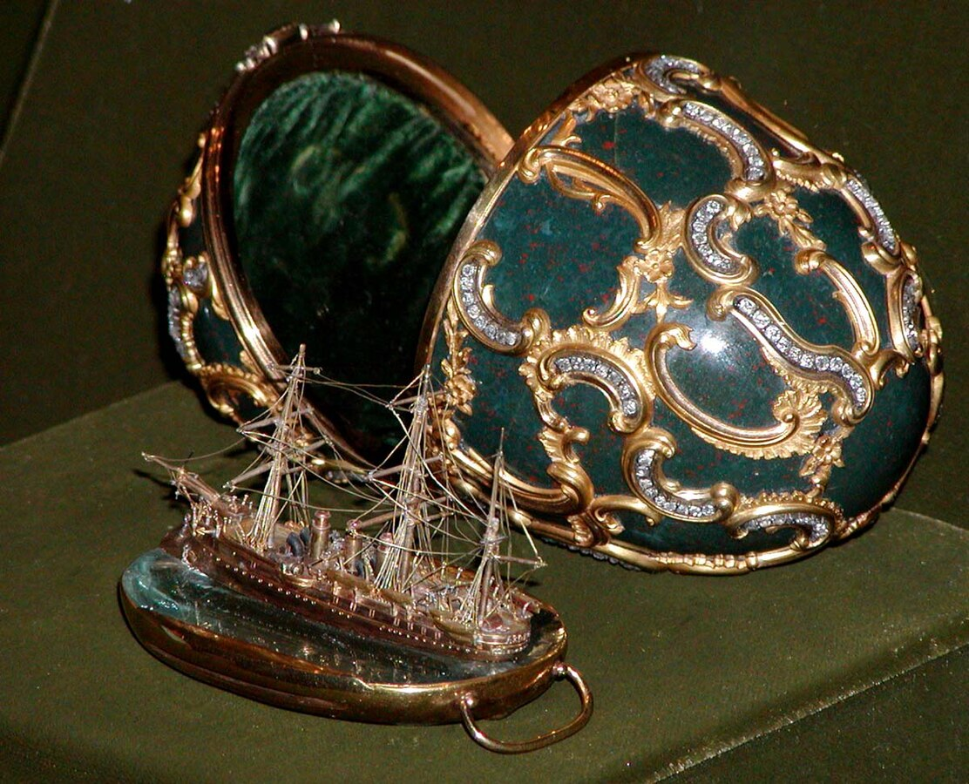

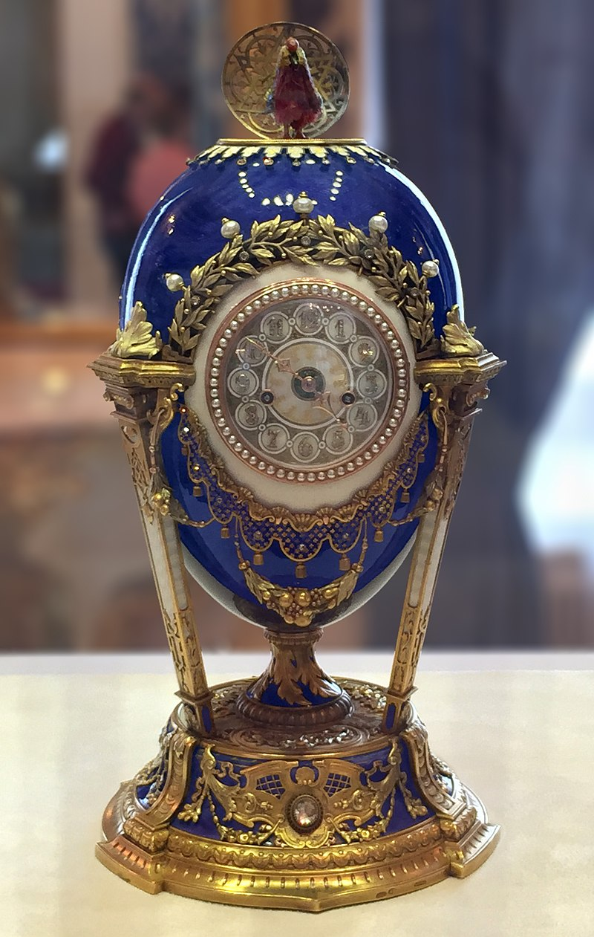
The Problem
I gotta find out if there’s any secrets hardcoded in a git repo
Notes:
Bottom left: Cockerel 1900
Top right: Rock Crystal 1896
To middle: Memory of Azov 1891

Slide 7
The Problem
So, what do I do?
Why?

Slide 8

The Problem
So, what do I do?
I rearrange ones and zeros.
Cause the trash business is a gold mine!

Slide 9
The Problem
So, what do I do?
I rearrange ones and zeros.
Cause the trash business is a gold mine!
But Seriously…

Slide 10
Login credentials, API keys, secret tokens, etc. can be in hardcoded into source code.
Notes:
Usually via “honest mistake”. But sometimes via malice.

Slide 11
Login credentials, API keys, secret tokens, etc. can be in hardcoded into source code.
Also, anything you commit will persist in the commit history of a repo. Including secrets hardcoded into the source code.

Slide 12
Login credentials, API keys, secret tokens, etc. can be in hardcoded into source code.
Also, anything you commit will persist in the commit history of a repo. Including secrets hardcoded into the source code. Even if the offending file was corrected or removed from the repo.
Notes:
You’ll have to scrub the git commit history of any secrets. BFG is a tool to help with this task, but that’s not what this talk is about.

Slide 13
Login credentials, API keys, secret tokens, etc. can be in hardcoded into source code.
Also, anything you commit will persist in the commit history of a repo. Including secrets hardcoded into the source code. Even if the offending file was corrected or removed from the repo.
The .gitignore file can only prevent the files listed in it from being committed.
Notes:
The best practice for separating secrets from your code is to: use a config file, list that config file in the .gitignore file, and commit an example config file filled with dummy data.
However, hard coded secrets can still get into your code base and get committed. Via incompetence or malevolence.

Slide 14
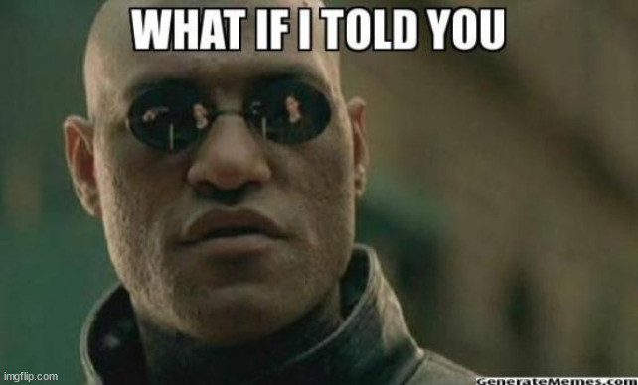
Notes:
But what if I told you…

Slide 15
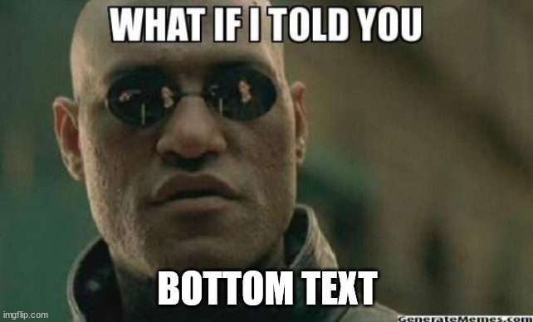
Notes:
We can not only scan a repo for hard-coded secrets, but we can also take further steps to prevent secrets from being committed in the first place.

Slide 16
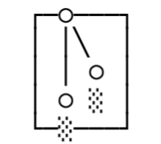
The Solution
GitLeaks
https://gitleaks.io
Notes:
Enter GitLeaks. It’s a free and open source (MIT licensed) secret scanner, written in Go. You can use it to scan git repositories, files, directories, and standard-input.

Slide 17
The Solution
GitLeaks
Install Options
#MacOS
brew install gitleaks
# From source
git clone https://github.com/gitleaks/gitleaks.git
cd gitleaks
make build
Notes:
You can download and install it via Brew for MacOS.
Or clone and install from source. Just make sure you have the Go compiler installed.
There are Docker images available too.

Slide 18
The Solution
GitLeaks
Anatomy of a Gitleaks command
./gitleaks [command] [flags] [file path]

Slide 19
The Solution
GitLeaks
# Everything is committed
cd my_project/
gitleaks detect .
gitleaks detect -v .
gitleaks detect . --report-path report.json
gitleaks detect . --report-format csv --report-path report.csv
# Not in a Git repo at all
cd my_project_thats_not_in_git/
gitleaks detect --no-git .
Notes:
-v, --verbose means: be verbose; show the details of secrets committed in your git repo
You can export your scan results to a text file. The default file format is JSON, but you can specify other file formats, such as .csv.

Slide 20
The Solution
GitLeaks
Commands
detect – scan repos, directories, and files
protect – scan uncommitted changes in a git repo
stdin – detect secrets from stdin
Notes:
These are the three commands that you’ll most likely use, when using gitleaks to sift for secrets.

Slide 21

The Solution
GitLeaks
Billy_Mays.PNG
https://gitleaks.io
Notes:
But wait, there’s more!
You can also use GitLeaks to “shift security left”, as a pre-commit hook in your local development environment.
Also, as a last line of defense in your CI/CD pipeline, there is Gitleaks-Action, which is the official Gitleaks GitHub Action. You can use that to automatically run a GitLeaks scan on all your team's pull requests and commits, or run on-demand scans.

Slide 22
The Solution
GitLeaks
Pre-commit-config
# Make sure pre-commit is installed
pip install pre-commit
# Create .pre-commit-config.yaml at root of your repo
touch .pre-commit
# Add the following to it
repos:
- repo: https://github.com/gitleaks/gitleaks
rev: v8.24.2
hooks:
- id: gitleaks
pre-commit autoupdate && pre-commit install # And then you’re done!
Billy_Mays.PNG
https://gitleaks.io
Notes:
With this pre-commit-config, we can automate the process of detecting secrets before they’re checked-in in your local repo.
The ‘pre-commit’ tool allows management of this config across the machines of each developer on the team (if you’re in one). But, what if a team mate does not update their pre-commit hook file and checks-in a secret? You could run gitleaks detect on your remote repo when ever code is checked in. And it could be configured via various continuous integration tools. Or…..

Slide 23
The Solution
GitLeaks
GitLeaks GitHub Action
https://github.com/gitleaks/gitleaks-action
You can schedule automated GitLeaks scans for pull requests and commits.
Or initiate manual scans on demand.
No license key is required for personal GitHub accounts.
But they are required for repos that belong to a GitHub organization. (And they’re free [as in $0]).
Billy_Mays.PNG
https://gitleaks.io
Notes:
…You could use The Gitleaks GitHub Action as a last line of defense, for your continuous integration process. That is if you’re using GitHub.

Slide 24
Any Questions?
FINISHED!

Slide 25
Thank you!
Alexan Mardigian
Information Security Engineer
amardigi@bu.edu
FINISHED!

