Slide 1
Phishing-Resistant MFA: Worth Your Time Reid Gilman

Slide 2
Agenda
Attackers Are Bypassing MFA
What Is Phishing-resistant MFA?
Un-Phishable
“Gold Standard of Authentication”
Why Should You Care?
Remote Account Takeovers
MFA Fatigue
Better User Experience
That Seems Like A Big Change, How Can We Do It?
Start Small
It’s a Journey
“I urge every CEO to ensure that FIDO authentication is on their organization’s MFA implementation roadmap. FIDO is the gold standard. Go for the gold.”
- CISA Director Jen Easterly

Slide 3
Attackers Are Bypassing MFA
Credentials + MFA
Credentials + MFA
Session Token
Session Token
Legitimate User
Phishing Site / Transparent Proxy
Real Website
Session Token
Session Token
Attacker

Slide 4
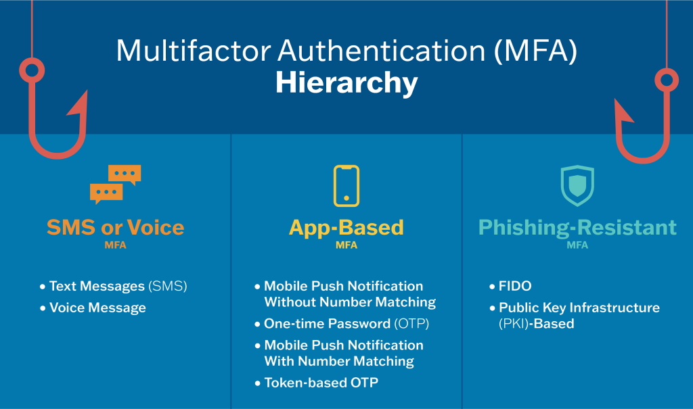
CISA’s MFA Hierarchy
Notes:
https://www.cisa.gov/MFA

Slide 5
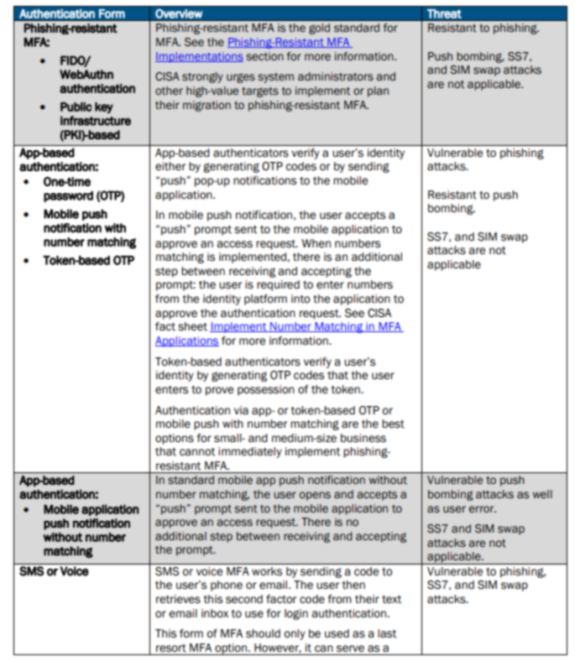
Phishing-Resistant MFA
Resistant to phishing tactics
MFA Fatigue [T1621]
AitM (evilginx) [T1557]
SIM Swap & SS7
FIDO2
Widely supported
Intended for end-users
PKI
Less widely supported
Scares end users
Graphic: https://www.cisa.gov/sites/default/files/publications/fact-sheet-implementing-phishing-resistant-mfa-508c.pdf
Notes:
https://www.cisa.gov/sites/default/files/publications/fact-sheet-implementing-phishing-resistant-mfa-508c.pdf

Slide 6
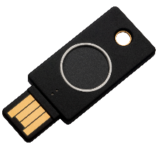
FIDO? Passkeys?
FIDO: Fast Identity Online
Authentication Standard
Often used interchangeably with “Passkeys”
Passkey: A password replacement based on FIDO
Public-key cryptography
Always unique, always strong
Device-bound
Synced or roaming
Passkeys are passwordless
Passkeys replace password + SMS/push
Notes:
https://fidoalliance.org/faqs/#PasskeysFAQs

Slide 7
Passkeys and Hardware Authenticators
Device-bound Passkeys | Synced Passkeys
Only exist on one device | Shareable across devices
Hardware-protected | Software-protected
No recovery process | Some vendors offer recovery
Highest security | Trades some security for usability
Various formfactors (built-in, USB, phone) | Implemented in software
Widest support | Not all vendors support
Most control | Less control
Best suited for enterprise environments | Less suited for enterprise environments

Slide 8
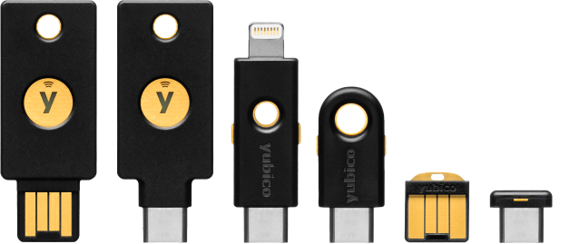
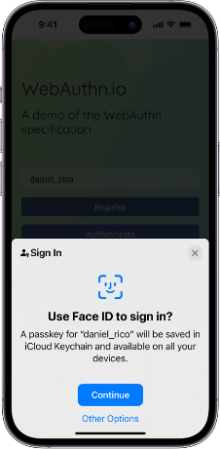
Device-bound Passkey Formfactors
Hardware Token
(Yubikey pictured)
Phone (not synced)
TPM (Windows Hello)

Slide 9
Combining Factors
Something You Have
Trusted Device
YubiKey
Something You Know/Are
PIN
Biometric
Phone

Slide 10
Who?
Privileged Identities:
Entra & other IdP admins
Password Vault admins
Azure, AWS, GCP admins
High Risk Users
Executives
HR / Finance
IT
Everyone?

Slide 11
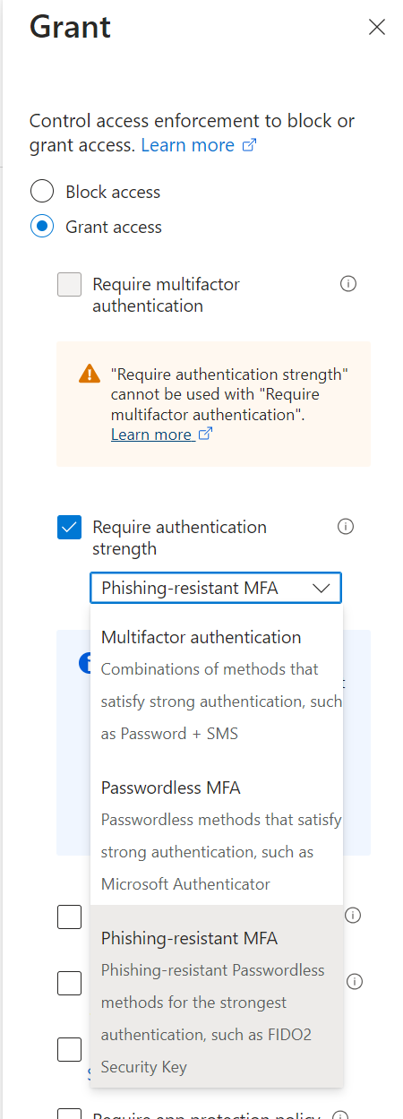
How?
Your MFA provider probably supports FIDO2
Entra (a.k.a. Azure Active Directory)
Native support in Conditional Access
Target by role, group, or app
Hardware tokens or Authenticator App
Passwordless experience

Slide 12
Getting Started
Start Small
Privileged IT users
Power users
Expect Some Bumps
Learning curve
Someone will lose their authenticator
Expect Incredulity
“This is easier and more secure?”
Leverage Vendor Relationships
You’re not the first organization doing this

Slide 13
Common Issues
RDP & VDI
Redirection supported over RDP*
“What If I Lose My Authenticator?”
YubiKeys: at least two
Device-bound Passkeys on iOS & Android
Break Glass Accounts
Change Is Scary
Phased Rollout
Test Period
“This Tool I Need Doesn’t Support FIDO2”
Self-service temporary exception process

Slide 14
In Conclusion
Attackers Are Bypassing MFA
What Is Phishing-resistant MFA?
Stronger
Easier to use
Why Should You Care?
Protect Privileged Identities
Improve user experience
That Seems Like A Big Change, How Can We Do It?
Start small
It’s a journey
Expect some bumps
“I urge every CEO to ensure that FIDO authentication is on their organization’s MFA implementation roadmap. FIDO is the gold standard. Go for the gold.”
- CISA Director Jen Easterly

Slide 15
Questions?

