Slide 1
A “Functional” Approach to Tabletop Exercises

Slide 2
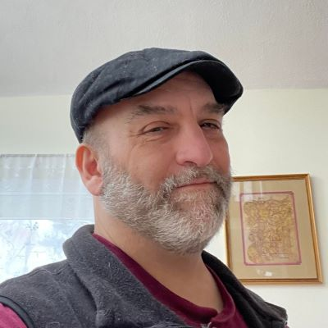
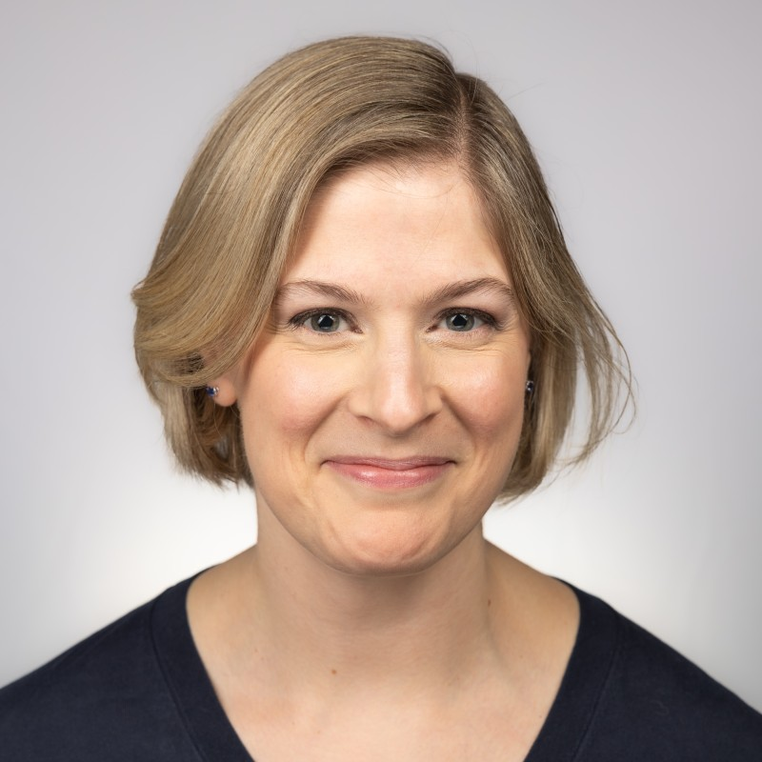
ABOUT US
Adam Scaramella
Data Privacy and Information Security Analyst at Harvard Business School
Ingrid Skoog
Data Privacy and Infosec Officer for Harvard Faculty and Staff

Slide 3
Agenda
Inspiration and Approach
Creating a Scenario
Preparing for the Event
Our First TTX
Takeaways and Tips

Slide 4


Inspiration
Stephen Safranek
Chief Information Security Officer at
West Chester University
Security Consultant with
K & J Safety and Security Consulting
https://www.linkedin.com/in/stephen-safranek-5812159a/
image generated by DALL-E
Notes:
A lot of people think of tabletop exercises as an executive function. A group of organizational leaders come together prepared to talk about a potential scenario.
Maybe they have a consultant come in.
At the 2022 EDUCause SPC conference, we had the opportunity to participate in a half-day workshop led by Stephen Safranek.

Slide 5
A broader approach
“A random Tuesday”
A diverse group of staff, including the “do-ers”
An evolving scenario
Notes:
Scenario is planned by members of the facilitation team; leadership has limited or no prior knowledge of event.
Especially the ones who will participate in the exercise.

Slide 6
Creating the Scenario

Slide 7
“A Random Tuesday”
Realistic
The Scenario
should be
Challenging
Relevant
Relatable
Be Mindful of your Audience!!!
Notes:
The scenario needs to be something which could theoretically happen but may not be something which people expect. The goal is to discuss the scenario in a low-stress, no fault environment to see where your plans were sufficient, and where they were lacking or could use improvement. Do you have an amazing playbook for a scenario…that no one knows exist?
Perspective: Anecdotes
FAS: A classroom discussion involved China being portrayed in a negative light, some participants were Chinese
HBS: An HBS faculty member conducted a case study during an HBS IT all-staff meeting. The topic was regarding a company which was considering out-sourcing their network team.

Slide 8
Preparation

Slide 9
Organizing
TTX Facilitation Team
Leadership
Creates scenario
Facilitates sessions
Participants
Approves effort
Supports participation
Consider perspective and experience.
Diversity across expertise & function
Size: 2+X
Groups of 4 or 6
Notes:
Facilitation Team Size: 2 plus the number of participation groups, 1 to run session, 1 for support
Group Size: 4-5 for online, 6-8 for in-person.
Leadership needs to support (or direct) managers to support team members being fully engaged in the exercise for the full 3.5 hours.

Slide 10
In-Person, Hybrid, or Online ?
In-Person
Online
Hybrid
Notes:
The recommended approach is always going to be to have everyone in person.
Less distraction
Ability to move people around between groups
Easier to ensure people are able to engage
Cross-table talk!
While Hybrid seems like it might be a good choice, it presents some challenges.
Remote parties often have difficulty engaging when in-person conversation is ongoing
Might lead to consolidation of expertise and experience.

Slide 11
Prior to Event
Communication with participants
No prep work ahead of time
Open mind
“Don’t fight the scenario”
Presentation
Power Point for Display
Feedback Mechanisms
Tools for collecting Discussion
During Event
Polls
Encourage contact
Thank you email
Be Present
Notes:
“Don’t fight the scenario” – It’s important to stress that a participant may believe that the scenario couldn’t happen. For example, perhaps they about a control in place which should prevent it. Our approach to this is to suggest to them that if they do believe this…to flip that thought, and think about what would happen if it did? What would happen if that control failed? What could cause it?

Slide 12
Our first TTXs

Slide 13
Basic Flow
Welcome
Agenda
Module
Provide participants with basic information about what’s happening.
Group Discussion
Participants move into groups to discuss.
Expectations
Guidelines
Resources
Provided with some questions to help guide conversation
Readout and Discussion
Each group presents
Debrief
Lessons learned, successes and opportunities
Discussion
Repeat through 3 modules
Notes:
Very important to do debrief during session while people are present and engaged.

Slide 14
Scenario: HUIT’s 1st TTX
A visiting professor is invited to give a presentation at Harvard. His theories are considered to be controversial by some groups.
An elite hacktivist group posts that they will make Harvard pay for giving him a platform.

Slide 15
The Exercise
Initial Response & Preparation
Development:
Website defacement
Groups discuss:
Development: Email Campaign
Email campaign designed to generate sympathy.
Groups discuss:
Lessons Learned
Session Debrief
Proactive actions
Likely potential threat vectors
How to classify
Actions to take
What comms need to occur?
Areas of Success
Areas of Improvement
Potential comms
Who to engage?
Notes:
During the third inject, we attempted to add a curveball midway through their discussion. The links on the email led to a website which wasn’t centrally managed, and likely held sensitive research data.
However, not all of the groups saw the message.
Debrief:
Important to have DURING the session.
Important to ensure that we call out successes as well as opportunities.
Both for the session itself and for the response plan.

Slide 16
Scenario: HBS’s 1st TTX
A member of the team who supports the campus’s Learning Management System is compromised.
A week into the new semester, students begin reporting bad links and missing content.

Slide 17
The Exercise
8:30 AM
12:00 PM
Discuss info gathered
3:00 PM
What are key priorities?
Lessons Learned
Debrief
Areas of Success
Areas of Improvement
Platform is being defaced
XLSX file with student PI is noticed in download section.
What info is needed?
Who is involved?
Who would be informed?
More info needed? (What/Where?)
Who else to engage/advise?
Surprise phishing attack!
Online survey was also made available for post-session comments
Notes:
12:00 Groups are provided with information they would discover in the next 3 hours.

Slide 18
Takeaways &
Lessons Learned

Slide 19
Wins
Discussions provide a level of awareness and training for many participants
Confidence built in many processes which may not have been tested
Updates suggested for documents and procedures
Sense of inclusion
Opportunity to engage with new individuals and groups
Success of Program
  HUIT: Quarterly
  HBS: Bi-annual
  Other groups looking to leverage this process

Slide 20
Challenges / Opportunities
Resistance
  Managers reluctant to release important staff for 3-4 hours
    Proactively worked with functional managers to ensure coverage
  Participants have a natural tendency to resist the scenario
    Encouraged them not to fight the scenario
    Reminded them that the goal is not to “win”
  Senior Leadership reluctant to relinquish control / input
    Met them halfway for the first scenario

Slide 21
Guidance for TTX Planning
Be mindful of the scenario…don’t be tone-deaf to the potential participants.
For online sessions, ensure you have a someone on the facilitation team to handle technical issues.
Format to use for breakout teams to take notes?
  Ideally, avoid tools which allow groups to see each other’s comments. This often impacts creative thinking.
  Word is easy, and allows multiple editors
  Miro boards are being considered

Slide 22
Guidance for Facilitators
Take a moment at the beginning for everyone to introduce themselves (Name, role, years in the organization)
“Require” rotation of note-taker and presenter
Keep an eye / ear out for
  Individuals who may not be contributing. Especially if there are very vocal people in the group. It’s a good idea to ask them if they have any thoughts.
  “Rabbit Holes”. People in IT are often “wired” to solve the problem. If they are getting too focused on the details or creating a solution, guide them back to the main topic.
Private chat channel

Slide 23
Guidance for Participants
Encourage this as a safe space.
  We want to honestly and informally explore a scenario.
  Especially for junior members. Let them know that expressing lack of knowledge makes the exercise more valuable.
Treat the scenario as a real event.
This is not a "we need to win this“ exercise.
  The goal is to examine what worked and what didn’t.
Avoid unnecessary interruptions. Be present for this exercise.

Slide 24
THANK YOU!
Ingrid Skoog
Ingrid_skoog@harvard.edu
Adam Scaramella
ascaramella@hbs.edu

