Slide 1
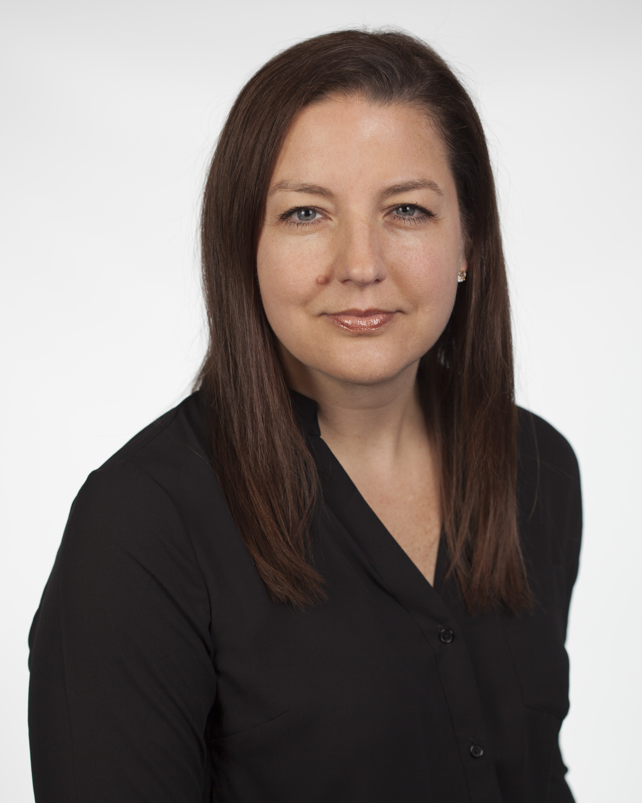
Security is Everyone’s Business
Joanna Huisman
SVP – Strategic Insights & Research
KnowBe4, Inc.

Slide 2

Joanna Huisman
SVP – Strategic Insights & Research

Slide 3
That moment when you ask,
“What’s the worst that could happen?”
Image Credit: Universal Studios, 2019

Slide 4
Agenda
The Threat Landscape
Phishing benchmark data by industry
Your Security Culture & “Human Firewall”

Slide 5
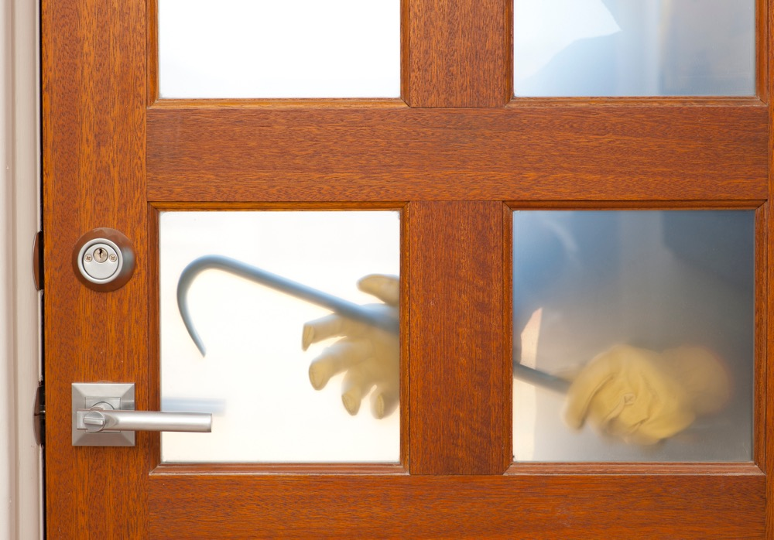
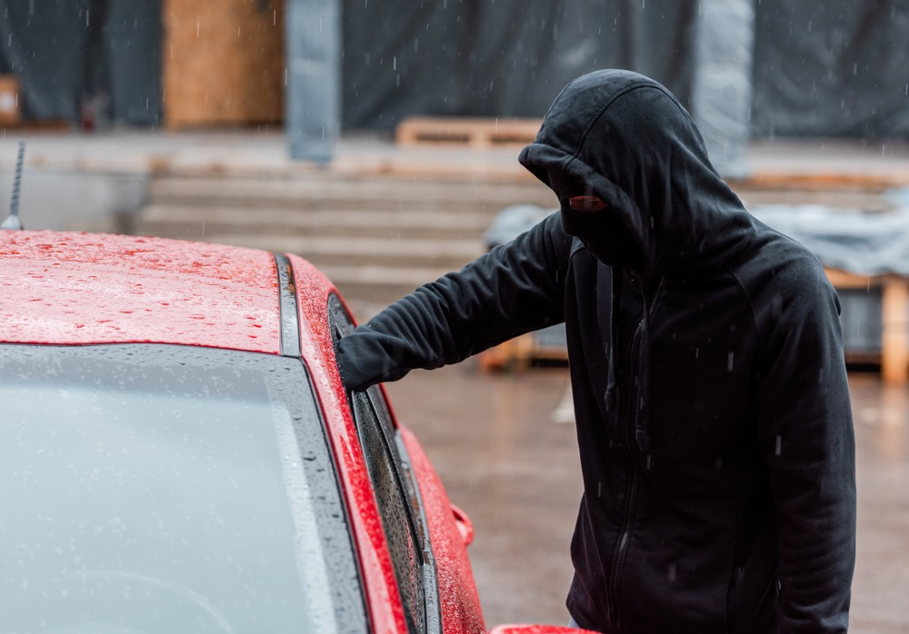
If you discovered burglaries were occurring
in your neighborhood,
what would you do to protect your home?
Notes:
Consider if in your neighborhood there was a string of break-ins & burglaries
What steps would you take – cameras, lights, security monitoring - protect your home!
Companies getting breached – what steps you can take

Slide 6
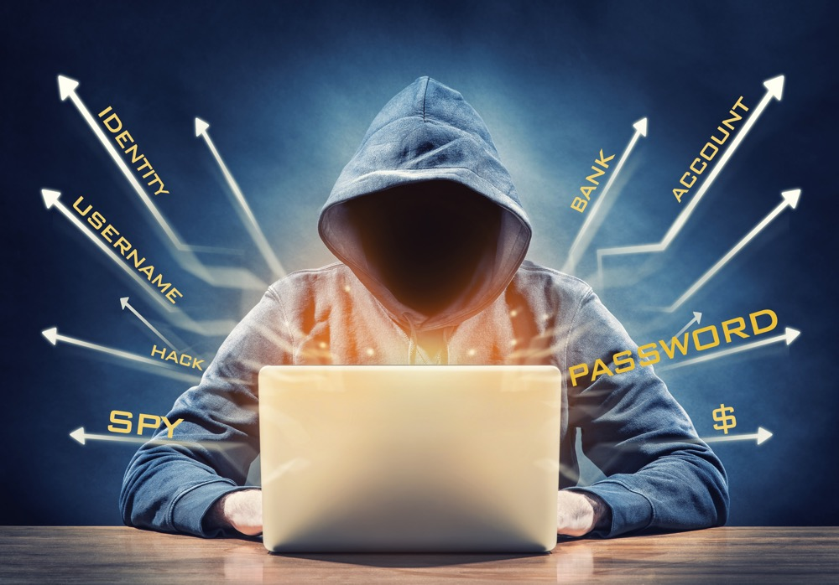
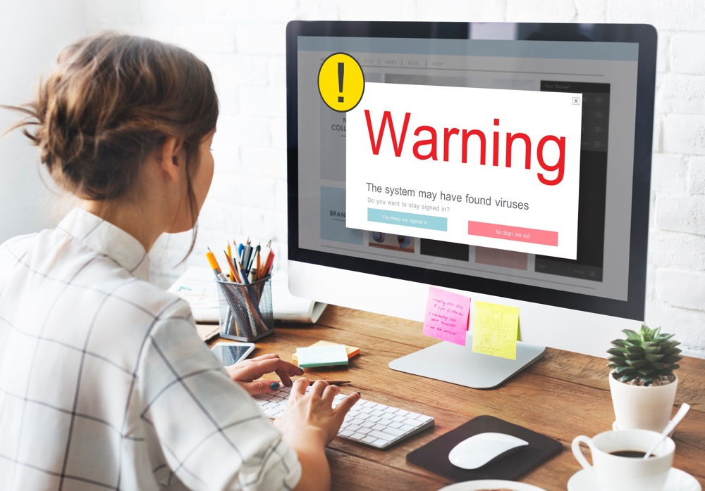
If you discovered cybercriminals were stealing data from other organizations, what would you do to protect your organization?
Notes:
Consider if in your neighborhood there was a string of break-ins & burglaries
What steps would you take – cameras, lights, security monitoring - protect your home!
Companies getting breached – what steps you can take

Slide 7


The Threat Landscape is
All of Us
All the Time
Everywhere
In All Contexts of Life

Slide 8
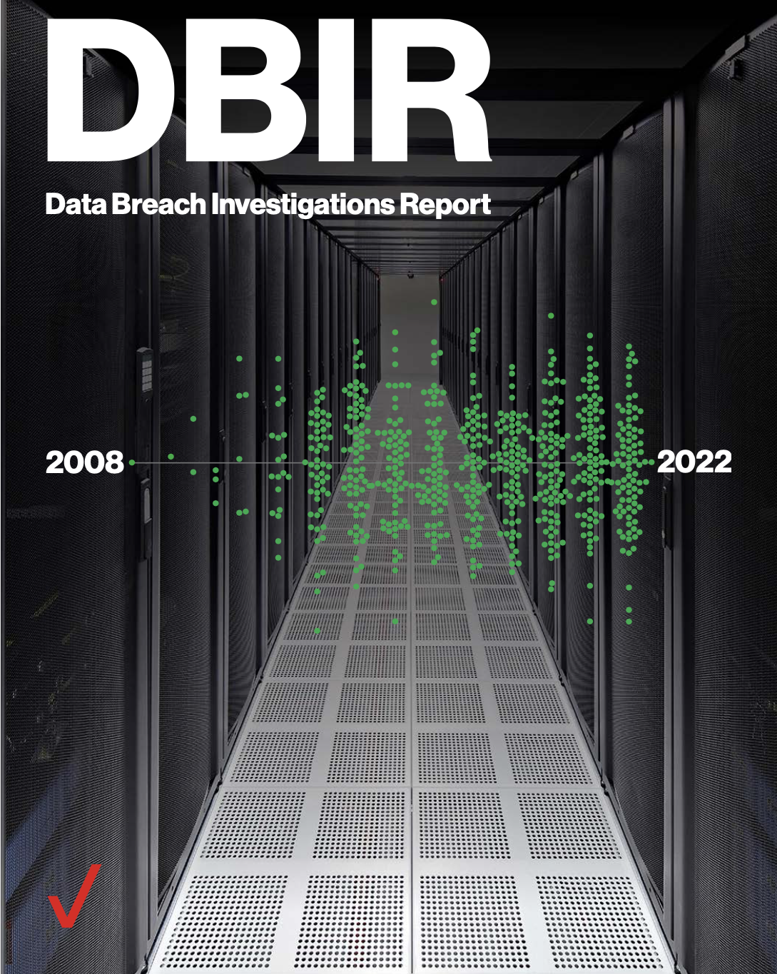
Cybercriminals rely on phishing because it continues to work…
Verizon’s 2022 Data Breach Investigations Report states that “the human element continues to drive breaches.”
“This year, 82% of breaches involved the human element. Whether it is the use of stolen credentials, phishing, misuse or simply error, people continue to play a very large role in incidents and breaches alike.”.”

Slide 9
Agenda
The Threat Landscape
Phishing benchmark data by industry
Your Security Culture & “Human Firewall”

Slide 10
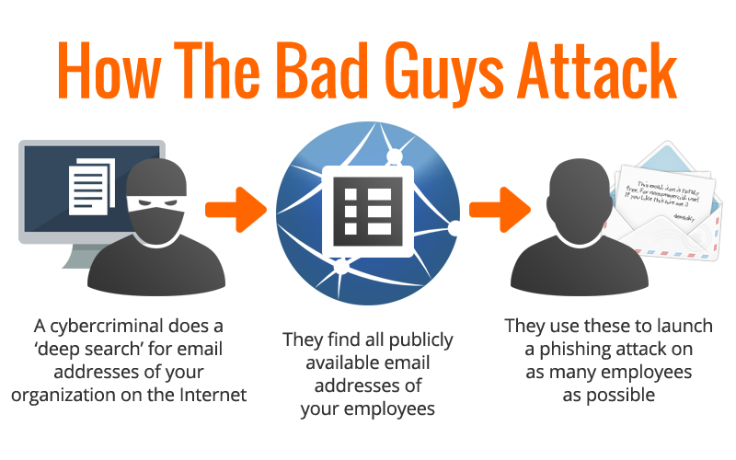

Slide 11
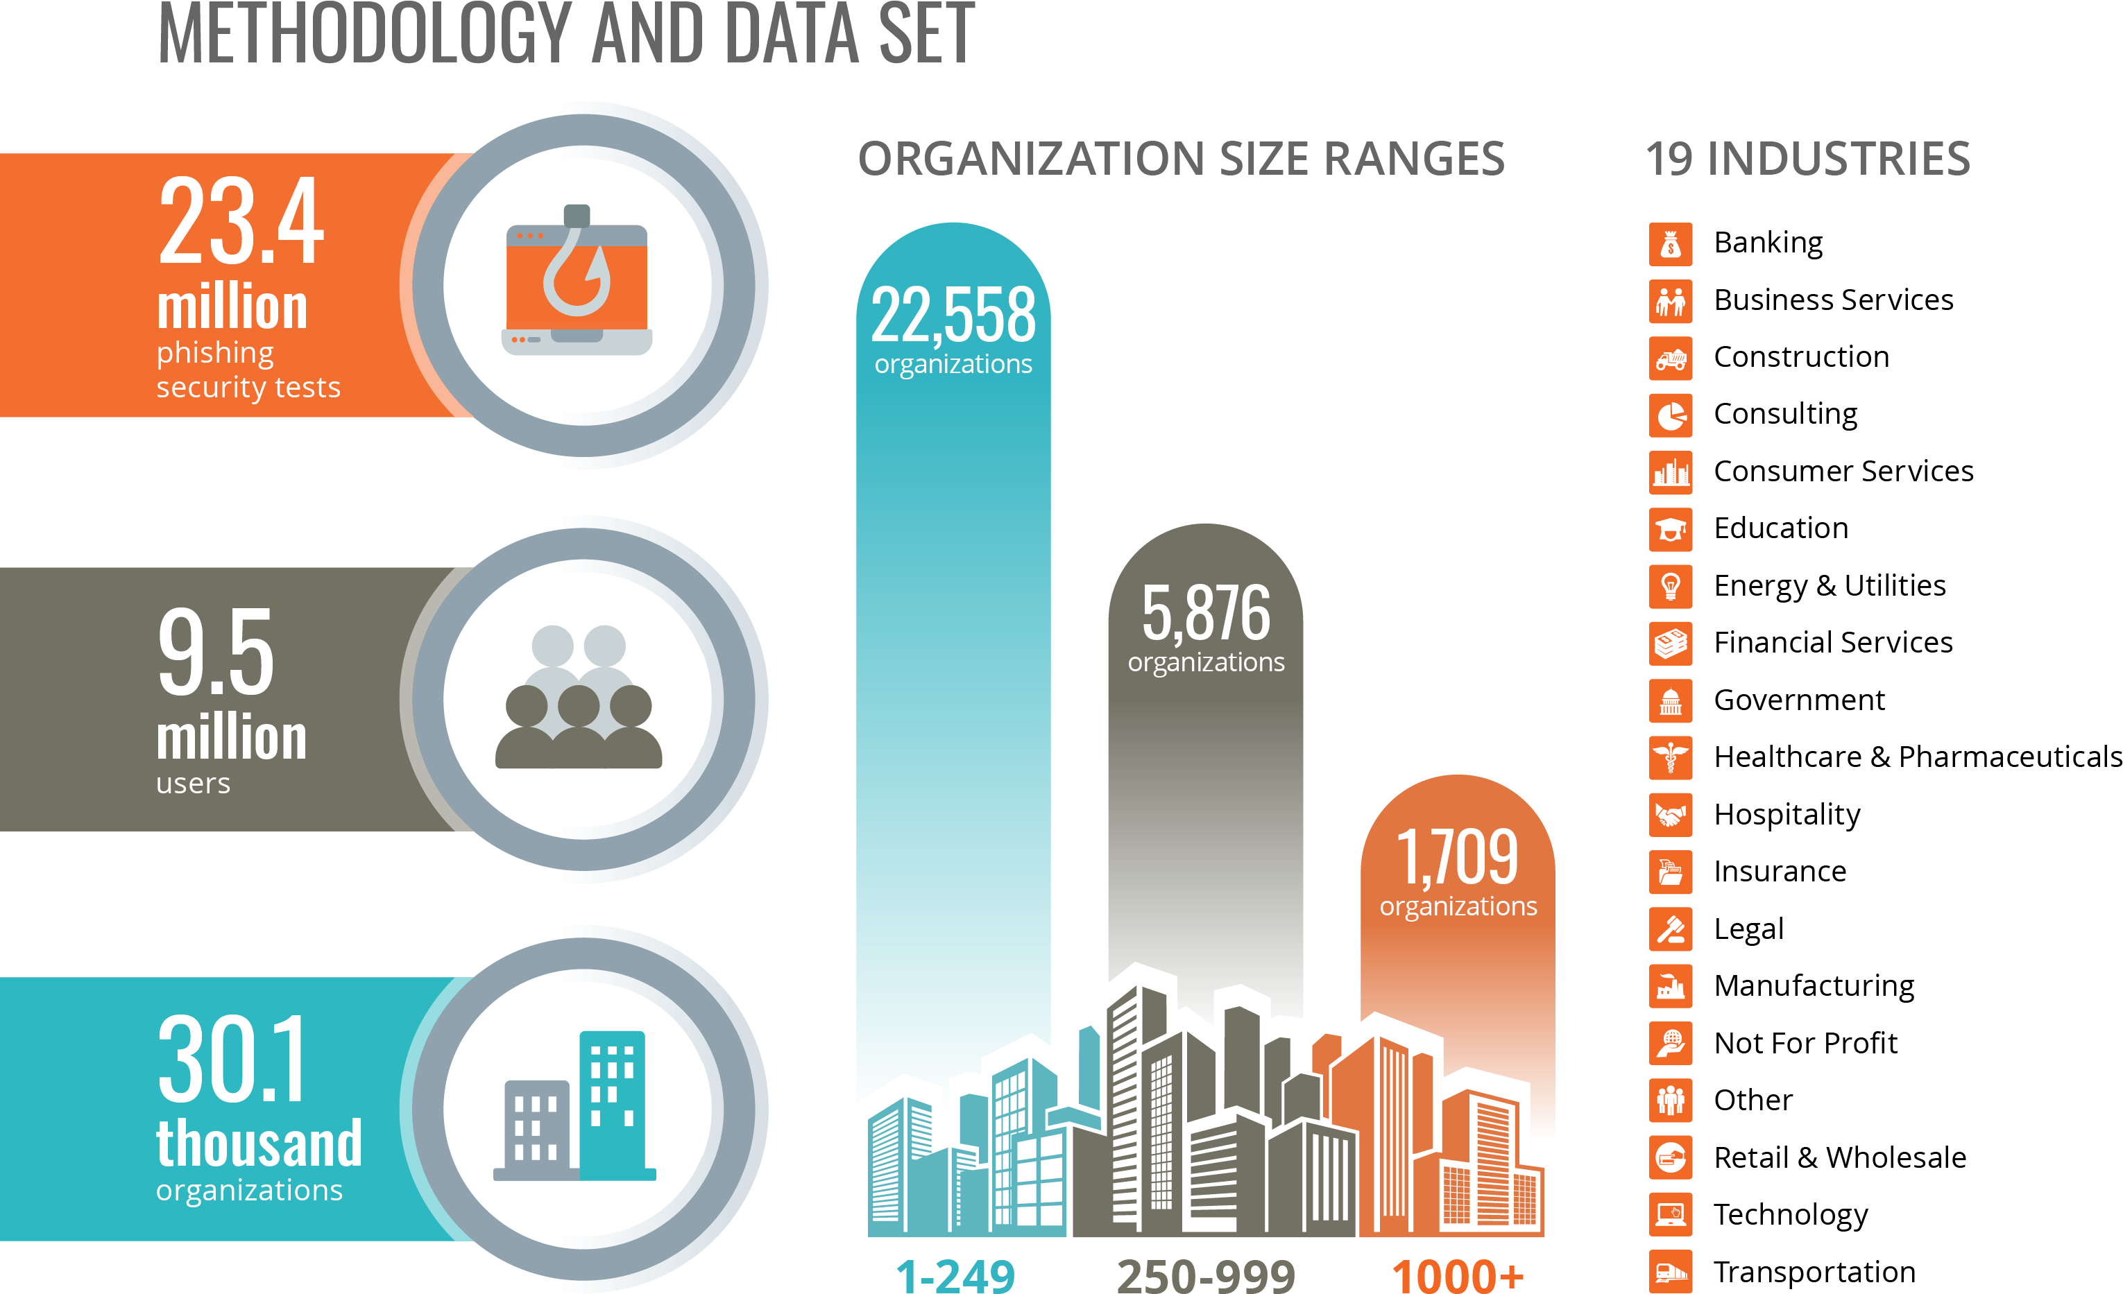
All 23,400 customers were using the KnowBe4 platform according to the recommended best practices for a new-school security awareness approach:
Running an initial baseline test
Training their users through realistic on-demand, interactive training
Frequent simulated testing at least once a month to reinforce the training

Slide 12
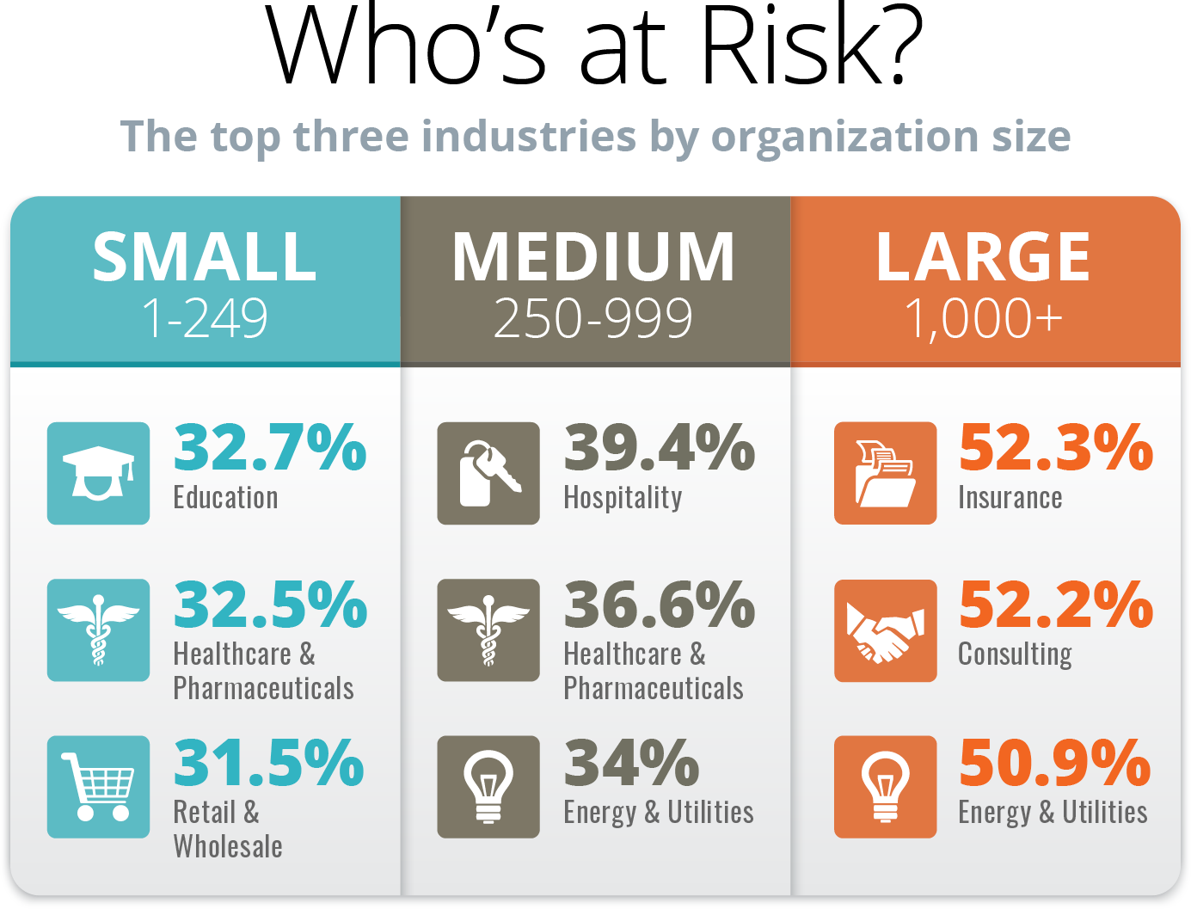
RISKY BUSINESS

Slide 13
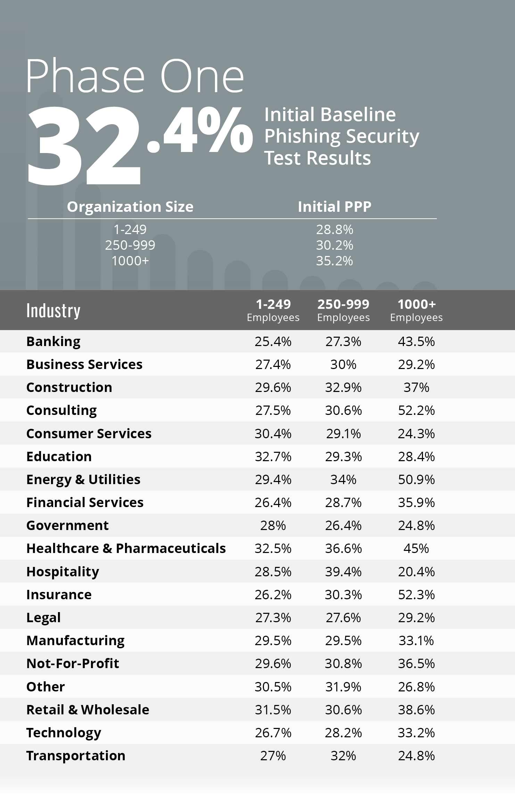

Slide 14
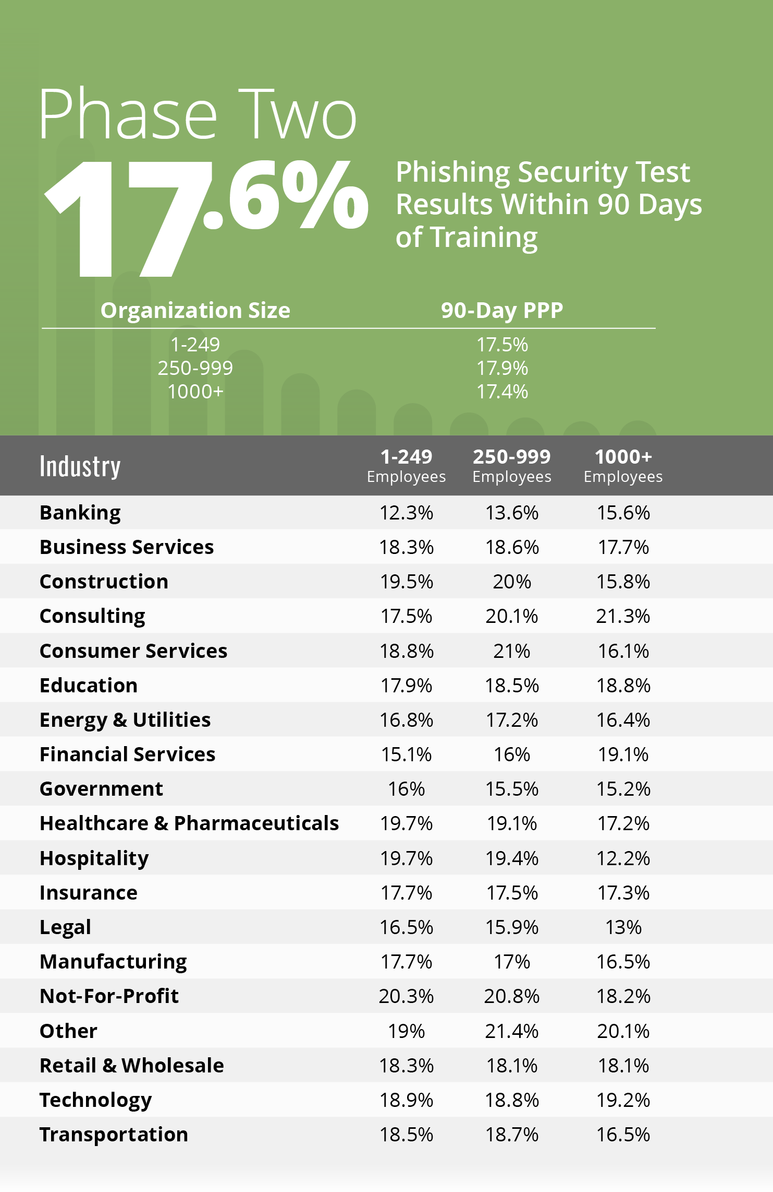

Slide 15
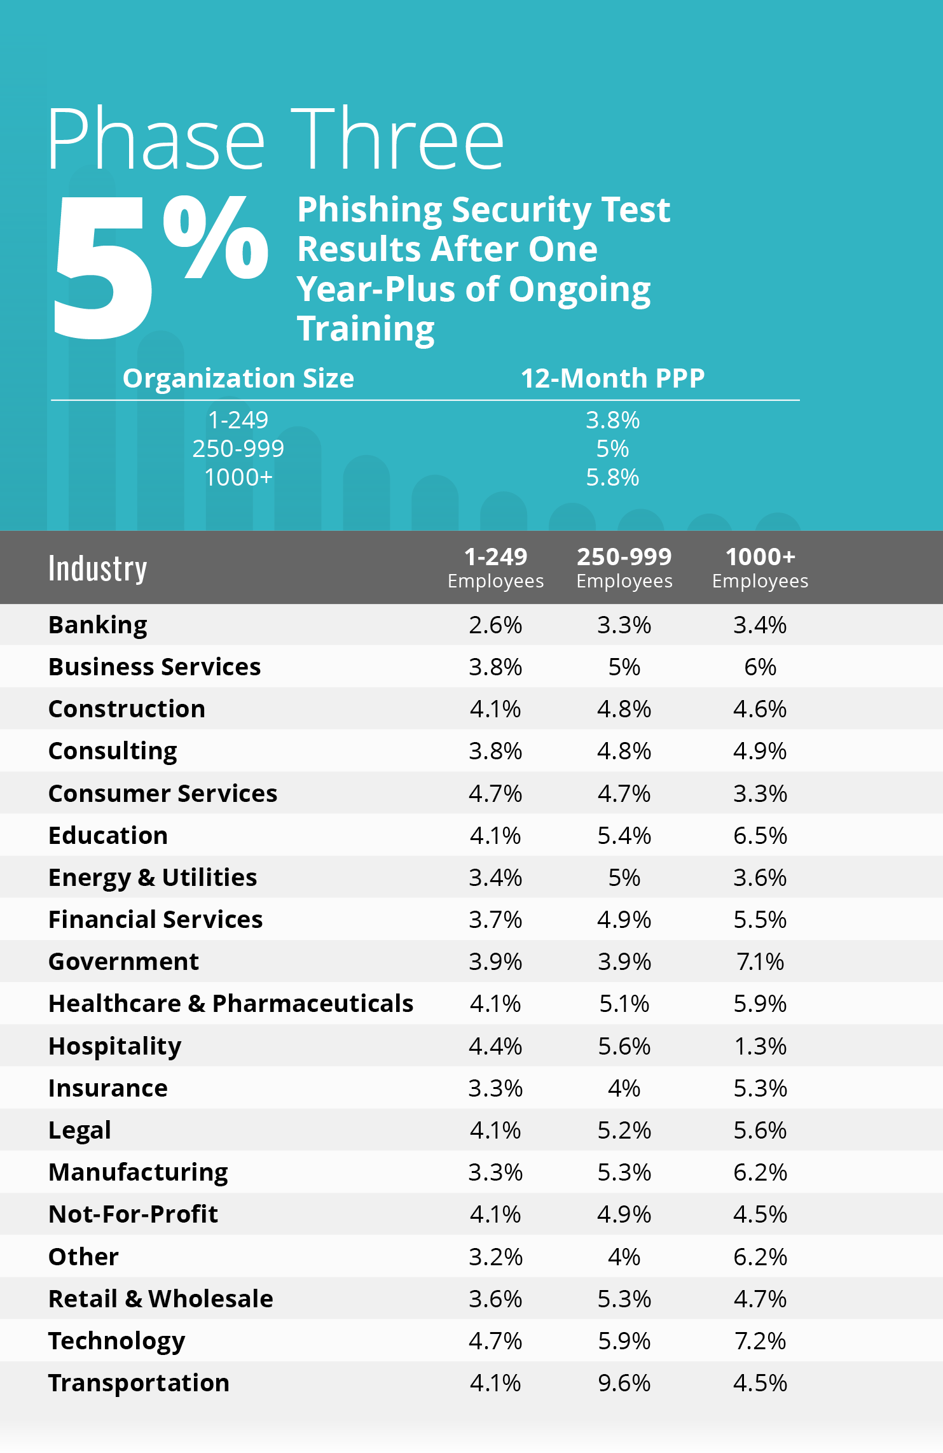

Slide 16
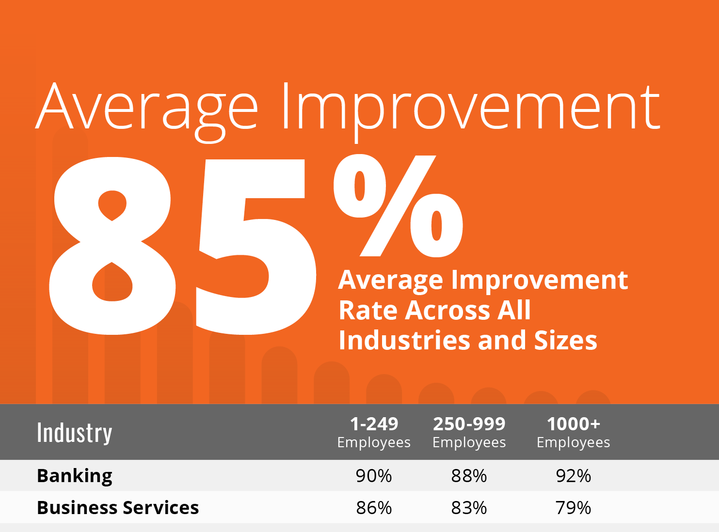

Slide 17
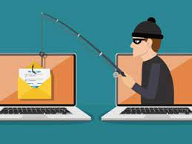
What is Phishing?
Sending a fraudulent communication that appear to come from credible source.
Types:
Spear Phishing – targets a specific group or types of individuals
Whaling – targets a specific person
Vishing – comes through a voice call
Smishing – sent through text or SMS
Email – comes through email…most common

Slide 18
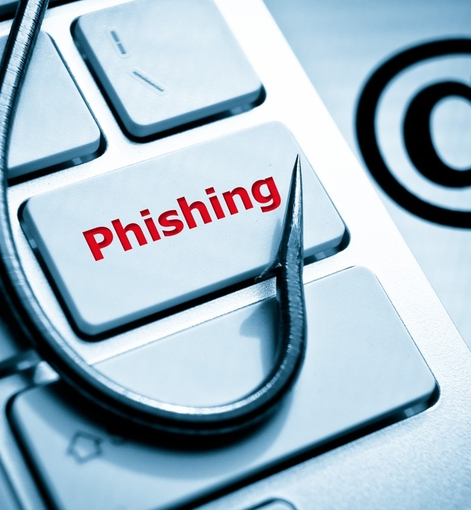
Most Common Phishing Techniques
Fake invoices, POs, and RFQs
  “Your invoice is past due. Click here to pay it now.”
Fake package or parcel delivery notifications
Email upgrade/update notifications
  “Upgrade your email or ALL of your email will be deleted. UPGRADE NOW.”
Email password expiration notifications
  “Your password is expired. Create your new password so you can log in.”
Fake file delivery, sharing, or signing notifications
Bogus online account “verifications” or “updates”
Email deactivation warnings
  “Your email will be deactivated if you don’t click here to cancel deactivation.”

Slide 19
Most Interesting Phishing Techniques
What are the bad guys up to this year?
Coronavirus-related attacks – up by 6,000%!
Google Calendar invites
Fake attachments
Fake “Trusted Sender” email headers
Online file sharing services…Microsoft Sway, Dropbox
Zoom, GoToMeeting, and other meeting invites…“Your meeting attendees are waiting!”
Instacart and other grocery delivery
Teladoc and telemedicine
Shipping notices…Amazon, FedEx, UPS
Use the Phish Alert Button!

Slide 20
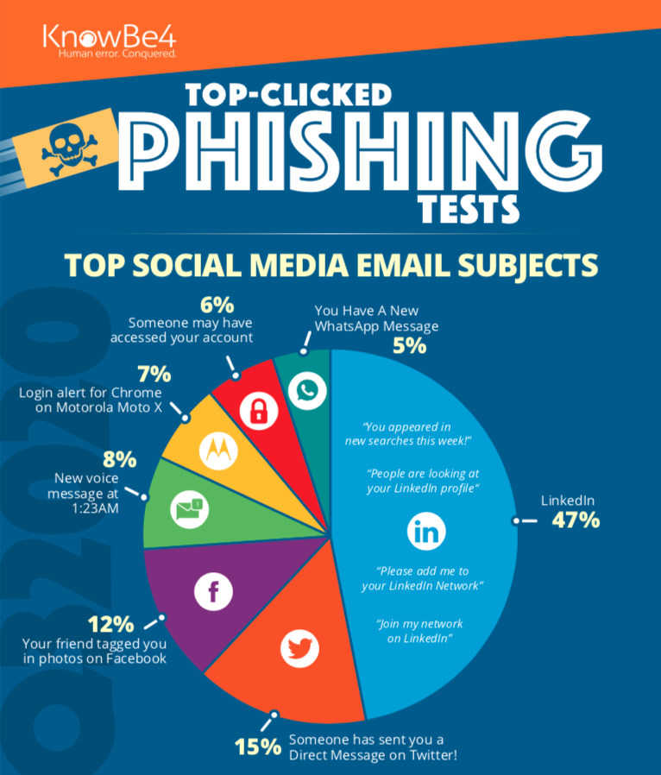
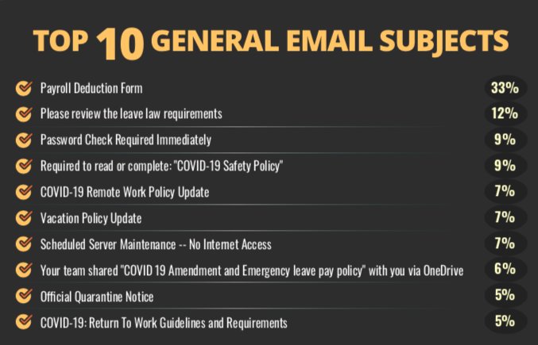
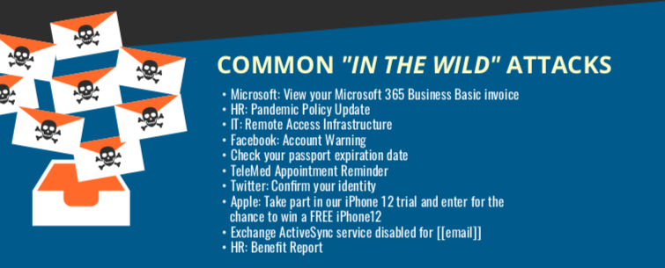

Top 5 Spoofed Brands
Microsoft
UPS
Amazon
Apple
Zoom
Notes:
Subjects related to working from home. Cybercriminals are preying on heightened stress, distraction, urgency, curiosity and fear in users. These types of attacks are effective because they cause a person to react before thinking logically about the legitimacy of the email.

Slide 21
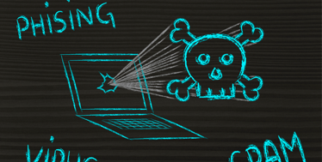
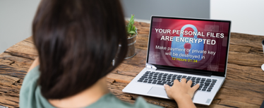
Ransomware is a data breach
Criminal hackers infiltrate your network
Install Trojans / other malware
Delete your backups
Steal your data before encryption
Hold the data for ransom
Leak Data, Intellectual Property
Public Shaming / Threatening Victim’s Customers

Slide 22
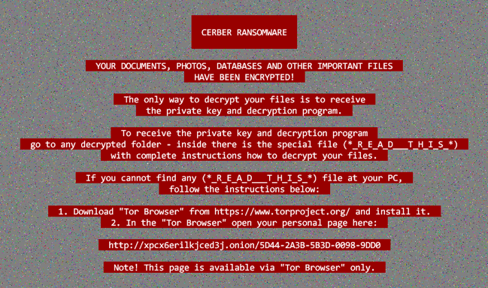
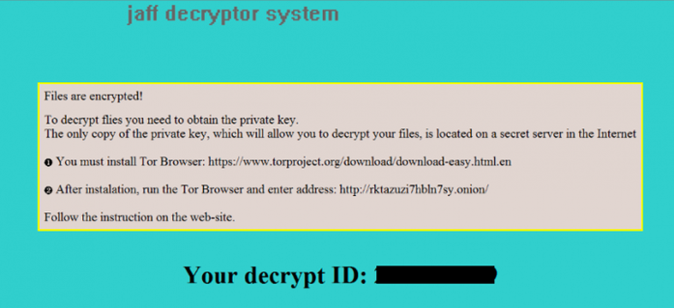
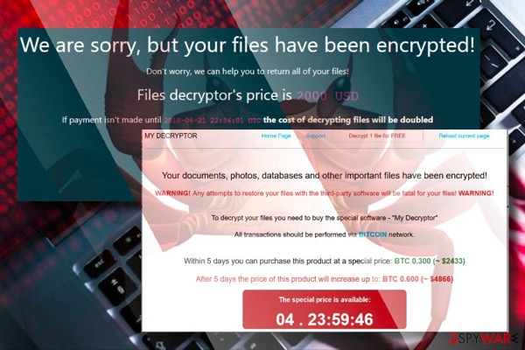
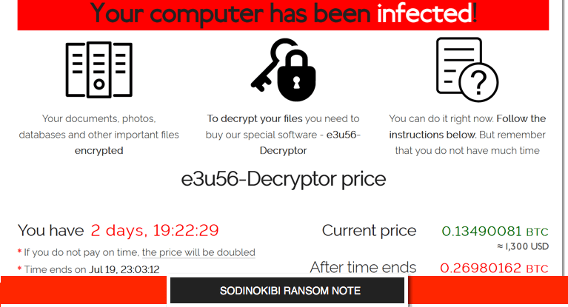



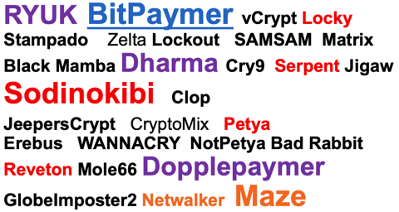
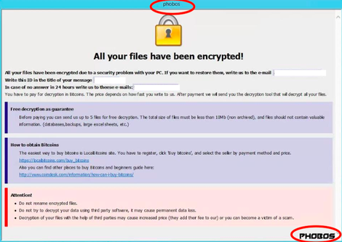
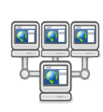
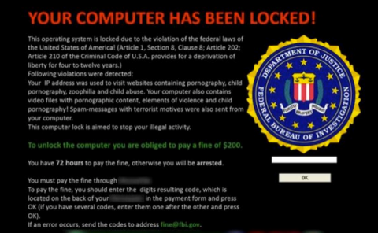


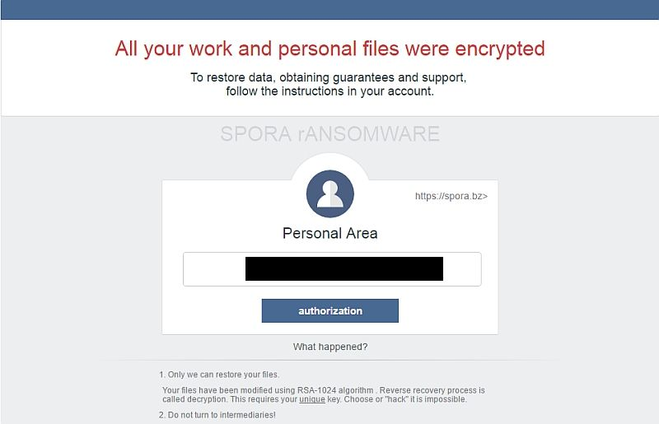
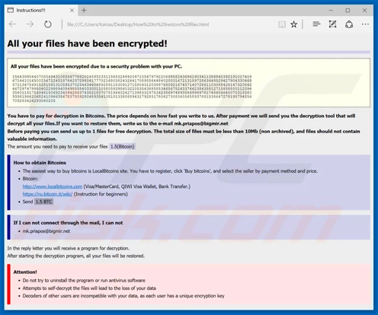

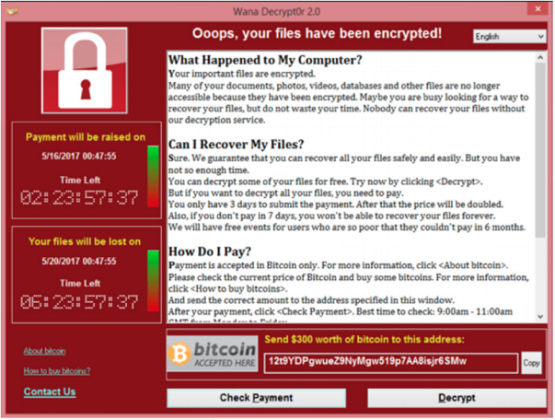
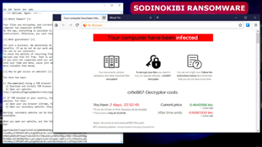


The Ransomware Process
The Internet
1
2
3
4
5
6
7
8
Notes:
1- user on the web
2- they click link and reach out to webserver with dropper (skipped if in the email attachment
3- dropper downloaded (Recon, persistence, lateral movement,
4- dropper reaches out for the actual malware
5 – malware downloaded
6 – encryption starts, keys are exchanged (data exfiltrated)
7 – encryption completes, page is displayed

Slide 23
Agenda
The phishing problem
Phishing benchmark data by industry
Your Security Culture & “Human Firewall”

Slide 24
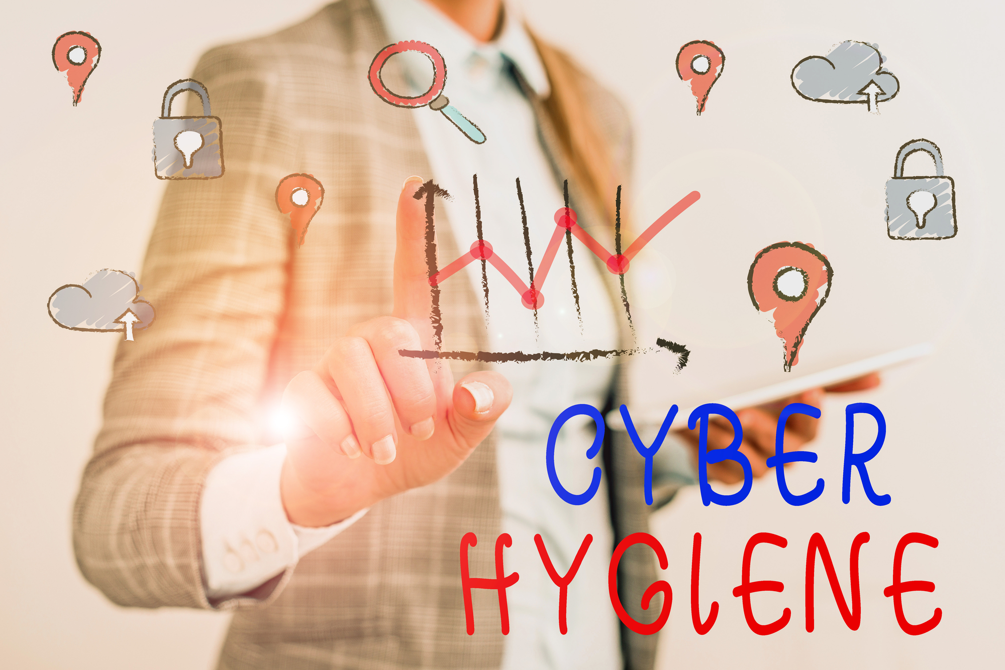
Personal Cyber Hygiene
Cyber Hygiene
Avoid strange links
Unique Passwords
Secure Wifi's
Password Manager
Backup, Backup, Backup

Slide 25
Notes:
PASSWORD IS A TOOTHBRUSH!
Avoid Reuse - Never use the same password on multiple systems, applications, or platforms – different accounts require different passwords. The use of the same password gives the cybercriminal an ability to use that credential set on multiple platforms and gain access.
Regularly change your password – while Microsoft killed the password expiration policy earlier this year, signaling the ineffectiveness of frequently changing passwords (e.g. every 30 days), the need for passwords to be changed at some regular interval (while not as frequent as every 30 days) is still necessary.
Longer passwords are better – rather than a complex short password (e.g., 3#f7Gw%8b), a longer password that uses a combination of upper/lower case letters, numbers, and symbols is more secure. The best is a passphrase with 25 characters or more. (e.g., Of the Top 10, I like #3 the best!)

Slide 26
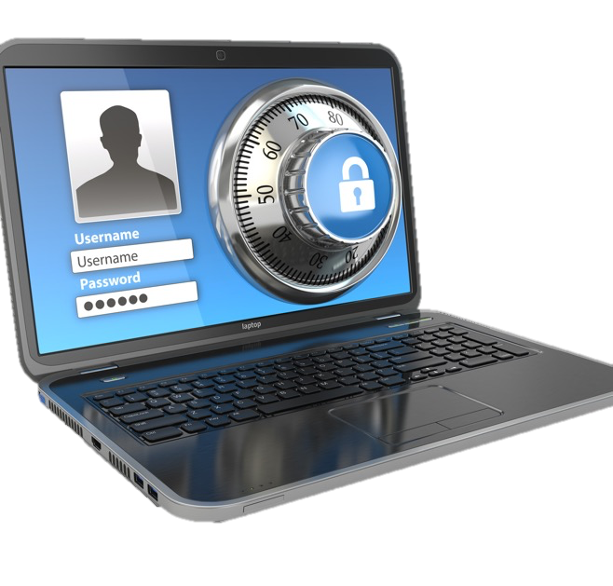
Password Vault
It reduces your risk because it can:
Store credential information
Generate the strong passwords
Alert you of compromised accounts
Keep the passwords unique
If possible, unique usernames too
Store the security question responses
  With social media it’s easier to discover the answers
  Consider different / wrong answers
Free vs Paid Options

Slide 27
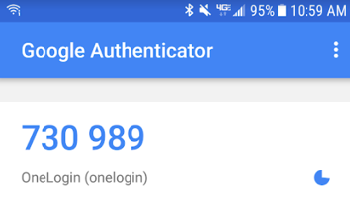

Multi Factor Authentication
SMS
Application
Hardware
Relies on a text message being sent
Usually containing a code,
Used in addition to the password
Most common type of 2FA
Not the most secure.
Long validity time,
Do not reset with each login
Uses an application
Installed on a smart phone
Generate a code to be used in addition to the password
Time-based Code
Change usually every 30-60 seconds
More secure than SMS
Uses a hardware token, like a Yubikey or your smartphone
Used in addition to the password while logging in to an account.
Very secure
Can be inconvenient when forgotten or damaged

Slide 28
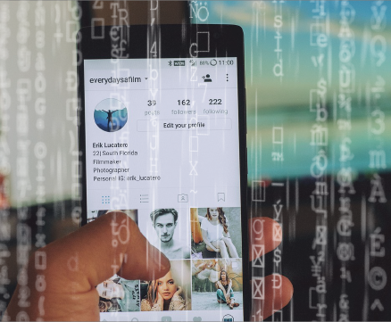
Social Media Cyber Safety & Security Tips
Manage your privacy settings (passwords)
Have kids? Beware of “Sharenting”
Be aware of what you’re sharing (limit)
Be aware of third-party apps – review frequently
“Once posted, always posted”
Remember it’s all about risk
Notes:
BREAK THIS SLIDE OUT

Slide 29


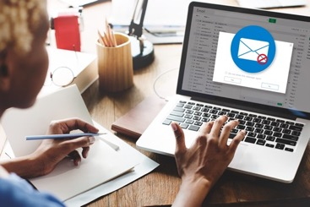
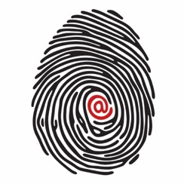
Virtual Private Networks (VPN): Uses
Coffee Shops or locations
with open WiFi
Hotels
Connecting to the Organization
Protect your identity
Notes:
Hotels
Coffee Shops
Work systems to organization
Disguise your home IP address

Slide 30

5 Principles of Being a Human Firewall
Never make assumptions: Don’t draw your own conclusions.
01
Stay alert:
Keep your guard up.
02
Think critically: Slow down, verify, and think before you click.
03
See something? Say something: Immediately report incidents.
04
Follow policy, no matter what: Circumventing policy jeopardizes the company.
05

Slide 31
Final Thoughts
Humans are the de-facto top choice for cybercriminals seeking to gain access into an organization.

Slide 32
Thank You

