Slide 1
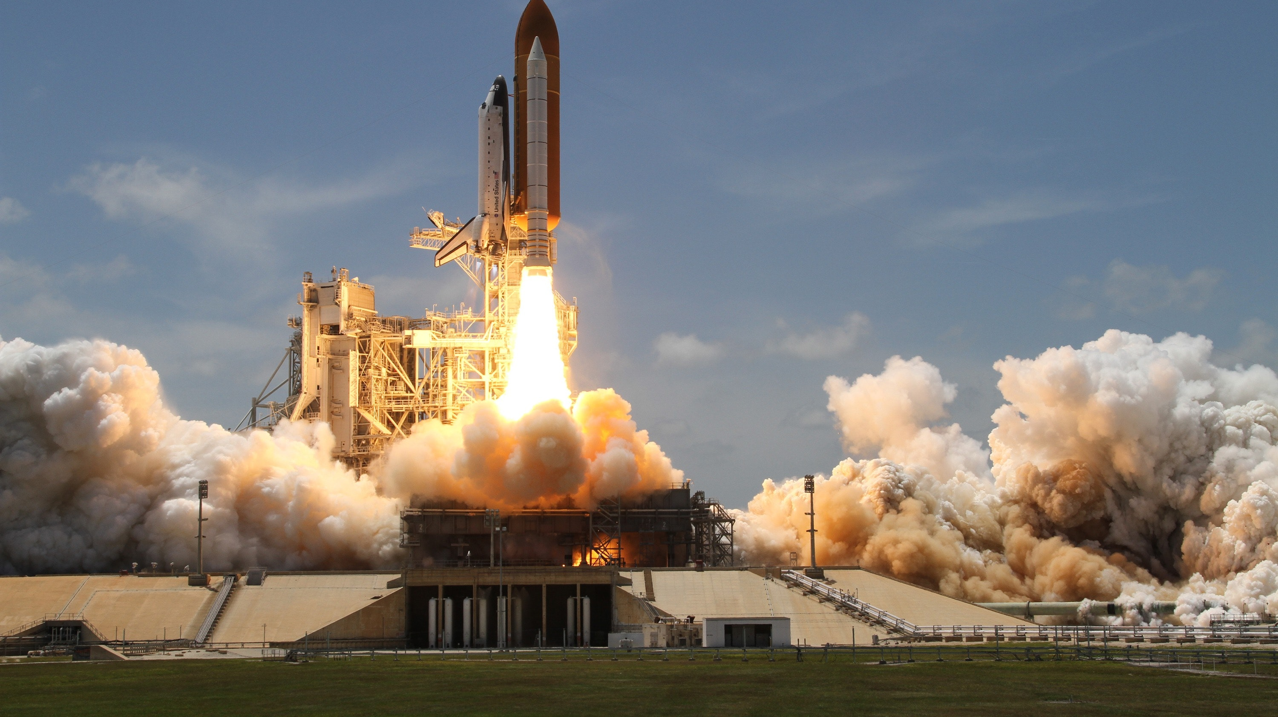
First Flight:
Our Foray
Into SOAR
Boston University Security Camp 2022

Slide 2

Hi – I’m Brian
….more than just a smiling face
Boston University’s Security Operations Center
I’m not a developer, but I like to script things

Slide 3
SOAR - What Is It?
Security Orchestration, Automation & Response
Per Gartner, SOAR tools can be used for many security operations tasks, including:
  To document and implement processes.
  To support security incident management.
  To apply machine-based assistance to human security analysts and operators.
  To better operationalize the use of threat intelligence.
Workflows can be orchestrated via integrations with other technologies, and automated to achieve desired outcomes
…it’s a journey

Slide 4

Our Initial Challenges
Too long to process individual alerts
  Enrich data
  Lookup for existing incident
  Update/log incident
  Send notice
We could be doing more
  Process alerts more frequently
  Process different types of alerts
How do we speed up our initial response time?

Slide 5

Choosing A Platform: The Goldilocks Problem

Slide 6
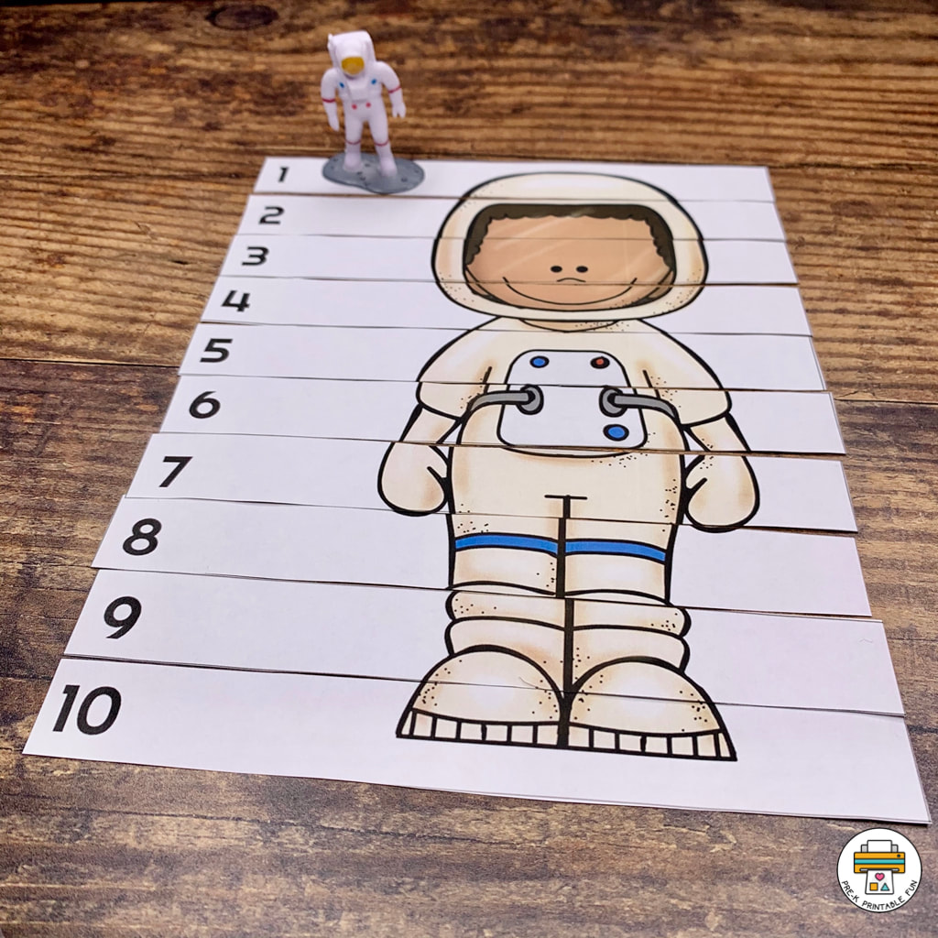
Our New Challenge:
Implementation
Cloud platform, privately addressed resources
Tools with no or limited APIs
What can we actually automate

Slide 7
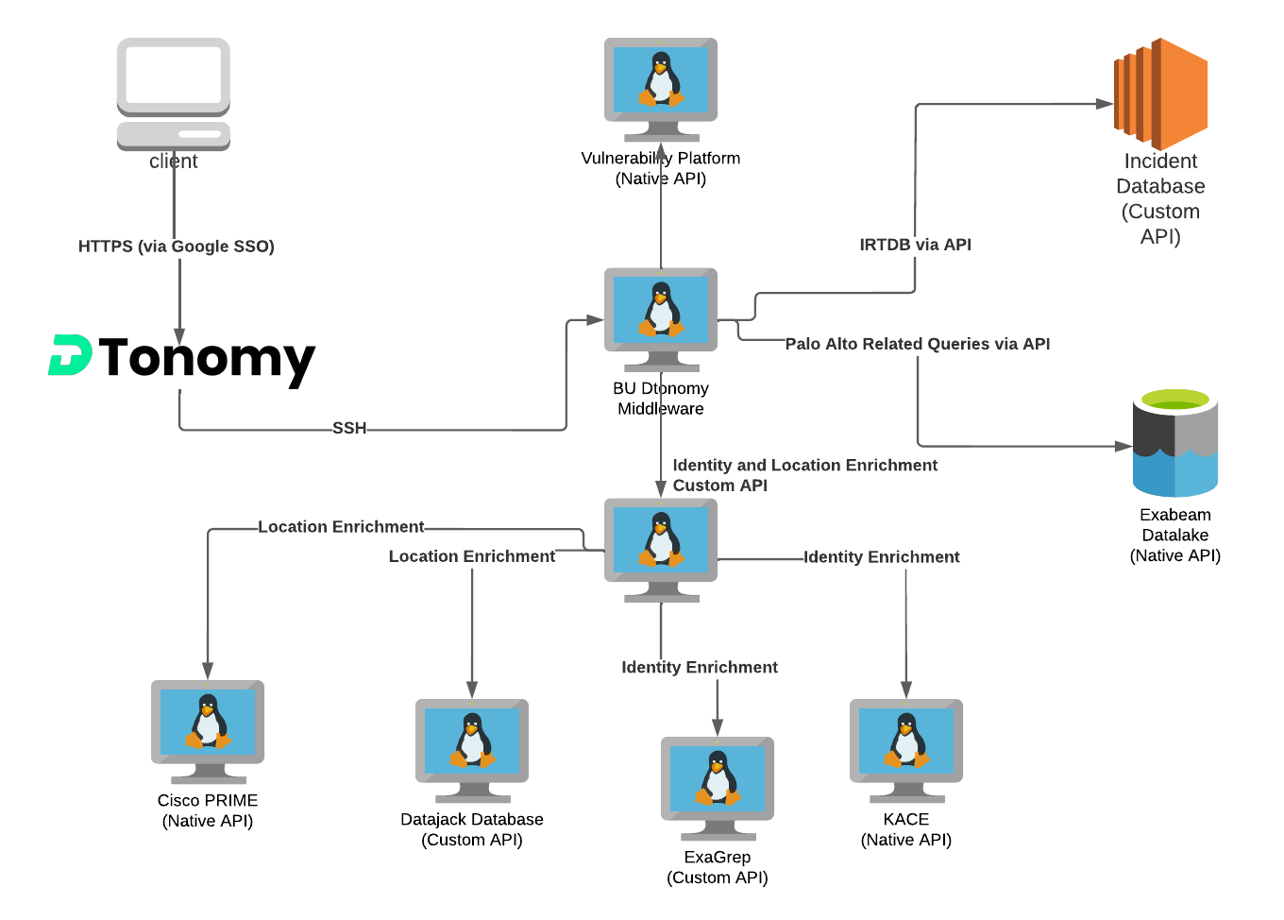

Slide 8
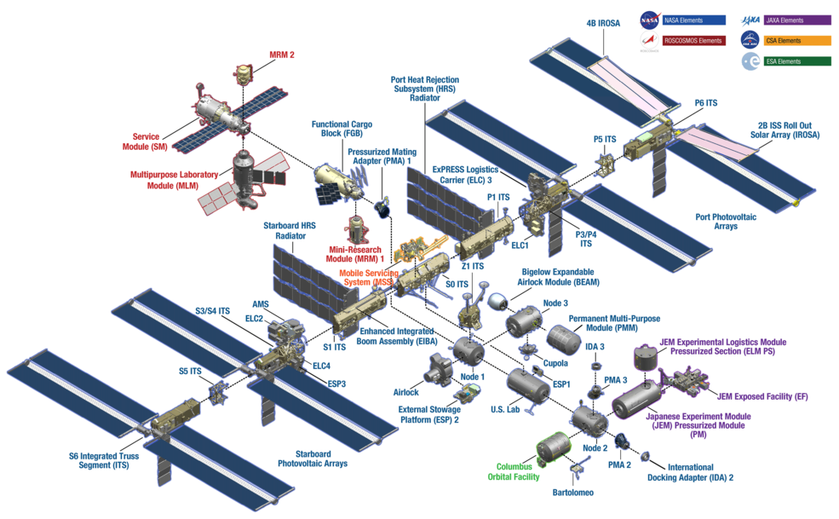
What Can We Automate?
Brainstorm possible ideas
Document workflow
Build pilot workflows
Notes:
https://www.nasa.gov/mission_pages/station/structure/elements/space-station-assembly

Slide 9
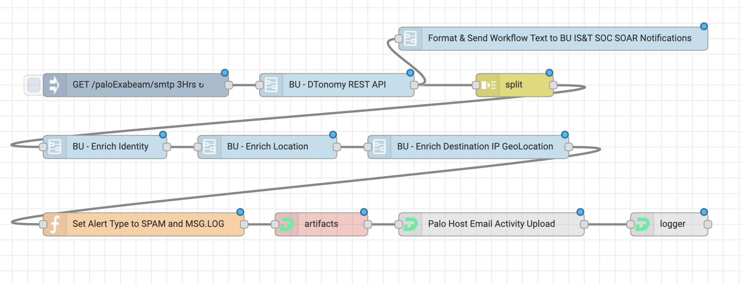
SMTP Alert Workflow

Slide 10
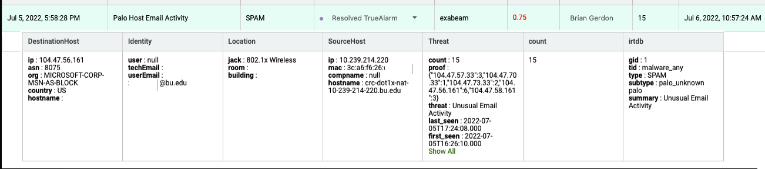
SMTP Alert

Slide 11
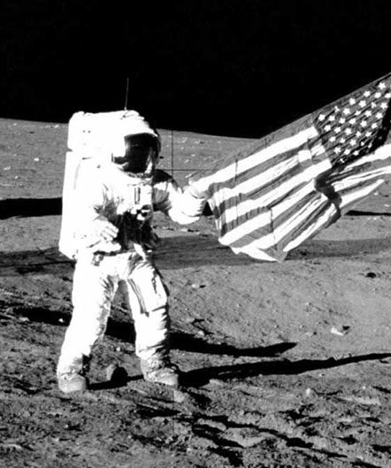
We Did It!
Reduced time to enrich and process incidents
Processing firewall alerts more frequently
Processing Vulnerability alerts
Automatically reset AWS WAF (avoid outages)

Slide 12
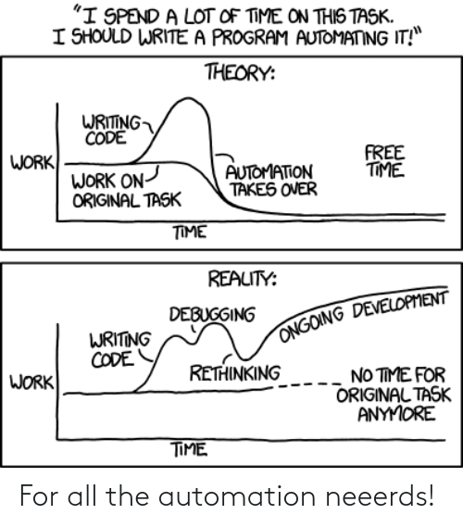
Our New Challenge:
Make It Better
SSH has its limits
Can we fully automate workflows
Can we expand workflows
Can we shorten time to notify
Can we leverage machine learning
Notes:
https://m.xkcd.com/1319/

Slide 13
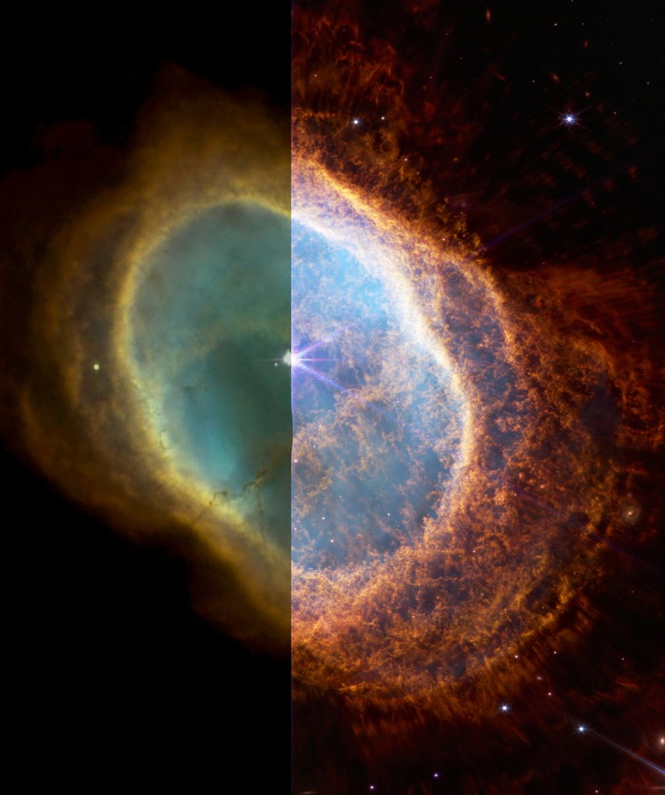
Recent Improvements
Built Flask-based API for middleware
End to End automated workflows for some alerts
Added Shadowserver, Log4j
Shorten our time to report window for some alerts
Leverage ML score to push down false positives
Notes:
https://hypebeast.com/2022/7/nasa-james-webb-space-telescope-vs-hubble-telescope-comparison-info

Slide 14
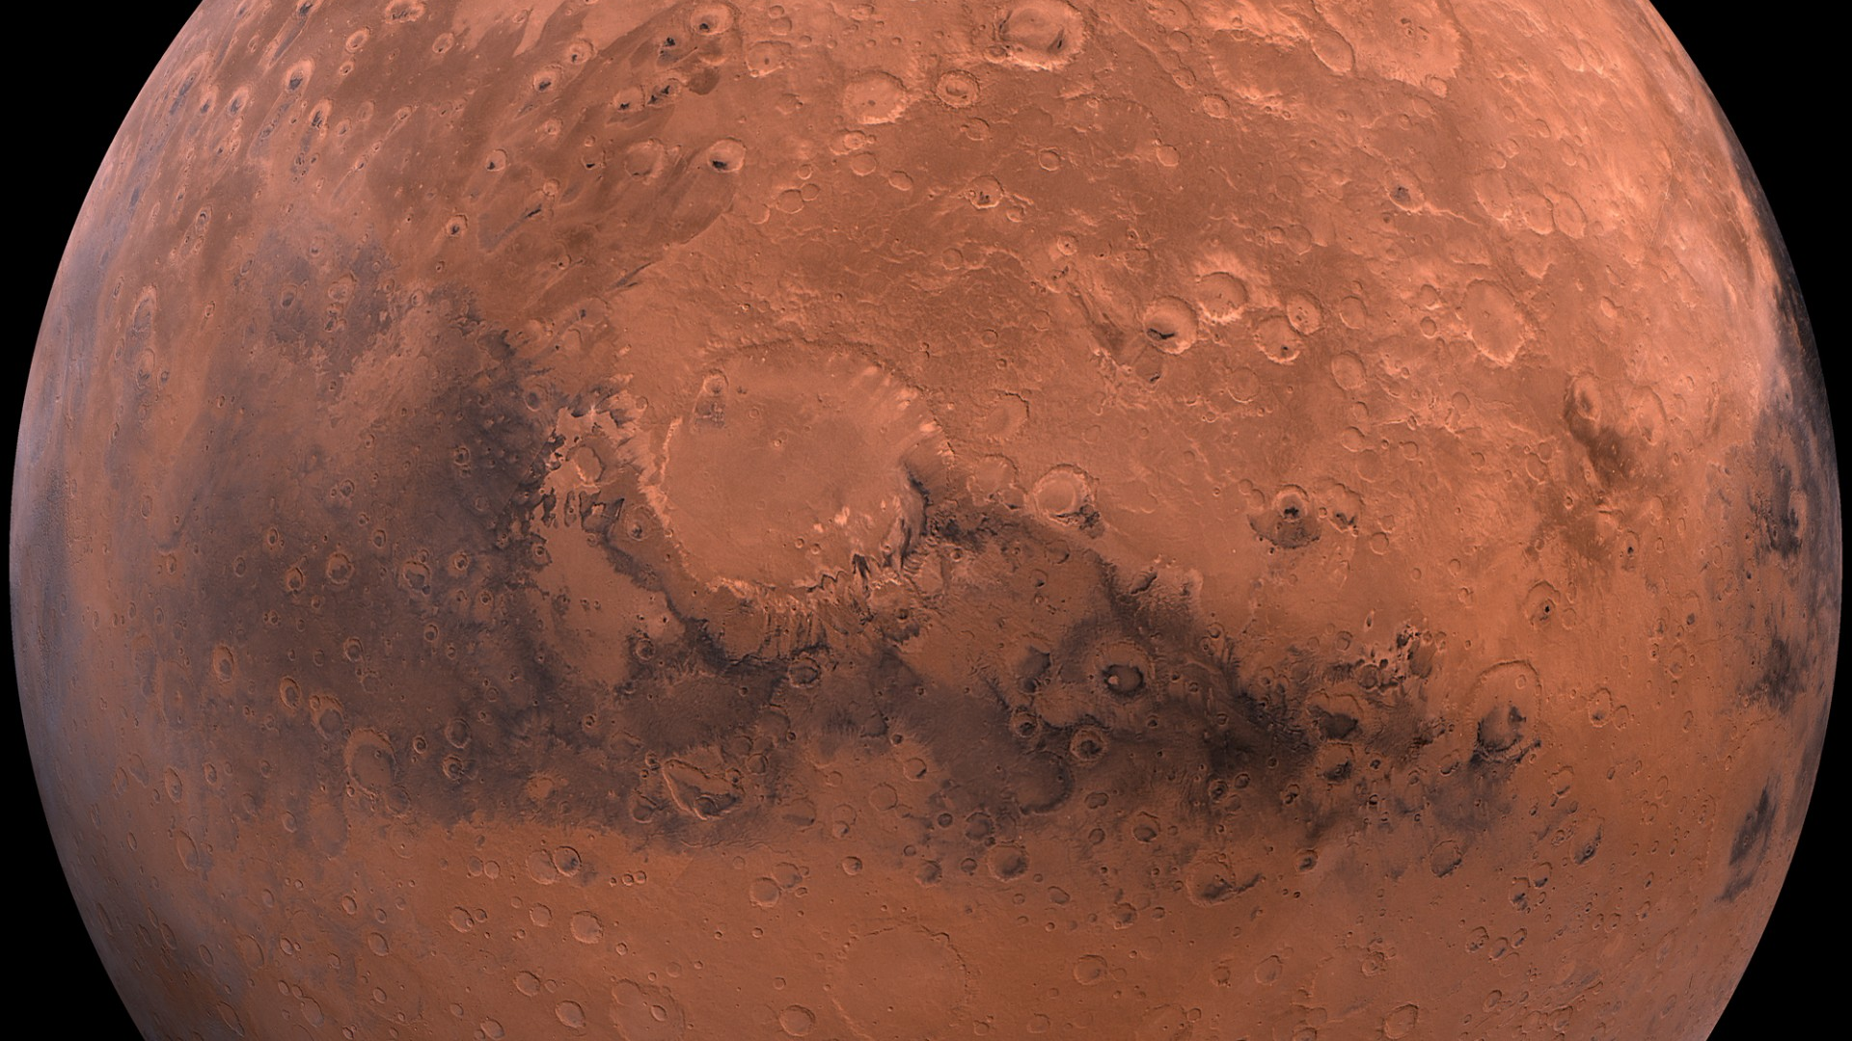
SOAR Is A Journey – Where Will It Take Us Next?
Automate some EDR detections
Fully automate more workflows
Further expand Vuln workflows
Automated scan blocking and reporting
Do more with ML scoring
Open up to other groups
Notes:
https://www.publicdomainpictures.net/en/view-image.php?image=86459&picture=mars

Slide 15
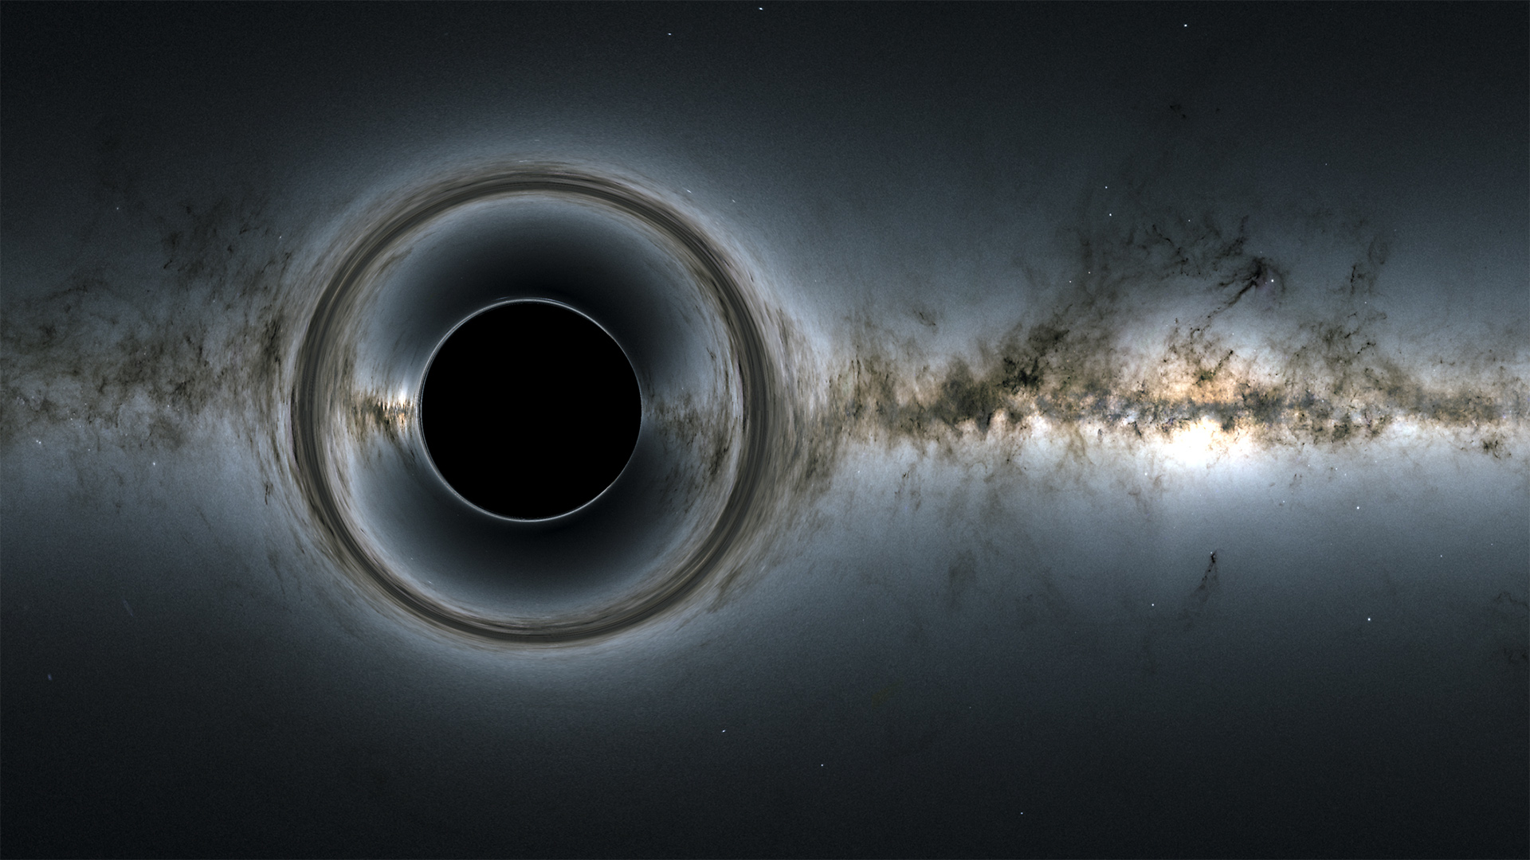
The End
Notes:
https://www.nasa.gov/vision/universe/starsgalaxies/black_hole_description.html

