Slide 1
Introduction to SQL
Research Computing Services
Yun Shen
http://rcs.bu.edu
http://rcs.bu.edu/eval
help@scc.bu.edu

Slide 2
A little bit of about our group and me
Research Computing services, visit http://rcs.bu.edu for more info
  Consulting
  Teaching
  Graphics
  Optimization
Experience:
  Database programming
  Software development

Slide 3
Tutorial Outlines
  What is SQL
  SQL History
  Terminology By Examples
  SQL Syntax By Examples
  SQL Category
  Small yet worth noting points
Tutorial sample db overview
Schema of the sample db
Data of the sample db
Hands on Tutorial Setup

Slide 4
What is SQL ( ‘Structured Query Language’ )?
SQL stands for ‘Structured Query Language’
SQL is domain-specific language, NOT a general programming language
  SQL is specialized to handle ‘structured data’ that follows relational model – data that incorporates relations among entities and variables.
  Used to interact with relational databases to manage data: create, populate, modify, or destroy data. Also can manage data access

Slide 5
SQL is a standard language
Nevertheless, SQL is a ‘language’. It has its language specification – a set of language elements, rules and syntax
Rigid and structural:
  Since the underlying data model is structural, SQL is very ‘structural’ too - requiring rigid predefined schema as compared with those of ‘noSQL’
  Syntax and grammar is also strict
SQL specific features – triggers, stored procedures

Slide 6
History of SQL
First developed in 1970s by two scientists at IBM following a theory of ‘relational algebra’ by Edgar F. Codd, who was also an IBM scientist.
First commercial implementation of SQL-based RDMBS was Oracle’s V2.
First adopted by ANSI in 1986, and ISO in 1987 as standard.
The latest version of the SQL standard is from 2016. There have been very many versions in between.
Though standardized, this does not necessarily mean SQL code can be migrated between different RDBMS seamlessly (Why?)

Slide 7
Terminology - Structure
Database
Table
Column
Row
Relation
Primary key
Foreign key

Slide 8
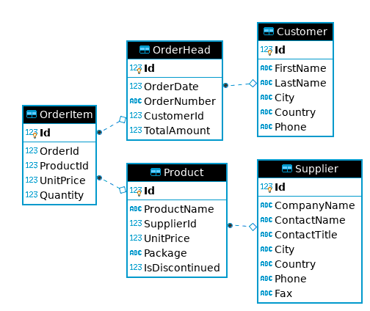
Take sample_ecomm.db as an Example - schema
Notes:
When write SQL, you must be very clear about the underlying table structure. Here is the ERD for sample_ecomm.db. It shows the overall structure and relationships of tables it has.

Slide 9
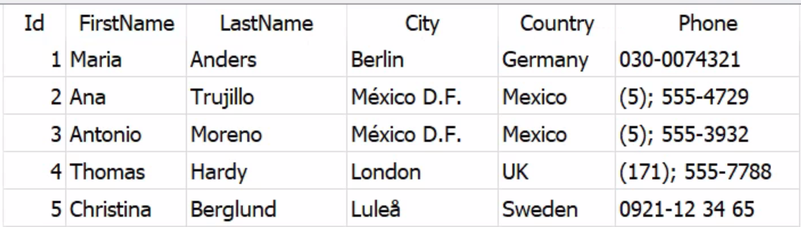
Customer
Notes:
When write SQL, you must be very clear about the underlying table structure. Here is the ERD for sample_ecomm.db. It shows the overall structure and relationships of tables it has.

Slide 10
Terminology - SQL Language Elements
Clause
Statement
Query
Function
Stored Procedure
Predicate
Expression
Keyword
Identifier

Slide 11
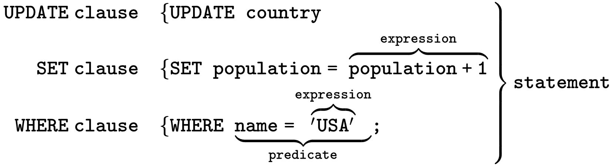
A SQL Example From Wikipedia
A chart showing several of the SQL language elements that compose a single statement
(source: https://wikimedia.org/api/rest_v1/media/math/render/svg/b83ad563285f7b0ebb325226d91f25ca0bffa7cd )

Slide 12
Our Own Query Example
SELECT FirstName, LastName -- SELECT clause
FROM Customer -- FROM clause
WHERE Id=1 – WHERE Clause
Clean way:
SELECT FirstName, LastName FROM Customer WHERE Id=1

Slide 13
Complete Query Statement Syntax – Order Matters !
Clause | Priority | Required?
SELECT <columns> | 5. | Mandatory ✓
FROM <table> | 1. | Mandatory ✓
WHERE <predicate on rows> | 2. | Optional ✓
GROUP BY <columns> | 3. | Optional ✓
HAVING <predicate on groups> | 4. | Optional, work with GROUP BY
ORDER BY <columns> | 6. | Optional ✓
OFFSET | 7. | Optional
FETCH FIRST | 8. | Optional

Slide 14
SQL Category
1. Data Query Language (DQL) - used to query data
2. Data Manipulation Language (DML) – used to create/modify/destroy data
3. Data Definition Language (DDL) – used to define database schema
4. Data Control Language (DCL) – used for security and access control

Slide 15
Most Important SQL Statements
SELECT - extracts data from a database (DQL)
UPDATE - updates data in a database (DML)
DELETE - deletes data from a database (DML)
INSERT - inserts new data into a database (DML)
CREATE DATABASE - creates a new database (DDL)
CREATE TABLE - creates a new table (DDL)
DROP TABLE - deletes a table (DDL)

Slide 16
Attention Please !
1. SQL keywords and table/column names are NOT case sensitive: ‘select’ and ‘SELECT’ are the same
2. The values stored in a table can be case-sensitive – depending on configuration
3. Usually single quotes (‘’) or double quotes (“”) don’t matter, but could be configured otherwise
4. Semicolon ‘;’ is the standard way to separate SQL statements. It can be required in some DBMS to end each statement with a ‘;’ even after a single statement
5. Comments can be used to make SQL more readable. Usually ‘--’ for single line comment, and ‘/*’ and ’*/’ for multiline comments. Add ‘--’ at the beginning to indicate a comment line
6. Standard is NOT STANDARD – none of SQL standard is fully implemented by all vendors. Pay attention to the differences that each vendor’s implementation have from the SQL ‘standard’

Slide 17
In this Tutorial
We will use all upper-case for all keywords
We will use double quotes “” to indicate strings
We will end each SQL statement with a ‘;’

Slide 18
Keywords Used in this Tutorial
SELECT
*
FROM
ORDER BY
ASC
DESC
AND
OR
NOT
WHERE
LIMIT
DISTINCT
AS
GROUP BY
INNER JOIN
ON
!=
INSERT
UPDATE
DELETE
CREATE
TABLE
LIKE
%
INTO
VALUES
DROP

Slide 19
Functions Used in this Tutorial
COUNT()
MIN()
MAX()
AVG()
SUM()
REPLACE()

Slide 20
Hands On Demo
Basic | SELECT + WHERE
Aggregation | SELECT + GROUP BY
JOIN | SELECT + JOIN
WRITE Queries | INSERT/UPDATE/DELETE

Slide 21
Tutorial Tools and Files Overview
  DB GUI : DBBrowser for SQLite
  sufficient yet simple/clean interface for demo purpose
  SQLite engine is already embedded in this tool
  Sample DB: sample_ecomm.db
  - a simple example e-commerce db. We will explore it a bit more …
Notes:
SQLite is a serverless, in-memory db engine. It doesn’t have its GUI by itself. Many other companies step up to fill the blank. DBBrowser is one of them.
Almost all major database engines provide programming APIs for application developers to get access to database through programming interfaces.

Slide 22
sample_ecomm.db preview
Notes:
When write SQL, you must be very clear about the underlying table structure. Here is the ERD for sample_ecomm.db. It shows the overall structure and relationships of tables it has.

Slide 23
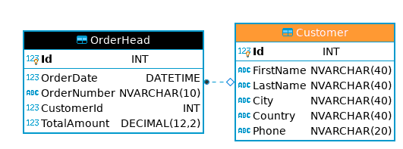
sample_ecomm.db preview – Customer

Slide 24
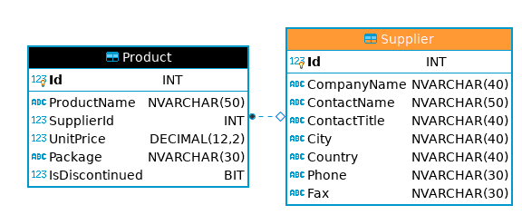
sample_ecomm.db preview – Supplier

Slide 25
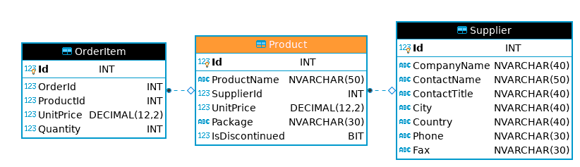
sample_ecomm.db preview – Product

Slide 26
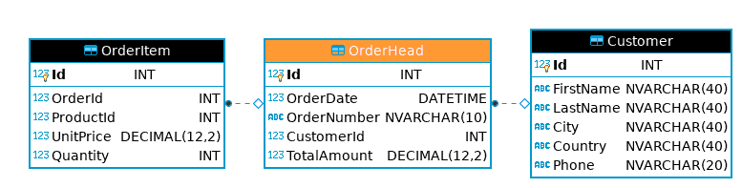
sample_ecomm.db preview – OrderHead

Slide 27
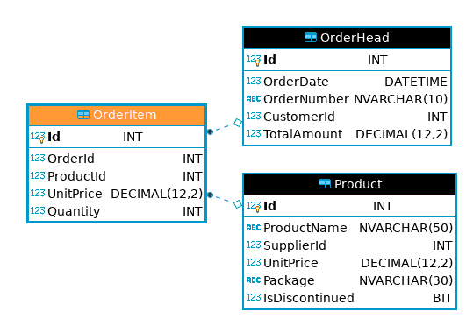
sample_ecomm.db preview – OrderItem

Slide 28
Customer
Notes:
When write SQL, you must be very clear about the underlying table structure. Here is the ERD for sample_ecomm.db. It shows the overall structure and relationships of tables it has.

Slide 29
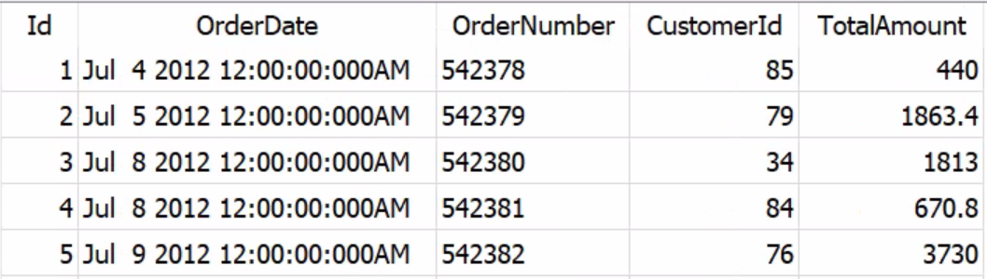
OrderHead
Notes:
When write SQL, you must be very clear about the underlying table structure. Here is the ERD for sample_ecomm.db. It shows the overall structure and relationships of tables it has.

Slide 30
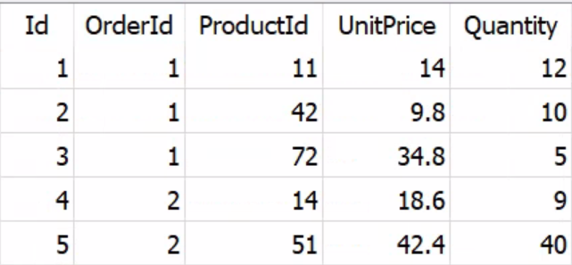
OrderItem
Notes:
When write SQL, you must be very clear about the underlying table structure. Here is the ERD for sample_ecomm.db. It shows the overall structure and relationships of tables it has.

Slide 31
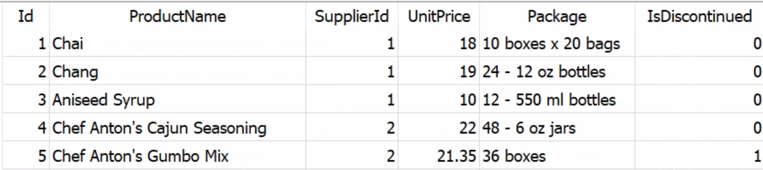
Product
Notes:
When write SQL, you must be very clear about the underlying table structure. Here is the ERD for sample_ecomm.db. It shows the overall structure and relationships of tables it has.

Slide 32
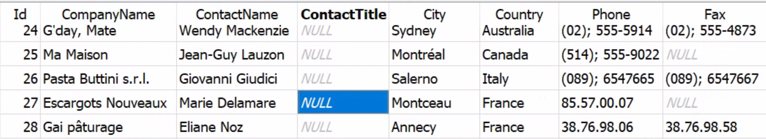
Supplier
Notes:
When write SQL, you must be very clear about the underlying table structure. Here is the ERD for sample_ecomm.db. It shows the overall structure and relationships of tables it has.

Slide 33
Tutorial Setup
  All the tutorial files can be accessed from:
  http://www.bu.edu/tech/support/research/training-consulting/live-tutorials/
  Tutorial Setup Instruction is at the following subdirectory:
  Intro2SQL\presentation\instr_tutorialSetup_vdi.docx
  Tutorial Software - using BU’s Common Lab Apps. It can be accessed at:
  https://rdweb.wvd.microsoft.com/arm/webclient/index.html

Slide 34
Some Extra Info:
The following is some extra information you may be interested in:

Slide 35
GUI tool is not the only way!
A GUI tool like DB Browser is not the only way to access databases!
There could be many other ways! The following are the two ways:
Notes:
SQLite is a serverless, in-memory db engine. It doesn’t have its GUI by itself. Many other companies step up to fill the blank. DBBrowser is one of them.
Almost all major database engines provide programming APIs for application developers to get access to database through programming interfaces.

Slide 36
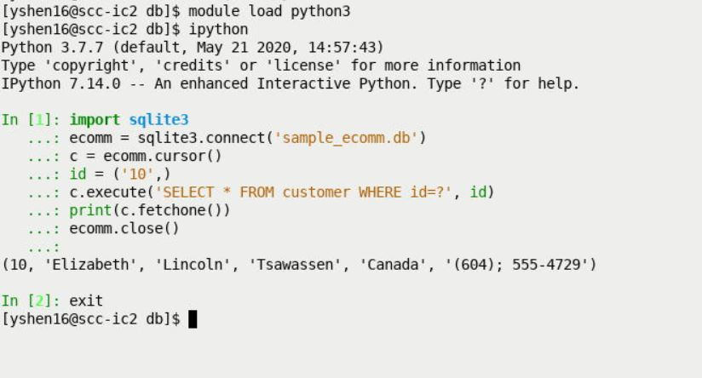
SQLite Programming Interface - Python

Slide 37
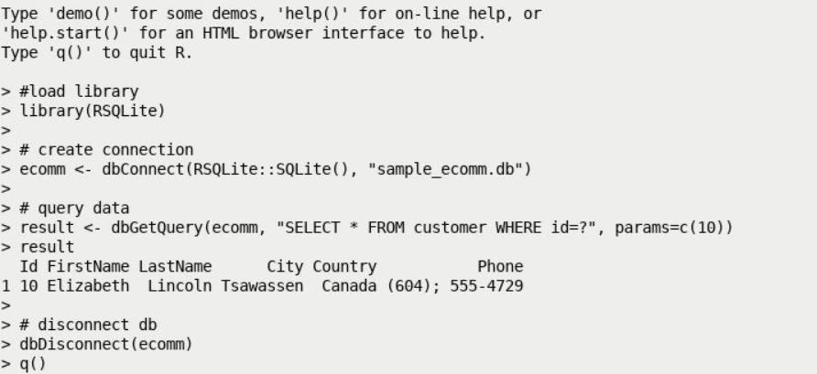
SQLite Programming Interface - R

Slide 38
Useful Resources:
This tutorial materials:
  http://www.bu.edu/tech/support/research/training-consulting/live-tutorials/
W3Schools SQL tutorial: https://www.w3schools.com/sql/
Khan Academy:
https://www.khanacademy.org/computing/computer-programming/sql

