Slide 1
DLP - How a lot of effort can potentially save you a lot of money
“Where is your data?” and how not knowing can cost you
Joel Rosenblatt
Director, Computer and Network Security
Columbia University
Virtual Security Camp
August 13, 2020

Slide 2
DLP – What is it and why do you care?
Data Loss Prevention or Data Leak Prevention
  How to stop the ex-filtration of information either through loss, theft or hacking
Privacy Laws
  FERPA - Family Educational Rights and Privacy Act
    http://www2.ed.gov/policy/gen/guid/fpco/ferpa/index.html
  HIPAA - Health Insurance Portability and Accountability Act
    http://www.hhs.gov/ocr/privacy/
  NYS Internet Security and Privacy Act
    http://law.onecle.com/new-york/state-technology/STT0208_208.html
  Institutional policies
$$$$

Slide 3
Columbia Environment
Large research university
Decentralized management structure
Over 250,000 network nodes
Over 80,000 MAC addresses active on average
Decentralized computer support
No sniffing traffic or scanning machines allowed
“Free Love” IP address assignments available
No university wide, corporate like, firewalls
Between 80,000 and 120,000 active email accounts

Slide 4
Columbia Environment
Seventeen schools
  Four undergraduate
  Thirteen graduate
Four affiliate schools
ApartmentNet – HS Internet sold through housing
Twenty five libraries with 9.5 million volumes
Twenty thousand employees
Forty thousand students

Slide 5
Columbia Environment
Network organized geographically – network segmentation is often done by building or area, not by use
  Example – SIPA (School of International and Public Affairs) is in the International Affairs Building, but so is the Economics department and the Political Science department – each of these has a different IT organization

Slide 6
Columbia Environment
Central IT (CUIT) organization only supports central IT functions (network, email, main web servers, payroll, student services, financial services, etc.)
Departments, schools, affiliates get to support themselves (or can buy support from CUIT)
This creates an uneven support model – rich departments (Law, Business) have good support, poor departments (Anthropology, Political Science) – not so good.

Slide 7

Create a DLP plan
Get authority to deal with the issue - Governance
Define what is important – Data Classification Policy
  http://policylibrary.columbia.edu/data-classification-policy
Define a policy to deal with the data found
  http://policylibrary.columbia.edu/encryption-policy
  http://policylibrary.columbia.edu/files/policylib/imce_shared/desktop_security_requirements.pdf
  http://policylibrary.columbia.edu/social-security-number-ssn-and-unique-person-number-upn-usage
Find the data – This is the tricky one
  Wash, Rinse and Repeat

Slide 8
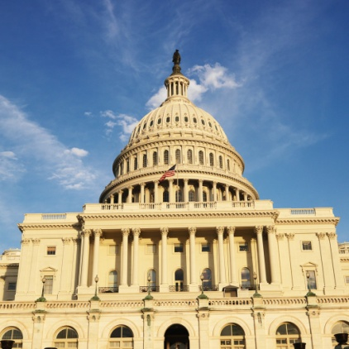
Governance
Governance is the act of governing. It relates to decisions that define expectations, grant power, or verify performance. It consists of either a separate process or part of decision-making or leadership processes. In modern nation-states, these processes and systems are typically administered by a government. Wikipedia

Slide 9


Governance …
Who do you report to?
What is your authority?
Who funds the project?
Can you change your situation?

Slide 10

Data Classification Policy
Don’t go crazy
  More is not better
We have four classes, but less is fine
  Sensitive (PII, PHI, Student)
  Confidential (contract)
  Internal (Proprietary)
  Public

Slide 11
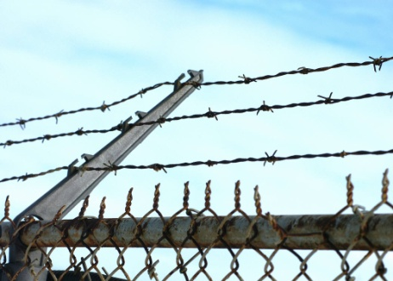

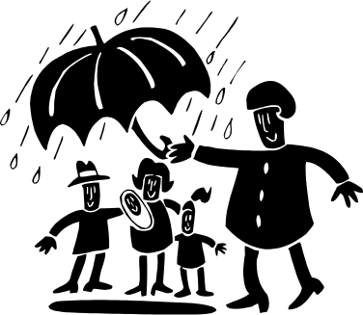
Protecting the data
There are three states of data
  Data at rest
    Device is turned off and data is stored inside
      Protection is static encryption
  Data in use
    Application is in use, data is decrypted
      Protection is dynamic encryption
  Data in transit
    Moving data from point A to point B
      Protection is network encryption

Slide 12
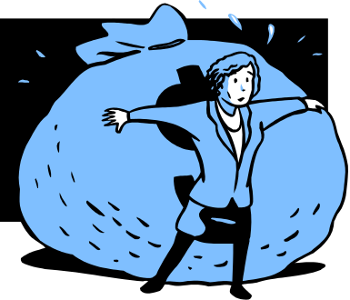
Protecting the data
Important notes on static encryption
  Static encryption is very useful to prevent a data breach through theft or physical loss, but it does not prevent data loss from hacking, user error or insider theft
  All sensitive static data that is on a device that can be lost or stolen should be encrypted
  This should include USB sticks, CDs, laptops, desktops and smart phones
  Please note that none of this helps with paper

Slide 13


Protecting the data…
Get rid of it – you can’t lose what you don’t have
  Never collect data you don’t absolutely need
Obfuscate it
  We have a UPN (Unique Person Number) that looks like a SSN to store in systems that need an SSN. We use a product called Mentis.
Encrypt it
  We use Winzip and Office 2007 & up
  Full Disk Encryption
  HTTPS, SSL

Slide 14

Finding the data
Centralized Data
  Data owned and maintained by Central Administration
    Human Resources
    Student Systems
    Finance
Stored on central servers
Best to secure dynamically
  Obfuscation – use UPN instead of SSN
  Field encryption – just encrypt PII in records
Full disk encryption is a waste of money if data is stored in a secure area (Central machine room)

Slide 15

Finding the data … Central
The best way to find central data is to ask for it - this will get messy
  Look at ORG chart and find SBOs in charge
    Send out survey
    Make phone calls
    Set up meetings
Ask “Do you really need to collect that information?”
When business use has been established, move on to
  Obfuscation – Think fields in a database
  Dynamic encryption

Slide 16

Finding the data … FCrawler
When done asking, it’s time to check
  Use “Trust but Verify”
Columbia uses Fcrawler
  Written at Columbia
  Runs on Linux, Solaris, AIX, Windows
  Crawls file system looking for PII
  Looks at changed files (since last run)
  Uses a Bloom filter to reduce false positives

Slide 17
Finding the data … FCrawler
Output from FCrawler
May 6 05:03:08 test1.ais.columbia.edu 128.59.555.221 fcrawler[4768]: HIT name=R:\Users\j\jco2116\Director's Office\China Elderly Care Policy.docx pattern=ssn hits=1 bf=0 user=0 group=0 mode=100666 uniq=1 step=-1 size=641710 ctime=1358398118 mtime=315550800 bin=1 lines=157 path=\word\media\image2.wmf
May 6 05:03:09 test2.cuit.columbia.edu 128.59.555.163 fcrawler[4976]: HIT name=C:\support\PT8.51\class\xml-apis.jar pattern=ssn hits=1 bf=0 user=0 group=0 mode=100666 uniq=1 step=-1 size=740864 ctime=1358026084 mtime=1125360824 bin=1 lines=181 path=D:\app\psoft\hr9trn\class\de.elster.lohn.util.eTIN.jar||\oraiw.msb

Slide 18
Finding the data … Reducing False positives
What is a Bloom filter?
  A Bloom filter, conceived by Burton Howard Bloom in 1970,^{[1]} is a space-efficient probabilistic data structure that is used to test whether an element is a member of a set. False positive retrieval results are possible, but false negatives are not; i.e. a query returns either "inside set (may be wrong)" or "definitely not in set". Elements can be added to the set, but not removed (though this can be addressed with a counting filter). The more elements that are added to the set, the larger the probability of false positives. Wikipedia

Slide 19

Finding the data … Bloom Filter
A Bloom filter was created with every SSN we could find – currently around three million numbers
Sources for finding possible SSNs
  HR
  Finance/Payroll
  IAM
  Student services
  Alumni

Slide 20

Finding the data … Mitigation
A file containing certified PII is found …
  Now what?
What group owns the data?
Who created the file?
Is the file needed?
  Old file
  Current business process
Can the file be deleted, and if not, encrypted?
Establishing ownership is critical

Slide 21


Finding the data … CUSpider
Now, on to the vast wasteland … The Desktop
Columbia started with the Cornell Spider program, then made lots of updates and changes
  Two version available
    Central version that reports findings back to a secured server
    Self service version
  Runs on Windows XP, 7, 8 and 10
Bloom filter plug in to reduce false positives

Slide 22
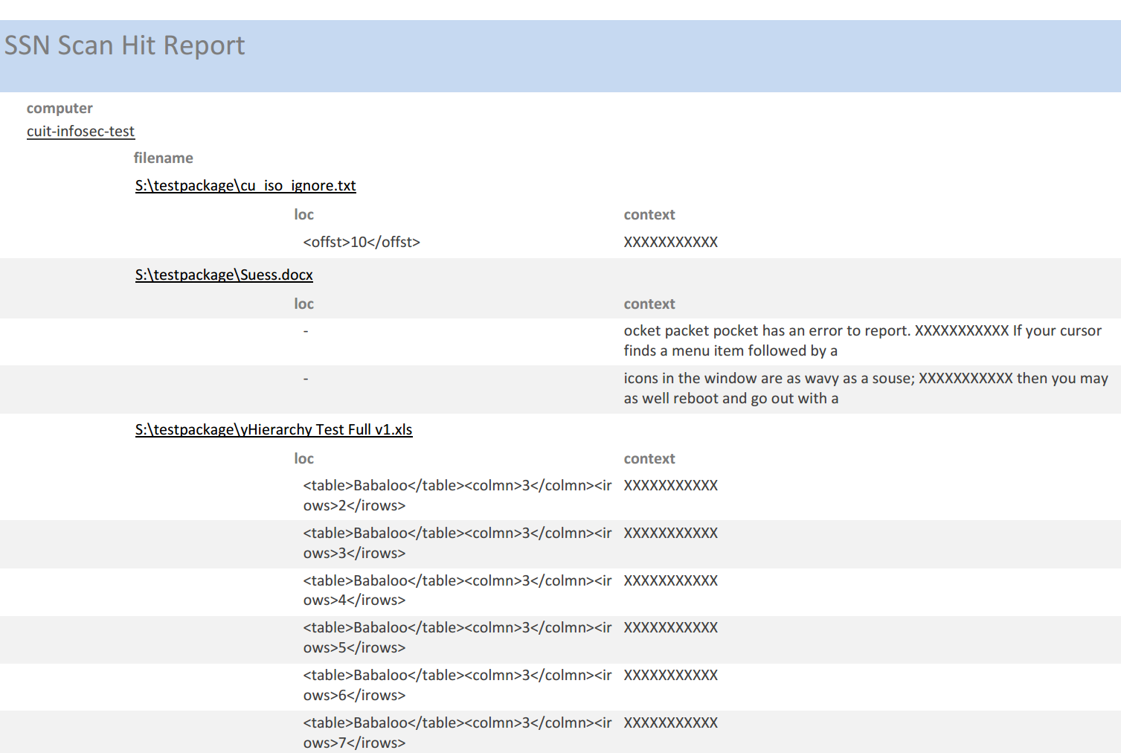
Finding the data … Spider Central

Slide 23
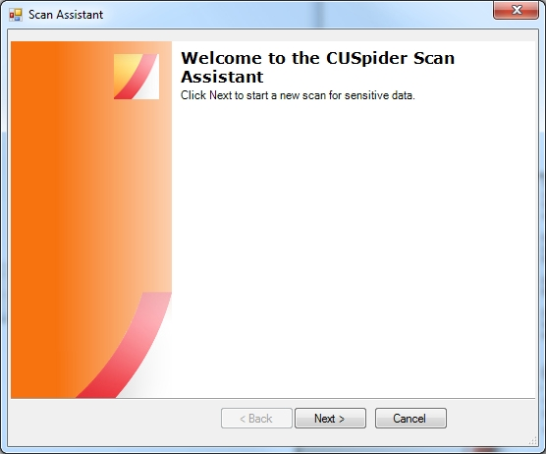
Finding the data … Spider desktop
Download CUSpider at
https://cuit.columbia.edu/content/cuspider-pii-scanning-application

Slide 24
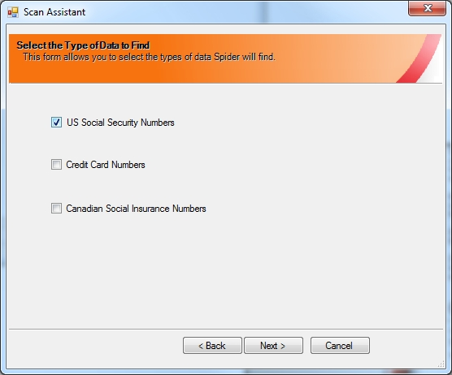

Slide 25
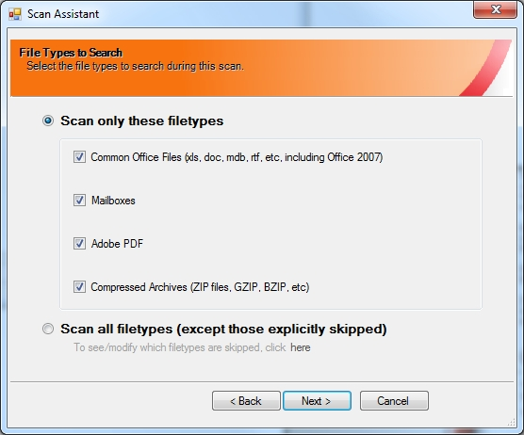

Slide 26
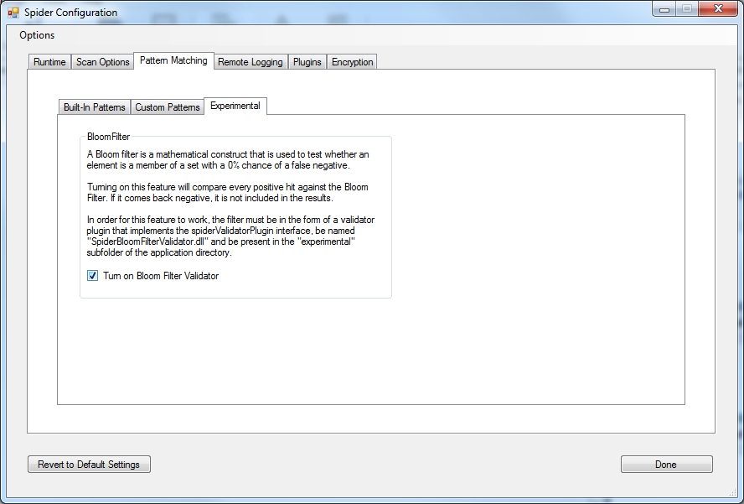

Slide 27
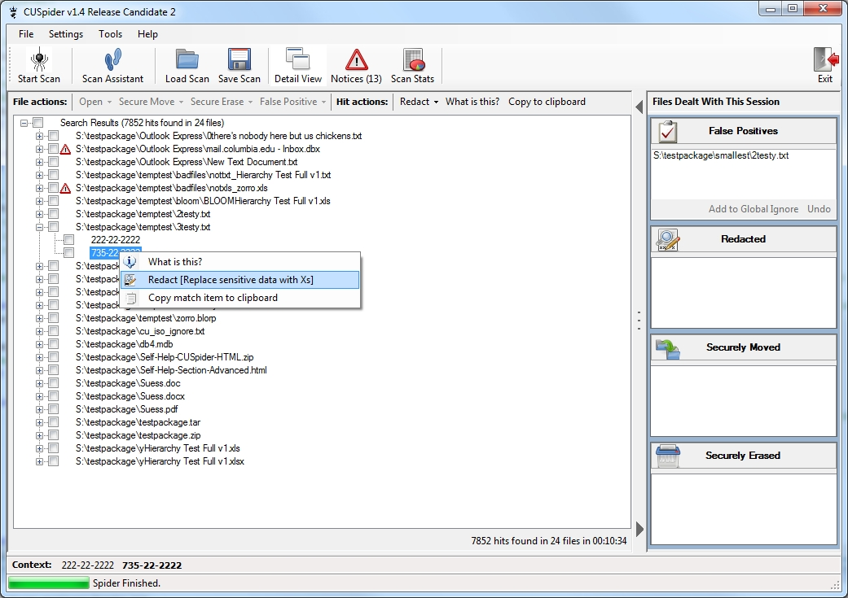

Slide 28

Finding the data … Email
Look at outgoing email using an automated scanning tool
Columbia is using Proofpoint
We are looking for:
  Nine digit numbers that are Columbia SSNs
  Numbers that match the SSN pattern XXX-XX-XXXX
To reduce false positives, we look for at least 10 unique numbers that match the pre-loaded numbers
If email matches pattern, we block it and send a message to sender asking them to encrypt and resend

Slide 29

Finding the data … In the Cloud
Now this is where the fun begins
  Data in the clouds is mostly beyond your reach
  You may be able to find it if you are using an enterprise wide cloud system (i.e. Google for Education/Business)
    We are using CloudLock to find check data stored in Google Drive
Mostly, your data will only be protected by your policy
  Our data encryption policy requires sensitive data to be encrypted regardless of where it is stored
  Trust, but Verify – not always possible in the Cloud

Slide 30
Consequences of losing data
Reputational damage
  Front page, NY Times – Not something that you want
Financial damage
  NYS disclosure law – we estimate that each lost SSN will cost between $150 and $200
    The number of data breaches and the number of exposed records in the U.S. have reached the highest figures to date in 2017. Nearly 179 million records were exposed in the U.S. in 2017, whereas the number of data breaches in the country added up to 1,579 that year. The business sector was the most affected by data theft as this particular sector accounted for nearly 91.3 percent of all exposed records in 2017.

Slide 31

Consequences of losing data …
Loss of confidence
  Nothing will get upper management more uneasy than a letter saying that their SSN, Name and Birthday may have been exposed through an inadvertent loss of data
Loss of Job
  Enuf said ….

Slide 32
Consequences of losing data …
Let’s do a quick example
  Let’s say a file containing an extract from a database gets left on a desktop system. The file contains Name, Address, Phone, DOB, SSN and there are 5,000 records in that file.
  Now lets say that the computer somehow “walks” out the door and it’s not encrypted.
  Using the number $194 per SSN, the computer will cost the University about $900 for the hardware and about $470,000 for the file

Slide 33
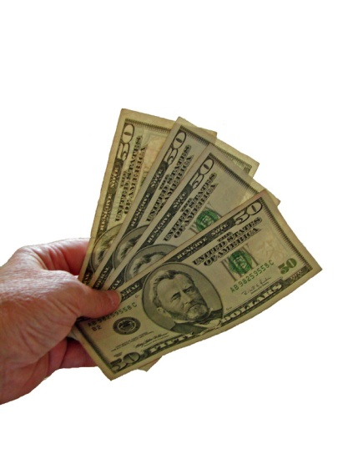
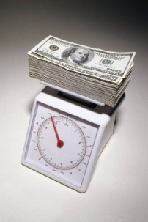
Costs for doing DLP – and ROI
Hardware
  Servers needed to run centralized data finders/sniffers
Software
  Search software – can be commercial or open source
Personnel
  You will need a person or people to process the output of your data sniffers. Remember that there are usually a significant number of false positives, which means that there will be lots of work for these people.
ROI (Return On Investment)
  You do the math – one breach can pay for a lot of DLP

Slide 34
Summary
DLP is not a cool and sexy security project
No matter what you do, DLP is not going to be perfect
A lot of groundwork needs to be done before you can start looking for the data (Governance, Policies)
Looking for the data will not be neat, easy or stress free
Mitigating the data found will not be fun
Finding a file with 50,000 SSNs, Names and Birthdays before it gets out will be Priceless
  … or about $9,700,000

Slide 35

Questions
Joel Rosenblatt
joel@columbia.edu

