Slide 1
InfoSec in the Telecommuting World
Virtual Security Camp
August 13, 2020
Or: How I spent my pandemic vacation

Slide 2
Who am I to talk about telecommuting security?
Sherry Horeanopoulos (formerly Help Desk Manager, Systems Admin, Project Manager and ISO) 28 years in IT
  CISO (recently dubbed) at Fitchburg State University
    Information Security Department of 2 (includes an - also newly dubbed - ISO)
  FSU is a Massachusetts State University
  Located in Central Massachusetts
  Undergrad students – Roughly 3500
  Grad students – Roughly 1400
  Full-time Staff – 300+
  Full-time Faculty - 200+
  +Adjuncts, part time employees and online students

Slide 3
The FSU COVID Calendar of Events
Friday, March 5, 2020 - Campus cheerfully vacates for Spring Break
March 8-12, 2020 - Spring Break Week
March 15-19, 2020 - Spring Break Extension Week
  FACULTY CRASH COURSE in “How to teach your classes online”…“for a few weeks until this thing is over”….
  STAFF Chaos week – Support everyone in setting up a home office
  Coupled with “let’s mail everyone a Chromebook” before classes resume
    Oh yes and maybe a MIFI thingy
  What do you mean, “Where can we order a couple hundred Chromebooks?”…”and MIFI thingies”?
March 22, 2020 - University of Fitchburg Online
(hereinafter known as UFO)

Slide 4
Let’s just be clear…
Never in the History of Massachusetts Public Higher Education have 9 State colleges and universities, plus 15 community colleges and the Board of Higher Education, plus 5 UMass campuses and Chancellors proposed and acted upon such a monumental systemic change and come to a common decision so quickly!
In days of consensus-reaching and thoughtful decision-making, we would, of course, have made rational and logical decisions about the ramifications of abandoning Brick and Mortar, including planning for responsible and robust security measures.
Instead we summoned all of our professional experience and instinct and said, “Holy Crap. We have to get this place online in a week!”

Slide 5
Mission Possible
All hands on deck in IT
  Network Engineers, CIO, IT Directors, Programmers, ISOs, Help Desk employees joined in a singular purpose – get employees online and working from home.
  Cyber Security was second fiddle to the mission
  Best Disaster Recovery Plan Test EVER!
  If you already have a robust Information Security Plan – and the tools to implement it – you were in reasonably good shape, with notable exceptions
  If you were already struggling with Security, well, best of luck to you!

Slide 6
Immediate Problems
Evacuating Offices
  Not everyone is issued a laptop
  Some people were bringing home full desktop setups
  Most employees unaware of exactly what was needed for telecommuting
VPN vs. Virtual Desktop remote access to Banner/other local apps and services
Payroll! Who knew the State Apps worked poorly from home?!
Multi Factor Authentication deployment
  Smart Phone as a “token”
Home Internet Access
Management policies for Telecommuting – confidence/doubt that employees will successfully work from home

Slide 7
Telecommuting for 6 months – longer term concerns!
Password Expiration policy in Active Directory
Domain-bound machines and related policies
Windows patches and updates controlled through SCCM or faith
Microsoft Office and OS updates depending on local services/license key servers
McAfee Antivirus updates controlled through on-prem ePO
Cloud Services work! Who knew?
Zoom. Google Hangouts and MEET
Auditing

Slide 8
IT Security and the terrible, horrible, no good, very bad Pandemic
Things we may have prepared for if we only knew:
  Overall institution focus is narrowed on the coronavirus its effect on the work environment.
  Computer viruses, malware, and security in general are being overlooked by management, IT staff and remote workers.
  Bad actors are taking advantage in this time of chaos.
  Workers, stressed about the virus, and in a less familiar computing environment, are inclined to forget their security training and are more likely to click a link in a phishing email or interact with a malicious website or hacker
  Security Training = Workplace
  Eager-to-assist and overworked Help Desk does not enable workforce to “fish”. It’s quicker to “fix” than “teach”.

Slide 9
If we only knew, continued
Hours of work can be flexible! Commute time = 0
  Resources for the workforce may not always coincide with flexible schedules
Remote Technologies present new opportunities and new challenges (ZOOM bombing!) and risks
And by the way, who had a Telework Policy in effect. Anyone? Bueller? Do established Security Policies address guidelines for working from home?

Slide 10
If we could start again….
Takeaways:
  Everyone should be issued a University-owned, configured and maintained mobile device. Period.
  Employees need to understand the applications and services they use. Mandatory training and participation in setup and use is important to successful telecommuting and security
  Security Awareness Training needs to consider both the workplace and alternative environments…appeal to the personal experience of trainees.
  The perceived riskiness of cloud services is far outweighed by the assurance that the services and applications are readily available remotely

Slide 11
Takeaways, continued
Multifactor Authentication for all
Local Admin Credentials
Engaging online Security Training (let ‘em know you’re still watching)
Control is an illusion…make sure resources are available on campus and remotely (External Repositories for updates to AV!)
Update loaner equipment regularly
Remote work is the new norm. (Finally!) It isn’t going away, and has proven to be surprisingly productive – which may require a review and upgrade of Security Policies and procedures
Promote a new level of enabling workers to be their own first responders in the world of IT HelpDesking

Slide 12
Counting Blessings
SO GLAD FSU made the switch to Google/GSuite Enterprise on November 22.
  Google Drives
  Gmail – cut down significantly on SPAM and Phishing
  Google Meet – easy to access and provide training – intuitive
  Robust DLP for Drive – but still allows sharing
  Chat and Hangouts – Great for quick check-ins and helping users
Chrome Remote Assistance – awesome for helping end-users
VPN and Virtual Desktop

Slide 13
To Do List for the CISO
Review Security Policies
  Where needed - adjust for Telework.
  Provide Guidelines for working from home
  Specify that campus-provided computers should not be used by family members nor should home computers be used tor business!
Adjust CyberSecurity Awareness Training to include remote workplace information
  Create online, recorded versions – in small doses
Take a look at Disaster Recovery Plan and update with “Lessons Learned”
Review Firewall Policies
  Remote access may have affected or been affected by emergency situation and rapid decisions

Slide 14
To Dos
Crosstrain! Redundancy in IT, especially as people burn out and need a break is critical when both the workforce and support people are remote.
Bump up licenses for VPN. Add client to laptop image
Adjust patching and update policies to effectively work remotely
Reset Password Expiration…(Best of luck with this!!)
Communicate! Encourage everyone to come to campus and connect for at least 15 minutes….to update and receive policy changes
Adjust Spirion to search for data on Google Drives

Slide 15
A knowledgeable workforce is a secure workforce
Protecting our institutions (or employees) from themselves has gone too far
Telecommuting requires that employees be self-reliant
Workarounds to make technology easier create robotic employees
  “I used to just click on this shortcut”
  “I’d just call Peter and he’d drop by and do something to my screen”
End the workarounds and EXPECT proficiency. Create problem-solvers, not dependents. Discourage fear.
Employees who UNDERSTAND what they are doing are SAFE in performing their work.
Train and Enable.

Slide 16
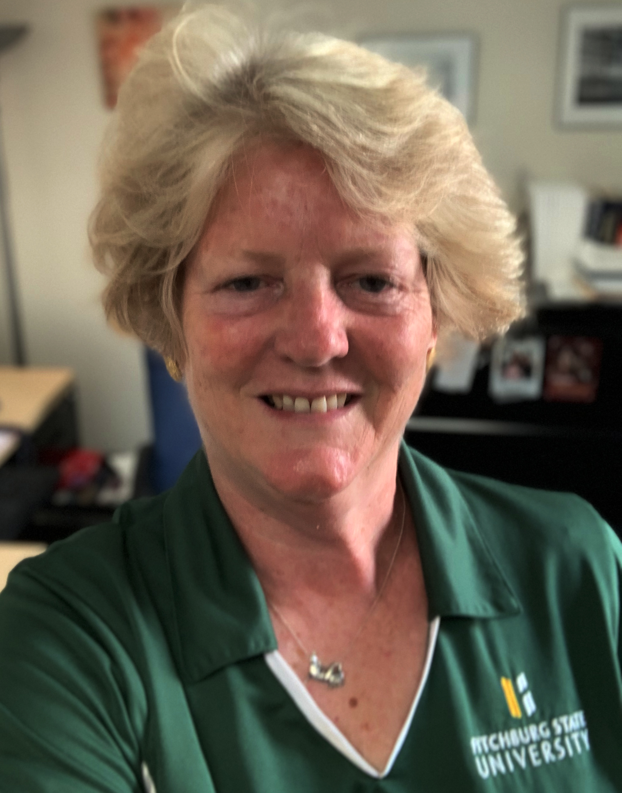
Questions? Comments?
Thanks for attending!
Contact info:
Sherry Horeanopoulos
Fitchburg State University
sah@fitchburgstate.edu

