Slide 1



GuidePoint Security
Infosec Observations From the Life of a Security Consultant
guidepointsecurity.com | GuidePoint Security © 2020

Slide 2

Introductions
20 years in Information Security
10+ years in security practitioner roles
  The Walt Disney Co.
  Publix Super Markets, Inc
  GuidePoint since 2012
Gary Brickhouse
CISO | VP, GRC Services

Slide 3


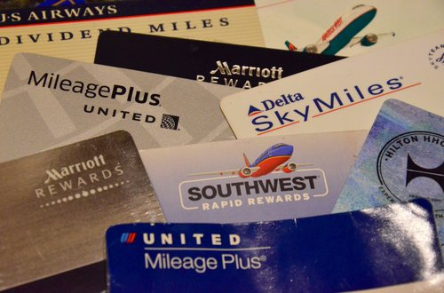
What this talk is NOT about
How to maximize your frequent traveler points
Clear up consulting lifestyle misconceptions

Slide 4

What are we here to talk about?
Three Key Observations
Getting Back to the Basics
InfoSec Pressures
Changing Landscape

Slide 5

Getting Back to the Basics

Slide 6
Just the Basics
Vulnerability Management
Good News:
Per the Verizon Data Breach and Investigations Report (DBIR), vulnerability exploits continue to decrease
Warning:
Not the time to relax
Must continue with comprehensive patch management

Slide 7

Just the Basics
Vulnerability Management
Zero Day Exploits aren’t necessarily your biggest issue
VS.

Slide 8
Just the Basics
Vulnerability Management
CVE | Date Published
CVE-2012-0158 | 04/10/2012
CVE-2015-1641 | 04/14/2015
CVE-2017-5638 | 03/10/2017
CVE-2017-0143 | 03/16/2017
CVE-2017-0199 | 4/12/2017
CVE-2017-8759 | 09/12/2017
CVE-2017-11882 | 11/14/2017
CVE-2018-4878 | 02/06/2018
CVE-2018-7600 | 03/29/2018
CVE-2019-0604 | 03/05/2019
Top 10 Most Exploited Vulnerabilities 2016–2019
Source: https://us-cert.cisa.gov/ncas/alerts/aa20-133a

Slide 9
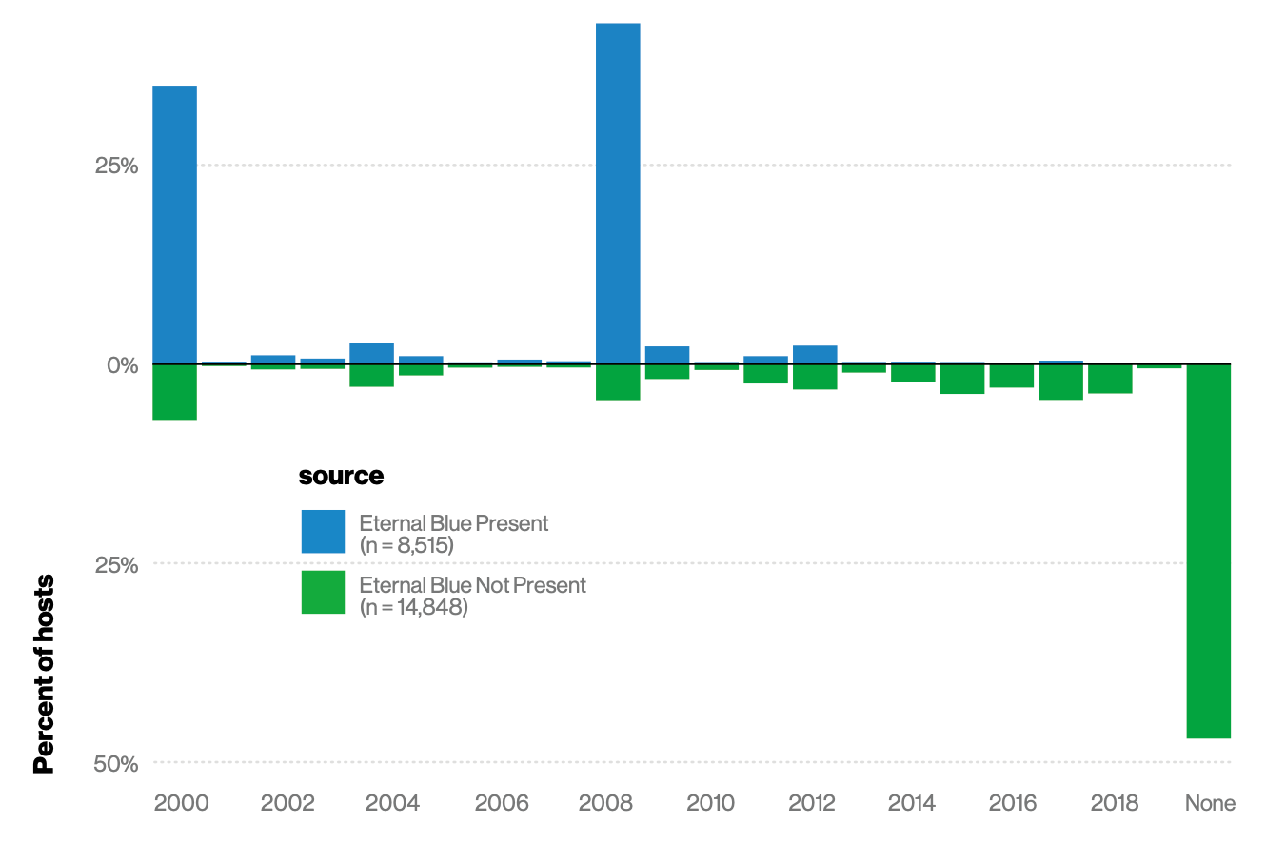
Just the Basics
Vulnerability Management
Source: 2020 Verizon DBIR

Slide 10
Just the Basics
Application Security
Reactive
vs.
Proactive

Slide 11
Just the Basics
Application Security
Lacking Proactive Activities:
Security integration into SDLC
Secure code standards and practices for Developers
  OWASP Top 10
    Four of the top 10 have been there since 2004!
    Six of the top 10 have been there since 2013!

Slide 12
Just the Basics
Application Security
OWASP Top 10 | 2017 | 2013 | 2010 | 2007 | 2004
A1-Injection | X | X | X | X | X
A2-Broken Authentication | X | X | X | X | X
A3-Sensitive Data Exposure | X | X
A4-XML External Entities (XXE) | X
A5-Broken Access Control | X
A6-Security Misconfiguration | X | X | X |  | X
A7-Cross-Site Scripting (XSS) | X | X | X | X | X
A8-Insecure Deserialization | X
A9-Using Components with Known Vulnerabilities | X | X
A10-Insufficient Logging & Monitoring | X

Slide 13
Just the Basics
Application Security
43%
of breaches involved web app attacks
2x
increase over 2019 findings
Source: 2020 Verizon DBIR
Source: 2020 Verizon DBIR

Slide 14
Just the Basics
Credential Management
Reuse of credentials / passwords
Simple, commonly used passwords
Lack of MFA
No password management tools
80%
of breaches within Hacking involve brute force or the use of lost or stolen credentials
Source: 2020 Verizon DBIR

Slide 15

Just the Basics
Patching the Human Firewall
Preventative controls are helping
  Not a replacement for good security awareness and training
Users seem blissfully unaware of the value of data or their impact on data security

Slide 16
Just the Basics
Network Segmentation
Attacker
Flat Network

Slide 17
InfoSec Pressures

Slide 18


Under Pressure
Keeping up with attackers
20 years ago the hardened perimeter was your best defense
Today it’s defense-in-depth and zero trust

Slide 19
Under Pressure
Keeping up with attackers
Ransomware is on the rise
Up from 48% in 2019
Primary EDU distribution means through websites
  Unmonitored web-based mail from BYOD
80%
of Malware-related incidents in EDU involved Ransomware
Source: 2020 Verizon DBIR

Slide 20
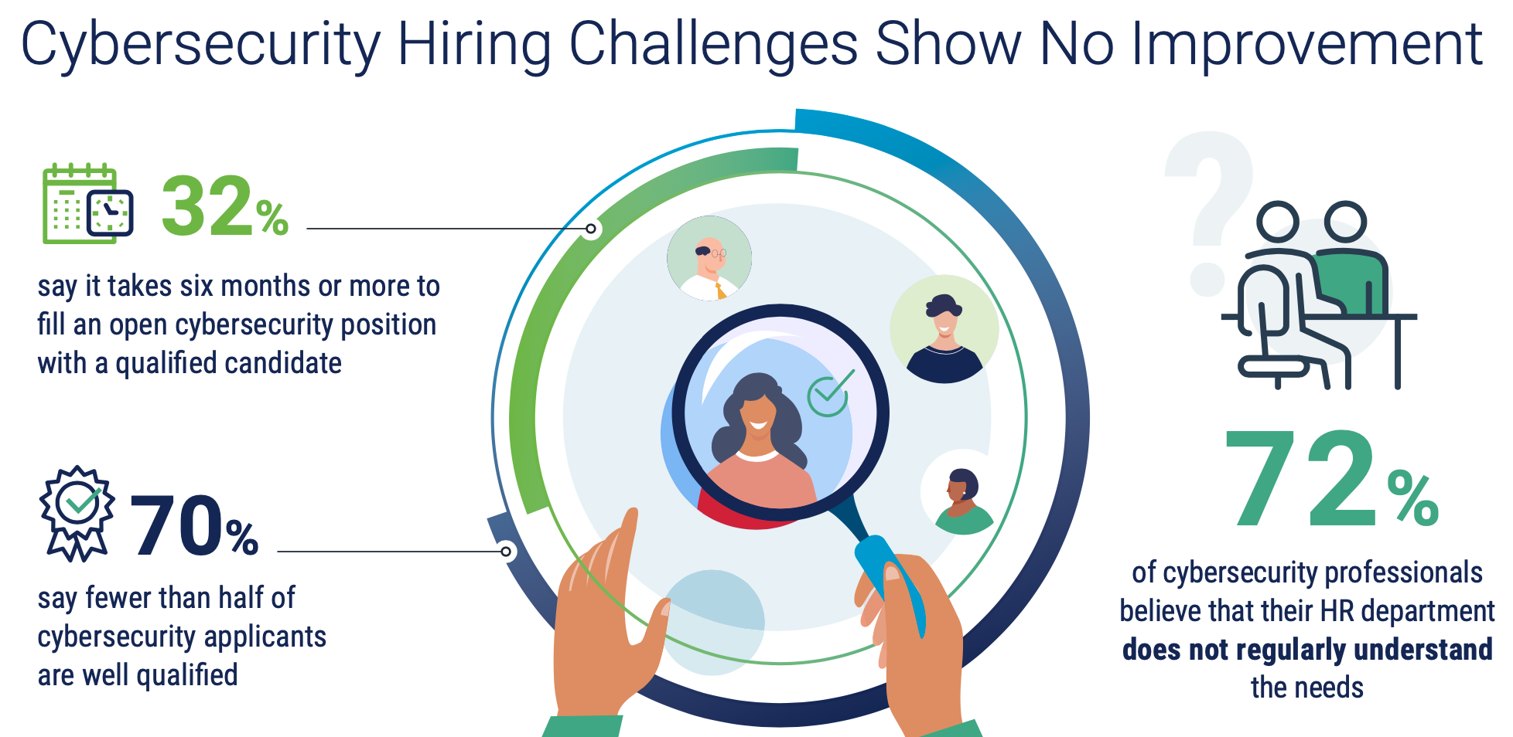
Under Pressure
Staffing
Getting them…
Source: ISACA State of Cybersecurity 2020

Slide 21
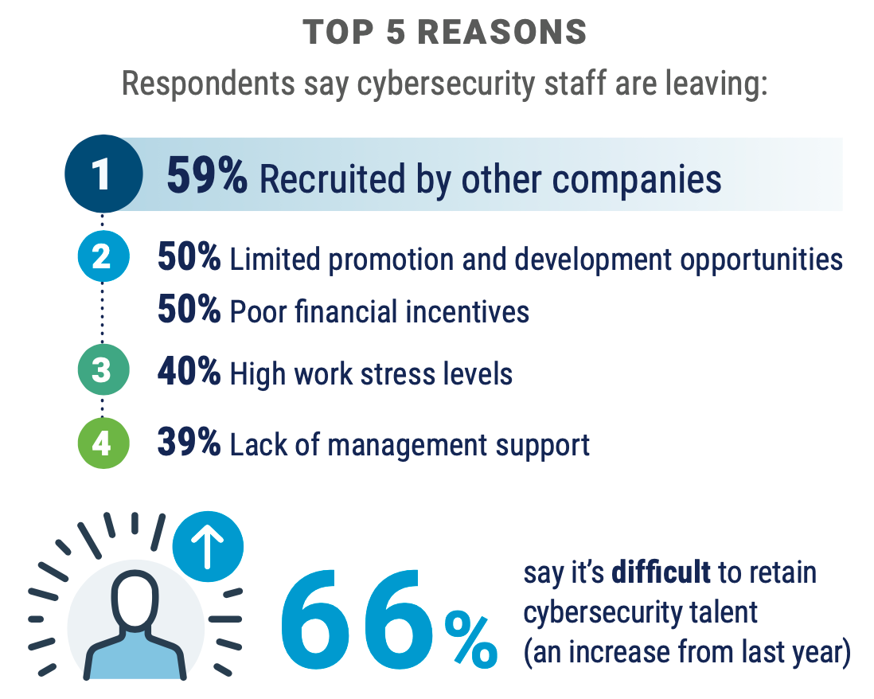
Under Pressure
Staffing
Keeping them…
Source: ISACA State of Cybersecurity 2020

Slide 22
Under Pressure
Chasing the Silver Bullet
Seen most often with technology solutions
Often lacks accounting for the necessary supporting people and processes

Slide 23
Changing Landscape

Slide 24

Changing Landscape
Data Privacy
State Legislation
New York
Maryland
Massachusetts
Hawaii
North Dakota
Washington
Here Today:
Proposed:

Slide 25
Changing Landscape
Data Privacy
Does this even apply to you?
Not-for-profit vs. For-profit
Vendors / Services Providers
  Obligation to protect covered data
Good reference article on this topic:
https://iapp.org/news/a/what-does-the-ccpa-mean-for-colleges-and-universities/

Slide 26
Changing Landscape
Data Privacy
Considerations for both Privacy and InfoSec
Privacy Implications
Right of Access
Right of Erasure
Right to Data Portability
Right to Object / Opt-Out
Breach Notification
Security Implications
pseudonymization and encryption of personal data
Appropriate measures based on risk which may include:
restore the availability and access to personal data
regularly testing, assessing and evaluating the effectiveness of controls

Slide 27

Changing Landscape
Third Party Risk Management
Breaches are regularly occurring
Breach through Canon Business Process Services
Data-leak through unauthorized access to an employee email account
Employee personal data
Breach through Third-party cloud hosting service
Misconfigured cloud services
Exposed SSN’s, drivers license numbers
Breach through Third Party Email Vendor
Malicious attack to access email accounts
>1MM customers and employees impacted
Ransomware
Exposed data from Tesla, SpaceX, Boeing, Lockheed Martin

Slide 28
Changing Landscape
Third Party Risk Management
60%
of organizations believe they are only somewhat or not effective at vetting third parties
Key Considerations
Vendor Identification
  Critical / High Risk
Assessment Strategy
Contractual Requirements
Resources
8%
of assessments result in organizational action
Source: The Cost of Third-Party Cybersecurity Risk Management
Ponemon Institute LLC, March 2019

Slide 29
Changing Landscape
Remote Workforce
Key Challenges
Decentralization
Reliance on home networks
Remote connectivity
End point protection
Data leakage

Slide 30
Lessons learned…

Slide 32
Thank You
Gary Brickhouse
gary.brickhouse@guidepointsecurity.com

