Slide 1
Introduction to C++: Part 2

Slide 2
Tutorial Outline: Parts 2 and 3
References and Pointers
The formal concepts in OOP
More about C++ classes
Inheritance, Abstraction, and Encapsulation
Virtual functions and Interfaces

Slide 3
References and Pointers
Part 1 introduced the concept of passing by reference when calling functions.
  Selected by using the & character in function argument types: int add (int &a, int b)
References hold a memory address of a value.
  int add (int &a, int b)→ a has the value of a memory address, b has an integer value.
  Used like regular variables and C++ automatically fills in the value of the reference when needed:
  int c = a + b ; → “retrieve the value of a and add it to the value of b”
From C there is another way to deal with the memory address of a variable: via pointer types.
Similar syntax in functions except that the & is replaced with a *:
int add (int *a, int b)
To get a value a pointer requires manual intervention by the programmer:
int c = *a + b ; → “retrieve the value of a and add it to the value of b”

Slide 4
 | Reference | Pointer
Declaration | int &ref ; | int *ptr ;
Set memory address to something in memory | int a = 0 ; int &ref = a ; | int a = 0 ; int *ptr = &a ;
Fetch value of thing in memory | cout << ref ; | cout << *ptr ;
Can refer/point to nothing (null value)? | No | Yes
Can change address that it refers to/points at? | No. int a = 0 ; int b = 1 ; int &ref = a ; ref = b ; // value of a is now 1! | Yes int a = 0 ; int b = 1 ; int *ptr = &a ; ptr = &b ; // ptr now points at b
Object member/method syntax | MyClass obj ; obj &ref = obj ; ref.member ; ref.method(); | MyClass obj ; obj *ptr = obj ; ptr->member ; ptr->method(); // OR (*ptr).member ; (*ptr).method() ;
int a = 0 ;
int &ref = a ;
int *ptr = &a ;
int a: 4 bytes in memory at address 0xAABBFF with a value of 0.
Value stored in ref: 0xAABBFF
Value stored in ptr: 0xAABBFF

Slide 5
When to use a reference or a pointer
Bother references and pointers can be used to refer to objects in memory in methods, functions, loops, etc.
Avoids copying due to default call-by-value C++ behavior
  Could lead to memory/performance problems.
  Or cause issues with open files, databases, etc.
If you need to:
  Hold a null value (i.e. point at nothing), use a pointer.
  Re-assign the memory address stored, use a pointer.
Otherwise, use a reference.
  References are much easier to use, no funky C-style pointer syntax.
  Same benefits as a pointer, with less chance for error.
  Also no need to check if a reference has a null value…since they can’t.
void add(const int *a, const int b, int *c)
{
if (a) { // check for null pointer
*c = *a + b ;
}
}

Slide 6
The formal concepts in OOP
Encapsulation
Inheritance
Abstraction
Polymorphism
Object-oriented programming (OOP):
  Defines classes to represent data and logic in a program. Classes can contain members (data) and methods (internal functions).
  Creates instances of classes, aka objects, and builds the programs out of their interactions.
The core concepts in addition to classes and objects are:
  Encapsulation
  Inheritance
  Polymorphism
  Abstraction
OOP

Slide 7
Core Concepts
Encapsulation
  As mentioned while building the C++ class in the last session.
  Bundles related data and functions into a class
Inheritance
  Builds a relationship between classes to share class members and methods
Abstraction
  The hiding of members, methods, and implementation details inside of a class.
Polymorphism
  The application of the same code to multiple data types
  There are 3 kinds, all of which are supported in C++. However only 1 is actually called polymorphism in C++ jargon (!)

Slide 8
C++ Classes
#ifndef RECTANGLE_H
#define RECTANGLE_H
class Rectangle
{
public:
Rectangle();
virtual ~Rectangle();
float m_length ;
float m_width ;
float Area() ;
protected:
private:
};
#endif // RECTANGLE_H
Open the Part 2 Shapes project in C::B
In the Rectangle class C::B generated two methods automatically.
Rectangle() is a constructor. This is a method that is called when an object is instantiated for this class.
  Multiple constructors per class are allowed
~Rectangle() is a destructor. This is called when an object is removed from memory.
  Only one destructor per class is allowed!
  (ignore the virtual keyword for now)

Slide 9
Encapsulation
Bundling the data and area calculation for a rectangle into a single class is and example of the concept of encapsulation.

Slide 10
Construction and Destruction
The constructor is called when an object is created.
This is used to initialize an object:
  Load values into member variables
  Open files
  Connect to hardware, databases, networks, etc.
The destructor is called when an object goes out of scope.
Example:
Object c1 is created when the program reaches the first line of the function, and destroyed when the program leaves the function.
void function() {
ClassOne c1 ;
}

Slide 11
When an object is instantiated…
#include "rectangle.h"
int main()
{
Rectangle rT ;
rT.m_width = 1.0 ;
}
The rT object is created in memory.
When it is created its constructor is called to do any necessary initialization.
  Here the constructor is empty so nothing is done.
The constructor can take any number of arguments like any other function but it cannot return any values.
  Essentially the return value is the object itself!
What if there are multiple constructors?
  The compiler chooses the correct one based on the arguments given.
#include "rectangle.h"
Rectangle::Rectangle()
{
//ctor
}
Note the constructor has no return type!

Slide 12
A second constructor
#include "rectangle.h"
/* OK to do this */
Rectangle::Rectangle(float width, float length)
{
m_width = width ;
m_length = length ;
}
rectangle.h
class Rectangle
{
public:
Rectangle();
Rectangle(float width, float length) ;
/* etc */
};
OR
rectangle.cpp
#include "rectangle.h“
/* Better to do this */
Rectangle::Rectangle(float width, float length) :
m_width(width),m_length(length) { }
Two styles of constructor. Above is the C++11 member initialization list style. At the top is the old way. C++11 is preferred.
With the old way the empty constructor is called automatically even though it does nothing – it still adds a function call.
Same rectangle.h for both styles.

Slide 13
Member Initialization Lists
Syntax:
Colon goes here
MyClass(int A, OtherClass &B, float C):
m_A(A),
m_B(B),
m_C(C) {
/* other code can go here */
}
Members assigned and separated with commas. Note: order doesn’t matter.
Additional code can be added in the code block.

Slide 14
And now use both constructors
#include <iostream>
using namespace std;
#include "rectangle.h"
int main()
{
Rectangle rT ;
rT.m_width = 1.0 ;
rT.m_length = 2.0 ;
cout << rT.Area() << endl ;
Rectangle rT_2(2.0,2.0) ;
cout << rT_2.Area() << endl ;
return 0;
}
Both constructors are now used. The new constructor initializes the values when the object is created.
Constructors are used to:
  Initialize members
  Open files
  Connect to databases
  Etc.

Slide 15
Default values
#ifndef RECTANGLE_H
#define RECTANGLE_H
class Rectangle
{
public:
Rectangle();
virtual ~Rectangle();
// could do:
float m_length = 0.0 ;
float m_width = 0.0 ;
float Area() ;
protected:
private:
};
#endif // RECTANGLE_H
C++11 added the ability to define default values in headers in an intuitive way.
Pre-C++11 default values would have been coded into constructors.
If members with default values get their value set in constructor than the default value is ignored.
  i.e. no “double setting” of the value.

Slide 16
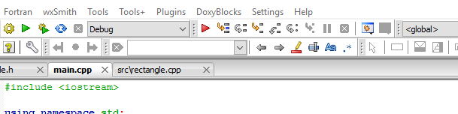
Using the C::B Debugger
To show how this works we will use the C::B interactive debugger to step through the program line-by-line to follow the constructor calls.
Make sure you are running in Debug mode. This turns off compiler optimizations and has the compiler include information in the compiled code for effective debugging.

Slide 17
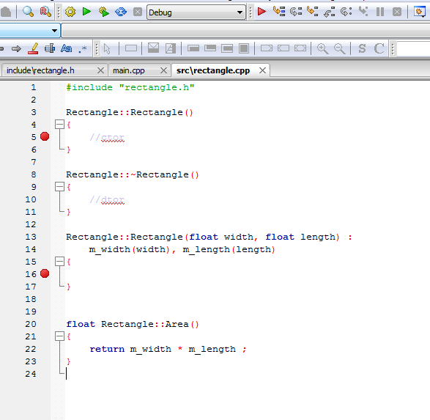

Add a Breakpoint
Breakpoints tell the debugger to halt at a particular line so that the state of the program can be inspected.
In rectangle.cpp, double click to the left of the lines in the constructors to set a pair of breakpoints. A red dot will appear.
Click the red arrow to start the code in the debugger.

Slide 18
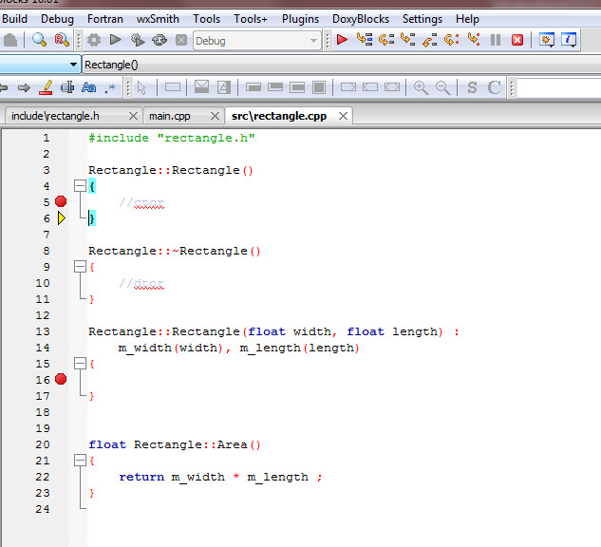
The program has paused at the first breakpoint in the default constructor.
Use the Next Line button to go back to the main() routine.
Press the red arrow to continue execution – stops at the next breakpoint.

Slide 19
Default constructors and destructors
The two methods created by C::B automatically are explicit versions of the default C++ constructors and destructors.
Every class has them – if you don’t define them then empty ones that do nothing will be created for you by the compiler.
  If you really don’t want the default constructor you can delete it with the delete keyword. Also in the header file you can use the default keyword if you like to be clear.
You must define your own constructor when you want to initialize an object with arguments (as done here)
A custom destructor is always needed when internal members in the class need special handling.
  Examples: manually allocated memory, open files, hardware drivers, database or network connections, custom data structures, etc.

Slide 20

Destructors
Note the destructor has no return type and is named with a ~. This class just has 2 floats as members which are automatically removed from memory by the compiler.
Destructors are called when an object is destroyed.
There is only one destructor allowed per class.
Objects are destroyed when they go out of scope.
Destructors are never called explicitly by the programmer. Calls to destructors are inserted automatically by the compiler.
Rectangle::~Rectangle()
{
//dtor
}
~House() destructor
House object

Slide 21
Scope
Scope is the region where a variable is valid.
Constructors are called when an object is created.
Destructors are only ever called implicitly.
int main() { // Start of a code block
// in main function scope
float x ; // No constructors for built-in types
ClassOne c1 ; // c1 constructor ClassOne() is called.
if (1){ // Start of an inner code block
// scope of c2 is this inner code block
ClassOne c2 ; //c2 constructor ClassOne() is called.
} // c2 destructor ~ClassOne() is called.
ClassOne c3 ; // c3 constructor ClassOne() is called.
} // leaving program, call destructors for c3 and c1 ~ClassOne()
// variable x: no destructor for built-in type

Slide 22
Copy, Assignment, and Move Constructors
The compiler will automatically create constructors to deal with copying, assignment, and moving.
  Moving occurs, for example, when an object is created and added to a list in a loop.
  Moving is an optimization feature that’s part of C++11.
Dealing with the details of these constructors is outside of the scope of this tutorial
How do you know if you need to write one?
  When you move, assign, or copy an object in your code and the code won’t compile!
  OR you move, assign, or copy an object, it compiles, but unexpected things happen when running.
You may require custom code when...
  dealing with open files inside an object
  The class manually allocated memory
  Hardware resources (a serial port) opened inside an object
  Etc.
Rectangle rT_1(1.0,2.0) ;
// Now use the copy constructor
Rectangle rT_2(rT_1) ;
// Do an assignment, with the
// default assignment operator
rT_2 = rT_1 ;

Slide 23
So Far…
Define a C++ class
  Adding members and methods
Use separate header and source files for a C++ class.
Class constructors & destructors
OOP concept: Encapsulation

Slide 24

The formal concepts in OOP
Encapsulation
Inheritance
Abstraction
Polymorphism
Next up: Inheritance
OOP

Slide 25
Inheritance
Inheritance is the ability to form a hierarchy of classes where they share common members and methods.
  Helps with: code re-use, consistent programming, program organization
This is a powerful concept!
Molecule
Inorganic
Organic
Mineral
Protein

Slide 26
Inheritance
Superclass
Base Class
The class being derived from is referred to as the base, parent, or super class.
The class being derived is the derived, child, or sub class.
For consistency, we’ll use superclass and subclass in this tutorial. A base class is the one at the top of the hierarchy.
Molecule
Inorganic
Organic
Mineral
Protein
Subclass

Slide 27
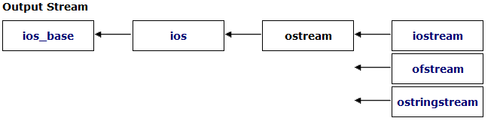
Inheritance in Action
Streams in C++ are series of characters – the C+ I/O system is based on this concept.
cout is an object of the class ostream. It is a write-only series of characters that prints to the terminal.
There are two subclasses of ostream:
  ofstream – write characters to a file
  ostringstream – write characters to a string
Writing to the terminal is straightforward:
cout << some_variable ;
How might an object of class ofstream or ostringstream be used if we want to write characters to a file or to a string?

Slide 28
Inheritance in Action
For ofstream and ofstringstream the << operator is inherited from ostream and behaves the same way for each from the programmer’s point of view.
The ofstream class adds a constructor to open a file and a close() method.
ofstringstream adds a method to retrieve the underlying string, str()
If you wanted a class to write to something else, like a USB port…
  Maybe look into inheriting from ostream!
    Or its underlying class, basic_ostream which handles types other than characters…

Slide 29
Inheritance in Action
#include <iostream> // cout
#include <fstream> // ofstream
#include <sstream> // ostringstream
using namespace std ;
void some_func(string msg) {
cout << msg ; // to the terminal
// The constructor opens a file for writing
ofstream my_file("filename.txt") ;
// Write to the file.
my_file << msg ;
// close the file.
my_file.close() ;
ostringstream oss ;
// Write to the stringstream
oss << msg ;
// Get the string from stringstream
cout << oss.str() ;
}

Slide 30
Single vs Multiple Inheritance
A
C++ supports creating relationships where a subclass inherits data members and methods from a single superclass: single inheritance
C++ also support inheriting from multiple classes simultaneously: Multiple inheritance
This tutorial will only cover single inheritance.
Generally speaking…
  Multiple inheritance requires a large amount of design effort
  It’s an easy way to end up with overly complex, fragile code
  Java, C#, and Python (all came after C++) exclude multiple inheritance on purpose to avoid problems with it.
B
C
D
  With multiple inheritance a hierarchy like this is possible to create. This is nicknamed the Deadly Diamond of Death as it creates ambiguity in the code.
  We will briefly address creating interfaces in C++ later on which gives most of the desired functionality of multiple inheritance without the headaches.
“There are only two things wrong with C++: The initial concept and the implementation.”
– Bertrand Meyer (inventor of the Eiffel OOP language)

Slide 31
Public, protected, private
class Rectangle
{
public:
Rectangle();
Rectangle(float width, float length) ;
virtual ~Rectangle();
float m_width ;
float m_length ;
float Area() ;
protected:
private:
};
These keywords were added by C::B to our Rectangle class.
These are used to control access to different parts of the class during inheritance by other pieces of code.

Slide 32
C++ Access Control and Inheritance
A summary of the accessibility of members and methods:
Access | public | protected | private
Same class | Yes | Yes | Yes
Subclass | Yes | Yes | No
Outside classes | Yes | No | No
Inheritance
class Super {
public:
int i;
protected:
int j ;
private:
int k ;
};
class Sub : public Super {
// in methods, could access
// i and k from Parent only.
};
Outside code
Sub myobj ;
Myobj.i = 10 ; // ok
Myobj.j = 3 ; // Compiler error

Slide 33
Abstraction
Having private (internal) data and methods separated from public ones is the OOP concept of abstraction.

Slide 34
C++ Inheritance Syntax
Inheritance syntax pattern:
class SubclassName : public SuperclassName
Here the public keyword is used.
  Methods implemented in class Sub can access any public or protected members and methods in Super but cannot access anything that is private.
Other inheritance types are protected and private.
class Super {
public:
int i;
protected:
int j ;
private:
int k ;
};
class Sub : public Super {
// ...
};

Slide 35
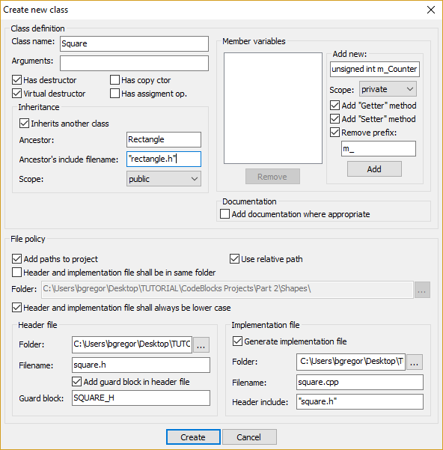
It is now time to inherit
The C::B program will help with the syntax when defining a class that inherits from another class.
With the Shapes project open, click on File → New → Class
Give it the name Square and check the “Inherits another class” option.
Enter Rectangle as the superclass and the include as “rectangle.h” (note the lowercase r)
Click Create!

Slide 36
square.h
square.cpp
#ifndef SQUARE_H
#define SQUARE_H
#include "rectangle.h"
class Square : public Rectangle
{
public:
Square();
virtual ~Square();
protected:
private:
};
#endif // SQUARE_H
#include "square.h"
Square::Square()
{
//ctor
}
Square::~Square()
{
//dtor
}
Note that subclasses are free to add any number of new methods or members, they are not limited to those in the superclass.
2 files are automatically generated: square.h and square.cpp
Class Square inherits from class Rectangle

Slide 37

A new constructor is needed.
A square is, of course, just a rectangle with equal length and width.
The area can be calculated the same way as a rectangle.
Our Square class therefore needs just one value to initialize it and it can re-use the Rectangle.Area() method for its area.
Go ahead and try it:
  Add an argument to the default constructor in square.h
  Update the constructor in square.cpp to do…?
  Remember Square can access the public members and methods in its superclass

Slide 38
Solution 1
#ifndef SQUARE_H
#define SQUARE_H
#include "rectangle.h"
class Square : public Rectangle
{
public:
Square(float width);
virtual ~Square();
protected:
private:
};
#endif // SQUARE_H
#include "square.h"
Square::Square(float length) :
m_width(width),
m_length(length)
{}
Square can access the public members in its superclass.
Its constructor can then just assign the length of the side to the Rectangle m_width and m_length.
This is unsatisfying – while there is nothing wrong with this it’s not the OOP way to do things.
Why re-code the perfectly good constructor in Rectangle?

Slide 39
The delegating constructor
C++11 added an additional alternate constructor syntax.
Using member initialization lists you can call one constructor from another. Here call a constructor within a class.
Even better: with member initialization lists C++ can call superclass constructors!
Rectangle::Rectangle(float width) :
Rectangle(width,7) {}

Slide 40
Solution 2
#ifndef SQUARE_H
#define SQUARE_H
#include "rectangle.h"
class Square : public Rectangle
{
public:
Square(float width);
virtual ~Square();
protected:
private:
};
#endif // SQUARE_H
#include "square.h"
Square::Square(float length) :
Rectangle(length, length)
{}
Square can directly call its superclass constructor and let the Rectangle constructor make the assignment to m_width and m_float.
This saves typing, time, and reduces the chance of adding bugs to your code.
  The more complex your code, the more compelling this statement is.
Code re-use is one of the prime reasons to use OOP.

Slide 41

Trying it out in main()
What happens behind the scenes when this is compiled….
#include <iostream>
using namespace std;
#include "square.h"
int main()
{
Square sQ(4) ;
// Uses the Rectangle Area() method!
cout << sQ.Area() << endl ;
return 0;
}
sQ.Area()
Square class does not implement Area() so compiler looks to superclass
Finds Area() in Rectangle class.
Inserts call to Rectangle.Area() method in compiled code.

Slide 42
More on Destructors
When a subclass object is removed from memory, its destructor is called as it is for any object.
Its superclass destructor is than also called .
Each subclass should only clean up its own problems and let superclasses clean up theirs.
Square object is removed from memory
~Square() is called
~Rectangle() is called

Slide 43
The formal concepts in OOP
Encapsulation
Inheritance
Abstraction
Polymorphism
Next up: Polymorphism
OOP

Slide 44

Using subclasses
A function that takes a superclass argument can also be called with a subclass as the argument.
The reverse is not true – a function expecting a subclass argument cannot accept its superclass.
Copy the code to the right and add it to your main.cpp file.
void PrintArea(Rectangle &rT) {
cout << rT.Area() << endl ;
}
int main() {
Rectangle rT(1.0,2.0) ;
Square sQ(3.0) ;
PrintArea(rT) ;
PrintArea(sQ) ;
}
The PrintArea function can accept the Square object sQ because Square is a subclass of Rectangle.

Slide 45

Overriding Methods
class Super {
public:
void PrintNum() {
cout << 1 << endl ;
}
} ;
class Sub : public Super {
public:
// Override
void PrintNum() {
cout << 2 << endl ;
}
} ;
Super sP ;
sP.PrintNum() ; // Prints 1
Sub sB ;
sB.PrintNum() ; // Prints 2
Sometimes a subclass needs to have the same interface to a method as a superclass with different functionality.
This is achieved by overriding a method.
Overriding a method is simple: just re-implement the method with the same name and arguments in the subclass.
In C::B open project:
CodeBlocks Projects → Part 2 → Virtual Method Calls

Slide 46
Overriding Methods
Seems simple, right?
To quote from slide 10 in Part 1 of this tutorial, C++: “Includes all the subtleties of C and adds its own”
Overriding methods is one of those subtleties.
class Super {
public:
void PrintNum() {
cout << 1 << endl ;
}
} ;
class Sub : public Super {
public:
// Override
void PrintNum() {
cout << 2 << endl ;
}
} ;
Super sP ;
sP.PrintNum() ; // Prints 1
Sub sB ;
sB.PrintNum() ; // Prints 2

Slide 47
How about in a function call…
class Super {
public:
void PrintNum() {
cout << 1 << endl ;
}
} ;
class Sub : public Super {
public:
// Override
void PrintNum() {
cout << 2 << endl ;
}
} ;
Given the class definitions, what is happening in this function call?
Using a single function to operate on different types is polymorphism.
void FuncRef(Super &sP) {
sP.PrintNum() ;
}
Super sP ;
Func(sP) ; // Prints 1
Sub sB ;
Func(sB) ; // Hey!! Prints 1!!
“C++ is an insult to the human brain”
– Niklaus Wirth (designer of Pascal)

Slide 48
Type casting
void FuncRef(Super &sP) {
sP.PrintNum() ;
}
The Func function passes the argument as a reference (Super &sP).
  What’s happening here is dynamic type casting, the process of converting from one type to another at runtime.
  Same mechanism as the dynamic_cast function
The incoming object is treated as though it were a superclass object in the function.
When methods are overridden and called there are two points where the proper version of the method can be identified: either at compile time or at runtime.

Slide 49
Virtual methods
class SuperVirtual
{
public:
virtual void PrintNum()
{
cout << 1 << endl ;
}
} ;
class SubVirtual : public SuperVirtual
{
public:
// Override
virtual void PrintNum()
{
cout << 2 << endl ;
}
} ;
void Func(SuperVirtual &sP)
{
sP.PrintNum() ;
}
SuperVirtual sP ;
Func(sP) ; // Prints 1
SubVirtual sB ;
Func(sB) ; // Prints 2!!
When a method is labeled as virtual and overridden the compiler will generate code that will check the type of an object at runtime when the method is called.
The type check will then result in the expected version of the method being called.
When overriding a virtual method in a subclass, it’s a good idea to label the method as virtual in the subclass as well.
  …just in case this gets subclassed again!

Slide 50
Early (static) vs. Late (dynamic) binding
Making a method virtual adds code behind the scenes (that you, the programmer, never interact with directly)
  A table called a vtable for each class is created that tracks all the overrides of the virtual method.
  Lookups in the vtable are done to figure out what override of the virtual method should be run.
This is called late or dynamic binding.
There is a small performance penalty for late binding due to the vtable lookup.
This only applies when an object is referred to by a reference or pointer.
What is going on here?
Leaving out the virtual keyword on a method that is overridden results in the compiler deciding at compile time which version (subclass or superclass) of the method to call.
This is called early or static binding.
At compile time, a function that takes a superclass argument will only call the non-virtual superclass method under early binding.

Slide 51
Behind the scenes – vptr and vtable
Func(SuperVirtual &sP)
C++ classes have a hidden pointer (vptr) generated that points to a table of virtual methods associated with a class (vtable).
When a virtual class method (base class or its subclasses) is called by reference when the programming is running the following happens:
  The object’s class vptr is followed to its class vtable
  The virtual method is looked up in the vtable and is then called.
  One vptr and one vtable per class so minimal memory overhead
  If a method override is non-virtual it won’t be in the vtable and it is selected a compile time.
sP is a reference to a…
SuperVirtual
SubVirtual
SuperVirtual’s vptr
SubVirtual’s vptr
Vtable
& SuperVirtual::PrintNum()
Vtable
& SubVirtual::PrintNum()

Slide 52
When to make methods virtual
If a method will be (or might be) overridden in a subclass, make it virtual
  There is a minor performance penalty. Will that even matter to you?
    i.e. Have you profiled and tested your code to show that virtual method calls are a performance issue?
  When is this true?
    Almost always! Who knows how your code will be used in the future?
Constructors are never virtual in C++.
Destructors in a base class should always be virtual.
  Also – if any method in a class is virtual, make the destructor virtual
  These are important when dealing with objects via reference and it avoids some subtleties when manually allocating memory.

Slide 53
Why all this complexity?
void FuncEarly(SuperVirtual &sP)
{
sP.PrintNum() ;
}
void FuncLate(SuperVirtual sP)
{
sP.PrintNum() ;
}
Called by reference – late binding to PrintNum()
Called by value – early binding to PrintNum even though it’s virtual!
Late binding allows for code libraries to be updated for new functionality. As methods are identified at runtime the executable does not need to be updated.
This is done all the time! Your C++ code may be, for example, a plugin to an existing simulation code.
Greater flexibility when dealing with multiple subclasses of a superclass.
Most of the time this is the behavior you are looking for when building class hierarchies.

Slide 54
Shape
virtual float Area() {}
Remember the Deadly Diamond of Death? Let’s explain.
Look at the class hierarchy on the right.
  Square and Circle inherit from Shape
  Squircle inherits from both Square and Circle
  Syntax:
  class Squircle : public Square, public Circle
The Shape class implements an empty Area() method. The Square and Circle classes override it. Squircle does not.
Under late binding, which version of Area is accessed from Squircle? Square.Area() or Circle.Area()?
Square
virtual float Area() {…}
Circle
virtual float Area() {…}
Squircle

Slide 55
Interfaces
Log
Shape
Another pitfall of multiple inheritance: the fragile base class problem.
  If many classes inherit from a single base (super) class then changes to methods in the base class can have unexpected consequences in the program.
  This can happen with single inheritance but it’s much easier to run into with multiple inheritance.
Interfaces are a way to have your classes share behavior without them sharing actual code.
Gives much of the benefit of multiple inheritance without the complexity and pitfalls
Square
Circle
Example: for debugging you’d like each class to have a Log() method that would write some info to a file.
  But each class has different types of information to print!
  With multiple inheritance each subclass might implement its own Log() method (or not). If an override is left out in a subclass it may call the Log() method on a superclass and print unexpected information.

Slide 56
Interfaces
#ifndef SQUARE_H
#define SQUARE_H
#include "rectangle.h"
class Log {
virtual void LogInfo()=0 ;
};
class Square : public Rectangle, Log
{
public:
Square(float length);
virtual ~Square();
// virtual void LogInfo() {}
protected:
private:
};
#endif // SQUARE_H
An interface class in C++ is called a pure virtual class.
It contains virtual methods only with a special syntax. Instead of {} the function is set to 0.
  Any subclass needs to implement the methods!
Modified square.h shown.
What happens when this is compiled?
Once the LogInfo() is uncommented it will compile.
(…error…)
include/square.h:10:7: note: because the following virtual functions are pure within 'Square':
class Square : public Rectangle, Log
^
include/square.h:7:18: note: virtual void Log::LogInfo()
virtual void LogInfo()=0 ;
C++ offers another fix for the diamond problem, Virtual inheritance. See: https://en.wikipedia.org/wiki/Virtual_inheritance

Slide 57

Putting it all together
Shape
Now let’s revisit our Shapes project.
In the directory of C::B projects, open the “Shapes with Circle” project.
  This has a Shape base class with a Rectangle and a Square
Add a Circle class to the class hierarchy in a sensible fashion.
???
Rectangle
Circle
Square
Hint: Think first, code second.

Slide 58
New pure virtual Shape class
Slight bit of trickery:
  An empty constructor is defined in shape.h
  No need to have an extra shape.cpp file if these functions do nothing!
Q: How much code can be in the header file?
A: Most of it with some exceptions.
  .h files are not compiled into .o files so a header with a lot of code gets re-compiled every time it’s referenced in a source file.
#ifndef SHAPE_H
#define SHAPE_H
class Shape
{
public:
Shape() {}
virtual ~Shape() {}
virtual float Area()=0 ;
protected:
private:
};
#endif // SHAPE_H

Slide 59
Give it a try
Add inheritance from Shape to the Rectangle class
Add a Circle class, inheriting from wherever you like.
Implement Area() for the Circle
If you just want to see a solution, open the project “Shapes with Circle solved”

Slide 60
A Potential Solution
Shape
A Circle has one dimension (radius), like a Square.
  Would only need to override the Area() method
But…
  Would be storing the radius in the members m_width and m_length. This is not a very obvious to someone else who reads your code.
Maybe:
  Change m_width and m_length names to m_dim_1 and m_dim_2?
    Just makes everything more muddled!
Rectangle
Square
Circle

Slide 61
A Better Solution
Shape
Inherit separately from the Shape base class
  Seems logical, to most people a circle is not a specialized form of rectangle…
Add a member m_radius to store the radius.
Implement the Area() method
Makes more sense!
Easy to extend to add an Oval class, etc.
Rectangle
Circle
Square

Slide 62
New Circle class
#ifndef CIRCLE_H
#define CIRCLE_H
#include "shape.h"
class Circle : public Shape
{
public:
Circle();
Circle(float radius) ;
virtual ~Circle();
virtual float Area() ;
const float PI = 3.14;
float m_radius ;
protected:
private:
};
#endif // CIRCLE_H
Also inherits from Shape
Adds a constant value for π
  Constant values can be defined right in the header file.
  If you accidentally try to change the value of PI the compiler will throw an error.

Slide 63
#include "circle.h"
Circle::Circle()
{
//ctor
}
Circle::~Circle()
{
//dtor
}
// Use a member initialization list.
Circle::Circle(float radius) : m_radius{radius} {}
float Circle::Area()
{
// Quiz: what happens if this line is
// uncommented and then compiled:
//PI=3.14159 ;
return m_radius * m_radius * PI ;
}
circle.cpp
Questions?

Slide 64
Quiz time!
void PrintArea(Shape &shape) {
cout << "Area: " << shape.Area() << endl ;
}
int main()
{
Square sQ(4) ;
Circle circ(3.5) ;
Rectangle rT(21,2) ;
// Print everything
PrintArea(sQ) ;
PrintArea(rT) ;
PrintArea(circ) ;
return 0;
}
What happens behind the scenes when the function PrintArea is called?
How about if PrintArea’s argument was instead:
void PrintArea(Shape shape)

Slide 65
Quick mention…
Aside from overriding functions it is also possible to override operators in C++.
  As seen in the C++ string. The + operator concatenates strings:
It’s possible to override +,-,=,<,>, brackets, parentheses, etc.
Syntax:
Recommendation:
  Generally speaking, avoid this. This is an easy way to generate very confusing code.
  The operator= is an exception.
MyClass operator*(const MyClass& mC) {...}
string str = "ABC" ;
str = str + "DEF" ;
// str is now "ABCDEF"

Slide 66
Summary
C++ classes can be created in hierarchies via inheritance, a core concept in OOP.
Classes that inherit from others can make use of the superclass’ public and protected members and methods
  You write less code!
Virtual methods should be used whenever methods will be overridden in subclasses.
Avoid multiple inheritance, use interfaces instead.
Subclasses can override a superclass method for their own purposes and can still explicitly call the superclass method.
Abstraction means hiding details when they don’t need to be accessed by external code.
  Reduces the chances for bugs.
While there is a lot of complexity here – in terms of concepts, syntax, and application – keep in mind that OOP is a highly successful way of building programs!

