Slide 1
ADW
Users Group Meeting
December 2, 2016

Slide 2
Agenda
Introductions and Updates
Update on Scheduled Releases
Enhancements to Enrollment Data
  Registration Data Right Away
  All Students Regardless of Status
  Details on Withdrawals and Leaves
  All Course Data from Registration – Including Drops/Withdrawals

Slide 3

ADW Releases
12/6/2016
  Release 1: Admissions – Undergraduate and Graduate
  Release 2: Registration & Enrollment
  Release 3: Admission and Financial Aid – Freshman
  Release 4:Registration & Enrollment-Enhancements
      New Indicators (Pardee, Athletic, KHC) in prod
      Enhanced GPA measurements
      Expansion of enrollment data
  Release 5: Outcomes: (graduation, dual degrees and expanded HEGIS)
  Release 6:Financial Aid – Undergraduate and Graduate
  Release 7: Faculty
4.3

Slide 4
Enhancements to Enrollment Data
Registration data will now be available for upcoming semesters, beginning as soon as students start to register for classes
Enrollment data will now include all students, regardless of whether currently registered or settled, or withdrawn
Data on student withdrawals and leaves of absence
Data on all courses regardless of status (registered, adds, drops and withdrawn)

Slide 5
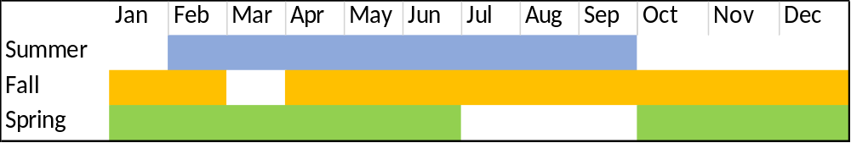
Data Available Before Semester Starts
Beginning the Saturday after registration opens for a semester, weekly snapshots of data will be available
Example for 2016- 2017 | Start | End | Additional Weeks
Summer 1 | 2/26/2016 | 9/9/2016 | 28
Summer 2 | 2/26/2016 | 9/16/2016 | 29
Fall | 4/9/2016 | 2/11/2017 | 21
Spring | 10/29/2016 | 6/17/2016 | 19

Slide 6
All Students Even if Not Settled
Officially Registered Students – Official Enrollment Counts Including Registered, Settled or Verified as Attending, or Withdrawn with No Refund
All Currently Registered Students – Registered Not Withdrawn
  Regardless of Settlement Status/Attendance
  Note: Students withdrawn with no refund are NOT included here
Students Registered Not Settled
Student Registered Attending But Not Settled

Slide 7
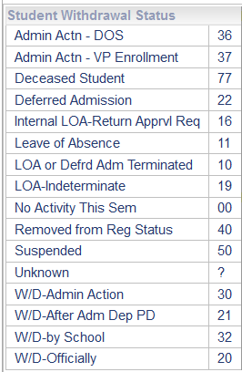
Data on Withdrawals and Leaves
All Student Withdrawal Status Codes
Student Withdrawal Reason
Codes and Interviewer
Withdrawal Reason Codes (5)
Withdrawn for Military Service or
Missionary Service
Withdrawal Date

Slide 8
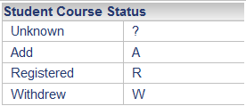
Data on All Courses Including Adds and Drops
Course Status
Enrolled, Dropped, and
Audit Indicators
Reason Course Dropped
Codes (Academic Withdrawal)
Course Withdrawal Date

Slide 9

Questions

