Slide 1
The benefits of externalizing Web DMZ-as-a-Service in the Cloud
James Smith, Sr. Security Consultant @ Sentrix
James@Sentrix.com

Slide 2
State of App Sec
52% of organizations test less than half of their apps for vulnerabilities
66% report fixing less than 40% of vulnerabilities found
50% of organizations report taking over 3 months to fix vulnerabilities after they have been identified in production systems
(Survey of over 100 Security executives at the 2015 Gartner Security Summit)

Slide 3
Agenda
The blind spots of web application security (often not covered by the SDLC processes)
  Uncontrolled areas of the code - web platform, 3rd party plugins, 3rd party embedded SaaS
What do we traditionally do about them
Cloud DMZ as an alternative architecture

Slide 4
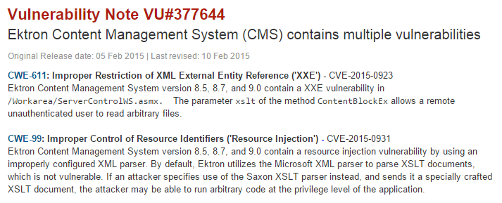

The Blind Spots of Web Application Security
Web Platform Vulnerabilities
  Content Management Systems (WordPress, Drupal, Joomla)
  Application Servers (SharePoint, WebSphere)
American Express
Pfizer
Pizza Hut
Walmart
...

Slide 5
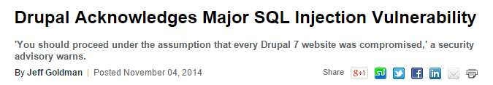
The Blind Spots of Web Application Security
Web Platform Vulnerabilities
  Content Management Systems (WordPress, Drupal, Joomla)
  Application Servers (SharePoint, WebSphere)
MTA
Warner Music
Timex
The weather Channel
...

Slide 6
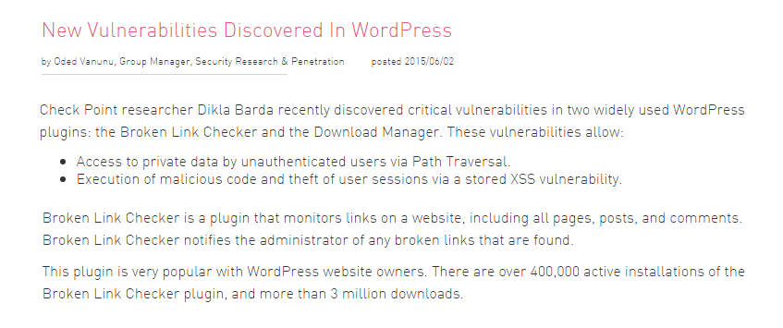
The Blind Spots of Web Application Security
3rd Party Plugin Vulnerabilities
NVidia
NDA
...

Slide 7
What Do We Traditionally Do About These
Blind Spots

Slide 8





First - Who Owns This?
Network Team?
App Development Team?
Security Team?

Slide 9
Secure Development
Lifecycle
Gap Exploited
for 0-Days & Platform Vulnerabilities
Network
Firewall
Application Logic SQLi
Application Logic XSS
JAVA
(CVE-2014-0410)
SharePoint
(MS14-022)
WebSphere
(CVE-2013-0462)
Drupal
(CVE-2014-1475)
Application
WordPress
(CVE-2014-5203)
Application Server & Content Management System
Apache
(CVE-2013-1777)
ShellShock
(CVE-2014-6271)
MS-RPC
HTTP Server
SNMP
Operating System

Slide 10
The traditional best practices
Patching – A loosing battle - Attackers are likely to know about these vulnerabilities before a patch is available
WAF-Based Signature Detection – Another loosing battle - Attackers find new attack signatures
WAF-Based Whitelisting – Can help – But, labor intensive and not a fit for continuous development

Slide 11
Cloud DMZ as an Alternative Architecture

Slide 12
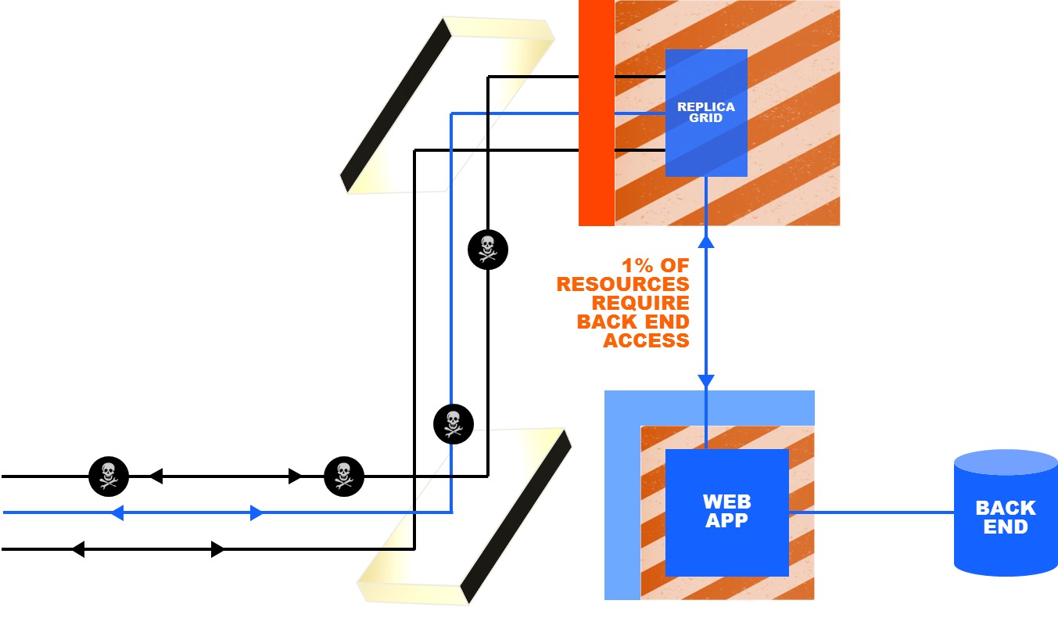
What is a Cloud DMZ?
Replica of the User Interface of a protected web system
Having a well defined API through which it is permitted to communicate with the protected system
✓
?

Slide 13
Active Learning Based Implementation of Cloud DMZ

Slide 14


1: Scan Website to Understand its Functionality
Proactive Learning Engine
A proprietary proactive learning engine performs a deep scan of site to determine the optimal method of defense for each resource, according to its functionality.

Slide 15
2: Analyze Scan Results
Business Logic:
Search Boxes, forms, and any assets that require access to the back end are classified and categorized based on the component's functionality as determined in the scan.
Presentation Layer:
Static resources, non-static forms and other components that can be served from the cloud, isolated from the back-end and fully excluded from the attack surface.

Slide 16

3: Decouple Website Components
Presentation Layer:
Decoupled from the business logic

Slide 17
4: Replicate

Slide 18

5. Securing the Website
Requests to the Business Logic:
The Business Logic is tightly protected by a handful of easy to manage white list rules.
Only valid requests are allowed to the back end
Secure Replica
Business Logic
White List
Validated Requests
Web Server Back End

Slide 19
5. Securing the Website
Requests to the Presentation Layer
Served from the cloud and never reach the back end, making this area of the back end immune to attacks.
Unlike CDNs the replica intelligently serves requests and does not use caching, therefore it never has to access the back-end.
White List
Web Server Back End

Slide 20
6. Elastic Scale Against DDoS
White List
White List
White List
White List
White List
White List
Web Server Back End

Slide 21
The Benefits
Secure & Immediate Cloud Migration
  High Availability (SLA 99.99% Uptime) w/ Layer 7 Coverage
    Disaster Recovery + Business Continuity Assured
    Transfer of hosting cost
CDN Performance Boost
  Geo-based global load balancing & Faster page load times
Enterprise Grade Security
  Elastic scale against legitimate or malicious traffic spikes (DDoS)
  Automated stack hardening through proactive WAF (includes WP, Drupal, etc.)
Real Time Synchronization
  Frictionless integration with current dev and content updates
  Reporting goes directly into existing tools (Splunk, Sourcefire, etc.)

Slide 22
Results: Mid-Atlantic Based University
Currently over 30,730 resources (Drupal Site Deployment)
BUT, only 4 business logic transactions
99.99% offloaded from the security & hosting infrastructure
Avg. 38% faster page load times
Business Transactions
  Search
  Contact Us
  How to Partner
  Health Feedback Form

Slide 23
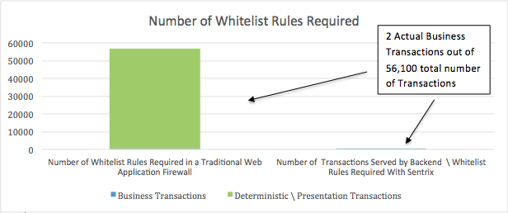
Results:
Currently over 56,000 user interaction types (WordPress Deployment)
Only 2 business logic transactions identified, mitigated through WL rules
99.9% of attack surface automatically eliminated
  Including platform, application, and server vulnerabilities
54% faster page load times
The 2 Business Transactions:
Search Bar
Contact Us Form

Slide 24
Demo

Slide 25
Wrap Up
Cloud DMZ architecture inherently reduces the attack surface resulting from usage of 3rd party platforms and plug-ins
Active learning based implementation can automate the process
Cloud based deployment of the static DMZ (i.e. Cloud-DMZ) can in addition improve scalability and performance of the protected application

Slide 26
Q&A www.SENTRIX.com

