Slide 1

MigratinG to the Shared Computing Cluster (SCC)
SCV Staff
Boston University
Scientific Computing and Visualization

Slide 2
Topics
Glenn Bresnahan – Director, SCV
  MGHPCC
  Buy-in Program
Kadin Tseng – HPC Programmer/Consultant
  Code migration
Katia Oleinik – Graphics Programmer/Consultant
  GPU computing on Katana and SCC
Don Johnson – Scientific Applications/Consultant
  Software packages for E&E

Slide 3
Highlights of Shared Computing Cluster (SCC)
At Massachussetts Green High Performance Computing Center, Holyoke
Hardware
  1024 cores (64 Intel Xeon E5-2670 nodes with 16 cores each) -- more later !
  594 TB of usable disk space
  No GPUs at present. Katana GPUs will be moved to SCC by July 1, 2013
Software
  Most system and application software packages have been installed
  Webpage available to check status of packages (later slide)
Operating system is Linux Centos 6.4
Login nodes:scc1.bu.edu,scc2.bu.edu,scc3.bu.edu,scc4.bu.edu
Network speed between main campus and MGHPCC is 10GBit/s
Who has access to the SCC ? Users with Katana/Blue Gene access
Home directory disk storage for each user is 10GB
  All projects get 50 GB each on /project and /projectnb to start.
  /project is backed up daily (just like on Katana)
  In addition, /project and /projectnb are backed up by snapshots ─ deleted files are retrievable by owner
PI may ask for up to 1 TB storage for free; purchase more through buy-in

Slide 4
Where are my files on SCC and Katana ?
For majority of users, /project and /projectnb migration is done !
  If your /project files not migrated yet, you will be contacted soon
Migrated /project and /projectnb are shared by SCC and Katana
Home directories ($HOME) on SCC and Katana are distinct (no migration)
In general, don’t copy dotfiles (e.g., .cshrc, .bash) among systems, otherwise things may break. Adding contents to them is OK
If you use .aliases on Katana, check before copying over to SCC
On SCC, to access Katana home directory, prepend file path with /katana
scc1:~ % cd /katana/usr3/graduate/user
scc1:~ % cp myfile /katana/usr3/graduate/....../ .
scc1:~ % cp -r /katana/usr3/graduate/....../myfolder .

Slide 5
How to Keep $HOME Files In Sync
To maintain a single copy of a file on both SCC and Katana home directories, you may accomplish it with:
makefile
# source is on Katana, executable is local on SCC
BASE = /katana/usr3/graduate/username
mm_mpi_gnu: ${BASE}/matrix_multiply_mpi.f90
mpif90 -o $@ ${BASE}/matrix_multiply_mpi.f90 -O3
# source on Katana, build exec for AMD & Intel & move back to Katana
mm_mpi_katana: ${BASE}matrix_multiply_acc.f90
mpif90 -o $@ ${BASE}matrix_multiply_acc.f90 –O3 -tp x64
mv $@ ${BASE}/
Symbolic link abc.c in folder Misc on SCC points to a real file on Katana
scc1:~ % ln –s /katana/usr4/ugrad/name/abc.c Misc/abc.c

Slide 6
Compilers . . .
Compilers
  GNU: gcc, c++, gfortran -- optimize with –O3
  PGI: pgcc, pgCC, pgfortran -- optimize with –fast
MPI
  MPI wrapper: mpicc, mpiCC, mpif90 – built for GNU compilers (PGI later)
  MPI implementation: OpenMPI
  mpif90 –show shows what compiler family, linked libs, etc.
OpenMP – shared-memory directive-based parallel computing for CPUs; turn on with -mp (PGI); -fopenmp (GNU)
OpenACC – directive-based parallel computing for GPUs;
turn on with: -acc (PGI)
Cuda-based GPU computing (Katia will talk about this)

Slide 7
Batch Usages
Open Grid Scheduler (OGS) is open source version of Katana’s SGE Batch scripts for both are essentially interchangeable
  Batch commands: qsub, qstat, qdel, qhost, . . .
  Files needed by a compute node must reside on SCC, e.g., executables and I/O data files (/katana not supported on nodes)
  OpenMP or thread-based jobs: -pe omp N (1 <= N <= 16)
  MPI jobs: -pe mpi_X_tasks_per_node N ( X=4, 8, 16; N=i*X; i=1, 2, 3, . . .)
    Example: X=4, N=16 => 4 nodes with 4 cores each (rest of each node shared)
    Example: X=16, N=16 => exclusive use of an entire node; 2 nodes if N=32
  Serial jobs: omit -pe
  Cuda-based GPU jobs: available July 1; use Katana now
  OpenACC-based GPU jobs: available July 1; use Katana now
  Default walltime limit: 12 hours (2 hours on Katana)
  Maximum walltime limit: no limit for now (24/72 hours on Katana)
  Core use limit: ≤ 256 cores (fewer later) concurrently per user (128 on Katana)

Slide 8
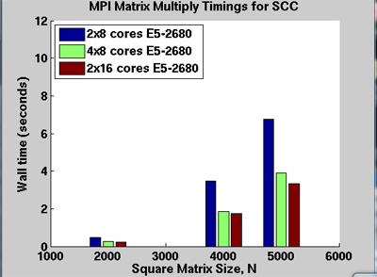
MPI Square Matrix Multiply on SCC
2x8 cores case uses -pe mpi_8_tasks_per_node 16
4x8 cores case uses -pe mpi_8_tasks_per_node 32
2x16 cores case uses -pe mpi_16_tasks_per_node 32

Slide 9
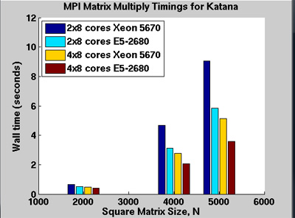
MPI Square Matrix Multiply on Katana

Slide 10
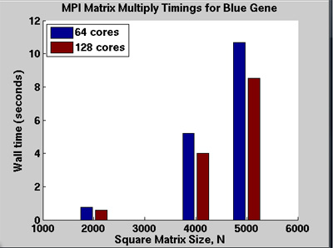
MPI Square Matrix Multiply on the Blue Gene
For this application, wall time is shorter with 16 cores on the SCC than 128 cores on the Blue Gene. With significantly more memory and application software, the SCC is more general-purpose and versatile.

Slide 11
Scratch Disks
Primarily to store temporary files during batch jobs
  /scratch on login and compute nodes
  Not backed up. File life is 10 days
  Nodes are assigned at runtime. Node info accessible from $PE_HOSTFILE
  I/O addressing /scratch points to local compute node’s scratch
  After batch job completes, assigned nodes are reported in your-batch-script.poXXXX. To access your data . . .
scc1:~ % cd /net/scc-ad8/scratch

Slide 12
Phasing Out of Katana & Blue Gene ?
Before the end of 2013

Slide 13
Relevant SCC Webpages
SCC home page
http://www.bu.edu/tech/about/research/computation/scc/
Status of Software packages: http://www.bu.edu/tech/about/research/computation/scc/software/
Software Updates
http://www.bu.edu/tech/about/research/computation/scc/updates/
Snapshots / IS&T Archive / Tape Archive
http://www.bu.edu/tech/about/research/computation/file-storage/
Technical Summary
http://www.bu.edu/tech/about/research/computation/tech-summary/

Slide 14
Useful SCV Info
Research Computing Home Page (www.bu.edu/tech/about/research)
Resource Applications www.bu.edu/tech/accounts/special/research/accounts
Help
  System
    help@scc.bu.edu
  Web-based tutorials (www.bu.edu/tech/about/research/training/online-tutorials)
  (MPI, OpenMP, MATLAB, IDL, Graphics tools)
  Consultations by appointment
    Katia Oleinik (koleinik@bu.edu) – Graphics, R, Mathematica
    Yann Tambouret (yannpaul@bu.edu) – HPC, Python
    Robert Putnam (putnam@bu.edu) – VR, C programming
    Kadin Tseng (kadin@bu.edu) – HPC, MATLAB, Fortran

