Slide 1
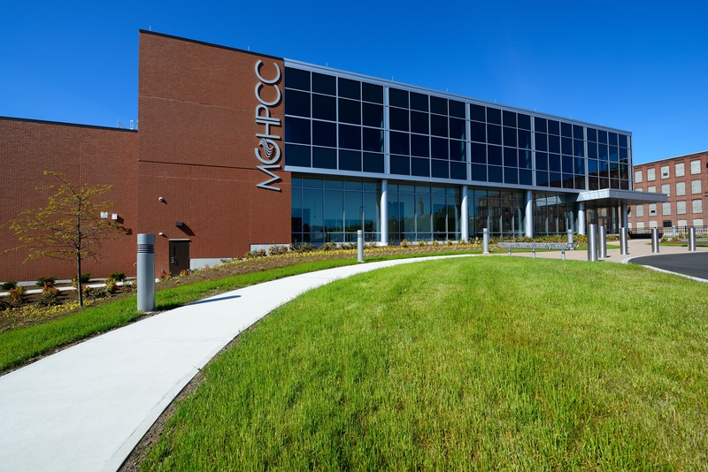
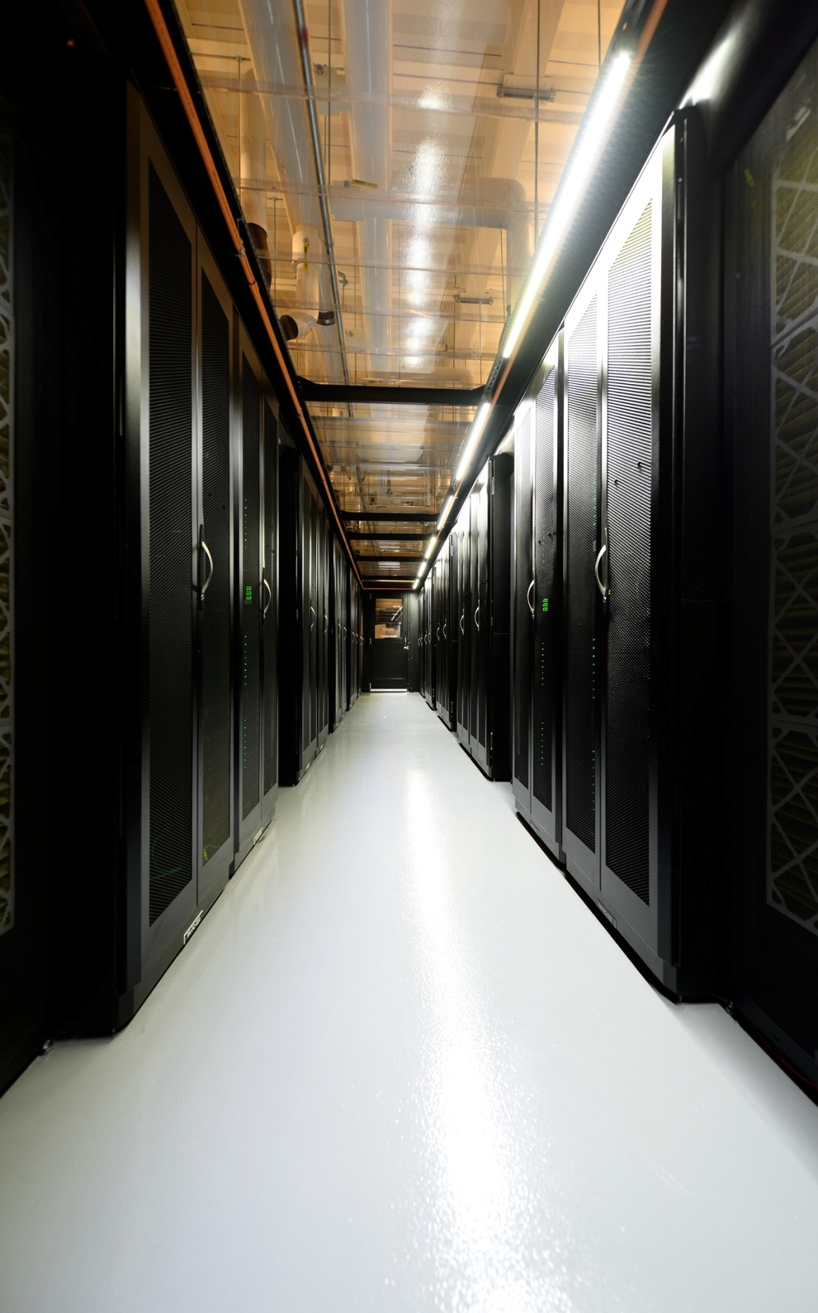
Shared Computing Cluster
Transition Plan
Glenn Bresnahan
June 10, 2013

Slide 2
BU Shared Computing Cluster
Provide fully-shared research computing resources for both the Charles River and BU Medical campuses
  Will Support dbGap and other regulatory compliance
Next generation of Katana cluster, merge with BUMC LinGA cluster
  1024 new cores, 1 PB of storage, 9 TB of memory
Provide the basis for a Buy-in program which allows researchers to augment the cluster with compute and storage for their own priority use
Installed & in production at the MGHPCC
  MGHPCC production started in May, 2013 w/ ATLAS cluster

Slide 3
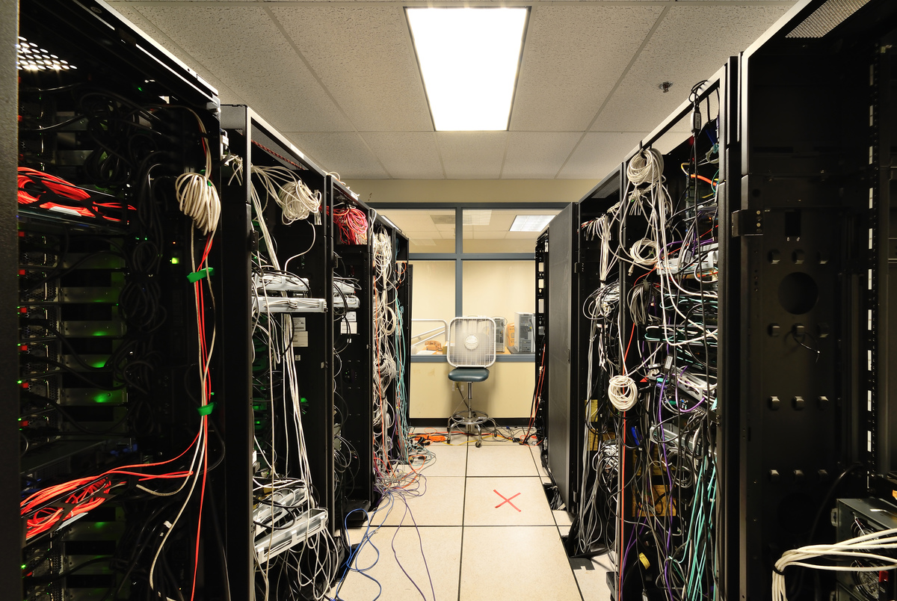
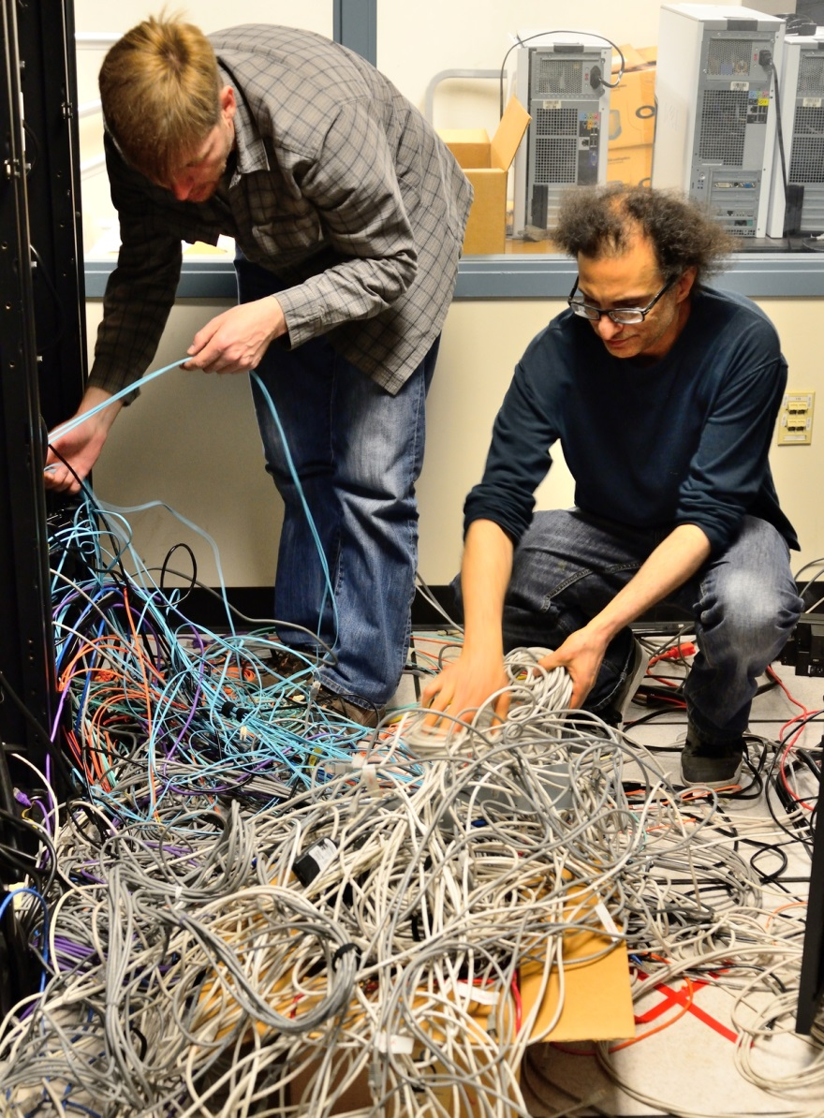
ATLAS de-install at BU

Slide 4
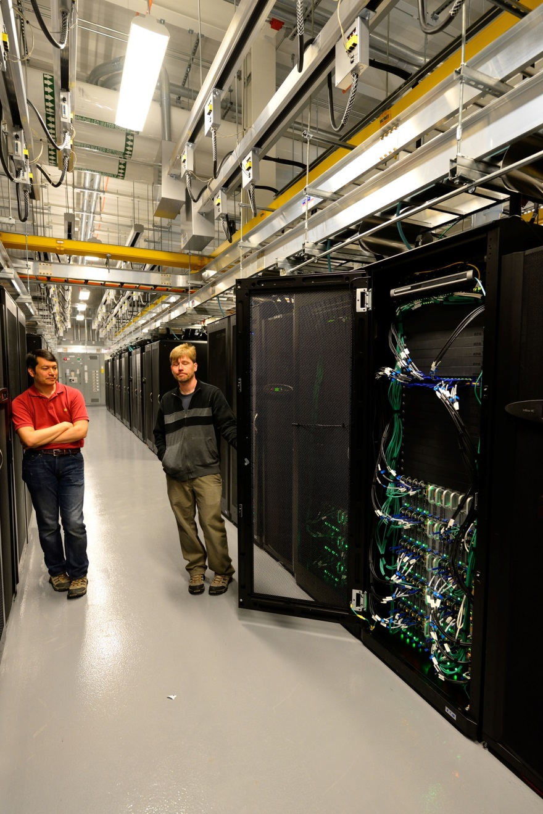
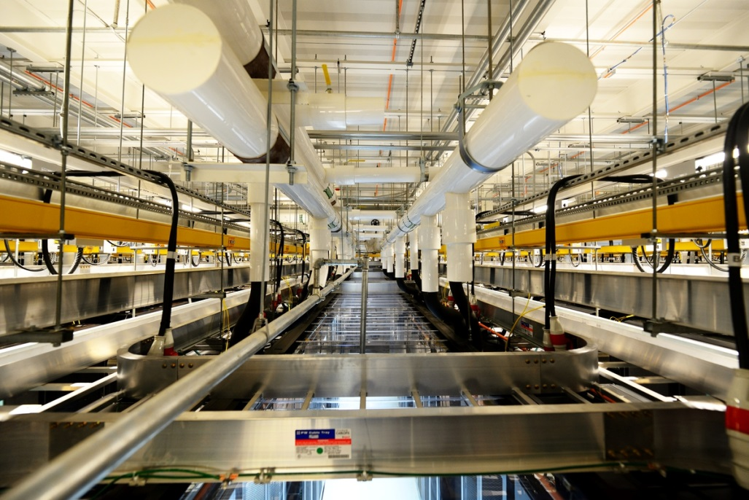
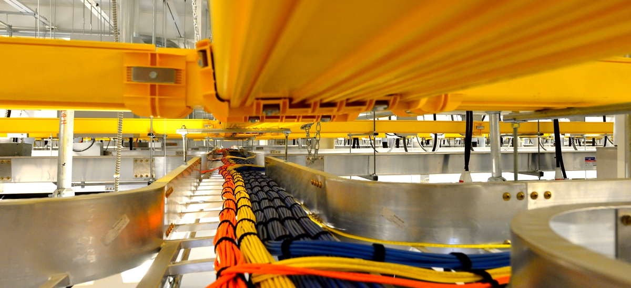
ATLAS installation at MGHPCC

Slide 5
Katana, Buy-in, & GEO
16 nodes
204 cores
Buy-in
Katana Cluster
GEO Cluster
GEO login
173 nodes
1572 cores
Katana login

Slide 6
Shared Computing Cluster
SCC1 login
Old “Katana”
LinGA/
SCC4
login
LinGA Cluster
GEO Cluster
SCC
GEO/SCC3 login
GPUs
Buy-in
~300 nodes
~3200 cores
SCC2 login

Slide 7
Before Data Migration
2x 10GigE
Holyoke-Boston
SCC Cluster
KatanaCluster
/project
/projectnb
/project
/projectnb

Slide 8
After Data Migration
2x 10GigE
Holyoke-Boston
SCC Cluster
KatanaCluster
/project
/projectnb
/project
/projectnb

Slide 9
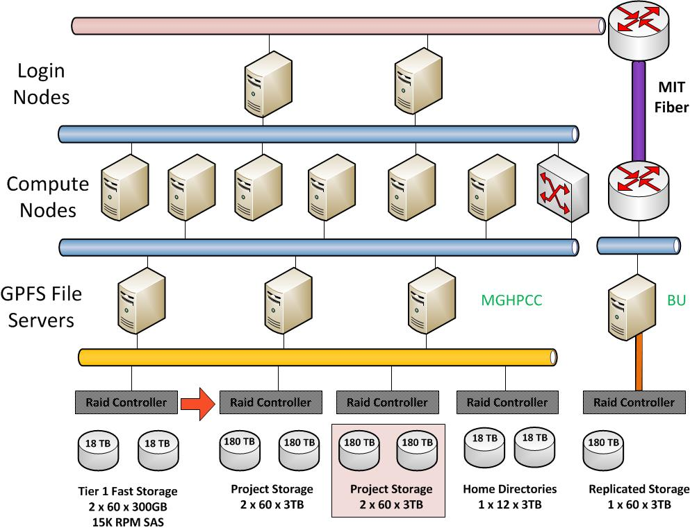
Notes:
Schematic diagram for the new compute and storage cluster. This cluster will be build in Holyoke first. Then pieces of the old cluster including the existing buy-in nodes will be moved and integrated (Q3-Q4)

Slide 10
Shared Computing Cluster
Description | Type | Source | When | Total Cores | GPUs (Fermi) | Core GFLOP/S | GPU GFLOP/S | Total Memory
4/6-core Nehalem | Shared | Katana | July | 104 |  | 1,218 |  | 480
4/6-core Nehalem | Buy-in | Katana | July | 172 |  | 2,015 |  | 1,152
8-core SandyBridge | Buy-in | Katana | July | 384 |  | 4,147 |  | 2,496
8-core SandyBridge | Shared | SCC | May | 1,024 |  | 21,299 |  | 9,216
6-core Intel SB + GPU | Buy-in | CompNet | July | 288 | 72 | 3,064 | 18,540 | 1,152
6-core Intel SB + GPU | Shared | BUDGE | June | 240 | 160 | 2,554 | 41,200 | 960
16-core Interlagos | Buy-in | LinGA | Jul/Aug | 1,024 |  | 9,408 |  | 4,352
TOTAL |  |  |  | 3,236 | 232 | 43,705 | 59,740 | 19,808
Notes:
Additional resources will come from 2013 Buy-in
Fermi GPU cards each comprise 448 Cuda cores (103,936 in total)
Notes:
Once all the systems are moved this will be the computing environment by the end of 2013
Each Fermin GPU is ~512 Cuda Core

Slide 11
MGHPCC Data Center Operational
 | Shared Computing Cluster Transition Schedule
Jan | Shared Computing Cluster (SCC) installed
April | 10GigE connection to campus live
May | SCC Friendly User Testing starts
June 3-21 | Data migration (/project, /projectnb)
June 10 | SCC Production begins
June 24 | GPU (BUDGE) cluster move
July 1 | 2013 Bulk Buy-in
July 8 | Geo, Buy-in, Katana blades move
July, August | Migration of CAS file systems
September | New Buy-in nodes in production
December | Katana, BG/L retired

Slide 12
Buy-in Program 2013
July 1 order deadline for 2013 bulk buy
Standardized hardware which is integrated into the shared facility with priority access for owner; excess capacity shared
Includes options for compute & storage
Hardware purchased by individual researchers, managed centrally
Buy-in is allowable as a direct capital cost on grants
Five year life-time including on-site maintenance
Scale-out to shared computing pool
Owner established usage policy, including runtime limits, if any
Access to other shared facilities (e.g. Archive storage)
Standard services, e.g. user support, provided without charge
  More info: http://www.bu.edu/tech/research/computation/about-computation/service-models/buy-in/

Slide 13
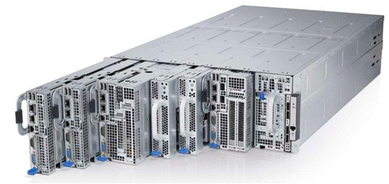
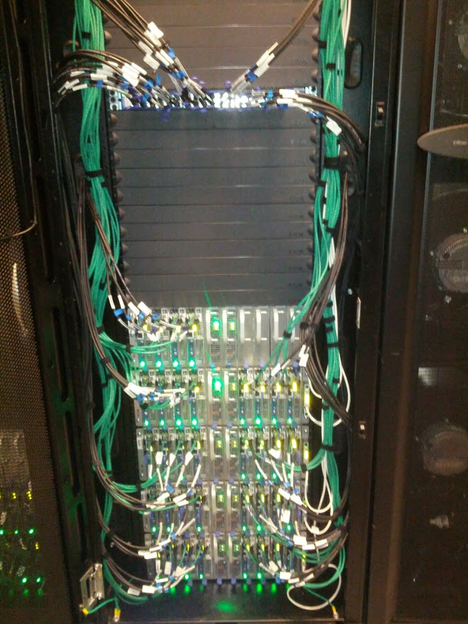
Current Buy-in Compute Servers
Dell C8000 series servers
  Dual-core Intel processor
  16 cores per server
  128 – 512 GB memory
  Local “scratch” disk, up to 12TB
  Standard 1 Gigabit Ethernet network
  10 GigE and 56Gb Infiniband options
  nVidia GPU accelerator options
  5-year hardware maintenance
  Starting at ~$5K per server

Slide 14
Dell Solutions
DELL | Value | Memory | HPC | GPU | GPU+ | Disk+
Model | C8220 (8 x 4u) | C8220 (8 x 4u) | C8220 (8 x 4u) | C8220x (4 x 4u) | C8220x (4 x 4u) | C8220x (4 x 4u)
Processor | Intel E5-2670 SB 2.6GHz 8 core | Intel E5-2670 SB 2.6GHz 8 core | Intel E5-2670 SB 2.6GHz 8 core | Intel E5-2670 SB 2.6GHz 8 core | Intel E5-2670 SB 2.6GHz 8 core | Intel E5-2670 SB 2.6GHz 8 core
Cores | 16 | 16 | 16 | 16 | 16 | 16
GPU | - | - | - | 1 NVIDIA Kepler K20 | 2 NVIDIA Kepler K20 | -
IB | - | - | FDR IB 56Gb/s, 1.3usec | - | - | -
Memory | 128GB @ 1.6 GHz | 256GB @ 1.6 GHz | 128GB @ 1.6 GHz | 128GB @ 1.6 GHz | 128GB @ 1.6 GHz | 128GB @ 1.6 GHz
Max Memory | 512 GB | 512 GB | 512 GB | 512 GB | 512 GB | 512 GB
Disk | 2x500GB 7.2k SATA | 2x500GB 7.2k SATA | 2x500GB 7.2k SATA | 2x500GB 7.2k SATA | 2x500GB 7.2k SATA | 2x500GB + 4x3TB 7.2k SATA
Price | $5,170 | $6,070 | $6,280 | $7,580 | $10,060 | $6,860
Notes:
10GigE addon: $610
512 GB available

Slide 15
Storage Options: Buy-in
Base allocation
  1TB: 800GB primary + 200GB replicate per project
Annual storage buy-in
  Offered annually or biannually depending on demand
    Small off-cycle purchases not viable
    IS&T purchases in 180 TB increments, divides costs to researchers
  Storage system purchased as capital equipment
    Minimum suggested buy-in quantity 15 TB, 5 TB increments
    Cost ~$275/TB usable, 5 year lifetime
  Offered as primary storage
    Determine capacity for replication
Large-scale buy-in by college, department or researcher
  Possible off-cycle or (preferably) combined with annual buy-in
  Only for large (180 TB raw/$38K unit) purchases
  180 TB raw ~ 125 TB usable
Notes:
180 TB raw yields ~130 TB usable

Slide 16
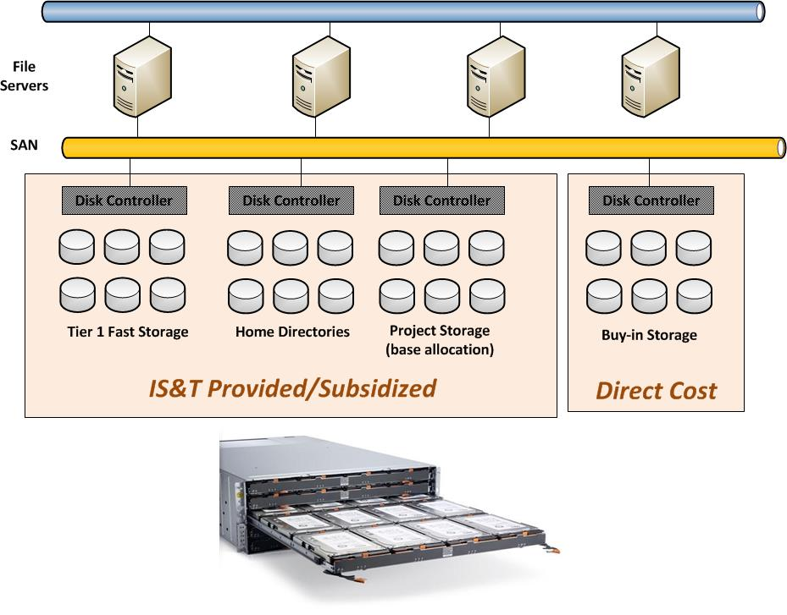
Buy-in Storage Model
60 Disks
180 TB raw
Notes:
Buy-in storage added to and integrated with shared Global Parallel File System (GPFS) storage

Slide 17
Storage Options: Service
SCC Storage as a service
  Cost $70-100/TB/year for primary (pending PAFO cost review)
  Cost & SLA for replication TBD
  Grants may not pay for service after grant period
  Only accessible from SCC
Archive Storage
  Cost $200 (raw)/TB/year, fully replicated
  Accessible on SCC and other systems
  Available now
Notes:
180 TB raw yields ~130 TB usable

Slide 18
Questions
?

