Slide 1
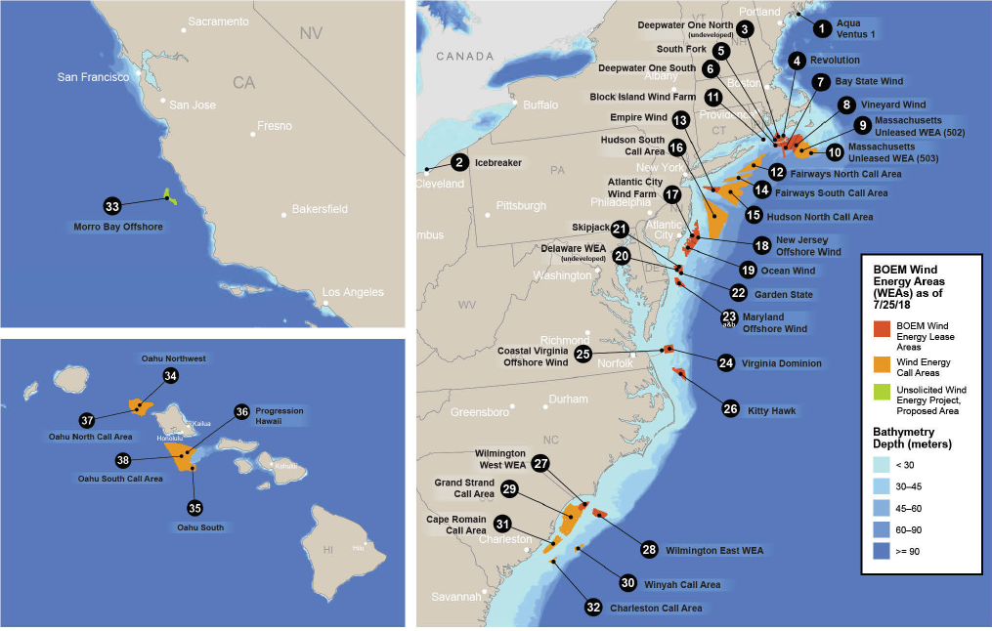
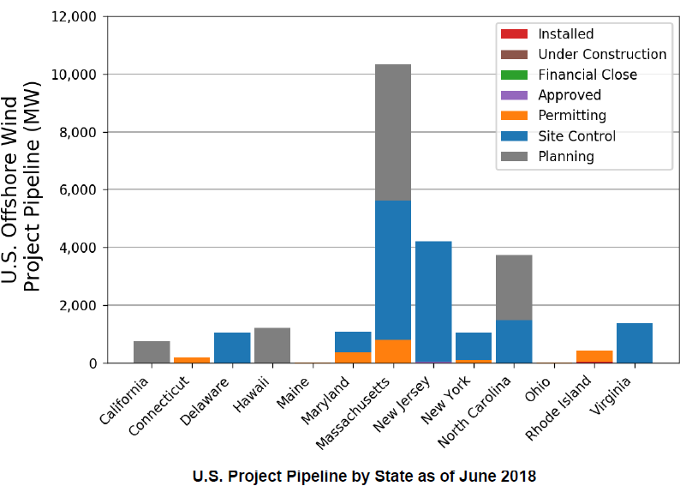
Currently Proposed U.S. Offshore Wind Projects
  5 projects selected for near-term development (1,900 MW), in MA, CT, RI, MD and NY
  18 projects with site control (14,585 MW), mostly in Mid-Atlantic and New England
  28 projects “under development” (25,435 MW)
Source: Beiter, Musial, et al. 2018. 2017 Offshore Wind Technologies Market Update. Figure “U.S. Offshore Wind Lease and Call Areas”; Figure “ U.S. Project Pipeline by States as of June 2018”
Notes:
Geography of each location is important to understanding transmission needs, primarily density of offshore wind sites, distance from shore, number of potential landing spots, and onshore network capacity.

Slide 2
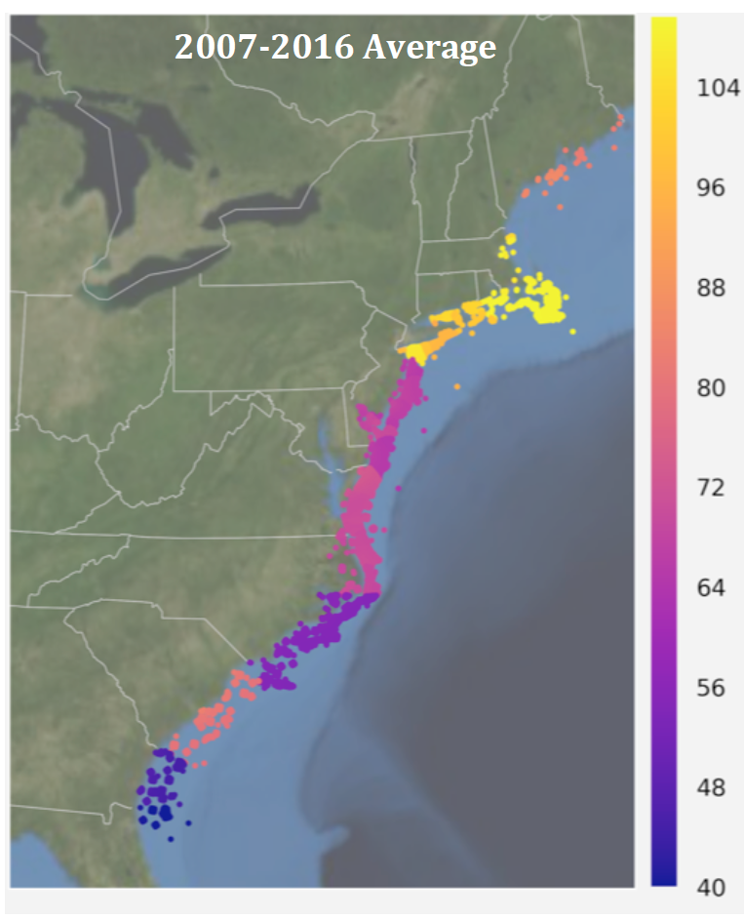
Market Value of Offshore Wind in the U.S.
LBNL estimated the total market value of offshore wind generation based on historical market prices for energy, capacity, and RECs:
  Highest value in New England at $110/MWh
  New York: $100/MWh
  Mid-Atlantic (PJM): $70/MWh
  South of PJM: $40-55/MWh
Total costs of Vineyard Wind (MA) is likely in the $70 – 85/MWh range, after accounting for the capacity market value
Source: LBNL (2018). Estimating the Value of Offshore Wind
Along the United States’ Eastern Coast
http://eta-publications.lbl.gov/sites/default/files/offshore_erl_lbnl_format_final.pdf

Slide 3
Competitive Auctions for Subsidized Policy Resources (CASPR)
ISO-NE’s Proposed Approach to Balancing Wholesale Markets and States’ Policies

Slide 4
Regional Concerns Over State-Supported Resources
Status quo
    Under Minimum Offer Price Rule (MOPR), most state-supported resources would not clear in FCM Limited MOPR exemption for some new renewables
States’ concern
    Consumers will “pay twice” Once for cost of subsidizing state-preferred new resources, and again for additional resources procured in forward capacity market (FCM)
Investors’ concern
    MOPR is essential to avoid capacity price suppression, and attract (non-state-supported) entry cost-effectively when needed Even if unintentional, subsidized entry has a similar effect as buyer-side market power, if unmitigated
    Both undermine competitive investment and cost-effectiveness of markets

Slide 5
Who Pays What to Whom, and Why?
  Who pays for this incentive?
    State subsidies enable high-cost, existing resources to receive a net payment to retire and be replaced by state preferred new resources (e.g., higher-cost clean energy)
  In the ISO-NE’s proposed two-settlement design, the logic is:
    Subsidies enable new units to offer capacity below their true costs.
    Provides an opportunity for potentially retiring units to transfer (buy out) their obligations at less than their true cost
  Retiring units
    Transfer supply obligations to subsidized units, and transfer part (but not all) of primary forward capacity auction (FCA) payments
    Keep a portion of primary FCA payment – a severance payment – in consideration for a final obligation to retire

