Slide 1

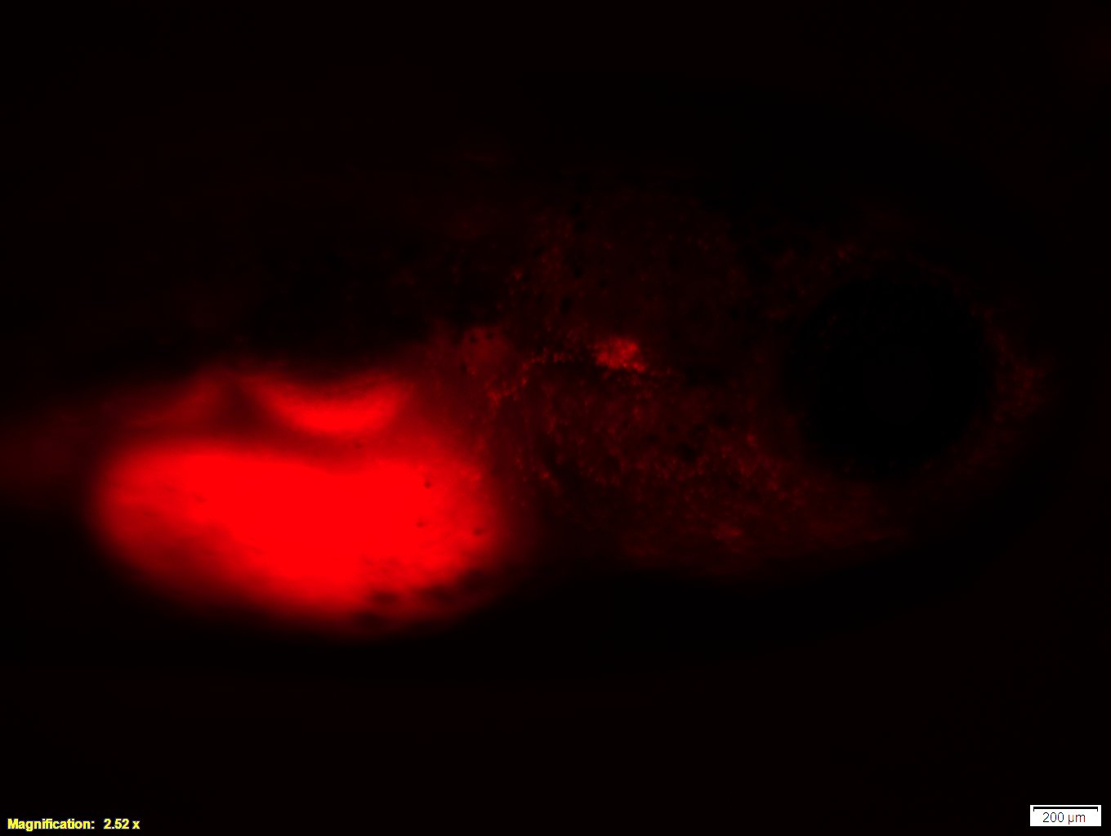
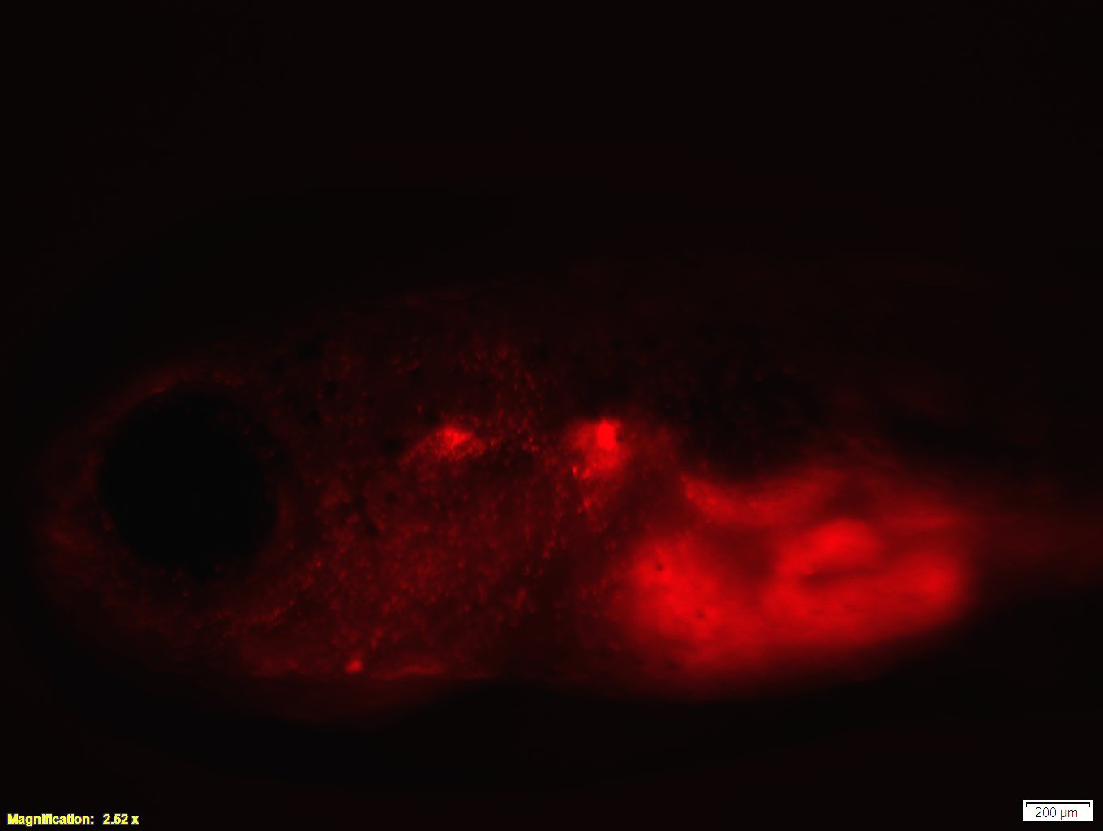
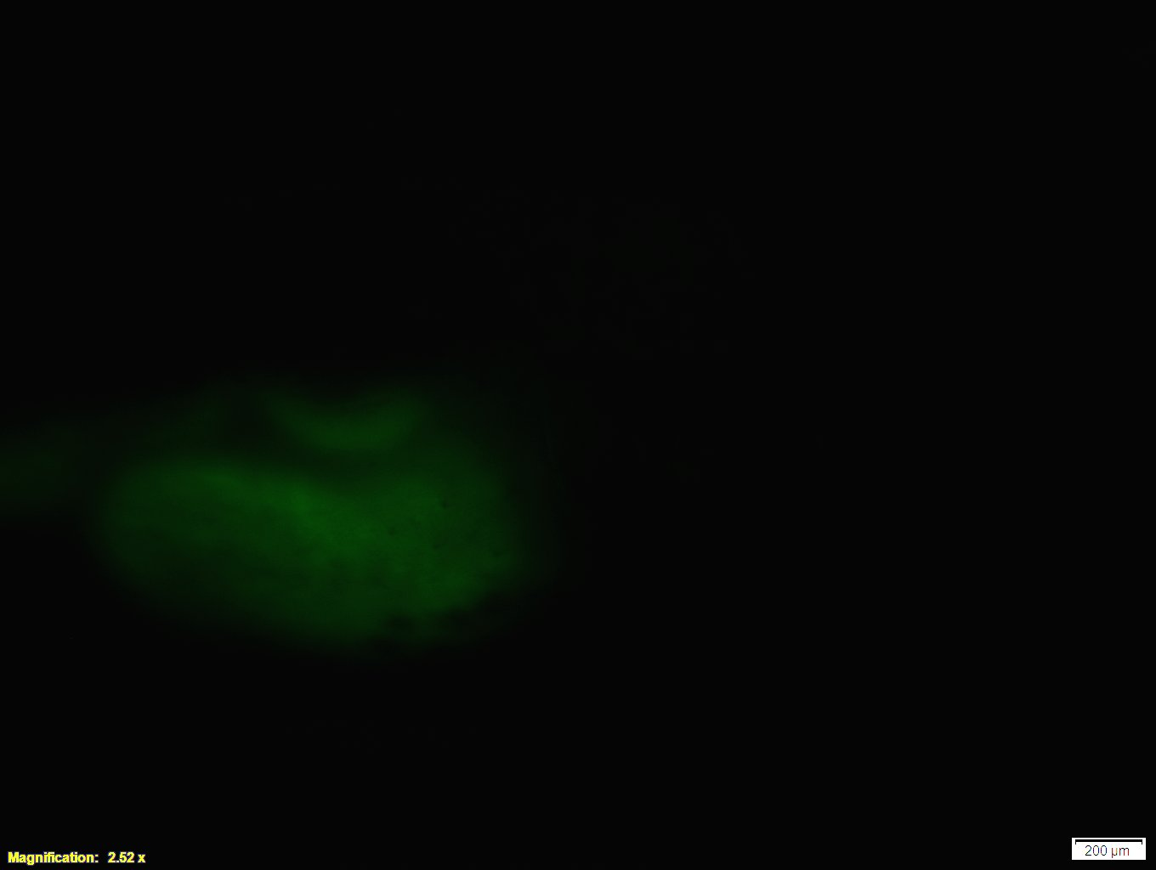
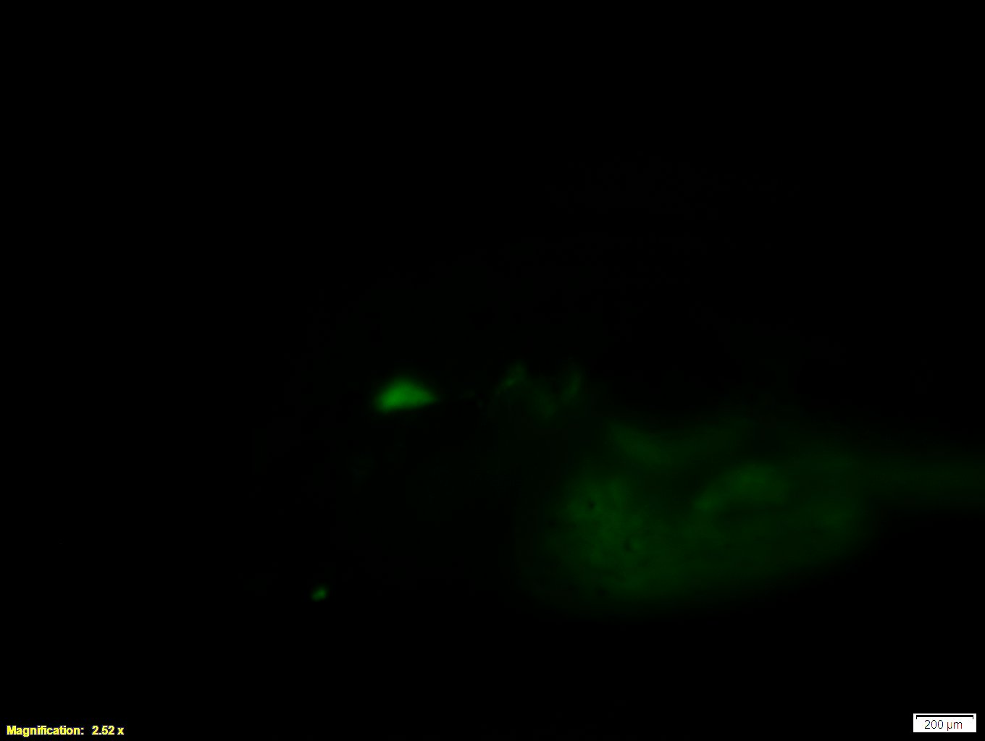
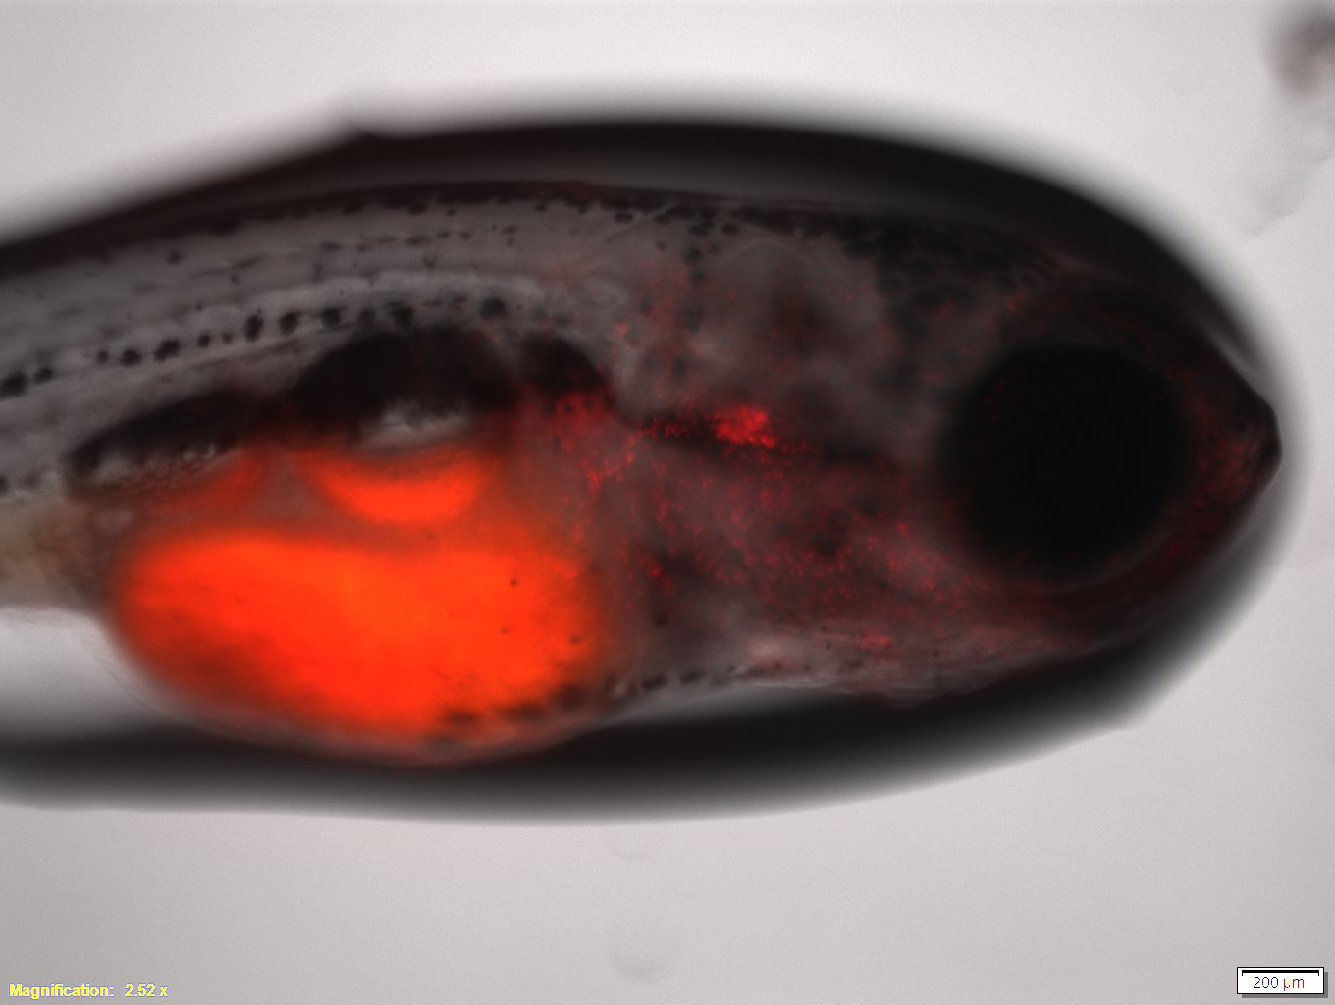
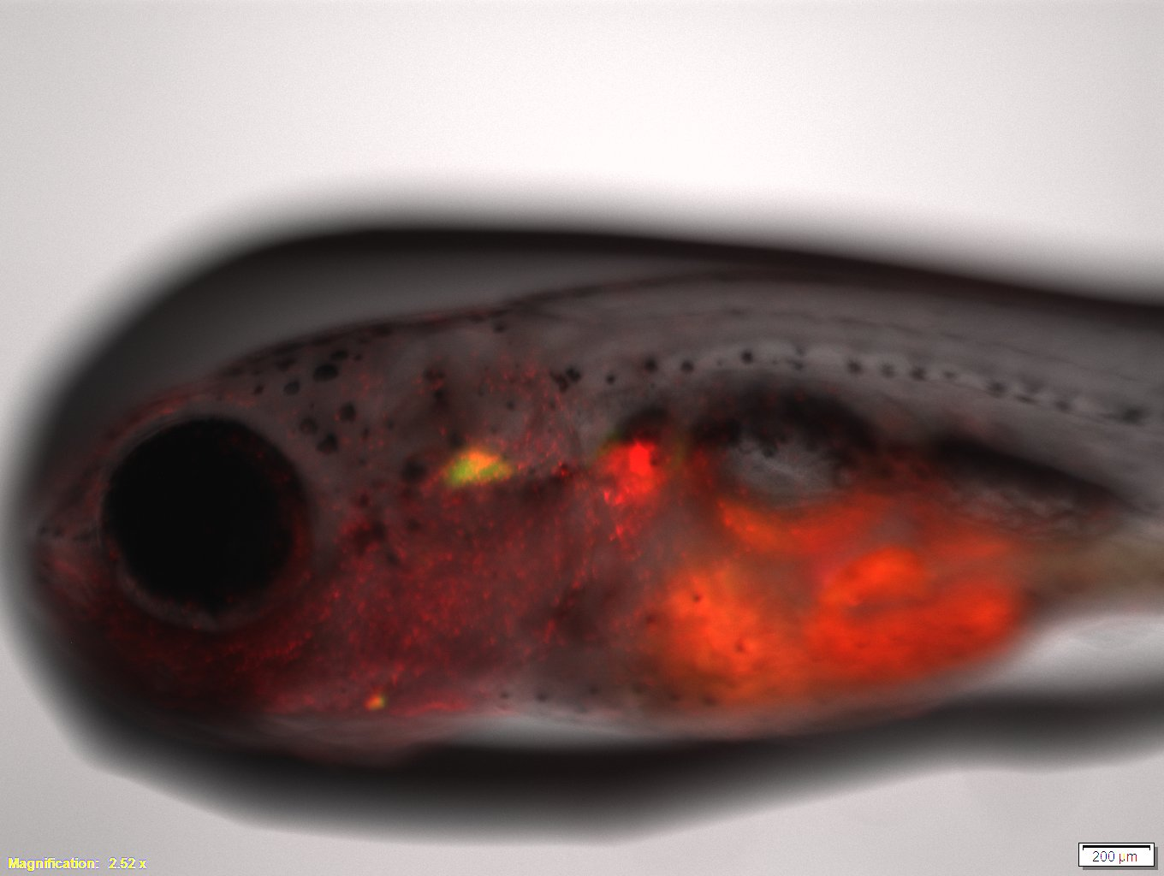
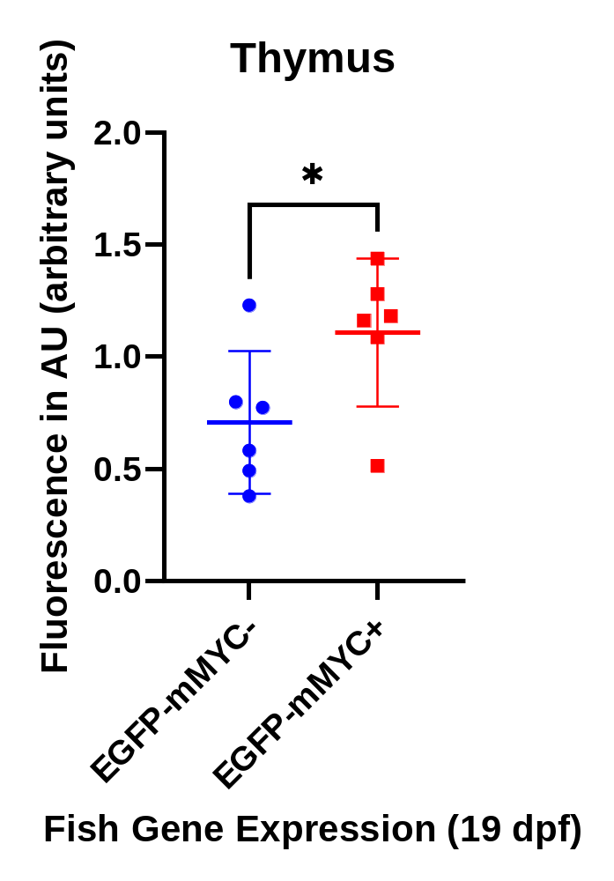
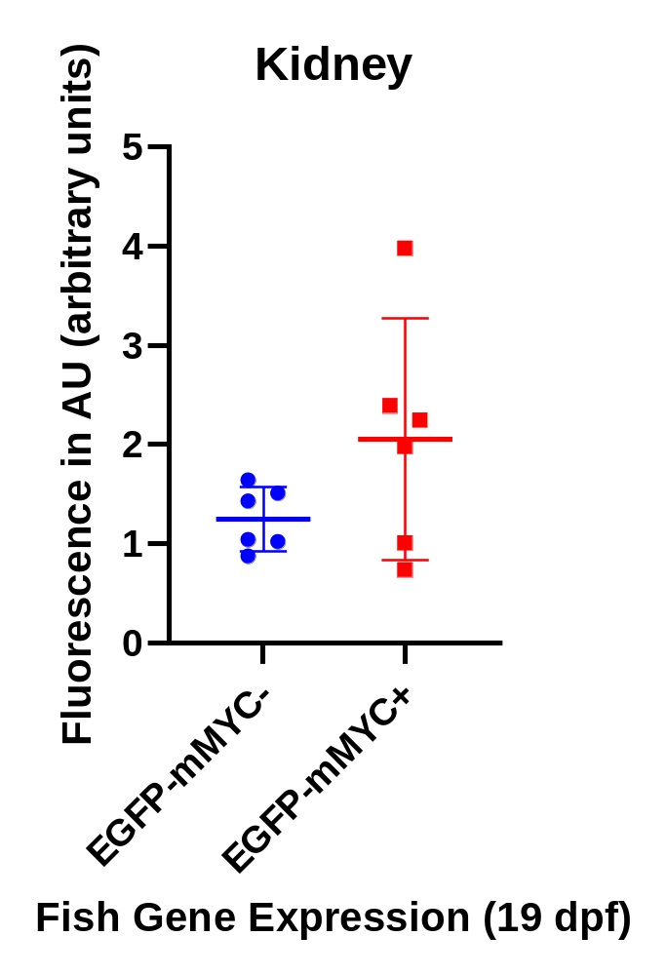
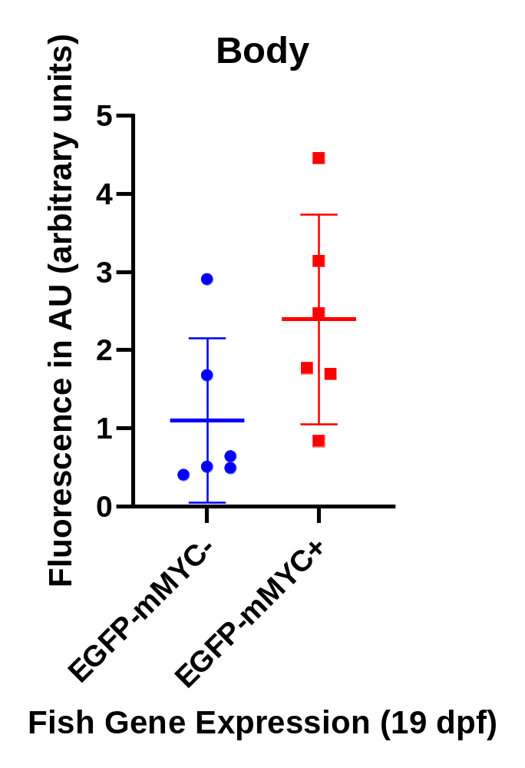
Determining the Interplay between Lymphocyte and Macrophage Development in Zebrafish
Elise Whitlinger^{1,2}, Madison Rager², Andrew Kwok-Ping Lam², Hui Feng²
Freeport Area High School, 625 S Pike Road, Sarver, PA 16055¹, Boston University School of Medicine, 72 East Concord Street, K-712A Boston, MA 021182
Introduction
Results
Conclusions
The zebrafish has emerged as a front-running animal model for human cancers.
Zebrafish share similar hematopoietic development with humans
  Lymphoid and myeloid lineages
Tg(mpeg1:mCherry) fish labels macrophages
Tg(rag2:EGFP-mMYC;rag2:EGFP) fish expresses the c-MYC proto-oncoprotein in T and B cell lineages
This research focused on utilizing these two fish lines to understand the developmental interactions between immune cells.
EGFP-mMYC -
EGFP-mMYC +
The amount of macrophages in fish that did and didn’t have EGFP-labeled T and B cells varied by location
In the thymus, EGFP+ fish had a significantly higher amount of macrophages (p = 0.0483).
In the kidney and cheek, they did not have a significantly higher number (p = 0.1308 and 0.0799)
However, the EGFP+ fish trended towards higher amounts of macrophages.
If more fish were analyzed, these two categories could have had statistical significance
RFP
GFP
RFP & GFP Overlay
Figure 1: The red and green fluorescent proteins being illuminated in each of the fish types. The EGFP- fish are negative because of the absence of GFP
Discussion
Methods
Thymus
Fish that express c-MYC in T and B cells could have more macrophages than fish that do not
This research is applicable to studies of leukemia because macrophages and T and B cells are vital to immunological responses
Future studies in this topic should analyze macrophage counts of the fish as they mature and monitor whether these trends change into adulthood
Zebrafish at 19 days post fertilization (dpf) expressing EGFP-labeled T and B cells as well as mCherry-labeled macrophages were observed and imaged under a microscope
Number of macrophages present was visually compared based on mCherry fluorescence intensity and distribution
ImageJ analysis software was used for quantitative analyzation
GraphPad Prism was used for statistical analysis
Kidney
Body
Figure 2: This shows the regions analyzed for fluorescence in each fish. Macrophages can be found concentrated in the thymus and kidney as well as scattered throughout the body.
p = 0.0483
p = 0.1308
Acknowledgements
I would like to thank my mentors Madi Rager and Andrew Lam for their assistance with this project. I would also like to thank Dr. Hui Feng for accepting me into her lab and providing me with this research project. I would also like to thank the rest of the Feng lab staff for all of their help and mentoring. Finally, I would like to thank RISE at Boston University for providing me with this incredible learning opportunity.
References
p = 0.0799
Anderson, N. M.; Li, D.; Peng, H.; Laroche, F.; Mansour, M.; Gjini, E.; Aioub, M.; Helman, D. The TCA cycle transferase DLST is important for MYC-mediated leukemogenesis. https://pubmed.ncbi.nlm.nih.gov/26876595/.
Delgado, M. D.; León, J. MYC Roles in Hematopoiesis and Leukemia. https://www.ncbi.nlm.nih.gov/pmc/articles/PMC3092227/.
Ferrero, G.; Gomez, E.; Sowmya, S. The macrophage-expressed gene (mpeg) 1 identifies a subpopulation of B cells in the adult zebrafish. https://jlb.onlinelibrary.wiley.com/doi/full/10.1002/JLB.1A1119-223R.
Langenau, D. M.; Traver , D.; Ferrando ; Kutok. MYC-induced T cell leukemia in transgenic zebrafish. https://pubmed.ncbi.nlm.nih.gov/12574629/.
Miller, D. M.; Thomas, S. D.; Islam, A.; Muench, D.; Sedoris, K. C-MYC and cancer metabolism. https://www.ncbi.nlm.nih.gov/pmc/articles/PMC3505847/.
Figure 3: These scatter graphs show the fluorescence in each indicated region. The bold bar represents the median and the error bars show the 95% confidence interval.

