Slide 1

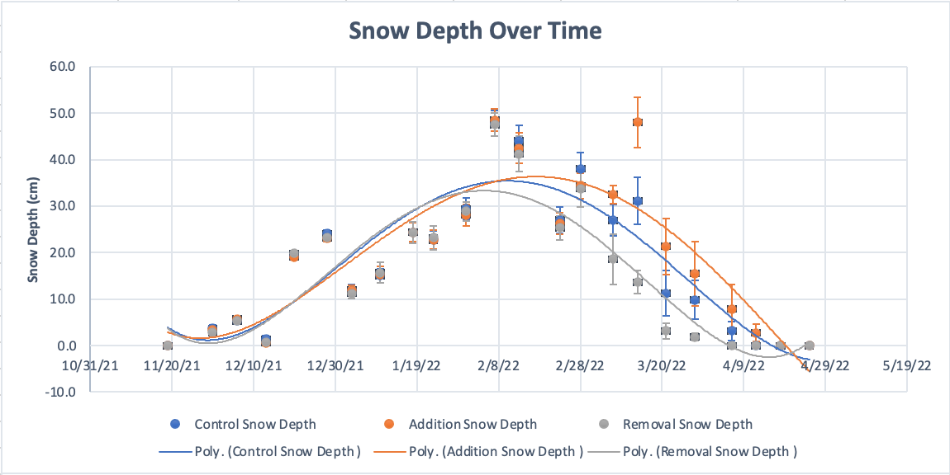
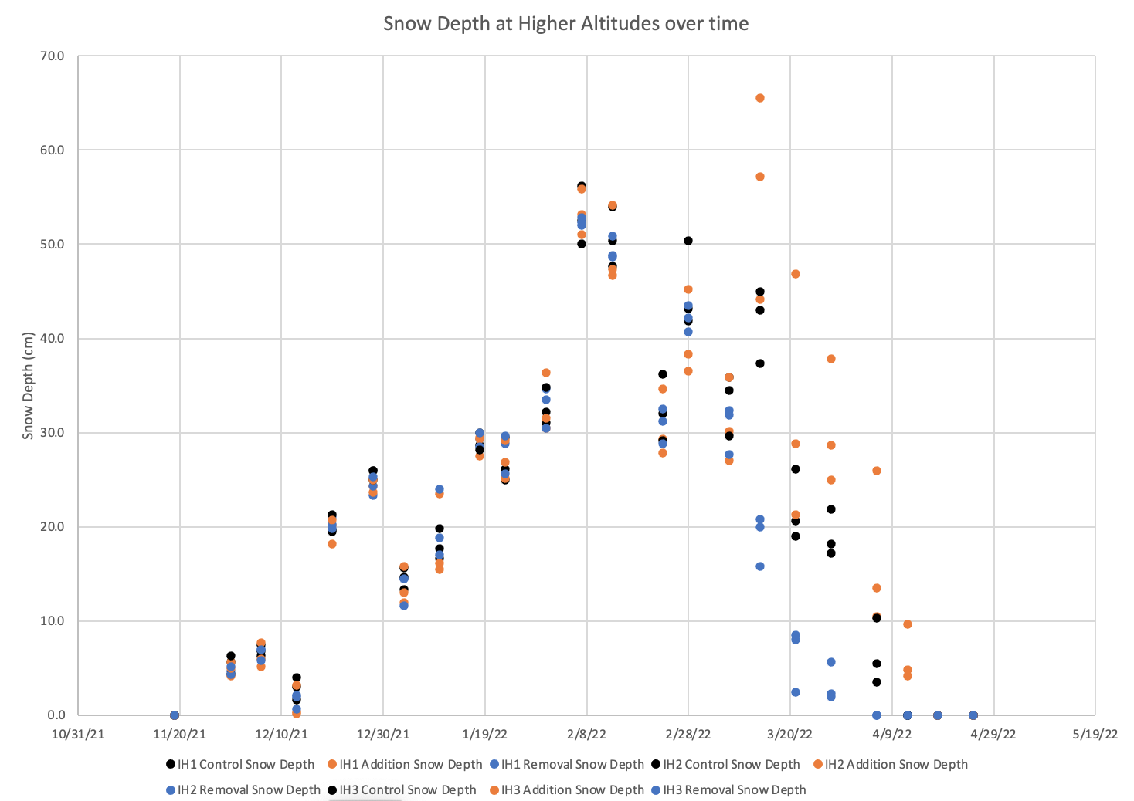
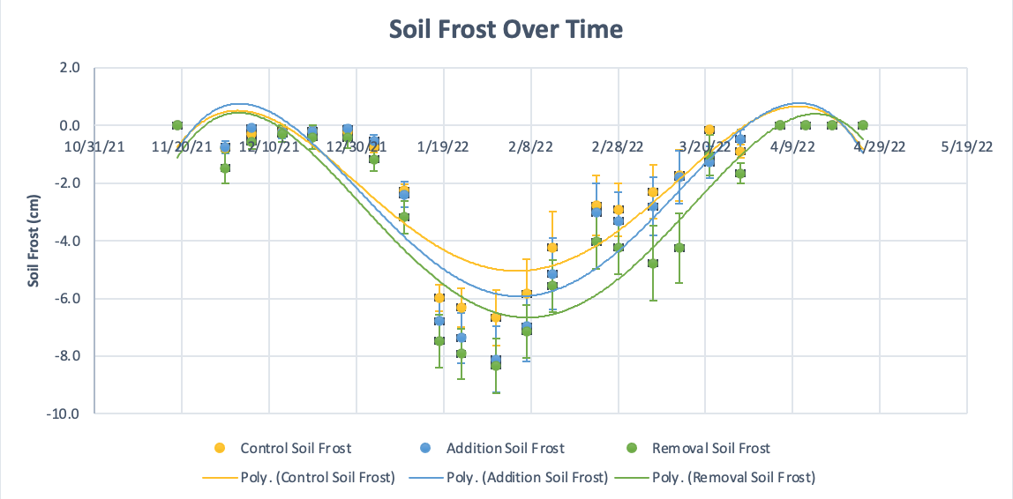
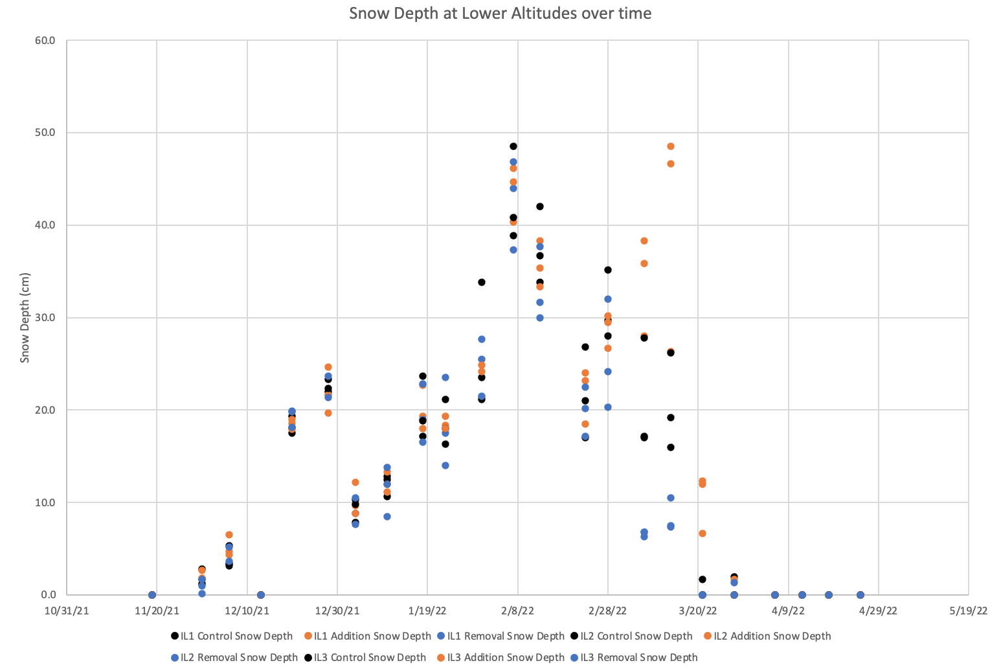
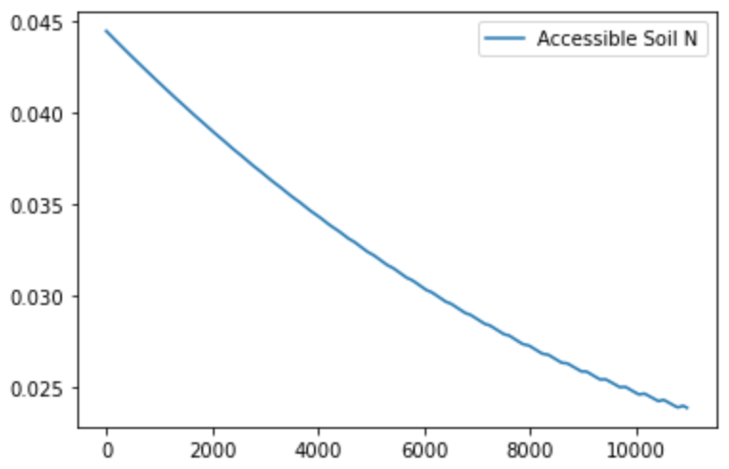
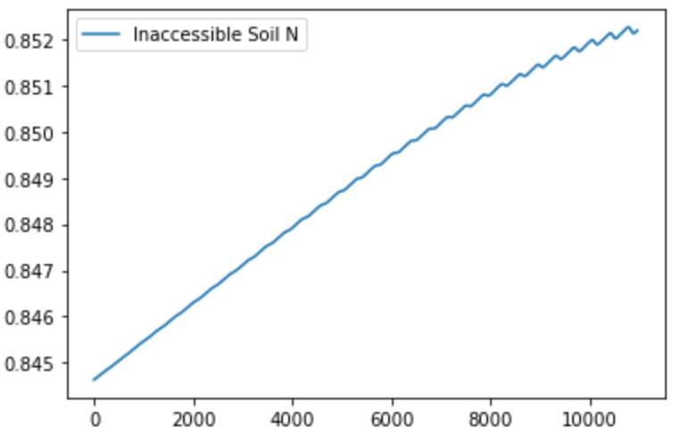
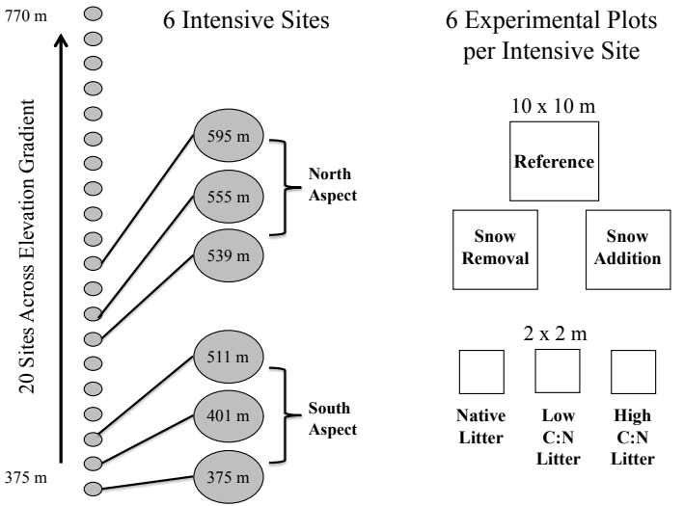
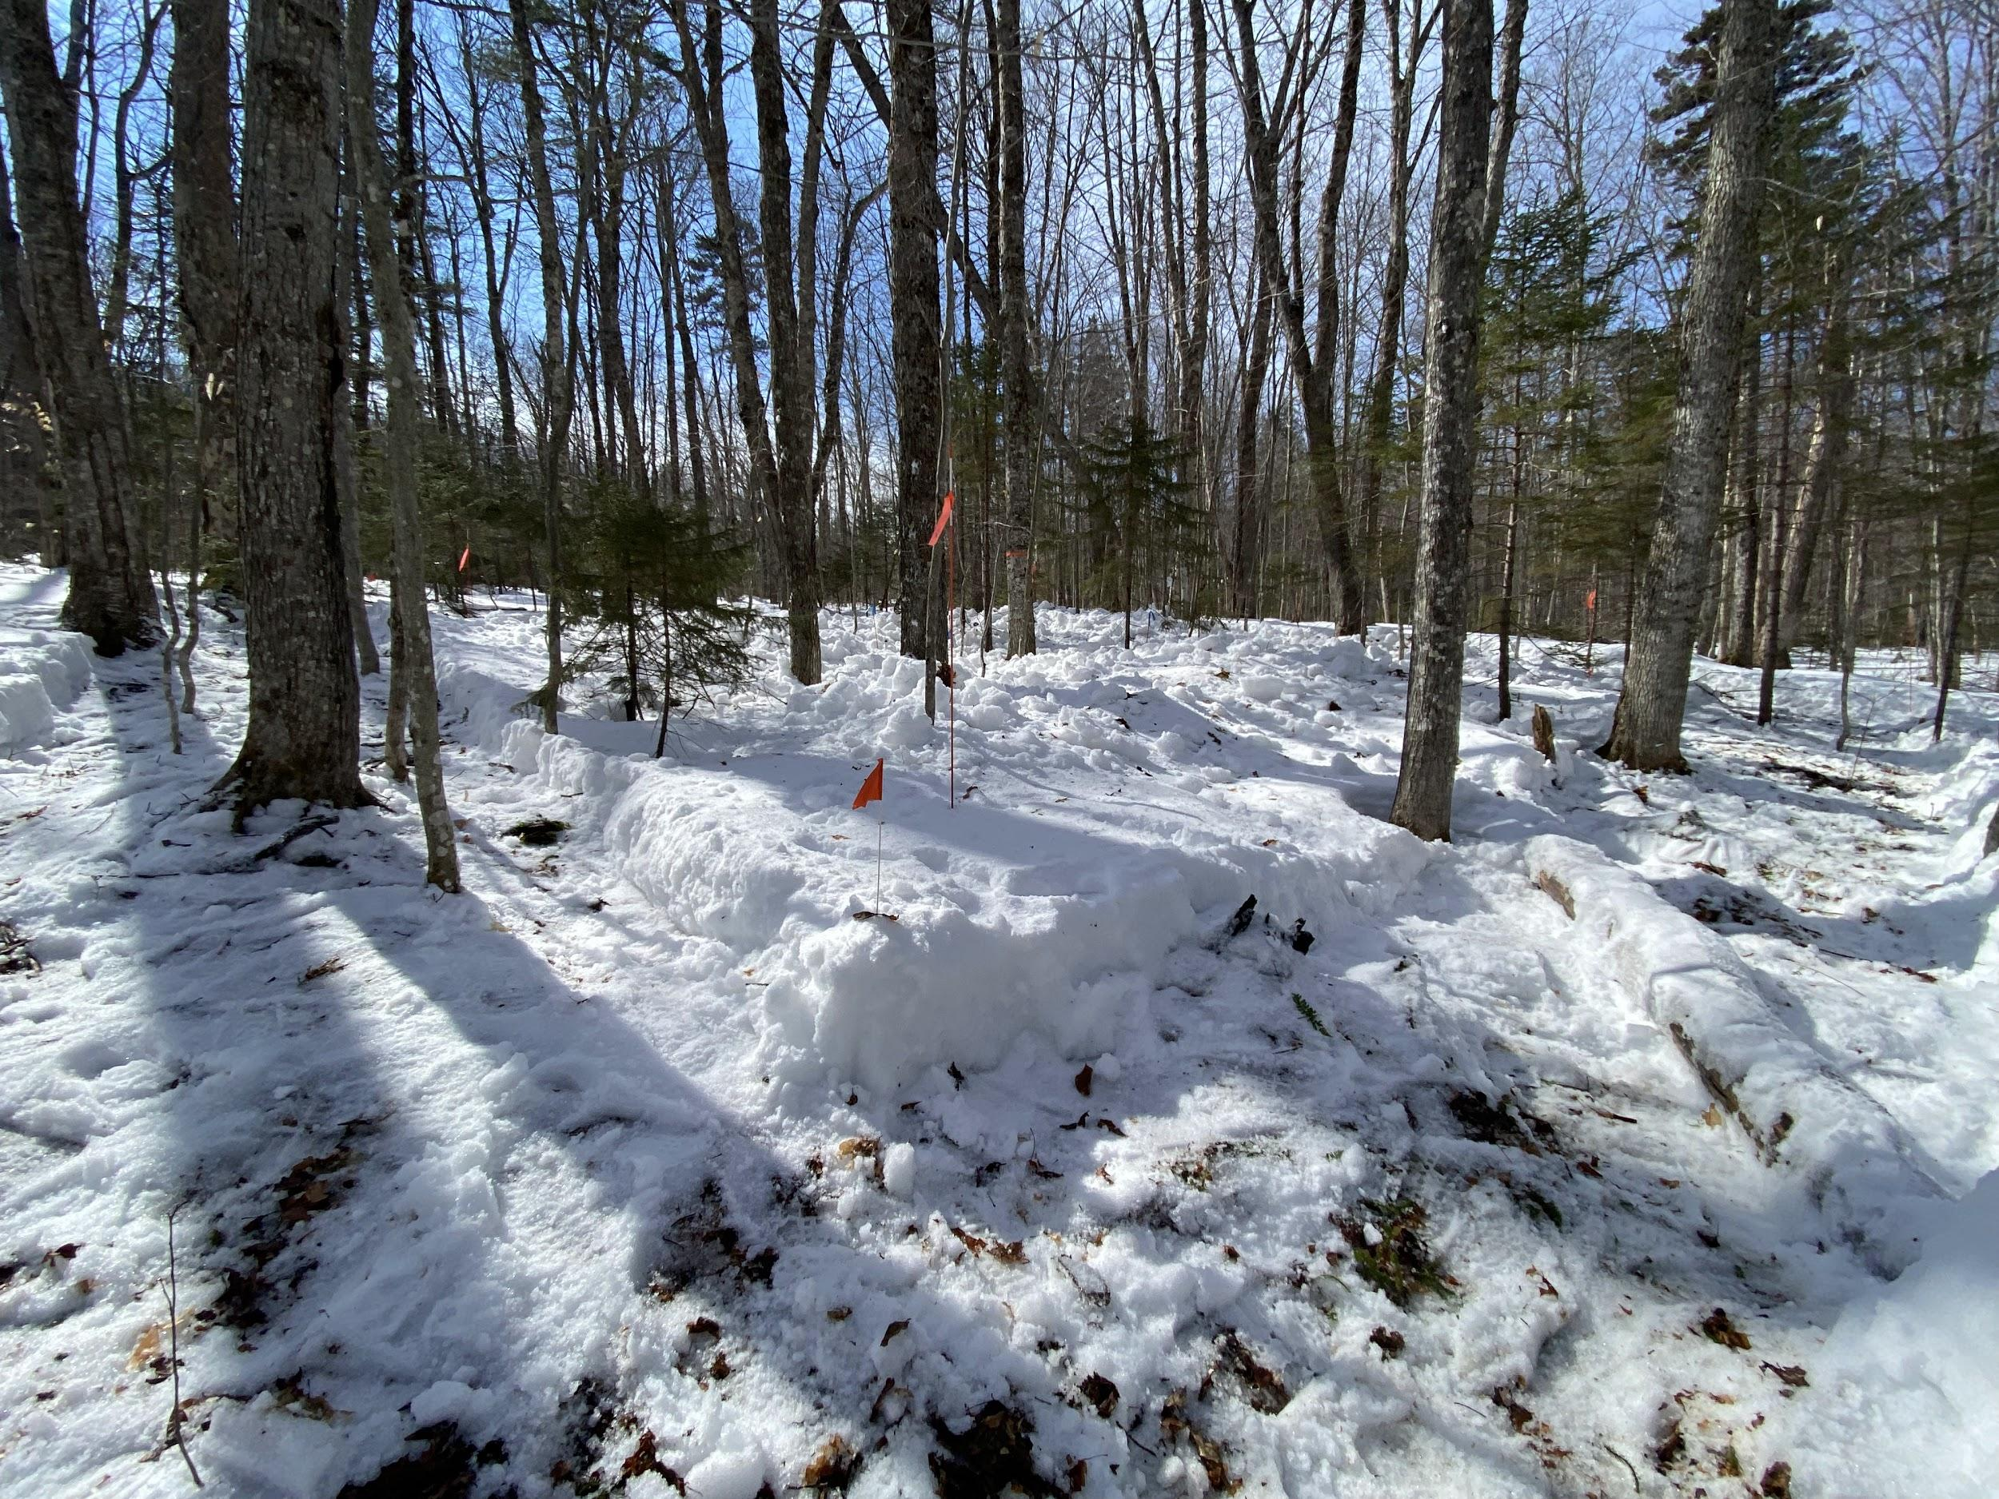
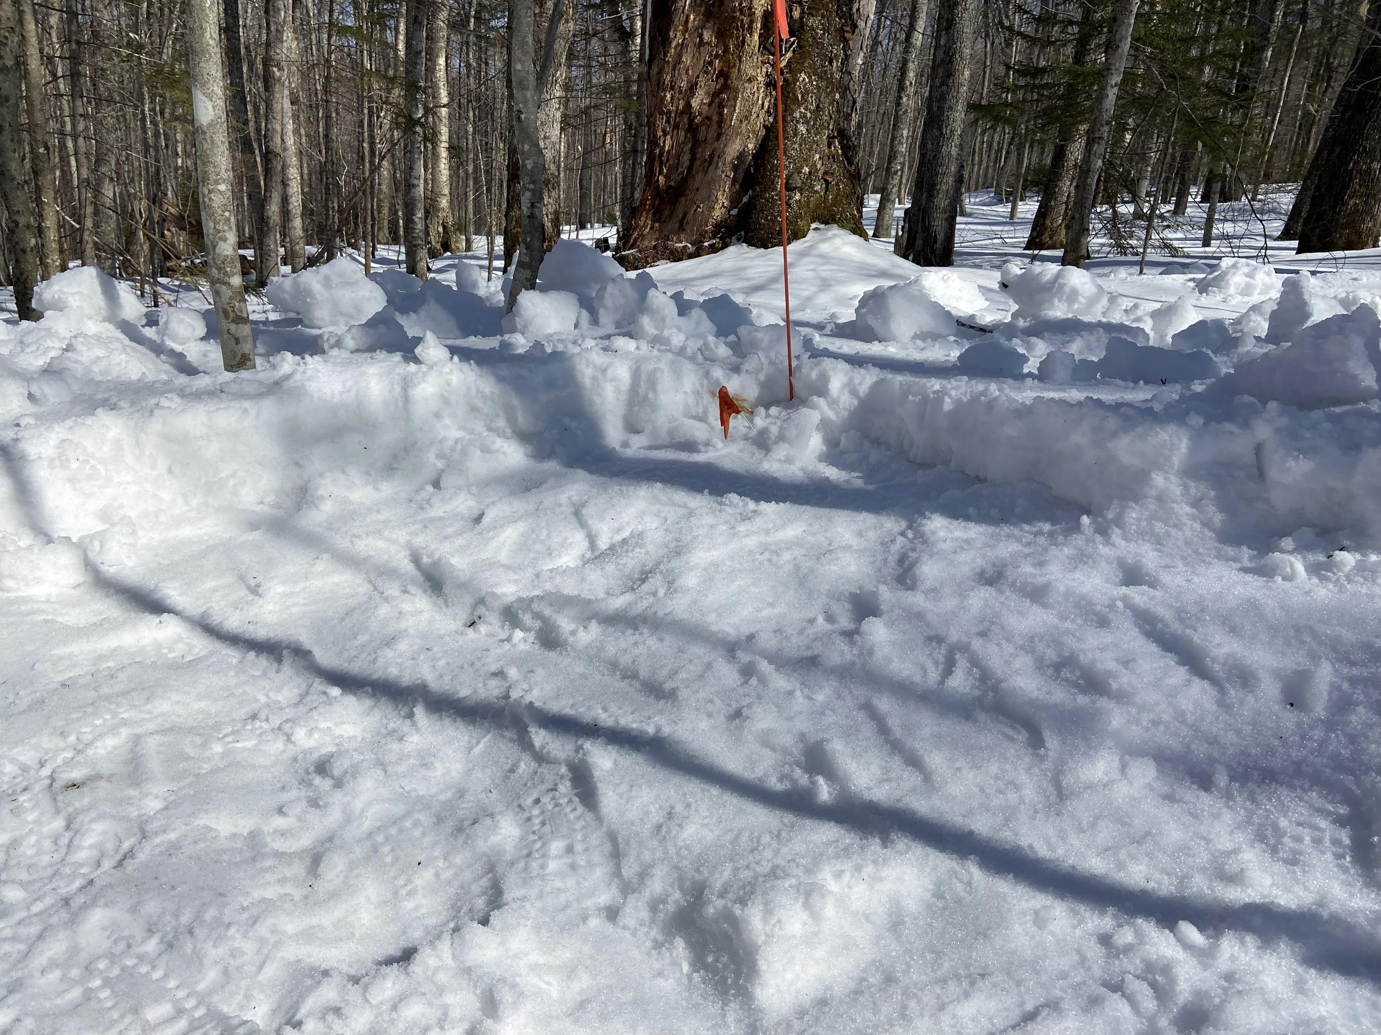
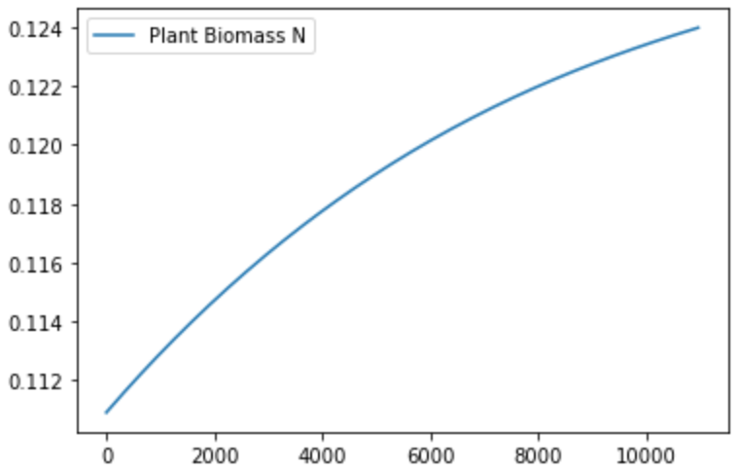
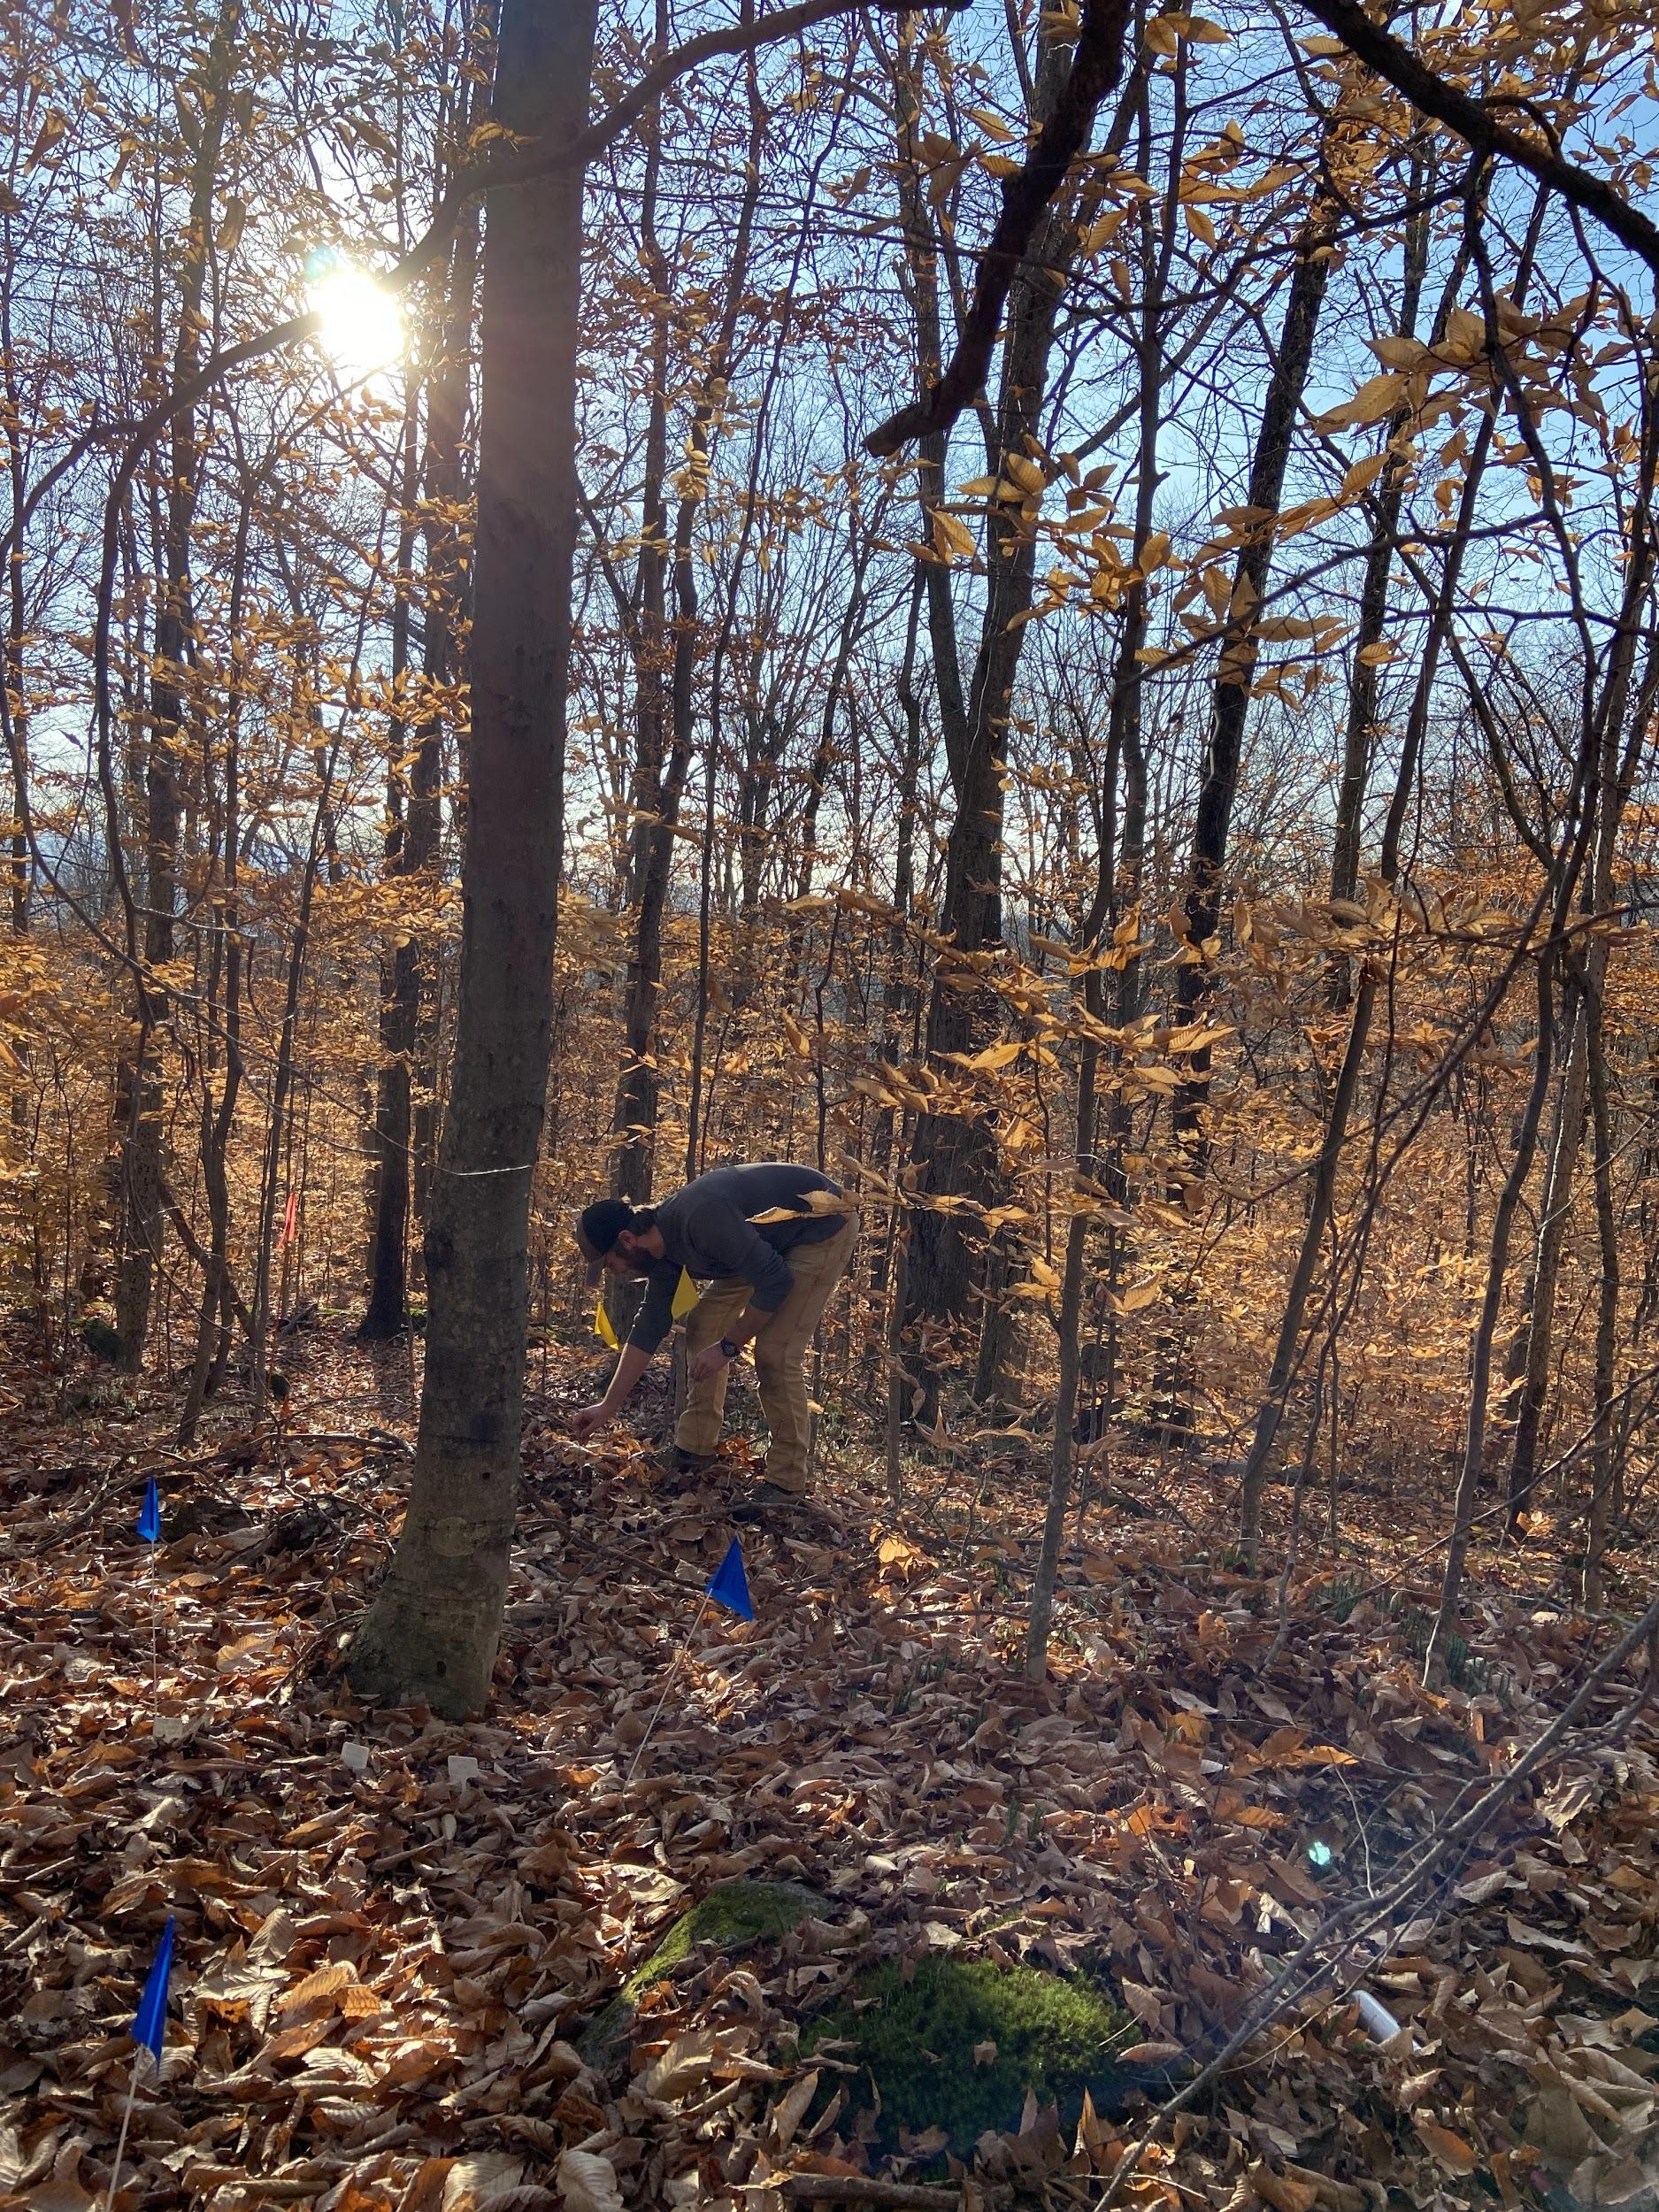

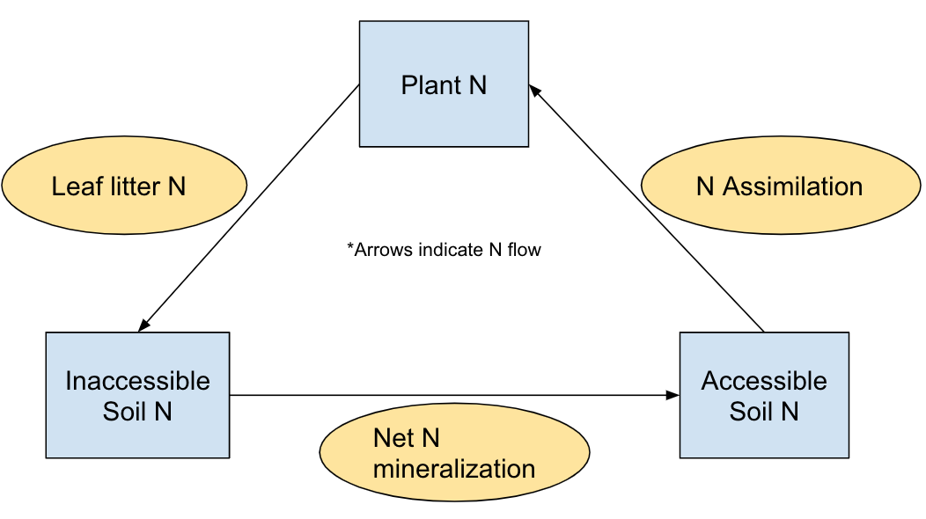

Modeling Nitrogen Cycling using Snow Depth and Temperature Data
Govind Malasani^{1, 2}, Stephen Caron², Pamela Templer²
Lynbrook High School¹; Department of Biology, Boston University²
INTRODUCTION
RESULTS & DISCUSSION/CONCLUSION
Snow Depth and Soil Frost Data
Recent studies have shown that there has been a decrease in microbial nitrogen (N) mineralization and available N relative to plant demand for N in the Hubbard Brook Experimental Forest, likely due in part to reduced snow depth caused by climate change. N mineralization is the process by which organic N (which plants cannot use) is converted to inorganic N (which plants can use). High amounts of N mineralization increase losses of N from the system via leaching and gaseous emissions. On the other end, decreased mineralization directly decreases the amount of inorganic N in the soil, which hinders plant growth. In order to predict the effects of changes in the winter snowpack and soil N availability on tree uptake of N, a model was created. Although there already are models that predict N levels in an ecosystem, they require many inputs. Therefore, this model aimed to accurately predict N levels while using as few model inputs as possible.
Snow Depth at Higher Altitudes over time
As the graphs here show, snow depth and soil frost are inversely related and this is shown especially clearly at higher elevations.
Snow Depth (cm)
Snow Depth (cm)
Snow Depth at Lower Altitudes over time
Soil Frost (cm)
Snow Depth (cm)
Model Data
Fraction of Accessible (inorganic) Soil N
Fraction of Inaccessible (organic) Soil N
Time (days)
METHODS
Time (days)
Fraction of N making up Plant Biomass
There is an elevation gradient set in place which allows to collect data for various temperatures.
At each site at a different elevation, there are 3 experimental plots, one control plot, another plot with the snow cover doubled, and a third plot with the snow cover halved. The snow depth and soil frost data is collected approximately every week while there is still a snow cover.
Time (days)
The Hubbard Brook Experimental Forest was used to collect all snow depth and soil frost data. This forest is located in New Hampshire and has a cool and humid climate. Average monthly temperatures range from -9ºC to 18ºC. Typically here, currently, a snowpack lasts around 110 days, from late-December to mid-April.
According to the model, the percentage of N accessible to plants is predicted to decrease 2.1% over 30 years. The percentage of N inaccessible to plants is predicted to increase by 0.7% over 30 years. The percentage of N making up plant biomass is predicted to increase 1.4% over 30 years. The rate of increase or decrease for each pool of N is decreasing.
This data shows how over time with increased temperature due to climate change, N remains in plants and in organic forms, likely due to microbes mineralizing less N due to soil frost and plants placing less N in leaf litter.
Next steps for this model could include collection of empirical data to test the accuracy of the model.
The model was constructed with three main pools of N in mind, the plants themselves, soil in inorganic forms (accessible to plants), and soil in organic forms (inaccessible to plants). In order to determine how these values would change, equations were set up with the rate of change of the three following variables: Microbial net N mineralization, Plant N assimilation, and N levels in leaf litter. These rate of change equations were integrated and the integral was plotted to determine the change in the levels of these variables over time.
ACKNOWLEDGMENTS
I would like to acknowledge the RISE program for helping me conduct this research in a lab setting. Thanks to Steve Caron, Ryan Shipley, and Kylie Blake for mentoring me early on in the lab. Thank you Professor Templer for allowing me to join her lab. I also appreciate Rohit Suresh for his technical help on this project. Thank you to Brendan Leonardi, Kylie Blake, and Geoff Wilson for their work in the field for this experiment.
Above is the van’t Hoff equation, which was used to determine net N mineralization rate (R² generally > 0.97). y is the amount of N mineralized in mg N/kg in 85 days. This was divided by 85 million to obtain the fractional net N mineralization rate per day. D is the net N mineralization at 0 degrees Celsius and b is a constant, which is around 0.05246. t is soil temperature (historically collected and fit using sinusoidal regression))
The rate of change of leaf litter N was estimated (around 0.0022% per year) by doing a linear regression of previously collected leaf data across an elevation gradient and using the correlation between elevation, temperature, and time to create an equation relating time to leaf N percentage.
The rate of change of plant N assimilation was determined using previously collected data which is then converted into percentage over time and then fit to a linear regression model to determine the rate at which it changes (6.85 x 10⁻⁵ percent change per day)
REFERENCES
(1) Campbell, J. Climate Change https://hubbardbrook.org/online-book-chapter/climate-change/ (accessed 2022 -08 -05). (2) Sanders-DeMott, R., P.H. Templer, P.O. Sorensen, and A.B. Reinmann. 2021. Climate Change Across Seasons Experiment (CCASE) at the Hubbard Brook Experimental Root Nitrogen Uptake Capacity ver 1. Environmental Data Initiative. https://doi.org/10.6073/pasta/b92f72bb2e3d7edbd721c25638800e32 (Accessed 2022-08-07). (3) Groffman, P. Nitrogen Cycling https://hubbardbrook.org/online-book-chapter/nitrogen-cycling/. (4) Curtin, D.; Beare, M. H.; Hernandez-Ramirez, G. Temperature and Moisture Effects on Microbial Biomass and Soil Organic Matter Mineralization. Soil Science Society of America Journal 2012, 76 (6), 2055–2067. https://doi.org/10.2136/sssaj2012.0011. (7)Groffman, P.M., J. Duran, J.L. Morse, G.F. Wilson, and M.B. Green. 2022. Soil temperature along an elevation gradient at the Hubbard Brook Experimental Forest, 2010 - present ver 1. Environmental Data Initiative. https://doi.org/10.6073/pasta/85d9bc546191e92dad23077acc90a4bf (Accessed 2022-08-08).

