Slide 1


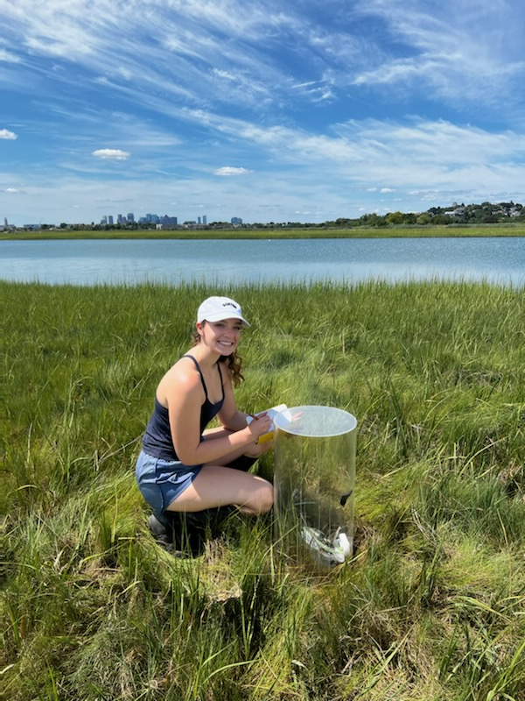

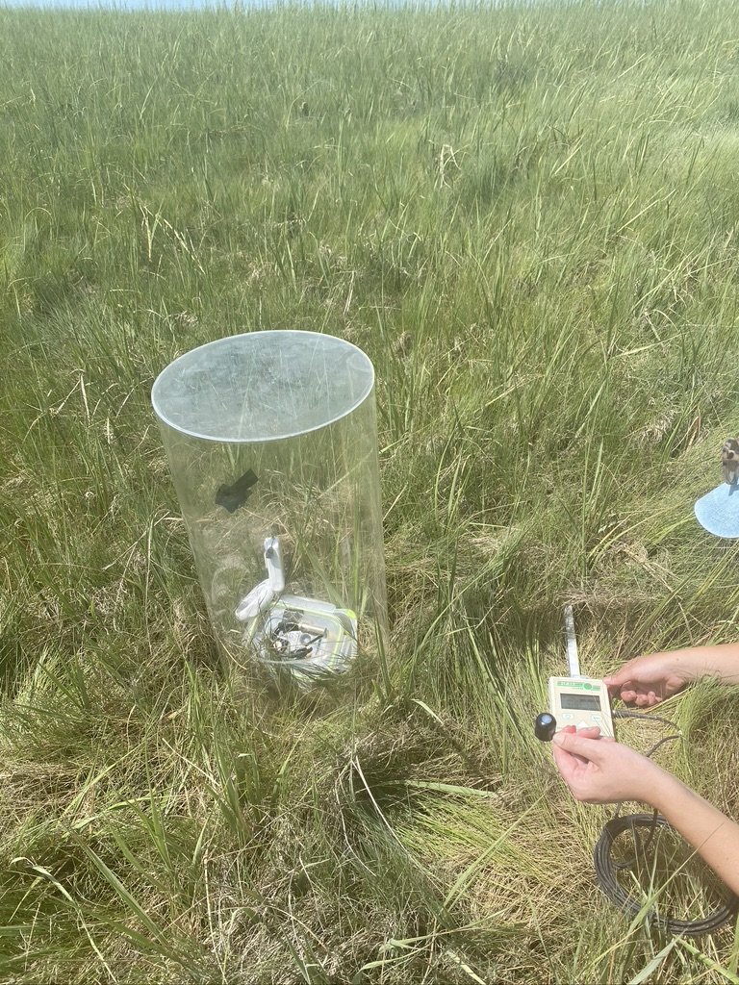
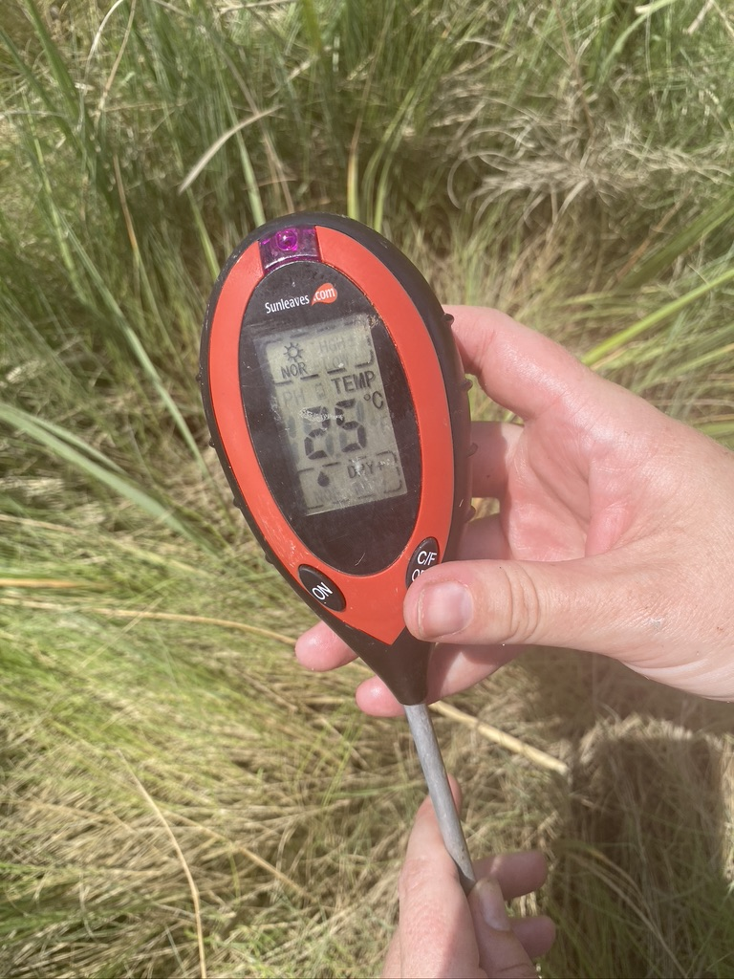
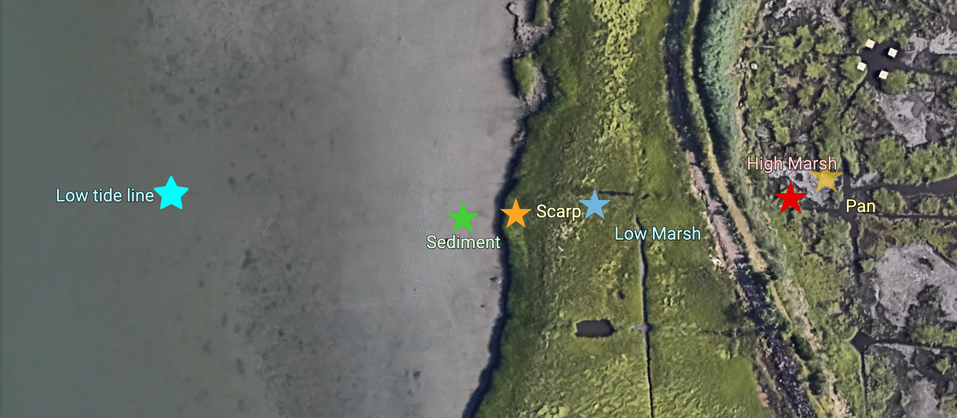
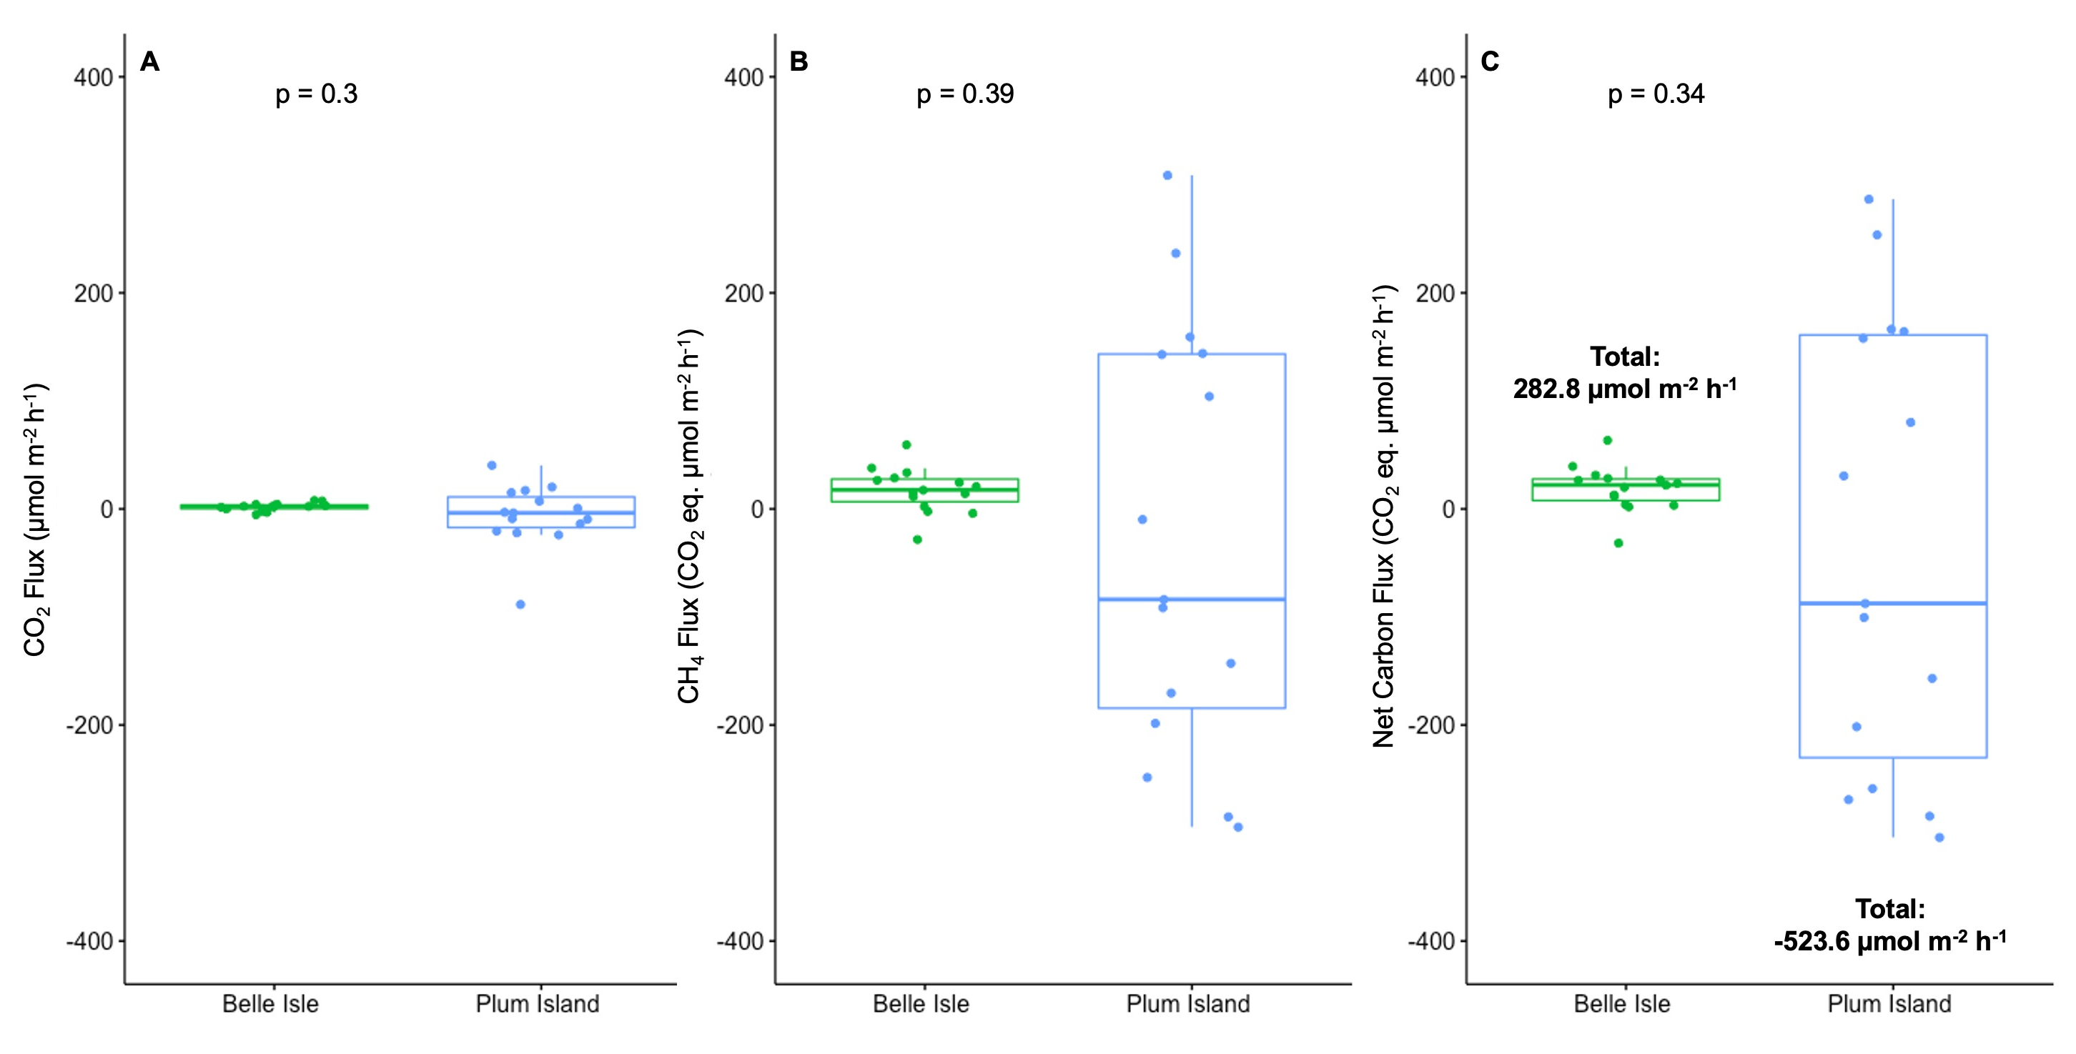
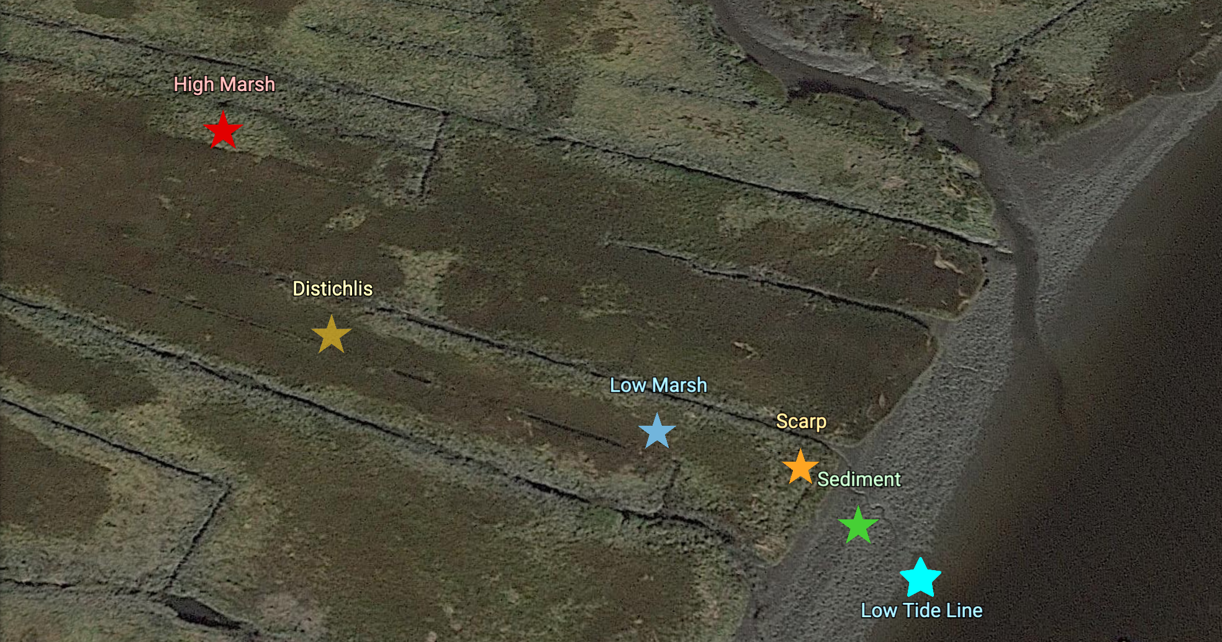
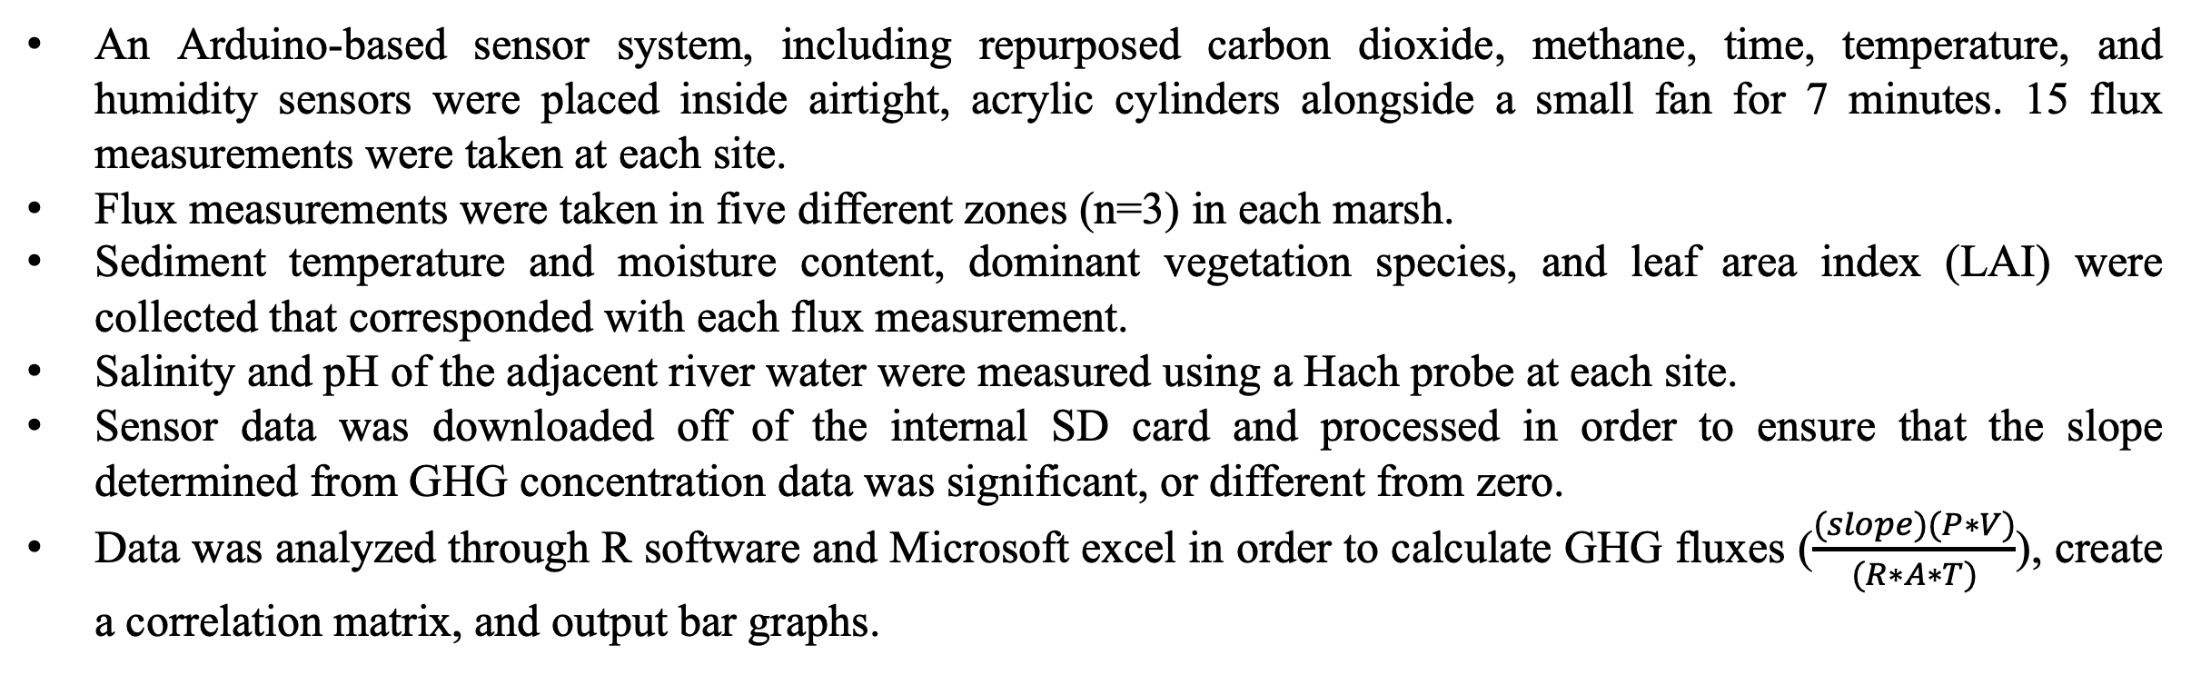
The Impact of Urbanization on Salt Marsh Greenhouse Gas Dynamics
Rebecca Adler^{1,2}, Amanda Vieillard², Robinson W. Fulweiler^{2,3}
¹Pine Crest School, Fort Lauderdale, FL, USA; ²Boston University, Department of Earth and Environment, Boston, MA, USA; ³Boston University, Department of Biology, Boston, MA, USA
Introduction
Methods
Discussion & Conclusions
Salt marshes provide numerous ecosystem services¹ including:
habitat for a range of diverse species
storm surge protection
nutrient filtration
carbon sequestration^{2,3,4}
This latter service is particularly relevant, as there are widespread efforts to understand the role of salt marshes in combatting climate change^{2,5,9}. While salt marshes can be both sources or sinks of two powerful greenhouse gasses (GHG), carbon dioxide (CO₂) and methane (CH₄), it is thought that they are net carbon sinks². If functioning as a net carbon (C) sink, salt marshes sequester C in their sediments^{1,2,6}. Alternatively, if functioning as a net C source, salt marshes will emit these GHG, contributing to an overall warming of the earth’s surface^{2,6}. However, there is a substantial knowledge gap in spatial and temporal CO₂ and CH₄ fluxes from salt marshes^{7,8}, particularly in urban ecosystems⁷, because GHG are difficult to quantify and are highly variable. Here a novel, ultra-portable, low-cost GHG sensor system was used to measure CO₂ and CH₄ fluxes in two contrasting marshes. Belle Isle Marsh Reservation is the largest remaining salt marsh in Boston and is bounded by urban development. The Great Marsh at Plum Island in Rowley, MA is a less anthropogenically impacted system. In this study, it was hypothesized that the less impacted marsh would function as a net carbon (C) sink, sequestering GHG, whereas the urban marsh would be a net C source.
Although this study is a snapshot of summer GHG emissions, it indicates that these two marshes are functioning differently:
While restoration efforts (to revitalize vegetation and animal species) have taken place in the Belle Isle Marsh, these effects have not extended to GHG restoration.
This snapshot of GHG flux results conclude that:
Belle Isle Marsh is functioning as a C source, contributing to an overall warming of the earth’s surface.
The Great Marsh is functioning as a net C sink.
The Belle Isle Marsh Reservation:
Interestingly, there was no net CO₂ sequestration at Belle Isle Marsh, but some CH₄ uptake in the high marsh zone.
The Great Marsh at Plum Island:
The low marsh and distichlis zones sequestered both CH₄ and CO₂.
The high marsh emitted both GHG, which is opposite of what was expected due to photosynthesis occurring within the zone’s abundant plant life.
The most CO₂ was sequestered in the sediment, which is also interesting because of its lack of vegetation .
Figure 3A: Sensors collecting data at Belle Isle Marsh Reservation.
Figure 3B: The Arduino-based sensor system used to measure GHG fluxes.
Figure 3C: LP-80 AccuPAR used to collect LAI at both locations.
Figure 3D: Thermometer used to collect sediment temperature and moisture content at both locations.
An Arduino-based sensor system, including repurposed carbon dioxide, methane, time, temperature, and humidity sensors were placed inside airtight, acrylic cylinders alongside a small fan for 7 minutes. 15 flux measurements were taken at each site.
Flux measurements were taken in five different zones (n=3) in each marsh.
Sediment temperature and moisture content, dominant vegetation species, and leaf area index (LAI) were collected that corresponded with each flux measurement.
Salinity and pH of the adjacent river water were measured using a Hach probe at each site.
Sensor data was downloaded off of the internal SD card and processed in order to ensure that the slope determined from GHG concentration data was significant, or different from zero.
Data was analyzed through R software and Microsoft excel in order to calculate GHG fluxes ($\frac{(slope)(P∗V)}{(R∗A∗T)}$), create a correlation matrix, and output bar graphs.
Results
Applications and Future Studies
Table 2: Belle Isle Marsh Reservation and Plum Island environmental data, divided by zone.
Site | Zone | Average Light (umol m⁻²) | Average LAI (umol m⁻²) | Average Sed. Moisture | Average Temp (°C) | Dominant Vegetation Species
Belle Isle Marsh Reservation | Sediment | 1635 | 0.97 | 4 | 22.67 | Microphytobenthos
 | Scarp | 1668.7 | 0.12 | 3 | 23 | Spartina alternaflora (long)
 | Low Marsh | 1799.3 | 0.15 | 3 | 25.67 | 1/2 Spartina alternaflora (short) 1/2 Spartina patens
 | Pan | 1878.7 | 0.98 | 3.33 | 28 | Purple sulfur bacterial mat
 | High Marsh | 1705.3 | 0.20 | 2 | 20.93 | Spartina alternaflora (long)
Plum Island | Sediment | 1682.3 | 1.0025 | 4 | 24.67 | Microphytobenthos
 | Scarp | 1845.3 | 0.013 | 3 | 25.67 | Spartina alternaflora (long)
 | Low Marsh | 1849 | 0.0809 | 3 | 27.33 | 1/3 Spartina alternaflora (short) 2/3 Spartina patens
 | Distichlis | 1940.7 | 0.24 | 3 | 29.33 | Distichlis spicata
 | High Marsh | 1668 | 0.0054 | 3 | 26.33 | Spartina patens
Even though restoration occurred in 1978 at the Belle Isle Marsh, the GHG flux data that was collected suggests that these efforts have not changed the Belle Isle Marsh from a C source to a C sink.
Restorative efforts at Belle Isle Marsh need to include a focus on GHG dynamics so that more C can be sequestered, pulling the harmful GHG from the atmosphere and preventing global warming rather than contributing to it.
In the future, I would like to:
Gather data throughout the year from both salt marshes in order to compare GHG fluxes during different seasons.
Look at GHG fluxes in different coastal vegetated ecosystems.
The objective of this study was to compare the GHG flux concentrations collected in the Belle Isle Marsh Reservation with those found in The Great Marsh in order to quantify how much salt marsh urbanization contributes to climate change.
Study Site Descriptions
Figure 4: Carbon Flux (µmol m⁻² h⁻¹) in all zones of Belle Isle (green) and Plum Island Marshes (blue). A: CO₂ flux; B: CH₄ flux (as CO₂ equivalence); C: net flux as CO₂ equivalence. Positive values indicate net carbon emissions and negative values indicate net carbon uptake. Total emission (Belle Isle) and uptake (Plum Island) are also shown (C).
Acknowledgements
Man-made Embarkment
This project would not be possible without invaluable guidance from my mentor, Dr. Amanda Vieillard–thank you so much for all of your help this summer. Thank you to Dr. Fulweiler for assisting me throughout my project, and the Boston University RISE program for providing me with wonderful lab experience. Additional thanks to the rest of the Fulweiler lab including Adam Crawford for helping with data collection. Funding for this project was provided by an NSF Grant (1940085) to Fulweiler.
Figure 1: Belle Isle Marsh Reservation. GHG Fluxes were measured in five positions which were determined based on their distance from the low tide line: Sediment, Scarp, Low Marsh, High Marsh, Pan. The High Marsh here has man-made tidal restriction. Samples were taken on July 27, 2022.
Key References
Rosentreter, Judith A., et al. “Methane and Nitrous Oxide Emissions Complicate Coastal Blue Carbon Assessments.” Global Biogeochemical Cycles, 28 Jan. 2021, 10.1029/2020gb006858.
Mcleod, Elizabeth, et al. “A Blueprint for Blue Carbon: Toward an Improved Understanding of the Role of Vegetated Coastal Habitats in Sequestering CO2.” Frontiers in Ecology and the Environment, vol. 9, no. 10, Dec. 2011, pp. 552–560, 10.1890/110004.
Emery, Hollie E., and Robinson W. Fulweiler. “Incomplete Tidal Restoration May Lead to Persistent High CH₄ Emission.” Ecosphere, vol. 8, no. 12, Dec. 2017, p. e01968, 10.1002/ecs2.1968. Accessed 5 Aug. 2022.
Rosentreter, Judith A., et al. “Half of Global Methane Emissions Come from Highly Variable Aquatic Ecosystem Sources.” Nature Geoscience, vol. 14, no. 4, Apr. 2021, pp. 225–230, 10.1038/s41561-021-00715-2.
Duarte, Carlos M, et al. “Rebuilding Marine Life” , Nature Journal, vol. 580, 1 April 2020, pp. 39-51
Al‐Haj, Alia N., and Robinson W. Fulweiler. “A Synthesis of Methane Emissions from Shallow Vegetated Coastal Ecosystems.” Global Change Biology, vol. 26, no. 5, 16 Mar. 2020, pp. 2988–3005, 10.1111/gcb.15046. Accessed 22 May 2020.
Doroski, April A., et al. “Greenhouse Gas Fluxes from Coastal Wetlands at the Intersection of Urban Pollution and Saltwater Intrusion: A Soil Core Experiment.” Soil Biology and Biochemistry, vol. 131, Apr. 2019, pp. 44–53, 10.1016/j.soilbio.2018.12.023. Accessed 14 Dec. 2021.
Bauer, James E., et al. “The Changing Carbon Cycle of the Coastal Ocean.” Nature, vol. 504, no. 7478, Dec. 2013, pp. 61–70, www.nature.com/articles/nature12857
Kennish, Michael J. “Environmental Threats and Environmental Future of Estuaries.” Environmental Conservation, vol. 29, no. 1, Mar. 2002, pp. 78–107, www.cambridge.org/core/journals/environmental-conservation/article/environmental-threats-and-environmental-future-of-estuaries/830CE2DF3F482B87AA60ADAB773906D6, 10.1017/s0376892902000061.
Bastviken, David, et al. “Technical Note: Facilitating the Use of Low-Cost Methane (CH<Sub>4</Sub>) Sensors in Flux Chambers – Calibration, Data Processing, and an Open-Source Make-It-Yourself Logger.” Biogeosciences, vol. 17, no. 13, 14 July 2020, pp. 3659–3667, 10.5194/bg-17-3659-2020. Accessed 5 Aug. 2022.
Neubauer, Scott C., and J. Patrick Megonigal. “Moving beyond Global Warming Potentials to Quantify the Climatic Role of Ecosystems.” Ecosystems, vol. 18, no. 6, 16 May 2015, pp. 1000–1013, 10.1007/s10021-015-9879-4. Accessed 18 Aug. 2020.
Figure 2: The Great Marsh at Plum Island. GHG Fluxes were measured in five positions, determined based on their distance from the low tide line. All locations found in Belle Isle were found here, except there were no unvegetated pans. Distichlis was looked at instead. Samples were taken on August 2, 2022.
Study Site | pH | Salinity (ppt)
Belle Isle | 8.16 | 30.7
The Great Marsh | 7.41 | 32
Figure 5: Average (± standard error) fluxes of CH₄ (grey) and CO₂ (green), as CO₂ equivalents, in Belle Isle (A) and Plum Island (B) from each of the five marsh zones sampled.
Key Findings
Table 1: The Great Marsh. pH and salinity measurements were taken at both study sites. Belle Isle water was shown to be more basic (>7) than The Great Marsh. The Great Marsh had a higher salinity, closer to that of the ocean, meaning it is more highly concentrated with salt water.
In terms of sustained flux global warming potential (SGWP)¹¹, or converting CH₄ to its CO₂ equivalence, Belle Isle Marsh emits 9.6x more CH₄ than CO₂. Belle Isle Marsh functioned as a carbon source, emitting emitting 18.6x more carbon than it sequestered.
The Plum Island marsh sequesters 2.6x as much carbon as it emits, 91.5% of its emissions are CH₄.

