Slide 1
Time Management for Graduate Students
Presented by Diana Lynch
Writing Tutor
School of Social Work
dirose@bu.edu
Created by Barbaranne Benjamin, Ph.D.

Slide 2
Graduate Studies
Not your undergraduate degree
Undergraduate skills
Graduate specialization
Independent

Slide 3
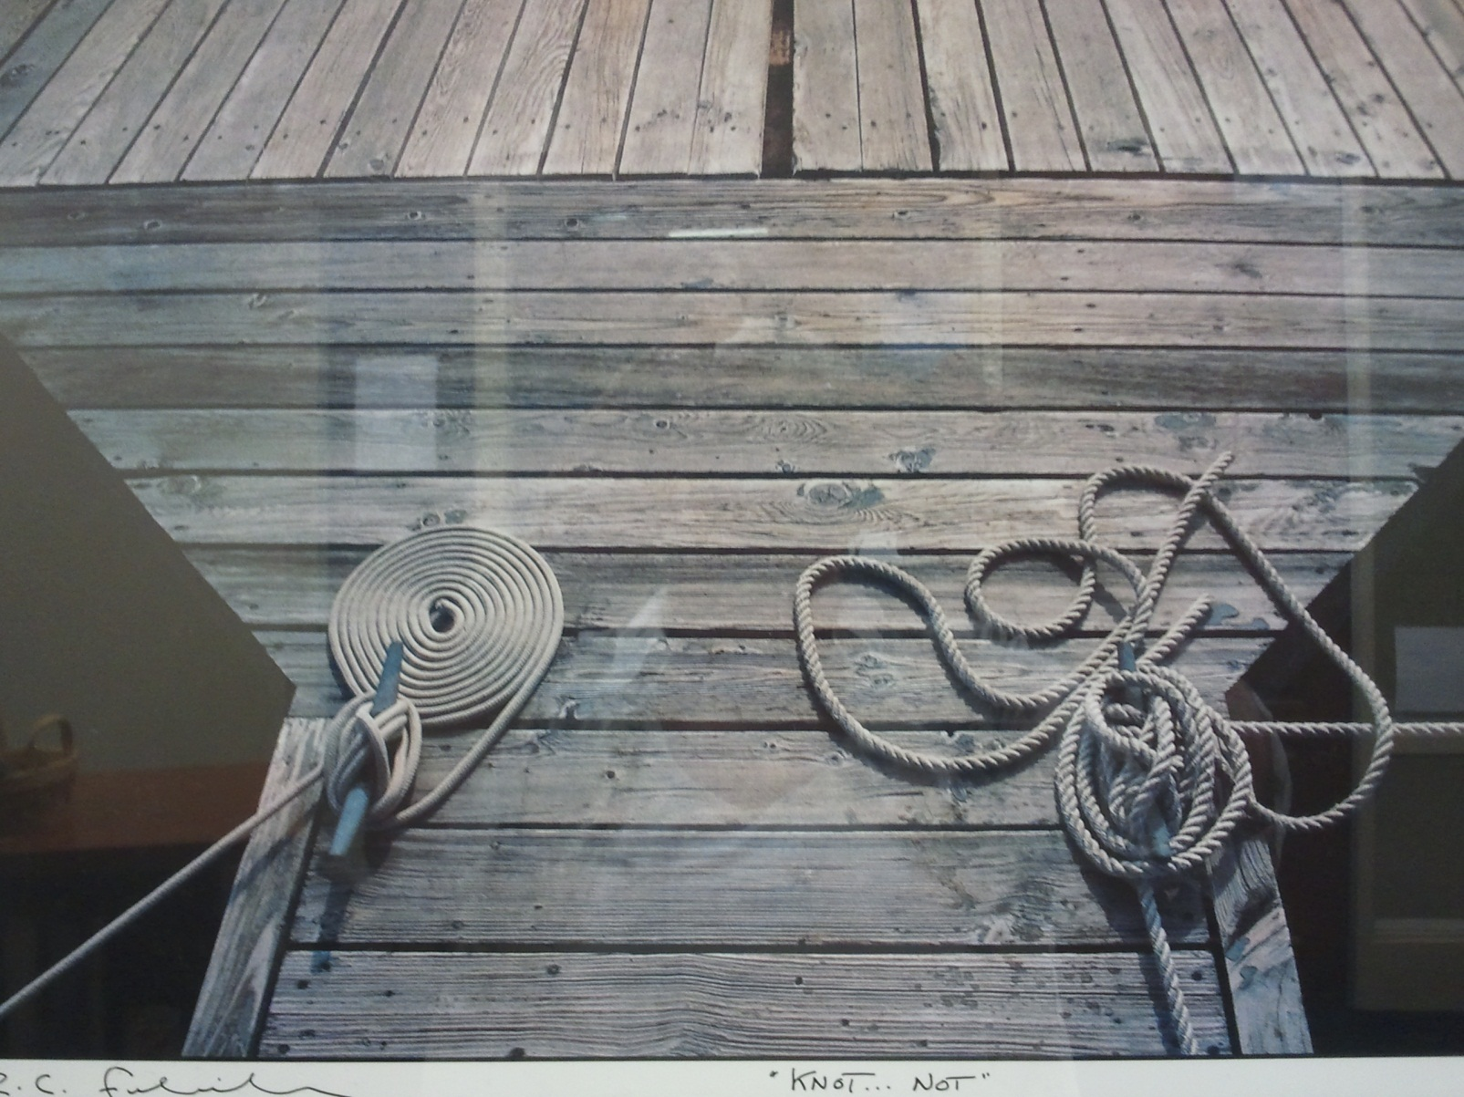
Two Types of People

Slide 4

Myths about Time Management
Time management is nothing but common sense. I do well in school, so I must be managing my time effectively.
It takes all the fun out of life!!!
Time management? I work better under pressure.
No matter what I do, I won’t have enough time!

Slide 5
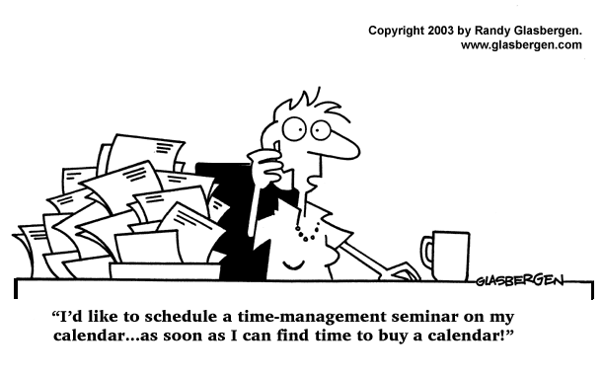

Slide 6
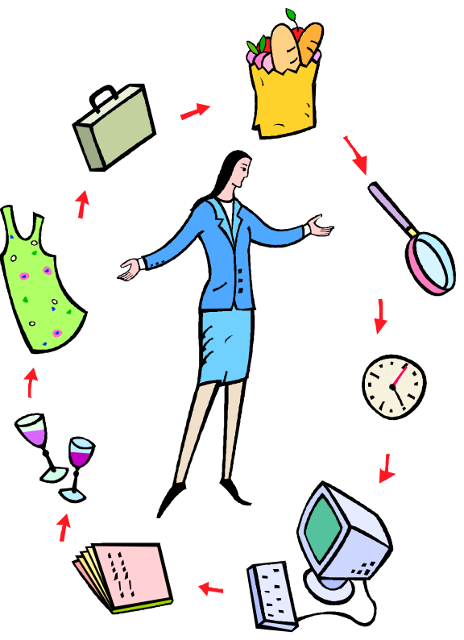
The Truth About Time Management
Increases productivity.
Reduces stress.
Improves self-esteem.
Helps achieve balance in life.
Increases self-confidence
Helps you reach your goals!

Slide 7
There are 168 hours in a Week
 | Urgent | Not Urgent
Important | Do Now | Plan to Do
Not Important | Reject Trivial requests from others Apparent emergencies Interruptions and distractions Scrutinize and probe demands. Help originators to re-assess. Wherever possible reject and avoid these tasks. | Resist ‘Comfort’ activities, computer games, net surfing Chat, gossip, text, social communications Daydreaming, doodling over long breaks Unnecessary adjusting equipment Habitual ‘comforters’ not true tasks. Non-productive, de-motivational. Minimize or cease altogether. Plan to avoid them.

Slide 8

Steps to Managing Your Time
Set goals
Set reasonable expectations (and remember that no one’s perfect)
Make a schedule
Revisit and revise your plan

Slide 9

Revisit Your Values
Knowing what is most valuable to you gives direction to your life.
Your energy should be oriented first toward things that reflect the values that are most important.
Examine your values to help you make time management decisions.

Slide 10

Where to start? Set Goals!
What is Important?
Make your goals specific and concrete. Don’t be vague.
Set both long-term goals and short-term ones to support them.
Set a deadline for your goals.
Integrate your goals: school, personal and career.
Realize that goals change, but know which goals to stick to!

Slide 11

From Goals…Set priorities
What’s important and what isn’t?
What order do things need to be done in?
Once you know what your priorities are, you need to plan out a schedule for the semester, the week and the day.
Acknowledge the realities of college schedules.
Planning may seem hard at first, but the more you do it, the easier and more natural it gets.

Slide 12

Make a Schedule
Set Up Your Semester Calendar
Block all important set time obligations.
Block all class and lab times.
Look at the syllabus for the class schedule.
  Note the weight of the activities.
  Highlight all exams and project due dates.
Work backwards from exams and papers (PERT).
Study time.
Time for your sanity.

Slide 13
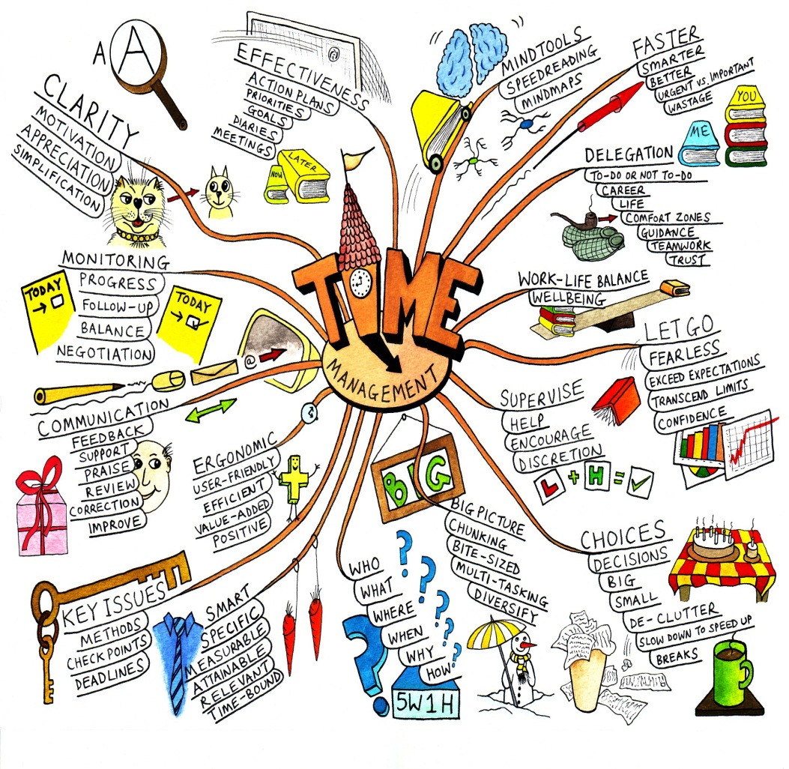
Organizing Your Time
Set realistic goals, there are only 24 hours in a day.
Use spare time to review.
Study at the same time each day: make it a habit
Divide study time into manageable chunks
Leave extra time at the end!

Slide 14

Calendars
Different Perspectives
The “to do” List

Slide 15

Year Calendar

Slide 16
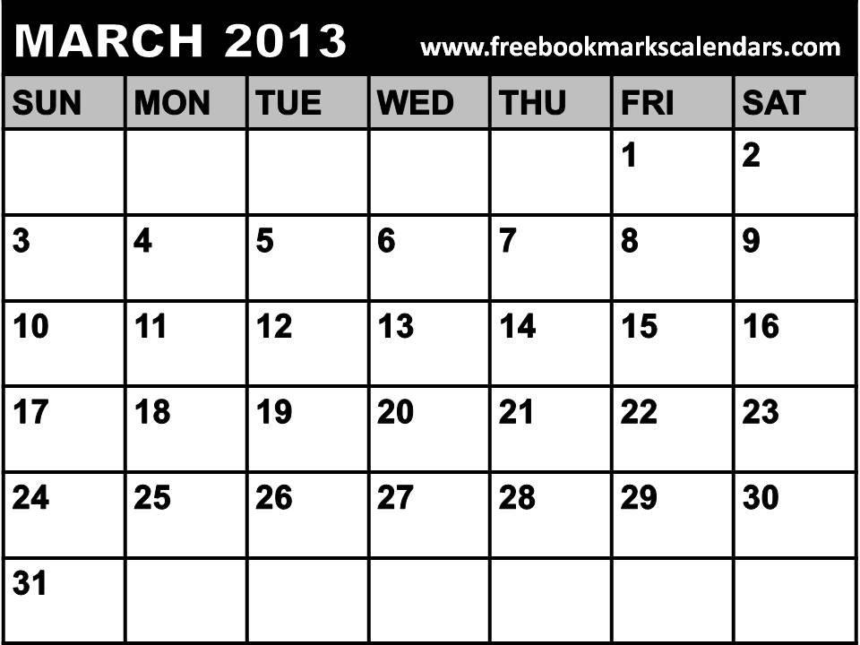
Monthly Calendar

Slide 17
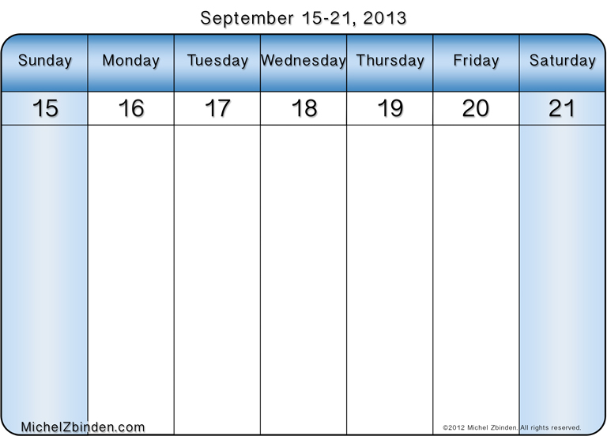
Weekly Calendar

Slide 18
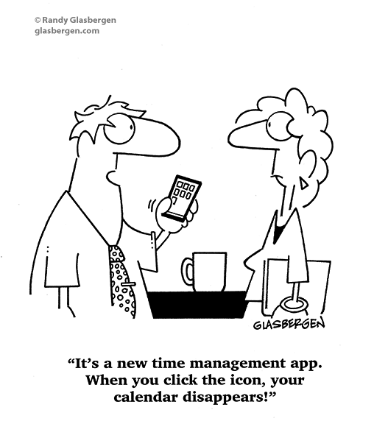

Slide 19

Try it and evaluate your plan!
How are you actually using your time?
Which tasks were you able to do? What didn’t get done?
Was your energy level appropriate? Your stress level?
What changes need to be made to your weekly schedule?
What are persistent time wasters?
Was procrastination an issue?

Slide 20
“Never do today what you can put off ‘til tomorrow!”
Procrastination is my sin.
It brings me naught but sorrow.
I know that I should stop it.
It fact, I will – tomorrow!

Slide 21
Forms of procrastination:
Ignoring the task, hoping it will go away
Underestimating how long it will take/overestimating your abilities and resources
Telling yourself that poor performance is okay/insisting on perfection
Doing something else that isn’t very important
Believing that repeated “minor” delays won’t hurt you
Talking about rather than doing it
Putting all your work on only one part of the task
Becoming paralyzed when having to make choices

Slide 22

How to Overcome Procrastination
Win the mental battle by committing to being on time.
Set and keep deadlines.
Organize, schedule & plan.
Divide a big job into smaller ones.
Find a way to make a game of your work or make it fun.
Reward yourself when you’re done.
Tell your friends and roommates to remind you of
priorities and deadlines.
Learn to say “no” to time wasters.

Slide 23
Tackle Time Wasters
Learn to recognize when you’re wasting time.
Decide what you need to do and can realistically do.
Learn how to say “NO” when you don’t have time.
Return calls at your convenience. The phone is a major time killer.
Learn to say “I can’t talk right now. I’ll get back to you.”
Wasting time is often linked to a lack of self-discipline.
Ask yourself, “Do I really need to do this or not?”

Slide 24

Learn to say “No!”
Avoid the temptation to socialize when you’ve scheduled work.
If friends ask you to join them last minute, decline outright, but ask if you could get together later in the week.
Socializing is important when you don’t have other things to worry about!
Study somewhere you won’t be tempted to chat, watch movies or YouTube, or use social utilities like Facebook.
Texts are a major distraction.

Slide 25
REVISE and PREVIEW:
Staying on top of things…
Immediately note all changes.
  Exam/Paper due date revisions
  Meeting additions/cancellations
  Work schedule changes
  Upcoming visitors, etc., etc…
Preview the upcoming week making any necessary adjustments.
Preview each day to see what might happen…

Slide 26
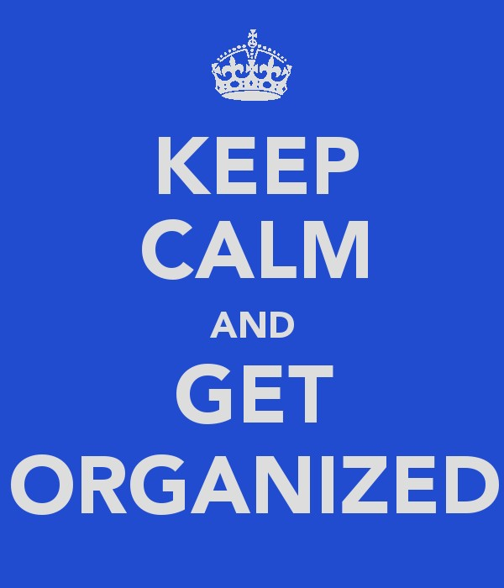

Slide 27
Review
Time and energy management can make you more productive and reduce your stress level.
The Three Steps
  Set goals
  Make a schedule
  Revisit and revise your plan
Be tough with your time. Actively avoid procrastination and time wasters. Learn to say “no” to distractions.
Employ a variety of time management strategies to maximize your time.
Relax and enjoy the extra time that you’ve discovered!

Slide 28

Enjoy your time as a graduate student!

