Slide 1
SPH Senate General Meeting
December 11, 2017 | 5-6 pm | L-311
Notes:
First Senate meeting?

Slide 2
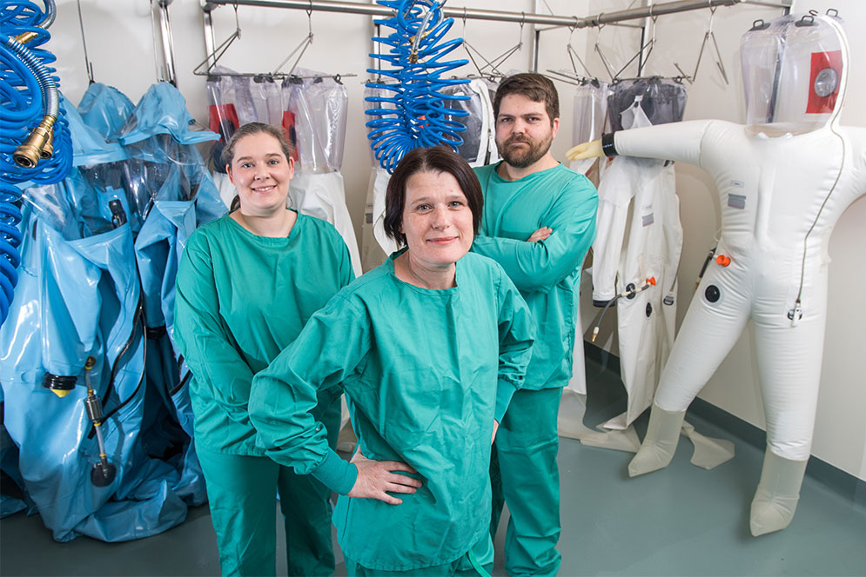
News & updates
The National Emerging Infectious Diseases Laboratories (NEIDL) – Biosafety Level 4
SPH Social @ Chequer’s
  BU Men’s Ice Hockey tickets winner: Shannon Hearney
Alumni Network Express
Phone changes
Lots of on-campus talks
and forums!

Slide 3

SPH This Year

Slide 4
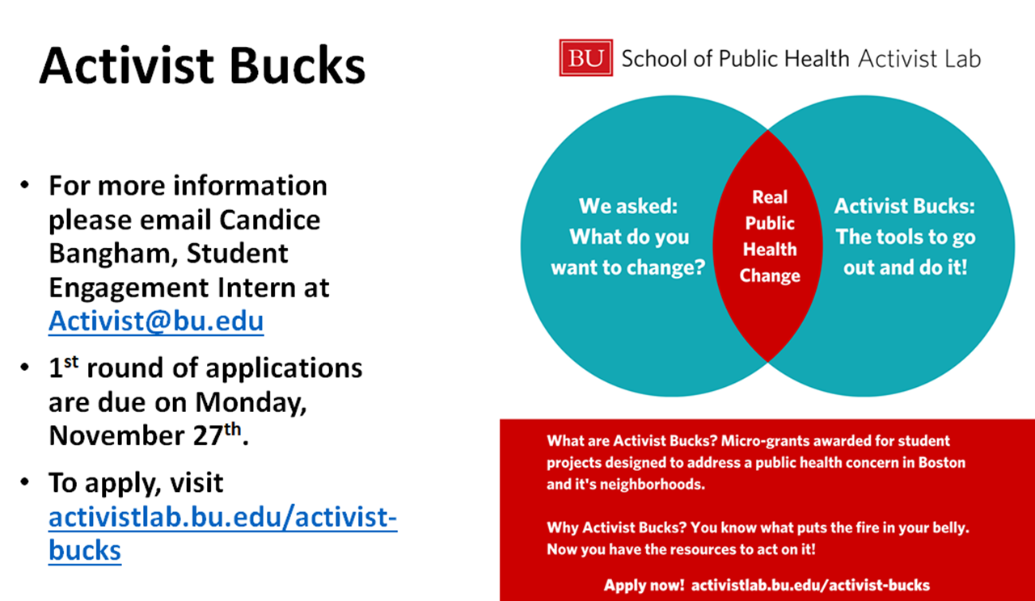

Slide 5
Upcoming Events
12/12 Precision Public Health: Balancing Scientific
Investment and Prevention (4:30-6 pm, Hiebert)
12/13 Barkley Holiday Party by the Activist Lab and
the Students of Color for Public Health
12/19 Student Coffee Chat with the Dean
(5-6 pm, Founder’s Room)
12/20 Take your student survey!
(Jacey Greece - jabloom@bu.edu)

Slide 6
Events: Next Semester
New Senate General Meeting format
  Student Org Fair
  Practicuum
1/17 (10am-3pm) New Member Orientation
  Campus tours, set up and clean up, team building activity
TBD - Mixer with Questrom

Slide 7
What’s going on with clubs?

Slide 8


What’s on your mind?

Slide 9
FINALS / Stress relief
Mugar Library open 24 hours from 12/14 – 12/21
Other library options:
  BU Medical Library
  BU Law Libraries
  School of Theology Library
  BUSPH Student Lounge
  BPL- main, Cambridge
Check the SPH Student Weekly for more options!

Slide 10
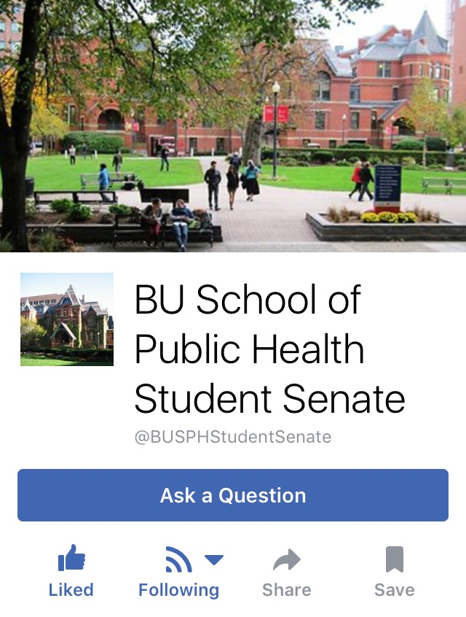
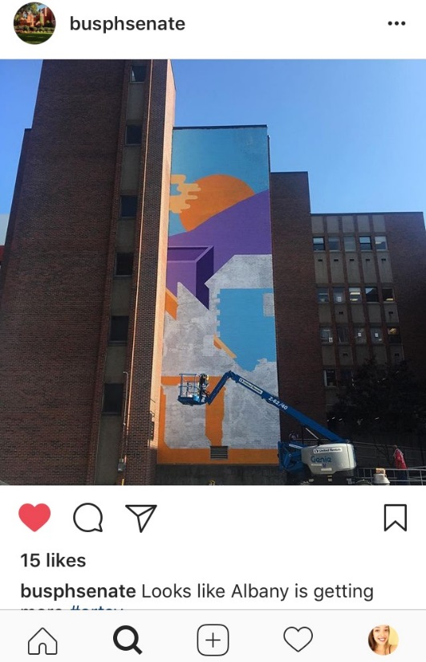
Social Media
Facebook @BUSPHStudentSenate
Instagram @BUSPHSenate

Slide 11
Thank you, Ola!
We’ll miss ya

Slide 12
New e-Board positions
...Let us know you’re
interested and we’ll be in touch!

Slide 13


