Slide 1
Boston University School of Public Health Student Senate
General Body Meeting 30 October 2017 5:00-6:00 L311

Slide 2
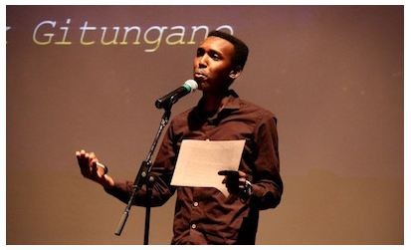
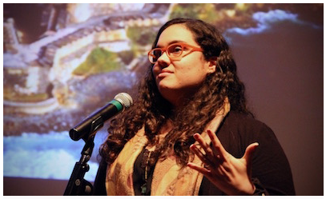
BUSPH Stories Recap
Thanks to all those who presented
7 AMAZING Stories
$1,500 raised in TOTAL
Thank you

Slide 3

One Health Movie Screening
Susan Knoll One Health President
Friday, 3 November 2017
5:00pm-8:00pm
INS 210

Slide 4
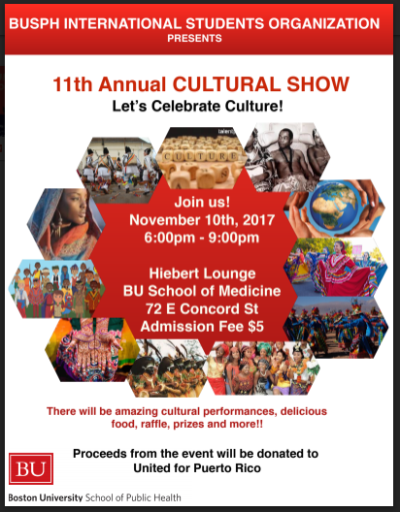
ISO Cultural Show
Gianni Bermudez President of ISO
Friday, 10 November 2017
5:00pm-8:00pm
Heibert Lounge 5$ tickets!
Proceeds benefit United Puerto Rico

Slide 5
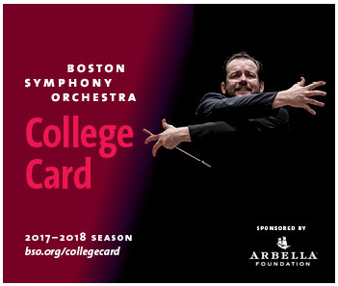
Boston Symphony Orchestra
For only $25 (College Card) students can attend many BSO concerts at no additional cost!
Great opportunity to explore the 2017-2018 Boston Orchestra season at a low cost!

Slide 6

Student Coffee Chat with the Dean
31 October 2017
Founders Room 5pm-6pm
Any mid-semester feedback can be given to the Dean

Slide 7

Chequers Student Social!!
Chequers Student Social
Thursday, 9 November 2017
5pm-6pm

Slide 8

Salvation Army Volunteer Opportunity
Thanksgiving Dinner Distribution
18 November 2017
10am-3:30pm
1500 Washington Street Boston, MA
http://www.signupgenius.com/go/508044ba8a92eaafc1-volunteer

Slide 9

Mid-semester Feedback?
Open forum time!
What feedback do you have for the student senate?

Slide 10

ChangeMaker Chats
Tamara Wyzanski
Changemaker Chats
http://changemakerchat.com

Slide 11

Thank you!!
Reach out to us at phsenate@bu.edu
Follow us!!

