Slide 1
Boston University School of Public Health Student Senate
General Body Meeting September 25th 5:00- 5:50

Slide 2
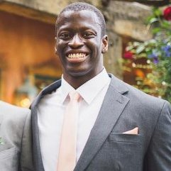
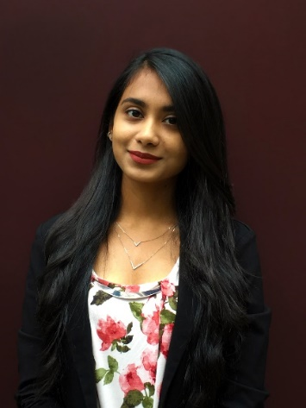
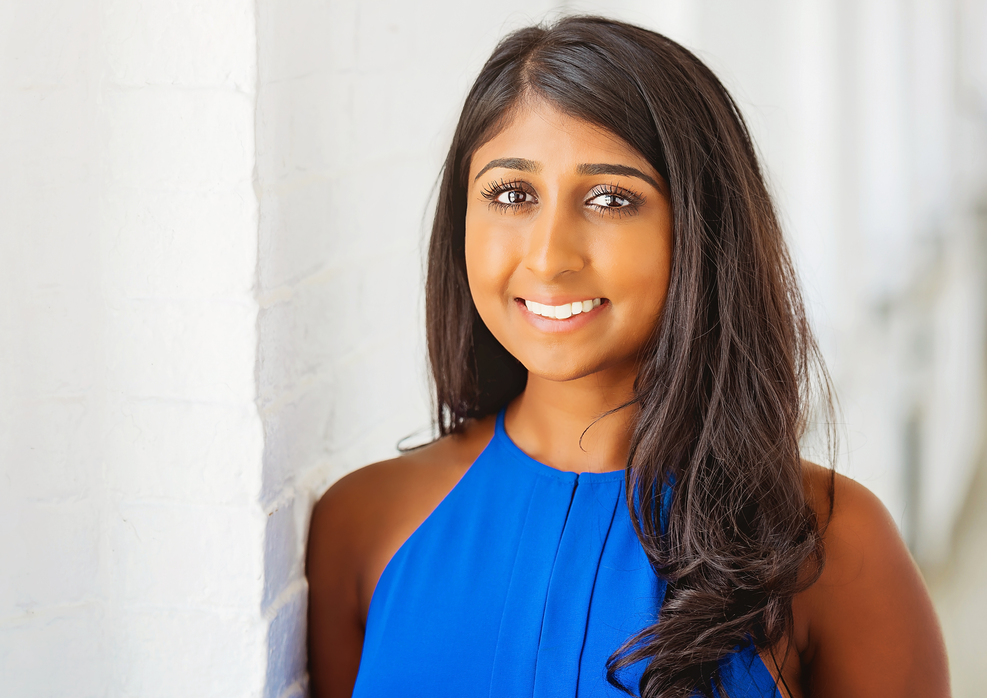
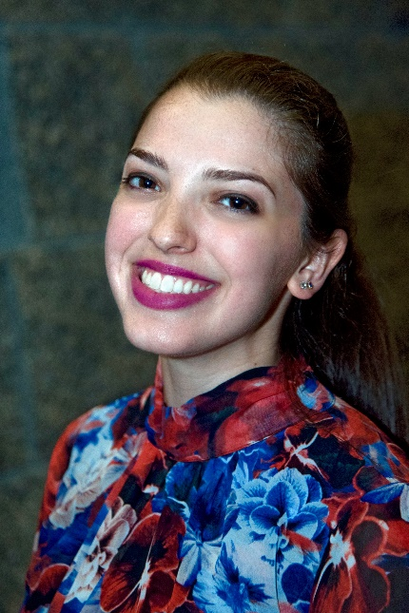
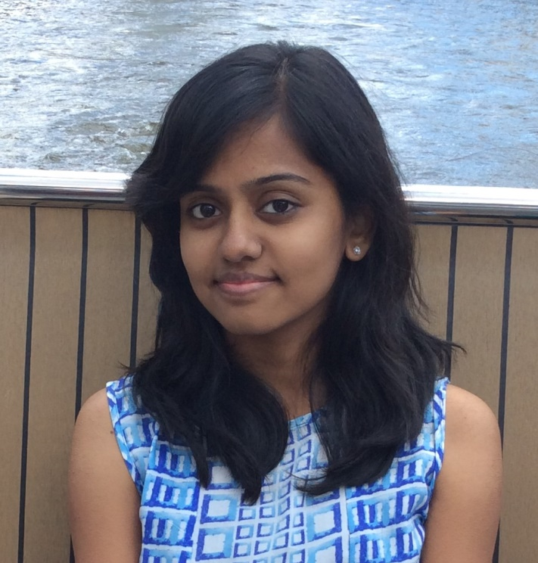
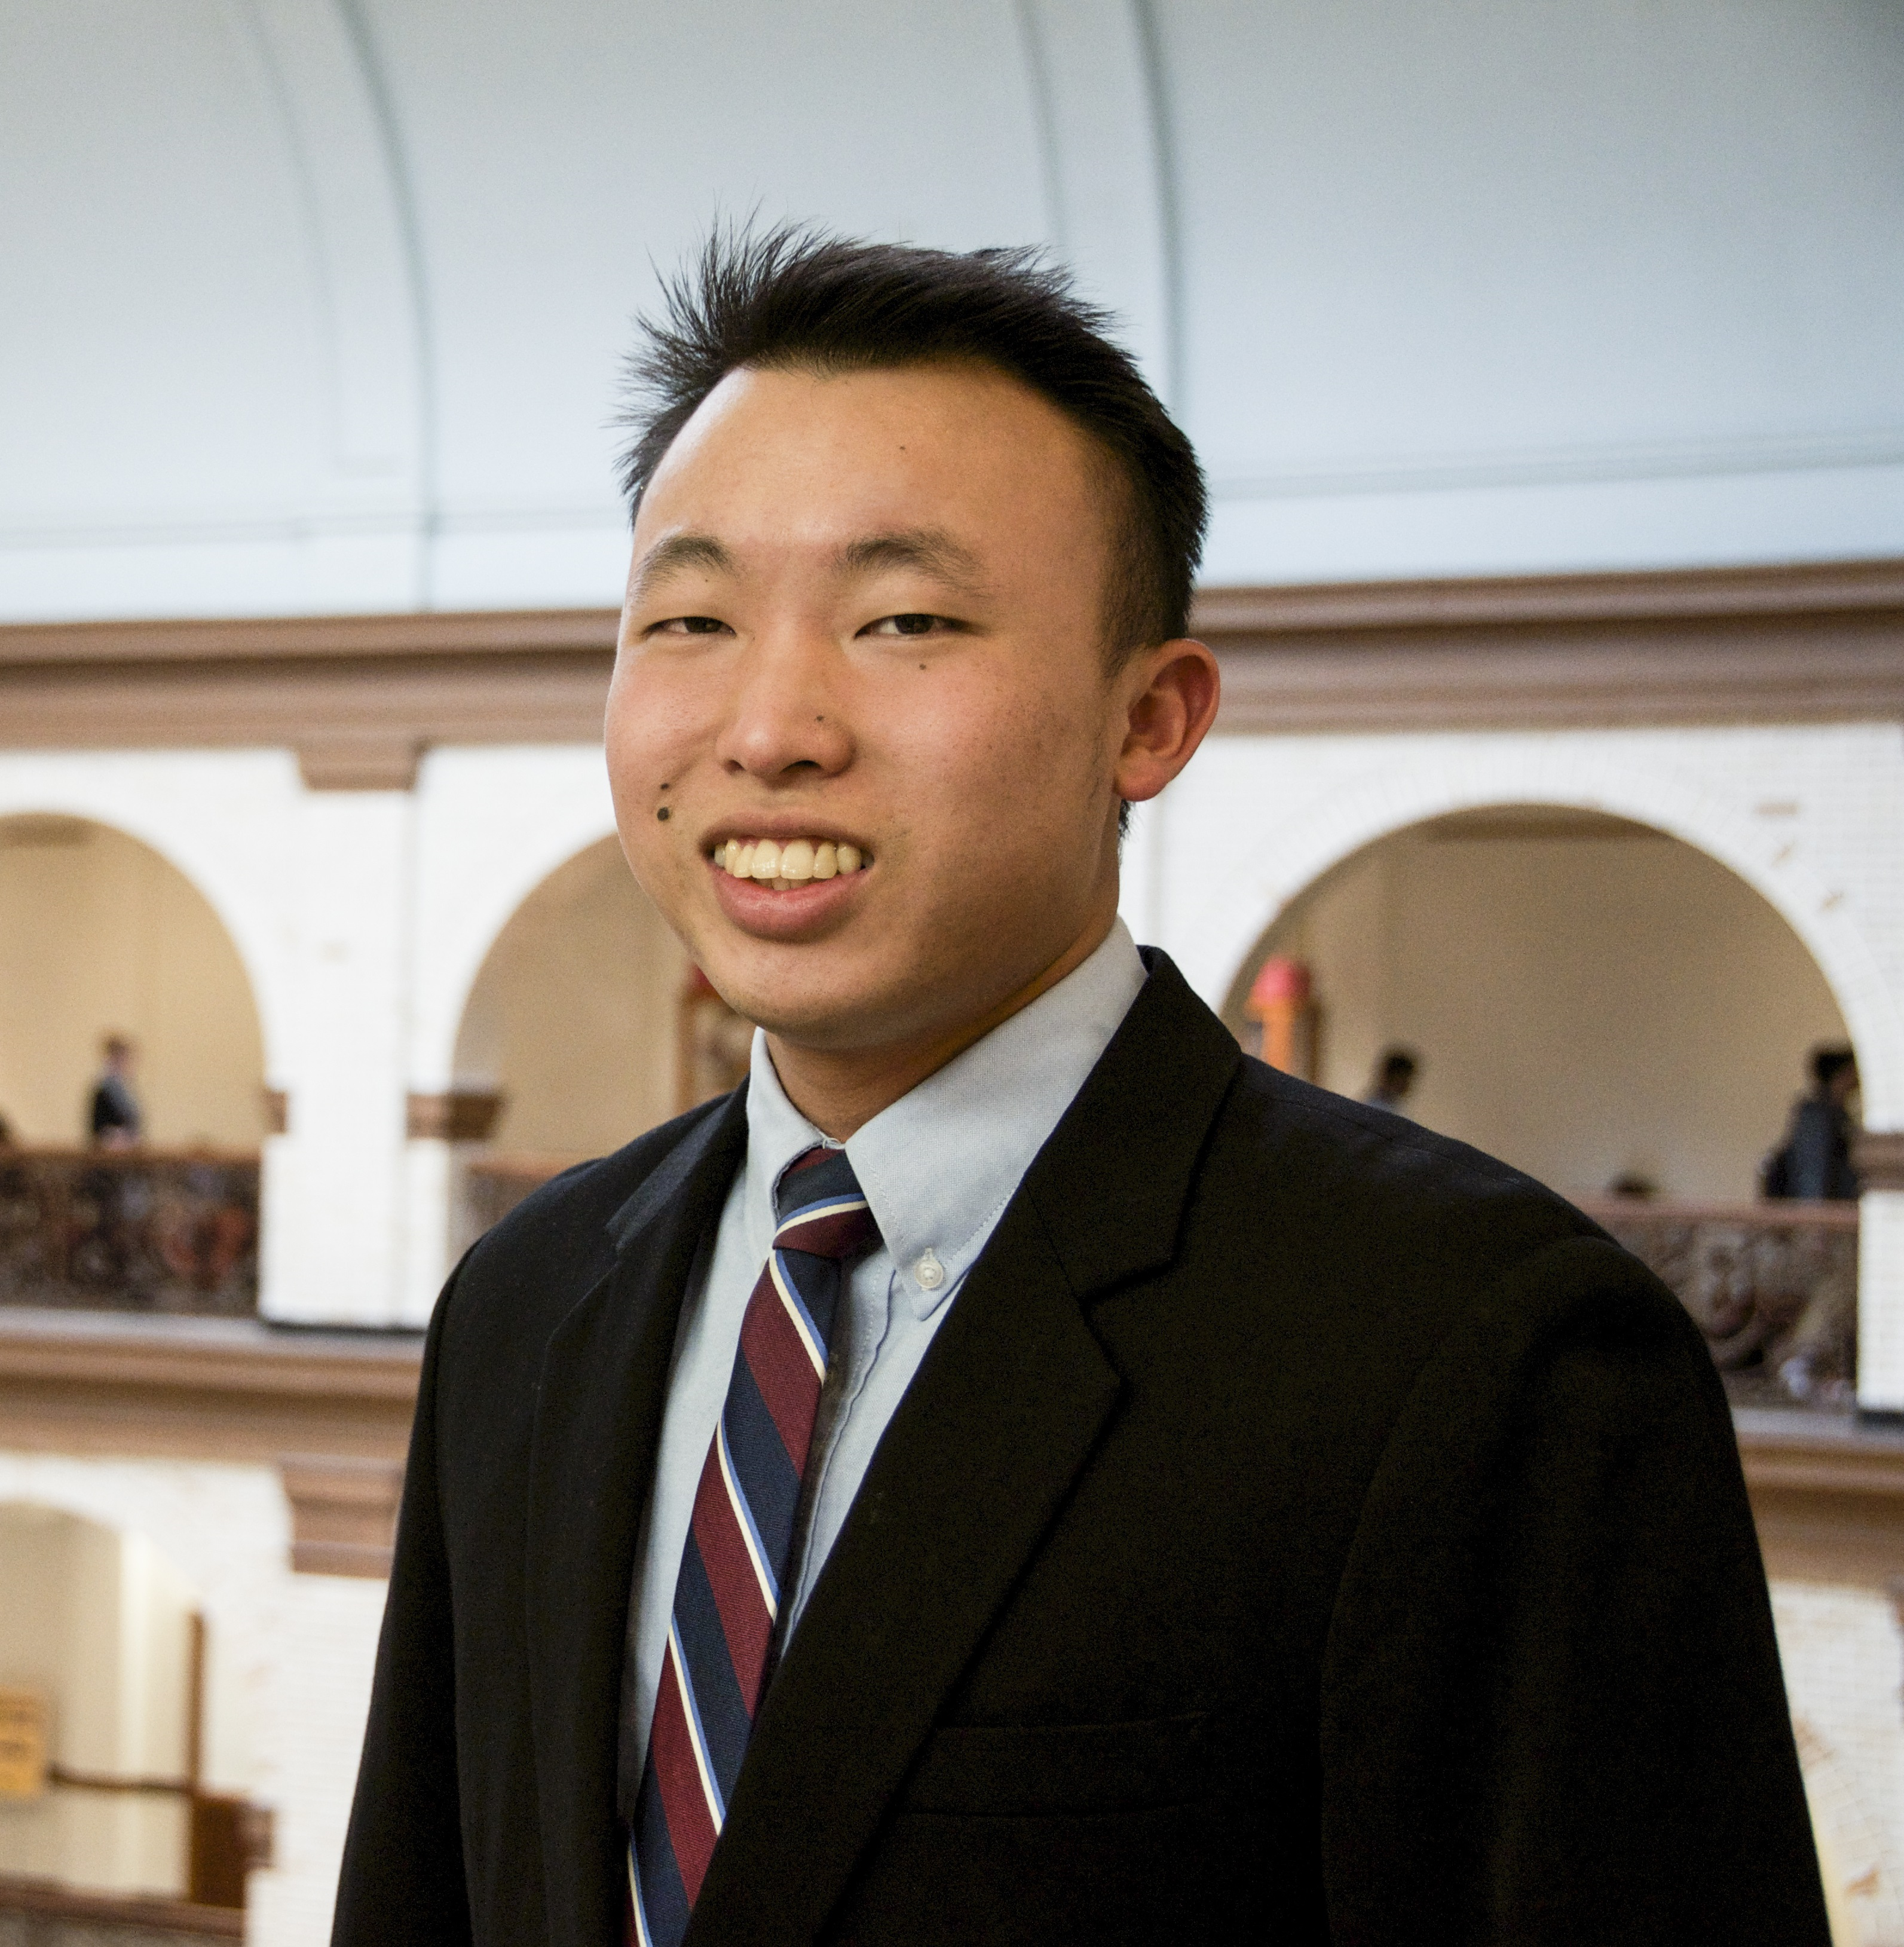
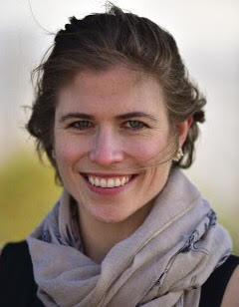
Who We Are
Olaoluwa Omotowa
Anna Ronning
Sonja Steck
Carolyn John
Weston Klimas
Qing Wai
Morgan Simko
Kalpita Patel
Edward Lai
Cindrel Jagedeesan

Slide 3
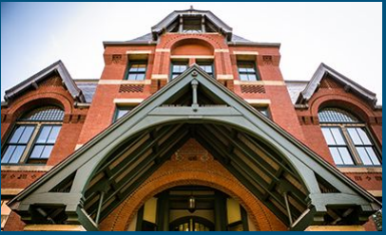

What We Do
Mission Statement: To disseminate information, support student-initiated projects, and represent the concerns of public health students to the faculty, staff and university community. Student Senate is actively involved in community projects and its members serve on a variety of advisory boards and committees at the School and University.
Represent and Advocate for the causes and interests of the student body
Serve as a channel of communication between students and the SPH faculty and administration
Coordinate and organize school wide events

Slide 4


What You Do
Spread the word
Distribute information
Check your emails
Make the Student Senate work!
Share Pain Points
Driving Force for BUSPH!

Slide 5


Upcoming Events
Annual Survey
  https://bostonu.qualtrics.com/jfe/form/SV_578fr2dVIKigBUh
Flu Season!
  Sept. 29
    Hiebert Lounge
    11-1pm!
  Oct. 25
    85 E. Newton St (Solomon Carter Fuller Building)
    5-8pm

Slide 6

SPH Apparel Sale
Deadline- October 6, 2017
Have you ordered your SPH apparel yet? The store will be active until next Friday, October 6th, 2017. The product will ship within two weeks after the end of the campaign date. This year, the funds collected will go towards helping communities in Houston and Florida affected by the recent hurricanes. Show off your favorite SPH apparel and shop for a good cause!
https://bustudentfundraisers.ignitecx.com/SPHFall17

Slide 7

Speaker Series
Please join the Health and Human Rights Caucus and the Center of Health Law, Ethics & Human Rights welcome Harold Koh, International Law Professor at Yale Law School for "Public Health as a Human Right: The Case for Tobacco Control." Harold Koh is one of the nation's leading experts in international law, national security and human rights.
RSVP is required as lunch will be served.

Slide 8

SPH Stories
Volunteer to table
  Oct 16th-Oct 20th
Spread the word
Keep an eye out on your emails!
Submit a story for BUSPH stories
  phsenate@bu.edu
Submit a story 5-7min by Friday, October 13
Share your story!
  Speech
  Art
  Song
Attend Signature Event
  Friday, OCT 20th 6:30-9:00pm Keefer Auditorium
  Prizes Prizes Prizes!

Slide 9
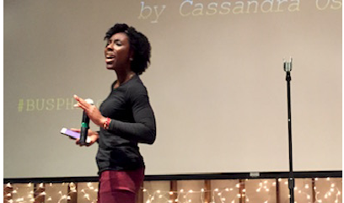
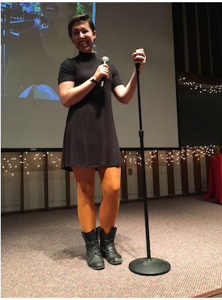
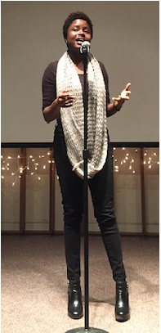
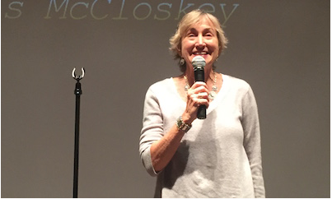

Slide 10

Student Resources
Access Student Calendar
  Resources
  Student Dashboard
  Join a Student Organization!
Graduate Student Life Resources
  Mahogany Price
  Mary Murphy-Phillips
  Erica Townsend
  sphgsl@bu.edu
Certificate Advising Fair!
  4:30-6pm Hiebert Lounge Oct. 2
http://www.bu.edu/sph/students/sph-student-dashboard/

Slide 11
Questions? Reach out!!
phsenate@bu.edu

Slide 12

Coffee Chat
Healthier Book Talk with Dean Galea
                Barnes & Nobles 7pm Today!

