Slide 1
BUSPH
Student Senate
Thusday November 16, 2017
5-6pm
L-311

Slide 2
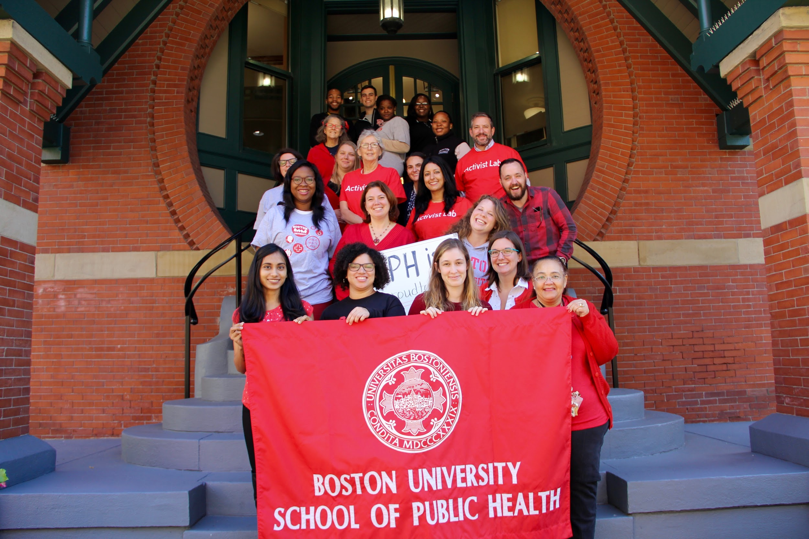
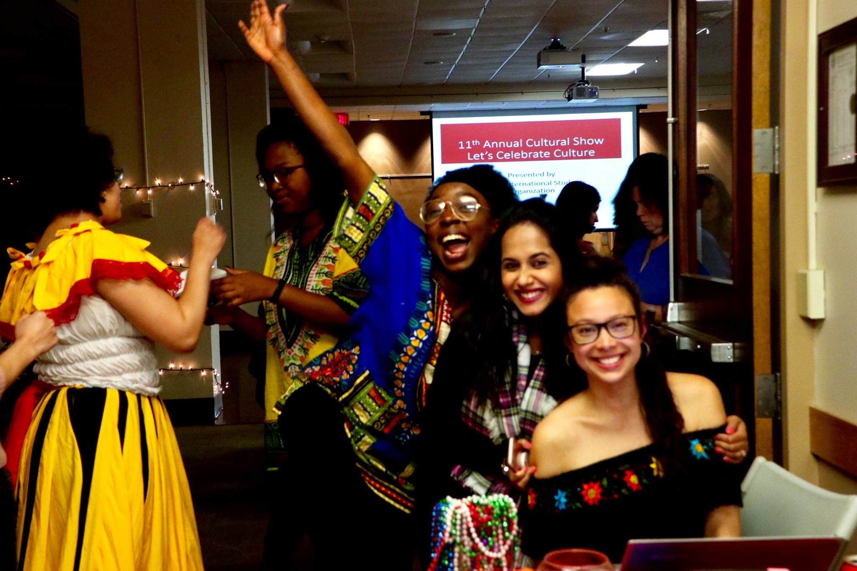
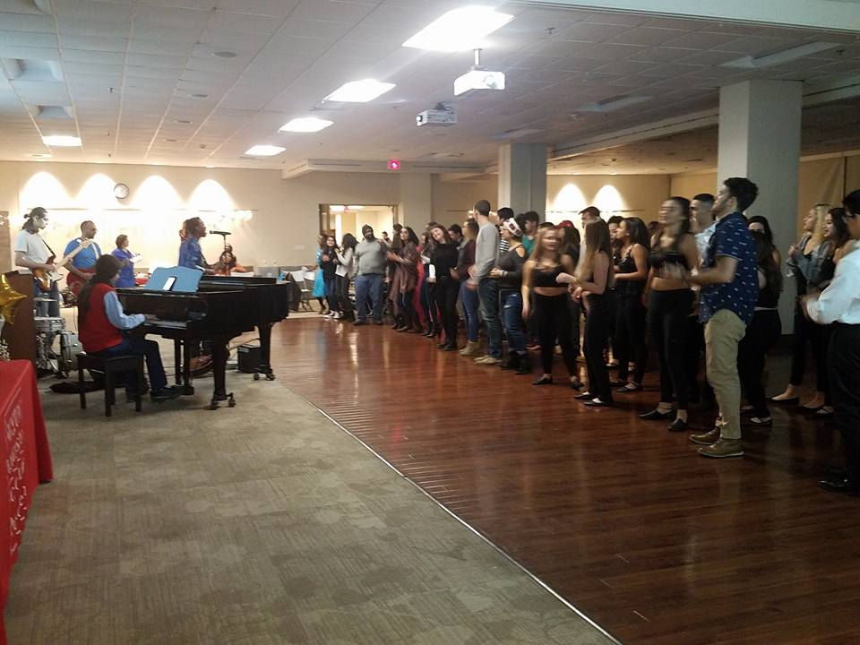
What you missed
BU Terrier Pride Day--->
ISO Cultural Show
Terrier Pride Day

Slide 3
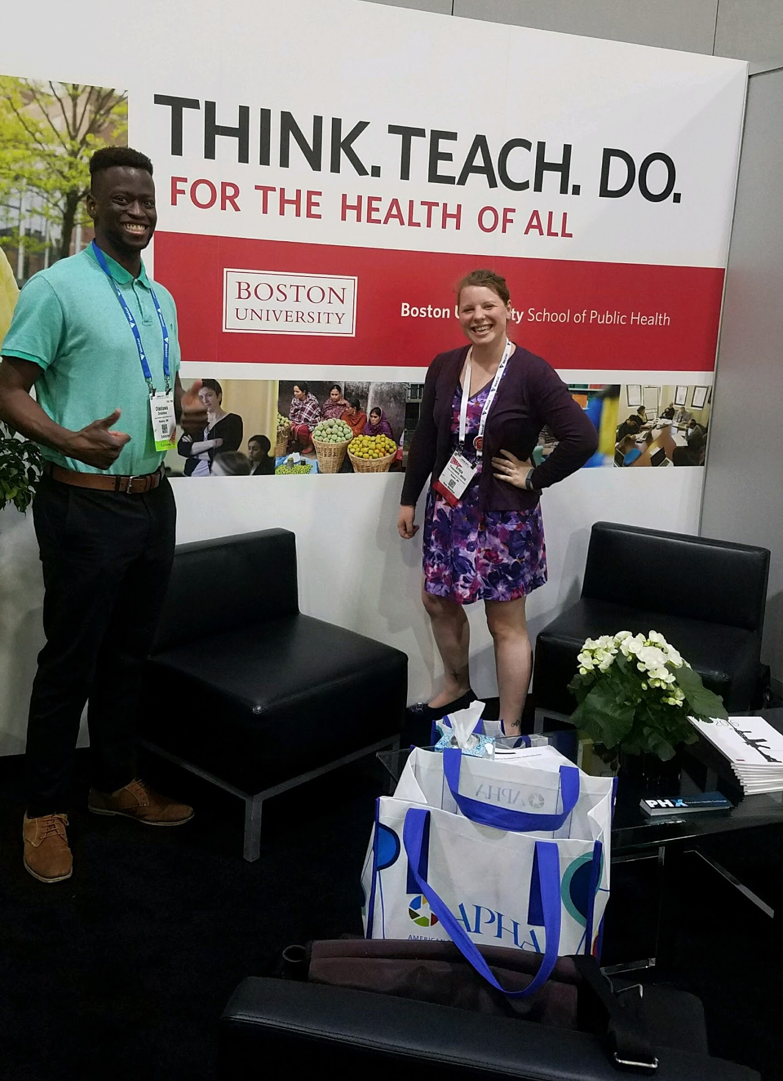

Get Involved
American Public Health Association
www.apha.org
Daily Themes:
Monday: Behavioral Health
Tuesday: Communicable Diseases
Wednesday: Environmental Health
Thursday: Injury and Violence Prevention
Friday: Ensuring the Right to Health

Slide 4

What’s on your minds?

Slide 5

Volunteering with the Salvation Army
Saturday, November 18
9:30am - 3:30pm | Talbot Green

Slide 6

SPH Governing Council Student Representative
SPH Governing Council is looking for a new student representative
Responsibilities:
  Liason between Student Senate and Dean’s Office
  Attend bi-weekly meetings
School-wide and leadership level events
Send resume & one paragraph cover letter to Mary Murphy-Phillips by Friday Nov 17

Slide 7

Student Meeting with the Deans
Wednesday November 29
5:00 - 6:00pm | L-311
Come hear from the Deans and discuss issues that are important to you as students

Slide 8
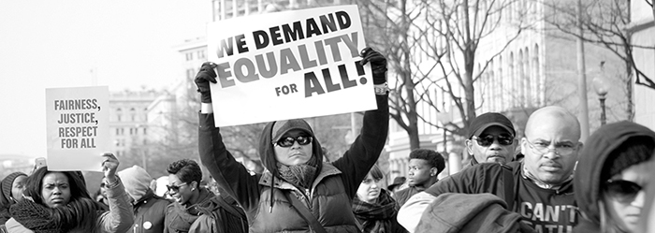
Racial Justice Talking Circle
Thursday, November 30
1:00 - 2:00pm | T-106E
All are welcome to discuss current events in an informal and unstructured conversation about racism, white privilege and inequity.

Slide 9

Ayooo

Slide 10

Student Social
Tuesday, December 5
5pm @ Chequers, L-Basement

Slide 11

December Graduate Reception
Thursday, December 7
4:30-6:30pm
Hiebert Lounge

Slide 12

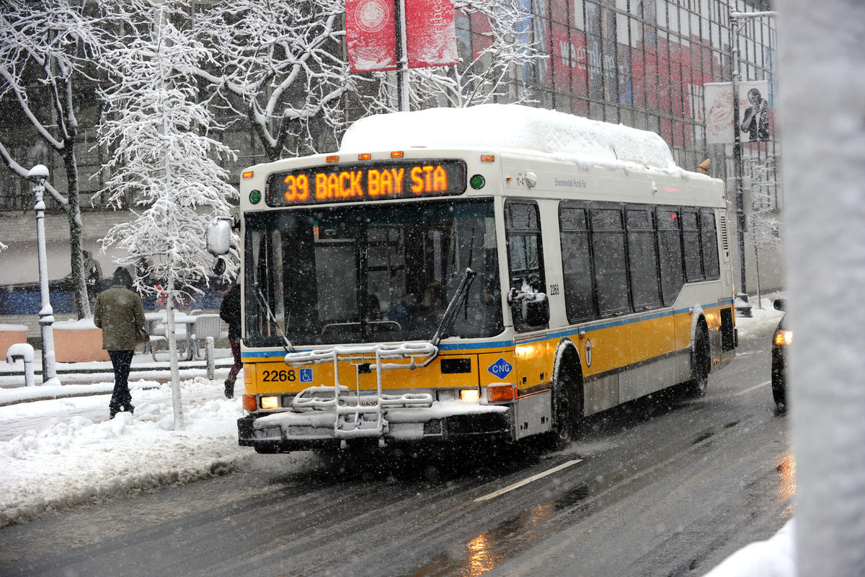
TranSComm
http://www.bumc.bu.edu/transcomm/
Spring 2018 MBTA Passes
Due Jan 10, 2018

Slide 13
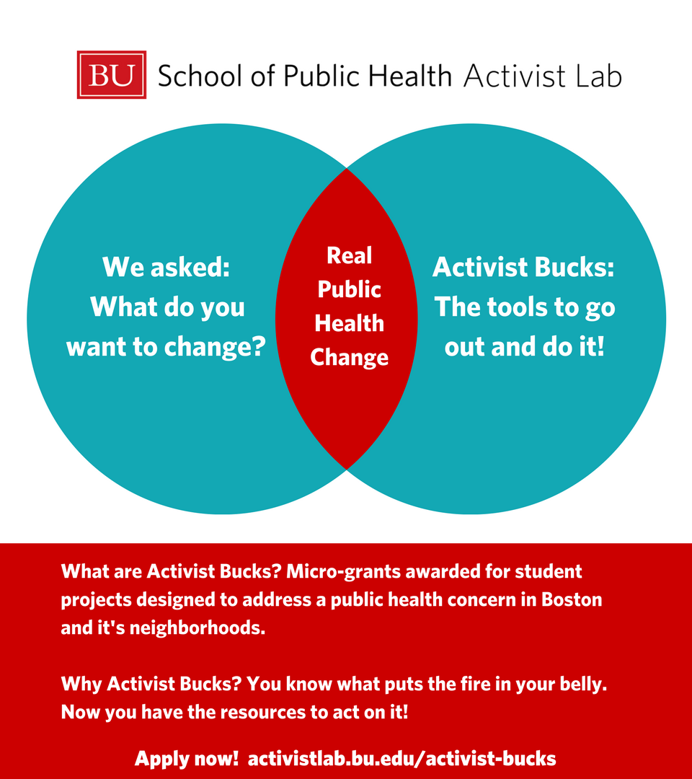
Activist Bucks
For more information please email Candice Bangham, Student Engagement Intern at Activist@bu.edu or Dr. Anne Fidler, Asst. Dean for Public Health Practice, at afidler@bu.edu
Applications will be accepted on a rolling deadline between Monday, November 27th and January 31st
To apply, visit activistlab.bu.edu/activist-bucks

Slide 14
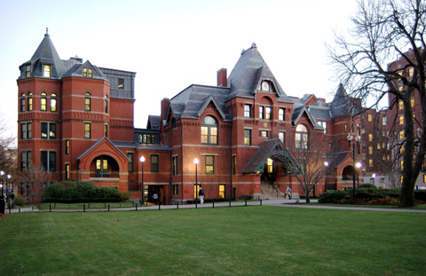
Admissions
http://www.bu.edu/sph/admissions/
Meet Victoria!
Student Ambassador Program-
            Applications are now available
            Contact Victoria Durst if interested at vdurst@bu.edu
            Seeking SPH Stars for new MPH Program Admissions Video. Interested? Sign up today!

Slide 15
Next General Body Meeting
Monday, December 11
5-6pm @ L-311

Slide 16
Thank You!
Contact us at phsenate@bu.edu with questions or ideas!

Slide 17

Have a Happy Thanksgiving!!!

