Slide 1

An Introduction To
Health And Medical
Coordinating Coalitions
September 11, 2013

Slide 2

INTRODUCTION
  Enhancing health and medical capacity across the disaster management cycle
  Responding to changing federal requirements
  Based on extensive literature review and national research
  Discussions with key leaders
  Beginning of a planning process

Slide 3
A COMPREHENSIVE, INTEGRATED REGIONAL APPROACH TO PREPAREDNESS AND RESPONSE
Health and Medical Coordinating Coalitions (HMCC) are entities that will coordinate health and medical planning, response, recovery, and mitigation activities in each region
HMCC =Healthcare Coalitions
Notes:
Answers the questions what are they and what do they do.
HMCC role
Conduct regional all-hazards planning
Support response and recovery activities in region
Coordinate information sharing and resource requests during and after incidents
Report regional activities to MDPH

Slide 4
HMCC RESPOND TO CHANGING NATIONAL PRIORITIES, BUILD REGIONAL CAPACITY TO SUPPORT LOCAL NEEDS
Nationally
CDC and ASPR focus on preparedness planning, changing funding models |  | Development and funding of regional health and medical capacity to prepare for, respond to, recover from, and mitigate the impact of disasters
Locally
Absence of statewide regional structure to coordinate information & resources during an emergency |  | A more integrated model of emergency preparedness and response across the Commonwealth
Notes:
Development of the required regional capacity will require greater integration of public health and healthcare system activities, and development and implementation of a framework that can support and coordinate the multi-disciplinary activities necessary to plan for, respond to, recover from, and mitigate the impact of health and medical emergencies. Funding local public health and Hospitals separately and individually will not accomplish this.

Slide 5
potential benefits
Enhanced capacity for disaster management
Resourced to provide 24/7/365 staffing
More accurate and timely situational awareness
Increased regional responsibility for deliverables
Streamlined communications with ESF-8
Access to regional support
Notes:
Address those issues of highest importance to HMCC members
Ensure 24-7-365 on-call capacity
Hire staff to support that region’s facilities during a disaster response

Slide 6
Dr. Paul Biddinger
Director, Emergency Preparedness and Response Exercise Program, Harvard School of Public Health, and Chief, Division Of Emergency Preparedness, Massachusetts General Hospital

Slide 7
Supporting Arguments for Coalition Development
24/7/365 Response Capacity
Consistency of Capabilities Across Regions
Continued Integration of Health Disciplines in Coordinated Planning and Response

Slide 8
Active engagement by core disciplines
Core Disciplines
  Community health centers and ambulatory care providers
  EMS
  Hospitals
  Local public health
  Long-term care
Other healthcare disciplines
  Dialysis centers, urgent care, pharmacies, home health agencies
  Mental and behavioral health providers
Notes:
Answer to the question: Who is involved?

Slide 9
OTHER PARTNERS
Emergency management
Public safety
Notes:
Of course work with our other partners in preparedness planning and response. We believe that the HMCC structure will integrate well with how these partners organize themselves.

Slide 10
EXISTING regional APPROACHES
  Legacy Entities
    Central Mass: Regional Medical Coordination Committee
    Boston: Boston Healthcare Coalition
  Other Regional Efforts
    Western Mass: Regional Medical Coordinating Group
    Cape and Islands: MACC
    Long-term Care: MassMAP
Notes:
None of these are as broad as the Health and Medical Coordinating Coalitions, and all are at different stages in terms of their evolution, but efforts like these provide a strong foundation for the work to come.
PERP = Partnership for the Enhancement of Regional Preparedness
The other regional entities are existing programs that provide some regional coordination during a response in certain circumstances. These efforts have some capacity that we will look at to build upon, much like we will be looking local plans and skills

Slide 11
HMCC: BUILDING ON THE GAINS WE’VE MADE
Support effective cross-jurisdictional, multi-discipline planning for incidents too large in scale for a single jurisdiction or that grow beyond the capabilities of local response resources
Address new, more specific federal expectations for public health and healthcare system preparedness and response capabilities and disaster management
Incorporate and build on the gains made by the work of existing coalitions

Slide 12
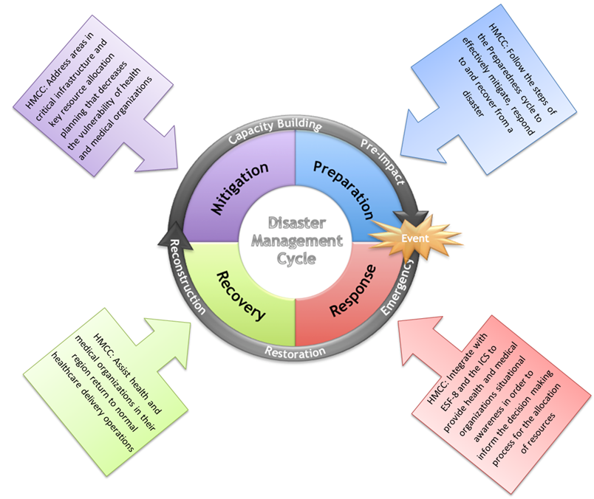
THIS DIAGRAM IDENTIFIES THE HMCC ROLE ACROSS THE
DISASTER CYCLE
Notes:
The mission statement (usually written, not spoken) is a longer explanation of the purpose. It answers the question: What is the purpose of a health and medical coalition in Massachusetts?

Slide 13
WHAT WILL AN HMCC DO?
Conduct regional all-hazards planning
Develop and maintain emergency response capacity with roles filled through identified staffing complemented with voluntary response elements (e.g., public health mutual aid, MRC)
Support a coordinated health and medical response with a regional point of contact for communication
Coordinate information sharing for situational awareness and a common operating picture
Notes:
Assist with recovery and mitigation efforts
Support completion of deliverables and report on regional activities to MDPH

Slide 14
WHAT WILL ORGANIZATIONS IN HMCC do?
Continue to develop and maintain organization plans
Coordinate plans with HMCC
Represent your organization to the HMCC
Represent the HMCC to your organization
Participate in HMCC planning and exercises

Slide 15
“real world” examples
Marathon bombing response
2013 Region 2 Hospital Strike preparations to support patient care
Notes:
While we are moving into uncharted territory, there are incidents that have elements what what an hmcc would do in response.
All disciplines are not involved in each of these examples. We think that many incidents wont require all disciplines. However, things like hurricanes, or pandemic, will likely involve and impact all disciplines.

Slide 16
City of Worcester
Division of Public Health
Region 2
Derek Brindisi MPA, R.S.
Director

Slide 17
Region 2 History
May 2002 - Metropolitan Medical Response System (MMRS)
2003 - Public Health Emergency Preparedness (PHEP)
January 2009 - Partnership for the Enhancement of Regional Preparedness (PERP)

Slide 18
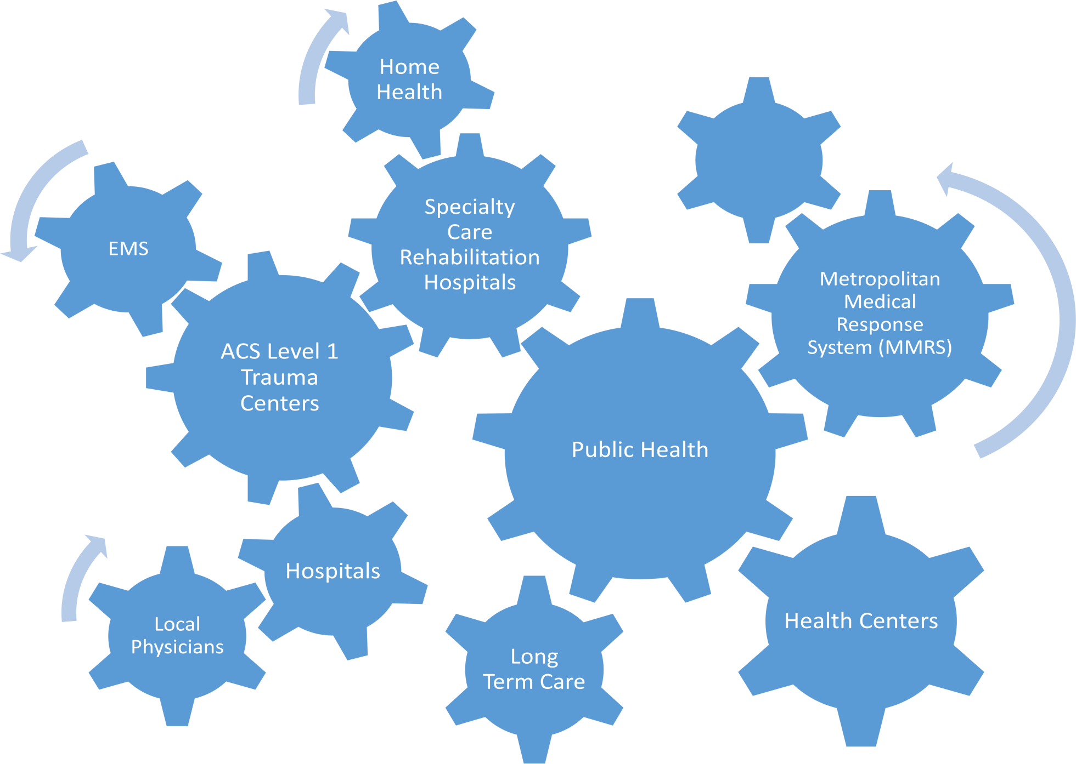
Region 2 Collaboration
Dialysis
Fire
Police
Emergency Management

Slide 19
Region 2 H&M Coalition Strengths
Mutual Aid
  Currently 10 acute care hospitals, 3 health centers, 2 specialty care rehabilitation hospitals, 74 long term care facilities and 68 local boards of health are members of regional mutual aid
Regional Medical Coordination Center (RMCC)
  Patient placement, patient tracking, transportation, resource/equipment/staff needs, local/state liaison
Situational Awareness
  WebEOC , mutual aid plan website, Listservs

Slide 20
Region 2 H&M Coalition Strengths
Networking & Relationship Building
  Stakeholder meetings, workshops, drills, exercises
Unified Vision & Strategic Plan
  Regional multi-disciplinary mitigation, preparedness, response, recovery
  Identification of strengths, challenges and gaps
    Region 2 HVA Conference September 2013

Slide 21
Region 2 Events
June 2013 – Worcester HazMat Incident
  Situational Awareness at Scene
  Worcester Health Care Situational Awareness
    POC, bed availability, facility capabilities
May 2013 – UMass Hospital Potential Labor Action
  Hospital Situational Awareness (local and regional)
    POC, capabilities, bed capacity, transportation vehicles
  Census Reduction Support
    Regional Medical Coordination Center: Patient placement, transportation and tracking
February 2013 – Blizzard Nemo
  Regional health and medical situational awareness
    Information Flow: WebEOC, listservs, mutual aid plan website

Slide 22
Contact Information
Derek Brindisi
brindisid@worcesterma.gov

Slide 23
What happens now?
September/October 2013
  EPB and BUSPH attend meetings for each coalition to provide information and take questions
  EPB meetings with stakeholders from health and medical disciplines
November 2013-June 2014
  Facilitated multi-discipline meetings in all regions
  Technical assistance for development of HMCC
Notes:
Stakeholders include organizations such as Mass Hospital Association, Mass Senior Care, Mass Ambulance Association, Mass League of Community Health Centers, LSAC, who have an interest in the work.

Slide 24
A PHASED TRANSITION TO NEW STRUCTURES
HMCC Milestones
By end of budget period (BP) 2 (June 30, 2014) | Identification of participating entities Proposed Governance plan
By Fall 2014 (mid BP3) | Release of HMCC RFR
By end of BP 3 (June 30, 2015) | HMCC operations established 24-7 regional point of contact established
During BP 4 (June 30, 2016) | Regional health and medical operations plan developed Begin exercising HMCC operational plans
By end of BP 5 (June 30, 2017) | Exercised all HMCC operational plans Fully operational
Notes:
The EPB will provide facilitation and planning support while coalitions are forming. In the coming months, EPB staff will begin informing and soliciting feedback from existing coalition executive committees, hospital and public health regional coordinators, MDPH bureaus and others through presentations, meetings, and informational materials. FYE 2014 deliverables will include work within single discipline coalitions to plan for an orderly transition to the multi-disciplinary structure beginning in FYE 2015.

Slide 25
Q&A
Notes:
We may not have time to answer all of the questions. And you may think of questions after the fact. We will be gathering questions and using them to regularly update a Frequently Asked Questions document that will be posted on the website www.bu.edu/coalitions.

Slide 26
For more information, including the ability to download The Case for Change document, recordings and transcripts of the webinar delivered on September 11th, and a copy of this presentation visit:
www.bu.edu/sph-coalitions

