Slide 1
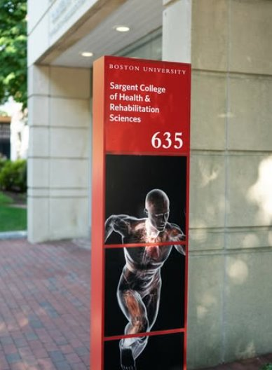
How to Register
Navigating MYBU
Registration: Preparing for Registration
Registration: Methods for Registration
Class Search (Filters Quick Card, Video)

Slide 2
Course Curriculum:
The Bulletin has the most complete list of programs and courses: bu.edu/academics/bulletin
Locate your major on the Bulletin website www.bu.edu/academics/sar/programs/ and scroll down to find the first-year course sequence.
If you are undeclared, choose the major that is closest to your current academic goals.

Slide 3
Additional Registration Information
Typical Course Load:
Register for 16–18 units per semester to stay on track for graduation.
SAR HP 150 Must be taken in your first semester.
SAR HP 151 Required by the end of your first year.
Can be taken in either the first or second semester, in addition to your 16-unit load.
Premed Students, PrePA (Physician Assistant), Predental Students
  Take CAS BI 107 (unless you have AP or IB credit).
  Take CAS CH 101 (required, even if you have IB credit — AP credit does not apply).
  (More info on AP/IB slide)

Slide 4
Selecting a WR120 course
You will be taking a first-year writing course, CAS WR120. These cover a wide range of topics so look for a section that you find interesting.
Fall writing sections: https://www.bu.edu/writingprogram/curriculum/schedule/

Slide 5
AP or IB credit
AP and IB courses: If you have not yet received your score, register for the required course (e.g. CAS PS101 for AP Psychology). If you have received advanced placement credit, you may be able to opt out of the course:
  Advanced Credit (AP) Guide
  International Baccalaureate Guide
You can replace the course with a 4-unit elective, HUB requirement or a course from a future semester. Sciences are only offered fall or spring, so you cannot advance sciences. Additionally, you cannot advance WR151,WR151 or WR153

Slide 6

BU Hub Req Requirements
https://www.bu.edu/hub/hub-courses/
You can find more information on the Sargent HUB page
HUB Chart: areas with a red HUB are areas that you need to fulfill for your major
You can find a HUB requirements on MyBU Student Portal : Go to Class Search (see "More Filters"> "Course Attributes", select "Hub Requirement")

