Slide 1
GoArmyEd Menu
New Account Creation
Cadet Course Planner Process
How to Create a Cadet Payment Request (CPR) for Tuition & Fees
How to Create a Cadet Payment Request (CPR) for Room & Board
Reimbursable Fees

Slide 2

Welcome to GoArmyEd
GoArmyEd is designed to be your one-stop location for the automated process of all scholarship payments to both Colleges/Universities and Cadets/2LTs

Slide 3

Create/Activate Account
Can’t Log in if you don’t “Create/Activate” your account. Cadet/2LT must select “Cadet Student”
*Note: Cadets with no Prior Service time login through www.goarmyed.com to create their account
*Note: Cadets with Prior Service time login through www.goarmyed.com/cadet to create their account
If you have created an account, skip to slide 10 and log in.

Slide 4

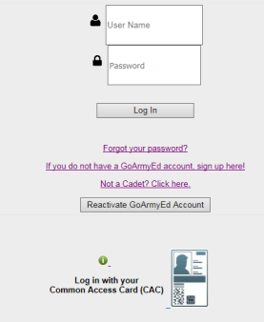
Create/Activate Account
*Scroll Down to Log In*
Click “if you do not have a GoArmyEd account” to create a new account

Slide 5
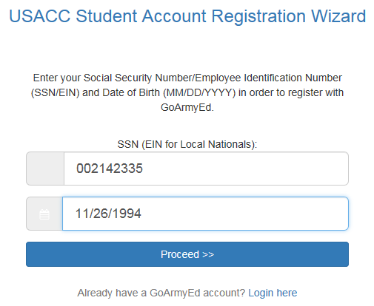
Student Account Registration
Input your SSN/DOB
Slide 202

Slide 6
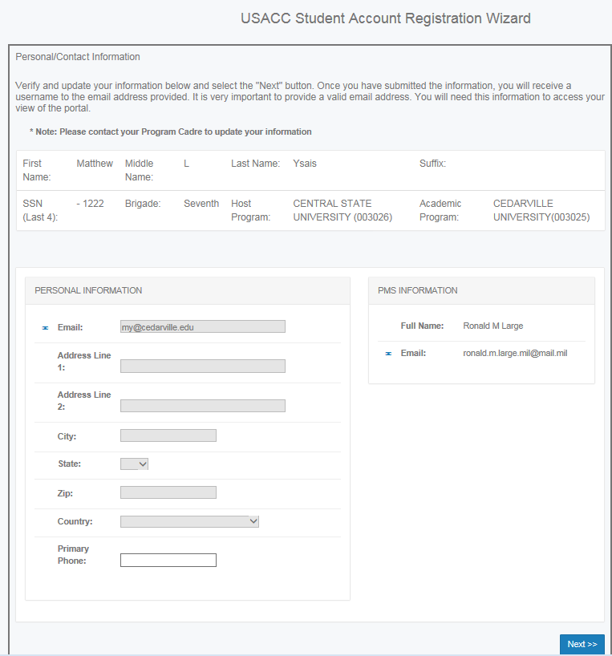
Student Account Registration
Use your University email
No AKO Emails!
Input a phone number, no dashes

Slide 7
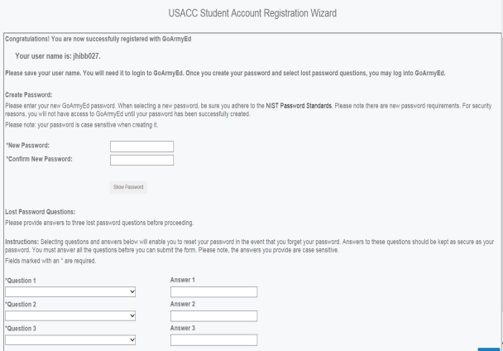
Student Account Registration
Write down your User Name
Also take a picture or save a screen shot of this page!

Slide 8
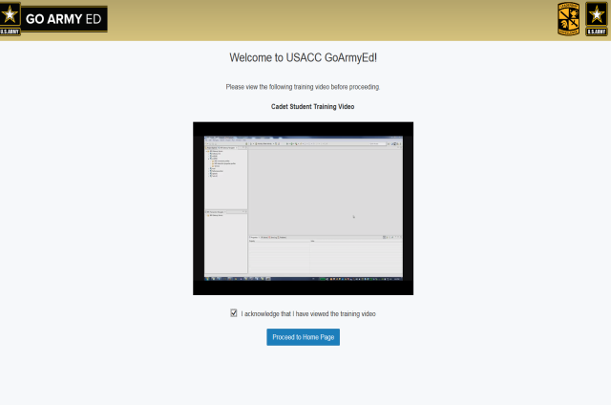
Student Account Registration
Watch the video and then acknowledge that you did
Select Proceed to Home Page

Slide 9
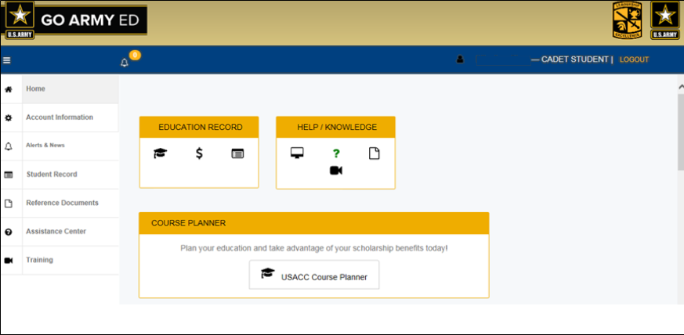
Cadet Homepage
LOGOUT !

Slide 10
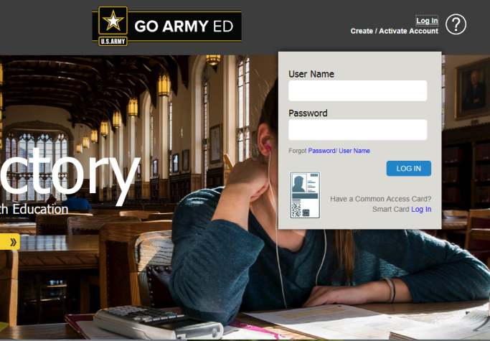
Log In
Type your User Name & Password or use your Smart card

Slide 11
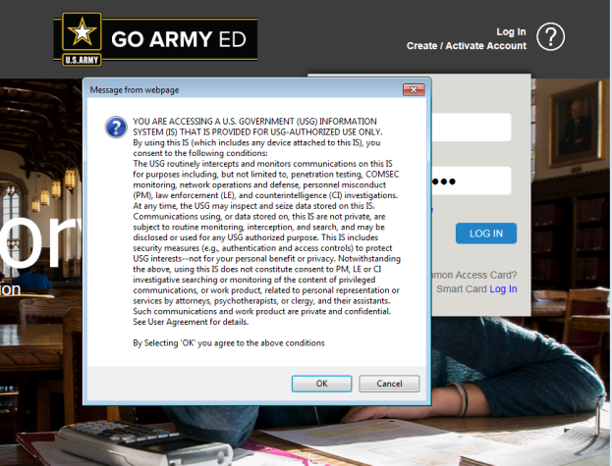
Message from Webpage

Slide 12
Log In
*Scroll Down to Log In*
Log in with your User Name and Password

Slide 13
Cadet Homepage
Course Planner
Cadet Payment Request
Training Videos
Course Planner

Slide 14
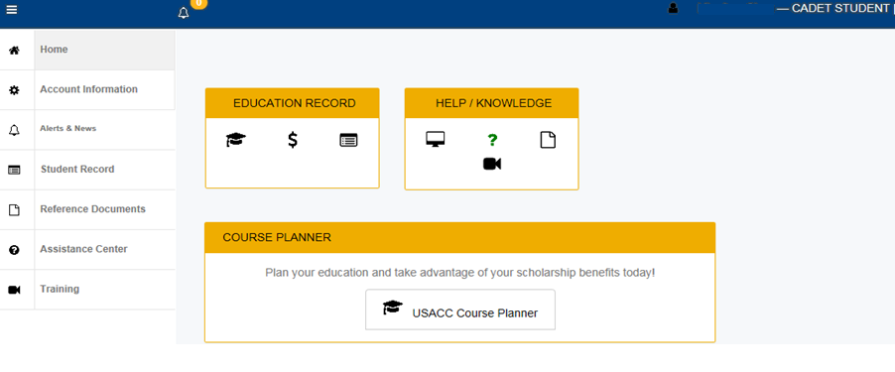
Cadet Course Planner Process
Select the “Course Planner” icon & add courses to your Course Planner starting with the current term

Slide 15
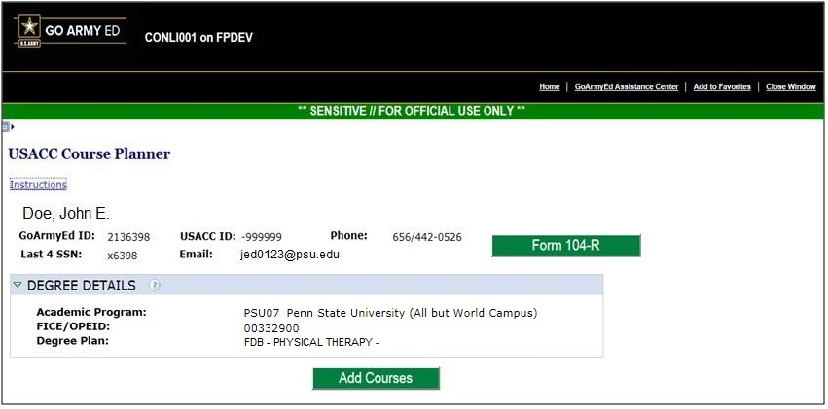
Cadet Course Planner Cont’d
You must upload USACC form 104-R in .pdf format. No handwritten 104-Rs! Be sure that you include your name in the name of your file!

Slide 16
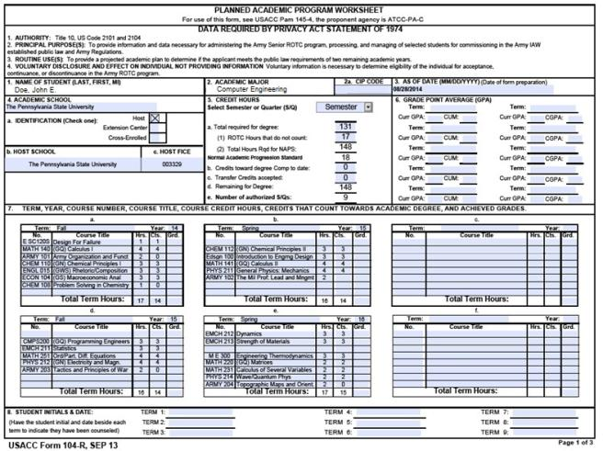
Cadet Course Planner Cont’d
  Only enter the current semester into the Course Planner (You could add future ones, but then you must update it).

Slide 17
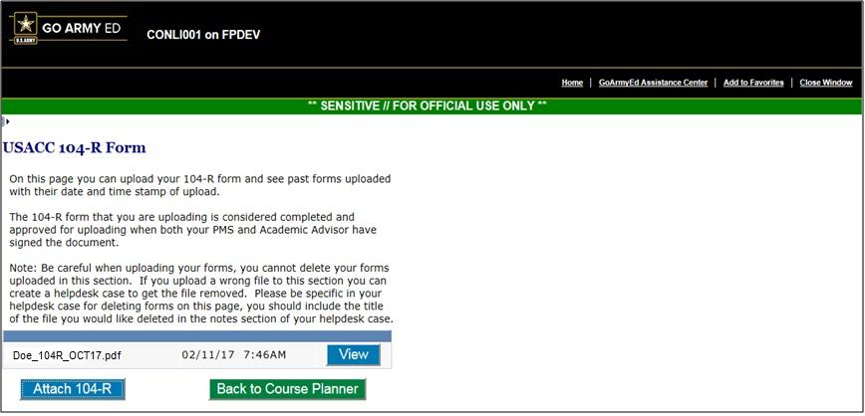
Cadet Course Planner Cont’d
Select “Attach 104-R” and attach document from “Browse” then select “Back to Course Planner”

Slide 18
Cadet Course Planner Cont’d
Select “Add Courses”

Slide 19
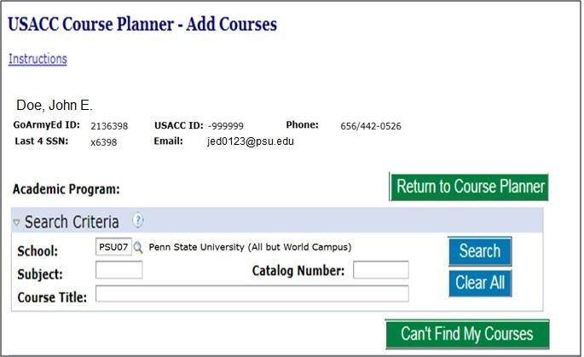
Cadet Course Planner Cont’d
Select “Can’t Find My Courses” (The University Course Catalog is not uploaded in GAE).

Slide 20
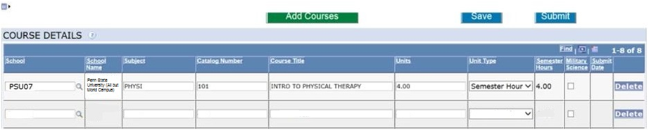
Cadet Course Planner Cont’d
You will have to click “Add Courses” and “Can’t Find My Courses” on previous screen to add new lines for each class.
University Park Cadets, Type “PSU07” in the “School” column
Altoona Cadets, Type “PSU32” in the “School” column
Then type the Course Catalogue subject abbreviation (e.g. ARMY, BIOL, ENGL) in “Subject” column; then course number, title, credits in “Catalog Number,” “Course Title,” and “Units” columns. Select “Semester Hour” under “Unit Type” column. This information should be on your USACC 104-R.
Duplicate courses not allowed. For second KINES 096, try KINES 96 or 096a

Slide 21
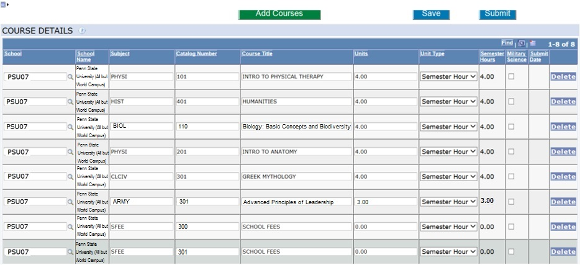
Cadet Course Planner Cont’d
Your Course Planner should initially have a row marked “SFEE” for every remaining semester. Do not delete these lines. (Re-add if you deleted them).
SFEE 100 and 101 are for freshmen first and second semester, 200 and 201 are for sophomore first and second semester, etc.

Slide 22
Cadet Course Planner Cont’d
Select “Military Science” box for ROTC classes

Slide 23
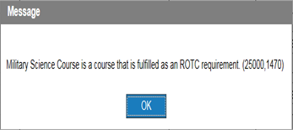
Cadet Course Planner Cont’d
✓
Click “OK” on this Pop-up.
Once you have all your courses in, click “Save”

Slide 24
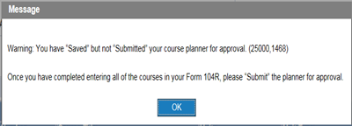
Warning Message
✓
You have “Saved” but not “Submitted” your Course Planner for approval!
Click “OK” ” on the Pop-up.
If you have all your courses for the current semester in the Course Planner, click “Submit”.

Slide 25
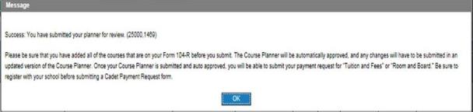
Success Message
✓
Select “OK” and the Course Planner will auto-approve

Slide 26
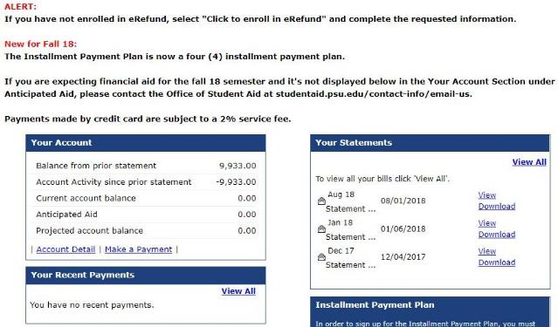
Cadet Payment Request (CPR)
  The date you can submit your CPR is determined by the school’s last Add date. You can submit one day after.
  Go to LionPath and download your August (Fall) or December (Spring) bursar’s statement and save as a .pdf file
  If you take a class with a fee and the fee is listed on a later statement, upload both that statement and your August or December statement.

Slide 27
Cadet Payment Request (CPR)
University Academic and CPR Calendar
Semester | First Day of Classes | Last Add Day | First day to submit CPR | Last Day of Finals
Spring 2018 | 8 Jan 2018 | 14 Jan 2018 | 15 Jan 2018 | 4 May 2018
Fall 2018 | 20 Aug 2018 | 26 Aug 2018 | 27 Aug 2018 | 14 Dec 2018
Spring 2019 | 7 Jan 2019 | 13 Jan 2019 | 14 Jan 2019 | 3 May 2019
Fall 2019 | 26 Aug 2019 | 1 Sep 2019 | 2 Sep 2019 | 20 Dec 2019
Spring 2020 | 13 Jan 2020 | 19 Jan 2020 | 20 Jan 2020 | 8 May 2020
Fall 2020 | 24 Aug 2020 | 30 Aug 2020 | 31 Aug 2020 | 18 Dec 2020
Spring 2021 | 11 Jan 2021 | 17 Jan 2021 | 18 Jan 2021 | 7 May 2021
Fall 2021 | 23 Aug 2021 | 29 Aug 2021 | 30 Aug 2021 | 17 Dec 2021
Spring 2022 | 10 Jan 2022 | 16 Jan 2022 | 17 Jan 2022 | 6 May 2022
Fall 2022 | 22 Aug 2022 | 28 Aug 2022 | 29 Aug 2022 | 16 Dec 2022

Slide 28
Cadet Payment Request Cont’d
You will select the “Cadet Payment Request” & add courses from your Course Planner starting with the current term

Slide 29
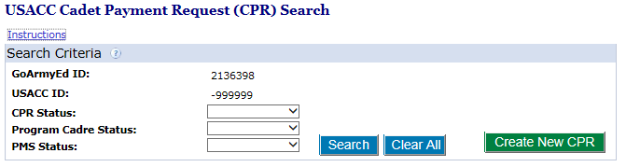
Cadet Payment Request Cont’d
Select “Create New CPR”

Slide 30
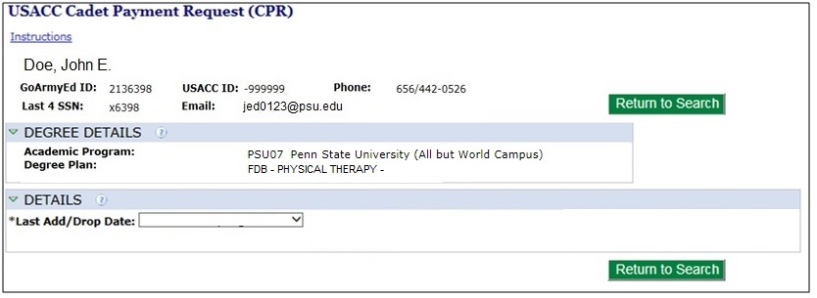
Cadet Payment Request Cont’d
Select the term that you are requesting payment from the pull-down list

Slide 31
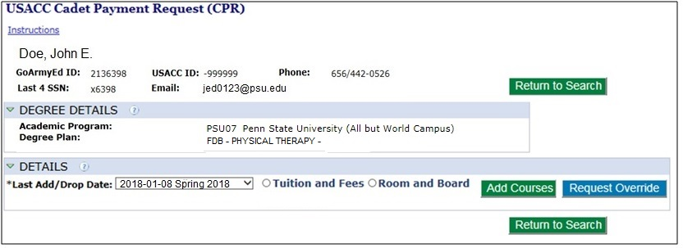
Cadet Payment Request Cont’d
  Once a term is selected, Cadet scholarship options will appear
You may choose a different option each term - but notify your instructor or an HRA before you make any change!
If selecting Room and Board, skip ahead to next section.

Slide 32
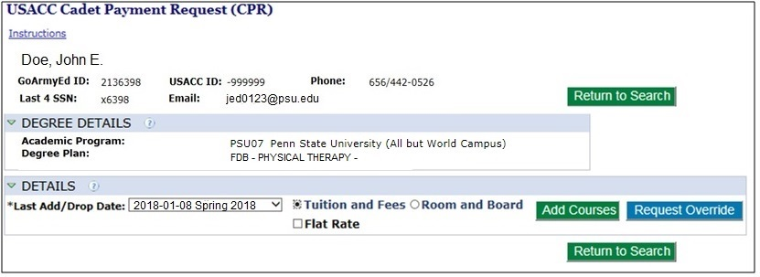
Cadet Payment Request Cont’d
  Cadet must select type of scholarship benefit: Tuition and Fees (T&F) or Room and Board (R&B)
When you select T&F it will generate the Flat Rate box also
DO NOT CHECK THE FLAT RATE BOX!

Slide 33
Cadet Payment Request - T&F
  Cadets who select Tuition and Fees will then add courses to the Cadet Payment Request
Select “Add Courses”

Slide 34
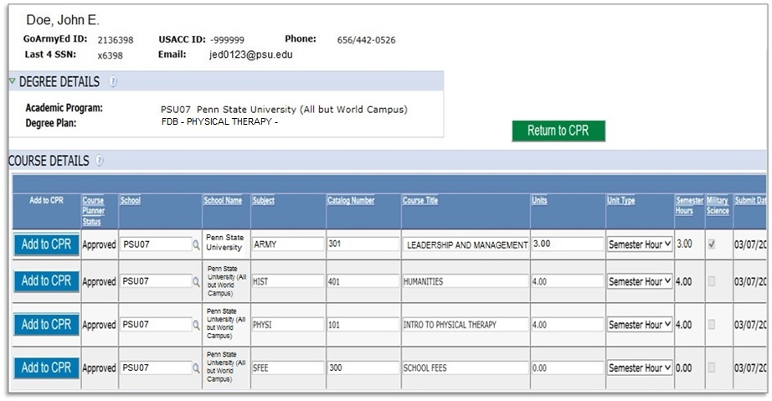
Cadet Payment Request - T&F
Listing of Courses from the Course Planner
You will click “Add to CPR” for the courses you want to be paid for the selected term

Slide 35
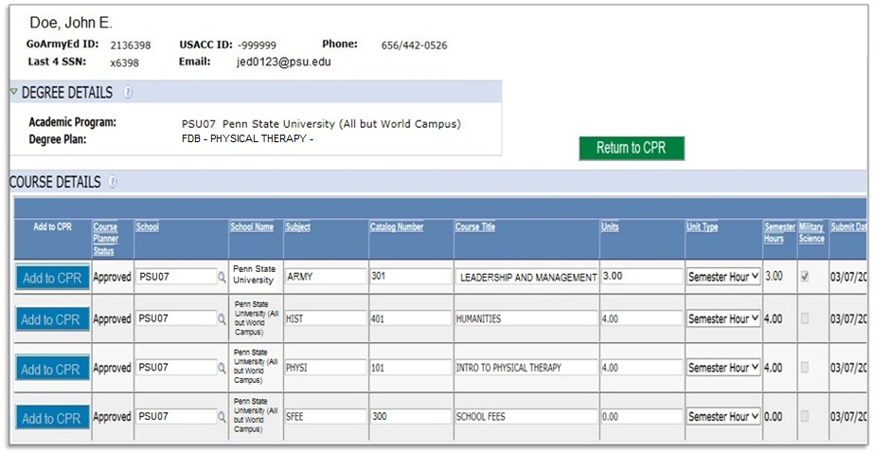
Cadet Payment Request - T&F
Return to CPR after all courses have been added
The “Add to CPR” will be grayed once courses are selected
Add one “SFEE” course to the CPR. SFEE 100 and 101 are for freshmen first and second semester, 200 and 201 are for sophomore first and second semester, etc.
You cannot reuse a course that you submitted in a previous CPR.

Slide 36
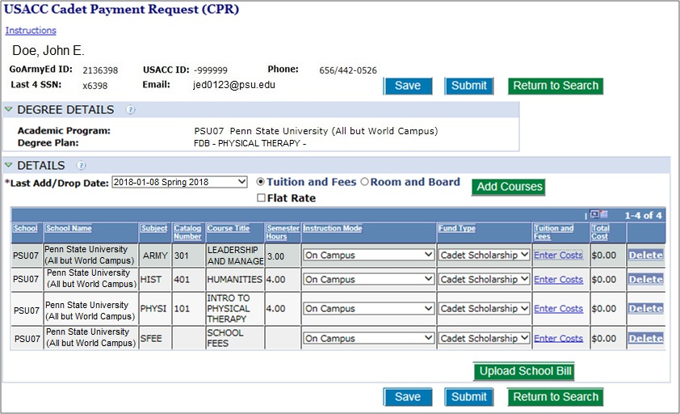
Cadet Payment Request - T&F
Choose Instruction Mode
Enter Costs (see following slides)

Slide 37
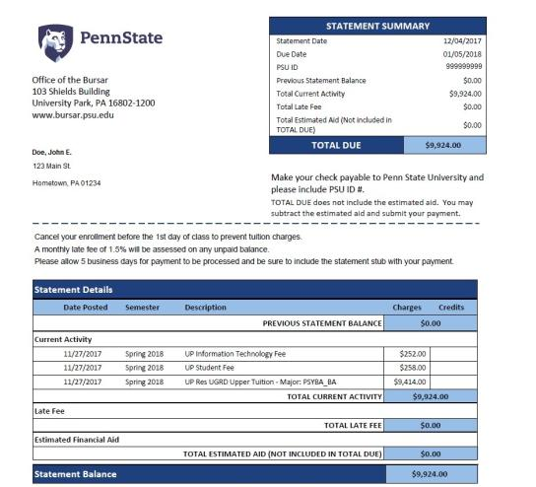
Cadet Payment Request - T&F
From your semester bill, look up the line for Tuition.
To determine the cost of each class divide the tuition amount by the number of classes that you are taking.
For example, this bill shows this student’s semester tuition as $9414.00.
If the student is taking six courses, they would divide $9414.00 by 6 or
$9414.00 ÷ 6 = $1659.00
If they were taking 7 courses, then $9414.00 ÷ 7 = $ 1344.8571428; so use $1344.00 of six courses and $1350.00 for one. To find the cost of the last class, take the tuition minus $1344 times 6 or
$9414.00 – ($1344.00 x 6) = $1350.00.
The total cost for each class MUST add up EXACTLY to the tuition cost!

Slide 38
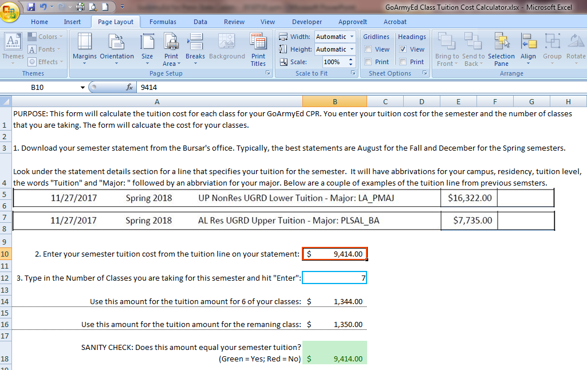
Cadet Payment Request - T&F
When you use the GoArmyEd Class Tuition Cost Calculator (Excel file),
enter your semester tuition in line 2, the number of classes in line 3, hit
enter, and the program will tell you the tuition costs for your classes.

Slide 39
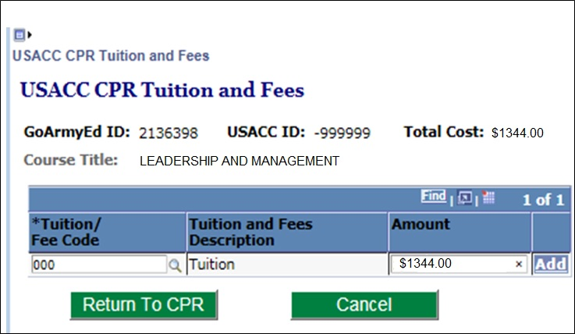
Cadet Payment Request - T&F
1. Type the numbers “000” for “Tuition”.
2. Type the cost for the class.

Slide 40
Cadet Payment Request - T&F
If your course has a lab fee or other course fee that is a separate line item on your school bill, click “Add” to create a second line and either enter “059” for Laboratory fees or click the magnifying glass to look up the most appropriate fee code.
Jump to Reimbursable Fees section

Slide 41
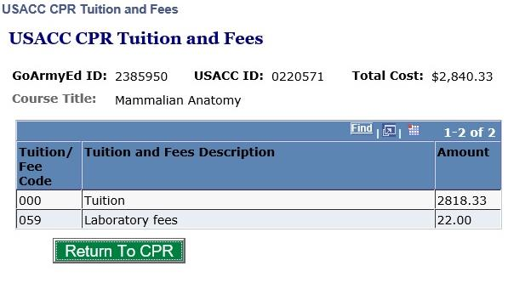
Cadet Payment Request - T&F
Example of a course with a specified fee on the Bursar’s bill.
3. When done, select “Return to CPR” and go to the next course

Slide 42
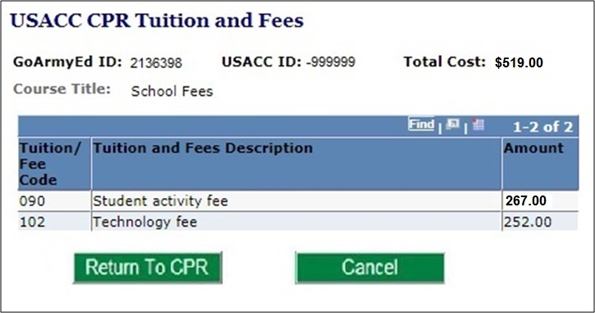
Cadet Payment Request - T&F
In the costs for “SFEE” (School Fees), enter the standard school fees.
Some Cadets, like nurses, may have additional fees not specified for one class.
Use codes 090 and 102.
090 = Student fee on the tuition bill.
102 = Information Technology fee on tuition bill.
Nurses with the “Nurse ATI Fee” on their bill, use code 059, laboratory fee.
(Nurses should pay University the Nurse ATI Fee now and get refunded later).

Slide 43
Cadet Payment Request - T&F
Select “Return to CPR” once all fees have been added

Slide 44
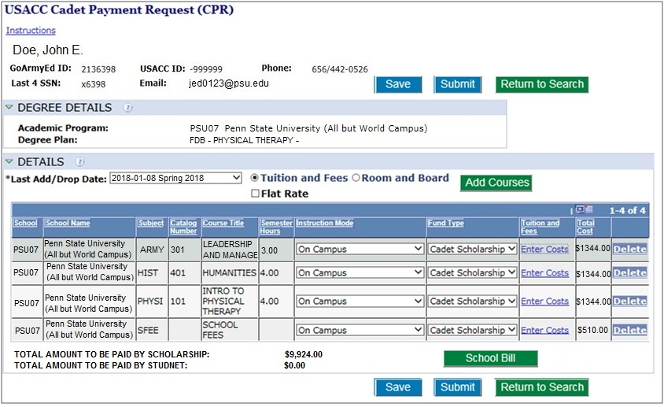
Cadet Payment Request - T&F
Select “Submit” when CPR is ready for review

Slide 45
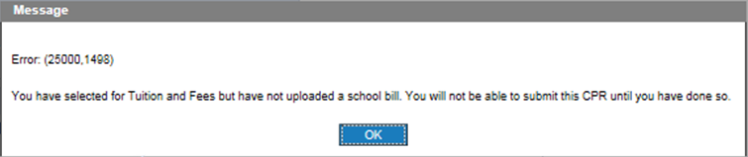
Cadet Payment Request - T&F
Cadet cannot submit T&F CPR without uploading school bill

Slide 46
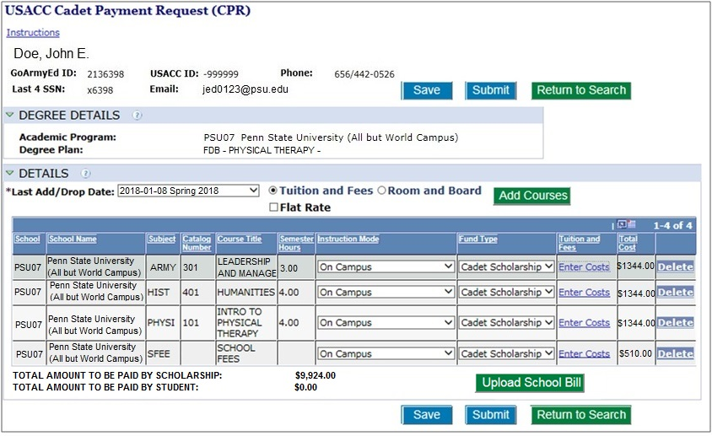
Cadet Payment Request - T&F
Select “Upload School Bill” to upload school billing invoice. Always include your name/date in your invoice file name.

Slide 47
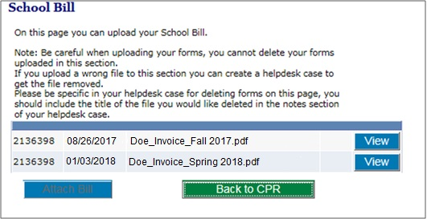
Cadet Payment Request - T&F
Select “Attach Bill” (Browse and Upload) then “Back to CPR”

Slide 48
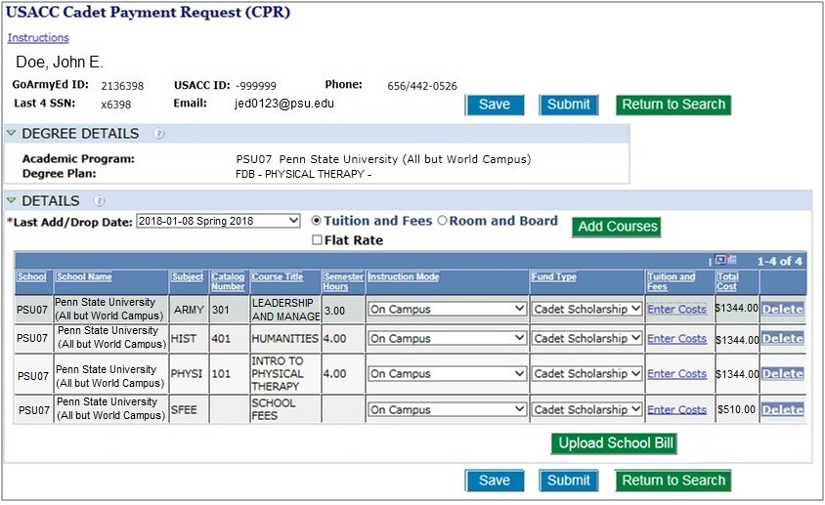
Cadet Payment Request - T&F
Select “Submit”

Slide 49
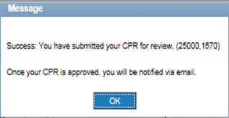
Cadet Payment Request - T&F
You have submitted your CPR for review!

Slide 50
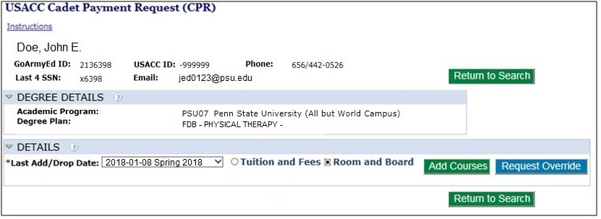
Cadet Payment Request – R&B
  Cadet may select Room and Board for their scholarship benefit. They receive a $5,000 Room and Board payment for the semester, but must pay for tuition and fees themselves.
When you select R&B it will generate a pop-up message

Slide 51
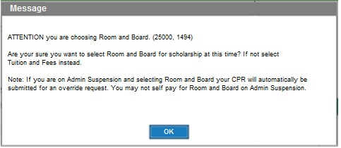
Cadet Payment Request – R&B

Slide 52
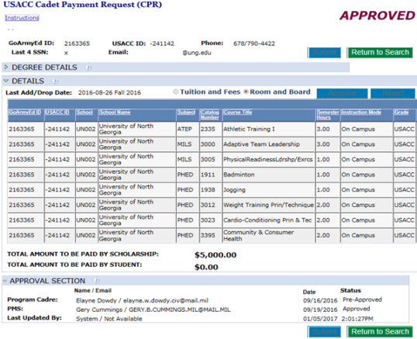
Room and Board CPR
  Once PMS approves, you cannot change this option
  Once PMS approves, file is routed to G8 for processing *
  No billing invoice needed for Room and Board

Slide 53
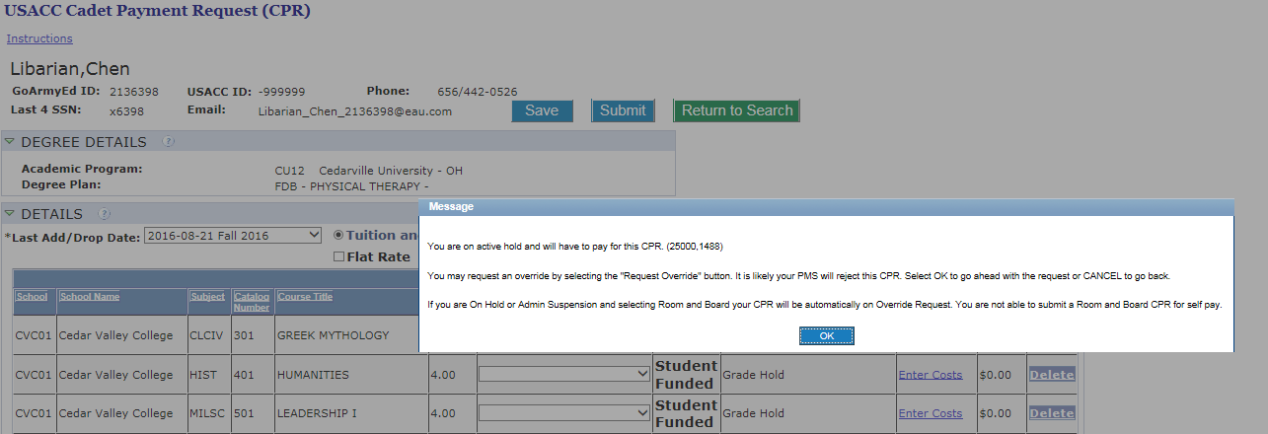
Warning Message
You are on active hold and will have to pay for this CPR!
Overrides will also apply to online course over 25%, Study Abroad, and failed courses! PMS can approve Overrides!*

Slide 54
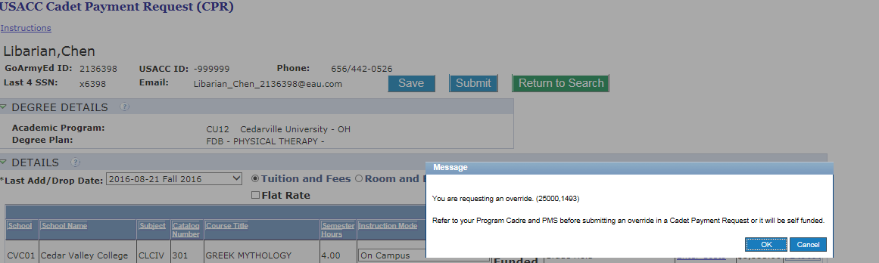
Warning Message
You are requesting an override! Cadet may select O.K. to continue the override process.
Refer to your Program Cadre or PMS before submitting an override in a CPR or it will be self funded!

Slide 55
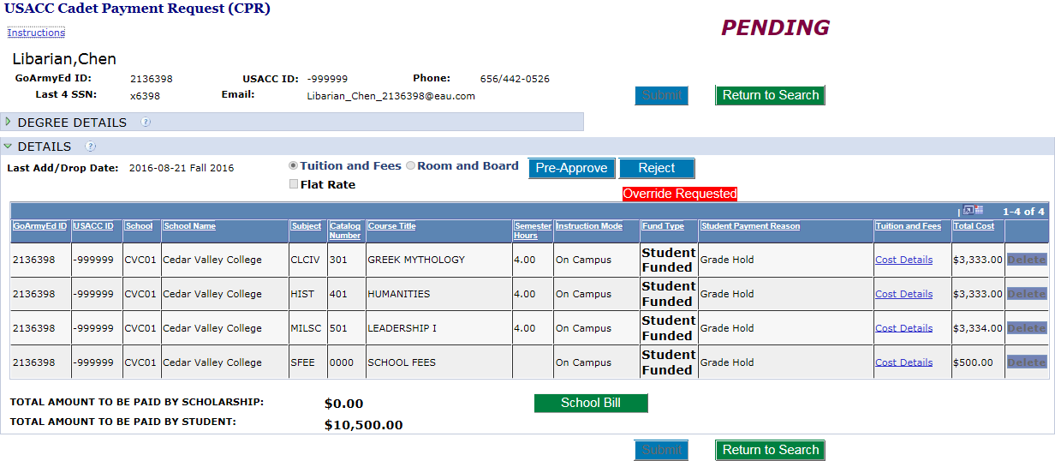
Warning Message
Once Cadre “Pre-Approve” and “Submit” it will send Override to PMS and PMS will select Approve if applicable

Slide 56
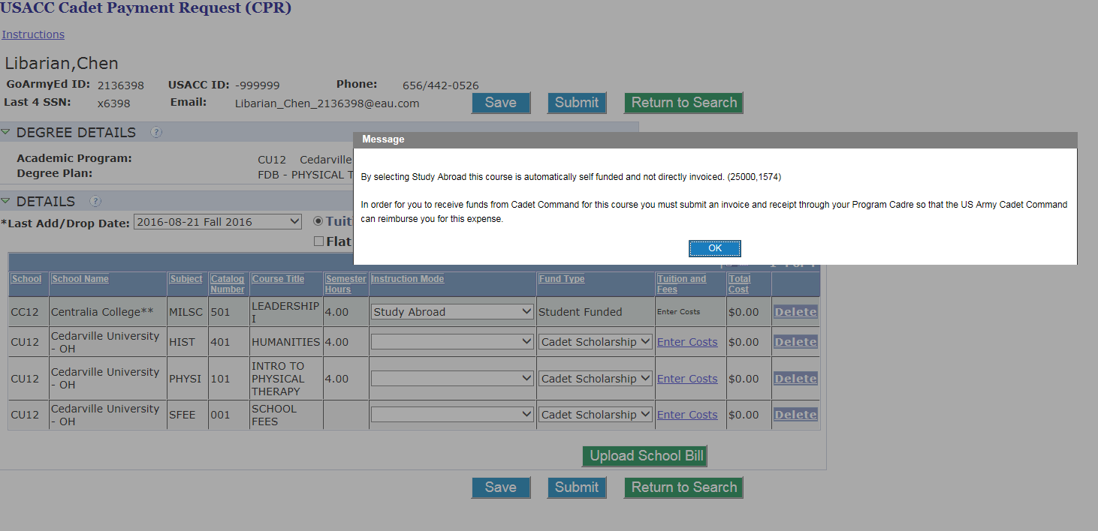
Warning Message
You selected Study Abroad and will have to pay for this CPR!
Note: Only Select Study Abroad if payment is to Cadet if to the School select “On Campus”

Slide 57
Reimbursable Fees
Payment of certain fees
  Applies to all students, all the time, every year
  Required for degree completion or attendance at the college/university
  Any fee listed as an optional fee in the school catalog is capped at $100.00 per course
Health Insurance/Health fees
USACC Pam 145-1, Appendix C-1, Reimbursable/Appropriate Fees for Payment
Notes:
Health Insurance/Health fees
a. When the school requires full health insurance, and it is the students choice to purchase the school policy or independent policy, the school policy premiums may be payable as a miscellaneous fee.
b. If all students are required to purchase the school’s health insurance, the policy premiums are payable as an authorized reimbursable fee.
All other Cadets will be reimbursed for health insurance up to $1000.00 annual cap.
VA covers ROTC Cadets, and those who are applicants to the program for serious injuries (permanent in nature) when participating in ROTC activities. Workman’s Compensation (through DOL) covers ROTC Cadets, and those who are applicants to the program for less serious injuries (temporary in nature) when participating in ROTC activities.

Slide 58
Reimbursable Fees/Items for Scholarship Nurse Cadets
Required Nurse Uniforms/Clinical Supplies/Equipment
  One-time only flat rate payment of $650.00
  Paid no earlier than the start of clinicals
  Submit memorandum to USACC, G8 Pay Operations Division
NCLEX-RN Test Fee Payment
  One-time only flat rate payment of $200.00
  Submit memorandum listing all eligible nurse scholarship Cadets applying to take NCLEX-RN test. Memorandum must be submitted to USACC, G8 Pay Operations Division no earlier than 60 days prior to graduation and no later than 30 days prior to graduation

Slide 59
Reimbursable Fees/Items for Scholarship Nurse Cadets Cont’d
NCLEX-RN Review Course Fee Payment
  One-time only payment
  Must be processed in sufficient time to allow the payment to be made prior to graduation
  Not authorized after graduation
  Submit memorandum with receipt to USACC, G8 Pay Operations Division
GRFD-NG and Dedicated National Guard scholarship nurse Cadets are not eligible for payment of NCLEX and NCLEX-RN Review Course
Nurses should pay University the Nurse ATI Fee by the bill due date. Once the Army pays University, the Bursar’s office will refund that fee.

Slide 60
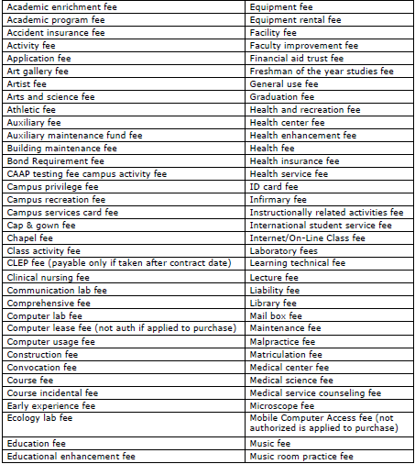
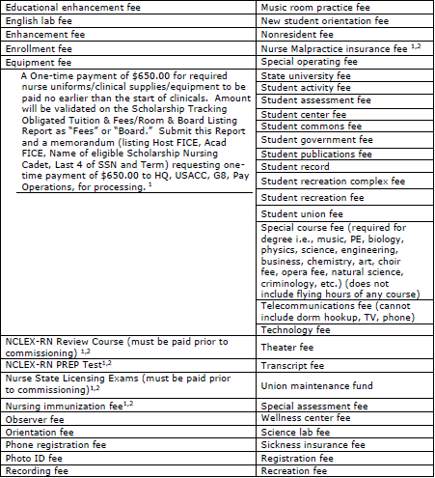
Reimbursable Fees
C-1. Reimbursable/appropriate fees for payment (when required for degree completion or to attend the college or university)
Extract from USACC Pamphlet 145-1, dtd 2 August 2016, Appendix C

Slide 61
Non-Reimbursable Fees/Items
Educational expenses prior to contracting
Travel, except as authorized by USACC Pam 145-1
Unauthorized summer sessions
Personnel fees (laundry, clothes, grooming)
Yearbooks (unless mandatory for all students)
State licensing applications
Flight flees/aviation flying hours and any fees related to flying hours required for degree
Field trips
USACC Pam 145-1, Appendix C-2, Non-Reimbursable Fees

Slide 62
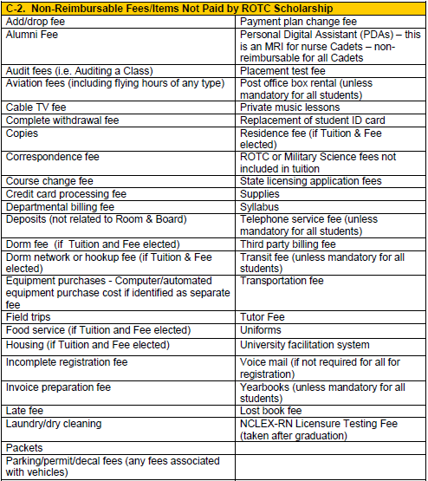
Non-Reimbursable Fees
Extract from USACC Pamphlet 145-1, dtd 2 August 2016, Appendix C
Return to Instructions on creating a CPR for Tuition and Fees

Slide 63

Common Mistakes
Entering incorrect courses/fees or forgetting to enter them!
No more benefits. Beyond Expected End Term!
Courses entered as education fee instead of tuition on Cadet Payment Request!
WHY ME!
Not uploading your school billing invoice!
Selected the wrong term!
Not uploading your 104R!
Currently on Admin Susp!
Notes:
Additional Common Mistakes
OBL report not signed
Room and Board elected, but validated Tuition and Fees in CCIMM
Cadet paid, but receipts not clear
No approval for extension of benefits (to include summer benefits)
Less than full-time student (not in last semester of MS IV year)
Early Commissioning Program payments missing memorandum
Nurse reimbursement for more than what is authorized
Cadet paid for NCLEX-Review and/or NCLEX-Test after graduation
Reimbursement for Nurse State License

Slide 64
Closing
If you have any questions, first ask your instructor.
If you cannot reach them, you may ask Ms. Miller or Mr. Foster

