Slide 1


Revealed
Notes:
Gretchen

Slide 2



Zoom Webinar Etiquette
Participants are muted, to speak unmute
Rename yourself to include department/school
You can also use the raise hand feature or chat window for questions or comments
We will use Zoom polls for questions and breakout rooms for discussions
Notes:
Gretchen

Slide 3

Agenda
Presenters:
Renna Lilly, Director, Pre Award Services, Sponsored Programs
Shelly Stewardson, Director, Research Administration, Post Award Financial Operations
Gretchen Hartigan, Assistant Vice President, Post Award Financial Operations
Types of cost share
Cost share in proposals
Funding sources for cost share
Tracking & Management
Reporting
Notes:
Gretchen

Slide 4
Part 1: Cost share basics
Cost share basics
Proposal & Award
Account Setup
Tracking & Management
Reporting
Administrators will understand the types of cost share and what they mean in practice, including what costs can be used to fulfill cost share requirements.
Notes:
SDS

Slide 5


Definition
Cost share: A portion of total sponsored project/ program costs not funded by the sponsor.
Notes:
SDS
Cash = operating budgets, other dept designated funds, other dept funds, gifts
In Kind = contributions other than cash. Add real value to project but do not require actual cash outlay. (equipment use without charge, waived F&A costs, third party contributions, donated labor, materials, services, space)
documented fair market value of equipment
volunteers, etc
Third party “in kind” cost sharing = outside organization submits letter of support clearly documenting its commitment to contributions included in proposal. Value must be documented for audit. (equipment use charges, donated labor, services, materials, equipment, space, waived F&A cost a of a subrecipient)

Slide 6

Types of cost sharing
Mandatory
Example
    The PI would like to submit a proposal to the NSF Major Research Instrumentation (MRI) program which requires a 30% cost share of total project costs.
    The total cost of the equipment is $130,000
    BU requests $91,000 from NSF
    BU must commit to provide $39,000 (Mandatory) of funding
    In order to meet the obligation BU has to have a commensurate 30% share.
Required by sponsor in proposal solicitation and as a condition of award
Quantified in proposal
Commitment from the University
Documented and reported to sponsor
Is sometimes referred to as matching
Notes:
RL
Sponsor specifies cost share is required as a condition of receiving the award
Identified or quantified in proposal
A commitment of the University
Might require certain percentage/type of cost sharing or that applicants match the sponsor’s contribution according to a certain formula
Must be documented and reported to sponsor

Slide 7

Types of cost sharing
Voluntary committed
Example
    There is no Sponsor requirement to cost share. The PI’s annual salary is $120,000. The PI commits 50% effort to the project in the proposal, but only requests 25% salary support.
    PI salary at 50% = $60,000
    PI salary support at 25% = $30,000 (sponsor pays)
    The balance of $30,000 = Cost Share (BU pays)
    Cost share must be approved at the proposal stage and accounted for at the award stage.
Not required by sponsor but quantified in proposal
Becomes a binding commitment from BU
May be documented and reported to sponsor
Highly discouraged
Notes:
RL

Slide 8

Types of cost sharing
Voluntary Uncommitted
Example
    An award requires 50% effort for the PI.
    The PI actually spends 60% time on the project.
    The department only charges the 50% effort to the award.
    The 10% effort over and above the budget (commitment) is voluntary uncommitted cost share and does not have to be documented.
Not required by sponsor and not quantified in proposal
Not a binding commitment from the University
Not documented or reported to sponsor
Notes:
RL

Slide 9

Types of cost sharing
Salary cap “Cost sharing”
Example
    NIH Salary cap changes annually
    NSF Limits Investigator effort to 2 months per year on all combined NSF Awards; may request more than 2 months with justification; may re-budget into salary and go over 2 months per year without prior approval
    DoJ, check Notice of Award
  Salary over a cap is an unallowable expense
  Sponsor-imposed limit for individual salaries
  Cannot be used as mandatory or voluntary committed cost sharing
  Must be identified (tracked) via the PAR, for cost accounting purposes
Notes:
RL
$197,300 as of Jan 5 2020

Slide 10

Sources of funding
Cash
Operating budgets
Other department’s designated funds
Recorded in BU financial system
  Example:
  10% effort not charged to sponsor
Notes:
SDS

Slide 11
Sources of funding
Adds real value w/o cash outlay
In-kind
Waived F&A costs
Third party contributions
Donated labor, services, materials, or space
Equipment use without charge
  Examples:
  10% uncompensated (i.e. summer salary on CRC)
  Subawardee provides cost share, it’s not reflected within BU SAP, but BU will account for it in reporting to sponsor
Value should
be documented
Notes:
SDS

Slide 12



Impacts of cost share
Pros
Allows sponsor to fund more projects
Maximizes sponsor contribution
Cons
Increases administrative burden (departments and central)
Takes away funds that could be used for other BU activities
Reduces PI’s effort flexibility to conduct other research
Decreases University F&A rate
Notes:
SDS
Pros of cost share: allows sponsor to fund more projects, enables University to compete for funding from sponsors who require cost sharing, demonstrate BU commitment to research, establishes partnership
Impact of cost share (institution has to contribute dollars, decreases F&A rate, and also you forgo the F&A for the cost shared amount, administrative burden of cost sharing)
Takes away funds that could be used for instruction and other activities.
There is administrative burden of carefully recording, tracking and reporting the cost share.
It doesn’t always increase the competitiveness of our proposal.
Cost sharing can reduce the University’s facilities and administrative rate because these expenses are included in the base calculation during F&A rate development. Not only do we subsidize the project itself but we fail to recover all of the operation costs.

Slide 13


Regulatory requirements (UG)
  Cost sharing contributions must meet all of the following criteria:
    Allowable as a direct cost under applicable cost principles and sponsor rules,
    Verifiable and documented,
    Necessary and reasonable,
    Not paid by another sponsored award (except as authorized by statute and sponsors),
    Provided for in the approved budget if required
Cost share expenditure must meet same requirements as direct charge on sponsored award
Notes:
SDS
Cost share expenditure must meet same requirements as direct charge on sponsored award – allowable, allocable and reasonable, incurred during project period, necessary to accomplish project, can’t be double counted on multiple awards)
Both in-kind and cash contributions by a recipient are acceptable as cost sharing when all of the following criteria are met:
Verifiable from recipient records,
Not included as contribution for any other federally assisted program,
Necessary and reasonable for proper and efficient accomplishment of project or program objectives,
Allowable as a direct cost under applicable cost principles,
Not paid by another federal award (except as authorized by statute),
Provided for in the approved budget when required by the federal awarding agency,
Conform to other provisions in OMB Uniform Guidance or A-110 as applicable.

Slide 14
Part 2: Proposal & Award
Cost share basics
Proposal & Award
Account Setup
Tracking & Management
Reporting
Administrators must ensure that proposals meet the sponsors’ cost sharing requirements and identify funding sources for both the sponsor-mandated and PI volunteered cost sharing commitments.
Notes:
RL

Slide 15
Is cost share required?
If the answer is “No” to any of these questions, cost sharing should not be included in the proposal.
Cost Share considerations
Is the cost sharing either mandatory or is there persuasive evidence that cost sharing is necessary?
Is the cost sharing being proposed directly related and integral to this project?
Will it be possible to document the cost sharing for reporting purposes?
Is the type and source of cost share being proposed allowed by the sponsor?
Will the cost sharing take place within the project period?
Have all University contributions (including effort) been documented/approved by someone authorized to do so?
Have all third party contributions been documented/approved by each organization’s authorized representative?
Notes:
RL

Slide 16

Follow sponsor guidelines regarding cost share
  Sponsor guidelines will specify if cost sharing is required or allowed, and if so where it should be included in the proposal
Example
NSF programs with mandatory cost sharing: I-Corps, Major Research Instrumentation Program, Robert Noyce Scholarship Program, Engineering Research Centers, Experimental Program to Stimulate Competitive Research, SBIR, STTR
In these instances cost share is included on “line M” of proposal budget
    NSF (National Science Foundation) prohibits voluntary committed cost sharing
    List resources in “Facilities, Equipment and Other Resources” section of proposal
    Description should be narrative
    Mandatory cost sharing only if explicitly authorized by NSF Director
Notes:
RL
When drafting and/or reviewing a proposal, it is essential to determine whether the notice of funding opportunity includes a discussion of either mandatory or voluntary cost sharing. If such a discussion is included, statements in the proposal, and particularly in the budget or justification, that may imply cost sharing should be reviewed carefully against the criteria in the funding notice to avoid unintended commitments.
NSF (National Science Foundation) prohibits voluntary committed cost sharing
All organizational resources necessary for project should be included in “Facilities, Equipment and Other Resources” section of proposal
Description should be narrative, no quantifiable financial information
Mandatory cost sharing only if explicitly authorized by NSF Director

Slide 17
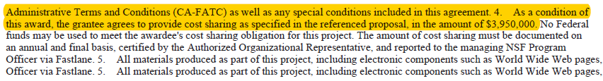
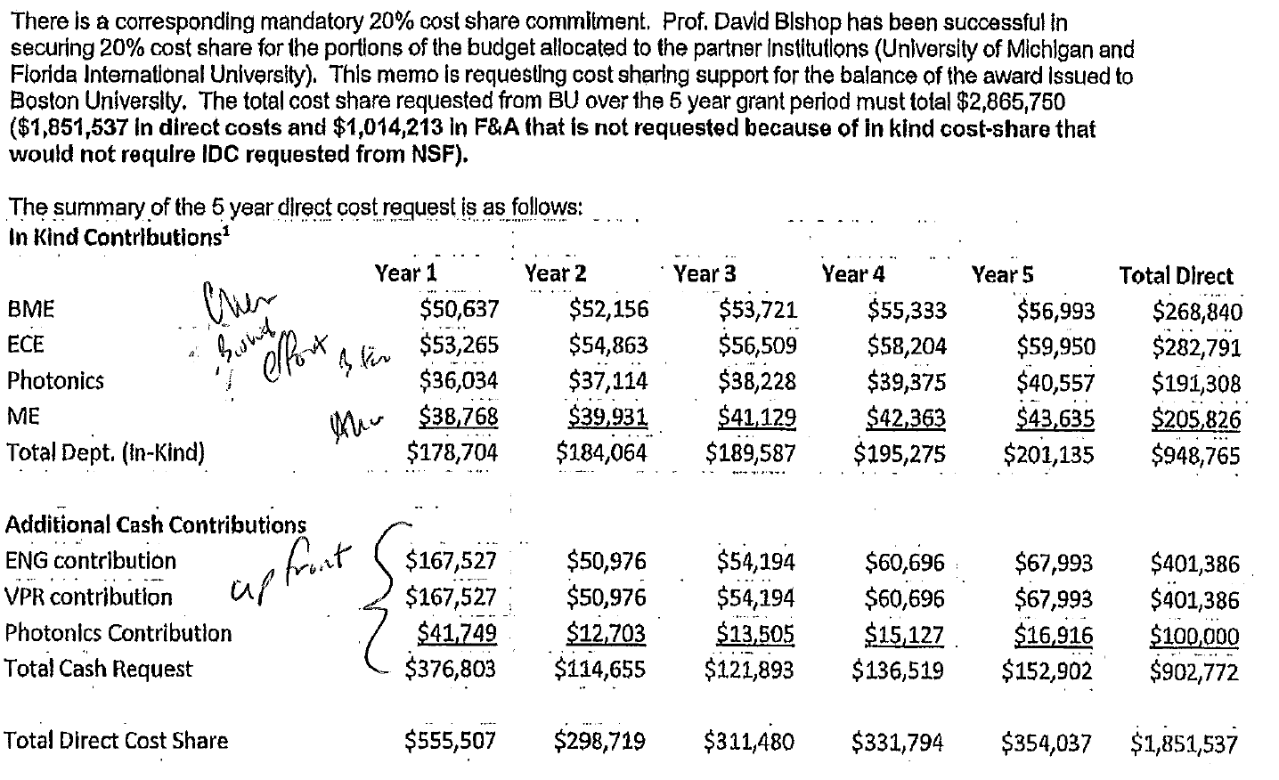
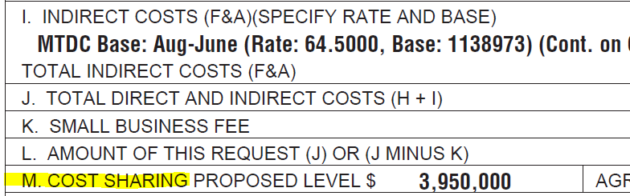
NSF Example
Notes:
RL

Slide 18

BREAKOUT ROOM ACTIVITY
Review the following three case studies (p. 3) with your group and determine whether cost share is required in each case.
You will get 10-15 minutes and we will prompt you when you should be moving on to the next case study to make sure you respond to all of them.
Mandatory
Voluntary Uncommitted
Voluntary Committed
Notes:
Gretchen
Assign Breakout Rooms
Renna will drop studies into chat
Folks open the deck before they go to breakout room
Gretchen will give 5 minute notification to move on to next case
Once you get message to leave breakout room, click on the link to come back

Slide 19
Case Study A
Analyze the following scenario and discuss in small groups.
PI is applying for a small foundation award. There is no specific language that they require cost share in the RFA. A lab tech’s salary would be too great a portion of the awarded amount so PI wants to volunteer lab tech’s hours and use the funds for supplies and equipment.
According to the list of considerations, what would you recommend to the PI?
Notes:
JR
VUC – don’t quantify in the proposal and don’t track
PI could remain silent, doesn’t say anything, not committed, not addressed, no need to put on PAR
If PI wants to talk about other people working on project, a lab tech will be available as needed

Slide 20
Case Study A ANSWER
Analyze the following scenario and discuss in small groups.
PI is applying for a small foundation award. There is no specific language that they require cost share in the RFA. A lab tech’s salary would be too great a portion of the awarded amount so PI wants to volunteer lab tech’s hours and use the funds for supplies and equipment.
According to the list of considerations, what would you recommend to the PI? Voluntary Uncommitted; PI should remain silent; not committed; not put on PAR
Notes:
JR
VUC – don’t quantify in the proposal and don’t track
PI could remain silent, doesn’t say anything, not committed, not addressed, no need to put on PAR
If PI wants to talk about other people working on project, a lab tech will be available as needed

Slide 21
Case Study B
Analyze the following scenario and discuss in small groups.
  PI from CAS is applying for a DHHS Award. The language in the RFA states they require matching. PI suggests that travel he has planned prior to the project start date is relevant to the research and can be used as cost share, in addition the PI proposes to use equipment purchases and a gift account to fund the remaining cost share
  Is cost share required? What do you think of the PI’s plan?
Notes:
JR
Scenario B:
Cost share is mandatory
travel unallowable (not during period of performance)
3 summer months needs provost approval
Equipment allowable
Can use gift account with general accounting approval

Slide 22
Case Study B ANSWER
Analyze the following scenario and discuss in small groups.
  PI from CAS is applying for a DHHS Award. The language in the RFA states they require matching. PI suggests that travel he has planned prior to the project start date is relevant to the research and can be used as cost share, in addition the PI proposes to use equipment purchases and a gift account to fund the remaining cost share
  Is cost share required? What do you think of the PI’s plan?
  Cost share is mandatory; travel is unallowable (not during the period of performance); 3 summer months require Provost approval; equipment is allowable as cost share; can use gift account with general accounting approval
Notes:
JR
Scenario B:
Cost share is mandatory
travel unallowable (not during period of performance)
3 summer months needs provost approval
Equipment allowable
Can use gift account with general accounting approval

Slide 23
Case Study C
Analyze the following scenario and discuss in small groups.
  PI is applying for a HRSA award, F&A is not capped by the sponsor but the PI would like to reduce the F&A to 20% to fit total cost cap. What kind of cost share would this be? Is this allowable?
Notes:
JR
VC
Requires provost approval – f&a reduction

Slide 24
Case Study C ANSWER
Analyze the following scenario and discuss in small groups.
  PI is applying for a HRSA award, F&A is not capped by the sponsor but the PI would like to reduce the F&A to 20% to fit total cost cap. What kind of cost share would this be? Is this allowable?
  Voluntary Committed; requires Provost approval for F&A waiver
Notes:
JR
VC
Requires provost approval – f&a reduction

Slide 25


What CAN’T be used as cost sharing
  Other awards
  Institute facilities such as laboratory space
  Expenditures included in the F&A rate (e.g. utilities, admin salaries)
  Salary dollars above a regulatory cap (e.g. DHHS cap)
  Unallowable costs as defined in UG or sponsor limitations
Notes:
RL

Slide 26

What CAN be used as cost sharing
  Direct costs
  Salaries and benefits
  Equipment
  Travel
  Supplies
  Indirect costs
  F&A (contributed or waived)
  In kind
  Donated supplies, materials, volunteer hours
  Third party contributions
    Contributed F&A refers to the F&A associated with any cash contributions, e.g.
    PI plans to contribute time and effort without compensation from sponsor, the monetary value of effort + F&A associated with it may be offered as cost sharing
    Monies from an unrestricted University fund will be used to pay for the PI’s project travel, both the amount of the travel funds + F&A associated with this amount can be offered and reported as cost sharing
    Waived F&A is when the University agrees not to charge its federally negotiated F&A rate to the sponsor.
    The portion waived is considered “unrecovered F&A” and can be used as cost share if this is allowed by the sponsor
F&A Cost share examples
Notes:
RL

Slide 27

Identifying cost sharing sources
Principal Investigator (PI) must identify and provide resources for cost sharing of direct costs
Confirm that all identified cost sharing funds are allowable/eligible as cost sharing
Use preferred cost sharing sources (less impact on F&A)
Identify cost center responsible for fulfilling BU-funded cost sharing commitments
Notes:
RL

Slide 28
ACTIVITY: Budgeting $10,000 Cost Share
The Sponsor requires $10,000 cost share. The type of cost we use will have an impact. In this example we use equipment for cost share:
Example A: Equipment
Equipment: | $10,000
Associated F&A @ 50% of MTDC: | $0
Total Cost Share: | $10,000
Capital equipment isn’t included in MTDC, so it’s $0 F&A
Notes:
Renna drop in the Calculating Cost Share Doc into the Chat
Discuss as a group

Slide 29
ACTIVITY: Example B
Let’s use travel as the cost, and try to get to $10,000 cost share.
Complete the worksheet below:
Example B: Travel
PI Travel: | $10,000 / 1.5 = ________ A
Associated F&A @ 50% of MTDC: | ________ x 50% = ________ A B
Total Cost Share: | __________+_________= $10,000 A B
Notes:
Discuss as a group

Slide 30
ACTIVITY: Example B
Let’s use travel as the cost, and try to get to $10,000 cost share.
Complete the worksheet below:
Example B: Travel
PI Travel: | $10,000 / 1.5 = ________ A
Associated F&A @ 50% of MTDC: | ________ x 50% = ________ A B
Total Cost Share: | __________+_________= $10,000 A B
$6,666.67
$6,666.67
$3,333.33
$6,666.67
$3,333.33
Notes:
Discuss as a group

Slide 31
Example C: Salary
Example C: Salary
PI’s AY Salary: | $10,000 / 1.5 / 1.3 = ____________ A
Related Fringe Benefits @ 30% of Salary: | ___________ x 30% = ____________ A B
Subtotal direct: | __________+_________= ___________ A B C
Associated F&A @ 50% of Subtotal: | __________ x 50% = ____________ C D
Total Cost Share: | __________+_________= $10,000 C D
Notes:
Discuss as a group

Slide 32
Example C: Salary
Example C: Salary
PI’s AY Salary: | $10,000 / 1.5 / 1.3 = ____________ A
Related Fringe Benefits @ 30% of Salary: | ___________ x 30% = ____________ A B
Subtotal direct: | __________+_________= ___________ A B C
Associated F&A @ 50% of Subtotal: | __________ x 50% = ____________ C D
Total Cost Share: | __________+_________= $10,000 C D
$5,128.21
$5,128.21
$1,538.46
$5,128.21
$1,538.46
$6,666.67
$6,666.67
$3,333.33
$6,666.67
$3,333.33
Notes:
Discuss as a group

Slide 33
ACTIVITY: Cost Share as a % of Sponsor Costs
When cost share is 20% of Sponsor Costs
$30,000 x 20% = __________________
Sponsor Share
% Cost Share
Cost Share Amount
$30,000 + _________________ = _________________
Sponsor Share
Cost Share Amount
Total Project Costs
Notes:
Discuss as a group

Slide 34
ANSWER: Cost Share as a % of Sponsor Costs
When cost share is 20% of Sponsor Costs
$6,000
$30,000 x 20% = __________________
Sponsor Share
% Cost Share
Cost Share Amount
$6,000
$36,000
$30,000 + _________________ = _________________
Cost Share Amount
Total Project Costs
Notes:
Discuss as a group

Slide 35
ACTIVITY: Cost Share as a % of Total Project Costs
When cost share is 20% of Total Project Costs
$30,000 ÷ 0.8 = __________________
Sponsor Share Total Project Costs
__________________ − $30,000 = __________________
Total Project Costs Sponsor Share Cost Share amount
100% - 20%
Notes:
Discuss as a group

Slide 36
ANSWER: Cost Share as a % of Total Project Costs
When cost share is 20% of Total Project Costs
$37,500
$30,000 ÷ 0.8 = __________________
Sponsor Share Total Project Costs
__________________ − $30,000 = __________________
Total Project Costs Sponsor Share Cost Share amount
100% - 20%
$37,500
$7,500
Notes:
Discuss as a group

Slide 37
ACTIVITY: Calculating sponsor share when total costs are known
Total project costs $30K and sponsor requires 20% cost share of the sponsor share
$30,000 ÷ 1.2 = __________________
Total Project Costs Sponsor Share
$30,000 − __________________ = __________________
Total Project Costs Sponsor Share Cost Share amount
1.costshare
Notes:
Discuss as a group

Slide 38
ACTIVITY: Calculating sponsor share when total costs are known
Total project costs $30K and sponsor requires 20% cost share of the sponsor share
$25,000
$30,000 ÷ 1.2 = __________________
Total Project Costs Sponsor Share
$30,000 − __________________ = __________________
Total Project Costs Sponsor Share Cost Share amount
1.costshare
$25,000
$5,000
Notes:
Discuss as a group

Slide 39
Comparing Examples
In each example we are starting from $30,000 and 20% cost share, but each scenario yielded a different result for how much BU needs to fund
Example A --- % of Sponsor Cost
$6,000 cost share
Example B --- % of Total Project Cost
$7,500 cost share
Example C --- % when Total Project is capped at known amount
$5,000 cost share
Language makes a difference!
Notes:
Discuss as a group

Slide 40
Calculating cost share tips
The Sponsor will say if the cost share is a percentage of total project costs or sponsor contribution, if in doubt ask the sponsor.
% v $: To avoid confusion, we recommend committing a total dollar amount, not a percentage, when applicable
Notes:
Discuss as a group

Slide 41
Poll Question
Do folks need a quick 5 minute break?
Notes:
Discuss as a group

Slide 42
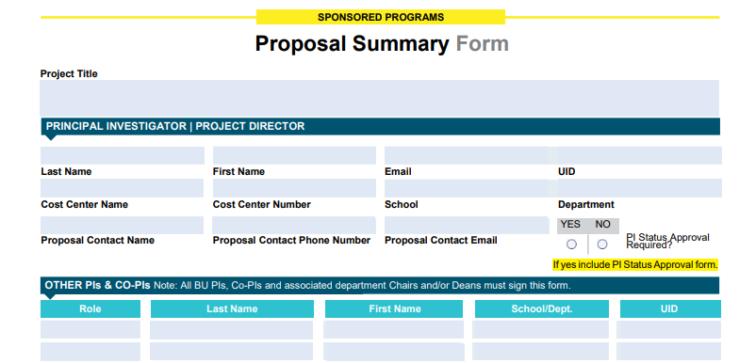
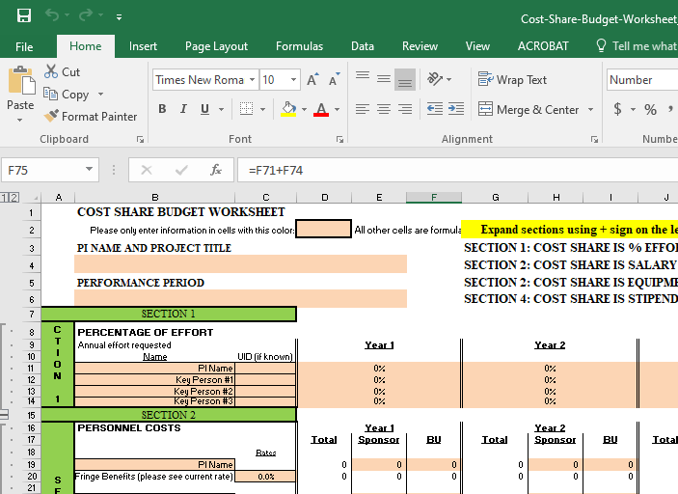
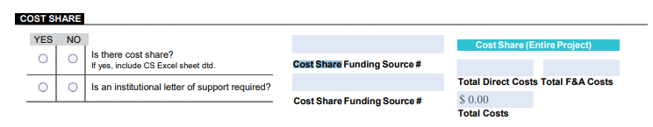
Proposal budget
Prepare cost sharing budget in same level of detail as sponsor-requested budget
Proposal Summary form
Cost share budget worksheet
http://www.bu.edu/researchsupport/files/2019/10/PSF_10.01.19v2.pdf
http://www.bu.edu/researchsupport/files/2016/12/Cost-Share-Budget-Worksheet_9.1.16-2.xlsx
Notes:
RL

Slide 43


Proposing effort – best practice
When personnel is written into a grant proposal and effort is quantified, it is committing their effort to the sponsor.
What to say if you don’t want to commit cost share
What NOT to say
For non key personnel
If not requesting salary use phrases like:
Person X will participate in the project as needed
Person X will provide guidance and expertise on an ad hoc basis
Person X may oversee aspects of the project
Person X will provide oversight as needed
Avoid saying anything like
Person X will work Y amount of time at no cost to the sponsor
because that is considered cost sharing
Notes:
RL

Slide 44
Pop Quiz
Using the “cost share considerations” slide as a reference, how would you word the proposal for the following scenarios?
Notes:
Gretchen --- Poll #2

Slide 45
Question 1
Which statement should be used in the Proposal to indicate cost sharing will be used?
  PI is applying for an award which requires 25% cost share of effort.
    The University demonstrates support to the project through the availability and expertise of the project director.
A
B
The University will contribute to the project through partial salary for the project director.
C
Dr. Who is PI and will be devoting 30% effort, and only 5% will be charged to the project.
Notes:
C: Dr. Who is PI and will be devoting 30% effort, and only 5% salary support to the project.
Poll Question with A, B, C answers

Slide 46
Question 1
Which statement should be used in the Proposal to indicate cost sharing will be used?
  PI is applying for an award which requires 25% cost share of effort.
    The University demonstrates support to the project through the availability and expertise of the project director.
A
B
The University will contribute to the project through partial salary for the project director.
C
Dr. Who is PI and will be devoting 30% effort, and only 5% will be charged to the project.
Notes:
C: Dr. Who is PI and will be devoting 30% effort, and only 5% salary support to the project.

Slide 47
Question 2
Which statement should be used if we DON’T want to commit to cost sharing in the Proposal?
PI is applying for a small foundation award. There is no specific language in the RFA that they require cost share. The PI wants to budget a Post Doc, but their effort would be too great a portion of the awarded amount so the PI would like to contribute additional Post Doc effort as needed.
    Post Doc will be involved in all research activities associated with the project. They will commit 5% effort, which will not be charged to the grant.
A
B
BU is highly supportive of this project and the Post Doc will perform effort as needed.
C
Post Doc’s annual salary is $30,000, we are requesting $10,000 for this project.
Notes:
B
Poll Question with A, B, C answers

Slide 48
Question 2
Which statement should be used if we DON’T want to commit to cost sharing in the Proposal?
PI is applying for a small foundation award. There is no specific language in the RFA that they require cost share. The PI wants to budget a Post Doc, but their effort would be too great a portion of the awarded amount so the PI would like to contribute additional Post Doc effort as needed.
    Post Doc will be involved in all research activities associated with the project. They will commit 5% effort, which will not be charged to the grant.
A
B
BU is highly supportive of this project and the Post Doc will perform effort as needed.
C
Post Doc’s annual salary is $30,000, we are requesting $10,000 for this project.
Notes:
B

Slide 49
Cost share approvals table
Type of Cost Share | Sponsor Type | Who is Funding the Cost Share | Required Approval(s)
Mandatory | Federal/Non-Federal | Dept. Chair/Center Director School Dean VP Research | Cost Share Funder(s) and If CRC: VP Research If BUMC: School Dean
Voluntary Committed | Federal | Dept. Chair/Center Director School Dean VP Research | Cost Share Funder(s) and If CRC: VP Research If BUMC: School Dean
Voluntary Committed | Non-Federal | Dept. Chair/Center Director School Dean | Cost Share Funder(s)
Voluntary Uncommitted* | Federal | Dept. Chair/Center Director School Dean VP Research | Cost Share Funder(s) and If CRC: VP Research If BUMC: School Dean
*Attributable to training and fellowship grants
http://www.bu.edu/researchsupport/forms-policies/treatment-of-cost-sharing-for-sponsored-awards/
Notes:
RL
Voluntary Uncommitted… raise as a question to group

Slide 50

Award
Whether cost sharing is required by the sponsor or is offered by the PI voluntarily in the proposal, once an award is made and the cost sharing is part of the terms and conditions, it becomes a commitment under the terms of the award and, as such, represents a binding obligation of the Institution.
Congrats – Award has been granted
Notes:
RL

Slide 51
Part 3: Account Setup
Cost share basics
Proposal & Award
Account Setup
Tracking & Management
Reporting
Administrators will understand when cost share accounts are required, and the roles and responsibilities for these tasks.

Slide 52
Does my award have cost share?
How do you know if your award has cost share?
  Review proposal budget, budget justification, PSF
  Review Notice of Award
  When in doubt, call your SP RA
Notes:
SDS

Slide 53
Does my award need a cost share account?
Cost Share Type? | Expense Type | Reportable? | Cost Share Account? | Notes
Voluntary Uncommitted | All | Not Reportable | No
Voluntary Committed | Salary / Effort | Reportable | No (but cost share account can be set up if requested by Department) | Capture on PAR (Manually calculate Fringe and F&A for reporting purposes). billing concerns
Voluntary Committed | Non Salary | Not Reportable | No
Voluntary Committed | Non Salary | Reportable | Yes
Mandatory | Salary / Effort | Reportable | No (but cost share account can be set up if requested by Department) | Capture on PAR (Manually calculate Fringe and F&A for reporting purposes). billing concerns
Mandatory | Non Salary | Reportable | Yes
3rd Party | All | Billable | Yes
3rd Party | All | Not Billable | No
Voluntary or Mandatory | Fringe Only | Reportable | No - Manually calculate for reporting purposes
  Cost share account created by SP, if required
    Cost share account created as “child” of prime award within fund “200xxx108x”
Notes:
SDS

Slide 54
Discussion
If no account set up, how is cost share tracked? When an account isn’t created, how is this being tracked and verified by departments. What evidence do you need to keep?
Notes:
SDS – Group Discussion

Slide 55
Part 4: Tracking & Management
Cost share basics
Proposal & Award
Account Setup
Tracking & Management
Reporting
Administrators are responsible for the accurate management of cost share commitments.
Notes:
SDS

Slide 56

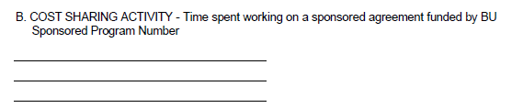
Documenting cost share
  Cost share needs to be properly documented, i.e.
  captured in accounting system (SAP)
  and captured in payroll and/or PARs
  Cost Share section on the PAR
    necessary for calculating MTDC
  Third party cost share
  invoice from subrecipient should indicate cost share has been met
  documentation from third party confirming commitment
Notes:
SDS

Slide 57
Funding cost share
PAFO or DA can transfer funds via the transfer in-transfer out GL and is done via a journal entry
GL 479999/579999
  Examples:
    the revenue piece can be funded as soon as the budget for the cost share account is set-up (direct costs only)
    the revenue piece can be funded when there are expenses, quarterly is the most frequent option
    the revenue piece can be funded when there are expenses at a minimum for all expenses by the end of the FY in which they post
Notes:
SDS

Slide 58
Part 5: Reporting
Cost share basics
Proposal & Award
Account Setup
Tracking & Management
Reporting
Reporting to sponsors will be accurate and timely.
Notes:
SDS

Slide 59
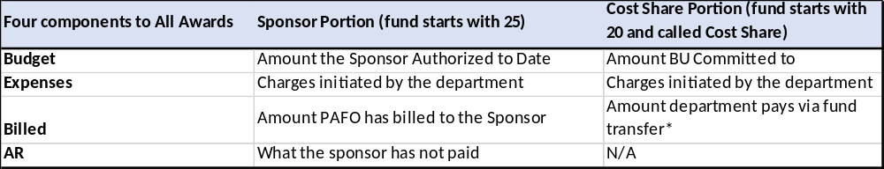
Key things to note
  BW Reports
  doesn’t include F&A since F&A isn’t applied to our cost shared accounts
  Cost share entries and reporting
  F&A manually calculated by PAFO RA and included on sponsor reports
  Entries are done to debit a department account (not a gift) using g/l 579999 and credit the cost share IO using g/l 479999
  Departments can do the entry to fund or PAFO can do the entry to fund but all cost share expenses must be funded by the end of each fiscal year
  Closeout
  Verify that all required cost sharing has been met, properly documented, and funded
Notes:
SDS

Slide 60
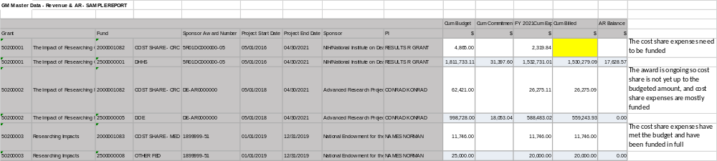
GM AR Revenue Report
  On this report you will see budget, expenses, and revenue.
  “Revenue” is the same as an invoice in the way it shows up in reports.
  Revenue is an internal invoice, funds transfer.
  Think of it as a billing BU for the cost share.
See FAQ: How to use the “GM Master Data - Revenue & AR” Report
http://www.bu.edu/researchsupport/project-lifecycle/managing-an-award/manage-an-award-faqs/
Notes:
SDS

Slide 61
Key Takeaways
Only commit to cost sharing at the level or amount that is required
Obtain approval for cost share prior to submitting proposal
Don’t propose it, if you’re not willing to cover the cost
Cost shared expenditures on sponsored projects are subject to audit
Cost share decreases BU’s F&A
Document, document, document!
Notes:
SDS

Slide 62

Questions

