Slide 1

Audit
Revealed
Notes:
Gretchen

Slide 2



Zoom Webinar Etiquette
Participants are muted, to speak unmute and let us know who is talking
Also utilize the raise hand feature or chat window for questions or comments
Notes:
Gretchen
Introductions: Me, Shelly, Craig, and Missy
Housekeeping:
We will mute you to start but you can unmute yourself if you have a question, or choose the raise your hand feature
We will record this session and make the recording and the PPT deck available after
We’ll email a feedback survey around after the session which will only take a few minutes and we would value your responses
Turn Camera’s on
Change your name to say “Dept and Name”
Use the Chat function to everyone as we will monitor
Or Raise Hand feature

Slide 3


Agenda
Presenters
Gretchen Hartigan, Assistant Vice President, Post Award Financial Operations
Missy Downs, Director, Research Finance and Property Management, PAFO
Craig Gerome, Assistant Director, Compliance, PAFO
Shelly Stewardson, Director, Research Accounting, PAFO
What Audits happen
What Auditors look at
Compliance categories
Notes:
GH

Slide 4
The Goal
BU’s responsibility to all external funders to be fiduciary responsible and compliant with rules and regulations.
PAFO’s responsibility to protect BU’s research program while maintaining a strategic balance of service and compliance.
Staff will connect how the actions and choices they make now will impact the department when an audit occurs later
Goal for today: Think like an auditor
Notes:
GH

Slide 5
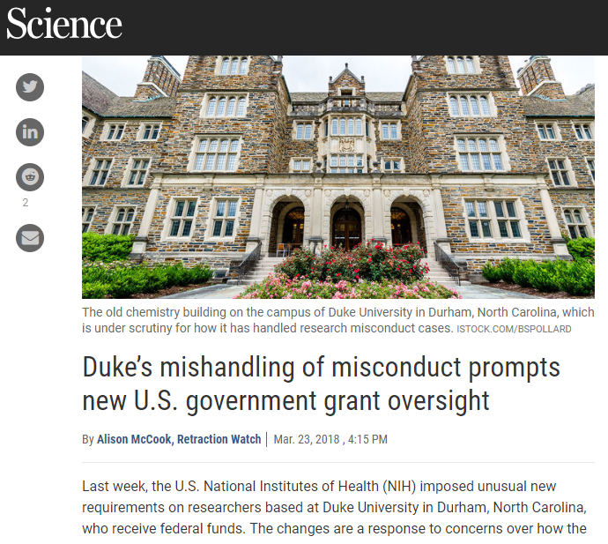
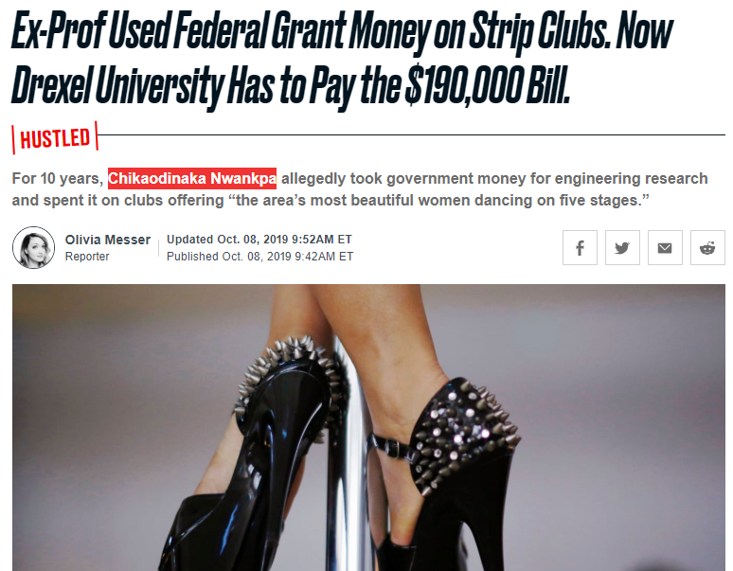
Why it matters
Notes:
SDS

Slide 6
BU Examples
Site Visit, Department of Justice
NSF, Office of Inspector General
Department of Defense
Uniform Guidance
  Rebudgeting
  Indirect costs
  Subrecipient monitoring
  Effort
  Subrecipient Monitoring
Paid back $18.63 in disallowed costs
Paid back $166,130
in disallowed costs (consultants, foreign travel)
Created what is now the current Effort Policy
Evaluation of sub’s risk of noncompliance with Federal regulations and subaward terms & conditions
Notes:
SDS

Slide 7
Question
How often is BU audited?
A
    <5 times a year
B
5-10 times a year
C
BU is always being audited
Notes:
SDS
Zoom poll question

Slide 8
Question
How often is BU audited?
A
    <5 times a year
B
5-10 times a year
C
BU is always being audited
Notes:
SDS

Slide 9
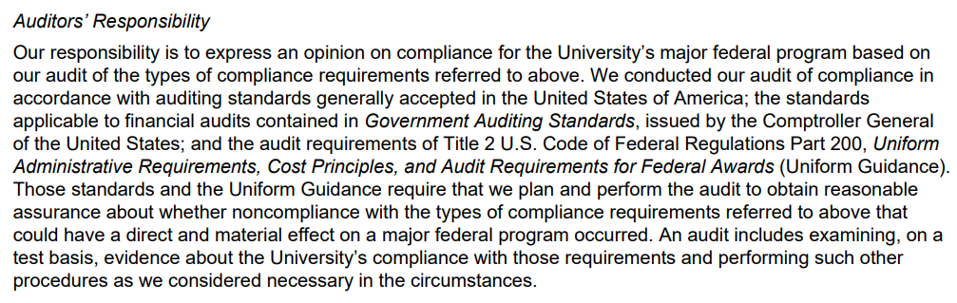
What an auditor does
Notes:
CG
This Language comes directly from our Audit Report.
Key Points here is that
UG requires that (1) they perform the audit and (2) assess our compliance with the UG requirements; and
“evidence” = Testing our documentation – Which we will be looking at today
Uniform Guidance requires that (1) they perform the audit and (2) assess our compliance with the UG requirements; and
Audit is examining evidence to assess our compliance – Testing our documentation.

Slide 10
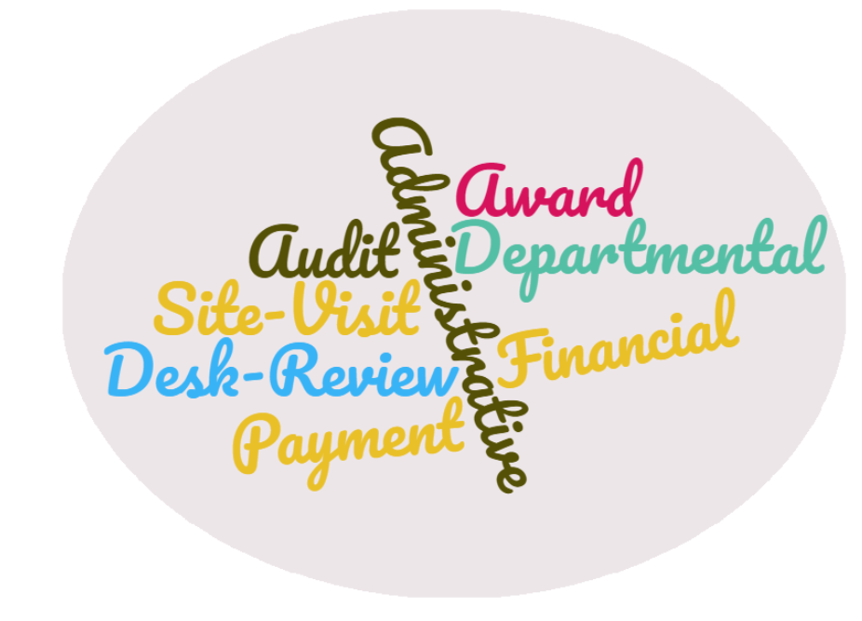

Types of Audit: Who and What
Office of Inspector General (OIG)
Sponsor (Federal or Non-federal)
Pass Through Entity (BU as Subrecipient)
Uniform Guidance Audit & Financial Statement (annual)
Internal Audit & Advisory Services (IA&AS)
Notes:
CG
OIG: - Oversight division of the federal agency; investigate fraud, waste, etc.
[NASA, NSF, DHHS, DOJ]
- Specific award, all of your awards (NSF data analytics)
SPONSOR: - Federal Agency (ex, DOJ)
- Specific award, a pyament
PTE: [ONR → MIT → BU]
- MIT Desk Review; or
- ONR audit of MIT (include a review of a BU invoice to MIT)
IA: (PAFO limited role)
- Review a specific process, such as Cost Transfers (University wide); or
- Review a particular Department

Slide 11

Audit Life Cycle: Notification
      Notification of the review
      Typically sent to Principal Investigator (PI). (Please forward to Craig Gerome)
      If sent to SP or PAFO, we will notify PI and Department Administrator (DA)
      PAFO is central contact to auditor and facilitates scheduling of visit with PI
Notes:
CG
Next few slides look at the Audit Cycle

Slide 12


Audit Life Cycle: Scope
      • Audit typically covers a specific award
      • Scope of the audit varies from sponsor to sponsor
      • No standard format among agencies
      • All audits will include one or more of the following elements
Notes:
CG

Slide 13





Audit Life Cycle: Scope
Audit
with Site Visit
Administrative
Programmatic
Financial
  University policy and procedures
  Meeting with PI, tour of lab
  Grant expenditures, Notice of Award
Desk Review
  Limited to reviewing all expenses on 1 invoice
Notes:
CG
If Sponsor audit, will most likely include a site visit; will cover both administrative/programmatic and financial aspects
If Sponsor desk review no site visit occurs; review is limited to one (1) invoice (covering all expenses included on invoice)
Administrative: includes a review of University policies and procedures (travel, procurement, code of ethics, whistleblower policy, employment policies, Chart of Accounts, University/department organization chart)
Programmatic: includes a meeting with the PI, could include a tour of lab facility. Project Status, issues, budget matters, proper infrastructure in place.
Financial: includes a review of all grant expenditures and Notice of Award

Slide 14
Audit Life Cycle: Financial Portion
PAFO provides report of all grant expenditures (general ledger), from which specific testing selections will be made.
PAFO provides supporting documentation for each individual testing selection.
PAFO will contact DA if unable to locate supporting documentation or for further information or clarification.
PAFO responds to auditor follow up questions.
Notes:
CG
For desk reviews: PAFO provides the same GL report and support for all invoice expenses.

Slide 15

Audit Life Cycle: Conclusion
      Final report from Sponsor (can take months)
      Form of final report varies widely
      Report will indicate:
          Findings and/or questioned costs
          Issues for Resolution (opportunity to respond)
          Recommendations (programmatic/ administrative)
Notes:
CG
Example from DOJ, “Issues for Resolution.” We successfully defended an issue for resolution claiming lack of competitive bidding and an unreasonable hotel charge.
Programmatic reviews will often come with recommendations for the project

Slide 16
Annual Uniform Guidance (UG) Audit
Covers entire fiscal year, broken up into two periods:
“Interim” covers July – February (occurs in the spring)
“Q4” covers March – June (occurs in the fall)*
*Q4 is the same process, just fewer selections; and they select 5 additional grants to test.
20 grants selected from a list of all federal grants with expenditures in given fiscal year.
PAFO provides supporting documentation for each individual testing selection.
Multiple rounds of follow up questions with auditor management team, then auditor firm partners.
Over 200 individual selections made during interim testing period.
Notes:
CG
1. PAFO provides expenditures for all 20 grants, from which auditors make individual testing selections.
Testing areas include: salary, non-salary, cost transfers, period of performance, procurement, subrecipient monitoring, key
personnel.

Slide 17


What does an auditor look at
High Risk Areas
Effort
Period of Performance
Cost Transfers
Procurement
Subrecipient Monitoring
Salary
Cost Transfers
Direct Costs
Notes:
SDS

Slide 18
Compliance Categories
Allowable Costs/Cost Principles
Cash Management
Eligibility
Equipment
Matching, level of effort
Period of performance
Procurement
Program Income
Subrecipient Monitoring
Special test and provisions
There are several compliance categories that auditors will look at, we’ll look at examples of a few now, those in bold.
Notes:
SDS

Slide 19

Documentation to Auditor
Allowable Costs/ Cost Principles
Salary expenses: (i) the PA15 Labor distribution report, (ii) the PAR, (iii) SAP/HR job description, (iv) evidence of salary increases and increase approvals.
Non-salary expenses: Invoice and AP disbursement request form, purchase order/shopping cart (see Procurement), P.Card approval, Concur expense report , etc.
Cost transfers: journal entry or salary adjustment along with PAFO approval, PI approval within the Cost Transfer E-Mail (if over 90 days), BW report showing original posting, and all additional supporting documentation (invoice, PAR).
Budget-to-Actual: screenshot from the Business Warehouse showing total Budget allowed per the Grant and cumulative expenditures to date.
Notes:
CG
Evidence of the University’s Compliance…What we provide to the auditor’s
Allowable Costs/Cost Principles: The largest testing block.
Salary: Major change in student payroll documentation. No longer accepting Student Payroll earnings history.
Non-salary: Documentation varies significantly.
Cost transfers: Other side of the transaction
Budget-to-Actual: Auditors are testing (1) The Budget in our system matches NOA; and (2) The Grant is not over spent.

Slide 20
Group Activity: Be the auditor
You have been tasked with auditing Grant BUCWC and the documents provided by your client.
In your groups, review the documents for the selected compliance categories (we will put a link to docs in the chat window).
Compliance categories
Allowable Costs/Cost Principles
Cash Management
Eligibility
Equipment
Period of performance
Procurement
Program Income
Subrecipient Monitoring
Special test and provisions
Notes:
Gretchen
You will be broken out into groups, open the link that we include in the chat window for the relevant documents and question. You will discuss as a group and then we will bring you back to the main room to review the answer.
http://www.bu.edu/researchsupport/2020/09/17/zoom-training-documents/

Slide 21
Question 1: Allowability
Review the following documents:
Budget narrative & proposal budget
BW report – Grant Document for Expenditures
BW report – Budget v Actuals
Q1: What issues (*hint there are three) do you see for allowability?
Look at salary, equipment and travel.
Notes:
Gretchen

Slide 22
Question 1: Allowability ANSWER
Review the following documents:
Budget narrative & proposal budget
BW report – Grant Document for Expenditures
BW report – Budget v Actuals
Q1: What issues, if any, do you see for allowability?
Issues:
Co-PI salary missing
Equipment not budgeted
Foreign Travel
Notes:
Gretchen

Slide 23
Question 2: Allowability
Review the following documents:
Documentation needed
Cost Transfer backup
Q2: What issues, if any, do you see for cost transfer allowability?
Notes:
Gretchen

Slide 24
Question 2: Allowability ANSWER
Review the following documents:
Documentation needed
Cost Transfer backup
Q2: What issues, if any, do you see for cost transfer allowability?
Issues:
Original transaction missing
PI approval?
Notes:
Gretchen

Slide 25

Documentation to Auditor
Period of Performance
  Selections cover all testing areas
  Documentation must show that expense was incurred during the award’s period of performance
  Invoices can still post after end date, but goods and services must be received during project period
Notes:
CG

Slide 26
Question 3: Period of Performance
Review the following documents:
Budget narrative & proposal budget
Grant Document for Expenditures
Subinvoice Issue #1
Q3: What issues, if any, do you see for period of performance?
Hint: Check Salary and Subawards
Notes:
Break out Room
Put the Q3 Link in Chat Window
Folks have to open on their computer as link will disappear when we move them to breakout rooms

Slide 27
Question 3: Period of Performance ANSWER
Review the following documents:
Budget narrative & proposal budget
Grant Document for Expenditures
Subinvoice Issue #1
Q3: What issues, if any, do you see for period of performance?
Issues:
January 2020 salary, fringe, and F&A
January 2020 sub-invoice

Slide 28

Documentation to Auditor
Subrecipient Monitoring
  Subrecipient invoice (with UG certification if applicable)
  AP Subrecipient Invoice Disbursement Form
  Subaward agreement
  PI approval of the invoice
  PAFO RA’s approval
  PAFO also submits records of all our annual subrecipient monitoring and desk reviews
Notes:
CG

Slide 29
Question 4: Sub Monitoring
Review the following documents:
Subinvoice Issue #2
Q4: What issues, if any, do you see for subrecipient monitoring?
Hint – can you find all 5!

Slide 30
Question 4: Sub Monitoring ANSWER
Review the following documents:
Subinvoice Issue #2
Q4: What issues, if any, do you see for subrecipient monitoring?
Issues:
Missing UG certification
Foreign Travel
No subaward agreement
Approval not from PI
Wrong FRN

Slide 31

Documentation
Cash Management
      Letter of Credit draws: copies of draw requests noting signature of preparer and approver, tie payment from government to bank statements, show GL support showing recording of cash received.
      Advance billing accounts: award agreement and copies of any payments received during fiscal year. Tie payments to bank deposit.
      All accounts: Auditors test expense paid for before it was drawn or invoiced. GL support showing posting date of expense, payment date and copy of check/bank statement proving expense was paid.
      Provide interest calculation worksheet to determine if calculation is being performed and funds are being returned properly.
Notes:
MD
For Letter of Credit draws - pull copies of draw requests noting signature of preparer and approver, tie payment from government to bank statements, show GL support showing the recording of cash received.
For all accounts regardless of how we receive the money - Auditors test that the expense was paid for before it was drawn or invoiced. We pull the GL support showing the posting date of the expense, the payment date and either a copy of the check or of the bank statement proving that the expense was paid.
For Advance billing accounts – provide award agreement and copies of any payments received during the fiscal year. Also tie payments to bank deposit.
Provide the interest calculation worksheet in order to determine if calculation is being performed and funds are being returned properly.

Slide 32
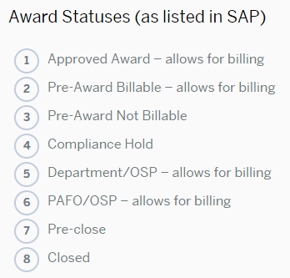
Award Statuses
Approved: used when an award has been received and is fully executed.
Pre-Award Billable: used when an award is not at BU but the sponsor has requested billing anyway. This is an unusual status and does not halt any expenses.
Pre-Award Not Billable: used when an award is not yet at BU and is therefore an advance account and no billing to the sponsor is allowed. This status does not halt spending in any way.
Compliance Hold: used by the Research Compliance Office and halts all activity on an account; when the PI or other Key Personnel haven’t completed their financial conflict of interest training and forms. No charges are allowed when an account is in this status.
Notes:
Missy
Statuses are important as an audit can occur on any status, even a Closed one.

Slide 33
Award Statuses
Dept/OSP: prevents new commitments such as shopping carts, but does not prevent payroll or journal entries from posting. Used when award has ended but adjustment needs to be processed by department other than PAFO
PAFO/OSP: used when account has had the final financial report or invoice submitted; when the account is overspent by more than $25K or at the request of the department in order to halt spending. Only PAFO can initiate changes in this status
Pre-close: signifies AEN has been sent to DA and PI
Closed: when the Budget = Expenses = Revenue and AR balance is $0.00 and all revenue and AR are matched
Notes:
Missy

Slide 34

Documentation
Procurement
  Purchase order and approval
  Shopping cart and approval
  Vendor invoice
  Competitive bid/sole source documentation
  Contract/Agreement
  Documentation showing suspension and debarment status was verified
Notes:
CG
We get these documents from Procurement

Slide 35
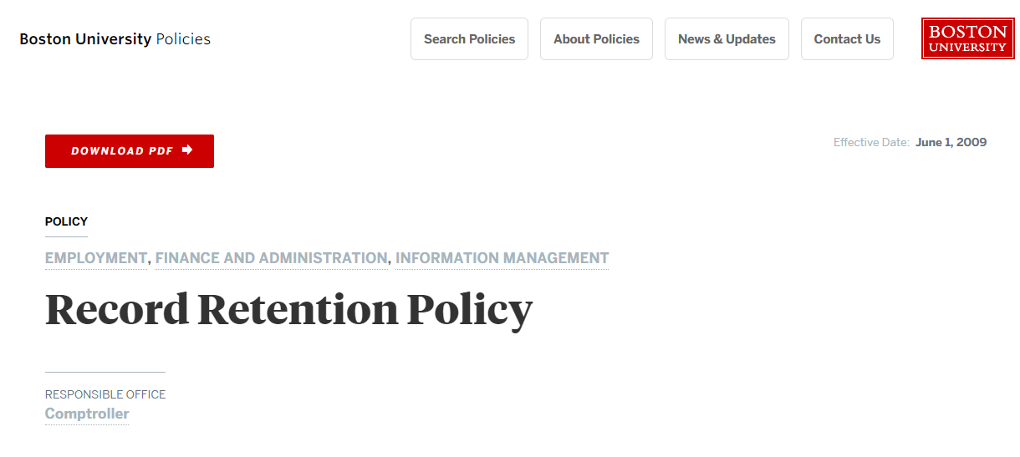
Record Retention Policy
https://www.bu.edu/policies/record-retention-table/
https://www.bu.edu/policies/record-retention/
Notes:
Gretchen

Slide 36
Discussion
In Groups – Discuss:
What can you do within your departments to make sure you are compliant – i.e. be your own auditor? What controls are in place now? What else could work?
Brainstorm a list of ideas/actions, you’ve got 5 minutes
Notes:
MD

Slide 37

Key Takeaways
If a Sponsor reaches out to you or your PI directly as it relates to Audits or Site Visits, please immediately contact Craig Gerome, Assistant Director, Compliance, PAFO at cgerome@bu.edu or 617.353.8085 as we need to be involved and/or lead the process.
Document everything and be careful what you say in emails
Notes:
Craig

Slide 38

Questions

Slide 39
Questions
STOP

Slide 40
Question 5: Cash Management
Review the following documents:
Grant Document for Expenditures
Documentation needed slide
GM Master Data – Revenue and AR Report
Letter of Credit Draw
Q5: What issues, if any, do you see for cash management?

Slide 41
Question 5: Cash Management ANSWER
Review the following documents:
Grant Document for Expenditures
Documentation needed slide
GM Master Data – Revenue and AR Report
Letter of Credit Draw
Q5: What issues, if any, do you see for cash management?
Issues:
Drawing on inappropriate expenses
Missing approver signature on letter of credit draw
Equipment*

