Slide 1

Session 5: Coffee with Colleagues
A conversation on the hiring and onboarding of
Post Docs/Students and the Visa process
April 6, 2021
Zoom 10am-12pm

Slide 2
Presenters
Hosts
Panelists
Sponsored Programs
Renna Lilly- Director, Pre Award Services
Post Award Financial Operations
Gretchen Hartigan- Assistant Vice President, PAFO
Sarah Hokanson- Assistant Provost, Professional Development and Postdoctoral Affairs
Jeanne Kelley- Managing Director, International Students and Scholars Office
Adeline Wong- Managing Director, Operations, Global Programs

Slide 3



Zoom Webinar Etiquette
Participants are muted, to speak unmute and introduce yourself
Utilize the chat window for questions or comments
This presentation is being recorded to be posted for future reference
Notes:
Gretchen
Introductions: Myself, Matt, Julia, Shelly
Housekeeping:
We will mute you to start but you can unmute yourself if you have a question, or choose the raise your hand feature
We will record this session and make the recording and the PPT deck available after
We’ll email a feedback survey around after the session which will only take a few minutes and we would value your responses
Background:
Comptroller Led – Derived because our Comptroller said if she’s not looking at her accounts then was concerned that others weren’t... This is something I do as well for my accounts.... Not monthly but regularly... quarterly
Focus group consisted of 27 people from across the University covering both Med and CRC and central and department administrators.
Also includes input from our colleagues from: Budget Office, Disbursements, General Accounting, Student Accounts, and PAFO

Slide 4


Professional Development & Postdoctoral Affairs
Who we are and what we do

Slide 5
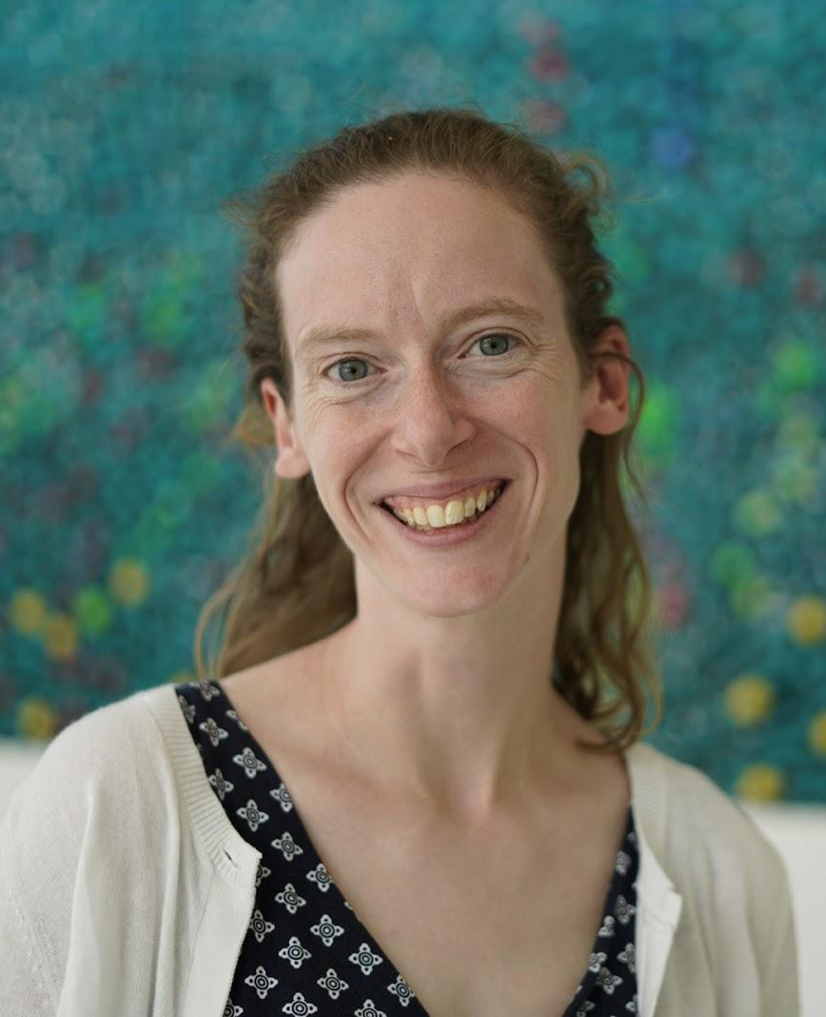
Professional Development & Postdoctoral Affairs bu.edu/pdpa
We provide services and resources for postdocs, doctoral students, faculty mentors and departments.
Professional Development: Build skills for postdocs, doctoral students, and faculty
Advising: Work with postdocs one-on-one by appointment and doctoral students in monthly office hours
Data: Manage information about our postdocs, collect research data
Grant-funded programs: Build national reputation and create impact at scale
Policy: Advance the training environment at Boston University
Sarah Hokanson, PhD
Assistant Provost
sch1@bu.edu
617-358-2111

Slide 6
Postdoctoral scholars definition
Temporary, defined period of mentored research or teaching training following a doctoral degree
Postdoctoral scholars at Boston University are individuals who have fulfilled the requirements for a doctoral degree (or equivalent) and are engaged in a temporary and defined period of mentored advanced training to enhance the professional skills and/or research independence needed to pursue their chosen career paths. Postdoctoral scholars are actively involved in research and/or teaching at Boston University, but are formally considered non-faculty research staff as part of the Academic Research Job Family.
Postdoctoral Associate: Employee (most postdocs), paid salary, benefits through HR
Postdoctoral Fellow: Non-employee (training, foreign funding), paid stipend or directly, benefits through PDPA

Slide 7
Postdoctoral appointment and renewal process overview
Varies by School/College - PDPA oversees process directly on MED
Create / maintain position in SAP: establishes job and job description, posting / ability to advertise
Proforma & Offer letter: Qualifications check (CV), role alignment (years of experience), salary/stipend
Visa requests: Offer letter and Dean’s signature required; each type of visa has different requirements; advance planning well-ahead of start date (3-4 months minimum)
Onboarding locally: Desk, workspace, research/teaching supplies, departmental procedures and contacts
PDPA New Postdoc Orientation: Describes resources, connects postdocs to other postdocs, Q&A

Slide 8
Changes to Postdoctoral Fellows - January 1, 2021
Backend changes in SAP allow for stipend payments through our payroll system
Monthly payments and direct deposit: not employees, but also not vendors
Important to terminate or transition positions: payments will continue automatically (not processed monthly)
Benefits pulled out of stipend: Health insurance, MBTA, and parking no longer paid in advance; PDPA still subsidizing health insurance and MBTA
Foreign fellows: same SAP set-up; pay checks to PDPA for portion of health care and/MBTA at frequency determined by postdoc
T32 covered benefits: PDPA will cover full cost of health insurance and then journal entry required to pay grant portion

Slide 9

About Global Programs
Comprehensive International Office for BU
Vice President & Associate Provost
for Global Programs
Global Offices
Study Abroad
Global Support
ISSO
CELOP
Operations
Finance &
Administration
Strategy &
Communications

Slide 10
International Mobility
Considerations for International Work
Traveling Internationally
  Travel Restrictions – BU, national, international
  International Travel Registry
  Global Medical Insurance
  Pre-Departure Support and Advice
Hiring/Working Internationally
  Local Regulations and Personal/Corporate Taxes
  Export Control
  Data Privacy
  Permanent Establishment in-Country

Slide 11




Coffee with Colleagues
April 6, 2021
ISSO Updates on international mobility & immigration processing during COVID
bu.edu/isso isso@bu.edu

Slide 12
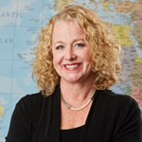
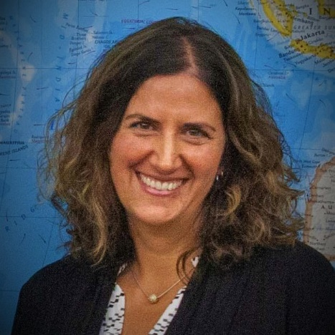
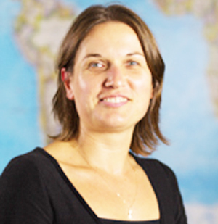
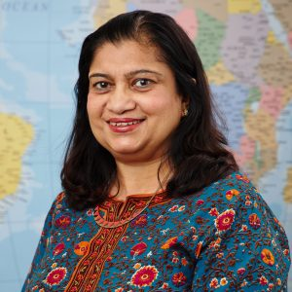
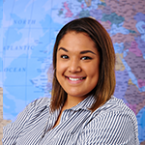
ISSO Scholar Services Team
Jeanne Kelley
Managing Director
Graded Staff & Administrative Positions; O-1 Petitions
Sharon Ralston
Assistant Director Scholar Services
QST, SPH
All Independent Research Centers
Tunde Kiss
International Scholar Advisor
CAS, CGS, CFA, COM, LAW, MET, SDM, SSW, SUM
Sonali Mukherjee
International Scholar Advisor
ENG, MED, SAR, SED
SHA, STH
Jennifer Dunkerley
International Scholar Administrator
bu.edu/isso issosch@bu.edu

Slide 13
Travel remains unpredictable due to COVID
President Biden extended/expanded country-specific COVID restrictions on travel to the US from China, Iran, Brazil, 26 Schengen countries, UK, Ireland, South Africa
    Prohibits direct to US travel from these countries within 14 days
    Requires proof of negative COVID test required within 72 hours of departure
Certain scholars/employee may qualify for an individual exemption from the COVID travel ban - National Interest Exceptions (NIE)
    to offer vital support to critical infrastructure sectors (including academics)
    for purposes related to humanitarian travel, public health response, and national security
Individuals must apply for the NIE
    directly from the US Consular post if they already have a valid visa or,
    directly from the US Consular post during their visa application
bu.edu/isso isso@bu.edu

Slide 14
Visa processing varies from post to post
Scholars/employees reporting mixed success with visa appointments as the local COVID situation changes daily
Routine visa processing at all posts in China suspended since last February – emergency services
Trump Ban on Chinese researchers with ties to PRC military entities remains in place since last June
Some relief for visa extensions as Consular posts waiving personal interview requirements if visa expired within past 48 months through 12/31/2021
Ban on H-1 visa processing at US Embassies expired 3/31/2021
bu.edu/isso isso@bu.edu

Slide 15
H-1b Temporary Worker Sponsorship Updates
USCIS Denial rate for H-1b petitions increased from 16% to 50% during the past 4 years
October 2020 - US Department of Homeland Security (DHS) and the US Department of Labor (DOL) published interim final rules that:
  modify the calculations to raise minimum prevailing wages for employment-based nonimmigrant and immigrant petitions
  increase the regulatory requirements for the H-1 specialty worker category
  implement other program restrictions
Lawsuits delayed implementation and now USCIS and DOL have postponed implementation until Fall 2022 and Spring 2023
DOL seeking new methods to obtain and calculate more equitable wages
bu.edu/isso issosch@bu.edu

Slide 16
Optimism under the Biden Administration
Support of policies that promote the recruitment of foreign national talent to infuse US economic development and international mobility
Reversal of travel ban executive orders (aka: travel ban 3.0 or Muslim travel ban)
Reversal of public charge rule
New TPS announced for nationals from Venezuela & Myanmar/Burma
60 days in we can see that the initial immigration focus from the Biden administration is:
  asylum eligibility and process
  immigrant case processing
  clearing backlog of immigrant visas at consular posts
  border security
  legislation
China approach/policies still unclear
Need to stress patience as it will take some time to unravel 4 years of restrictive policies, regulations and anti-immigration rhetoric
bu.edu/isso isso@bu.edu

Slide 17
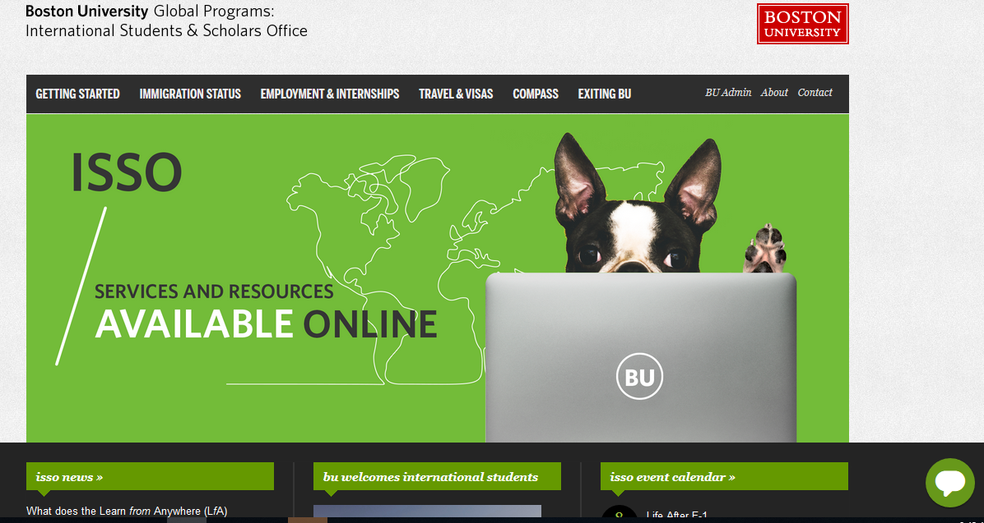
www.bu.edu/isso
bu.edu/isso issosch@bu.edu

Slide 18
Resources for scholars/employees
Updated ISSO travel advisory:
www.bu.edu/travel-visas/traveltips/current-travel-advisory/
Tax deadlines and information:
www.bu.edu/isso/employment-internships/taxinformation
ISSO news section:
www.bu.edu/isso/news/
FAQs during COVID for scholars/employees
www.bu.edu/isso/news/faqs-and-travel-considerations-for-scholars/
Scholar services team contact information
www.bu.edu/isso/contact/scholar-advising/
bu.edu/isso isso@bu.edu

Slide 19


Slide 20
Save the Date!
Next Coffee w/ Colleagues
May 12th 1-3pm
w/ Matt Abrams and Heather Gillis

