Slide 1

Advisory Council for Research Administration
3/22/21 Monday
2:00pm – 4:00pm
Zoom Meeting

Slide 2
WELCOME

Slide 3
Agenda
Welcome
Strategic Plan
Central and Community Updates
Open Positions
Best Practices
Proposal Review Matrix
Work from Home Survey Results
January Poll Results / Questions for Planning
Notes:
Agenda topics can change order… just putting topics out there for now… <Gretchen>

Slide 4
Strategic Plan

Slide 5

Community Updates/News:
Developing
Research
Staffing changes
  Job Postings
  Promotions
  News
  Upcoming
  changes
  In the horizon
Notes:
Agenda topics can change order… just putting topics out there for now… <Gretchen>

Slide 6
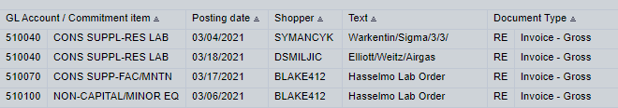
Central Updates – PAFO
  PARs due Friday, April 9th
  To date, we have received 25% or 973
  Heading into FY21 Q4 --- folks should be reviewing their University accounts to begin preparing for Fiscal Year End
  BW Report: Grant Document for Expenditures
    Shopper has been added as a Free Characteristic – it is the Kerberos/Email Username
Notes:
Open Link during Meeting

Slide 7
Central Updates – Sponsored Programs
Effective July 1, 2021, the FY22 salary and stipend minimum for all BU postdocs will be $53,760. Please budget these on proposals going forward
Upcoming Changes to the Biographical Sketch and Other Support Format Page for Due Dates on or after May 25, 2021
(NOT-OD-21-073) National Institutes of Health
Notes:
Open Link during Meeting

Slide 8

Job Postings
ADMINISTRATIVE ASSISTANT,MED School of Medicine, Dean's Office
Tracking Code: 5116
Contact : Solaris Bujor srbujor@bu.edu
VETERINARY RESEARCH SUPPORT ASSISTANT/TECHNICIAN/SPECIALIST,BUMC Lab Animal Science Center
Tracking Code: 0862
Contact: Richard Trevino
rtb@bu.edu
ASSISTANT DIRECTOR, Global Economic Governance Initiative, Global Development Policy Center
Tracking Code: 2234
Contact : William Kring wkring@bu.edu
DIRECTOR, FINANCE & ADMINISTRATION, Pardee School of Global Studies
Tracking Code: 4469
Contact : Call 617-358-0988 or email the general box at psgs@bu.edu
DIRECTOR OF RESEARCH,Wheelock College of Education and Human Development
Tracking Code: 2226
Contact : Angela Coletta-Acevedo acoletta@bu.edu
ASSISTANT DIRECTOR,Center for Excellence in Teaching, BU Hub
Tracking Code: 1490
Contact : Jean Otsuki
jotsuki@bu.edu
Notes:
Open Link during Meeting

Slide 9
Job Postings …Continued
PROGRAM DIRECTOR,Wheelock College of Education and Human Development
Tracking Code: 2207
Contact: Angela Coletta-Acevedo acoletta@bu.edu
ASSOCIATE, OFFICE OF PROPOSAL DEVELOPMENT, School of Medicine, Dean's Office
Tracking Code: 1339
Contact : Julia Huntsman jhunts@bu.edu
PROJECT MANAGER III,IS&T Project Management
Tracking Code: 6325
Contact : Wayne Gilmore waygil@bu.edu
GRANT MANAGER,MED School of Medicine, Framingham Heart Study
Tracking Code:8639
Contact : Nick DiPerso dipersio@bu.edu
RESEARCH PROJECT MANAGER, Dept. Health Policy/Health Svcs Research
Tracking Code: 1277
Contact : Patrick Decoste
pdecoste@bu.edu
GRANTS ADMINISTRATOR,Wheelock College of Education and Human Development
Tracking Code: 2575
Contact : Amie Grills agrills@bu.edu
Notes:
Open Link during Meeting

Slide 10
Job Postings …Continued
RESEARCH ADMINISTRATOR, Post Award Financial Operations
Tracking Code: 1536
Contact: Kathleen Pantaleon kpantale@bu.edu
DIRECTOR OF ADMINISTRATION, Faculty of Computing and Data Sciences, Office of the Provost
Tracking Code: 2406
Contact: Laura Jenks ljenks@bu.edu
Notes:
Open Link during Meeting

Slide 11
Shared Services-Best Practices Update

Slide 12
Shared Services-Best Practices Update
Best Practices to discuss today:
  Large Proposal Guidance
  Hiring Students
  Hiring Staff
  Outgoing Subawards
  Subaward Invoicing & Monitoring
  Salary Cost Distributions
We will go through the overall Inventory and Process Flow next
Best Practices draft documents will be shared after this meeting
We welcome Feedback
Notes:
www.polleverywhere.com

Slide 13
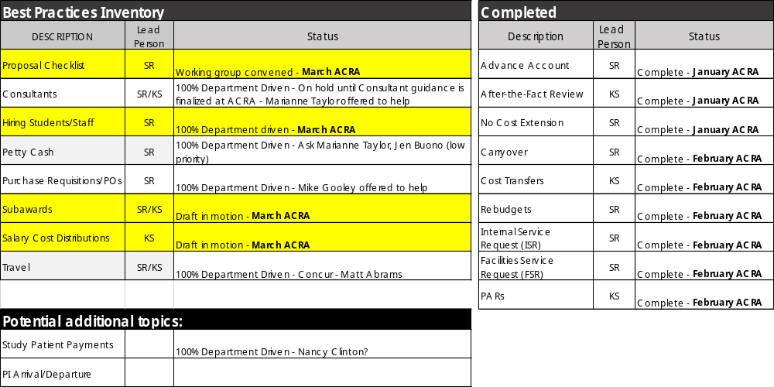

Slide 14
Shared Services-Best Practices Update
Large Proposal Guidance
PI notifies DA/SA of the Funding Opportunity
DA/SA sets up a meeting with the PI and together create an action plan
  Carefully read the FOA and note the required/optional components and any special instructions
  Distinguish roles and responsibilities
  Set timelines for completion of each task
DA/SA notifies their SP RA of the intent to submit and provides a link to the Funding Opportunity and the action plan developed above
DA/SA initiates application in the sponsor system
Based on roles and responsibilities identified above, DA/SA should start reaching out to subcontract sites to engage them in the budget process and establish deadlines to collect final materials
Enter application data for all components and check often to ensure application structure is correctly presented
Finalize components and prepare application for submission
DA/SA alerts SP RA that application is ready for a full review, and sends along internal documents
Notes:
www.polleverywhere.com

Slide 15
Shared Services-Best Practices Update
Hiring Students
  The PI connects the DA with the student to hire. The student will provide the UID or you can find it via Business Link.
  The DA asks the PI which account to charge, verifies whether it’s an hourly job, weekly stipend, or a job study award.
    Hourly rate - verify the current MA minimum wage rate.
    Weekly stipend - verify the department’s weekly rate. Please note that all departments do not have the same stipend amounts.
    Work study - post a job in student employment. If there isn’t an existing job description, create one
  In BU Works, select Business Link, Student Employment and “New Hire/Rehire” in the Hiring Process Functions section.
  Select “Departmental” for hourly and weekly stipend rate, or “work study” if work study award
  Insert the students UID, select the semester, and select whether it is a new hire or rehire
  If you receive an error message about a missing I-9, the DA or the Department will need to follow up with the student to complete it.
Notes:
www.polleverywhere.com

Slide 16
Shared Services-Best Practices Update
Hiring Staff
  The PI connects the DA/SA with information on the staff member to hire: funding source, start and end date of appointment, salary information
  The DA/SA corresponds with the candidate to gather the following information:
    CV
    3 letters of recommendation
    Biographical Data Form: http://www.bu.edu/eng/files/2018/10/BIODATA.pdf
    Intellectual Property Agreement (BU email and ID is left blank): http://www.bu.edu/academics/policies/intellectual-property-policy/
  If candidate is considered an international scholar, additional files are needed:
    http://www.bu.edu/isso/getting-started-old/joining-the-bu-community/scholar-processing/
  DA/SA (or other designee) processes the paperwork for the Dept. Chair and Dean’s approval. After approved by the Dean, the package is sent to ISSO for processing where the DS2019 form is created.
  DA/SA (or other designee) will email the appointment letter to the staff member and PI (DA if needed).
    The DA/SA verifies that the staff member was hired on the correct source in the Payroll Coordinator Tab in BU Works.
If Post Doc will be paid by NIH grant, Post Doc must be hired at the Ruth L. Kirschstein National Research Service Award (NRSA) minimum rate
Notes:
www.polleverywhere.com

Slide 17
Shared Services-Best Practices Update
Outgoing Subawards
Proposal Stage:
At the proposal stage, the DA/SA works with the PI to identify what subrecipients are included in the application
As part of the roles and responsibilities established by the DA/SA and PI for proposal preparation, typically the DA will work with the subrecipient on obtaining and reviewing their budget, budget justification, scope of work and letter of intent, along with any other administrative documents needed for the inclusion in the proposal (such as biosketches/CVs, facilities pages, etc).
DA/SA inserts final subrecipient budget numbers into the overall project budget and uploads other materials into sponsor system, as needed, and sends subrecipient documents to SP as part of the final application materials.

Slide 18
Shared Services-Best Practices Update
Outgoing Subawards
Award Stage:
NOA is received in SP and an internal grant account is established by the SP Award Set-Up team, based on the awarded budget (usually aligns with proposed budget)
  If any changes have occurred since proposal stage, DA/SA needs to send revised subaward documents to SP RA
The SP Award Set-Up team triggers the sub action in the SP Sub team queue
DA/SA will be contacted by SP should questions arise during the subcontract drafting process
SP Sub Team sends a draft subcontract to PI (with DA/SA on cc) for confirmation of details before sending to subrecipient
Upon full execution of subcontract, it is distributed to BU PI, DA/SA, SP RA and PAFO RA
Subrecipient monitoring, including payment of invoices, by the DA/SA and PI begins

Slide 19
Shared Services-Best Practices Update
Outgoing Subawards: Subrecipient Invoicing Processing
PI completes initial review of invoice
  Ensures sufficient technical progress has been made to justify payment.
  Pays special attention to salary and wages costs invoiced.
  Verifies the need for the travel during the billing period if the invoice contains travel expenses.
  Reviews material and supply charges for reasonableness.
  Alerts both DA and PAFO RA immediately if any invoice issues arise.
DA utilizes Subaward agreement, Business Warehouse reports and/or SAP functions to complete a further review of invoice
  Ensures dates are within the project period and share no overlap with the previous invoice.
  Confirms sufficient funds are available in the Fund Reservation Number (FRN) to cover the invoice amount.
  Makes sure the cumulative amount on the invoice matches the total of the new invoice plus the previous amount billed.
  Verifies the invoice contains signed certificate.
  Alerts both PI and PAFO RA immediately if any invoice issues arise.

Slide 20
Shared Services-Best Practices Update
Outgoing Subawards: Subrecipient Invoicing Processing – Continued
PI approves invoice by signing it or sending approval to DA via email.
DA completes and submits the online Subrecipient (Subaward) Invoice Disbursement Form found on the Forms page of the Accounts Payable website.
  Attaches invoice and PI approval.
  Accurately enters the name and email address of the PAFO RA so that the form correctly routes through workflow.
PAFO RA receives the form, invoice and PI approval via workflow.
PAFO RA reviews the documents and if appropriate approves the disbursement request. If the form is not approvable, the PAFO DA will contact the DA to discuss next steps.
Once approved, the disbursement form is routed to Accounts Payable via workflow where it will be processed for payment.

Slide 21
Shared Services-Best Practices Update
Salary Cost Distributions
PI and/or DA/SA identifies an error in direct salary expense allocation to or missing from a sponsored project for an active non-student employee.
DA/SA gathers documentation to support the necessity of the transfer including a detailed explanation of what caused the allocation error and how it was discovered.
  Grant salary cost transfer requests in excess of the 90-calendar day period must also include the reason for the delay in processing the transfer, identification of the controls that will be implemented or what action has been taken to ensure the error does not occur again and approval of PI.
  A salary transfer is considered an Adjustment if it is done within the same SAP Grant or is the result of an Award Set-Up Issue where a Sponsored Program account is killed or cancelled. It is acceptable to answer “reallocation of expenditures” as the reason for the Grant Salary Adjustment.
  The fringe calculation is excluded from the salary transfer adjustment amount.
  For Charles River Campus faculty on accrual, DA/SA includes all original salary and accrual changes.
  Period being adjusted cannot overlap PAR periods. A separate form must be submitted for each PAR period.
  If the adjustment being requested changes the effort percentages for an employee whose Personnel Activity Report (PAR) has previously been certified and submitted, the DA/SA revises the PAR to include the adjustment and obtains the appropriate PAR signature.
  If DA/SA is not also acting as the Payroll Coordinator submitting the form, DA/SA follows Department/Unit/School instructions for communicating all required

Slide 22
Shared Services-Best Practices Update
Salary Cost Distributions
3. PYC initiates retroactive Salary Cost Distribution change via “Personnel Actions” in SAP and completes the form accurately and in its entirety.
  Pays close attention to the period being corrected when deciding between the REPLACE and INSERT options.
    REPLACE to remove and replace existing cost distributions from the effective date (past) continuing forward (future).
    INSERT to change a particular period of time in the past only.
      Confirms that the answers/explanations to the questions asked in the “Additional Fields” section of the form are complete.
  Selects the appropriate PI approver for Over 90 Day transfer requests.
  Checks the applicable “Acknowledgement” in situations where the payroll adjustment affects a cost distribution outside of the initiator’s responsible Cost Center.
  Attaches any additional documentation or comments necessary to support a complete record of the grant salary cost transfer request.
  Submits retroactive Salary Cost Distribution form.
4. PI provides electronic approval of Over 90 Day transfer request when requested.
5. PAFO RA attaches PI Over 90 Day approval when applicable, reviews request and processes as required.

Slide 23
Proposal Review Matrix

Slide 24
Work from Home Survey Results

Slide 25
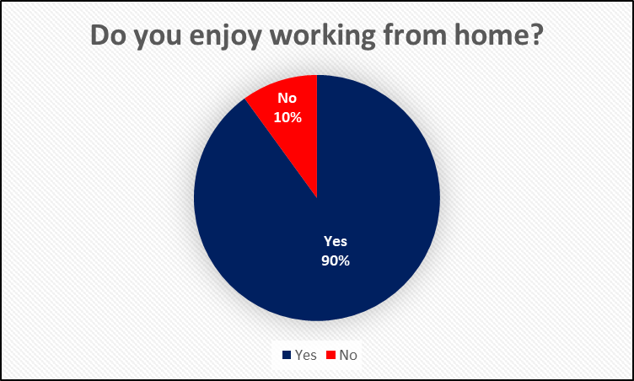
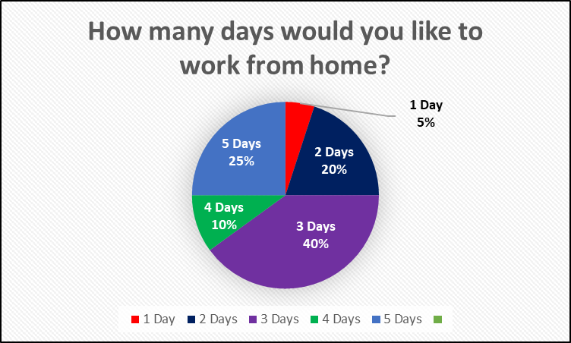
WFH Survey Results
Q1:
Q2:

Slide 26
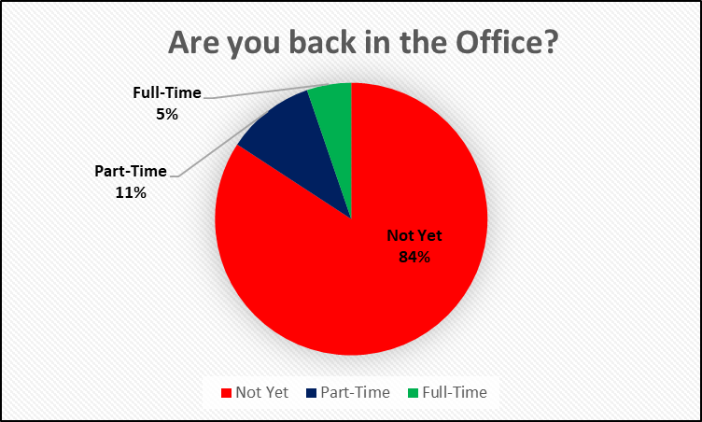
WFH Survey Results
Q3:

Slide 27
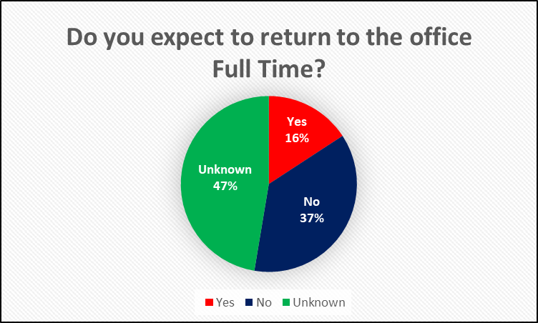
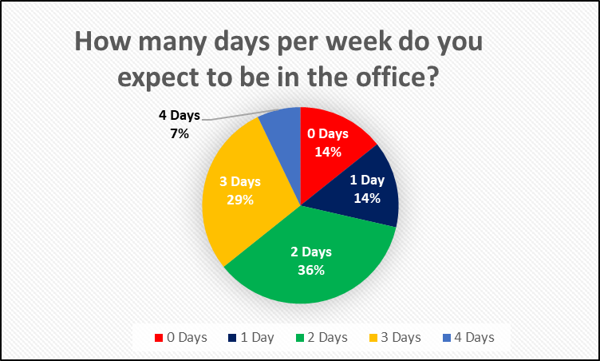
WFH Survey Results
Q4:
Q5:
Q6: If Q4 is “Unknown”, when do you expect this to be determined? Summer / Fall

Slide 28
WFH Survey Results
Q7: Job wise, what have you found the most difficult to do while working remote?
Miss informal learning opportunities / access to someone to help work through problems
Work/Life Balance
Not having quick phone access to people
Facilitating the PAR certification process 100% electronically
Connect with co-workers
Starting and ending my day
We had a few folks say: None/Nothing
Not working 24/7, not checking email
Setting Limits
Navigation of files
Managing my assistant

Slide 29
WFH Survey Results
Q8: What is your number one tip for making the best of work from home during this time?
Set a schedule and stick to it!
Take advantage of the time what would be used for commuting; try not to work beyond 10 hours per day
Stay connected with co-workers
Dedicated workspace
Good tech support and training
The work is hard no matter if you are home or in office; you just do what you always to do keep up. The only difference for me is not having to spend 2 hours a day commuting on buses.
Schedule your time and keep your schedule
Block off time every day for a walk. Treat it like a meeting and respect it. I often eat lunch at my desk so this is much needed time away from the computer
Take a walk daily
Having clear hours for your self to log out

Slide 30
WFH Survey Results
Q8: What is your number one tip for making the best of work from home during this time?
Be flexible
Take a walk at lunch
Get a desk
Structure and boundaries – just because you can work 15 hours per day, doesn’t mean you should
Shut down your laptop when you finish for the day, otherwise you’ll find yourself wandering back to it
Be adaptable
Disengage from work for some time each day

Slide 31
WFH Survey Results
Q9: One recommendation you can share to help keep staff engaged?
Bi-weekly check-in’s with Manager
Zoom, Teams, regularly scheduled meetings, chats and being available for unscheduled calls
Recognition
Take advantage of opportunities to learn about the work you are supporting and celebrate wins. Why does this matter? What challenges did they overcome?
Keep up regular Zoom meetings with Staff
Communication and conduct regular check-ins
Continue to treat them as responsible adults who are working hard while working remote. The comments section on the BU Today article should be read carefully.
Fun Opportunity
“Virtual” Volunteering

Slide 32
WFH Survey Results
Q9: One recommendation you can share to help keep staff engaged?
Be flexible
Non-Business Zooms
Schedule a “social” hello visit with someone at work to learn more about their experience
Have meetings with them sometimes to just see how they are; don’t focus on work or workload. Let them talk, share their frustrations or what is making them happy right now
Some social thing like a weekly coffee hour, an ongoing group slack conversation, etc to maintain a connection; presumably staff are already engaged concerning the work.

Slide 33
HR/OD&L Resources
Learning More About Zoom Bundle
This month’s bundle comprises video resources on a range of Zoom features, including group collaborations, direct sharing, sharing multiple screens simultaneously, and closed captioning, as well as Zoom basics such as scheduling a meeting, hosting break-out rooms, and others. Available on Terrier eDevelopment.
Workshop-Difficult Conversations
Many of us face the need to have difficult conversations. Having a positive outcome is a matter of skill and will. This session will help you build those skills and provide tools to help ensure your difficult conversations are effective.
Zoom: Wednesday March 24 9-10:30am, registration required.

Slide 34
HR/OD&L Resources
Working Remotely Bundle
Working remotely presents a unique set of challenges that require resilience, collaboration, and stress management practices. Virtual work during a crisis adds additional complexity. Enhance your skills by learning how to apply mindfulness techniques, manage mental well-being, and adapt to unexpected change. The Working Remotely bundle includes a diverse array of resources (11 videos, 23 reads, and 4 listens). You can engage all of them or only one of them. You can mix and match. And you can engage them individually or with your team and department. Available on Terrier eDevelopment.
For more, check out: https://www.bu.edu/hr/learningbu/

Slide 35

2021 Poll Future Topics

Slide 36
Future Topic Questions
Service Centers
HR Systems
HR Framework Follow Up (Fall 2019)
Pat O’Brien’s Office / Provost

Slide 37
Closing/Central Links
Confirmed Future Agenda Items
  April: Shadow Systems
  May: TBD
Minutes and slides from today’s meeting will be posted on the ACRA webpage
ACRA Research Administration page https://www.bu.edu/researchsupport/administration/committees/research-administration-advisory-council/
ACRA email: acra@bu.edu (to email the central office mailbox for ACRA)
ACRA Group – vpr-advisory-council-RA@bu.edu (to email the entire group)
COVID-19 updates for Research
LinkedIn ACRA https://www.linkedin.com/groups/12320374/

Slide 38

QUESTIONS

