Slide 1

Revealed
Notes:
Gretchen

Slide 2



Zoom Webinar Etiquette
Participants are muted, to speak unmute and introduce yourself
Also utilize the raise hand feature or chat window for questions or comments
We will use Zoom polls for questions and breakout rooms for discussions
Notes:
Gretchen
Introductions: Myself, Matt, Julia, Shelly
Housekeeping:
We will mute you to start but you can unmute yourself if you have a question, or choose the raise your hand feature
We will record this session and make the recording and the PPT deck available after
We’ll email a feedback survey around after the session which will only take a few minutes and we would value your responses
Background:
Comptroller Led – Derived because our Comptroller said if she’s not looking at her accounts then was concerned that others weren’t... This is something I do as well for my accounts.... Not monthly but regularly... quarterly
Focus group consisted of 27 people from across the University covering both Med and CRC and central and department administrators.
Also includes input from our colleagues from: Budget Office, Disbursements, General Accounting, Student Accounts, and PAFO

Slide 3


Agenda
Presenters
Gretchen Hartigan, Assistant Vice President, Post Award Financial Operations
Craig Gerome, Assistant Director, Compliance, Post Award Financial Operations
Shelly Stewardson, Director, Research Accounting, Post Award Financial Operations
Anne DiNoto, Compliance Analyst, Post Award Financial Operations
Renna Lilly, Director, Pre Award Services, Sponsored Programs
Effort Recap
  What, Why, When, Who, How
PAR Process
Group Discussions
Breakout Room Case Studies
Notes:
Gretchen

Slide 4

Recap – What is effort
Effort is the amount of time someone spends on an activity
Personnel Activity Reports (PARs) are the mechanism BU uses to report and certify effort after the fact
Effort Reporting: Uniform Guidance requires a system of Internal Controls to ensure salary charges made to the Award are accurate, allowable, and properly allocated
Notes:
Craig
UG – 200.430 Compensation – personal services... (i)(viii)(C):
BU’s system of internal controls includes processes to review after-the-fact interim charges made to a Federal awards based on budget estimates. All necessary adjustment must be made such that the final amount charged to the Federal award is accurate, allowable, and properly allocated. NCURA has good resources to understand "accurate, allowable, and properly allocated"
PARs and the BU Effort Policy is our way of ensuring we comply with this regulation.

Slide 5
How is effort defined
Expressed as a percentage
Not an exact measurement, “average” percentage, which will vary over time and does not hinge on a 40-hour work week.
Based on time spent
All of a person's activities that are part of his/her institutional responsibilities (regardless of how many hours per week) are part of his/her effort.
Unrelated to who pays
Allocation based on effort spent, regardless of monetary compensation.
Notes:
Craig
Effort measures the average of a person’s actual amount of time spent on professional work. It is not an exact measurement, because it is based on the “average” percentage, which will vary over time and does not hinge on a 40-hour work week. All of a person's activities that are part of his/her institutional responsibilities (regardless of how many hours per week or where the work takes place) are part of his/her effort.
Typically, a person will have a specified amount or percentage of his/her time that is to be spent on a project (allocated). Sponsors want to ensure that they aren’t paying for incorrectly allocated effort (salary + fringe + IDC). Our goal is to ensure that effort is allocated (charged) appropriately based on the work that occurred and in accordance with sponsor and institutional policies and guidelines. Our role is to help individuals who have effort on sponsored research projects to understand the expectations and requirements of accurate effort tracking and reporting.

Slide 6

Why do we track effort
  Must abide by 2 CFR 200: Uniform Guidance, 200.430
  Provide assurance to sponsors that –
      Salary charged is justified
      Commitments have been met
  Effort reports nearly always reviewed by federal auditors when sponsored program are under review
Notes:
Craig
Provide assurance to sponsors that –
Salary charged is justified: Salaries charged to sponsored projects are reasonable in relation to the work performed
Commitments met: Researchers devoted the effort that was promised in the proposal and agreed upon at the time of the award
Effort reports nearly always reviewed by federal auditors when sponsored program are under review
Must abide by 2 CFR 200: Uniform Guidance, 200.430 (Cost Principles) which requires effort certification system that encompasses all employee activities, confirms effort after-the-fact, certification by person with first-hand knowledge of work performed, encompassed in official records

Slide 7

Poll #1: Risks
Respond to the Poll question
Choose two risk areas that are most concerning/relevant for your school, college, or department?
100% research faculty
Faculty with 5 or more federal awards
Change in Level of Effort
Faculty with 1 or 2% of their effort on many awards
Faculty Effort Certification – is it timely?
Retroactive Salary Cost Transfers (is it affecting time periods when effort has already been certified?)
Total effort commitments (paid and cost shared) to the sponsor
University effort reporting policy – is it being followed?
Notes:
Craig

Slide 8
Effort reporting lifecycle
PRE AWARD
POST AWARD
Proposal Budget
Effort in budget based on base or allowable salary, % time or person month, and duration
Effort Committed
Award negotiation and/or acceptance of award
Charging Salary
Effort charged to award account (or department account as cost sharing)
Certifying Effort
Proposal submitted to sponsor
Effort reported on PAR after activity has occurred, certified by eligible employee
Perform the work
Notes:
Craig

Slide 9
Case Studies:
From Proposal to PAR
Notes:
First couple of questions we will be looking at effort and allocation, and then the later case studies are specifically the PAR

Slide 10
Types of cost share
Mandatory
Voluntary Uncommitted
Voluntary Committed
Required as condition of Award
Quantified in proposal
Tracked on PAR
Not required as condition of Award
Quantified in proposal
Tracked on PAR
Not required as condition of Award
Not quantified in proposal
Not tracked on PAR
Notes:
Renna
Voluntary Committed, per Uniform Guidance, is not expected.
Voluntary Uncommitted (“in kind”) should not be listed anywhere, not getting paid for it and not going to declare it but going to work on it anyway
Mandatory is listed in proposal and Feds expect it and it’s part of the NoA
On PAR, sometimes mandatory cost sharing account is already set up and this will appear on PAR under cost share accounts.
If it’s not there then people need to manually write it in.
Per Uniform Guidance, July 2017 FAQs: They don’t consider salary above the NIH Salary Limit to be cost sharing amounts, these costs are unallowable, However unallowable costs must be included in the appropriate MTDC base for F&A rate proposal preparation, therefore BU’s mechanism of calculating this is via the cost share section of the PAR.
BU doesn’t encourage cost sharing unless the sponsor requires it in writing because it:
reduces the flexibility PIs have to conduct other research when their effort is pledged to specific projects
increases the requirements for auditable recordkeeping; and
has an adverse effect on the University's recovery of indirect (Facilities and Administrative) costs.

Slide 11

Cost Share Example
Cost shared effort still needs to be included on the PAR.
  If “Grant A” proposal says PI will devote 30% of effort to the grant for one year, and requests salary support for 10% of effort, then:
BU doesn’t encourage cost sharing unless sponsor requires it because:
reduces flexibility PIs have to conduct other research
increases requirements for auditable recordkeeping
has adverse effect on BU's recovery of indirect (F&A) costs
Sponsor pays 10%
BU Pays 20%
30% effort
*cost share
Notes:
Renna
BU doesn’t encourage cost sharing unless the sponsor requires it in writing because it:
reduces the flexibility PIs have to conduct other research when their effort is pledged to specific projects
increases the requirements for auditable recordkeeping
has an adverse effect on the University's recovery of indirect (Facilities and Administrative) costs

Slide 12


Proposing effort
When personnel is written into a grant proposal and effort is quantified, it is committing their effort to the sponsor.
What to say if you don’t want to commit cost share
What NOT to say
For non key personnel
If not requesting salary use phrases like:
Person X will participate in the project as needed
Person X will provide guidance and expertise on an ad hoc basis
Person X will oversee [all aspects of] the project
Person X will provide scientific direction and supervision for the project [including...]
Avoid saying anything like
Person X will work Y amount of time at no cost to the sponsor
because that is considered cost sharing
Notes:
Renna

Slide 13
Breakout Room Activity #1: Proposing effort
Open “BOR Activity 1” doc in chat – 5 min
Given an excerpt from a proposal, review what percent effort each individual is committing and what salary support is being requested.
Select the name(s) of the individual(s) whose effort includes cost sharing.
Is there anyone on the list who might not have a PAR printed for them?
Discuss: What considerations, if any, need to be made for the students and trainees?
Notes:
Craig
Select the names of the individuals whose effort includes cost sharing. (Dr Who)
Is there anyone on the list who might not have a PAR printed for them? (Dr Who won’t, Prof Peacock might, AND timesheet student)
What considerations, if any, need to be made for the students and trainees? (UROP vs timesheet)

Slide 14
Activity #1: Proposing effort ANSWER
Given an excerpt from a proposal, review what percent effort each individual is committing and what salary support is being requested.
Circle the names of the individuals whose effort includes cost sharing. Dr Who
Is there anyone on the list who might not have a PAR printed for them? No PAR for Dr Who and timesheet student, Prof Peacock might
What considerations, if any, need to be made for the students and trainees? UROP, timesheet
Notes:
Craig
Circle the names of the individuals whose effort includes cost sharing. (Dr Who)
Is there anyone on the list who wouldn’t have a PAR printed for them? (Dr Who won’t, Prof Peacock might, AND timesheet student)
What considerations, if any, need to be made for the students and trainees? (UROP vs timesheet)

Slide 15
EXAMPLE – Cost Share
From 1/1/2019-6/30/2019, Dr. Tan received salary support for the following awards:
  Grant A: 25%
  Grant B: 35%
  Grant C: 20%
Dr. Tan estimates her effort was consistent with salary support for Grants A, B, C
The rest of Dr. Tan’s salary support was provided from departmental funds
Dr. Tan also worked on Grant D and estimates that she spent about 10% effort on this grant during the applicable period with no salary support
Dr. Tan estimates she spent about 10% effort on non-sponsored activities during the applicable period
How do you show cost share on the PAR?
Notes:
Craig
How can you ensure that you capture that cost share rather than waiting for the PAR? Set up a cost share account to allocate the salary for Grant D would make it easier for tracking. Keep records of the commitments.
What if they ONLY had effort on Grant D (and it was voluntary committed cost share), no PAR would print, Then you would get in touch with Effort to get a manual PAR

Slide 16
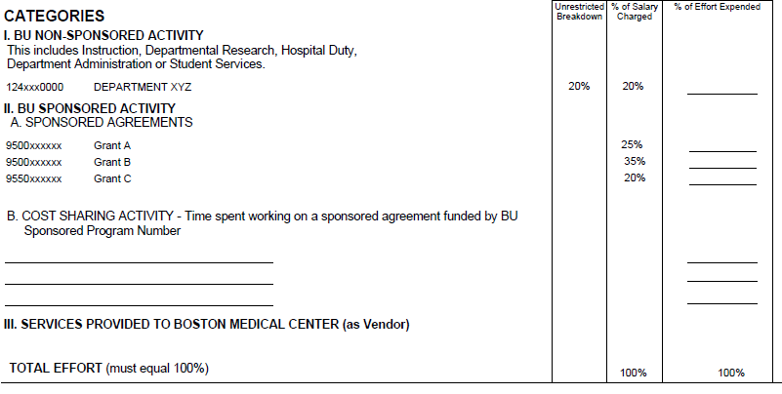
Cost Share ANSWER
What should the PAR look like?
10%
25%
35%
20%
9550xxxxxx Grant D
10%
Notes:
Craig
Grant D won’t appear on the PAR, it would need to be added in under cost share. Would a cost share account have caught this on the PAR?
How can you ensure that you capture that cost share rather than waiting for the PAR? Set up a cost share account to allocate the salary for Grant D would make it easier for tracking. Keep records of the commitments.
What if they ONLY had effort on Grant D (and it was voluntary committed cost share), no PAR would print, Then you would get in touch with Effort to get a manual PAR

Slide 17
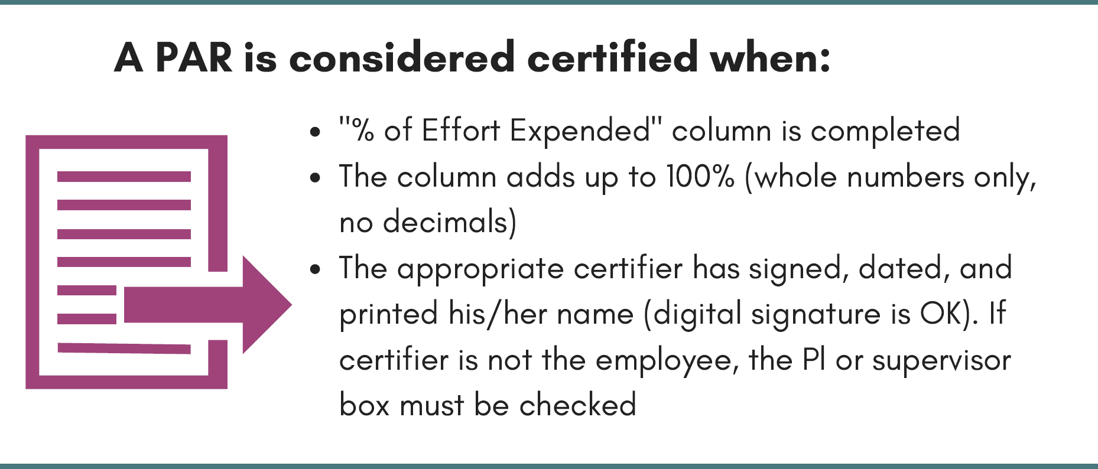
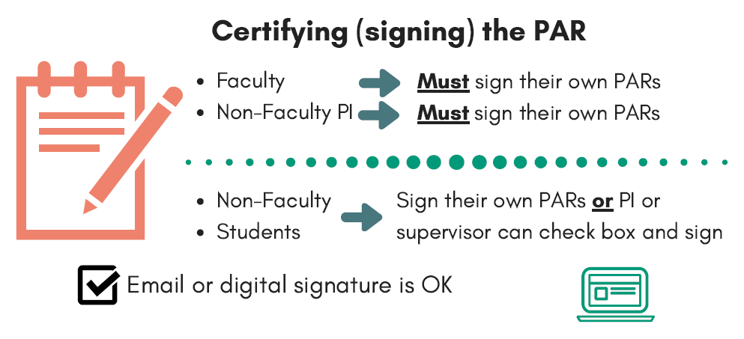
Certifying the PAR
A PAR prints for anyone with salary charged to a sponsored research account (950xxxxxxx, 955xxxxxxx, or 994xxxxxxx)
  All individuals paid from, or with effort committed to, a sponsored project required to complete
  Not hourly employees because timesheets count as verification
Notes:
Anne
Certification must be done by someone with suitable means of verification (best practice is the individual expending the effort) but if not possible (e.g. they left the university) then it can be done by their supervisor for example

Slide 18
EXAMPLE – employee no longer at BU
You have two PARs in front of you for people who are no longer working at Boston University. We still need to certify the PARs, so what do you do?
What information should you look at on the PAR?
What are your options for who can sign?
Notes:
Anne
Answer:
Looking at the 2 examples check their PAR type (student, professional, or non pro) and whether they are marked as faculty on the PAR.
For anyone other than faculty - supervisor can sign, needs to check the box.
For the faculty:
a. Reach out to the Faculty - if you are still in touch with any of them then please email them the PAR and see if they will certify;
b. PI – if the employee is not the PI then the PI may certify (add Faculty termination date and check the PI box)
c. Department Chair – if a and b are not options then the Department Chair needs to sign (add Faculty termination date and check the Supervisor box)
d. After-the-fact knowledge – if a-c are not options then contact Effort to discuss who may be able to verify the work was performed

Slide 19
Employee no longer at BU ANSWER
You have two PARs in front of you for people who are no longer working at Boston University. We still need to certify the PARs, so what do you do?
What information should you look at on the PAR?
check their PAR type (student, professional, or non pro) and whether they are marked as faculty
What are your options for who can sign?
For anyone other than faculty - supervisor can sign, needs to check the box.
For the faculty:
a. Reach out to the Faculty - if you are still in touch with any of them then please email them the PAR and see if they will certify;
b. PI – if the employee is not the PI then the PI may certify (add Faculty termination date and check the PI box)
c. Department Chair – if a and b are not options then the Department Chair needs to sign (add Faculty termination date and check the Supervisor box)
d. After-the-fact knowledge – if a-c are not options then contact Effort to discuss who may be able to verify the work was performed
Notes:
Anne
Answer:
Looking at the 2 examples check their PAR type (student, professional, or non pro) and whether they are marked as faculty on the PAR.
For anyone other than faculty - supervisor can sign, needs to check the box.
For the faculty:
a. Reach out to the Faculty - if you are still in touch with any of them then please email them the PAR and see if they will certify;
b. PI – if the employee is not the PI then the PI may certify (add Faculty termination date and check the PI box)
c. Department Chair – if a and b are not options then the Department Chair needs to sign (add Faculty termination date and check the Supervisor box)
d. After-the-fact knowledge – if a-c are not options then contact Effort to discuss who may be able to verify the work was performed

Slide 20
ALL GROUP DISCUSSION – faculty unresponsive
You have emailed the PAR to Professor Soanso to certify, but they still haven’t replied after 2 additional emails and a phone call.
What do you do?
Who should you contact?
Does it matter where in the certification period we are, i.e. have PARs just been distributed or are we a week from the deadline?
Notes:
Anne
Answer:
Who else can sign - make note of why they didn't sign on PAR.
Compliance timing issue.
Where are we in certification period, do you have time to wait for the person to respond, or are you days away from deadline - plan B.
ANSWERS we’ve received for this question=
-stand outside of meetings to get signatures
-give an earlier deadline and say that if they aren’t returned to you by that date then they have to return them to PAFO themselves
-tell people if they don’t turn them in they can’t spend on the research account

Slide 21
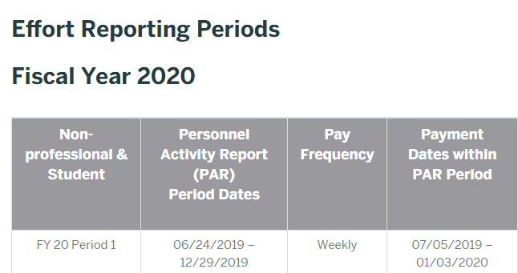
PAR periods
Two PAR periods a year, Based on Fiscal year not calendar year
January to June
July to December
PAFO reviews calendar and sets dates
    PARs get emailed to the owner of the “mail code”
    Completed PARs due within 60 days
http://www.bu.edu/researchsupport/forms-policies/effort-reporting-periods/
Notes:
Craig

Slide 22
ALL GROUP DISCUSSION – employee no longer on grant (1 of 2)
You have sent the student PARs for Grant 955xxxxxx to the lab supervisor for signing. The supervisor tells you they aren’t signing the PAR for Linda because she no longer works on the Grant.
What do you do?
What information should you look for on the PAR?
What other information do you need?
Notes:
Craig
Answer:
Check the dates on the PAR
And check the dates on the PA15. Did Linda work during the period of performance?
Yes, she was paid from the sponsored account Jan to April and worked 100% on the Grant.
The supervisor signed and returned the PAR.

Slide 23
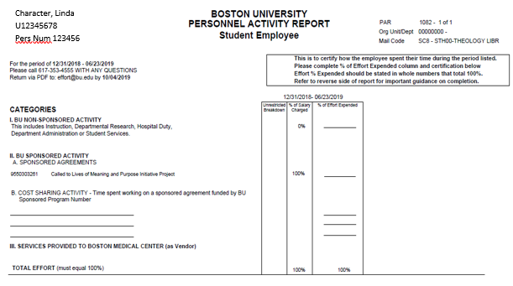
ALL GROUP DISCUSSION – employee no longer on grant (1 of 2)
Notes:
Craig
Answer:
Check the dates on the PAR
And check the dates on the PA15. Did Linda work during the period of performance?
Yes, she was paid from the sponsored account Jan to April and worked 100% on the Grant.
The supervisor signed and returned the PAR.

Slide 24
ALL GROUP DISCUSSION – ANSWER (1 of 2)
You have sent the student PARs for Grant 955xxxxxx to the lab supervisor for signing. The supervisor tells you they aren’t signing the PAR for Linda because she no longer works on the Grant.
What do you do?
Check the dates on the PAR
And check the dates on the PA15. Did Linda work during the period of performance?
Notes:
Craig
Answer:
Check the dates on the PAR
And check the dates on the PA15. Did Linda work during the period of performance?
Yes, she was paid from the sponsored account Jan to April and worked 100% on the Grant.
The supervisor signed and returned the PAR.

Slide 25
PAR – employee no longer on grant (2 of 2)
You run the PA15 and see that Linda was paid on the Grant during Jan 2019 – April 2019.
What does this mean for the PAR certification?
Labor Distributions: Payroll Inquiry by Employee (PA15)
 |  |  |  |  |  |  | Period / Fiscal Year - Posting | JAN 2019 | FEB 2019 | MAR 2019 | APR 2019 | Overall Result
 |  |  |  |  |  |  |  | Total Gross | Total Gross | Total Gross | Total Gross | Total Gross
Employee Name | Employee (PERNR) | BU ID | Funds Center |  |  | Order | Wage Type | $ | $ | $ | $ | $
CHARACTER, LINDA | 12345 | U00000000 | 1302000000 | STH INSTRUCTION |  | 9550xxxxxx | 2727 | 352.95 | 470.60 | 588.25 | 235.30 | 1,647.10
Overall Result |  |  |  |  |  |  |  | 352.95 | 470.60 | 588.25 | 235.30 | 1,647.10
Notes:
Craig

Slide 26
PAR – ANSWER (2 of 2)
You run the PA15 and see that Linda was paid on the Grant during Jan 2019 – April 2019.
What does this mean for the PAR certification?
PAR must be signed, Linda worked 100% for 4 months of the PAR period
Labor Distributions: Payroll Inquiry by Employee (PA15)
 |  |  |  |  |  |  | Period / Fiscal Year - Posting | JAN 2019 | FEB 2019 | MAR 2019 | APR 2019 | Overall Result
 |  |  |  |  |  |  |  | Total Gross | Total Gross | Total Gross | Total Gross | Total Gross
Employee Name | Employee (PERNR) | BU ID | Funds Center |  |  | Order | Wage Type | $ | $ | $ | $ | $
CHARACTER, LINDA | 12345 | U00000000 | 1302000000 | STH INSTRUCTION |  | 9550xxxxxx | 2727 | 352.95 | 470.60 | 588.25 | 235.30 | 1,647.10
Overall Result |  |  |  |  |  |  |  | 352.95 | 470.60 | 588.25 | 235.30 | 1,647.10
Notes:
Craig

Slide 27
ALL Group Discussion – multiple funding centers
Your Dept receives a PAR for someone who works in your department, but the sponsored research grant(s) they are paid from is in another department. The faculty supervisor plans to sign the student PARs.
DISCUSS: If your section is the non sponsored activity, is it your responsibility since PARs are for grants?
Notes:
Craig
It's a Policy that affects everyone, so we are all responsible, it's in all of our best interest to be compliant
In this case, two departments signed it (neither could see 100% of her salary in their reports) - working with the available data in their reports

Slide 28
Multiple funding centers ANSWER
You receive a PAR for someone who works in your department, but the sponsored research grant(s) they are paid from is in another department. Sent out by mail code, easy check to make when you first receive PARs
What are your options? (Do you sign just your section, do you leave it, do you send it back? Do you ask the certifier? What if they aren’t available?) Coordinate with other dept and you can both sign relevant sections
If your section is the non sponsored activity, is it your responsibility since PARs are for grants?
It's a Policy that affects everyone, so we are all responsible, it's in all of our best interest to be compliant
Notes:
Craig
It's a Policy that affects everyone, so we are all responsible, it's in all of our best interest to be compliant
In this case, two departments signed it (neither could see 100% of her salary in their reports) - working with the available data in their reports

Slide 29
Department review
Review checklist
Salaries charged % consistent with certified effort?
If the researcher has a commitment of mandatory or voluntary cost share is it reflected in the Cost Share section?
Does the effort certified include all committed cost sharing?
Incorrect or missing funding sources?
Incorrect percentages?
Best practices
Someone in the department should be reviewing PARs
Spot check a random sample –
  Over the cap
  Pending adjustments
  UROP*
  *For students in UROP, all effort should be associated with the Sponsored Award. UROP paid the salary but the Effort was on the Award so the Sponsored Research Internal Order Number should reflect all effort in this case and not the account the salary was paid from.
Notes:
Anne

Slide 30
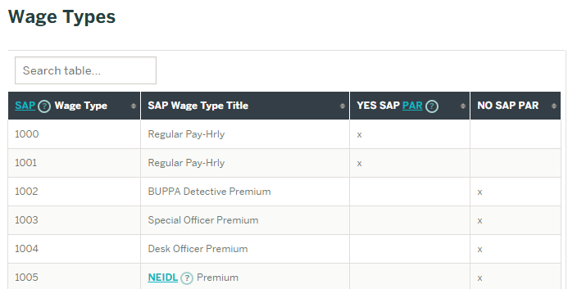
Wage types
PARs are generated based on salary data within SAP
Wage Types determine which salary charges are included in percent of salary charged calculations. (PAR eligible or not PAR eligible)
http://www.bu.edu/researchsupport/forms-policies/wage-types/
Notes:
Anne
Incidental wage types – based on policies and regulations
Departments are responsible for determining wage type
How are you all determining the right wage type? What happens if you do a salary adjustment to fix it?
PARs are printed from SAP - Percent of salary charged is printed on PAR (system-generated)

Slide 31
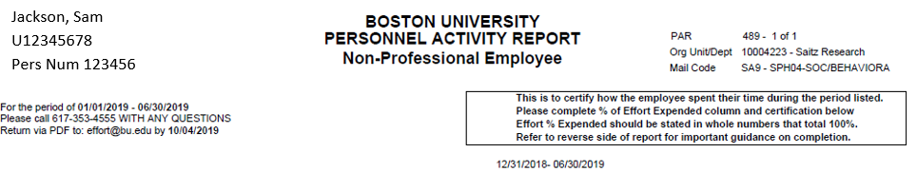
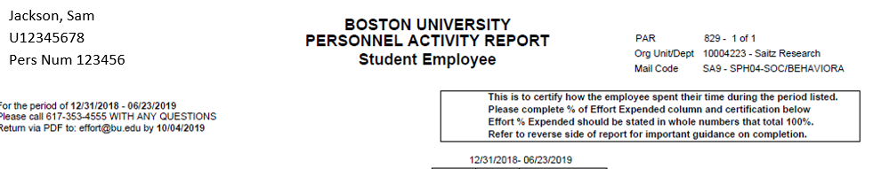
EXAMPLE – duplicate PARs printed
You receive two PARs for the same individual. The PARs appear to be identical.
What key information do you look at on the PAR?
Do you have one, both, or neither signed?
Notes:
Anne
What key information do you look at on the PAR?
--Ok so one says Student and one says Non Prof.
How did this happen?
Show of hands…
Who would have the student PAR signed?
Who would have the prof PAR signed?
Who would have both signed?
ANSWER:
It depends, but most of the time sign both because the system generated it and it needs to be signed.
In both of those cases, they signed both.
The reason SAP creates 2 is because the person was set up as a student years ago, and when they get set up as non prof SAP still has the data of them being a student

Slide 32
Duplicate PARs printed ANSWER
You receive two PARs for the same individual. The PARs appear to be identical.
What key information do you look at on the PAR?
One says Student and one says Non Prof.
Do you have one, both, or neither signed?
Both should be signed
Notes:
Anne
What key information do you look at on the PAR?
--Ok so one says Student and one says Non Prof.
How did this happen?
Show of hands…
Who would have the student PAR signed?
Who would have the prof PAR signed?
Who would have both signed?
ANSWER:
It depends, but most of the time sign both because the system generated it and it needs to be signed.
In both of those cases, they signed both.
The reason SAP creates 2 is because the person was set up as a student years ago, and when they get set up as non prof SAP still has the data of them being a student

Slide 33
POLL – does the SARF need a PAR
Open “Poll-SARF” doc – link in chat
You are doing a student salary adjustment, moving June salary from a department account to a grant account. Does a PAR need to be created for the individual?
Determine if it meets the criteria of needing a PAR:
Is salary being charged to sponsored program IO/SP beginning with 955 or 950?
Is the employee group PAR eligible?
Is the wage type PAR-eligible (ie not hourly)?
Notes:
Anne
Answer:
Check the employee group and wage type, they might not need a PAR - for example students using timesheets don't need PARs because timesheets act as the certification of effort
In these cases the wage type was not PAR eligible, so they didn't a PAR generated

Slide 34
POLL – does the SARF need a PAR ANSWER
You are doing a student salary adjustment, moving June salary from a department account to a grant account. Does a PAR need to be created for the individual?
Determine if it meets the criteria of needing a PAR:
Is salary being charged to sponsored program IO/SP beginning with 955 or 950? Yes
Is the employee group PAR eligible? Yes
Is the wage type PAR-eligible (ie not hourly)? No
Does not need a PAR. If you think someone being paid on grants in missing a PAR, check the wage types to confirm.
Notes:
Anne
Answer:
Check the employee group and wage type, they might not need a PAR - for example students using timesheets don't need PARs because timesheets act as the certification of effort
In these cases the wage type was not PAR eligible, so they didn't a PAR generated

Slide 35

PAFO Review
Reasons PARs might be returned to departments:
Additional certification needed
Incomplete certification statement
Unacceptable signature
Effort not 100%
Missing percent
Over the Cap (DHHS) and no cost share listed
SARF needed
Escalation
Notes:
Anne

Slide 36
performing effort
Notes:
Shelly

Slide 37

Effort variations within a sponsored project budget period
    It’s OK if level of effort varies throughout sponsored project budget period, as long as overall effort commitment for the entire budget period is fulfilled.
  Example
  If PI has committed 30% effort to a project during a calendar year budget period, they could fulfill that commitment by expending:
  If doing 40% / 20% they CANNOT charge salary and certify effort at a constant 30% rate for both six month periods of performance
  30% effort Jan – June
  30% effort July – Dec
  OR
  40% effort Jan – June
  20% effort July – Dec
Notes:
Shelly
During the course of a sponsored project budget period, an individual’s level of effort may vary. This is acceptable, as long as they fulfill the overall commitment for the entire budget period.
EXAMPLE
If the PI has committed 30% of their effort to a project during a calendar year budget period, one way they could fulfill that commitment is by expending:
40% effort during the first six months of the year, and 20% during the last six months
They must charge salary and certify effort in a manner that is consistent with how they actually devote effort to the project. In the example above, where they work 40% in the first six months and 20% in the last six months - a perfectly acceptable way to fulfill the commitment - it would not be acceptable to:
Charge salary at a constant 30% rate for the entire budget period, or
Certify effort at a constant 30% rate for both six-month periods of performance.
However, short-term fluctuations of two months or less are acceptable. This would be an effort deficit of not more than two months, provided that the catch-up occurs within a comparable period and it all evens out.

Slide 38
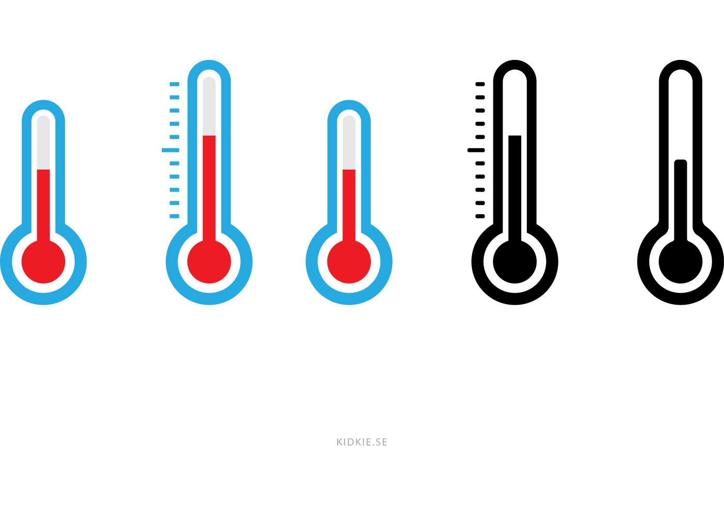
Changes to effort
Overcommitted
Reducing effort
If receipt of new award increases PI total effort commitments >100% then PI must revise level of committed effort on this award or other activity
Reduction of 25% might require prior written approval from sponsor
>100%
40%
30%
Notes:
Shelly
If you reduce your effort, paid or cost-shared, on a federal grant by 25% or more, you must have sponsor approval*. If you reduce your paid effort, you may choose to document cost-sharing so that the total effort does not decrease.
If committed effort is 40%, and the PI wants to reduce it to 30%. The drop is 25 percent of their original effort commitment, so it requires prior written approval from the sponsor
If receipt of award increases PI total effort commitments to greater than 100%, the PI must revise the level of committed effort requested by communication with the sponsor, reduce effort on other activities or refuse the award

Slide 39
Changes to effort and/or salary support
PIs generally have some flexibility in managing their sponsored project budgets, including their salary charges for project staff. However, this rebudgeting authority does not confer the right to*:
Make significant changes in work activity without prior approval from the sponsor, or
Change effort commitments for key personnel without documenting the changes
For an investigator or key person
For a project staff member who is not a key person
If you want to: | Then you must:
Reduce the salary charges without changing the effort commitment | Document as cost sharing the effort for which the sponsor will not provide salary support
Reduce both the salary charges and the effort commitment by less than 25% of the original commitment level | Document the change to the commitment level
Reduce both the salary charges and the effort commitment for a key person as listed on the NoA by 25% or more of the original commitment level | Obtain approval from the sponsor prior to the change in writing, and document the change to the commitment level when approved
If you want to: | Then you must:
Reduce the salary charges without changing the effort commitment | Document as cost sharing the effort for which the sponsor will not provide salary support
Reduce the salary charges and the effort by commensurate amounts | No documentation, notification, or approval required
*Generally applies to NIH awards but sponsor approval requirements will vary from sponsor and awards
Notes:
Shelly

Slide 40
Breakout Room Activity #2 – Overcommitted
Dr. Green has the following effort commitments
25% on Grant A
25% on Grant B
25% on Grant C (of which 20% is cost shared)
Teaching, admin, and departmental research activities which comprise approx. 1-2 days/week
Dr. Green receives a notification that she will be awarded a new grant next month, on which she has a 20% commitment.
Which of the following are acceptable methods of managing this new commitment? Discuss each option as a group and decide which are feasible and why.
Work 20% more hours than before
Reduce effort by approx. 5% on Grants A-C (changing payroll distribution accordingly), and reduce effort by 5% on non-sponsored activities
Reduce effort on Grant C by 20%. Since it is mandatory committed cost-sharing, no notification to the sponsor is necessary
Reduce effort on Grants A and B by 10% each, notifying each sponsor of the planned reduction in effort
Open BOR #2 Doc in chat –
8 mins
Notes:
Shelly
Work 20% more hours than before
No, that just changes the distribution for all of the effort percentages
Reduce effort by approx. 5% on Grants A-C (changing payroll distribution accordingly), and reduce effort by 5% on non-sponsored activities
Yes, this could work. Remember to do salary adjustment so that it is reflected accurately in SAP
Reduce effort on Grant C by 20%. Since it is cost-shared, no notification to the sponsor is necessary
No, cost shared commitments should be treated no differently than charged commitments
Reduce effort on Grants A and B by 10% each, notifying each sponsor of the planned reduction in effort
Yes, these reductions in effort are each 40% (10/25), so they require PRIOR notification. Note: review sponsor budgeting rules as requirements may vary

Slide 41
Breakout Room Activity #2 – Overcommitted ANSWER
Dr. Green has the following effort commitments
25% on Grant A
25% on Grant B
25% on Grant C (of which 20% is cost shared)
Teaching, admin, and departmental research activities which comprise approx. 1-2 days/week
Dr. Green receives a notification that she will be awarded a new grant next month, on which she has a 20% commitment.
Which of the following are acceptable methods of managing this new commitment? Discuss each option as a group and decide which are feasible and why.
Work 20% more hours than before NO
Reduce effort by approx. 5% on Grants A-C (changing payroll distribution accordingly), and reduce effort by 5% on non-sponsored activities YES
Reduce effort on Grant C by 20%. Since it is mandatory committed cost-sharing, no notification to the sponsor is necessary NO
Reduce effort on Grants A and B by 10% each, notifying each sponsor of the planned reduction in effort YES
Notes:
Shelly
Work 20% more hours than before
No, that just changes the distribution for all of the effort percentages
Reduce effort by approx. 5% on Grants A-C (changing payroll distribution accordingly), and reduce effort by 5% on non-sponsored activities
Yes, this could work. Remember to do salary adjustment so that it is reflected accurately in SAP
Reduce effort on Grant C by 20%. Since it is cost-shared, no notification to the sponsor is necessary
No, cost shared commitments should be treated no differently than charged commitments
Reduce effort on Grants A and B by 10% each, notifying each sponsor of the planned reduction in effort
Yes, these reductions in effort are each 40% (10/25), so they require PRIOR notification. Note: review sponsor budgeting rules as requirements may vary

Slide 42
Salary over the DHHS Cap
Certain Sponsors limit the amount of money that can be charged to their awards
DHHS is the most common Sponsor and changes their CAP Annually (CY2019 DHHS Cap is $192,300)
It is always important to read the RFP carefully when applying for new funding and the Notice of Award once your proposal is awarded
Notes:
Gretchen

Slide 43

EXAMPLE: Over the Cap (OTC)
Prof X is a 12-month salary faculty member
Prof X’s Salary: $250,000
Working 50% on Grant A
DHHS Cap: $192,300
Grant A Salary % on PAR
Charged to Grant A
÷
Total Salary
% effort on PAR
What is the maximum salary you can charge to Grant A?
How should effort be presented on the PAR?
Cost Share on PAR
Effort on Grant A
-
% effort on PAR
% Cost share
Notes:
Gretchen

Slide 44
OTC EXAMPLE – ANSWER 1
DHHS Cap
$192,300
50%
Max you can charge to Grant
$96,150
Grant A Salary % on PAR
$96,150
÷
$250k
38%
Charged to Grant A
Total Salary
% effort on PAR
Cost Share on PAR
50%
-
38%
12%
Effort on Grant A
% effort on PAR
Cost share
Notes:
Gretchen

Slide 45
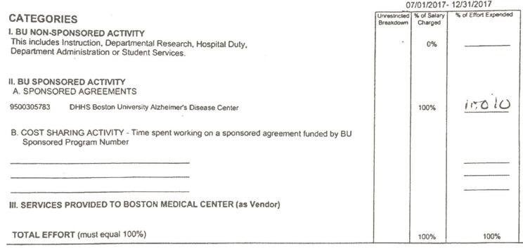
OTC EXAMPLE – ANSWER 2
Personnel Activity Report (PAR)
63%
50%
160XXXXXXX
9500XXXXXX
38%
38%
50%
9500XXXXXX
12%
100%
Notes:
Gretchen

Slide 46
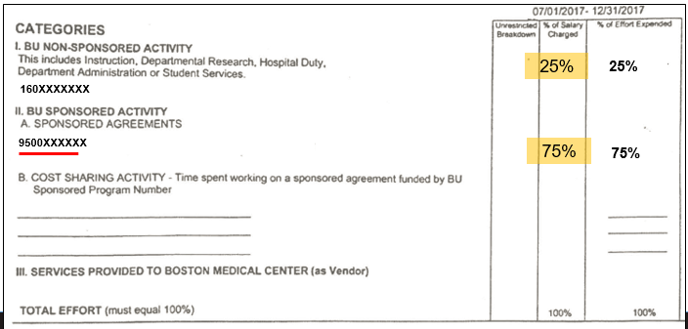
EXAMPLE: K AWARD
          Conditions of Award:
          Maximum requested salary from NIH = $100K
          Minimum effort required = 75%
If Professor X earns $100K and effort was 75%, ideally, $75K would be charged to Grant #950xxxxxxx.
Notes:
Gretchen

Slide 47
EXAMPLE: K AWARD
          Conditions of Award:
          Maximum requested salary from NIH = $100K
          Minimum effort required = 75%
What if the PI earned $150K?
75% effort of $150K is $112,500, but based on the rules, only $100K of it can be charged to the K award so the department would have to cover the difference
In this case the PAR would only print effort of 67% to the K Award Grant ($100K / $150K)
    What would need to be recorded on the PAR in the effort expended column?
Notes:
Gretchen

Slide 48
EXAMPLE: K AWARD
33%
25%
50%
160XXXXXXX
9500XXXXXX
67%
67%
75%
9500XXXXXX
8%
Notes:
Gretchen

Slide 49
Key Takeaways
PARs provide assurance to sponsors that salary charged to grants is commensurate with effort
Departments should ensure salary is being charged to the correct accounts so that it’s reflected accurately when the PAR is generated
Review and return PARs timely
Resources
http://www.bu.edu/researchsupport/project-lifecycle/managing-an-award/effort/
Contact
Effort@bu.edu
Notes:
Gretchen

Slide 50

QUESTIONS
Resources
http://www.bu.edu/researchsupport/project-lifecycle/managing-an-award/effort/
Contact
Effort@bu.edu
Notes:
Gretchen

