Slide 1
Dimensions
Boston University Libraries, Fall 2019

Slide 2
About Dimensions
Find data from across the entire research lifecycle. Search for and analyze data about:
    Publications
    Grants
    Patents
    Clinical trials
    Policy documents

Slide 3
Dimensions uses a number of underlying data sources and controlled vocabularies.
  Fields of Research (FoR) is a taxonomy that classifies research outputs and R&D activity according to the research methodology of the discipline.
  Global Research Identifier Database (GRID) enables the product to disambiguate names and creates links between entities.
  CrossRef, PubMed Central, and OpenCitations provide some of the publication records.
  ClinicalTrials.gov, ANZCTR, CHICTR, CTRI, and EU-CTR are some of the available clinical trial registries.
  IFI Claims is a global patent database of indexed and enhanced data from multiple patent offices.
  Policy documents are harvested from CDC, UNESCO, WHO, NBER, World Bank, and more.
Notes:
Fields of Research (FoR) Codes: Guidelines for ERA
https://www.adelaide.edu.au/research-services/systems-reporting/era/field-research-codes/docs/for-coding-flyer-sm.pdf
Global Research Identifier Database (GRID)
https://grid.ac/
CrossRef
https://www.crossref.org/
OpenCitations
https://opencitations.net/
https://i4oc.org/#
IFI Claims Patent Services
https://www.digital-science.com/products/ifi-claims/
https://www.ificlaims.com/start.htm
A guide to the Dimensions data approach
https://www.dimensions.ai/resources/a-guide-to-the-dimensions-data-approach/
Digital Science is the parent company for Dimensions, Symplectic Elements (My CV), IFI Claims, and Uberresearch (GRID).

Slide 4
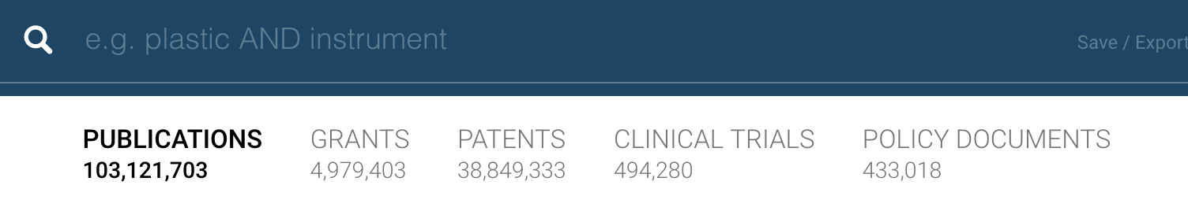
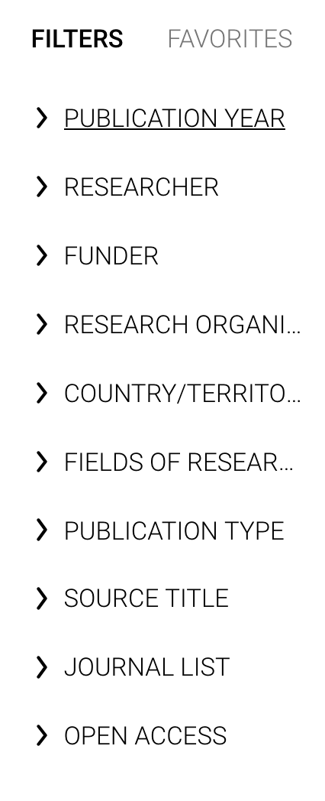
Search Dimensions
Select a category at the top and then enter some keywords.
Use the filters to the left to refine your search. There are different filters for each category.
The journal list filter contains multiple high-quality directories and indexes of journals from around the world.
The full text of some items are open access; others may be available through the BU Library. Look for: to find the publication in the BU Libraries.
Notes:
Journal lists:
ERA 2015
Unofficial site: http://lamp.infosys.deakin.edu.au/era/?page=jmain
News release from the Australian Government Research Council: https://www.arc.gov.au/news-publications/media/feature-articles/era-2015
Download file of the entire list: https://www.adelaide.edu.au/research-services/systems-reporting/era/docs/era-submitted-journal-list.xlsx
Norwegian Register for Scientific Journals, Series and Publishers
https://dbh.nsd.uib.no/publiseringskanaler/Forside?request_locale=en
Dimensions includes Norwegian Register’s Level 0, Level 1, and Level 2 lists.
Level 2 is considered the most prestigious and includes publications such as Proceedings of the IEEE and The Lancet.
European Reference Index for the Humanities and the Social Sciences (ERIH PLUS)
https://dbh.nsd.uib.no/publiseringskanaler/erihplus/
Directory of Open Access Journals
https://doaj.org/
Scientific Electronic Library Online (SciELO)
https://scielo.org/en/
https://en.wikipedia.org/wiki/SciELO
Originally established in Brazil, this directory and open access online publishing platform serves a number of countries and is indexed by major databases such as WoS.

Slide 5
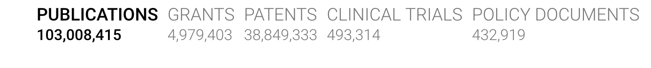
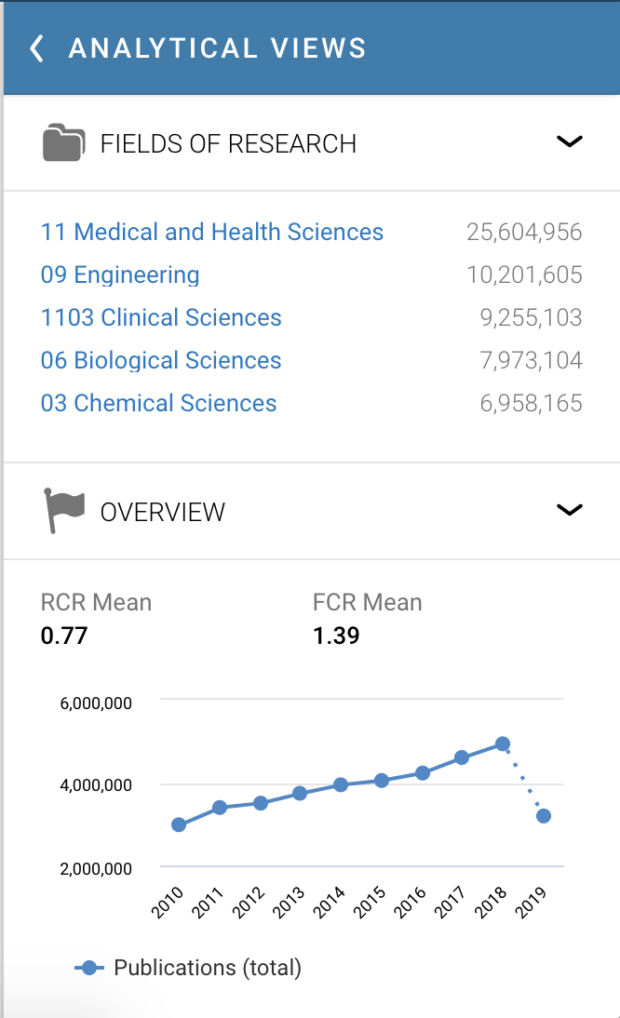
Expand the menu to the right to analyze results by subject, researcher, institution, funding body, and more.
Do side-by-side comparisons to get a detailed look at the field you are working in.
Use this information to pinpoint funders, identify collaborators, figure out where to publish, find conference proceedings, and compare research outputs by a variety of metrics.

Slide 6
Tips
Too many/few/irrelevant results?
  Remove some of the filters.
  Edit your keyword list.
  Use the controlled vocabulary to find the standardized terms for the topics you are searching for.
Unable to use Analytical View?
  Create an account with Dimensions, then make sure you are logged in using your BU ID and password in order to be able to access all of the features.
Questions?
  Contact BU Libraries at ask@bu.edu or disc@bu.edu

Slide 7
Please reach out with any questions.
Ellen Phillips, Open Access Specialist | ephillip@bu.edu
Boston University Libraries

