Slide 1
CO₂ Euthanasia Procedure
October 2013

Slide 2
AVMA Guidelines for the Euthanasia of Animals: 2013 Edition
Small Laboratory rodents:
mouse, rat, hamster, gerbil, guinea pig
  Compressed CO₂ gas in cylinder – allow precisely regulated flow rate by using a pressure reducing regulator and flow meter (liters/minute)
  Prefilling chambers unacceptable
  Flow rate should displace 10-30% of the cage volume/minute
  Should be done in home cage to minimize stress and anxiety
  If home cage not used – chamber should be emptied & cleaned between uses.
  Observe complete cessation of breathing
  Wait at least 2 minutes before turning off CO₂
  Secondary method must be performed – cervical dislocation, bilateral thoracotomy, exsanguination, tissue procurement. Decapitate pups with sharp scissors.

Slide 3
STEP 1
DETERMINE CAGE SIZE
FLOW RATE
LID SIZE NEEDED

Slide 4
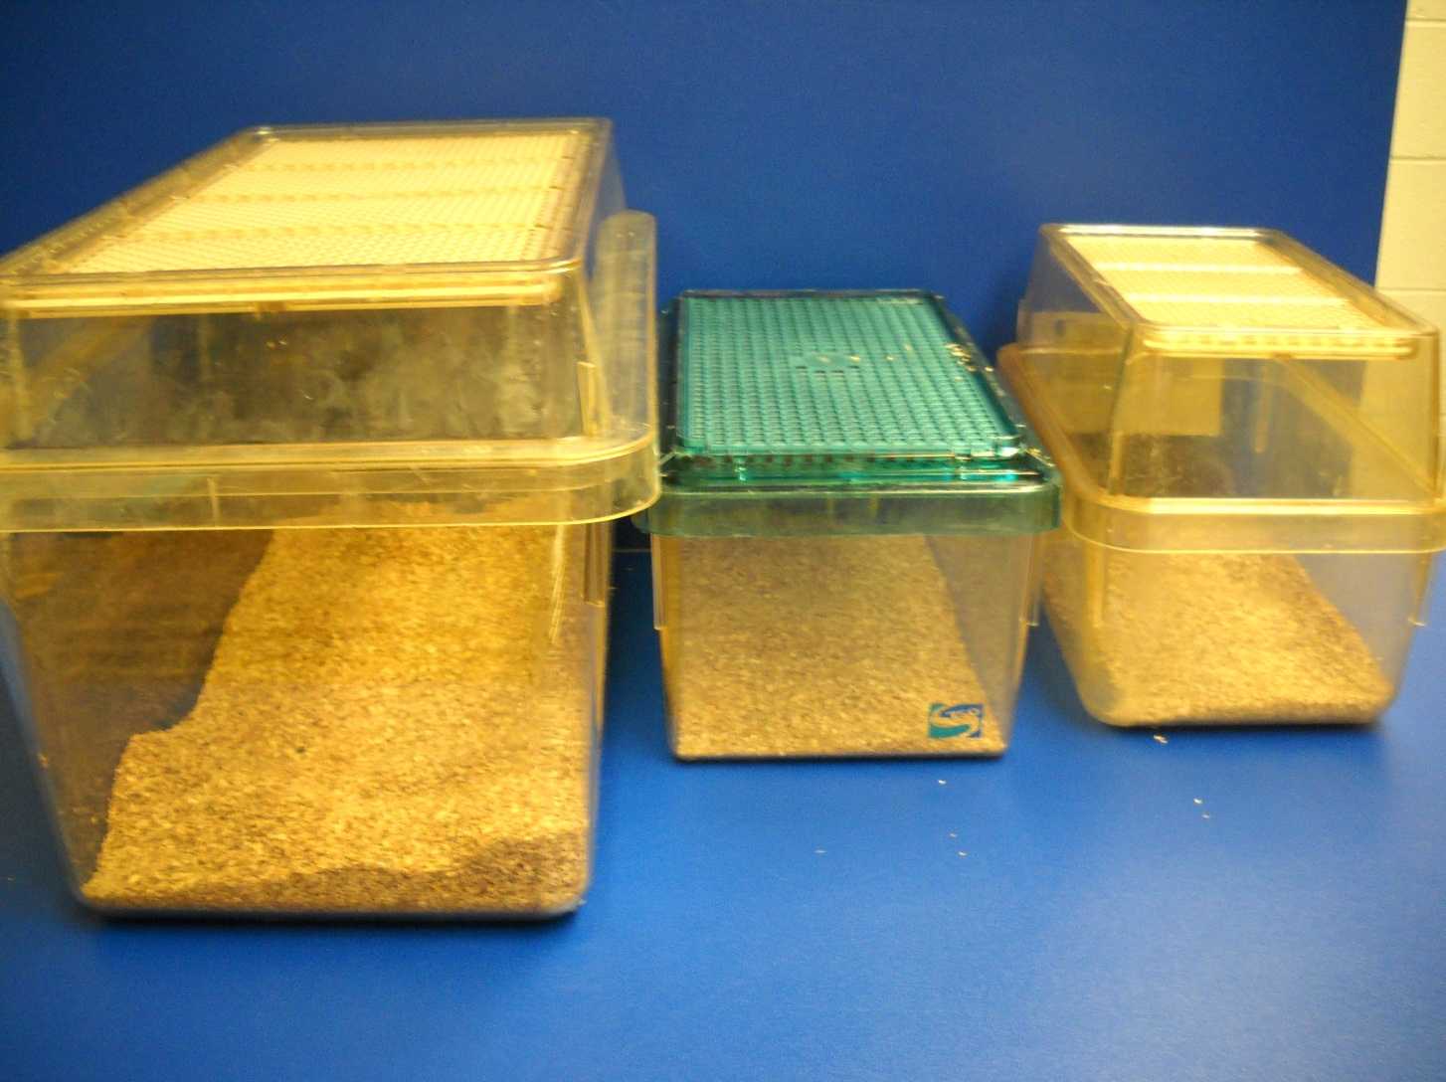
Standard cage sizes
Mouse
(C)
Mouse
(B)
Rat
(A)
Cage size in liters X 0.20 = flow rate for flow meter

Slide 5
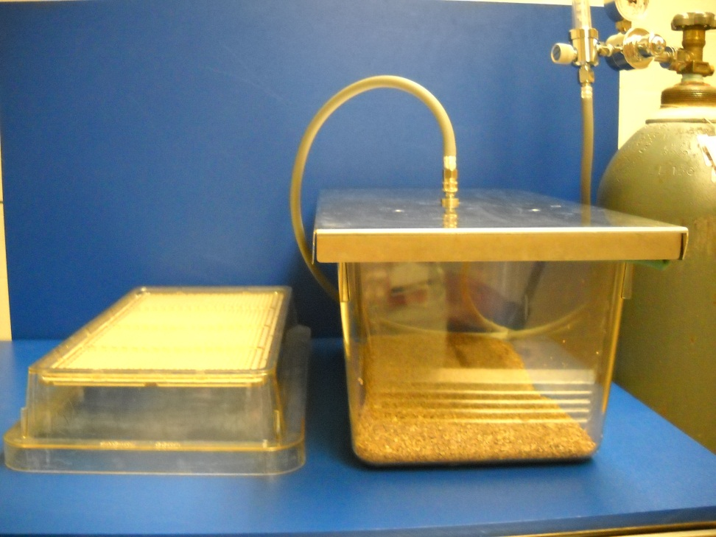
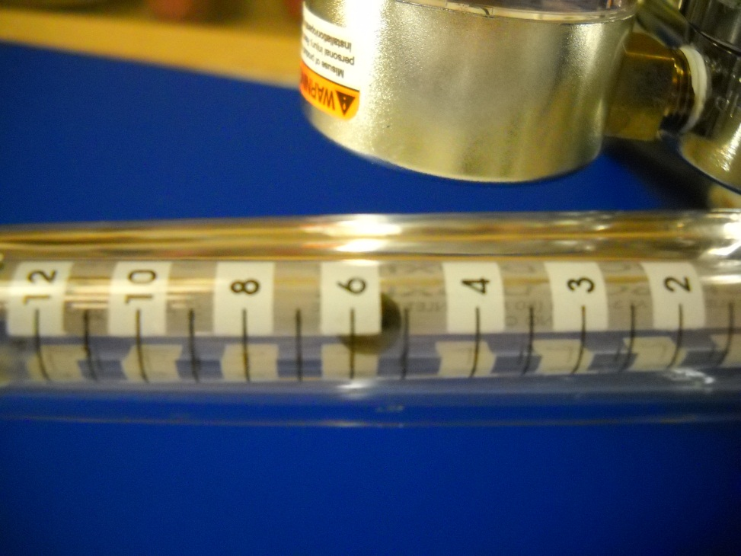
Rat Cage (10” x 19” x 9”)
5.6 L/min
6.0 L/min
~5.6 L/min
5.5 L/min
Rat (A)

Slide 6
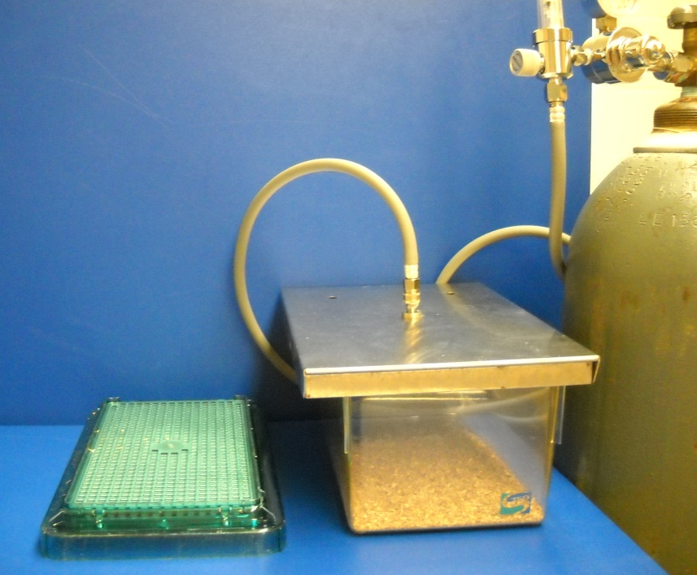
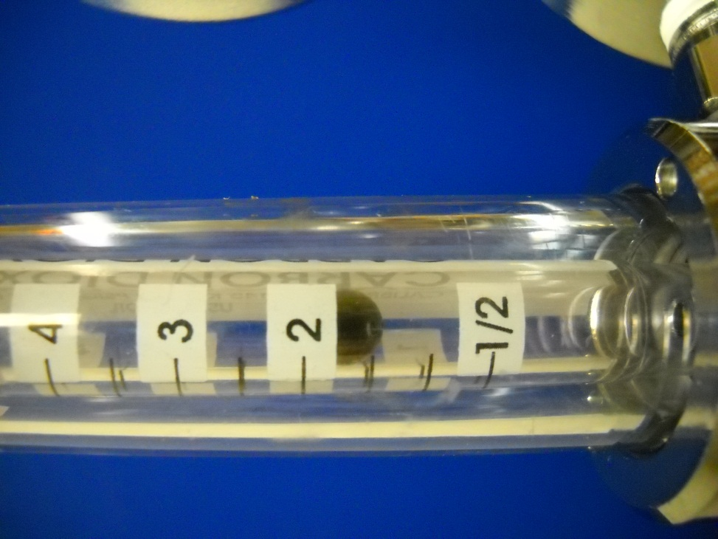
Mouse Cage (8” x 13” x 5”)
1.7 L/min
2.0 L/min
~1.7 L/min
1.5 L/min
Mouse (B)

Slide 7
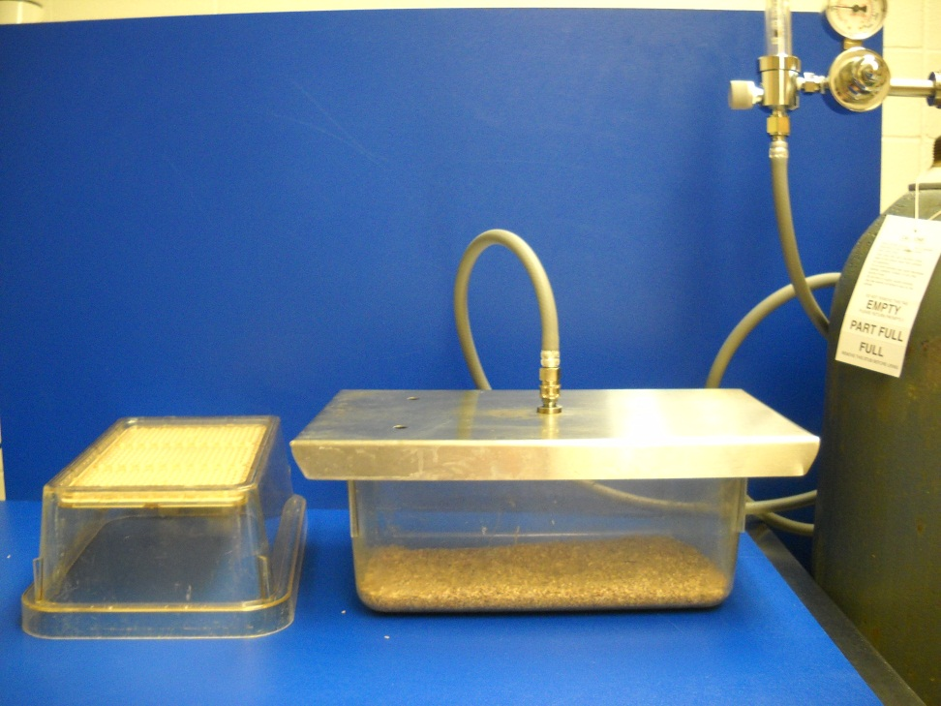
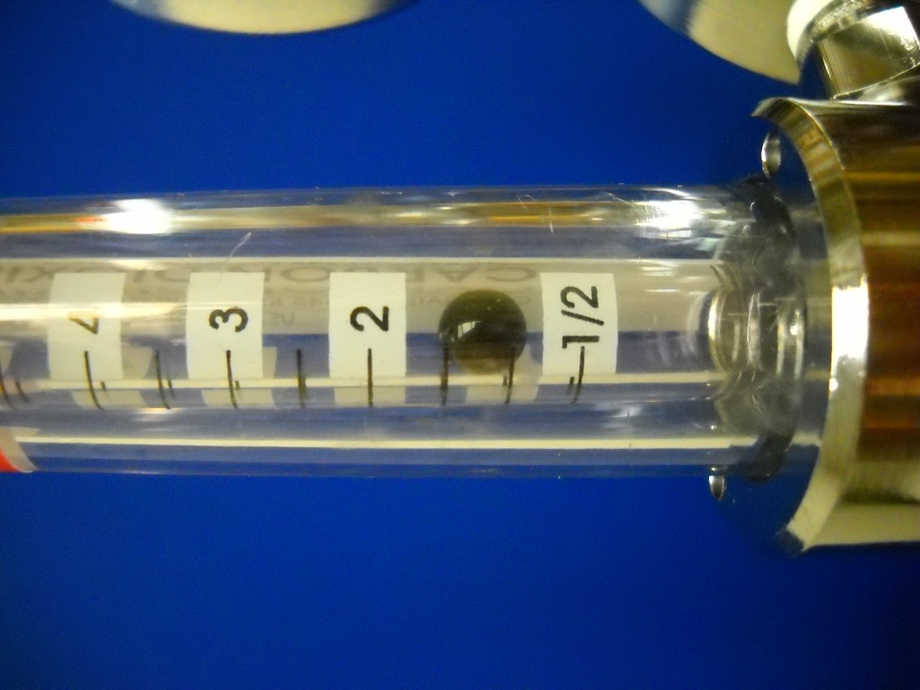
Mouse Cage (7” x 11”x 5”)
1.3 L/min
1.5 L/min
~1.3 L/min
1.0 L/min
Mouse (C)

Slide 8
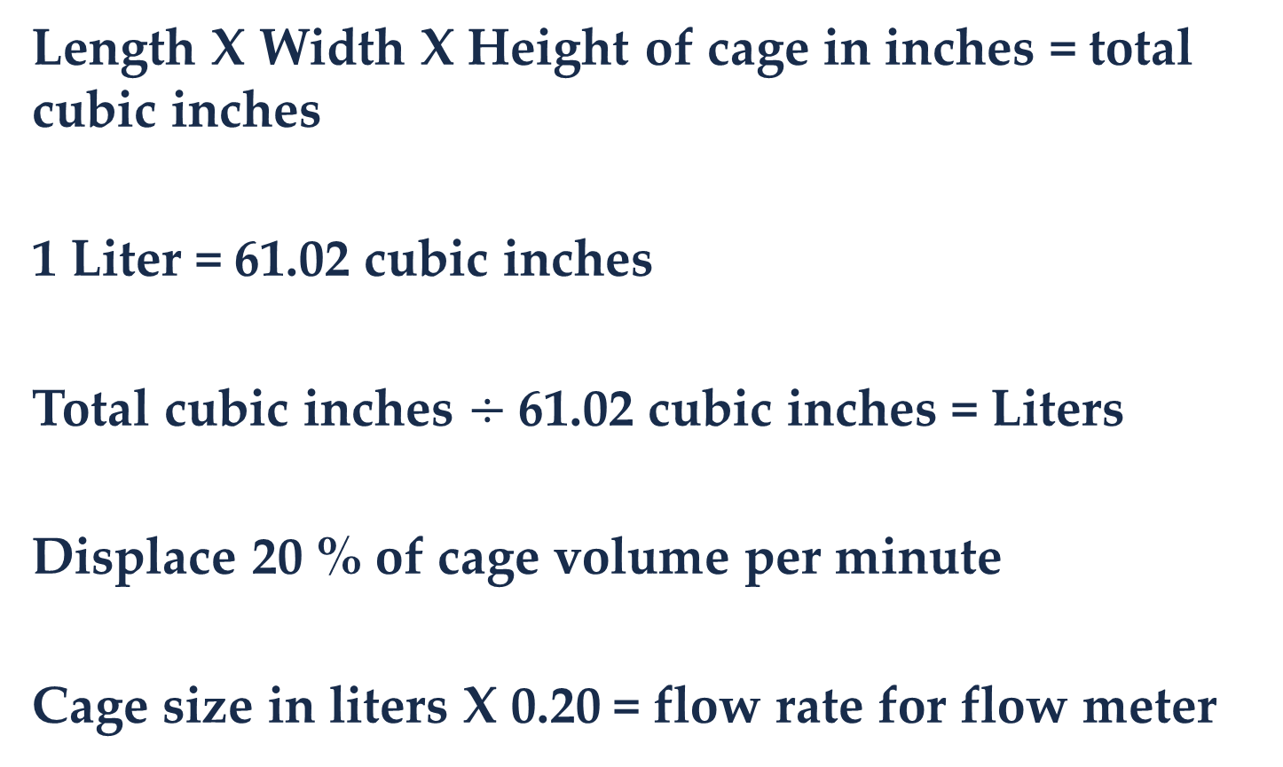
To Calculate Flow Rate for Unusual Cages
Length X Width X Height of cage in inches = total cubic inches
1 Liter = 61.02 cubic inches
Total cubic inches $÷$61.02 cubic inches = Liters
Displace 20 % of cage volume per minute
Cage size in liters X 0.20 = flow rate for flow meter

Slide 9
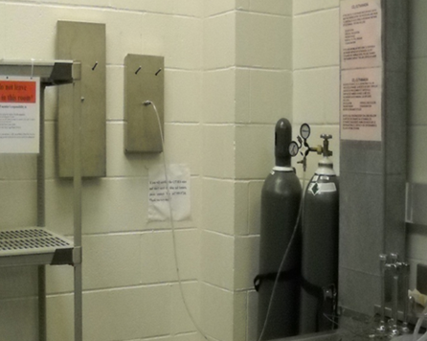
Lids for cages
Pick the correct size lid for cage

Slide 10
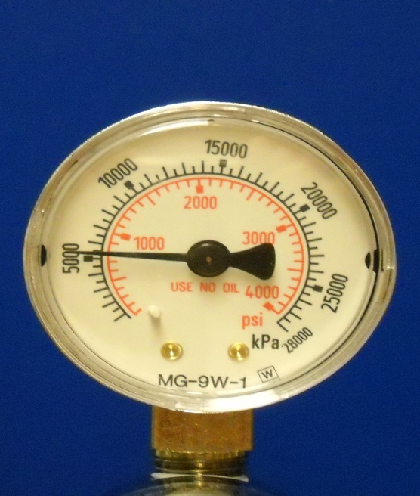
STEP 2
Turn on Tank & Check Volume
800 PSI in tank
A full tank has 2000 PSI

Slide 11
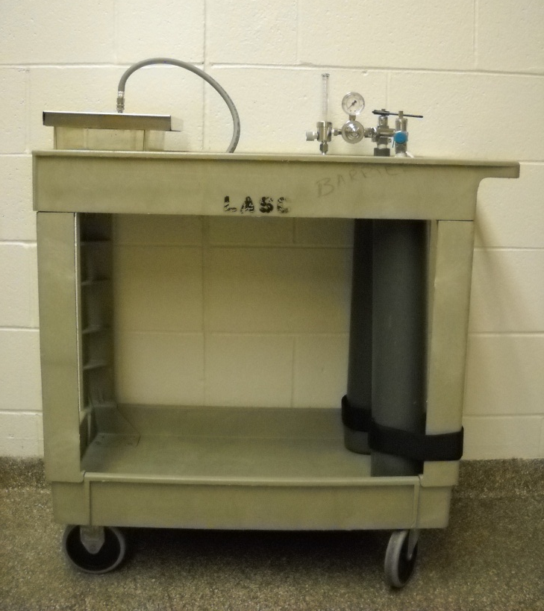
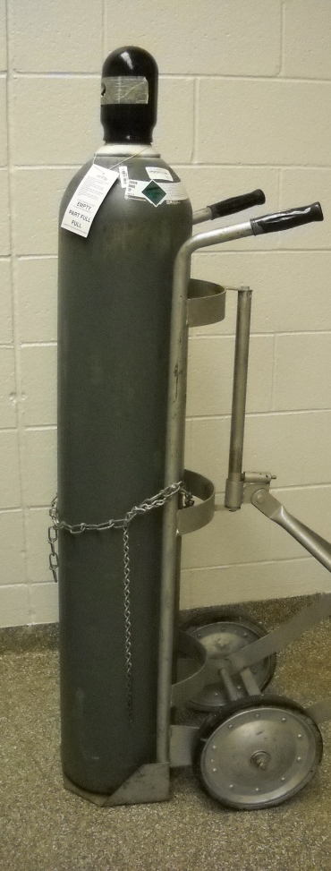
CO₂ Cylinders
“E” – small cylinder mobile station
“H” – large cylinder

Slide 12
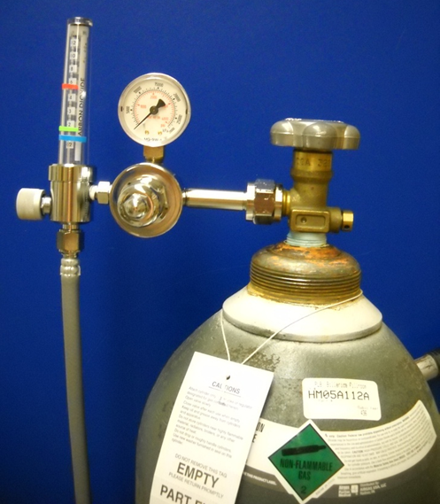
CO₂ Regulator & Flow meter
“H” cylinder setup: Large Tank
Euthanex model #M1-320-12FM
Flow meter on/off knob
for CO₂ flow rate
Regulator – volume in cylinder
Knob to open/close CO₂ cylinder

Slide 13
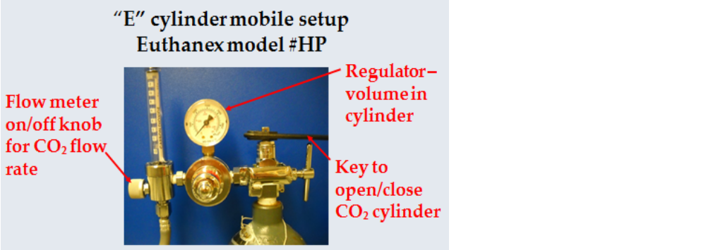
CO₂ Regulator & Flow meter

Slide 14
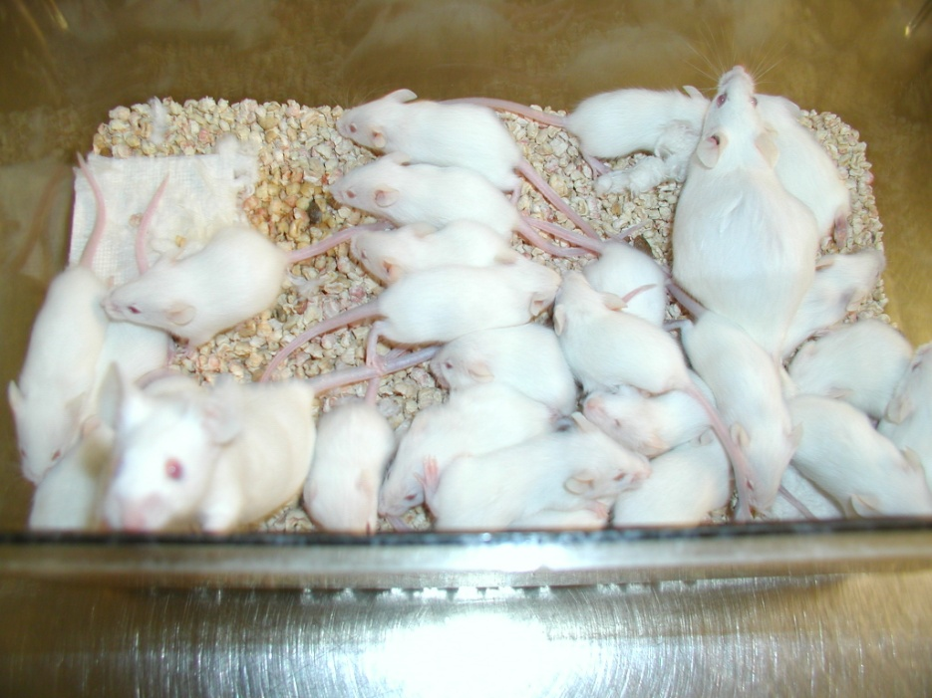
Do Not overload the cages
5 mice per cage maximum
Animals under 500g no more than 2 per cage
Animals larger 500g 1 per cage
Do not leave surviving animals in the presence of animals to be euthanized.
X
X
X
X
X
X
X
X
X
X
X
X
X
X
X
X
X
X
X

Slide 15
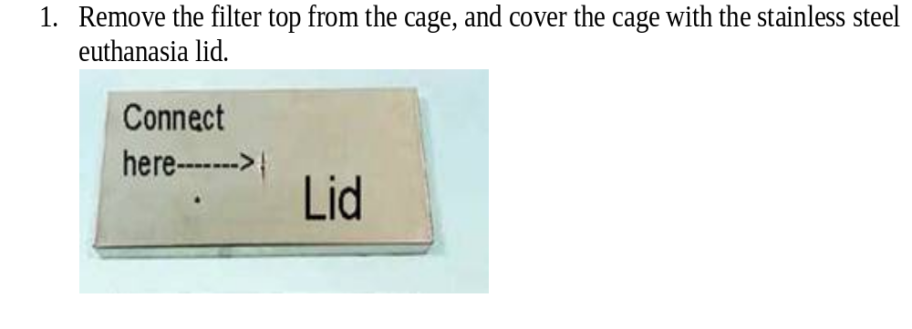
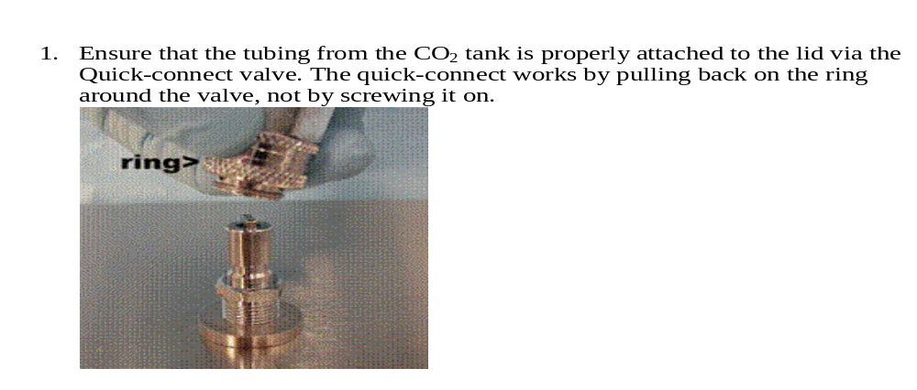
STEP 3
Remove the filter top from the cage, and cover the cage with the stainless steel euthanasia lid.
Ensure that the tubing from the CO2 tank is properly attached to the lid via the Quick-connect valve. The quick-connect works by pulling back on the ring around the valve, not by screwing it on

Slide 16

STEP 4
Turn on flow meter to calculated flow rate
Flow meter on/off knob
for CO₂ flow rate

Slide 17
STEP 5
Observe complete cessation of breathing.
Wait at least 2 minutes before turning off CO₂.
Neonates are highly resistant to CO2 and require at least 10 minutes of exposure
A secondary method must be performed – cervical dislocation, bilateral thoracotomy, exsanguination, tissue procurement.
Decapitate pups with sharp scissors.

Slide 18
STEP 6
At this point, if you have another cage to euthanize, repeat steps 3-5.
When all cages of animals are euthanized, turn the main tank control knob off, and return the lids to their racks.
Be sure to check again that all animals have been euthanized completely before securely double-bagging them in plastic bags. Excess bedding is not to be placed in the bag.
Place the carcass bag in the facility cooler. Return the empty dirty cages in the dirty cage wash.

Slide 19
Secondary Physical Methods
CO₂ is the primary method of euthanasia.
Cervical dislocation
Bilateral Thoracotomy
Decapitation
Exsanguination

Slide 20
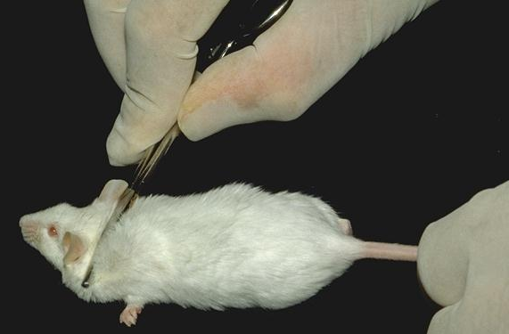
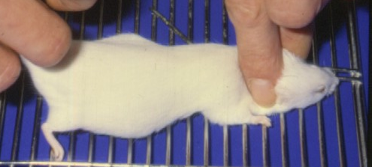
Cervical Dislocation
Used for animals under 200 grams

Slide 21
Bilateral Thoracotomy
Incision of the chest cavity to produce a “pneumothorax” (collapsed lung) and cessation of respiration.
Used for larger animal over 200 grams.

