Slide 1
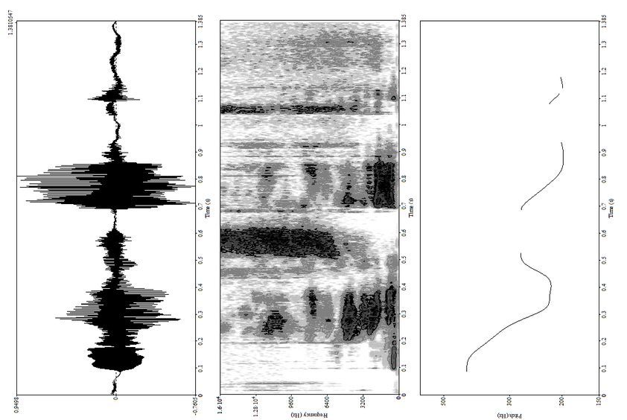
Quiet Communities
FALL 2024
Theodore Delisio
&
Kimberly Cummings

Slide 2
Index
INTRODUCTION
DATA
Quiet Communities Recap
TESTIMONIES
CONCLUSION
01
02
03
04

Slide 3
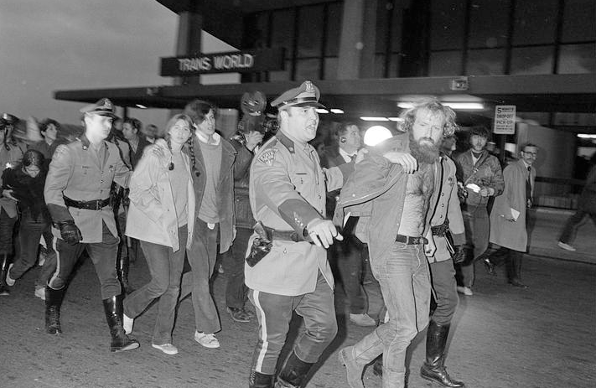
Intro
What is the background for noise pollution?
Quiet Communities
#
In 1972 the Noise Control Act was passed. This act created the Office of Noise Abatement and Control (ONAC) which was created to research, regulate, educate, and enforce noise pollution.
Noise was declared to be a public health hazard, causing or contributing to hearing damage, cardiovascular disease, metabolic disease, and psychological disorders.
Arrests taking place at Logan Airport during protests against noise pollution during the first Earth Day in 1970
Notes:
https://www.digitalcommonwealth.org/search/commonwealth:fn109w06f

Slide 4
Intro
What happened?
Ronald Reagan
Quiet Communities
After only 10 years, ONAC was defunded under the Reagan administration, leaving no national noise committee.
Not only has this led to minimal research on the dangers of noise for the past 40 years, but a lack of enforcement when it comes to noise.
This has caused significant harm in individuals and is part of a larger issue: the erosion of the administrative state.

Slide 5
What is Quiet Communities?
Nonprofit organization, promotes quiet as a valuable natural resource and works to reduce harmful noise and related pollution
A consortium of scientific, medical, and legal professionals — from the United States and abroad — concerned with the adverse impacts of noise and related pollution on health and the environment.
Taking legal action against the EPA
Provide support for solutions and advocacy

Slide 6
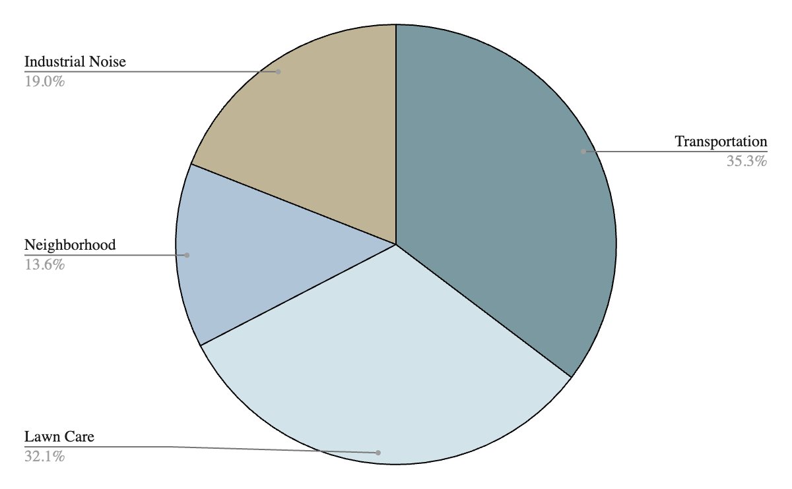
Distributions of Complaints

Slide 7
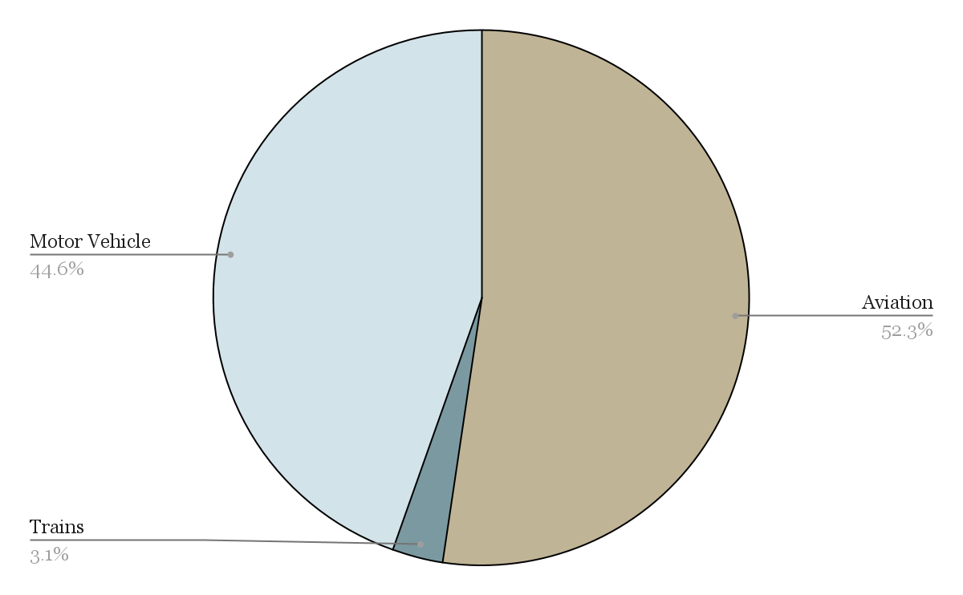
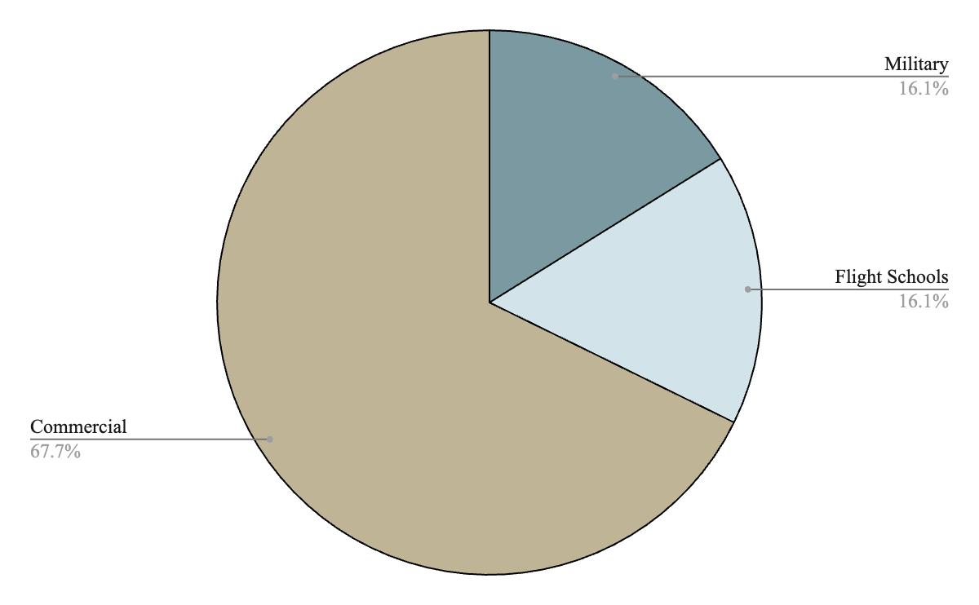
Breakdown of Transportation
Breakdown of Aviation

Slide 8
Points of Interest
10% of all complaints were related to the modification of vehicles
7% of all complaints had a relationship to defense
People do not know what to do
Feelings of frustration and hopelessness
Noise is more than dB

Slide 9
Cranston, Rhode Island

Slide 10
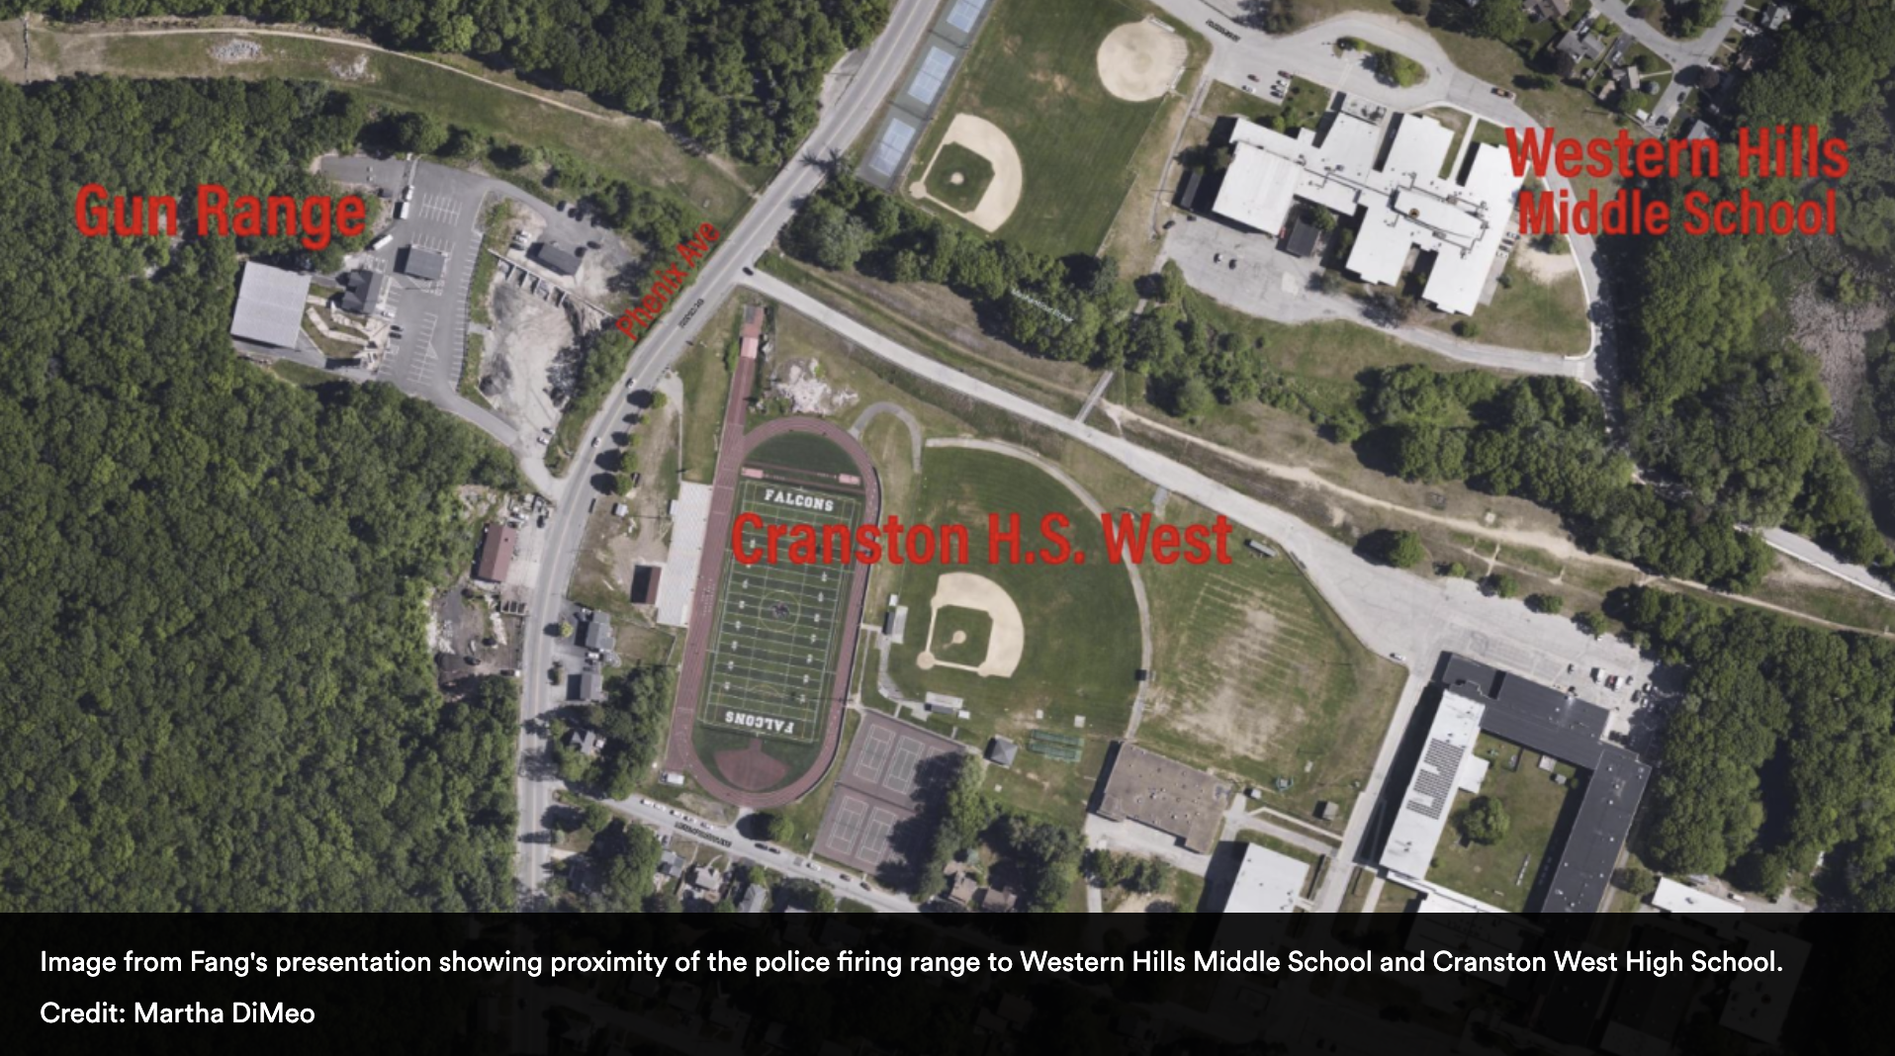
Cranston, Rhode Island
Couple moved to the town over the winter when shooting does not occur
Concerned for the wellbeing of their child who will attend Western Hills Middle School
Many people who have lived in the town for a long time ignore the issue
City official have not been helpful, the police have political clout

Slide 11
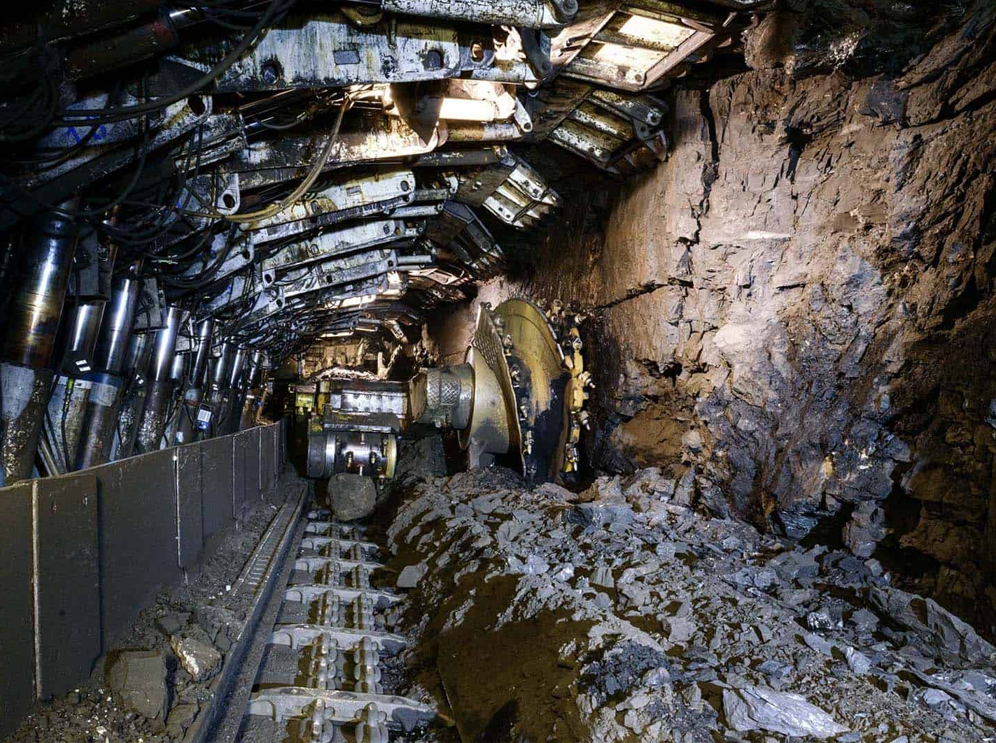
Jamie Lutz
Manitou, Kentucky
Warrior Coal
Ventilation fan causing noise
Jamie suffers debilitating headaches
Her daughter is falling behind in school
Her house is literally falling apart from the vibrations
“It’s not our jurisdiction, we can’t help you”
Noise not the only problem–contaminated water, etc.
Noise a problem with the mine workers too–labor issue

Slide 12
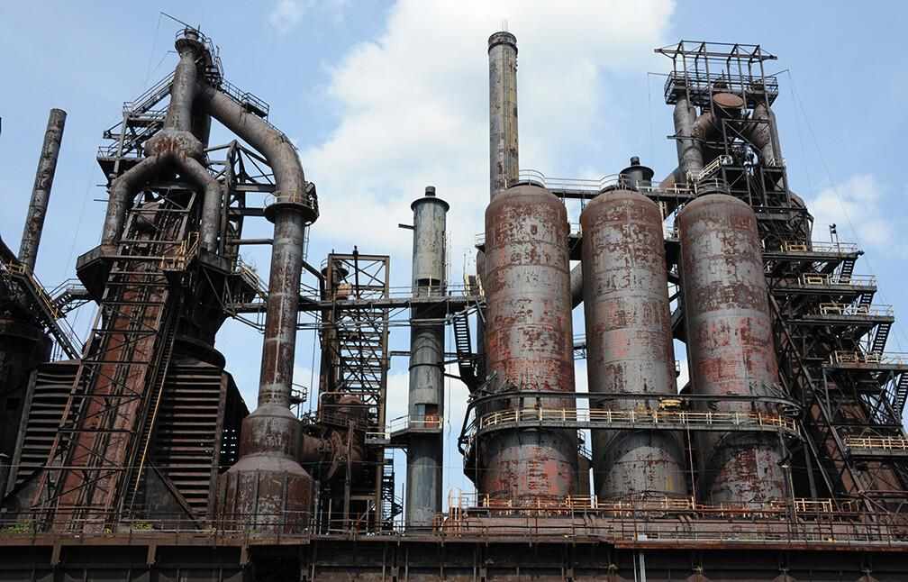
Cathy Bishop
Ohio Steel Mill
Disturbing her sleep constantly, unbearable experience
She inherited the house but the noise has reduced its value so harder to move
Officials have mostly failed to act – some have denied there is a problem
Persistent efforts to seek help from officials at every level have failed
Cathy’s research led her to the Noise Control Act and further puzzlement concerning its lack of effect

Slide 13
Peter Bahouth
Gas-powered leaf blowers
Unneighborly
Destroys habitat for lightning bugs and luna moths
Contributes to air pollution and climate change
MAJOR health and quality of life issue, anything but trivial.
“A homeowner's historic ‘right to quiet enjoyment’ means the legal right to use and occupy their property without unreasonable interference from others, essentially allowing them to live peacefully on their land without disturbances like excessive noise, nuisance behavior, or other disruptions from neighbors or the community; this right is considered a fundamental principle in property law.”

Slide 14
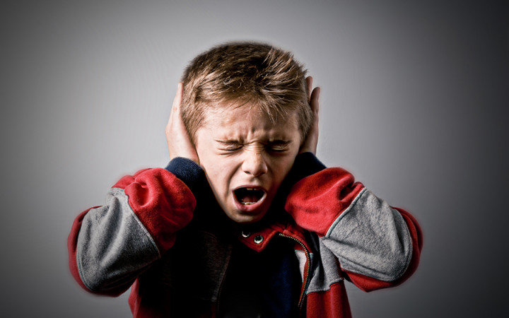
Common Threads
Unresponsive government
There are laws, but the laws aren’t being enforced
Corruption?
Hard to get people to care
Health problems
Often, a simple solution: soundproofing or switching equipment
Right to peace in their home being violated

Slide 15
Thank You
Special Thanks To:
Jamie Banks
Josh Galperin
Trish Glass
Richard Reibstein
+ All the wonderful people who told their stories

