Slide 1
Salting Our Earth
Road Salt Impacts and Alternatives

Slide 2
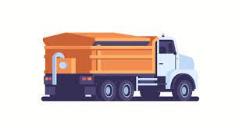
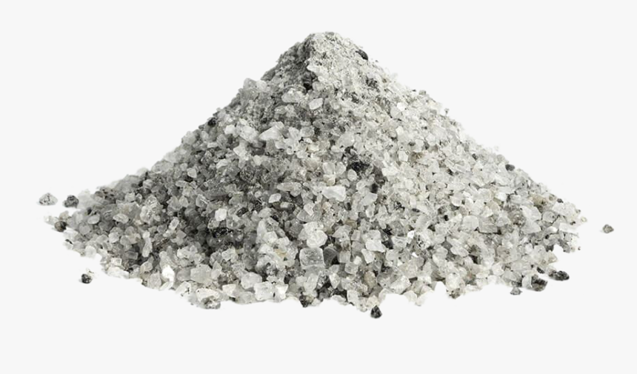
Outline
The Problem | Why do we care about road salt applications?
The Effects | What are some effects we have already seen? Who is this relevant to?
Current Alternative | What are current alternatives to road salt being used?
Promising Alternatives | What are some promising novel alternatives?
Call to Action | How can you help?

Slide 3
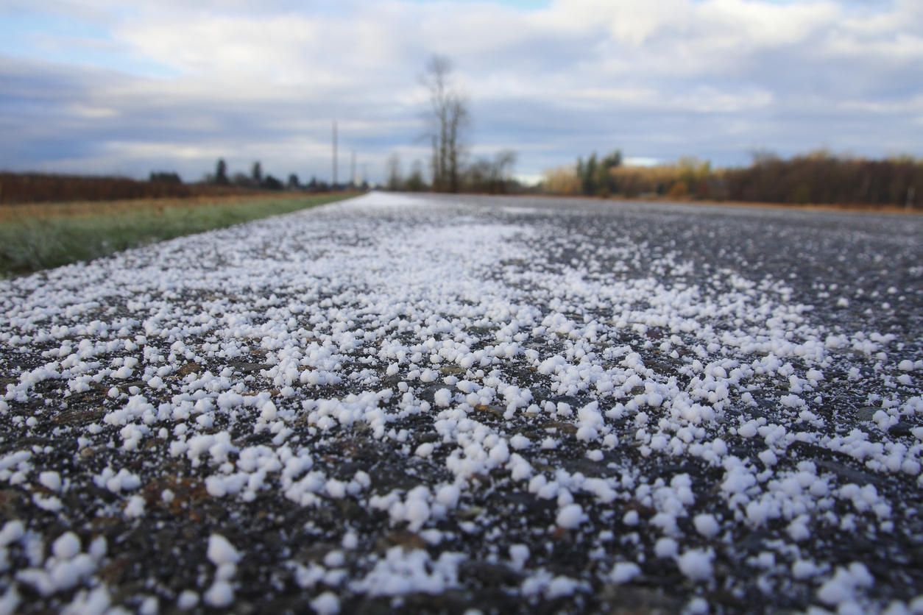
What is road salt?
Most common: NaCl
Implemented before 1940s
Road safety
Image from: https://thewatershed.org/21074-2/
Source: Cary Institute
Notes:
Most common form used is rock salt- which is the larger chunk version of table NaCl
Implemented in New Hampshire before 1940s and quickly expanded across the US and the world
Used to make roads safer for winter driving by lowering the freezing point of water allowing ice to melt and reducing risk of accidents

Slide 4
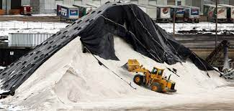
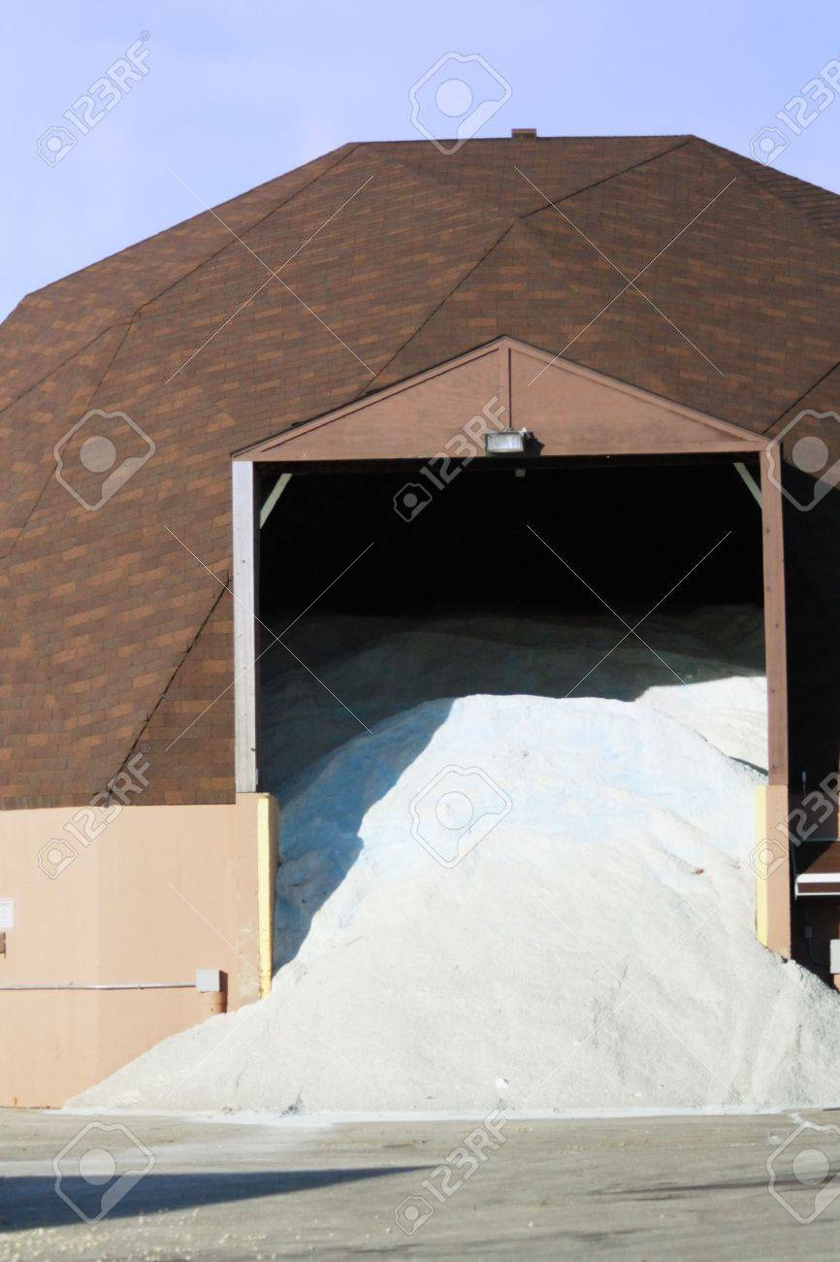
Problems with Road Salt Usage
Volume
  Inefficiency
Regulatory mandates
  Salting
  Storage
Lack of public awareness
Sources: USA Today, NY Gov, Cargill, Will County FPD
Notes:
Volume: usage went from the order of a hundred thousand tons in 1940 to tens of millions of tons today- this is a very dramatic increase over less than 100 year timespan
Inefficiency: the salt spread on the road is also not being totally utilized, as it often bounces off the road and can also be washed away by rain;
Regulatory mandates
Of salting- New York state mandates that all roads be returned to “bare pavement” as soon as possible and this state has one of the the highest salt dependencies; wording in legislation matters
Lack of public awareness
Salt spread by homeowners/business owners is also usually much more than is actually needed to keep walkways safe (at 30 degrees F 1 lb salt melts 46 lbs ice, at 20F 1 lb melts 9 lbs)
You only need about 12 oz of salt to cover 20 feet of driveway- people often use much more than this because they would rather be “safe than sorry” but this can have negative effects

Slide 5
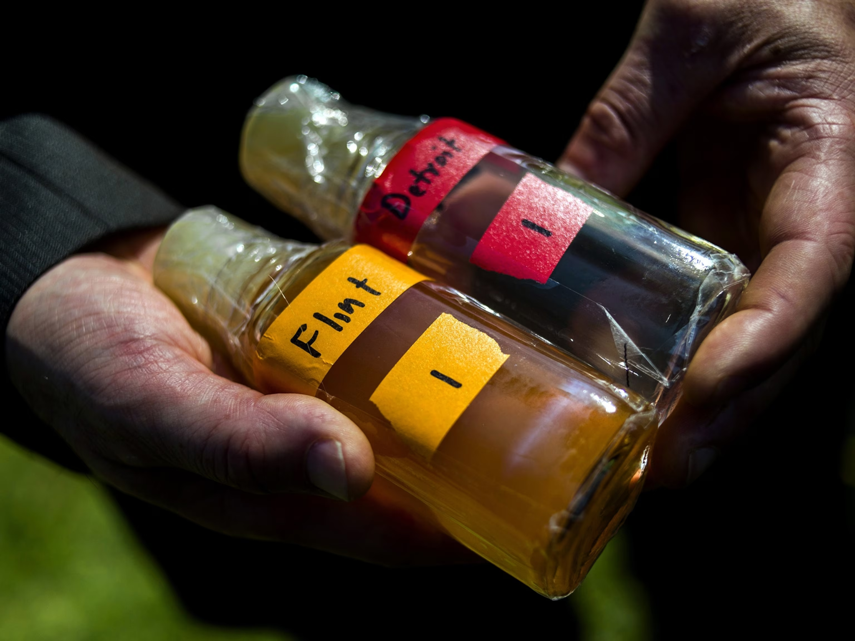
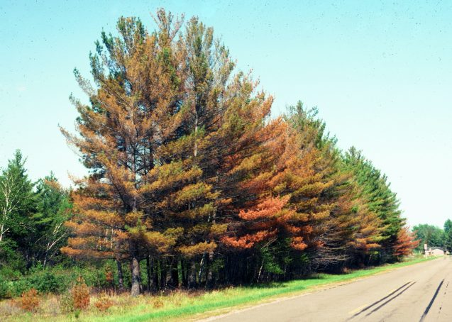
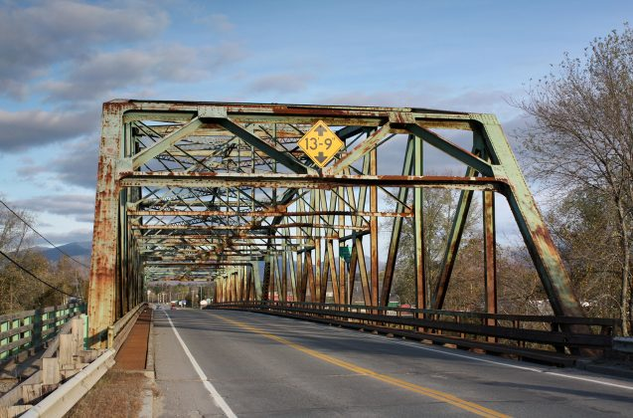
The Effects
Natural Communities
Anthropogenic Interests
Animals
Amphibians
Birds
Moose and other mammals
Ecosystems
Freshwater salinization
Roadside vegetation
Soil health
Human Health
Salt intake
Mobilization of contaminants
Infrastructure
Pipes
Cars
Bridges
Sources: USGS, Journal of Environmental Toxicology and Chemistry, etc.
Notes:
Animals:
Amphibians- mortality and skewing sex ratios- population level effects
Birds- hit by cars and also salt poisoning
Moose- hit by cars which is also dangerous for people
Ecosystems:
Freshwater salinization- polluting water sources for everyone, levels above lethality for some freshwater species
Roadside vegetation- stunted growth, mortality of seedlings, damage of photosynthetic tissues
Soil health- change osmotic gradient which impacts water and nutrient availability to trees and other organisims
Human Health:
Salt intake- humans can’t have too much salt, some places drinking water salinity is significantly above “safe” levels- bad for people on sodium reduced diets especially but not great in general cuz modern diets are already high in salt
Mobilization of contaminants- high levels of chlorides and sodium can lower pH and allow other contaminants to infiltrate drinking water- including lead (and other heavy metals), nitrates, and arsenic
Infrastructure:
Pipes- the lowered pH can corrode the pipes water runs through- concerning because many of the pipes in the US have lead (NRDC) that can contaminate drinking water
*This is thought to have contributed to the Flint water crisis- brought attention to the fact that not all people in the US have access to drinkable water which is often taken for granted
Cars- corrosive effects of salt can “eat up” the undercarriage of cars, rusting also increases due to sodium chloride
Bridges- same concerns plus; penetration of chloride into concrete and once critical densities reached corrosion starts and this causes the concrete to crack/break and reduces the amount of reinforced steel in the concrete making it less safe
-> 0.03 percent chloride to weight of concrete = initiation of corrosion, 0.08 percent chloride to weight of concrete = accelerated corrosion, and 0.18 percent chloride to weight of concrete = major section loss of steel

Slide 6
Current Alternatives
Alternative Salts
Brine and Organics
Traction Materials
Magnesium Chloride
Potassium Chloride
Calcium Chloride
Sand
Cat litter
Brine
Pickle, Cheese, etc Juice
Better Application
Reduced Service
Best Management Practices
Computer systems to control amount of salt released and reduce scatter
Closing non-essential roads
Using least amount of salt possible while maintaining safety of roads
Notes:
Salts still have similar problems, some work better at lower temperatures than sodium chloride
Brine and organics allow salt to stick to road better reducing scatter and the amount of salt needed
Traction materials allow tires to gain traction on snowy roads
Computer controls on trucks that spread salt allow for more precise application and reduces the excess salt put on the roads
Closing roads that aren’t essential has been used in various places across the US and in China, this makes drivers think about conditions and plan accordingly- in New York some residents said they would be ok if roads were closed during inclement weather
Best management practices are the combination of many of these alternatives that attempts to keep roads safe while maintaining the current expected level of service

Slide 7
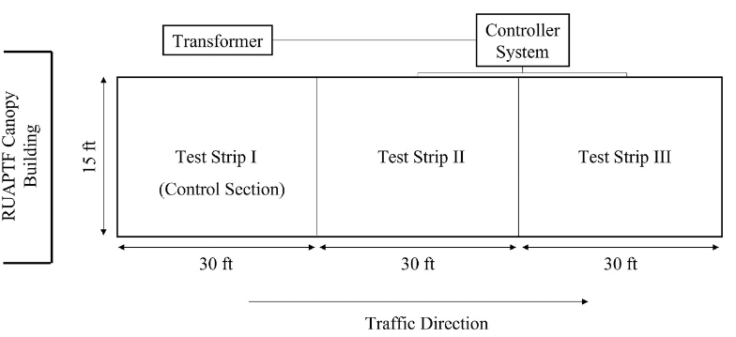
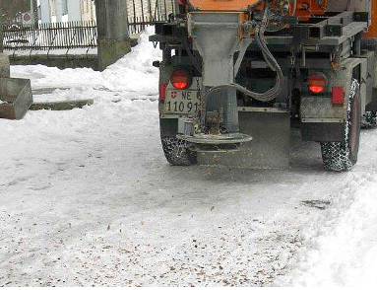
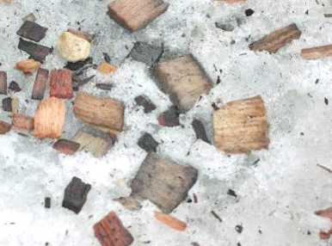
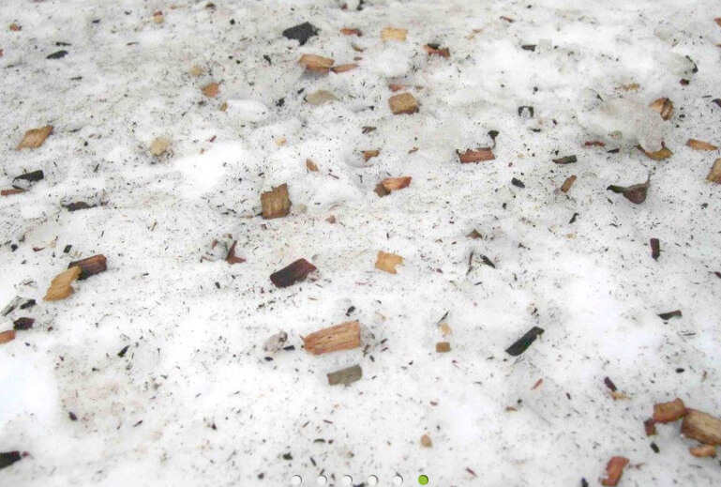
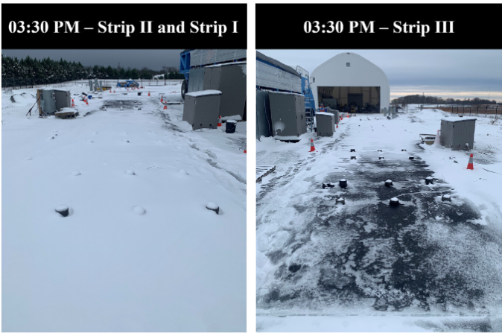
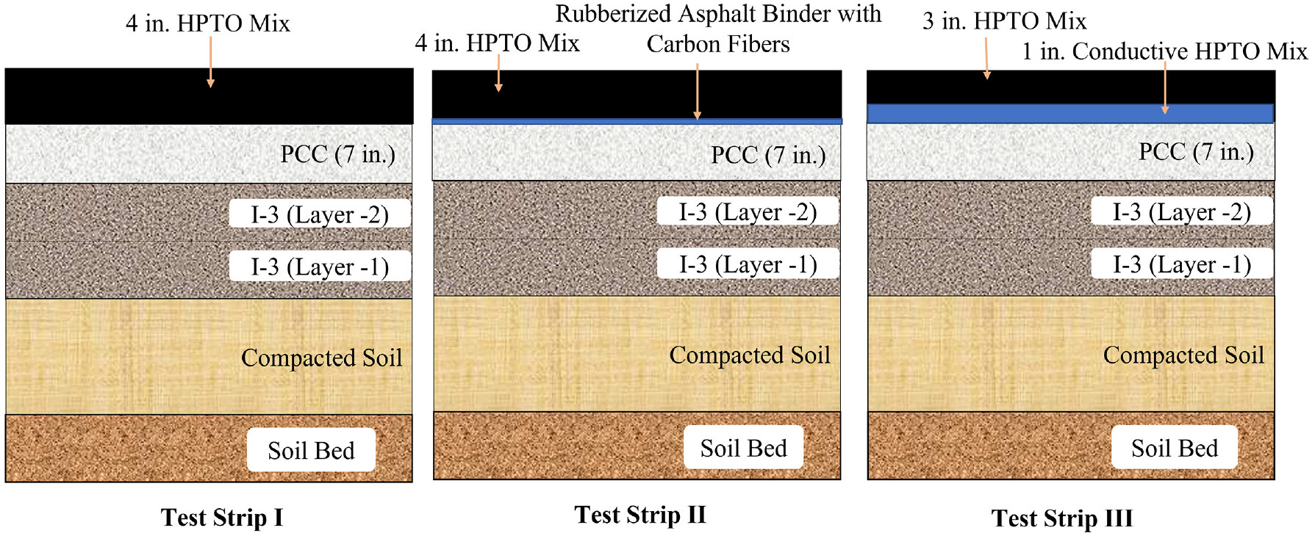
Promising Novel Alternatives
Modified Pavement
Coated Woodchip
Heated pavement tested by Rowan University
Activated by environmental conditions
Developed in Switzerland
Coated in Magnesium Chloride
Locks in place to provide traction
Notes:
Rowan university has been testing pavement that is heated using electricity. This pavement begins to heat when triggered by certain ambient conditions, and they found that their heated pavement was able to keep the surface temperatures 10 degrees higher than control plots when temperatures drop when the ambient temperature drops from 25°F to 12°F using 24 V of electricity
In Switzerland, there has been an engineered wood chip coated in magnesium chloride that melts into the snow/ice and then locks into place, providing more traction without spreading the mass amounts of salts- the chips are engineered to fit in the salt spreading trucks in Europe (could probably be made to fit here too) used to

Slide 8
Call to Action
01
02
03
04
Reduce Your Salt Use
Advocate For Legislative Change
Shovel first
12 oz for 20 ft driveway
Alter language
Call on govt to teach
Get Involved in Your Community
Use Government Resources!
Talk to city council, sustainability committee
State revolving funds
Notes:
How can you get involved in reducing the amount of salt dependence in the US?
The first way is by reducing the amount of salt you put down! When I started this project I thought about the way that I personally used salt, and how I have never considered the amount I place down. After working on this, I realized I am putting too much salt down. This small change can make an impact!
Advocate for changes to the way that laws are written, as NY state’s mandate to return to bre pavement has caused this state to become on of the highest dependency states in the US, potentially changing the wording to not require bare pavement and instead safe roads or something similar
Talk to your local government about the amount of salt they use, the protections in place to prevent excess salt from being released, and if they have any alternatives that may be utilized in the near future. Also, talk to your fellow neighbors and spread the word about this problem! One of the main issues is actually knowledge of this issue, as most people dont think about road salt very much since it is “hust a part of life”
Encourage you city to use government funds to being infrastructure that reduces the opportunity for excess salt to be released ito the environment, advocate for education of laypeople about the issue and how much salt is actually needed to keep roads and sidewalks safe during winter
local sustainability committee, city council, talk to DPW or conservation commission
Call to action for lawmaker

Slide 9
Thank You!!
Thank you to Professor Reibstein, fellow classmates, and also the wonderful professionals that helped me learn about this topic!

Slide 10
Sources:
Cary Institute- https://www.caryinstitute.org/sites/default/files/public/reprints/report_road_salt_2010.pdf
Cargill- https://www.cargill.com/at-what-temperature-does-rock-salt-stop-working#:~:text=At%2030%200F%2C%201,amount%20of%20ice%20melting%20action.
Will County Forest Preserve Distict- https://www.reconnectwithnature.org/news-events/the-buzz/too-much-road-salt-bad-for-environment/

