Slide 1
Lead Paint Right to Know Act
S. 2353 (Kavanagh) / A. 4820 (JD Rivera)

Slide 2
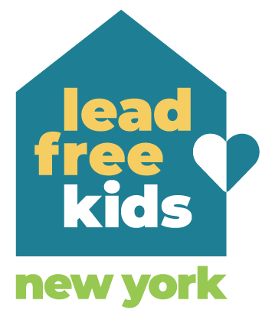
Lead Free Kids NY
Lead Free Kids New York (LFKNY) is a growing statewide coalition of individuals, groups and organizations working together to end childhood lead exposure and poisoning in New York by advocating for state-level policy solutions to eliminate lead hazards in housing and other community settings.
Our members include parents, teachers, healthcare workers, child, environmental, public health and tenant advocates, researchers, lawyers, and many others united in our belief that all New York children deserve to be #LeadFreeKidsNY.

Slide 3
New York State’s Lead Issue
🏠
About 78% of New York’s housing stock was built before 1978 when the lead paint ban went into effect nationally
🏙
New York State has some of the highest rates of lead poisoning yearly. In 2017, 25 upstate counties had higher percentages of children testing positive for lead poisoning than in Flint, Michigan at the height of its crisis
🚸
Lead disproportionately impacts children of color and low-income children. The distribution of lead poisoned children along racial and socioeconomic lines affirms lead poisoning as a racial and environmental injustice

Slide 4
Why is this bill important?
Lead in paint and dust, causes detrimental health effects
Purchasers of residential properties often do not know if the property they are buying contains lead paint or lead-based paint hazards. Without this knowledge, families cannot take steps to prevent their children from being exposed to lead. Currently, the primary way that people are alerted to the presence of lead paint is when their children are found to have elevated blood lead levels. It is therefore critical to identify lead hazards before children are poisoned.

Slide 5
Why is this bill important?
This act will complement existing state and local laws on lead poisoning prevention. Section 1377 of the public health law, enacted in 2023, requires DOH to develop a registry of all rental residential dwellings with two or more units built before 1980 within communities of concern outside of NYC, and require they be inspected for lead hazards at least every 3 years. The act will require inspection reports that are developed to be included on the registry of lead inspections that DOH is creating.

Slide 6
What does the bill do?
Requires owners to arrange for testing for lead-based paint and related hazards in their residence at any time prior to selling their property, and to provide purchasers with a certificate confirming that the property has been tested along with a report on the results. That certificate and testing report will be filed with the county department of health and the NYS Department of Health’s statewide registry of information about lead paint in housing. If the owner conducts the testing in connection with the sale, they may deduct the cost of testing from the transfer tax.

Slide 7
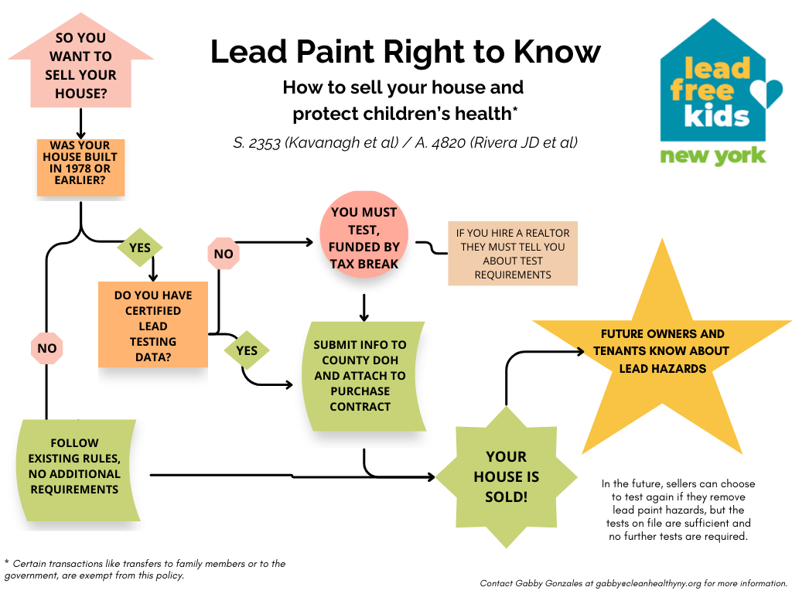

Slide 8
Thanks
Email gabby@cleanhealthyny.org with questions or ways to get involved! Or go to LeadFreeKidsNY.org for more information about our coalition.

