Slide 1

The Wildcat
Green Chat
EE 538: RESEARCH FOR ENVIRONMENTAL AGENCIES AND ORGANIZATIONS 2
ISABELLA DIAS-LAM
Boston University
Notes:
Hi everyone, thank you for attending. My name is Isabella and I will be presenting my project, The Wildcat Green Chat.

Slide 2
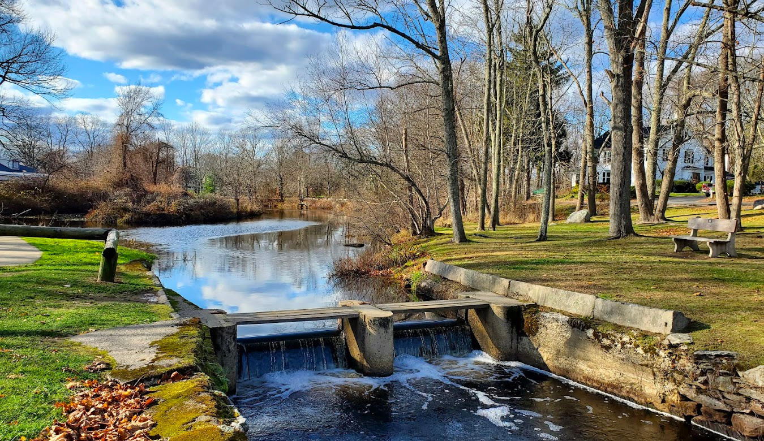
The Town of West Bridgewater, MA
  Population: 7,000+
  Area: 15.7 miles²
  Median age: 39.8 years
  30 miles south of Boston
  Primarily consists of residential, farming, and industrial zones
  Major open spaces include the Hockomock Swap, West Meadows, and WB State Forest
Notes:
For my project, I wanted to go back to my roots and investigate conservation efforts within my hometown, West Bridgewater, MA.
West Bridgewater, which I will refer to as WB, is a small farm town consisting of over 7,000 residents across almost 16 square miles.
The town's land is primarily made up of residential, farming, and industrial zones.
The town is home to a large number of protected and open spaces, the most well known of them being the Hockomock Swap, West Meadows, and the WB State Forest.

Slide 3
Current Conservation Efforts
Master Plan
of 2001
Conservation Commission
Open Space and Recreation Plan
  1
  2
  3
  Comprehensive town plan made in 2001
  Developed by the town in coordination with private partners
  Still in effect to this day
  Active since 2014
  Aim to create planned development in concordence with protecting wetlands and waterways
  Hosts town events
  Allows the town to apply for state grants
  Goal of fostering environmental stewardship
  Aims to support the lifestyle of residents
Notes:
I began my investigation by looking into current conservation efforts within town.
The Master Plan is a comprehensive town plan made in 2001, made to set guidelines on town development and the management of our natural resources and open spaces.
The Master Plan is still in effect today over 20 years later.
The Conservation Commission has been active since 2014 and aims to develop the town while keeping the natural landscape in mind. The Conservation Commission also helps coordinate events to get residents outside and engaging, with events such as the WB Clean-Up Day and River Walk.
The existence of an Open Space and Recreation Plan allows the town to apply to state grants, and has goals of fostering environmental stewardship and support the lifestyle of residents. Similarly to the Conservation Commission, the Open Space and Recreation department hosts town events for residents.

Slide 4

The Need to Improve Information &
Engagement Amongst Residents
Findings from Tracy
Field Research
  Most town information is shared on the town website or social media
    Leaves out residents who are less tech savvy or not on social media
    Written information would hit a missing segment
  Open Space and Recreation (OSR) Plan
    Looking for resident input to prioritize appropriate open spaces
    Recently had a 50+ person event when there is typically 10 - social media works but how can we get more people
  Conducted interviews with local residents
    Most residents are unaware of the Master Plan
    Wishes that information was more easily located and compiled
    There is a lot of value around the local nature - just not enough involvement
  Reviewed town documents
    No official invasive species management plan
    No biodiversity monitoring
    No composting intiatives
Notes:
After looking into the conservation efforts currently going on in town, I became interested in how effective they were, and how residents can become more informed.
I spoke with Tracy Altrich, who serves as the Town Planner. I learned from Tracy that the main methods of spreading town information are the town website and social media, mainly Facebook. These methods of sharing information have been proving effective following a recent spike in resident attendance to an Open Space and Recreation event, with over 50 residents attending compared to the usual 8-10.
I also spoke to local residents ranging from young adults to adults. The information I gathered suggests that residents appreciate and value the local environment, but are uninformed on current efforts and find the information to be difficult to locate without visiting multiple sites. I also looked into town documents and found that the town is lacking initiatives that could motivate residents to enact personal change, such as a composting initiative and an invasive species management plan.
From all of this information, and with guidance from Tracy, I decided that residents need another form of receiving information, such as a written form, as well as a way to receive all information pertaining to sustainability and conservation in a simple, compiled form.

Slide 5
Proposal: A Brochure
to Increase Resident
Engagement in Conservation
Notes:
That is why I am proposing a brochure to increase resident engagement and the flow of information regarding conservation.

Slide 6
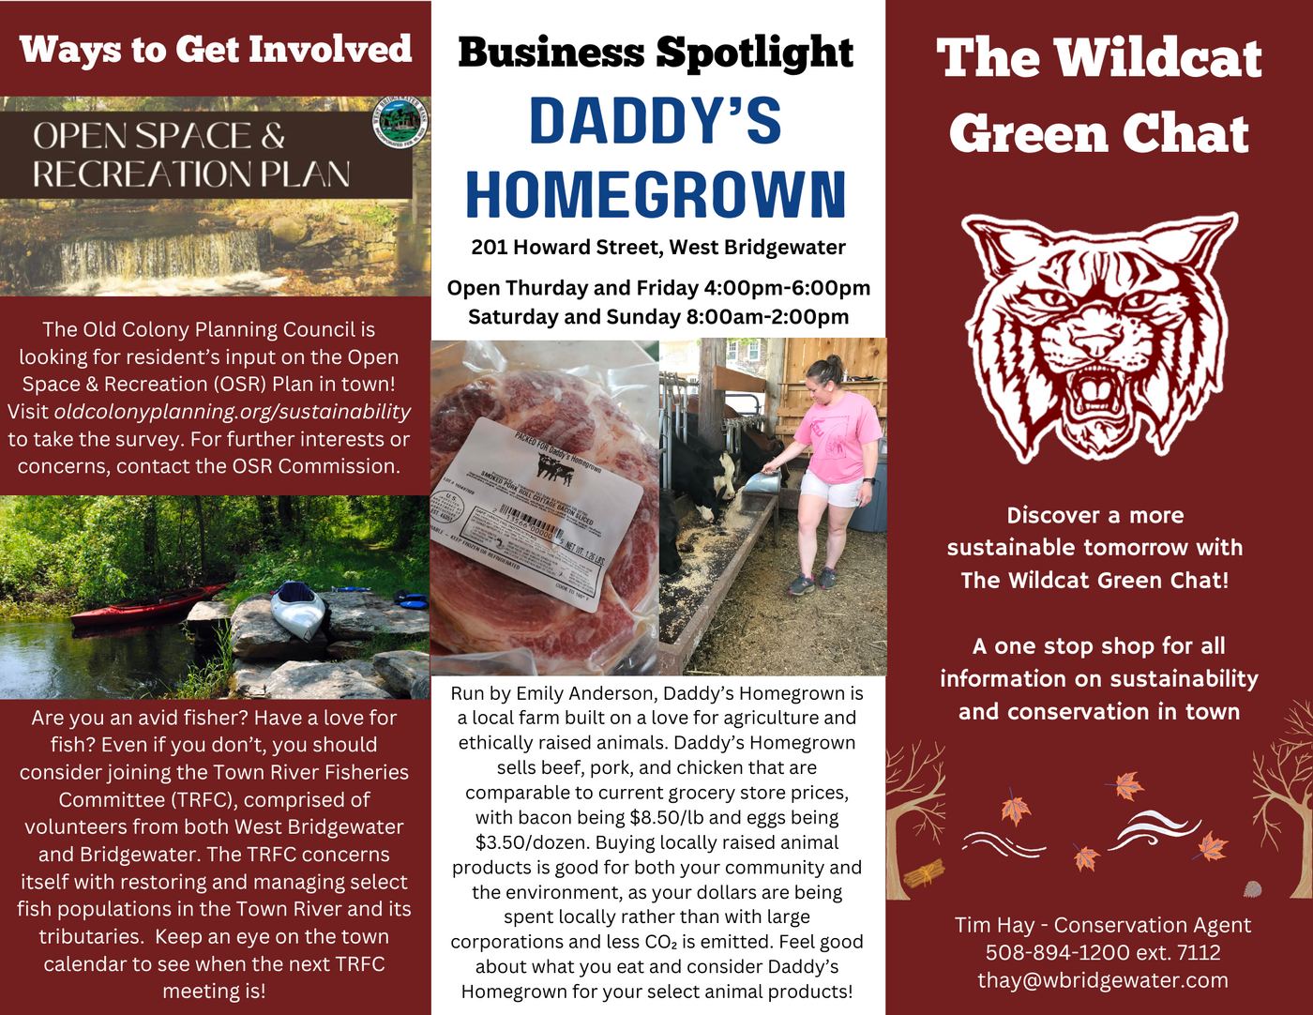
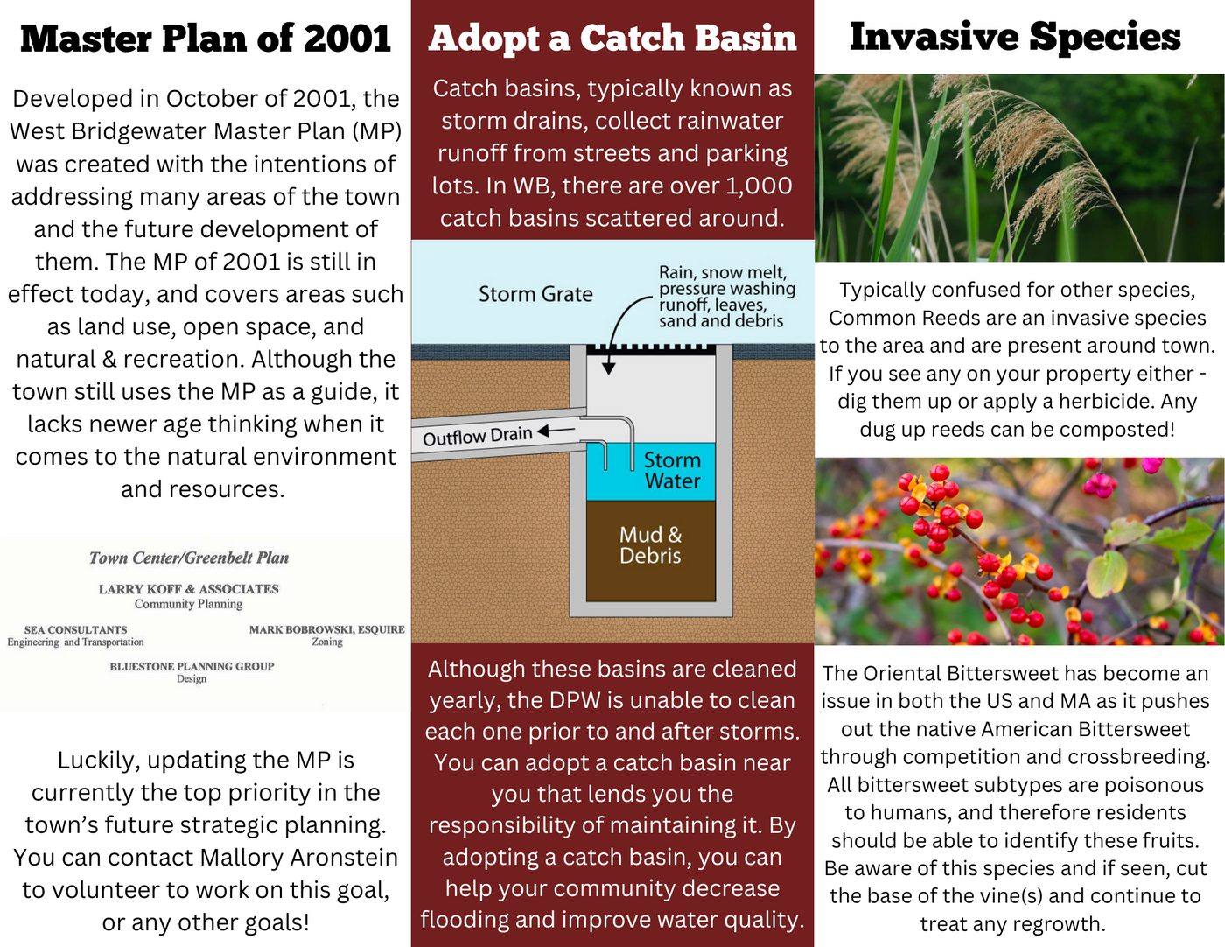
Design Overview
Front/Back
Inside
Notes:
Here is a draft design of said brochure, titled The Wildcat Green Chat. The front and back would include the title page, a business spotlight that serves as advertisement, and ways residents can get involved. The inside would include information on local programs, policies, as well as information that the town is not addressing currently.

Slide 7
Content Breakdown - Front/Back
  Business Spotlight:
    Promote buying from local businesses
    Contributes to the local economy and environment
    Provide environmental benefits behind it
  Ways to Get Involved:
    Another method of spreading the word about initiatives and events
    Raise meeting attendance numbers
    Further the progress of current and future intiatives
Notes:
The business spotlight aims to promote buying from local businesses to contribute to both the local economy and environment. The spotlight should also include reasons as to why buying from said local business would be more environmentally conscious, which in my example of Daddy's Homegrown, includes the fact that buying locally raised animal products can lessen CO2 emissions associated with transportation.
The ways to get involved section would serve as another method of reaching out to residents and hopefully raise attendance numbers in local meetings and events - all of which would further the progress of current and future initiatives.

Slide 8
Content Breakdown - Inside
  Master Plan of 2001:
    Raise awareness of the MP
    Call to action for upgraded MP
  Adopt a Catch Basin:
    Inform residents of the program
    Increase community engagement through adoption of these
  Invasive Species:
    Get residents thinking about invasives
    Encourage the eradication of invasive species
    Provide instruction for the means of ridding these invasives
Notes:
For my draft, I decided to include the Master Plan of 2001 as through my interviews, I found many residents to be unaware of the plan, including residents who have been in the town since before 2001. This not only raises awareness for the Master Plan, but acts as a call to action for an upgraded Master Plan to address newer issues.
In the middle, I included a section for the Adopt a Catch Basin program, as both my interviewees and I myself were unaware this program existed. Informing residents is the first step, and the hopes are that by informing them, residents will spread the world and increase resident engagement.
Lastly, I included a section on Invasive Species to address that 1) the town does not have an invasive species management plan and 2) get users interested in this topic and serve as a call to individual action. Providing instructions for the removal of these species would serve as a simple way to support the eradication of invasives without spending additional town funds.

Slide 9
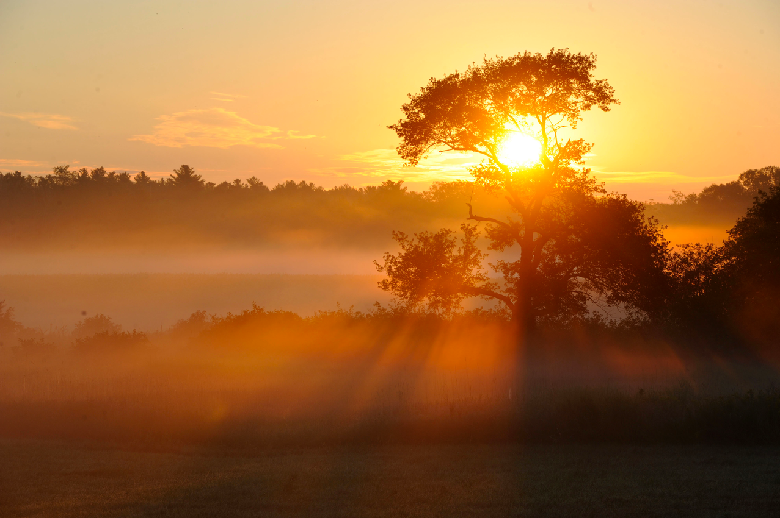
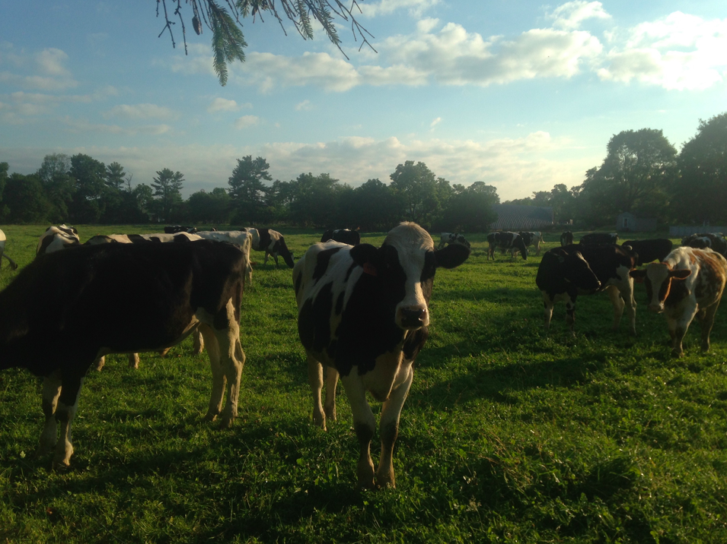
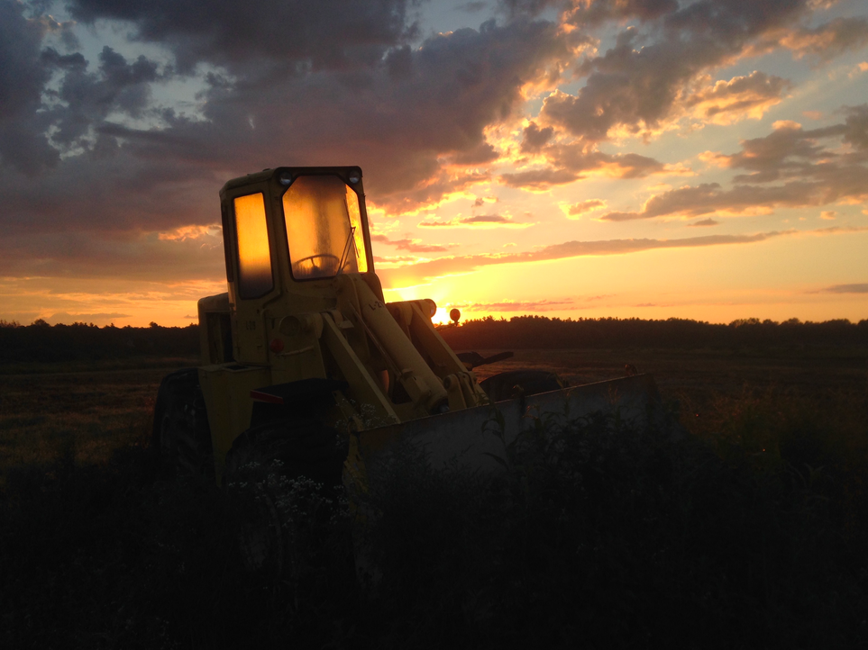
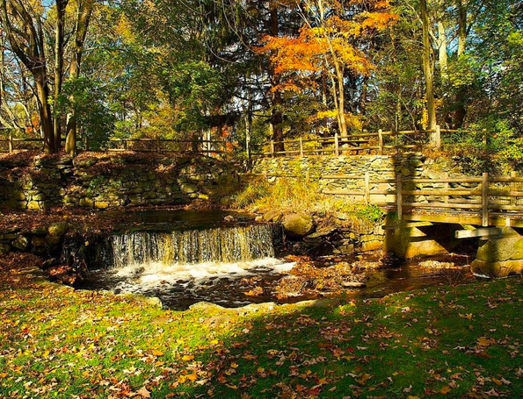
Anticipated Benefits
Greater interest in local landscapes
Local business support
Engagement amongst all residents
Increased use of open spaces
Notes:
With the development of my brochure, the town can anticipate a number of benefits, including:
1. Greater interest in local landscapes
2. Local business support
3. Engagement amongst all residents of all ages
and
4. Increased use of open spaces, which should in turn continue to further interests in local landscapes.

Slide 10
Timeline
Find volunteers:
Reach out to local organizations and the highschool environmental club to develop a team to manage the brochure
Get the ball rolling:
Host a community event to premiere the brochure and to get residents excited and engaged
Presentation:
Present draft brochure and findings to the town and make revisions for a final draft
Advertise:
Speak to local businesses about being highlighted under the business spotlight section
Launch:
Release the brochure and monitor reader engagement for possible improvements
Notes:
As for the actual development, here is a timeline for the town to follow.
Following this presentation, the town should reach out to local organizations and the head of the highschool environmental club, Jonathan Pike, to look for volunteers to manage the brochure. The town could also incentivize the students by offering service hours in exchange.
Once a team has been formed, they should speak to local businesses about being highlighted and consider collaborative events with related businesses, such as local farms.
To raise excitement, the team should host an event that would garner attention and allow them to premiere the brochure.
After launching, the team should monitor reader engagement and consider possible improvements addressed by residents.

Slide 11
Thank you
for your time!
Notes:
I hope you find inspiration in the brochure and your own home town, thank you!

