Slide 1
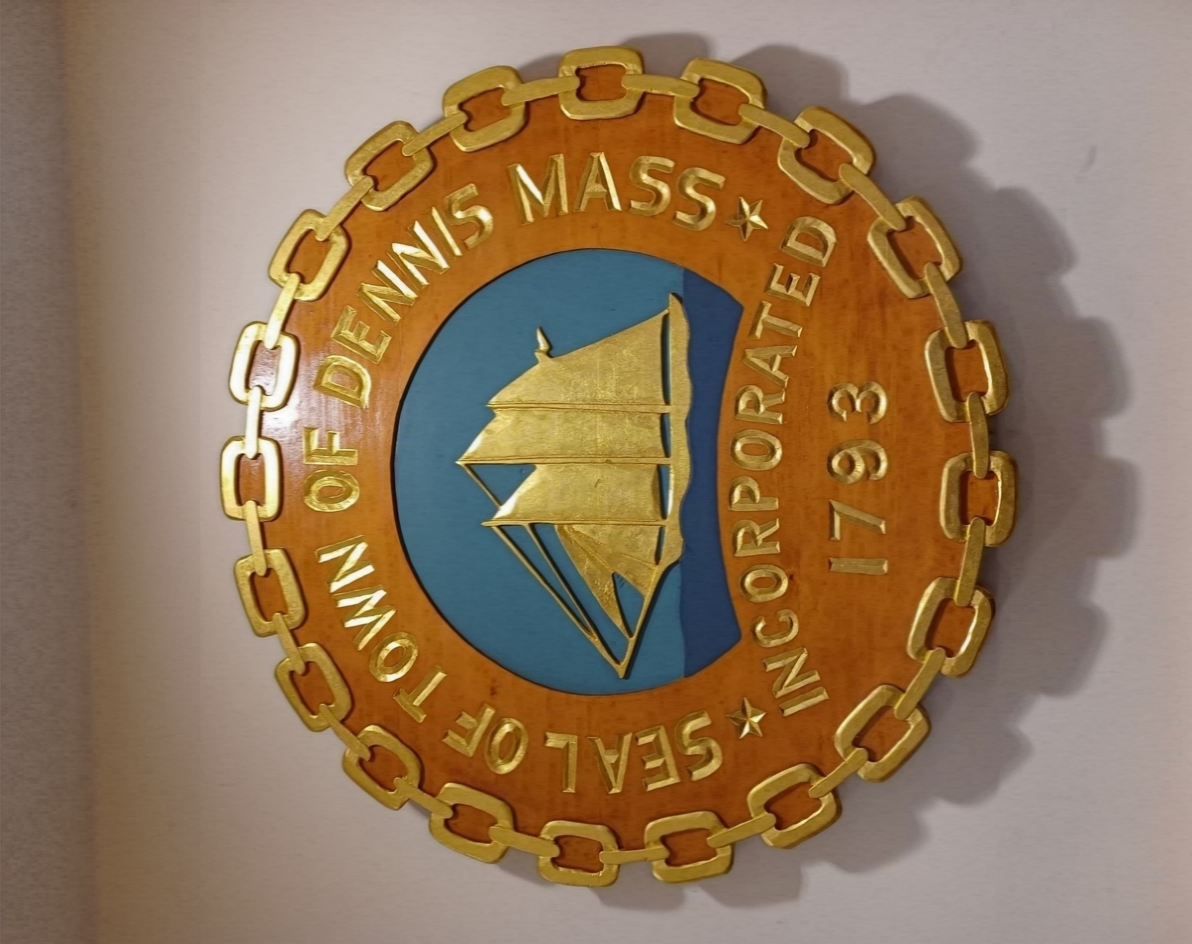
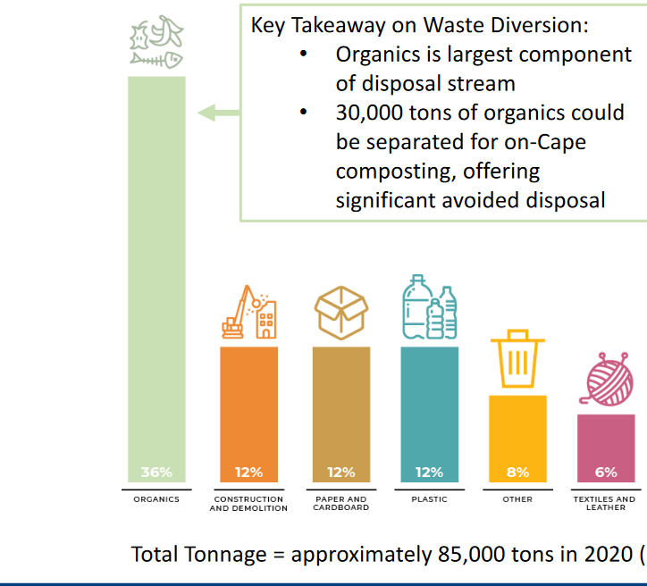
Town of Dennis, MA
Michael Lavin – Public Works Director
Julie Kennie – Climate & Coastal Resiliency Committee
Barnstable County Waste Profile
Cape Cod Commission – 12/21 Report
15,000 year-round residents (estimated 5,000 households) - doubles in summer
Rely on SEAMASS sole-source incinerator - running near capacity – fees rising fast
Moratorium on new incinerators in MA - no available landfills
Unreliable recycling markets & infrastructure BUT state now investing heavily
Export C&D out of state
Risk needing to export all MSW via rail, out-of-state
Reducing our dependence on SEAMASS key to both
“risk- & cost-avoidance” & reduction of town’s carbon footprint
Need to educate & motivate citizens to both reduce household waste,
& increase the amount we “divert” from SEAMASS
7 project opportunities for students
Organics
Construc-tion
Paper
Plastic

Slide 2
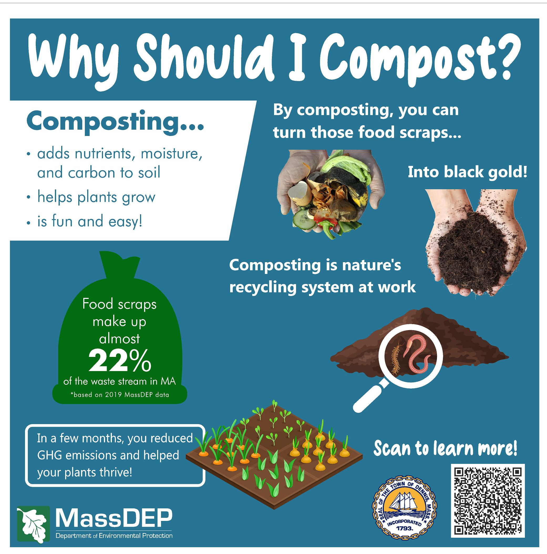
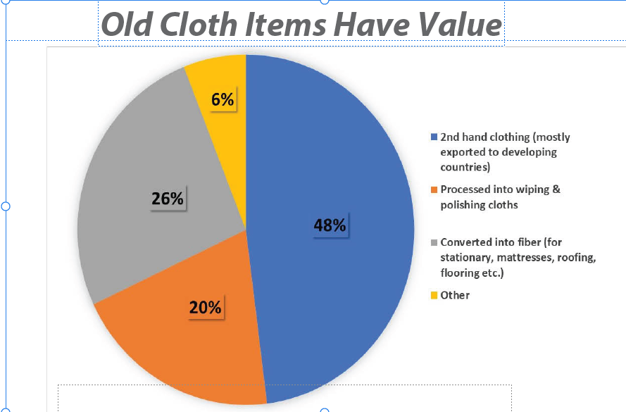
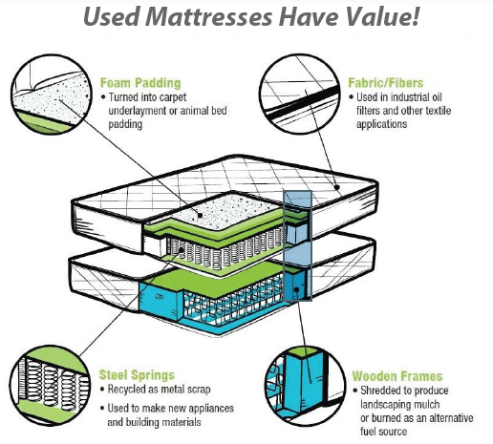
Dennis “Zero Waste” Goal - Increase diversion of MSW from 15% to 30% by 2030
  Expand use of food composting (25% of organics) & recycling
  Outreach & education for households, businesses & schools
  Improve visibility of composting bins
  Promote “reduced use” & “re-use”
  Educate public on current state of recycling & incineration, & benefits of
  “reduced use/re-use”
  Communicate Zero Waste goals. Provide “challenges” & “dashboards” via app, to engage/motivate the community & show progress
  Improve visibility & access to places for large & hard-to-dispose-of items, textiles, donation locations
  Educate public on new state laws
  Promote waste reduction via “re-development” &
  sustainable building
  Review zoning/ bldg. codes
  Research new materials & educate public on “re-use”
  Develop enabling partnerships/infrastructure
  Promote sustainable building practices, to consumers & businesses, through toolkits, seminars, showcases & fairs
350 tons Food Scraps
$40k
200 tons Textiles
$50k
2800 Mattresses
$50K

Slide 3
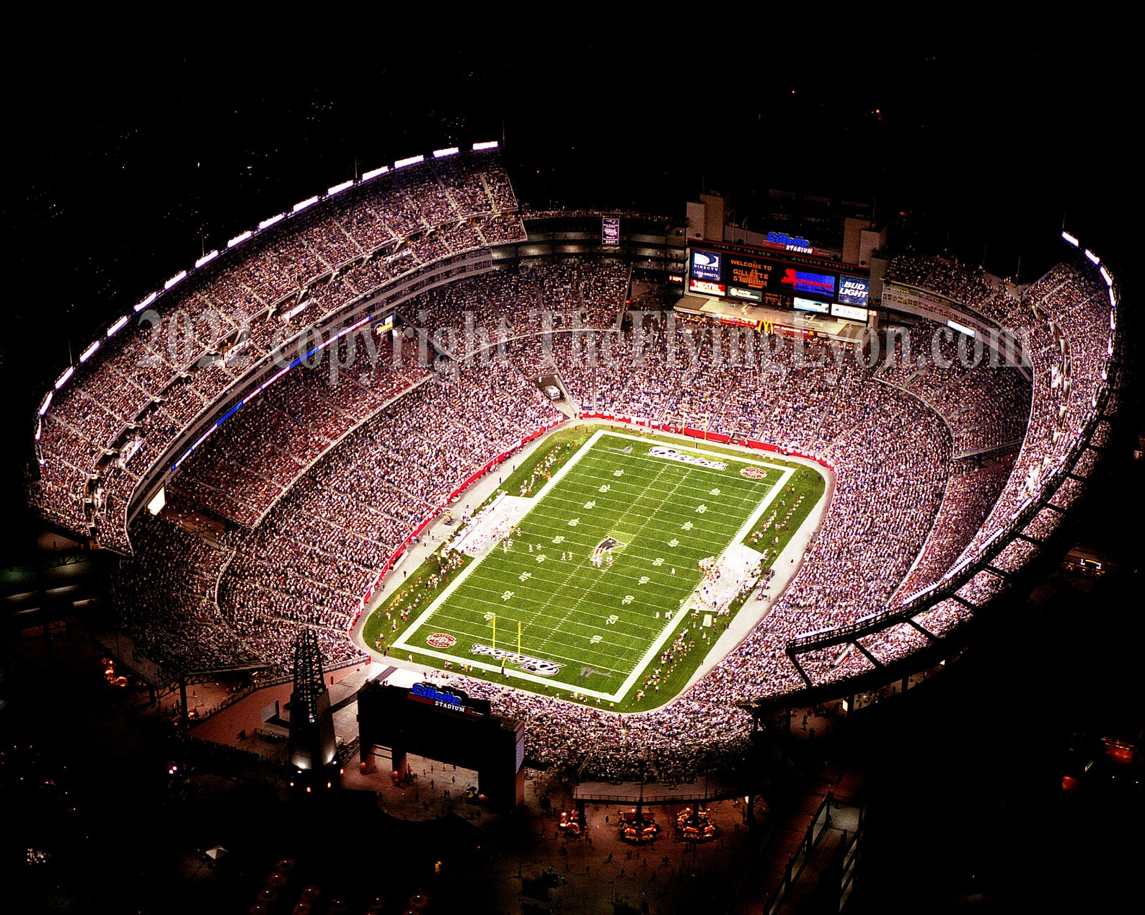


Example – Targeting Dennis Food Waste
Annual averages for solid waste disposal at Dennis Transfer Station. (* Food tonnage estimates based on 2022 data from Barnstable County DEP)
3816 tons of bagged household waste including 345 tons* of food scraps = 327 tons of C02 emissions from incineration!
Avg lbs per Household Annually, 2017 to 2022
Enough food scraps to…
Fill almost 1 ½ football fields
1000 lbs bagged waste
Haulage is $109/ton & accelerating!
Composting food is free!
Annual “opportunity cost” of
not composting food nearly $40K!
Drive a gasoline car
761,000 miles or…
Dennis Infrastructure
in Place
3 lbs/HH
composted
Charge 36 million smartphones
Source: (EPA WARM Model & GHG equivalency calculator)

Slide 4
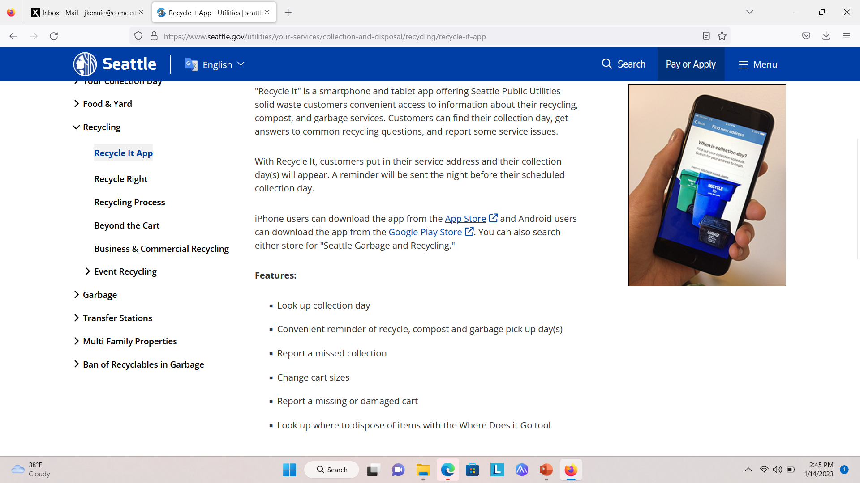
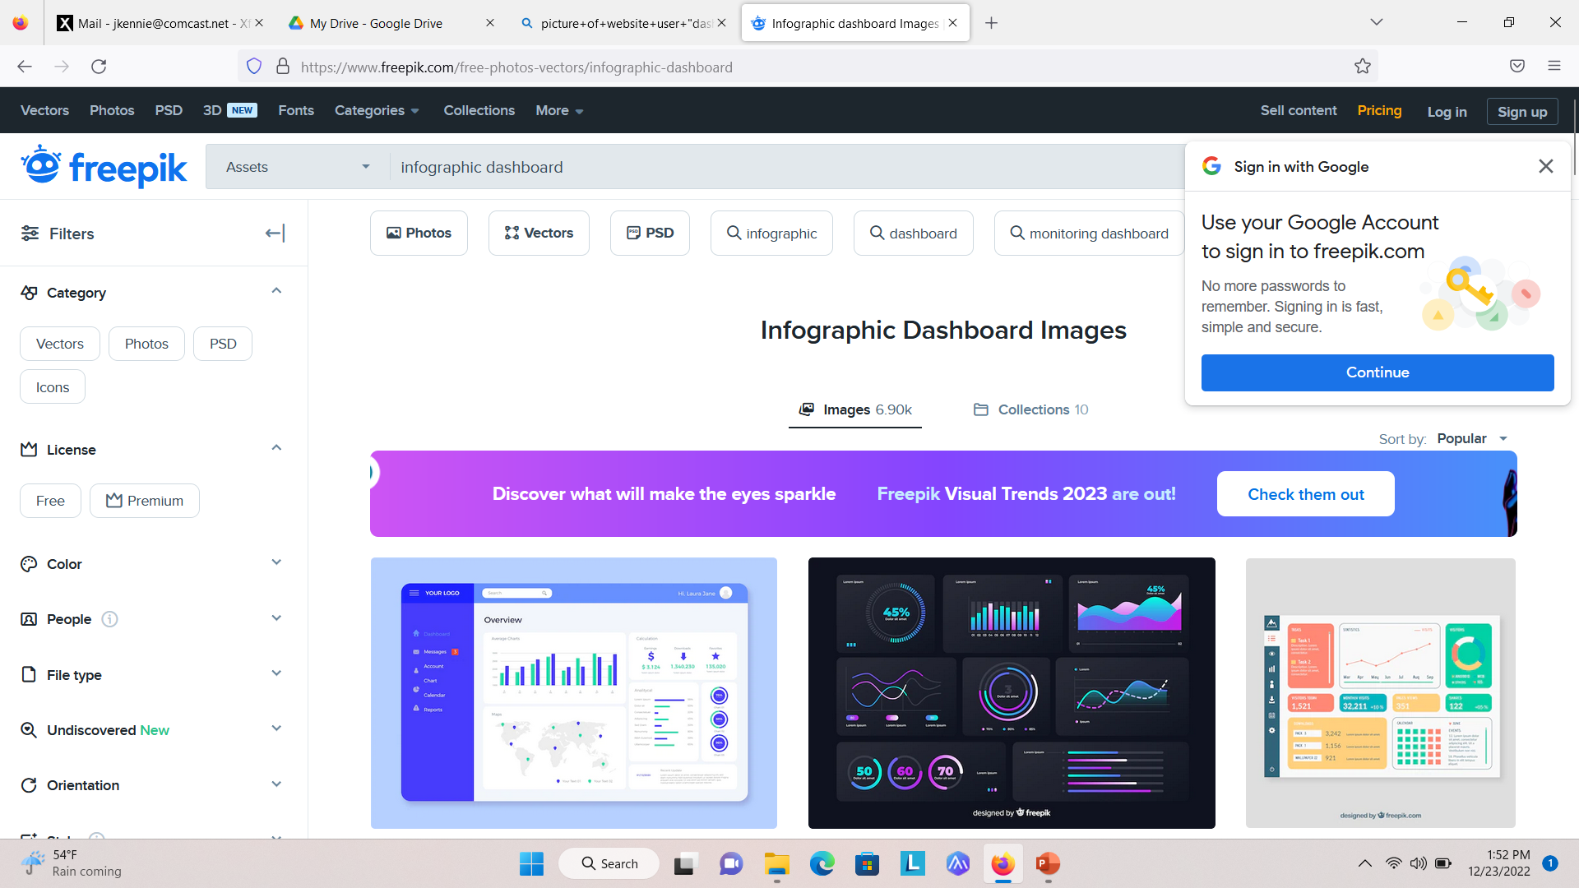
Project Priority #1
Develop “Sustainable Dennis” App for Dept of Public Works Transfer Station
Inform, educate, instruct & motivate our Dennis stakeholders (households, businesses, visitors, students) about how to improve our diversion rates
Use at the point-of-purchase, at home, at our transfer station & to educate/motivate our kids & visitors to produce less waste
Investigate apps most highly-rated by users. Explore opportunities to leverage best practices of municipalities on the Cape & in the US
Include features proven to provide productivity benefits for DPW personnel
Research & determine budget needed to code, de-bug, launch & maintain
Make a recommendation on relevant grants to pursue & how best to do it

Slide 5
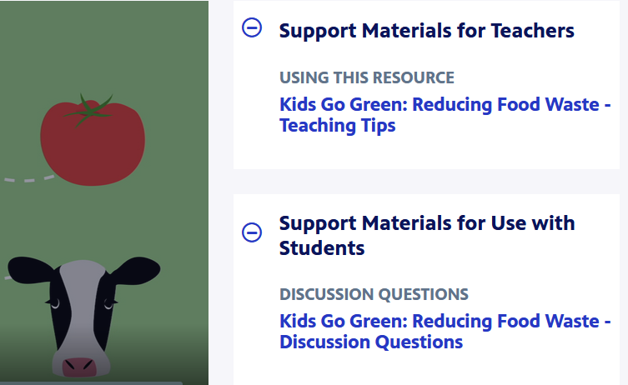
Project Priority #2
Develop Food Composting Educational Program for Dennis K-12 Schools
Work with Dennis Library staff & K-12 schools, to develop programs to educate the students about food composting. Later campaigns may focus on sustainable building practices, plastics or other materials in our MSW
Research & identify the very best free educational “content” & courseware, that Dennis can leverage
Sources to investigate include National Geographic, Society, PBS Learning Media, World Wildlife Fund, USDA, EPA & other municipalities & environmental non-profits.
Evaluate “content” & do necessary outreach to organizations who “own” it, to confirm our ability to use it in our community outreach & education campaigns

Slide 6
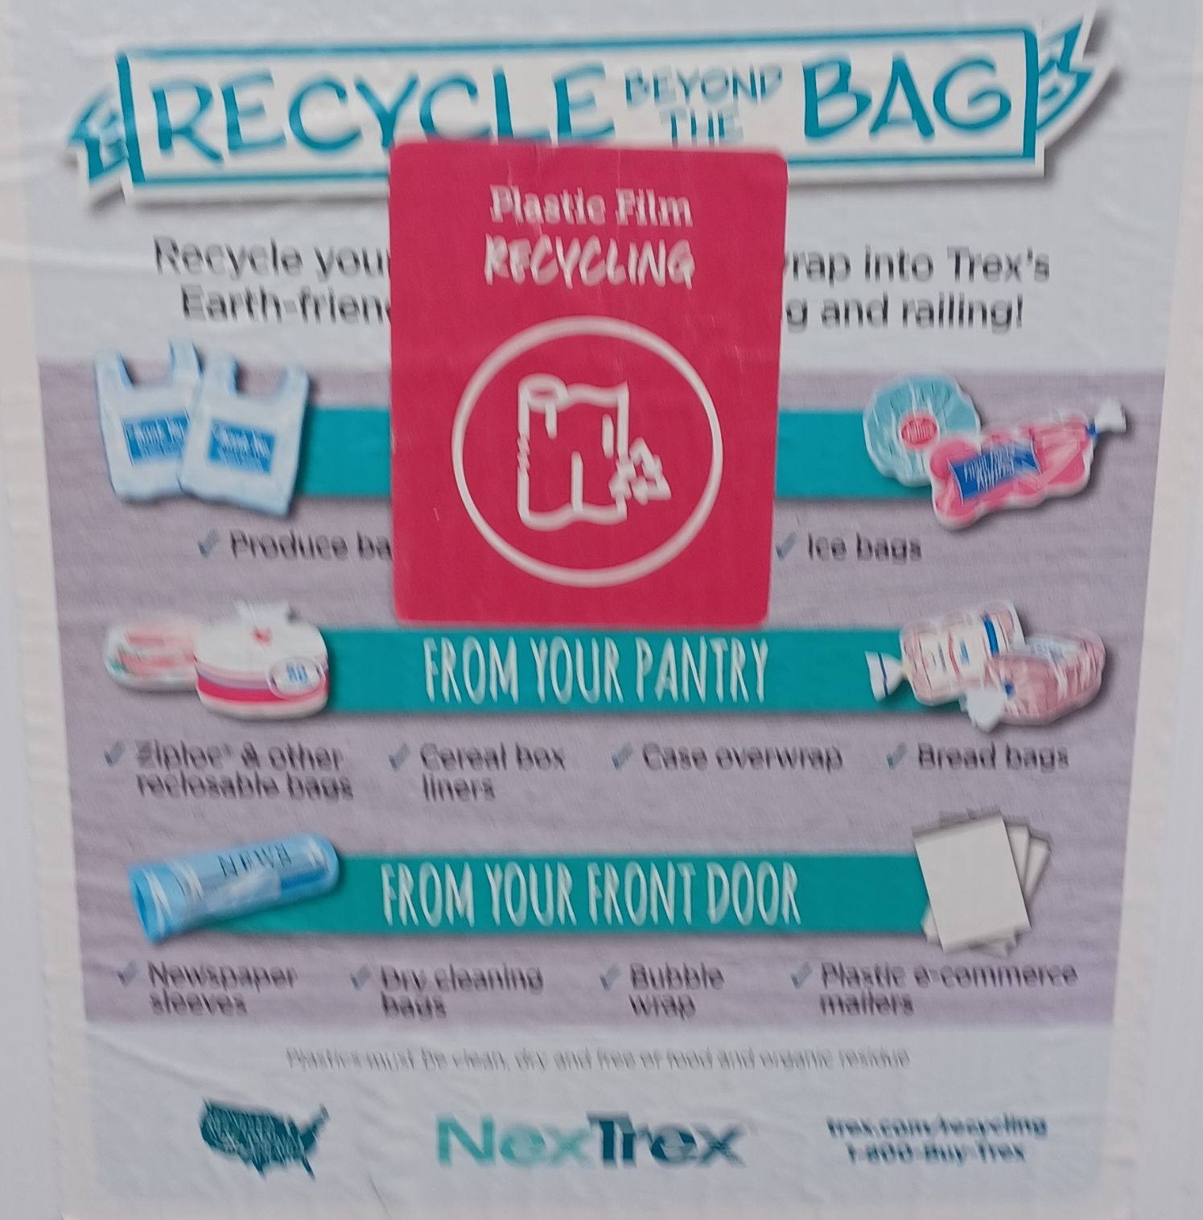
Project Priority #3
Investigate Feasibility of Thin Film Service at
Dennis Transfer Station
Only 14% of 86 million tons of plastic packaging produced during pandemic was recycled
NexTrex® Retail Recycling Program, helps companies such as Rent the Runway, LL Bean & Urban Outfitters transform their single-use plastic waste into sustainable Trex® outdoor products
Research & ID opportunities to work with companies such as NexTrex, to add new services to our Transfer Station, for thin film & other typically non-recycleable plastic waste:
Grocery & retail bags, Plastic mailer bags, Bread bags, Case overwraps, Dry cleaning bags, Newspaper sleeves, Ice bags, Ziploc® & other reclose-able bags, Produce bag, Bubble wrap, Salt bags, Cereal box liners, Wood pellet bags.
Work with Dennis DPW to assess feasibility in terms of logistics & costs. Estimate potential benefits of such a service, & the expected reduction in disposal costs & Co2 emissions. Using EPA GHG equivalency calculator, find good contextual examples, for use in campaign messaging.
https://www.trex.com/deck-ideas/nextrex-creates-sustainable-solutions-for-your-favorite-br&s/?utm_id=go_cmp-15878461184_adg-_ad-__dev-c_ext-_prd-_mca-_sig-EAIaIQobChMIq9z07vvNgAMVvqVaBR0DjQ9VEAAYASAAEgKJ-PD_BwE&utm_source=google&utm_medium=cpc&gclid=EAIaIQobChMIq9z07vvNgAMVvqVaBR0DjQ9VEAAYASAAEgKJ-PD_BwE

Slide 7
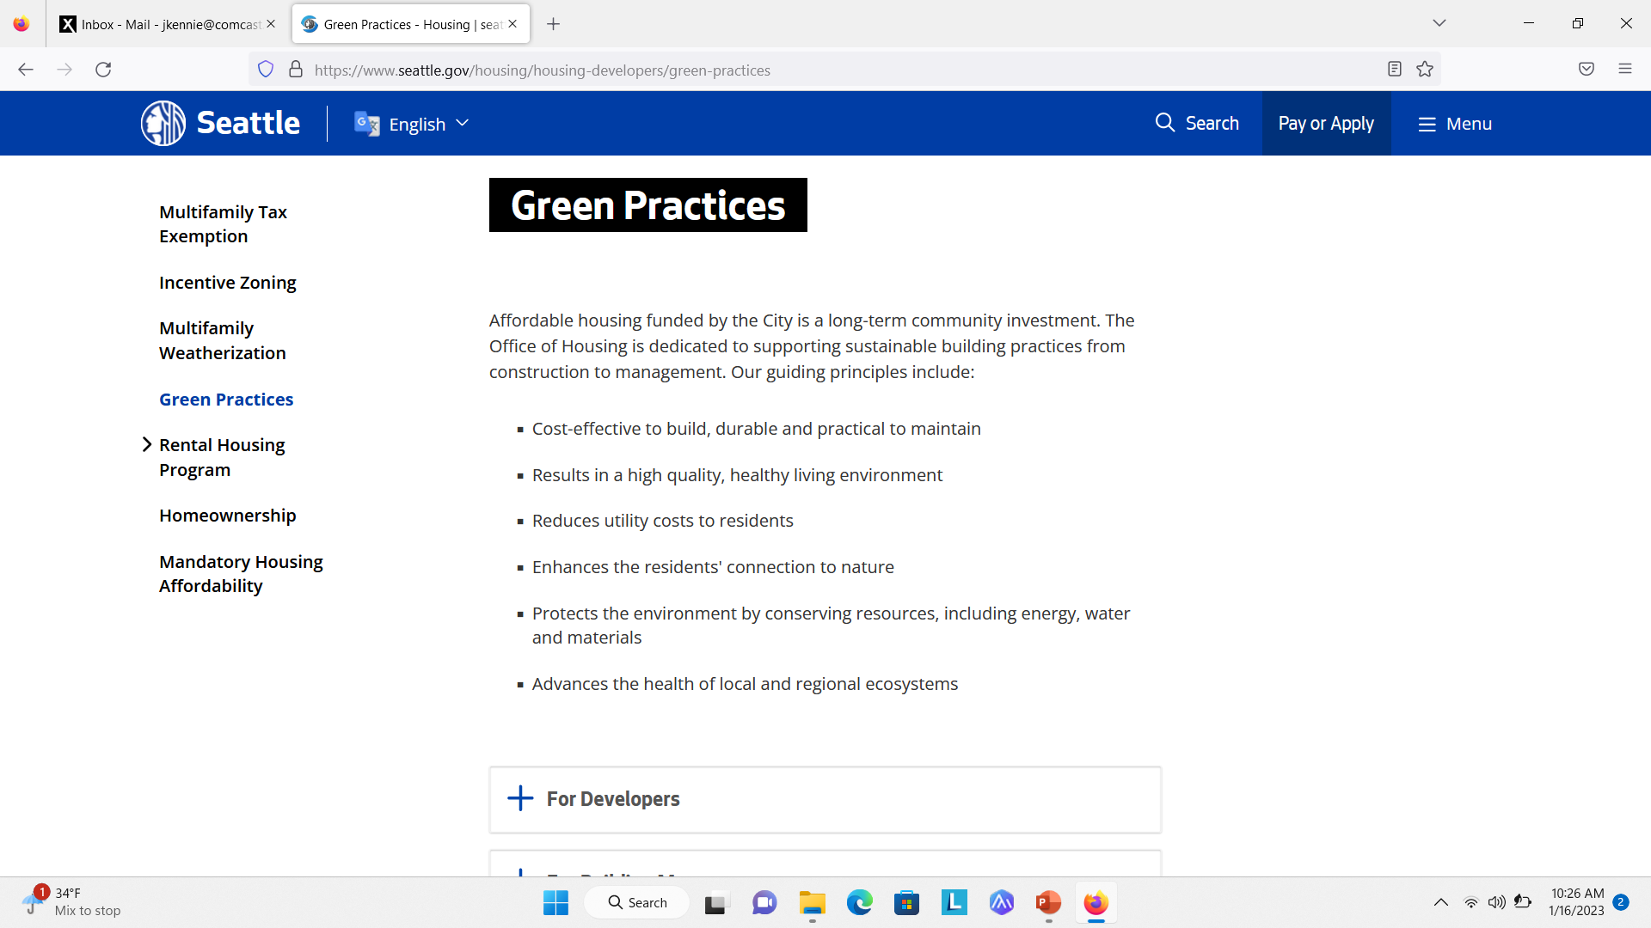
Project Priority #4
Build a website Resource for Sustainable Building Practices
Learn about MCAN’s “embodied carbon” & determine if Dennis can leverage toolkits
Research & create plan to help Dennis decrease the volume of construction & demolition materials (about 12% of our MSW), now being exported out of state
Investigate “best practices” being used by municipalities like Seattle
Advise on specific tactics for promoting more sustainable building practices, including methods for materials re-use, & availability of new, more sustainable building materials

Slide 8
Project Priority #5
Design & Conduct Repeatable Survey of all Dennis Households
Design & execute primary, repeatable market research to establish a "baseline“ on community awareness, perceptions, knowledge, attitudes & behaviors with regard to all aspects of waste:
  New concepts & movements - ZeroWaste, Sustainability, Circular Economy, Food Waste, Plastic Pollution
  Recycling & Composting
  Dennis’ MSW management - where our waste really goes, how it gets there & what it costs to remove, harms of incineration, risks to Dennis
Identify key gaps in knowledge that require added or new types of outreach & education efforts.

Slide 9
Composting Survey Learnings & Best Practices Research
Inform Strategy & Messaging
Great starting point with Sticker-Holders!
Very good underst&ing of composting benefits
Strongly agree it is “important to do”, “more sustainable”, & “makes a difference”
Composting enjoys strong positives & very few negatives
Perceive time & convenience as “somewhat” of a barrier
Only half of respondents were aware that our waste is sent away for incineration but do underst& its negative impacts
We have a baseline!
Knowledge gaps
Desire for community education
Information-delivery preferences
Value proposition & motivating messages
Things that could help increase penetration of HHs
A low-cost approach may be able to shift HH behaviors sufficiently
Beliefs
Values
Awareness

Slide 10
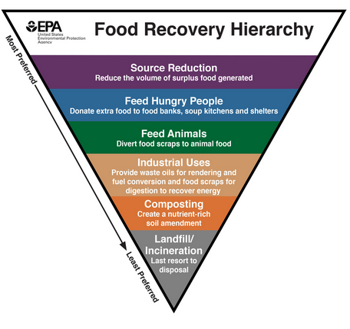
Project Priority #6
Assess & Create Plan to Leverage EPA Resources & Tools for Community Education & Outreach Campaigns
Circular Economy
https://www.epa.gov/rcra/epas-office-resource-conservation-&-recovery-orcr
Food Waste
Https://www.epa.gov/sustainable-management-food
https://www.epa.gov/sustainable-management-food/reducing-impact-wasted-food-feeding-soil-&-composting
https://www.epa.gov/sustainable-management-food/forms/preventing-wasted-food-your-community-social-marketing-toolkit
https://www.epa.gov/circulareconomy/success-stories-reducing-waste
https://www.epa.gov/sustainable-management-food/reducing-impact-wasted-food-feeding-soil-&-composting#success
https://www.epa.gov/sustainable-management-food/forms/preventing-wasted-food-your-community-social-marketing-toolkit#download
https://www.epa.gov/node/282010/webform/confirmation?token=48zZEYwQGgq_he_fa9lGbHoAuRpZmR1ptrdsArZImzc
EPA Resources for Food Waste
https://www.epa.gov/facts-&-figures-about-materials-waste-&-recycling/food-material-specific-data
https://www.epa.gov/facts-&-figures-about-materials-waste-&-recycling
https://www.epa.gov/research-grants/sustainability-research-grants
https://www.epa.gov/research-grants/research-reduce-consumer-food-waste-united-states-grants

Slide 11
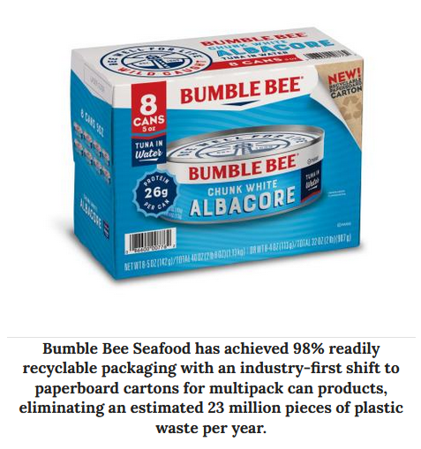
Project Priority #7
Analyze Future Impacts of Sustainable Packaging on Municipal Infrastructure
Sustainable Packaging has strong momentum in MA., third highest acceptance rates in nation
“Forecast” how Dennis’ MSW “mix” could change in composition over the next ten years, & make recommendations on how Dennis should plan for this transition.
ID new opportunities, especially services that can be monetized
Report should assess impacts such as:
  Costs of disposal
  Tonnages
  Need for new contractual arrangements
  Impact on & potential changes needed for disposal infrastructure (regional composting?)
Additionally, implications & requirements for community outreach & education specific to consumer choices on packaging, should be analyzed, & recommendations made

