Slide 1



Clean Water Action: Lead Service Line Replacement
Lauren Cardenas

Slide 2

“Campaign for safer water, cleaner air, and protection from toxic pollution”

Slide 3
“There is no safe level of lead exposure.”
Notes:
Lead exposure can lead to long standing health issues, and is especially effective toward young children who are still developing.

Slide 4
Lead Service Lines (LSLs)
1986 Ban
No Inventory
Banned, but did not affect existing lines
There is no easily accessible, accurate, widespread LSL database
Notes:
Measures against lead paint have taken the spotlight while it seems as though lead issues in water are still fighting for notice. Lead service lines were effectively banned in 1986, but this did nothing for the lead service lines that were already established. In a state like Massachusetts, many communities were built before the ban was put into place.
Another problem was with LSL inventories; currently, there is no official widespread database of existing lead service lines, which makes it difficult to find and replace them. However, based on the inventory that does exist, CWA estimates that MA has 200,000 lead service lines.

Slide 5


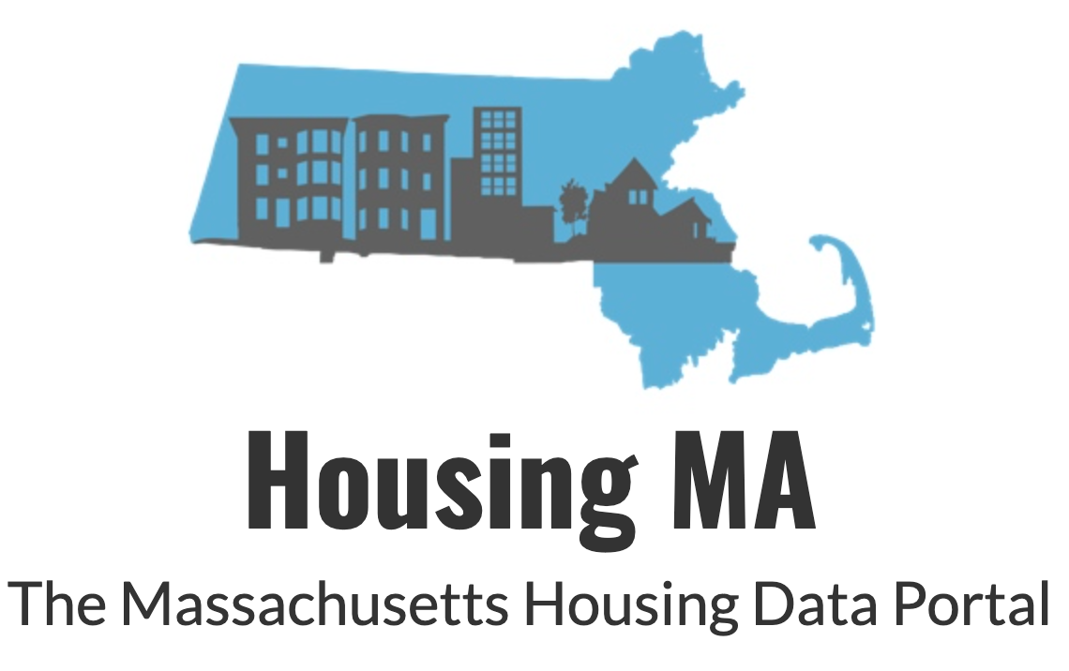
My Research
Demographics
Environmental Justice
Housing Stock
01
02
03
Notes:
From the issue listed, the goal is clear: initiate lead service line replacement to protect communities in Massachusetts. What I was able to help CWA with is determining what communities to prioritize for this initiative based on a few different parameters

Slide 6
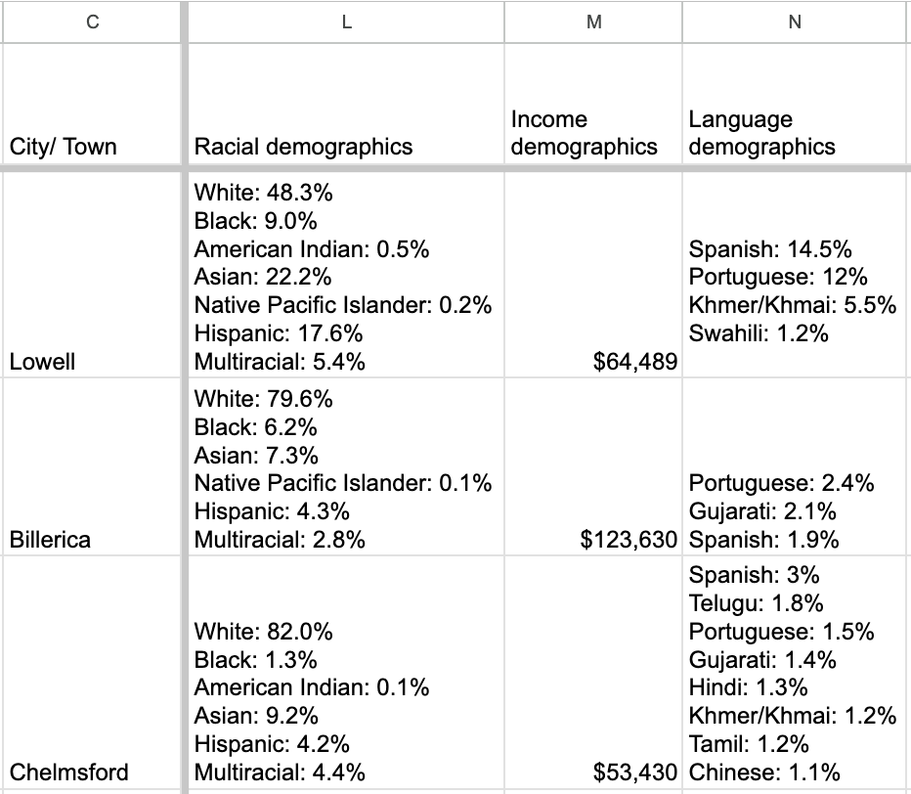
Demographic Data
Race
Household Income
Language
Notes:
This included demographic data,
Where I looked at the races, languages, and household incomes that made up different cities in different Massachusetts counties. This information was obtained from US census data

Slide 7
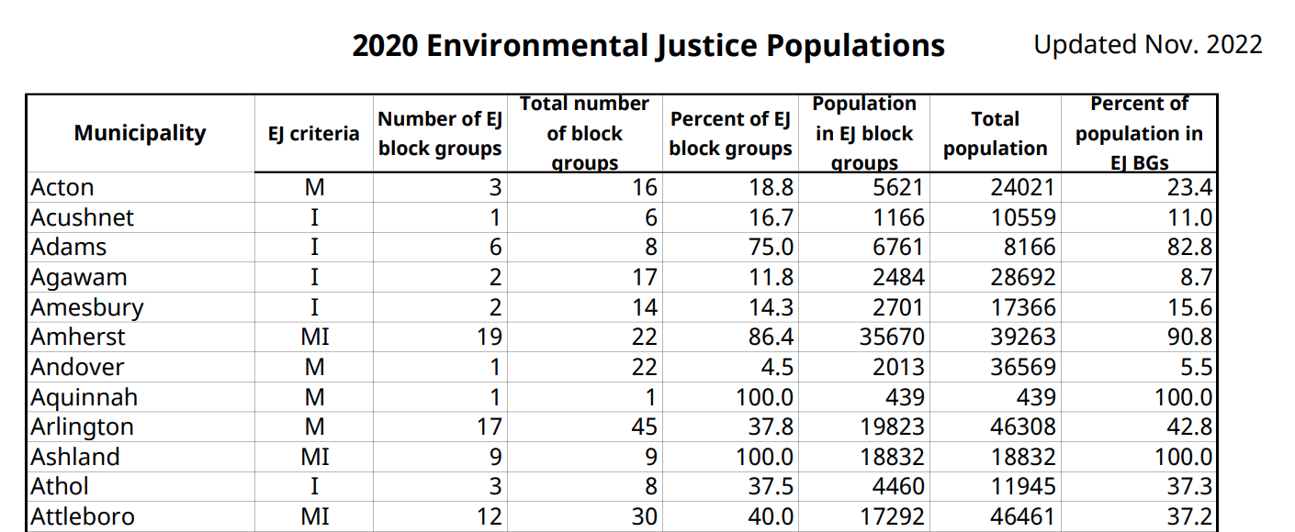
Environmental Justice Designation
Household Income
Minority Population
Language Isolation
Notes:
Next, I researched cities environmental justice designation
This information comes from the official Massachusetts government website. The designation of an environmental justice community is based on three categories; household income, minority population, and language isolation
If a community is a majority community of color, the annual median household income is 65% or less of the statewide household income, and/or 25% or more of households identify as speaking english less than “very well,” a community will be labeled as an environmental justice community under one or more of these categories

Slide 8
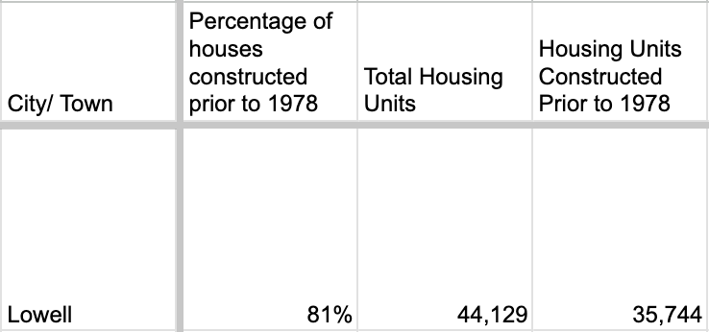
Housing Stock
Percent of houses constructed before 1978
Notes:
I also took down housing stock information
I was tasked to search for the percent of houses constructed before 1978, as these houses would be more at risk of using lead service lines for their water since it is before the ban.
This data was hard to come by; getting specific information on when a majority of houses in a city were constructed is difficult, and the specificity with the year was almost impossible to narrow down. However, I was able to find a housing massachusetts site that was made to compile housing information such as this that may be difficult to obtain by joining data from the US census, building permits, zillow, and similar sites.
Here I was able to get percentages in MA cities that were constructed prior to 1978 and compare that with the number of houses in the area.

Slide 9
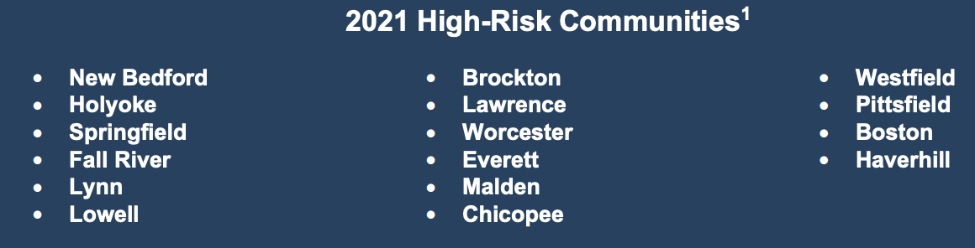
“High Risk”
Massachusetts Department of Public Health
  Lead levels from screening
  Age of housing
  Income Levels
16 Communities since 2021
Notes:
The last category I noted was the designation by the Massachusetts Department of Public Health of a “high risk community” to lead exposure
Based on lead poisoning statistics from lead screaming, age of housing, and income levels.
In 2021 there was a list of 16 communities

Slide 10
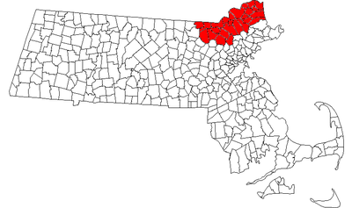
What’s the Goal?
LSL Replacement Grant
  Chosen focus on Merrimack Valley
    Includes high risk communities
Notes:
All of this research and narrowing down of communities culminates into the big goal, which is a Grant for Lead Service Line Replacement
The areas they have chosen to focus on are the communities in Merrimack Valley, which spans through Essex and Middlesex Counties
Notably, Lowell, Lawrence, and Haverhill are designated as high risk communities, EJ communities

Slide 11
75,870
Houses constructed prior to 1978 in Lowell, Haverhill, and Lawrence
Notes:
My research is outlined in the grant: 75870 housing units were constructed prior to 1978 in these communities

Slide 12
300,000
People who would benefit in a single generation
Notes:
“If each unit contained an LSL and served 4 residents, 300,000 people would benefit in one single generation”; and this is certainly a lowball estimate

Slide 13

Starting Somewhere
Focus on prioritizing childcare facilities
Merrimack Valley, EJ communities, and childcare center focus will minimize harms from lead
Eventually, remove existing LSLs everywhere completely
Notes:
While LSL replacement will have widespread effects and benefits, there has to be a start somewhere, especially as this will certainly be a long process. This is where the focus on prioritizing childcare facilities comes in, especially those run out of residential homes
Focusing on Merrimack Valley, EJ communities, and childcare centers first will allow CWA to minimize the harms stemming from lead exposure where they might be more dangerous first; of course, the final goal is to remove and replace these systems everywhere completely
This research allowed me to expand my knowledge on the wide scope of environmental issues that need to be tackled. One of the biggest ways change can happen is through advocacy. Even as progress is made, like the banning of lead service lines or the restrictions on lead paint laws, there is more work to be done; expanding lead in water issues into legislature, or toxics in general, or correcting the mistakes that have already been made in the past. It meant a lot to work with an organization that prioritizes fighting for EJ communities first and foremost, and although I was able to provide an initial stepping stone for change, I know that myself and CWA will continue this work in the future to keep making sure people have the chance to live that they deserve.

Slide 14
Thank you!

