Slide 1
Forward looking policy to driver safer chemistry
Joel A. Tickner, ScD
UMass Lowell
Detoxifying Commerce
4/19/23

Slide 2
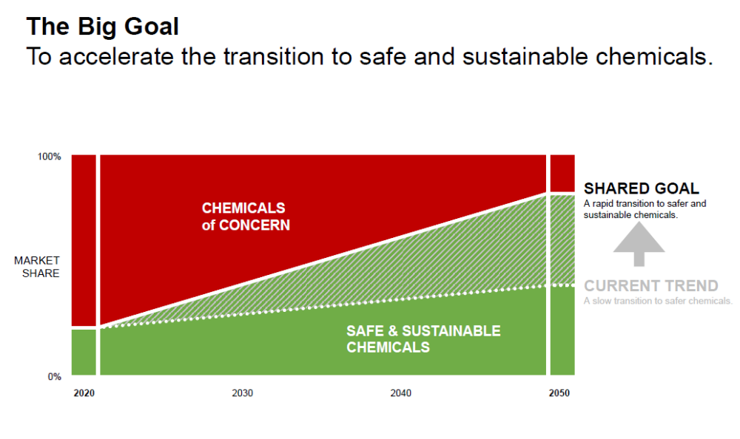
The goal- accelerate the growth of green and sustainable chemistry while reducing dangerous chemicals

Slide 3
Three Pathways to Safer Chemistry
Policy Transformation
Incentives- based
Regulatory
Science Transformation
Green Chemistry
Alternatives Assessment
Market Transformation
Demand-Side
Supply-Side
21st Century Toxicology

Slide 4
Barriers and enablers of green/sustainable chemistry
Inhibitors dominate and adoption rate is slow
Drivers enable some growth in adoption
Accelerators can create significant growth in adoption
Growth Deterrents
Growth Accelerators
ADOPTION
Confusion
Switching Risk
Price/Performane
Supply & Demand
Transparency
New Technology Access/Placement
Incumbency
Supply Chain Complexity
Green Definition
Collaboration
Technology Forcing
Compromise
Enhanced Education
Growth Drivers
Government Regulation
Consumer Awareness
TIME
https://greenchemistryandcommerce.org/resources/gc3-publications

Slide 5
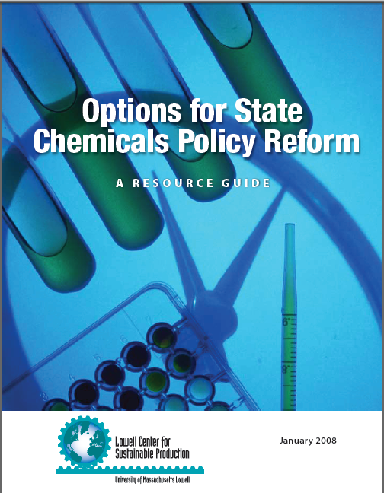
Designing Comprehensive Chemicals Policy – What’s Needed
https://www.sustainablechemistrycatalyst.org/chemicals-policy

Slide 6
Comprehensive – Smart - Chemicals and Materials Policy
Integrated – focused on all chemicals/materials/interagency
Early assessment – provides signals/warnings through technology assessment so problems are identified and addressed before market
Functional based. Focus on the function to be achieved, its need, and the most sustainable way to meet it.
Transparent and information rich – ensure good information through supply chains, to regulators and the public
Efficient – focused on best available science to allow rapid prioritization, assessment and decision-making
Proactive, preventive and innovative – focused on reducing hazards and supporting transition to safer chemistry/materials
Responsible. Avoids harm while supporting innovation

Slide 7
Designing Smart Policies to Drive Safer Chemistry
Core Elements
  Willingness
    Restrictions, information requirements, planning requirements, purchasing policies, recognition
  Capacity
    Technical assistance, information requirements, R&D support, Education
  Opportunity
    R&D, education, tax incentives, grants
Ashford, Nicholas. 1999. An innovation-based strategy for a sustainable environment. In Innovation-Oriented Environmental Regulation: Theoretical Approach and Empirical Analysis. Potsdam, Germany: European Commission Joint Research Centre.

Slide 8
Designing supportive government policy
Champions and clear, coordinated and resourced policy, strategic roadmap and implementation
Research and finance support
  Funding for basic R&D, applied R&D, pilot and scale
  Supporting creation of sectoral and value chain consortia
  Leveraging the work of national laboratories
  Tax incentives and credits for commercialization and adoption
  Creating an ecosystem for sustainable chemistry innovation
Incentives and recognition through procurement, labelling, and other programs
Workforce development
Links to regulatory, market, and societal priorities
  Need for both strong, clear and consistent drivers, but focus on supporting alternatives, including addressing regulatory barriers

Slide 9
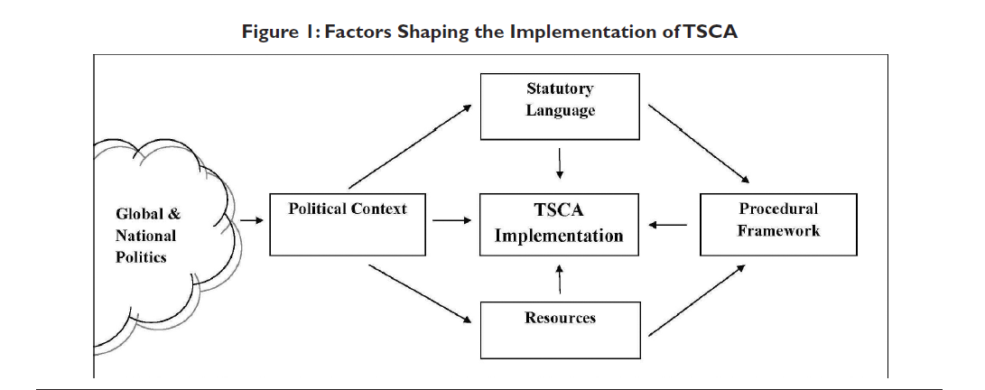
Implementation matters – the regulatory process is slow….
Schifano, Geiser, and Tickner. The Importance of Implementation in Rethinking Chemicals Management Policies: The Toxic Substances Control Act. 41 Environmental Law Reporter 10528, 2011
http://chemicalspolicy.org/downloads/ELRArticleonTSCAImplementation.pdf

Slide 10
EU Green Deal
An overarching set of European policy developments related to chemicals
REACh revisions
Ecodesign directive
Transition pathways
Strategic Research and Innovation Agenda
Taxonomy
Strategy for
Financing the
Transition to a
Sustainable
Economy
Industrial
Strategy
Circular Economy Action Plan
Chemical Strategy for Sustainability
Sustainable Carbon Cycles
Zero Pollution Action Plan

Slide 11
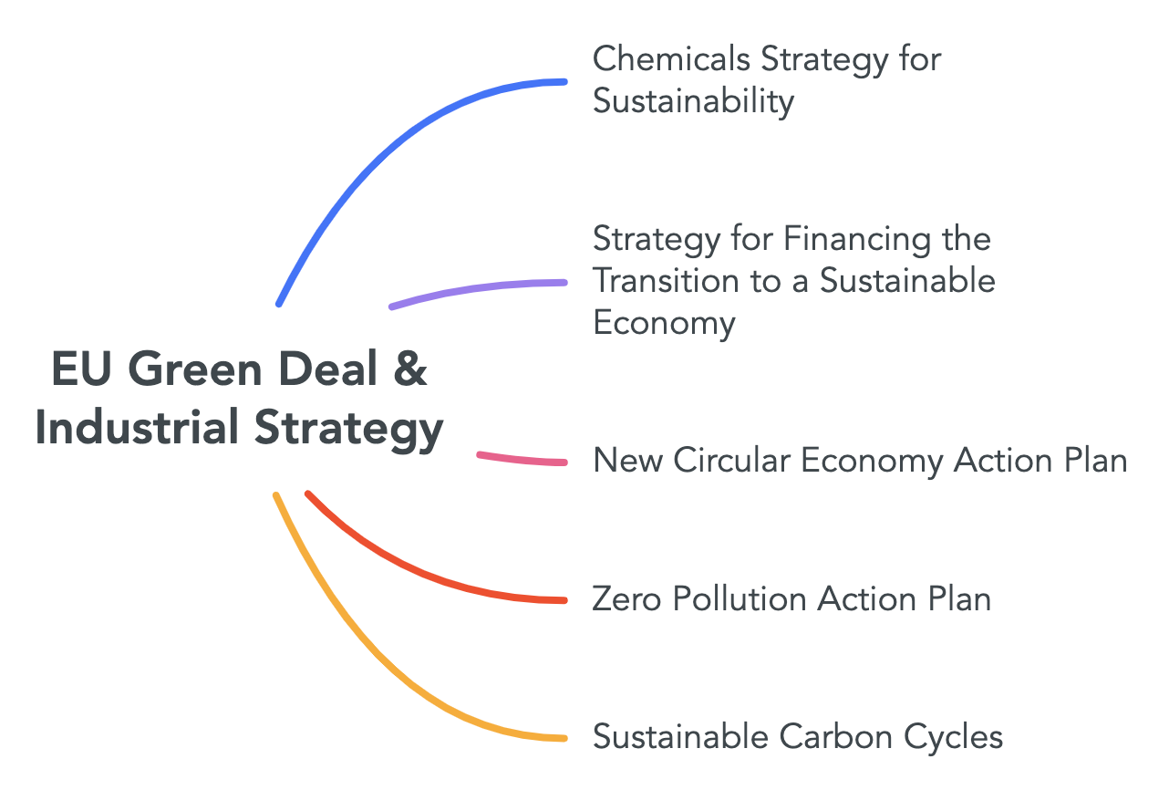
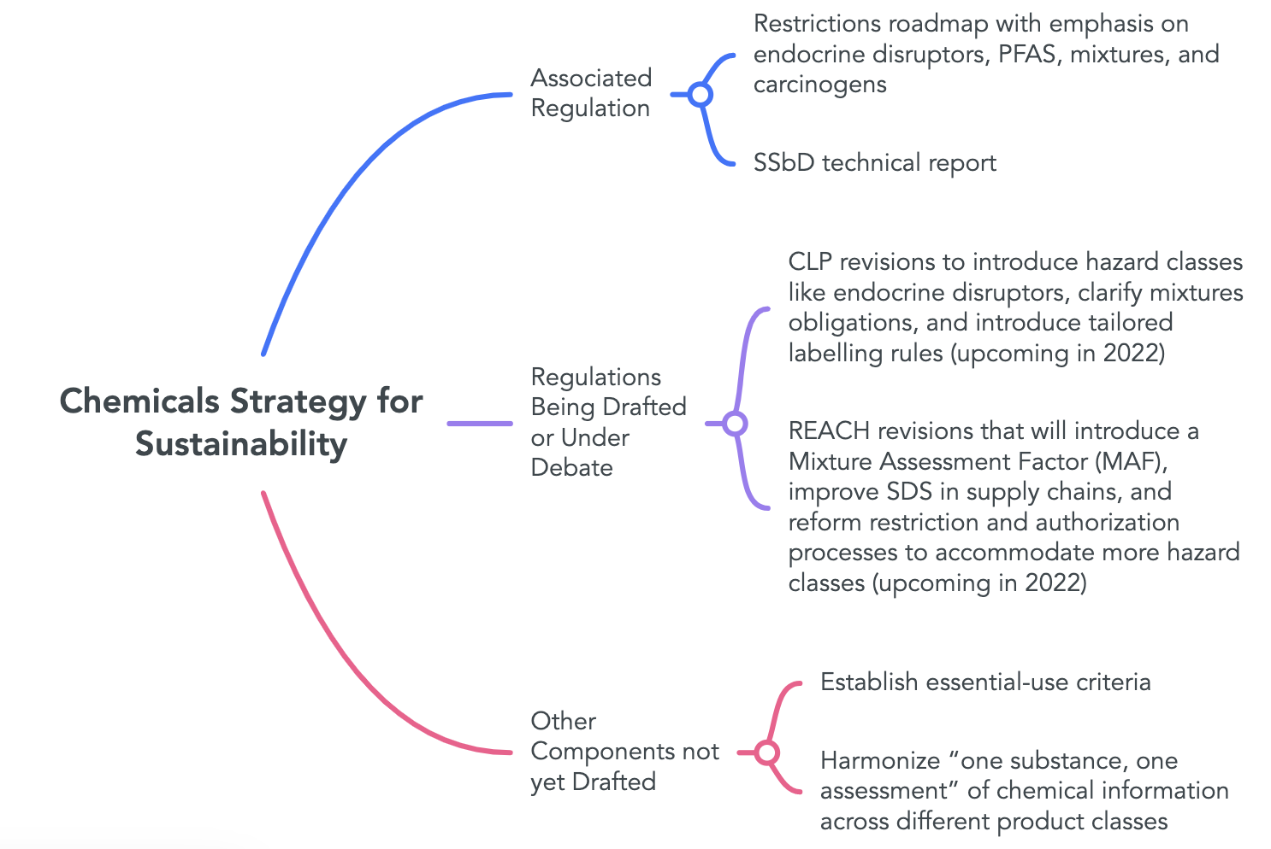
Example: Hazard Classes
The introduction of new hazard classes into the CLP revisions allows for new restrictions under REACH. CEFIC, the EU chemical industry trade group, estimated that 28% of the sectoral turnover could be affected by these new restrictions (if regulations are implemented by 2040).
Notes:
SSbD is already drafted though because the guidance just came out? How could the SSbD be integrated into policy?
Restrictions Roadmap timeline? Potential REACH/CLP timeline in Transitions Document?
Other box on how relates to US?
Other box on how relates to REACH?
Add a timeline slide and a summary of the EU decision-making process (it’s in the EU chemicals policy report from 2003) – chemicalspolicy.org under reports and https://europarlamentti.info/en/decision-making/#:~:text=Heads%20of%20state%20and%20government,Parliament%20approve%20the%20laws%20together
Also: https://www.consilium.europa.eu/en/council-eu/decision-making/
CEFIC source: https://cefic.org/app/uploads/2021/12/Economic-Analysis-of-the-Impacts-of-the-Chemicals-Strategy-for-Sustainability-Phase-1.pdf

Slide 12
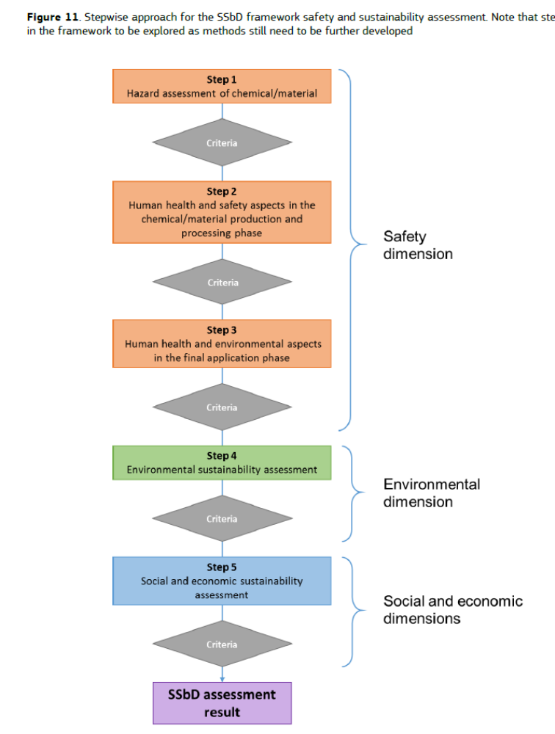
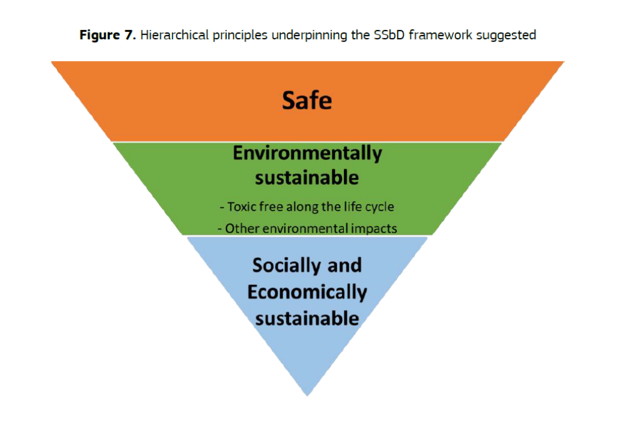
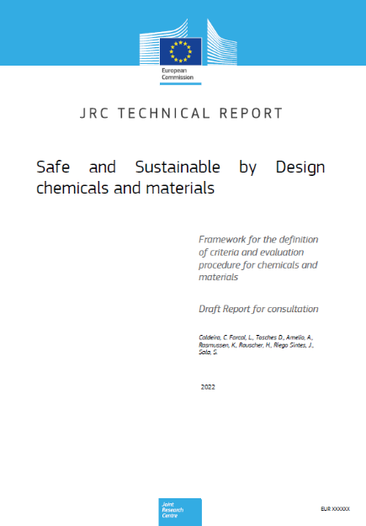

Slide 13
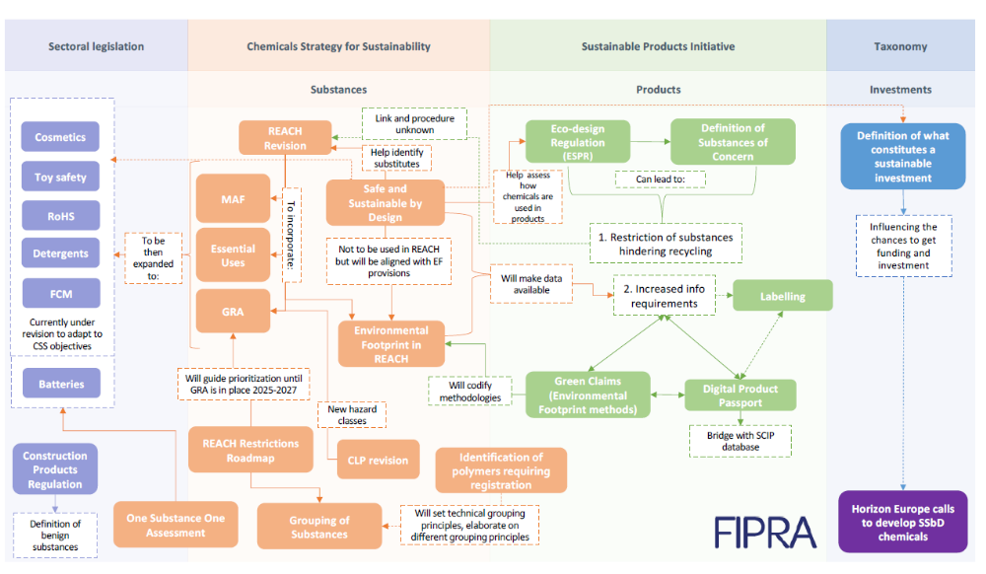

Slide 14
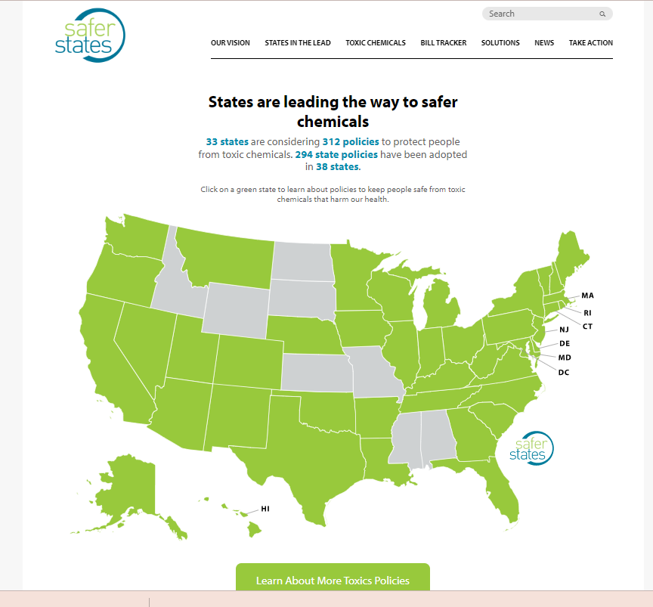

Slide 15
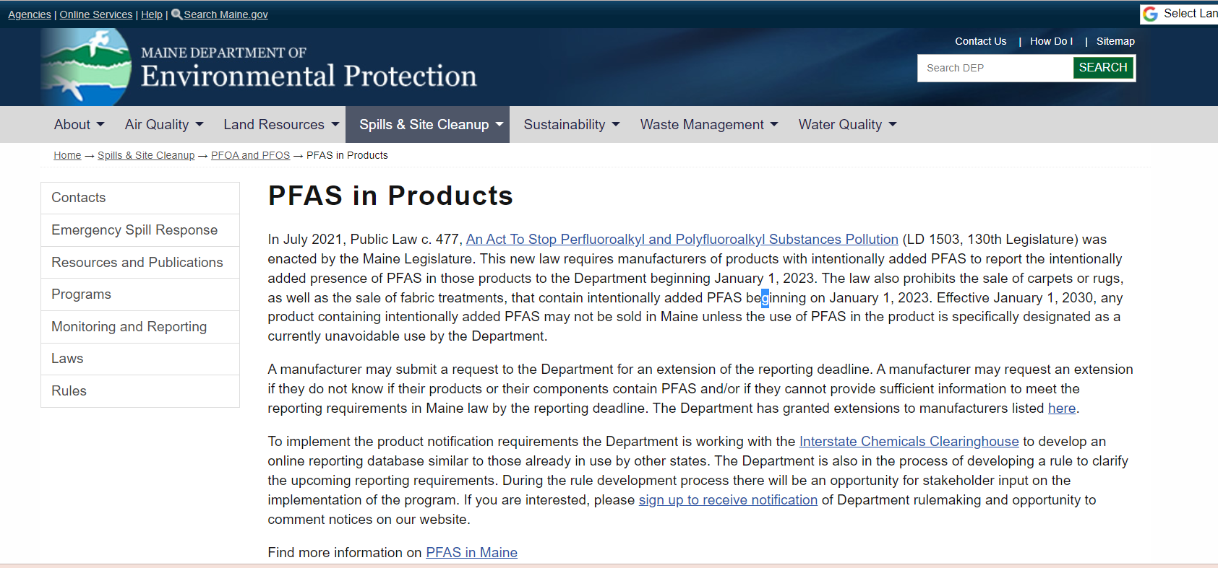

Slide 16
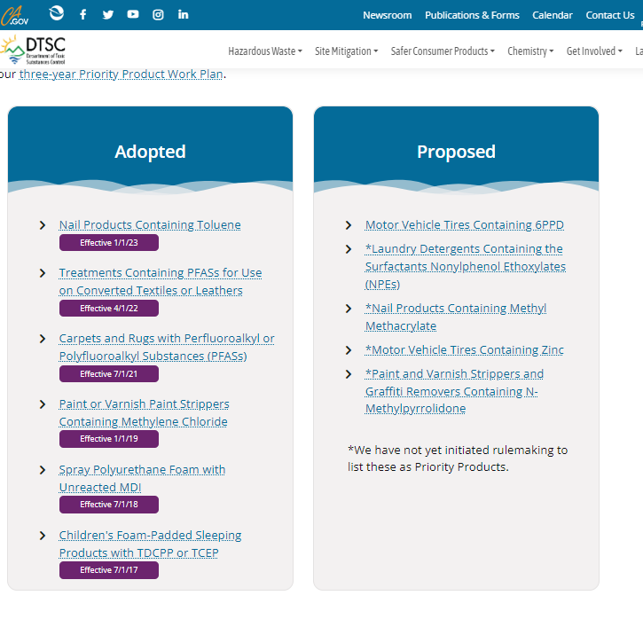
California Safer Consumer Products

Slide 17
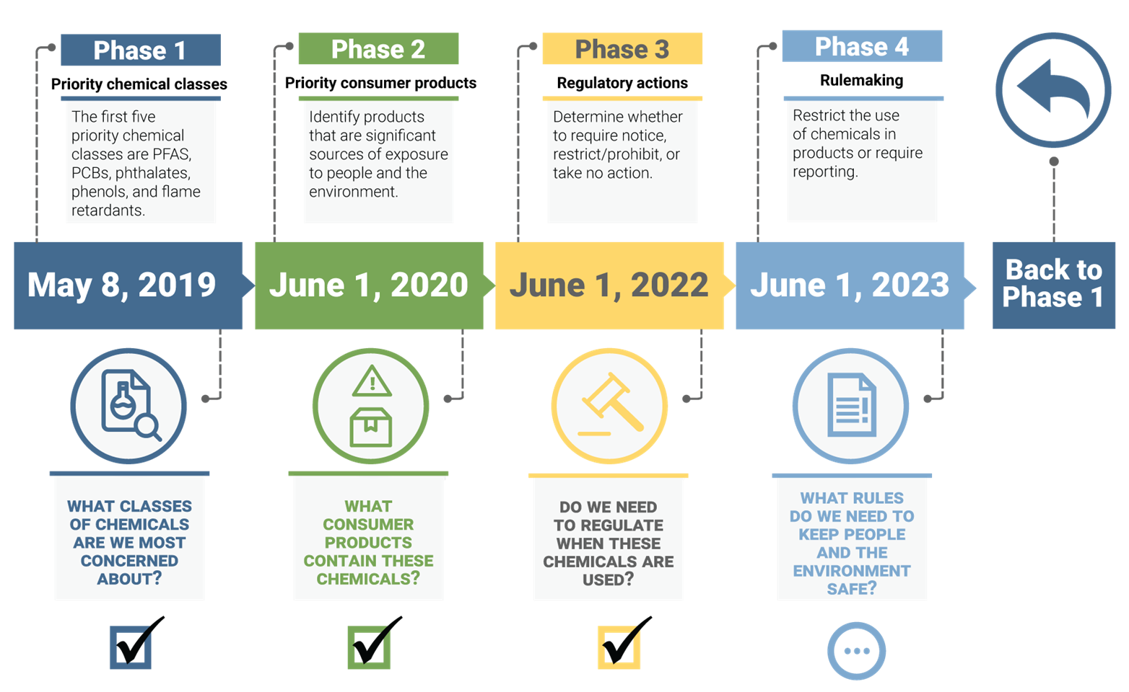
Safer Products for Washington
Reporting and restrictions for:
PFAS in carpets and rugs, aftermarket stain and water resistance treatments, and leather and textile furnishings.
Phthalates in personal care products (fragrances) and vinyl flooring.
Flame retardants in electric and electronic products and recreational polyurethane foam.
Phenolic compounds in laundry detergent, food and drink can linings, and thermal paper.

Slide 18
Prioritizing sustainable chemistry investment in recent US federal policy
Inflation Reduction Act
  48C Tax Credit
  Advanced Industrial Facilities Deployment Program at DoE
  DOE Loan Office
  Greenhouse gas reduction fund/Green Bank
  Climate Pollution Prevention grants
CHIPS and Science
Sustainable Chemistry R&D Act
Bioeconomy Executive Order
  Identify policy recommendations to expand domestic biomanufacturing capacity for products spanning the health, energy, agriculture, and industrial sectors, with a focus on advancing equity, improving biomanufacturing processes, and connecting relevant infrastructure

Slide 19
Conclusions
Progress to detoxify commerce will be slow without a significant rethinking of chemicals policy at the federal level.
Learning from European and state level policy development may help reshape policy at the federal level (which may be complicated due to limited political opportunity)
Policy efforts to address chemicals of concern will struggle without equal attention to increasing the supply of safer alternatives
Leveraging current momentum on decarbonization with an environmental justice lens (which brings in toxicity) may be one way to drive change, along with increasing market action and ensuring state and European policies are as strong as possible

Slide 20
For More Information
Joel Tickner, ScD
joel_tickner@uml.edu
https://www.sustainablechemistrycatalyst.org/
www.greenchemistryandcommerce.org
www.saferalternatives.org

