Slide 1
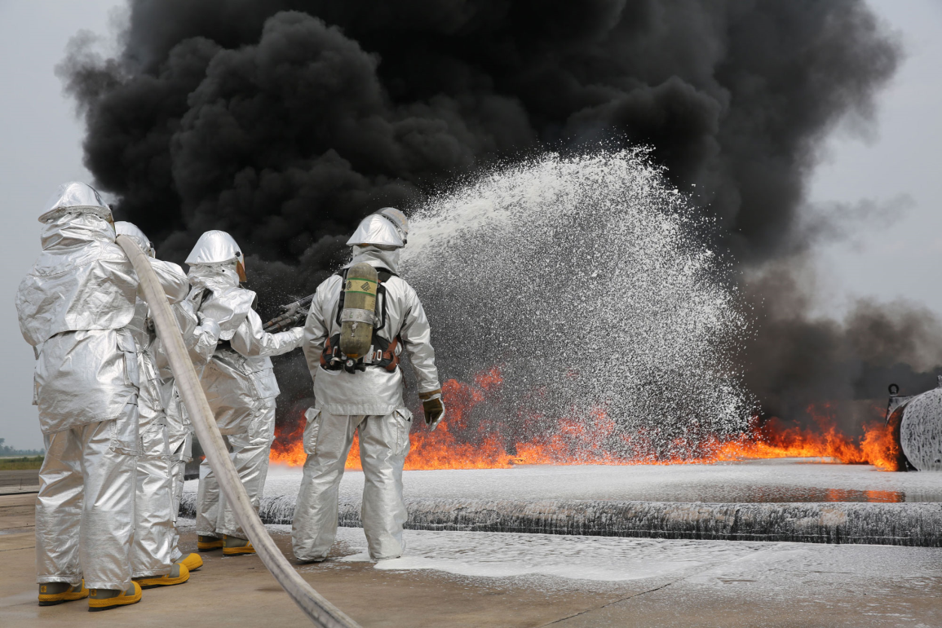
“Emerging” concerns
Military use of toxic firefighting foams, The Intercept, 2/2/18
Perfluorinated compounds
Flame Retardants
Endocrine Disruptors
Genetically Modified Organisms
Nanomaterials

Slide 2
Per- and polyfluoroalkyl substances (PFAS)
PFOS, PFOA and GenX
“Forever Chemicals”
In non-stick pans, water-resistant clothes, food packaging, firefighting foam, carpets.
Can cause kidney, testicular, bladder, and prostate cancer, as well as immune, reproductive, and hormonal dysfunction: a “seminal public health challenge,” - Patrick Breysse, director of the Centers for Disease Control’s National Center for Environmental Health
3M marketed scotchguard in the fifties, aqueous film-forming fire-fighting foam for the Navy, which required it, in the sixties, stopped in 2002, made shorter chain molecules – supposedly safer, worked on detecting it and devoted $200 million to cleanup.
Dupont continued making it (Teflon and other products) and claims it does so in small amounts – relative to global production. It can say that because it split off the division that made it as Chemours in 2015. Chemours, saddled with liability, is fighting Dupont in court.
Lawsuits show both companies knew of the dangers for decades.

Slide 3

Almost three hundred military bases and hundreds of communities with documented contamination
Environmental Working Group:
“New laboratory tests commissioned by EWG have for the first time found the toxic fluorinated chemicals known as PFAS in the drinking water of dozens of U.S. cities, including major metropolitan areas. The results confirm that the number of Americans exposed to PFAS from contaminated tap water has been dramatically underestimated by previous studies, both from the Environmental Protection Agency and EWG’s own research.
Based on our tests and new academic research that found PFAS widespread in rainwater, EWG scientists now believe PFAS is likely detectable in all major water supplies in the U.S., almost certainly in all that use surface water. EWG’s tests also found chemicals from the PFAS family that are not commonly tested for in drinking water.”
EPA issued a health advisory, and is in a process to consider whether to require testing and treatment. Some states have set lower levels. MA has followed EPA’s level and states: “a risk would be expected only if an individual continuously drinks only contaminated water at a level significantly higher than the HA.” https://www.mass.gov/service-details/per-and-polyfluoroalkyl-substances-pfas-in-drinking-water

Slide 4

MYTH: “PFOA-free” means safe. FACT: Products advertised as “PFOA-free” often contain replacement chemicals made with the same problematic chemical building blocks as PFOA. Since PFOA has been phased out, numerous related chemicals that are equally persistent and may pose similar health risks have replaced it4. To prevent such “regrettable substitutions”, the entire class of highly fluorinated chemicals should be avoided.
MYTH: Short-chain fluorinated alternatives like the 6 and 4 carbon-based compounds have been thoroughly tested and are safe. FACT: Recent studies suggest these alternatives may cause similar health problems as the long chain compounds.
(Also harder to filter out)
The institute was founded and is led by Arlene Blum, after she learned that the “same chlorinated tris that her research had helped remove from children’s pajamas in the 1970s was back in furniture and baby products. Since its founding, Green Science Policy Institute has stopped ten unneeded flammability standards and prevented hundreds of millions of pounds of toxic flame retardants from being added to consumer products.

Slide 5
NIEHS on Flame Retardants
Can be used in making furnishings, such as foam, upholstery, mattresses, carpets, curtains, fabric blinds; electronics and electrical devices, such as computers, laptops, phones, televisions, and household appliances, plus wires and cables; building and construction materials, including electrical wires and cables, and insulation materials, such as polystyrene and polyurethane insulation foams; Transportation products, such as seats, seat covers and fillings, bumpers, overhead compartments, and other parts of automobiles, airplanes, and trains.
Many flame retardants have been removed from the market or are no longer produced. However, because they do not easily break down, they can remain persistent in the environment for years. They can also bioaccumulate, or build up in people and animals over time.
Endocrine and thyroid disruption, Impacts to the immune system, Reproductive toxicity, Cancer, Adverse effects on fetal and child development, Neurologic function

Slide 6
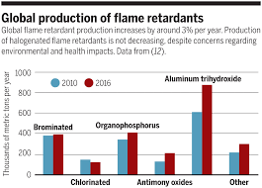
Response
A move away from brominateds and other halogen-based products
“trend toward polymeric versus small-molecule flame retardants. The former are seen as environmentally friendly, because if you formulate a plastic with an inherently flame-retardant polymer—making it an inherent part of the plastic—it won’t bleed out of the host polymer over time, because the polymer chain of the host polymer bonds to the FR polymer. The two polymers mix and the chains link tightly so that there is no migration.” (Plastics Today, 10/2/17)
“Furniture containing polyurethane foam is most likely to contain the highest amount of chemical flame retardants, especially if it is accompanied by a tag stating that the product meets the California furniture flammability standard TB117.” (Chanler group, 2013) Polyester and wool better.
Design for the Environment program at EPA found
alternatives for electronics manufacturers 2015
Vilification of environmentalists for causing deaths
from fires
see Chicago Tribune series of articles showing
chemical flame retardants hardly effective, toxic,
and marketing deception: http://media.apps.chicagotribune.com/flames/index.html Science 19 Apr 2019:

Slide 7

Endocrine Disruptors
Dose-response different from many other toxic chemicals.
Can have impact at very low dose and not at high.
Timing of exposure critical, particularly when impacting developing fetus.
Colburn studied chemicals in wild birds in the Great Lakes, noting persistence as well as impacts on developing young. She organized the Wingspread Conference in 1991 bringing together scientists from many disciplines, which issued perhaps the best-known statement on the importance of the Precautionary Principle and coined the term endocrine disruption.
1996 Our Stolen Future (with Dianne Dumanoski, former environmental reporter for the Boston Globe)
2003 founded The Endocrine Disruption Exchange
Theo Colburn
Endocrinedisruption.org

Slide 8
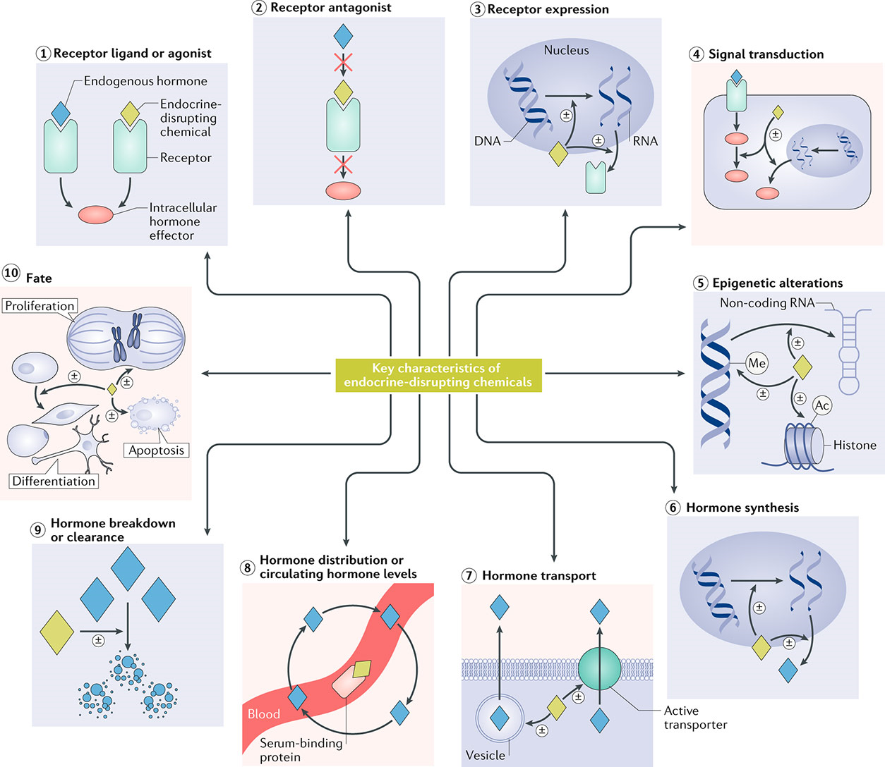
Environmental Factor, NIEHS newsletter, Dec, 2019 - https://factor.niehs.nih.gov/2019/12/feature/1-feature-endocrine-disruptor/index.htm

Slide 9
https://www.ncbi.nlm.nih.gov/pubmed/31719706
Expert Consensus Statement, 2020
EDCS can cause “cancer, reproductive impairment, cognitive deficits and obesity. A complex literature of mechanistic studies provides evidence on the hazards of EDC exposure, yet there is no widely accepted systematic method to integrate these data to help identify EDC hazards. Inspired by work to improve hazard identification of carcinogens using key characteristics (KCs), we have developed ten KCs of EDCs based on our knowledge of hormone actions and EDC effects.”
Only three of the 10 ways in which endocrine-disrupting chemicals can act on the body are robustly considered in chemical testing programs.
This work will lead to establishment of better methods for identifying EDCs and accounting for how they alter physiology.

Slide 10
Examples of EDCs (source: NIEHS)
Bisphenol A (BPA) -- used to make polycarbonate plastics and epoxy resins, which are found in many plastic products including food storage containers
Dioxins -- produced as a byproduct in some manufacturing processes such as herbicide production and paper bleaching; also a byproduct of waste burning and wildfires
Perchlorate -- a by-product of aerospace, weapon, and pharmaceutical industries found in drinking water and fireworks
Perfluoroalkyl and Polyfluoroalkyl Substances (PFAS) -- used widely in industrial applications, such as firefighting foams and non-stick pan, paper, and textile coatings
Phthalates -- used to make plastics more flexible, they are found in some food and cosmetic packaging, children’s toys, and medical devices
Phytoestrogens -- naturally occurring substances in plants that have hormone-like activity, such as genistein and daidzein that are in soy products, like tofu or soy milk
Polybrominated diphenyl ethers (PBDE) -- used to make flame retardants for household products such as furniture foam and carpets
Polychlorinated biphenyls (PCB) -- used to make electrical equipment like transformers, and in hydraulic fluids, heat transfer fluids, lubricants, and plasticizers
Triclosan -- may be found in some anti-microbial and personal care products, like liquid body wash

Slide 11
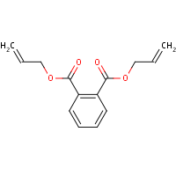
Toxics Use Reduction Institute study, 2016
“Phthalate esters (abbreviated here as “PEs”) were considered in groups according to their structure, with position of the side chains at ortho-, meta- (or iso-) and para- (or tere-). The ortho-phthalates are the most commonly used, have the most scientific information on their hazard, and are of the most concern in terms of human hazard.
DAP - Diallyl phthalate [c3]
CAS #131-17-9
A plasticizer used in making thermoset plastics, polyester resins, varnishes.
An ortho-phthalate ester comprising two three-carbon backbones (CPSC 2011b).
Dystocia (difficult labor) was seen at 50 mg/kg (CPSC 2011b). Saillenfait 2008 observed reduced fetal weight at 250 mg/kg and bone growth delay. DAP was not found to be teratogenic until >250 mg/kg. Saillenfait 2008 concluded that carbon backbone length alone does not predict developmental effects.
The 2003 NTP CERHR noted uterine tumor effects (negative correlation – control highest). Saillenfait 2008 indicated hepatotoxic effects and maternal effects with a NOAEL of 50 mg/kg. Nakai 1999 noted that the ortho isomer of diallyl phthalate is most potent (3 times more potent vs. di-n-propyl) in binding to the estrogen receptor due to hydrophobic interaction.
Of most concern are so-called “transitional” PEs (C4-C7 branched or linear molecules)…Higher molecular weight/longer side chain backbone length substances also have health effects but are less potent. After C7, there is a general tendency as the carbon backbone chain length increases, for the effects to diminish and for there to be fewer scientific studies.
C1-C3 chain length substances have significant health effects, but not always the same effects as other PEs. These substances often are used as film-forming solvents; most of the known commercial plasticizer products are not in this range.“
Studies show cumulative and low-dose effects, migration and persistence in the environment .

Slide 12
GMOs
Allergenicity
As a matter of principle, the transfer of genes from commonly allergenic organisms to non-allergic organisms is discouraged unless it can be demonstrated that the protein product of the transferred gene is not allergenic. While foods developed using traditional breeding methods are not generally tested for allergenicity, protocols for the testing of GM foods have been evaluated by the Food and Agriculture Organization of the United Nations (FAO) and WHO. No allergic effects have been found relative to GM foods currently on the market.

Slide 13
Gene Transfer
Gene transfer from GM foods to cells of the body or to bacteria in the gastrointestinal tract would cause concern if the transferred genetic material adversely affects human health. This would be particularly relevant if antibiotic resistance genes, used as markers when creating GMOs, were to be transferred. Although the probability of transfer is low, the use of gene transfer technology that does not involve antibiotic resistance genes is encouraged.

Slide 14
Outcrossing
The migration of genes from GM plants into conventional crops or related species in the wild (referred to as “outcrossing”), as well as the mixing of crops derived from conventional seeds with GM crops, may have an indirect effect on food safety and food security. Cases have been reported where GM crops approved for animal feed or industrial use were detected at low levels in the products intended for human consumption. Several countries have adopted strategies to reduce mixing, including a clear separation of the fields within which GM crops and conventional crops are grown.

Slide 15
Environmental concerns
the capability of the GMO to escape and potentially introduce the engineered genes into wild populations; the persistence of the gene after the GMO has been harvested; the susceptibility of non-target organisms (e.g. insects which are not pests) to the gene product; the stability of the gene; the reduction in the spectrum of other plants including loss of biodiversity; and increased use of chemicals in agriculture. The environmental safety aspects of GM crops vary considerably according to local conditions.

Slide 16
In food
GM foods currently available on the international market have passed safety assessments and are not likely to present risks for human health. In addition, no effects on human health have been shown as a result of the consumption of such foods by the general population in the countries where they have been approved. Continuous application of safety assessments based on the Codex Alimentarius principles and, where appropriate, adequate post market monitoring, should form the basis for ensuring the safety of GM foods.

Slide 17
Regulation varies
The way governments have regulated GM foods varies. In some countries GM foods are not yet regulated. Countries which have legislation in place focus primarily on assessment of risks for consumer health. Countries which have regulatory provisions for GM foods usually also regulate GMOs in general, taking into account health and environmental risks, as well as control- and trade-related issues (such as potential testing and labelling regimes).

Slide 18
International Trade
The Codex Alimentarius Commission (Codex) is the joint FAO/WHO intergovernmental body responsible for developing the standards, codes of practice, guidelines and recommendations that constitute the Codex Alimentarius, meaning the international food code. Codex developed principles for the human health risk analysis of GM foods in 2003.
Principles for the risk analysis of foods derived from modern biotechnology
The premise of these principles sets out a premarket assessment, performed on a caseby- case basis and including an evaluation of both direct effects (from the inserted gene) and unintended effects (that may arise as a consequence of insertion of the new gene) Codex also developed three Guidelines:
Guideline for the conduct of food safety assessment of foods derived from recombinant-DNA plants
Guideline for the conduct of food safety assessment of foods produced using recombinant-DNA microorganisms
Guideline for the conduct of food safety assessment of foods derived from recombinant-DNA animals
Codex principles do not have a binding effect on national legislation, but are referred to specifically in the Agreement on the Application of Sanitary and Phytosanitary Measures of the World Trade Organization (SPS Agreement), and WTO Members are encouraged to harmonize national standards with Codex standards.

Slide 19
Some requirements pertain
The Cartagena Protocol on Biosafety, an environmental treaty legally binding for its Parties which took effect in 2003, regulates transboundary movements of Living Modified Organisms (LMOs). GM foods are within the scope of the Protocol only if they contain LMOs that are capable of transferring or replicating genetic material. The cornerstone of the Protocol is a requirement that exporters seek consent from importers before the first shipment of LMOs intended for release into the environment.

Slide 20
Ownership of Food Production and Narrowing Diversity
…potential problems of the technological divide and the unbalanced distribution of benefits and risks between developed and developing countries and the problem often becomes even more acute through the existence of intellectual property rights and patenting that places an advantage on the strongholds of scientific and technological expertise.
Sustainable agriculture and biodiversity benefit most from the use of a rich variety of crops, both in terms of good crop protection practices as well as from the perspective of society at large and the values attached to food. These groups fear that as a result of the interest of the chemical industry in seed markets, the range of varieties used by farmers may be reduced mainly to GM crops. This would impact on the food basket of a society as well as in the long run on crop protection (for example, with the development of resistance against insect pests and tolerance of certain herbicides). The exclusive use of herbicide-tolerant GM crops would also make the farmer dependent on these chemicals. These groups fear a dominant position of the chemical industry in agricultural development, a trend which they do not consider to be sustainable.

Slide 21

JonathanLatham.net
Former molecular biologist making transgenic products, left to farm
2006 article Transformation-induced mutations in transgenic plants: Analysis and biosafety implications generated demand for his expertise
Claims researchers are substantially undercounting gene errors
Extensive fraud at labs used by the industry
Diets fed to test animals contain substances that mask the presence of the toxic indicator

Slide 22

NonGMO project
Natural Food producers and consumers who won’t use it
“Sixty-four countries around the world, including Australia, Japan, and all of the countries in the European Union, require genetically modified foods to be labeled. Canada does not require any GMO labeling.
GMOs are not currently labeled in the United States. However, the National Bioengineered Food Disclosure Standard (NBFDS) was published in the Federal Register on December 21, 2018. This law, which you may have heard called the DARK Act, is the start of mandatory GMO labeling in the United States. It means that some—but not all—products containing GMOs will have to be labeled by 2022. In its current form, categorical exemptions prevent this law from delivering the meaningful protections Americans deserve.
More than 80% of all genetically modified crops grown worldwide have been engineered for herbicide tolerance.² As a result, the use of toxic herbicides, such as Roundup®, has increased fifteenfold since GMOs were first introduced.³ In March 2015, the World Health Organization determined that the herbicide glyphosate (the key ingredient in Roundup®) is “probably carcinogenic to humans.”
Genetically modified crops also are responsible for the emergence of “superweeds” and “superbugs,” which can only be killed with ever more toxic poisons such as 2,4-D (a major ingredient in Agent Orange).^{4,5}
Most GMOs are a direct extension of chemical agriculture and are developed and sold by the world’s largest chemical companies. The longterm impacts of these GMOs are unknown. Once released into the environment, these novel organisms cannot be recalled.”

