Slide 1
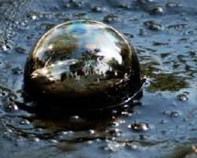
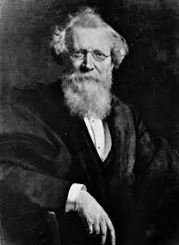
One key strand in this story: coal tar
1856. Coal and coke have replaced wood and candles for heat and light. Coke is made by heating coal in the absence of oxygen. The tar residue, disposed on land kills vegetation, and makes horrible black smoke if you try to burn it away. August Wilhelm von Hofmann of the Royal
College of Chemistry pulls creosote out of
tar – industry uses it to coat RR
ties, (later) telephone poles.
            Take a look at telephone poles today.
            Notice how they are darker at
            the bottom than at the top.

Slide 2


His student William Perkin tries to pull quinine (for malaria, to replace cinchona bark from Peru) from tar
He gets black goo, washes it out of the test tube, sees a brilliant purple clinging to the glass, wipes it with alcohol, and sees it has now transferred to the cloth => aniline dyes.
Tyrian purple, derived from molluscs, was
known as “Royal Purple”
in ancient times. It
was rare and
reserved for
royal use. Now
any fashionable
middle class lady
could have it.
The 1890’s became
known as “the Mauve
Decade”.
Emperor Justinian

Slide 3
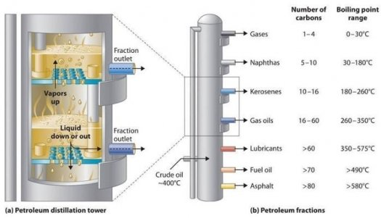
The industry grows and comes here
Ciba-Geigy, BASF, Bayer, Hoechst, Dow, etc. – the organic chemical industry grows from making products out of what was waste from fossil fuel use. 1864 city of Basel orders a Geigy plant closed and successfully sues for poisoning of water, soil, and people. Evidence mounts that coal tar derivatives benzene, toluene, napthalene, acids, solvents are injuring workers as well but the industry spreads. American tariffs are high so they start locating production in America. Cincinnati Chemical Works makes dyes for
military uniforms and DDT.
Fouling of Ohio River –
Congressional hearings
from 1936 – 1945. Ciba
(part of CCW) moves to
Toms River, NJ.
Fractional Distillation – a basic operation in organic chem. mfg
(petroleum refining example)

Slide 4
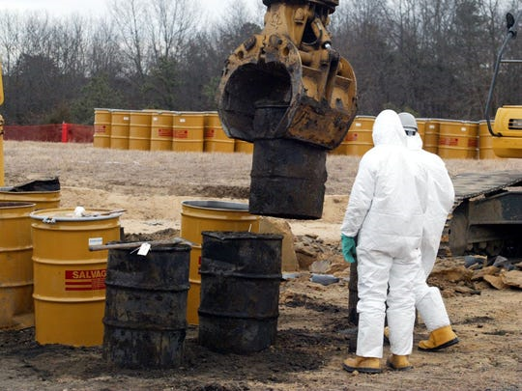
The result
The Toms River
Superfund Site
Dan Fagin writes in Toms River
(2013) about the filter cake,
still bottoms and other residues:
“Where to put it? Ciba made the
cheapest and most obvious choice,
if not the safest one. The company
would get rid of its solid waste in
Toms River in the same way it had in Basel (at first) and the same way its competitors did at their own plants if they were lucky enough to have sufficient room. Ciba would dump it on the factory grounds – all of it, enough to fill more than a thousand fifty-five gallon drums every year. (By the late 1970s, the annual total would be closer to ten thousand drums.)” (p. 33)

Slide 5
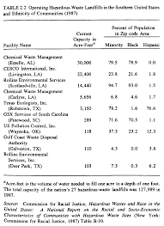
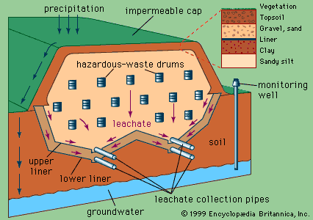
RCRA and CERCLA
Barry Commoner:
“there’s no away”
RCRA imposed management standards on
HW generation – you must pay to have it
shipped by licensed firms, to a licensed
destination, you have to store it safely. This
raised the costs and reduced generation and
irresponsible disposal but companies still make HW.
CERCLA imposed liability for when HW or other hazardous substances cause contamination of land or water. This liability is perpetual, retroactive, joint and several, and strict.
Encyclopedia Brittanica
From Dumping in Dixie, Robert Bullard, 2000

Slide 6
Population 312,572,412
Cancer Risk per million 31.6890
189 Toxic Air Pollutants are regulated under the Clean Air Act
https://www.epa.gov/haps/initial-list-hazardous-air-pollutants-modifications
EPA is supposed to assess toxics in air to see if we need to tighten up regulations. (The idea of checking on the Residual Risk after regs have been in effect)
https://www.epa.gov/national-air-toxics-assessment/2014-nata-assessment-results#emissions

Slide 7
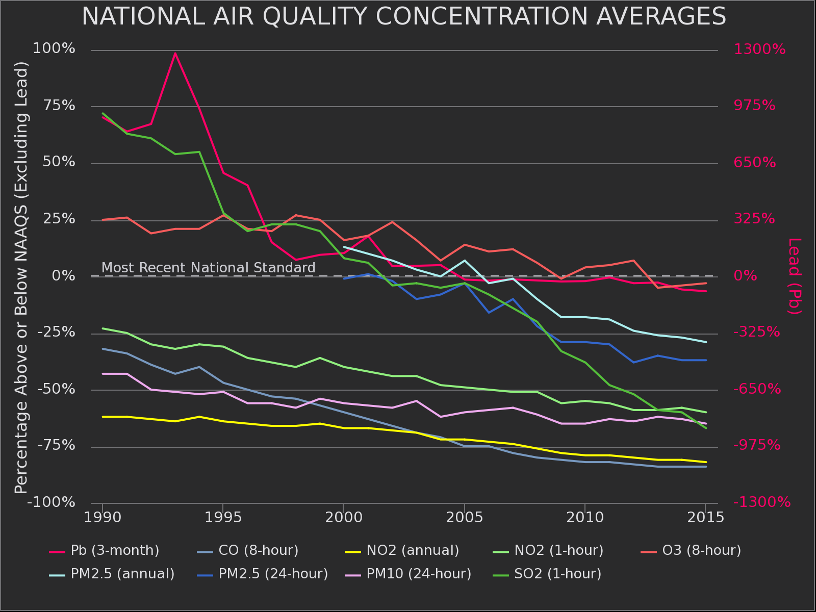
There is improvement

Slide 8
https://www.epa.gov/national-air-toxics-assessment/2014-nata-assessment-results#nationwide
1,3 butadiene, benzene, acetaldehyde, chromium, ethylbenzene, napthalene, nickel, carbon tetrachloride, arsenic, and the largest by far, formaldehyde – half of which is secondary formation.
In “less than 1%” of census tracts, residents have a cancer risk of greater than 100 in million (one in ten thousand).
Ethylene oxide (used to make detergents, thickeners, solvents, plastics, and various organic chemicals, chloroprene (from the production of synthetic rubber) and coke oven emissions

Slide 9
Clean Water Act toxics
Broad categories of pollutants originally – in 1977 EPA created Priority Pollutants list (forced to by NRDC suit). 129 chemicals – some are categories. Has not been updated since.
States are to develop numeric limits. 14 states did not, EPA published national limits for them.

Slide 10
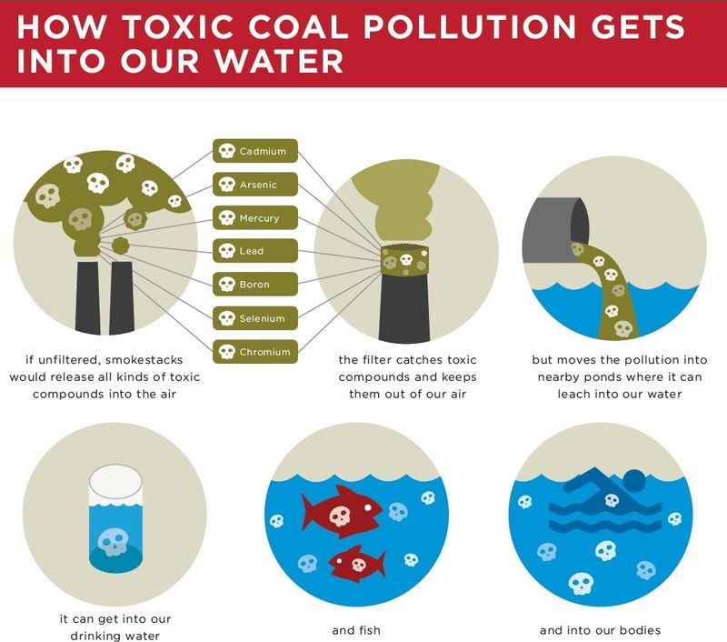
Sierra Club clarifies things

Slide 11
From Oliver Houck’s “The Regulation of Toxic Pollutants under the Clean Water Act” (1991) https://elr.info/sites/default/files/articles/21.10528.htm
The Clean Water Act prohibits the discharge of toxics "in toxic amounts." Therein lies its flaw. It presumes that we are able to determine what "toxic amounts" are, and to act on that knowledge in the rare event we can make the call. Neither assumption is correct. In fact, after 19 years of struggle, the most effective abatement of toxic pollution has been achieved through technology standards that are not predicated on toxicity at all.

Slide 12
Creeping incorporation of economic considerations
“…Section 112 of the Clean Air Act also requires regulation of toxics to provide an "ample margin of safety.” Unable either to include considerations of costs and feasibility in the development of these standards, or as a practical matter to exclude them, EPA did neither … relying on its more discretionary authority under the Clean Air Act to pursue other pollution abatement options.
By the mid 1980s, with EPA's track record on air toxics every bit as meager as that on water toxics,104 the issue came to a head over the regulation of a particularly well-documented and persistent toxin, vinyl chloride. EPA's adopted standard had frankly considered the economic effects of its proposed control level. In one of the most innovative environmental law decisions from a circuit with a long history of innovation, Judge Bork, writing for the U.S. Court of Appeals for the District of Columbia, distinguished all prior precedent precluding considerations of cost from Clean Water Act toxic standards and from National Ambient Air Standards under the Clean Air Act, and approached the questions of "costs"/"no costs" with Solomon-like pragmatism. What "ample margin of safety" meant was that EPA would set a threshold margin of safety based exclusively on health, but it could then adjust the standard for reasons of cost. However satisfying to the judicial mind, there was no doubt about the message down the line. As one EPA official explained, on remand the Agency was going to arrive at a standard similar to the one it had the first time by "scaling back" its "most conservative assumptions" on the health threshold; but of course, he added, this would be done "in a scientifically credible manner." In practice, health effects would be adjusted to an economically feasible level, as would science.”
104. By 1980 EPA had listed only seven toxic air pollutants, and regulated only four; by 1984 EPA had proposed standards for only the remaining three, and listed no more.

Slide 13
Houck recommends
“Indeed, Congress should fix several timetables, based on relative risk. Science may not be able to set absolute risk numbers, but it can identify categories of greater and lesser risk. Industry can obtain adequate lead time for the necessary process changes. Economists can identify incentives that will encourage industry to arrive on or ahead of schedule. And the engineers can, at last, design for the inevitable. To the extent that certain industries are participating willingly and even aggressively in voluntary pollution prevention and toxic reduction programs, a mandate this firm should only strengthen their hand, and lessen their competitive disadvantage.

Slide 14
How It CAN WORK
The critical elements of this alternative are that the mandate, lists, and schedules be made congressional, and therefore beyond litigation, and that they be made firm, When it finally becomes time to make batteries without PCBs, paint without lead, and refrigerants without CFCs, industry finds the way. At which point, ambient levels of these toxins drop precipitously.”

Slide 15
That’s one aspect of how one arm of government can work. There are other tools of governance.
Technical and Compliance Assistance
Education
Guidance
Grants
Subsidies
Tax Incentives
Recognition
Partnership
Shared Development
Community Assistance
Research and Development
Site Designations
Organization of public engagement and planning
Obtaining and providing data
Ensuring public access to information and participation in decision-making
Developing innovative organizations and businesses
Developing needed standards for quality, disclosure, accountability

Slide 16
Right to Know
- in OSHA Safety Data Sheets, for workers, but useful for everyone
- on state and federal websites on emissions to air and what monitoring tells us
- some information about hazardous waste
- some information about toxics and haz substances use
- some information about storage of dangerous substances, for emergency responders but could be useful to everyone
- lots of complex information about water quality
- less complex information about water discharges
- FOIA and state public documents laws
- FACA and state open meetings laws
- In adversarial proceedings, notice of all opportunities to be heard by the court and of motions of opposing parties
- public notice of local development, taking down of trees
- disclosure of material facts in real estate being sold or rented, such as lead
- notice of opportunities to vote and be heard in public hearings
- disclosure of conflicts of interest, real and/or potential
,

Slide 17
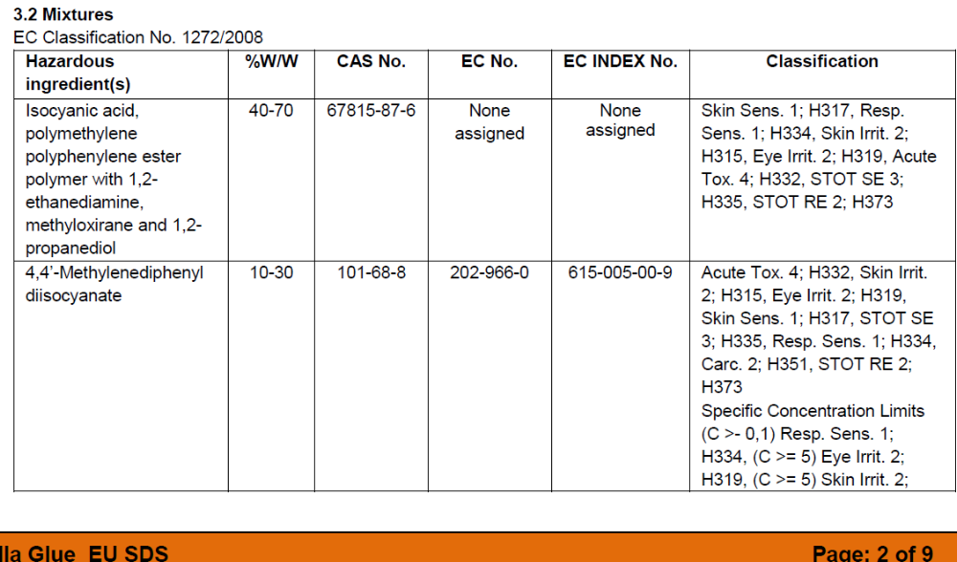
Safety Data Sheets
https://www.osha.gov/sites/default/files/publications/OSHA3514.pdf

Slide 18
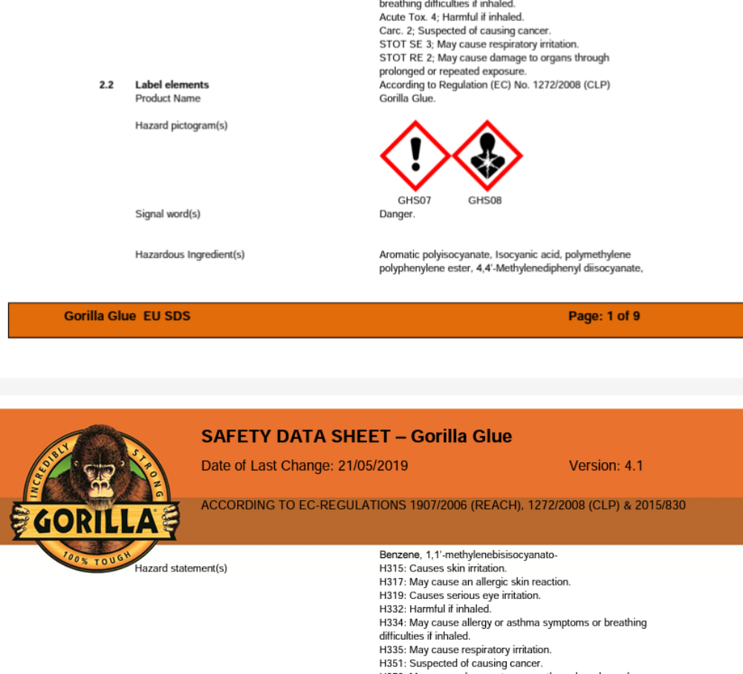

Slide 19
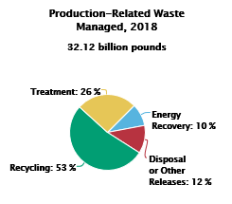
Toxics Release Inventory - Annual reports that people once paid a lot of attention to
21,557 facilities reported to TRI for 2018
Most releases were in the form of land disposal, primarily from metal mining operations
Since 2007, releases decreased by 9%

Slide 20
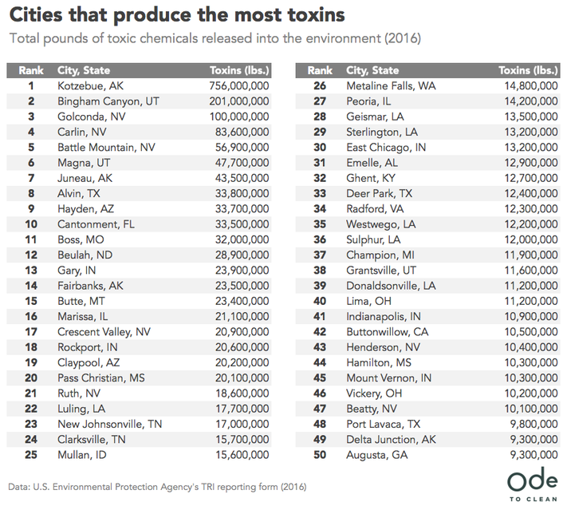
They may still pay attention in these places

Slide 21

The original idea - TSCA
Meant to control pollution risks at the source – but as in the opera, it ends badly

Slide 22
The Useless Form U and what it could do
It asks manufacturers to answer for Processors as to whether the chemical is used for
b. Consumer or Commercial (purposes) or both
c. Used in Products Intended for Children?
d. Percent Production Volume
e. Maximum Concentration
f. Number of Commercial Workers Reasonably Likely to be Exposed
Manufacturers can say “I Don’t Know”.
WHY HAVE MANUFACTURERS fill this out? Have them fill out the first part – which tells about the chemical – information THEY HAVE – and then have them submit that to an electronic database. Let the processor then fill out the rest. Let the form follow the chemical.

Slide 23
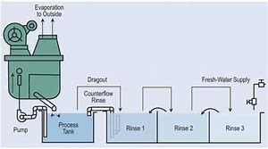
The P2 Revolution
Drag out reduction in metal plating

Slide 24
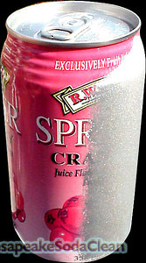
Baking soda blasting paint removal

Slide 25
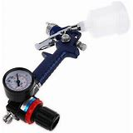
High Volume Low Pressure Spray Paint

Slide 26
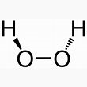
Hydrogen peroxide based cleaners
Substitute for chlorine-based, other toxics
“I use the 3% Hydrogen Peroxide and no longer have to worry about my dogs having residual traces of chemical cleaners on the floors,etc that they may get on their feet,or fur that they may lick off and get sick from.”
Testimony at “The Greenest Dollar”

Slide 27

Immortal etchants
Acids used to make wiring boards, decorative metal products
Can extend their useful life by maintaining constant pH precisely
Several methods of
reversing the oxidation/
reduction chemical process
Regeneration or life extension found to be widely feasible but few were doing it because disposal was cheap

Slide 28
Risk in the Context of Relationship
You can calculate the severity of risk all you want, but I don’t think you have the right to impose risks on me. RISK IMPOSITION is a value question. RISK ASSESSMENT can be a dodge of the more important question.
It is hubristic to think we can actually calculate risk with precision.
We mislead ourselves by looking at risk in a vacuum. Risks exist in combination.
We should simply adopt the moral strategy of reducing risks where we can. The existence of risk does give rise to a responsibility to investigate and to try to reduce the risk. We should only use Acceptable Risk as a temporary compromise while working to reduce risks.
If someone says you are unrealistic to articulate the precautionary principle, because we cannot expect to live in a risk-free world, ask them if they think we should have the right to choose our own risks? Or is that something others should do for us?
Ask them if you served them a glass of wine having one part per billion sewage in it (without telling you), would that be ok, given that there is no medical evidence that that level will harm you? Or would they rather you told them and gave them the choice not to drink it?

Slide 29
Elements of A Detoxification Agenda
Restore Impacted Communities
Ban Never Chemicals
Fund SDWA testing and provision everywhere
Fund updating CWA treatment everywhere
Restore funding to state enforcement programs
Provide funding and assist states in providing technical, financial and compliance assistance to greening industry
Ensure expertise is available to every community and citizens on knowing how to purchase green, live green, work green, and more safely consume
Work with community development corporations on healthy housing and development
Operationalize environmental justice
Prevent industry dominance in policy-making at all levels
Operationalize responsibility
Remove Preemption

Slide 30
More Items for the Agenda
13. Institute ALARA
Shift the burden of proof
Engage communities in planning
Build Toxics Recognition and Prevention into Health Care, Housing, Purchasing
Reclaim International Leadership
Make the form follow the chemical so we have universal tracking of hazardous substance movements
Work with every hazardous industrial sector to continuously reduce hazards
Reward risk sources for risk reduction through insurance rebates and other means
Initiate public-private partnerships to develop green alternatives and keep a public share in what is developed so that the green alternatives will both provide business incentives and be available to everyone at reasonable prices – create shared intellectual capital in such public-private partnership green alternative development.
Counter propaganda and political action against regulation by convening regular public discussion of the information of concern and the options for reducing risks, potential and real, as continuous business as usual, of concern to both private and common bodies.

Slide 31

Enjoy!

